Slide 1
Creating Portable Student Support for Writing and Math:
How To Help Faculty Embed Student Support Services Into Their Courses
Office of Online Education

Slide 2
How many of you would have attended this session pre-pandemic?
Quick Poll

Slide 3
How many of you are here to figure out new ways to provide student services during the pandemic?
Quick Poll

Slide 4
Role of OOE
SECTION 1

Slide 5
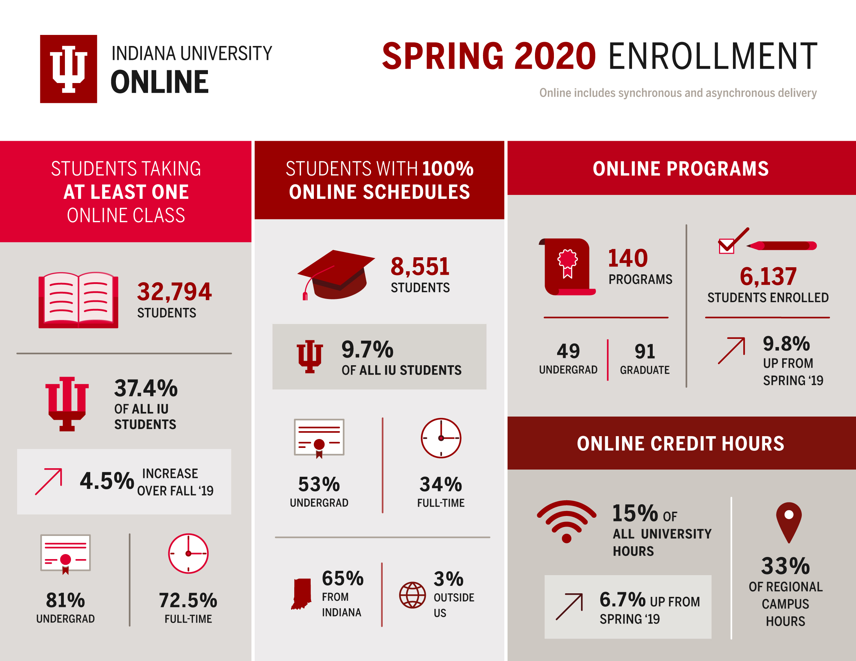

Slide 6
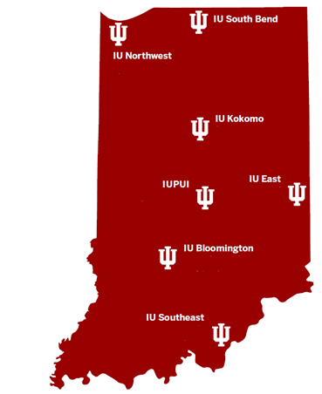
Overview
Providing leadership, management, and coordination of online education
Key Functions of OOE:
  Compliance with state, federal regulations
  Academic Program Development
  Seamless Student Support
  Marketing and Recruitment

Slide 7



Possible Solutions in a Multicampus Environment
Decentralized
Centralized
Collaborative
Graphic credit: https://gingkoapp.com/jaynemba.html

Slide 8
Key Collaboration: eLearning and Design Services
Partners to provide:
  instructional design and technology support to foster high-quality, interactive, and engaging and accessible experiences for students
  faculty development (QM, accessibility, pedagogy)
Supporting faculty at all seven campuses and all degree levels
Supporting development of non-credit

Slide 9
Result
Improves student experience
Creates efficiencies in course design and delivery
Fosters active collaborations between academic and student support stakeholders

Slide 10
General Standard 7:
Learner Support
SECTION 2

Slide 11
QM GS 7 (“Learner Support”)
Asks us to think about how students learn about resources like:
  accessibility support
  technology help
  tutoring
There are four (4) specific review standards

Slide 12
Four Review Standards
7.1 The course instructions articulate or link to a clear description of the technical support offered and how to obtain it.
7.2 Course instructions articulate or link to the institution’s accessibility policies and services.
7.3 Course instructions articulate or link to the institution’s academic support services and resources that can help learners succeed in the course.
7.4 Course instructions articulate or link to the institution’s student services and resources that can help learners succeed.

Slide 13
Where we started - Onboarding
SECTION 3

Slide 14


Summer

Slide 15
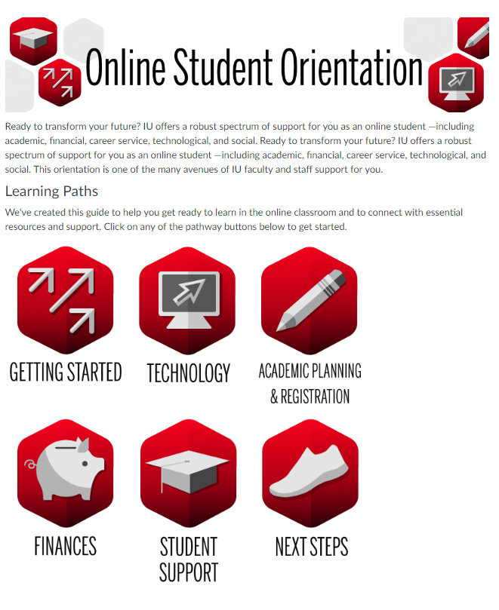
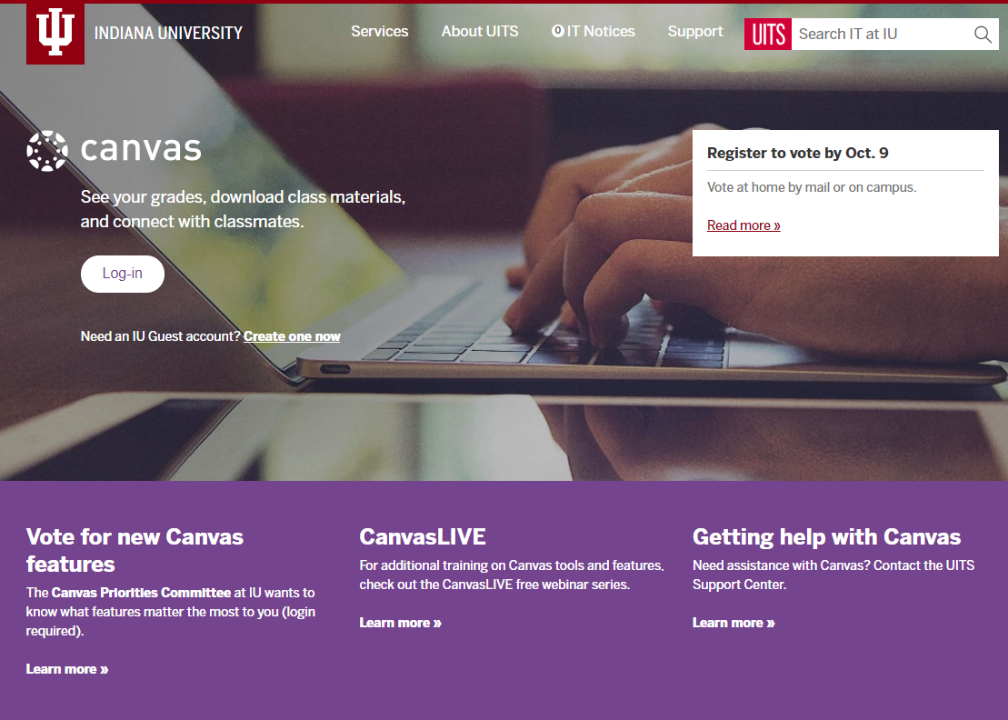
Version 1

Slide 16
Background
LMS-based resource
Needed to serve multiple campuses and programs
Prioritization by “phase” of topics for online students
No existing resource – V1 launched in less than 6 months
Version 1

Slide 17
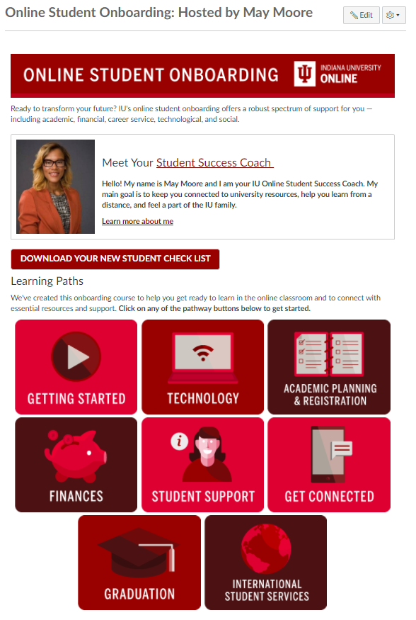
Aligning with QM
QM standards were intentionally incorporated starting with V2 to:
  Introduce the purpose and provide a self-paced onboarding resource
  Emphasize the learning objectives
  Identify available student services and learner supports
Version 2

Slide 18
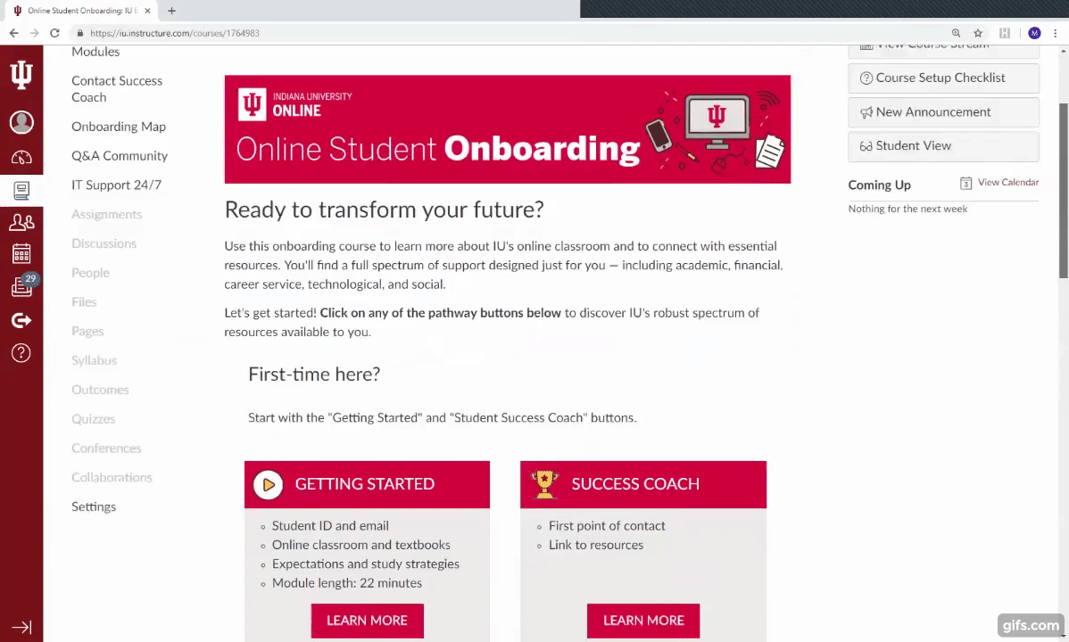
Aligning with QM
QM standards were intentionally incorporated starting with V2 to:
  Outline required proficiencies and tools
  Provide accessible content to better serve our students
Version 3

Slide 19
Quick case studies from the student services “side”
SECTION 3

Slide 20
Three Quick Case Studies
Tightening QM alignment in onboarding and orientation resources
Enabled…
Creation of non-credit academic support course
Portable math and writing support modules
Supplemental Instruction template

Slide 21
Three Quick Case Studies
Tightening QM alignment in onboarding and orientation resources
Enabled…
Creation of non-credit academic support course
Portable math and writing support modules
Supplemental Instruction template

Slide 22
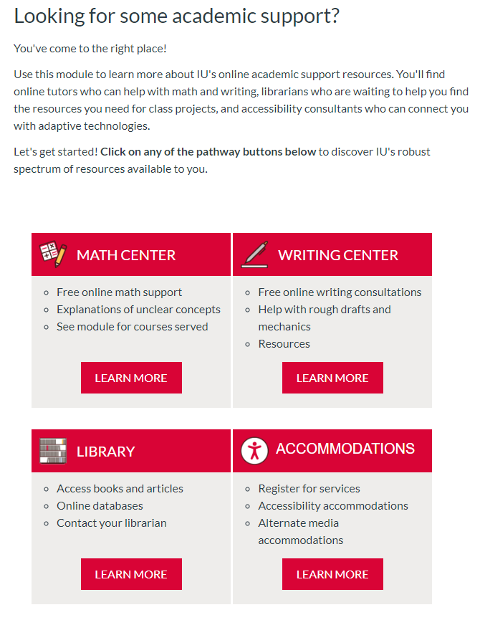
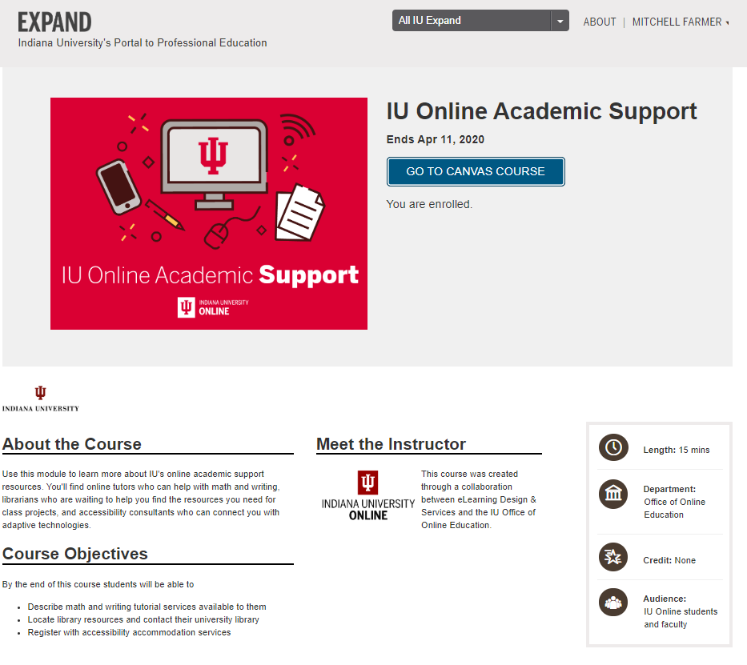

Slide 23
Three Quick Case Studies
Tightening QM alignment in onboarding and orientation resources
Enabled…
Creation of non-credit academic support course
Portable math and writing support modules
Supplemental Instruction template

Slide 24
Three Quick Case Studies
Tightening QM alignment in onboarding and orientation resources
Enabled…
Creation of non-credit academic support course
Portable math and writing support modules
Supplemental Instruction template

Slide 25

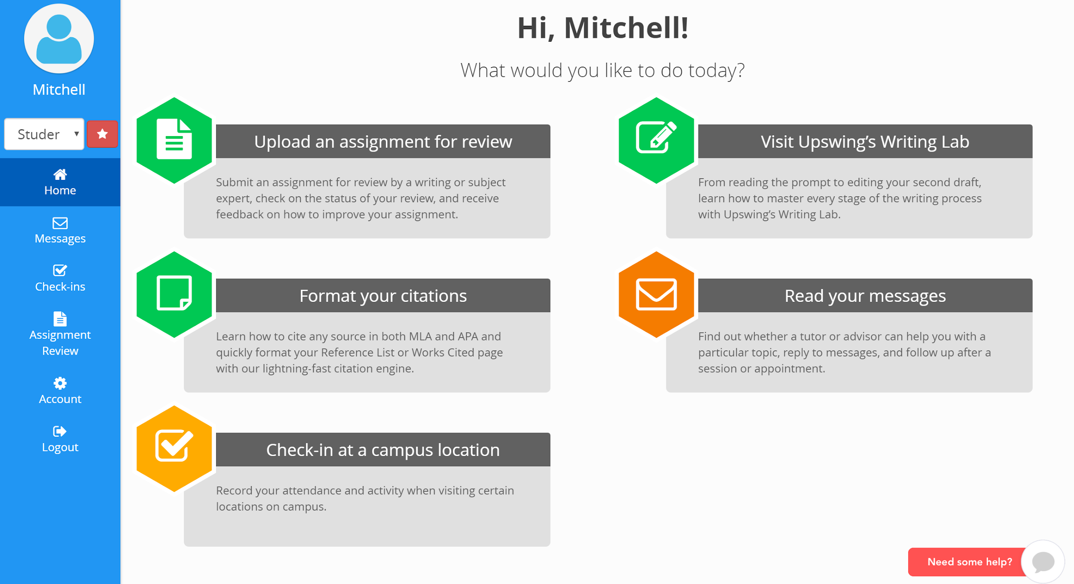
Math and Writing Support
Available to students enrolled in online courses through asynchronous tutoring services and work with faculty and courses

Slide 26
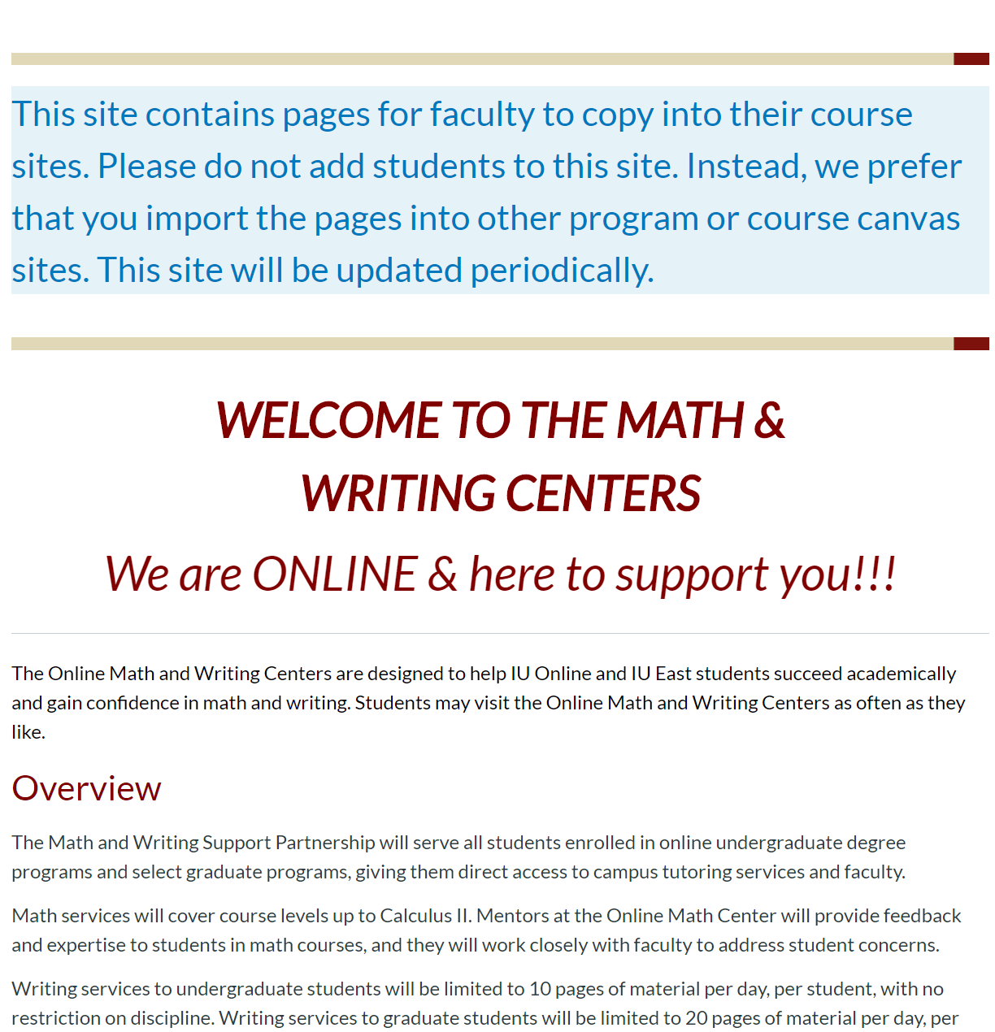
Math and Writing Support
Supporting Resources
Math course test drive
Portable modules for faculty
Bridge courses

Slide 27
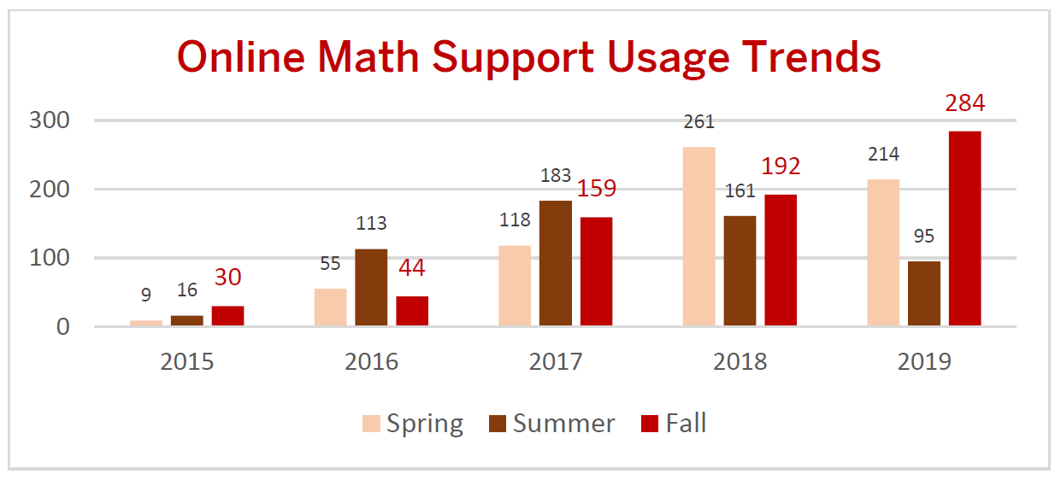

Slide 28
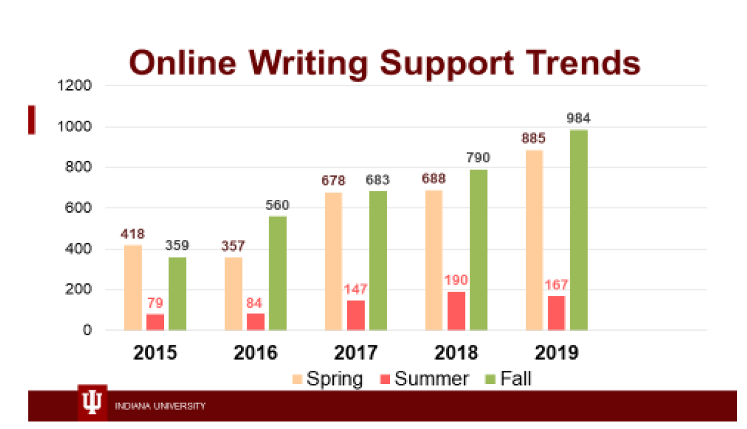

Slide 29
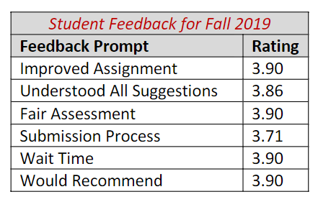
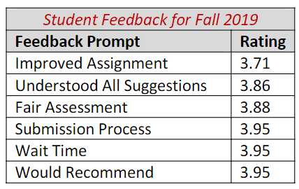
Student Satisfaction
Math
Writing
4-point Scale

Slide 30
Three Quick Case Studies
Tightening QM alignment in onboarding and orientation resources
Enabled…
Creation of non-credit academic support course
Portable math and writing support modules
Supplemental Instruction template

Slide 31
Three Quick Case Studies
Tightening QM alignment in onboarding and orientation resources
Enabled…
Creation of non-credit academic support course
Portable math and writing support modules
Supplemental Instruction template

Slide 32
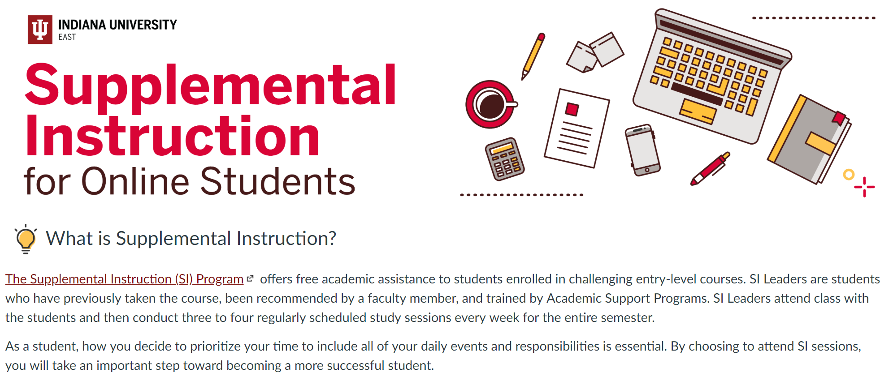
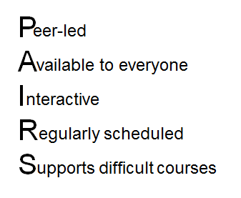
Supplemental Instruction
Serve students enrolled in select online courses with direct tutoring services embedded within the course

Slide 33
How it works online
Online SI Leaders plan and hold sessions throughout the week through Zoom.
Leaders:
  are added to Canvas by their instructors (in the TA role).
  are trained with the same agenda/expectations as face-to-face leaders
  schedule 3-4 regular weekly session; survey students
  record sessions and post on Canvas for students who cannot attend live
  provide assistance asynchronously through Canvas messages, email, etc.

Slide 34
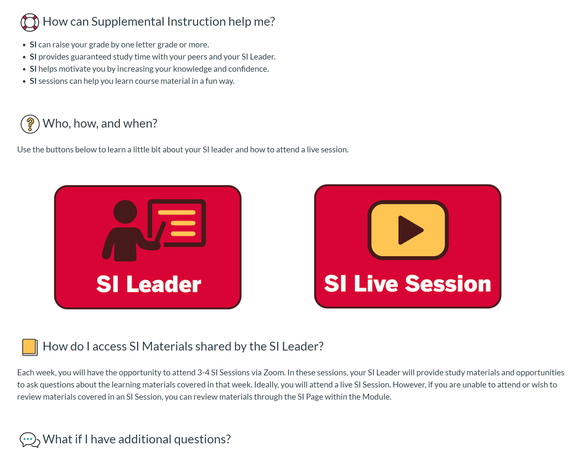
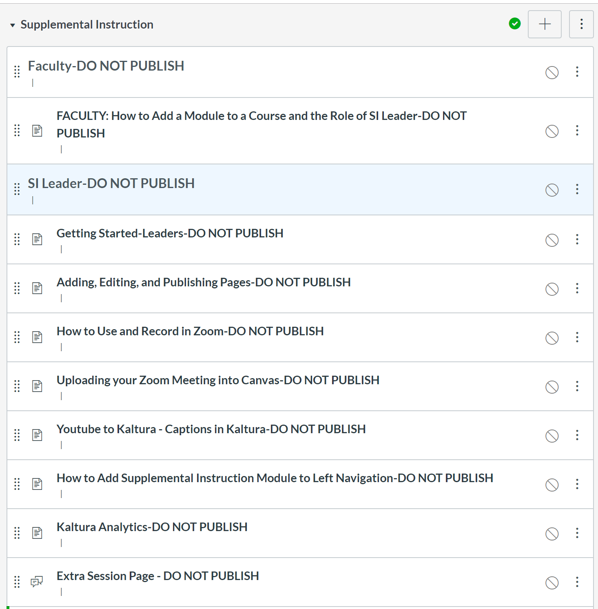

Slide 35
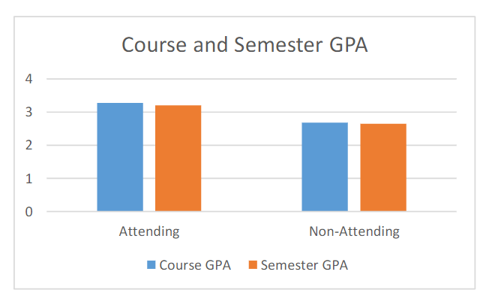
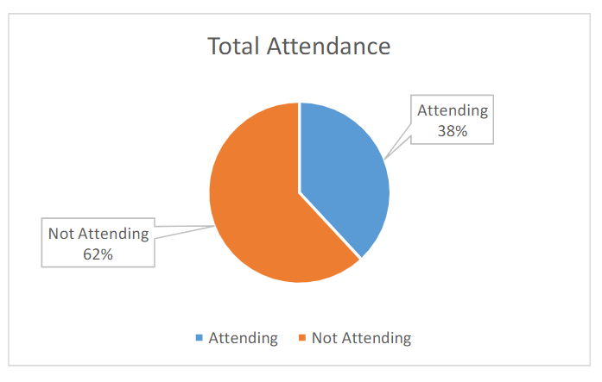
Mean SI participant evaluation rating on the helpfulness was 4.7/5.0
98.21% rated SI sessions as satisfactory or above

Slide 36
Three Quick Case Studies
Tightening QM alignment in onboarding and orientation resources
Enabled…
Creation of non-credit academic support course
Portable math and writing support modules
Supplemental Instruction template
All available for linking to or
embedding into courses

Slide 37
Contact
Mitchell Farmer
Assistant Director
Campus Partner Programs
Office of Online Education
812-856-7170
mgf@iu.edu
David Becker
Quality Matters Lead Coordinator
Office of Collaborative Academic Programs
812-941-2076
dabecker@ius.edu

