Slide 1
The NeverEnding Story…
Continuous Improvements to Online Programs
KEVIN HULEN
Assistant Director, Quality and Assessment
University of North Florida
UNF Online
kevin.hulen@unf.edu
PRESENTATION URL
tinyurl.com/ynw8crtr

Slide 2


The NeverEnding Story…
As the demand for online programs in higher education continues to increase, online program leaders need quality assurance mechanisms
to support online course design and delivery for extended periods.

Slide 3
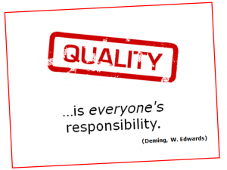
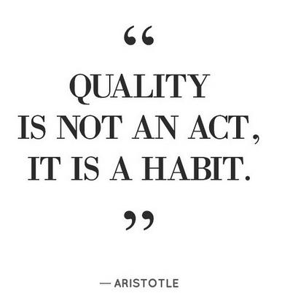

What is quality and why does it matter?
“Quality means doing it right when no one is looking.”
-Henry Ford

Slide 4
About UNF
Challenges and Goals
Variability and Quality Assurance
Implementation
Lessons Learned and Moving Forward
Group Activity: Identify sources of variability in course design and delivery within online programs at your institution.
AGENDA
Group Activity: Construct an Online Program Quality Plan (OPQP).
“What one has not drawn, one has not seen.”
- Julius V. Sachs, German Biologist, late-1800’s

Slide 5

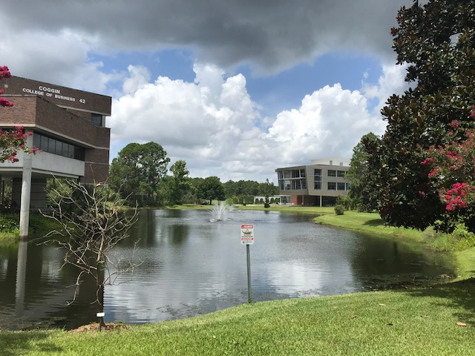
ABOUT UNF
Located in Jacksonville, Florida
17,043 Students
1,043 Faculty
1,250 Staff
~500 Online Courses
25 Online Programs
7 Instructional Designers
1 Centralized DL Administration
*data shown as of April 2022
60-70% of online courses delivered by certified online faculty
10-14% of online courses certified
Florida Quality Course Design

Slide 6
Centralized DL Administration
Two units within Academic and Student Affairs, partner to manage and support quality assurance of coursework within online programs:
UNF Online
Compliance and stewardship
Online student support
Online program support
Facilitation and best practices
QM implementation
Center for Instruction and Research Technology
Canvas support
Media creation
Research support
Equipment checkout and online tools
Instructional design
  Teaching online certification for faculty
  Course design based on QM rubric

Slide 7

QM IMPLEMENTATION (by the numbers)
Internal QM Reviews (CRMS, myCR)
300+
2014-present
Unique Faculty Members
172
2014-present
QM-Managed Reviews
65
2014-present
Online Programs with
100% QM-Certified Courses
4.5
2018-present
QM-Certified
Faculty Peer Reviewers
17
QM-Certified
Staff Peer Reviewers
10
QM-Certified
Master Reviewers
3
QM Coordinator
1

Slide 8
CHALLENGES
Instructional design teams face increasing challenges to maintaining quality of services while being able to rapidly scale up to meet institutional goals
Balancing time and effort towards the development of new online programs against the need for ongoing maintenance and continuous improvement of existing online programs
Ensure course design quality standards are updated and consistently maintained throughout the lifetime of online programs

Slide 9
ADMINISTRATIVE GOALS
Provide robust faculty support and guidance
Implement sustainable instructional design practices
Promote ongoing collaboration and communication between key program stakeholders
Develop streamlined and customizable approach to developing and implementing quality course design within online programs
Provide students with high-quality online learning experiences

Slide 10
The Balance Of Variability
Department maintains
all aspects of quality within online programs
Institutional-level quality assurance standards and instructional-design practices to develop and continuously improve online programs

Slide 11

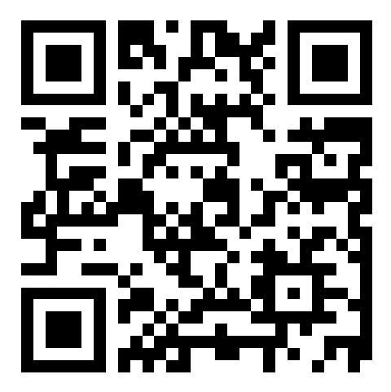
Group Activity 1: Identify sources of variability in course design and delivery within online programs at your institution.
Join at
slido.com
#299759

Slide 12


SOURCES OF VARIABILITY
Sources | Variability | Implementation | Partner
Institutional ITS services and support | low | default
Learning Management System (i.e., Canvas) | low | default
Course Design and Review | medium | course template and course reviews based on QM rubric
Content (cost, assignments, materials, media) | medium | OER, librarians, studio
Technology (purposeful and useable) | medium | LTI’s, 3rd-party, LMS support
Accessibility | medium | training and support
Instructors (SME’s, full-time, adjuncts) | medium-high | training, support, refresh, ongoing communication, new instructors
Students | TBD | feasibility, eligibility, affordability, enrollment, success, labor market

Slide 13




QUALITY ASSURANCE MECHANISMS
UNF implements quality assurance mechanisms to mitigate variability in
course design and delivery within online programs over extended periods.
8-weeks
Faculty development
Online course development and review resulting in the Florida High-Quality (HQ) designation (based on QM rubric)
12-months
3-years
QM Certification for eligible online programs
ongoing
Continuous improvements through audits and ongoing communication

Slide 14
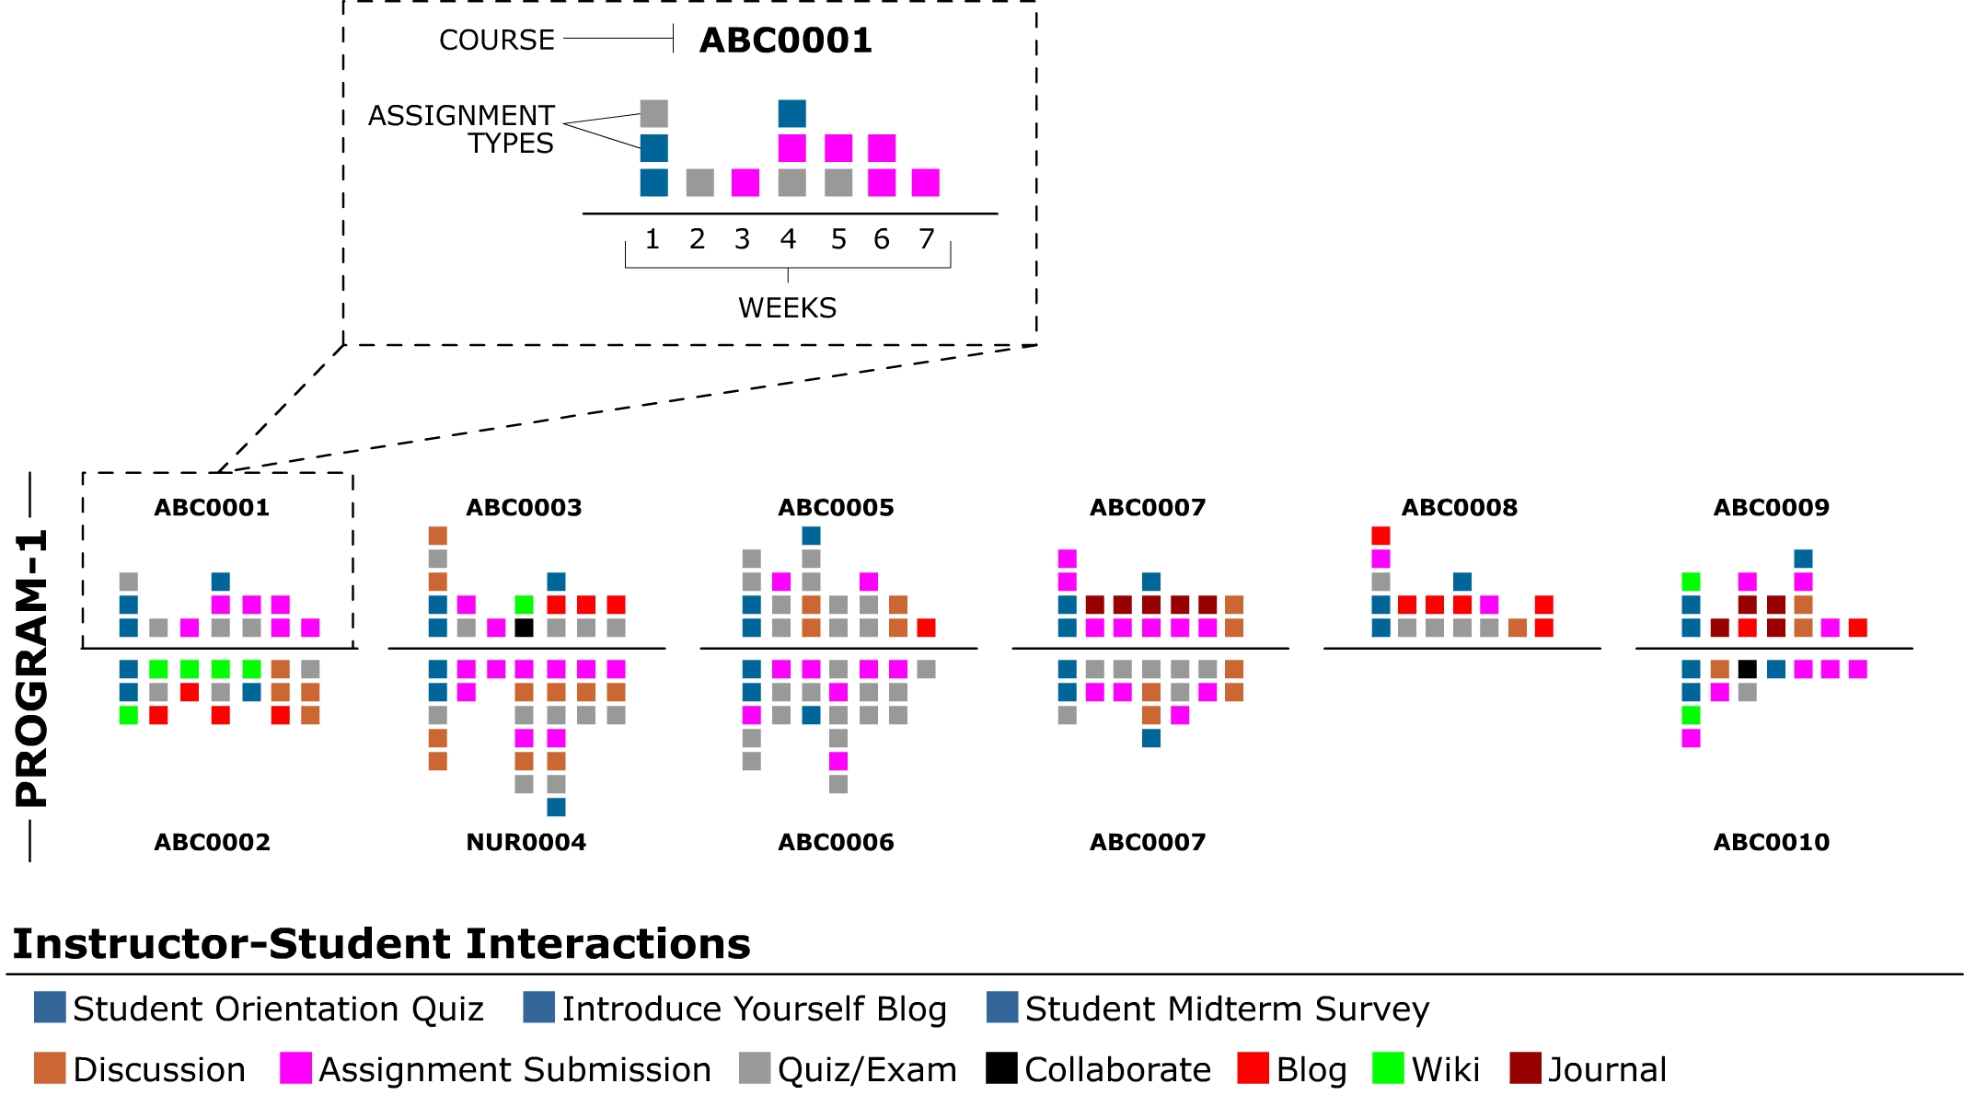
ADDITIONAL EXPLORATION
Compare assignment richness and diversity within online programs.

Slide 15
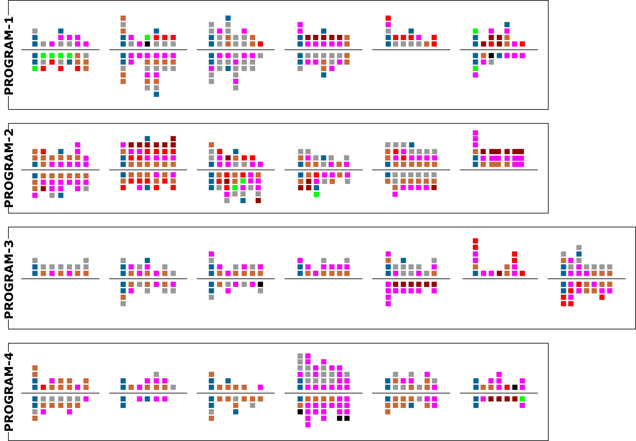
Comparisons across multiple online programs.

Slide 16
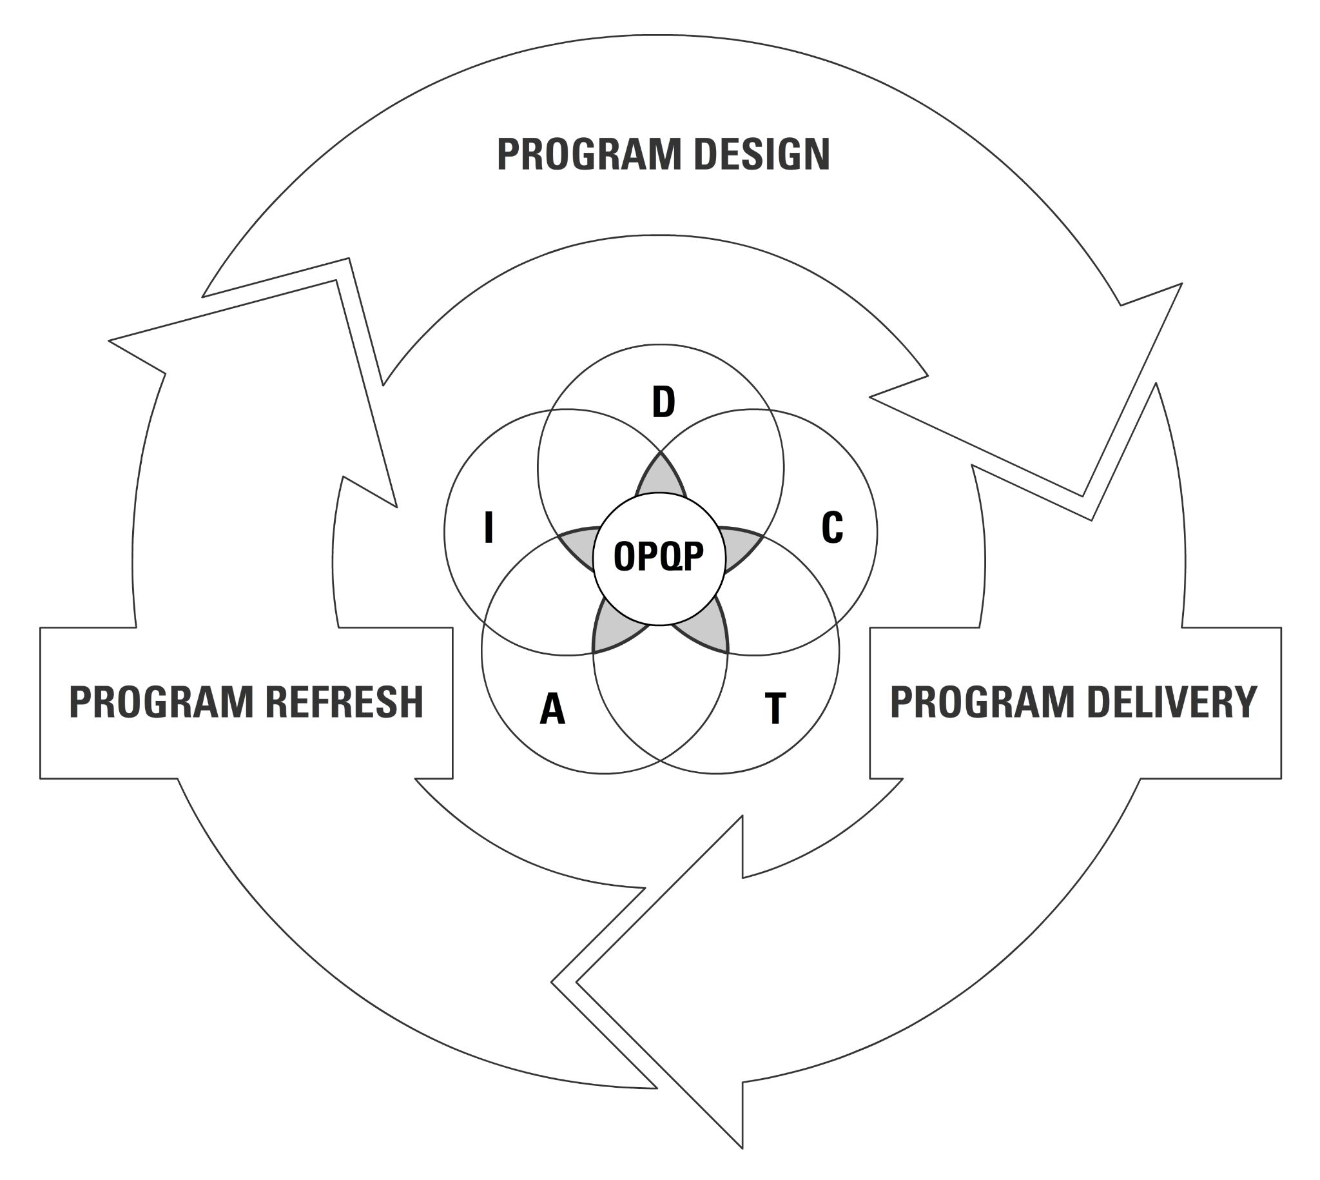
IMPLEMENTATION
Quality Assurance Framework for Online Programs
More than a sum of individual course challenges, an online program requires a comprehensive approach to maintaining design-centric quality assurance practices.
“Quality assurance of online programs is not a one-and-done event.”
Program-Specific Quality Assurance Cycle
Phase 1: Program Design
All courses receive the Florida High-Quality (HQ) designation based on the QM Rubric
All instructors complete UNF Teaching Online Foundation Course (TOL)
Phase 2: Program Delivery
Promote ongoing communication
Faculty training and LMS support
Marketing and enrollment support
Ensure quality course design
Phase 3: Program Refresh
Discuss the immediate and future needs
Opportunity for QM Certification and continuous improvements to course design

Slide 17

Group Activity 2: Identify factors that impact quality of course design and delivery within online programs at your institution.
JAMBOARD URL
tinyurl.com/ycx29swa

Slide 18
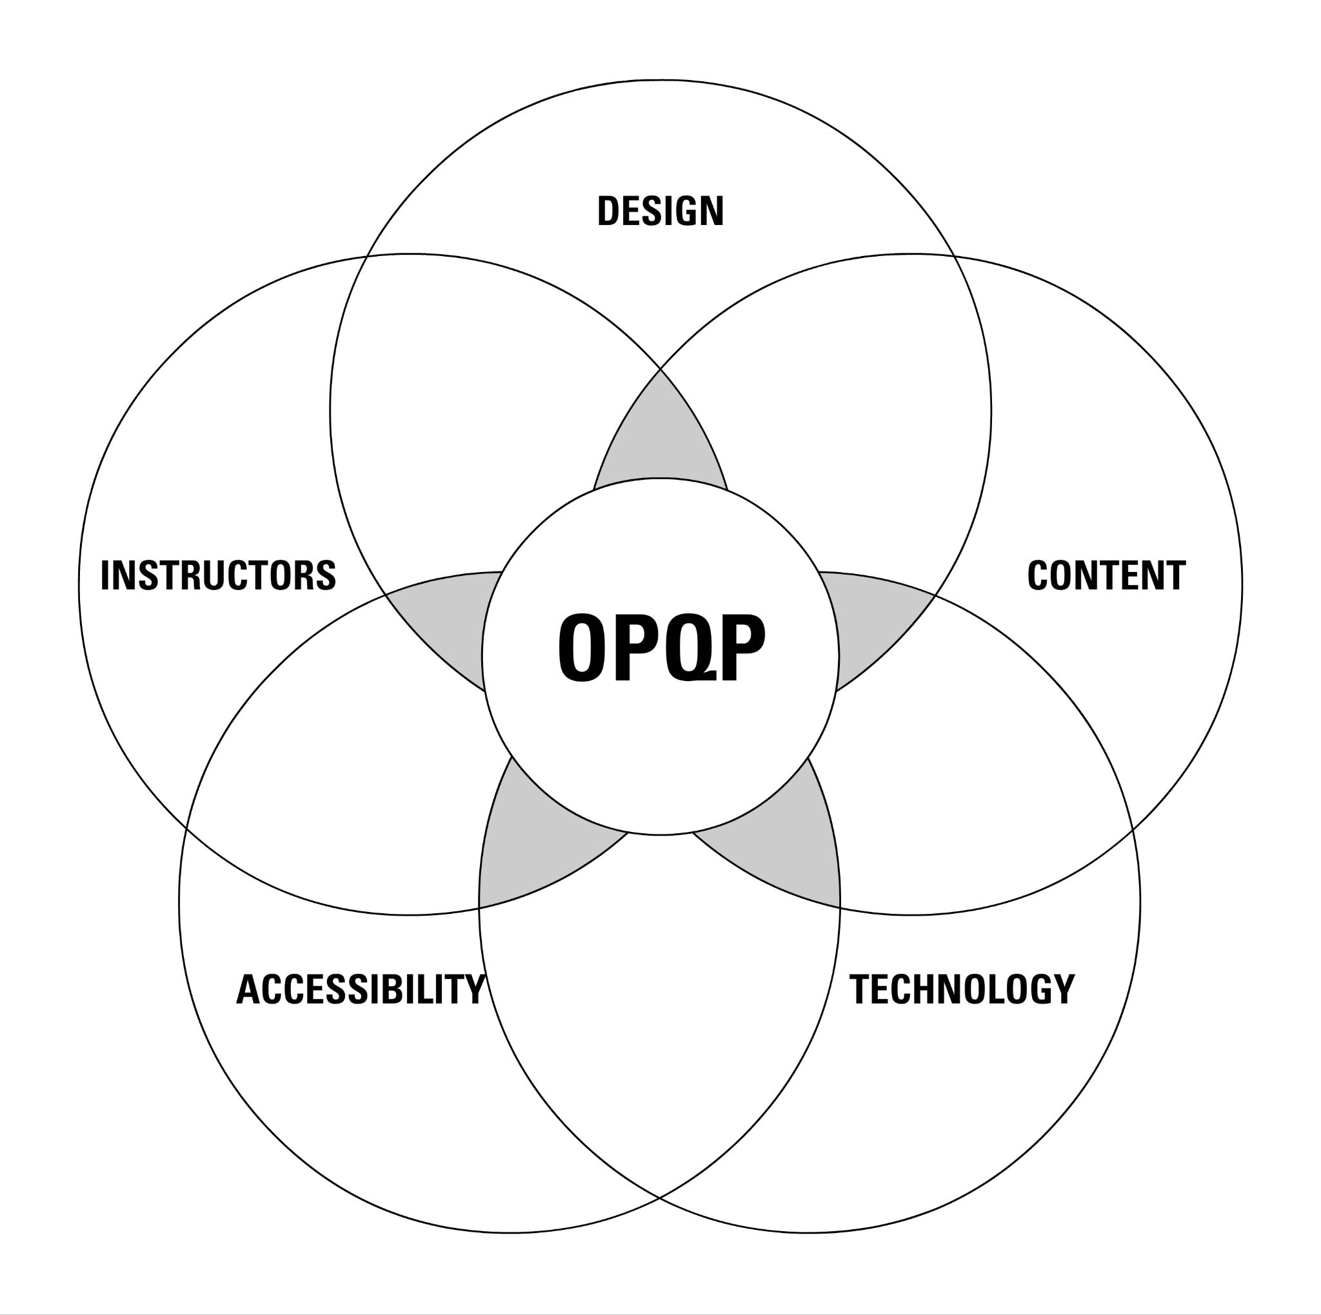
IMPLEMENTATION
Online Program Quality Plan (OPQP)
Develop a program-specific blueprint that provides program stakeholders with clear and concise instructions to guide design, development, and continuous improvements to online programs.
“An OPQP is the picture on a puzzle box that helps us build the puzzle.”
Five Core Tenets
Design
Establish clear and concise guidelines for implementing high-quality course design.
Content
Select content that aligns with program goals and course objectives, and meets access and affordability criteria.
Technology
Select technology that is purposeful and tactical and can be applied consistently across all coursework.
Accessibility
Provide alternative means of access to course materials in formats that meet the needs of diverse learners.
Instructors
Provide support for whatever training and resources are needed.

Slide 19
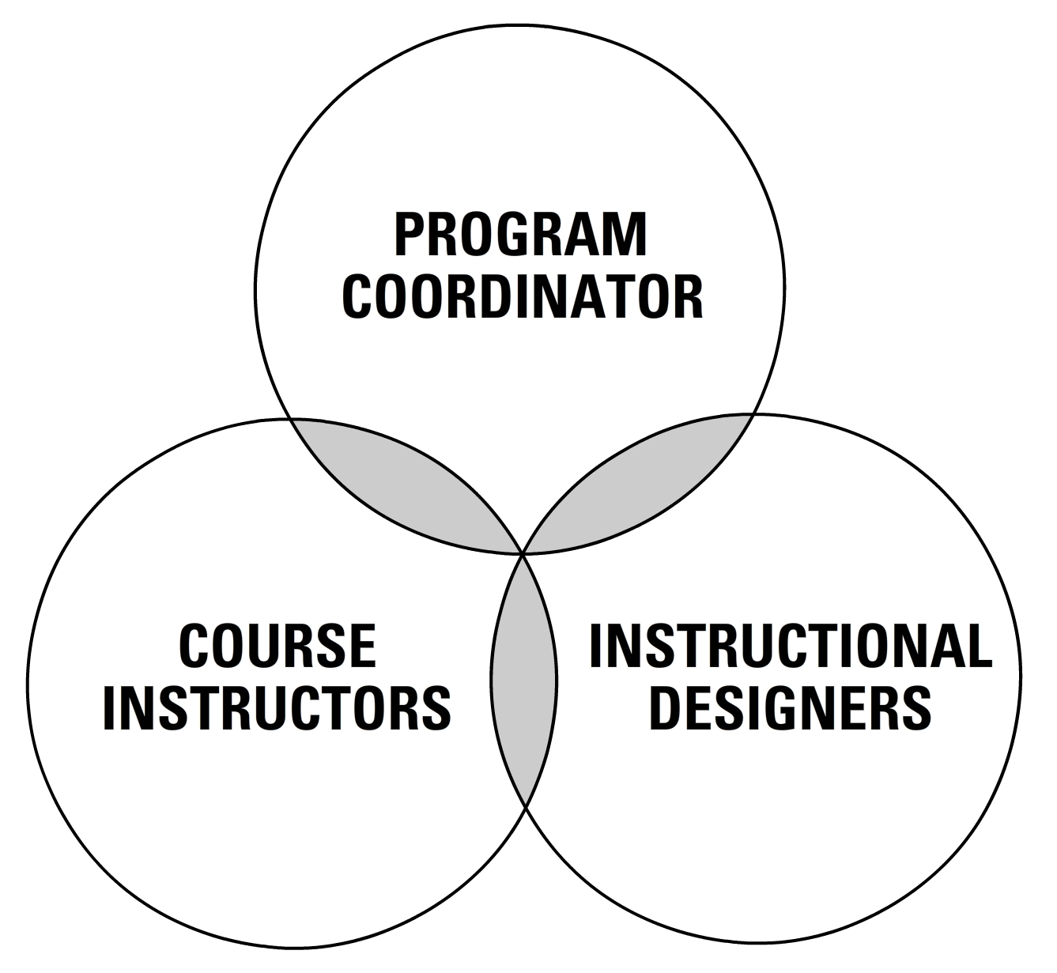
IMPLEMENTATION
Collaboration Between Key Program Stakeholders
Involving program stakeholders in all aspects of decision-making contributes to a clearer perspective of program scope and more concise expectations for meeting quality assurance.
To get started, programs view UNF's Online Program Development Process
Communication Timelines
Approval of program-specific communication timeline and course development/review schedule
Engage program stakeholders in UNF’s community of practice on sustainable instructional design teamwork (i.e., Canvas support and instructional design team)
Program Development Schedules
Create scheduled based on number of program courses and the availability of instructors to participate in the process

Slide 20
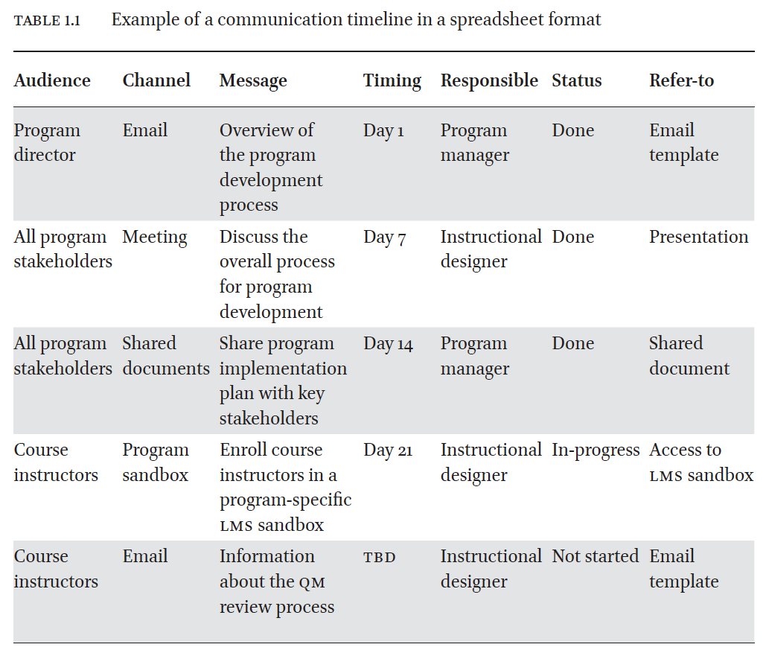
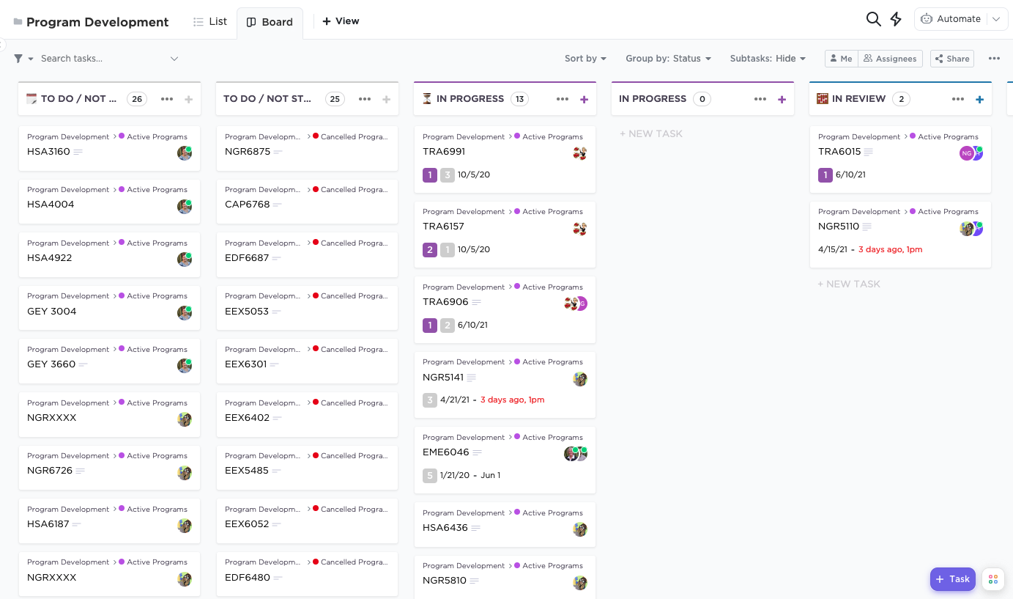


UNF Online tracks online program implementation through program-specific communication timelines and program development schedules to ensure administrative and faculty efforts are arranged consistently across all online programs.

Slide 21

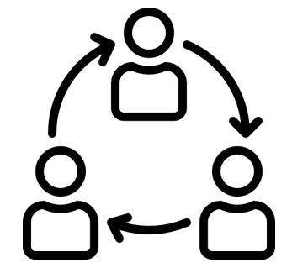

LESSONS LEARNED
Keep an eye on program course design
Continuously meeting QM standards
Accurately represents online program template
Does not present new course design or technology issues
Identify new online instructors
Orientation to the online program quality plan
Training on quality course design standards (e.g., QM)
Sharing of best practices among instructors and admin
Plan for program refresh within 5 years
Ongoing communication with program stakeholders
Be aware of immediate or future needs
Identify new courses early
Encourage QM certification of all coursework

Slide 22
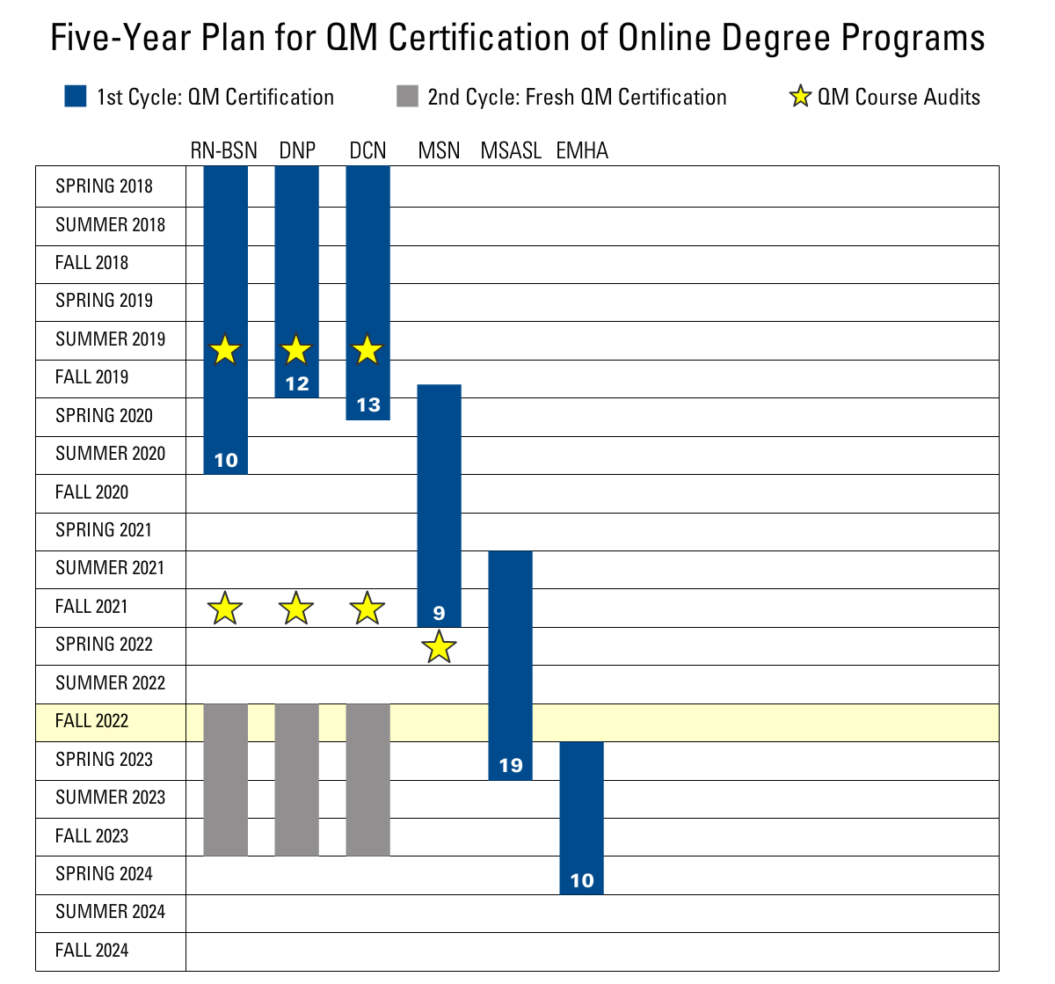
The NeverEnding Story…
ONLINE PROGRAMS
RN to BSN Bridge
DNP: Doctor of Nursing Practice
DCN: Doctor of Clinical Nutrition
MSN: Master of Science in Nutrition and Dietetics
MSASL: Master of Science in ASL/English
EMHA: Executive Masters in Health Administration

Slide 23
THANKS FOR ATTENDING
PRESENTATION URL
tinyurl.com/ynw8crtr
*Presentation based on a recent publication:
Hulen, K. (2022). Quality Assurance Drives Continuous Improvements to Online Programs. In S. Kumar & P. Arnold (Eds.), Quality in Online Programs: Approaches and Practices in Higher Education. The Netherlands: Brill.

