Slide 1

Engaged Learning Design for Motivation, Comprehension and Application
Tianhong Shi (Ph.D)
Senior Instructional Designer
Oregon State University Ecampus
Tianhong.shi@oregonstate.edu

Slide 2




About Tianhong
Hiking
Gardening
Reading
Singing
Notes:
I enjoy hiking, exploring nature (Alaska aurora northern light; Morane Lake, In Banff, Canada, Oregon Coast, Oregon Pumpkin field). I also enjoy gardening, reading, learning new languages.

Slide 3
Road Map
QM Standard #5
Engaged Learning Principles
Showcase #1
Showcase #2
Showcase #3
Hands-On Application
Q&A

Slide 4
QM Standard #5
5.1: The learning activities help learners achieve the stated objectives.
5.2: Learning activities provide opportunities for interactions that support active learning.
5.3: The instructor’s plan for regular interaction with learners in substantive ways during the course is clearly
stated.
5.4: The requirements for learner interaction are clearly stated.

Slide 5
QM Standard #5 in Online Learning Design
Learner-Content interactions
Learner-Instructor Interactions
Learner-Learner Interactions

Slide 6

Engaged Learning Principles
Acknowledging and building on students’ prior knowledge and experiences.
Facilitating relationships, including substantive interactions with faculty/staff members and peers and development of diverse networks.
Offering feedback on both students’ work-in-progress and final products.
Fostering reflection on learning and self.
promoting integration and transfer of knowledge.
Framing connections to broader contexts, including practice in real-world applications of students’ developing knowledge and skills.

Slide 7
Design Challenges
Accounting Course: Students are non-accounting majors and lack motivation for studying accounting.
Math Course: Students lack motivation in learning and feel disconnected with abstract math content in first year college math.
Engineering Course: Senior engineering students lack full access to construction sites, to get hands-on experience and understanding the fundamentals of construction site structures.

Slide 8

Design case 1
Accounting Course: Students are non-accounting majors and lack motivation for studying accounting.
Engaged learning Principle: Acknowledging and building on students’ prior knowledge and experiences
Design Solution:
Mock-up student-run company and assign students to work with accounting related to students activities such as buying and selling textbook and offering tutoring services to making learning materials relevant and meaningful to students;
Create an online monopoly simulation game modified with Oregon State University themes to further engage students in accounting practices.

Slide 9
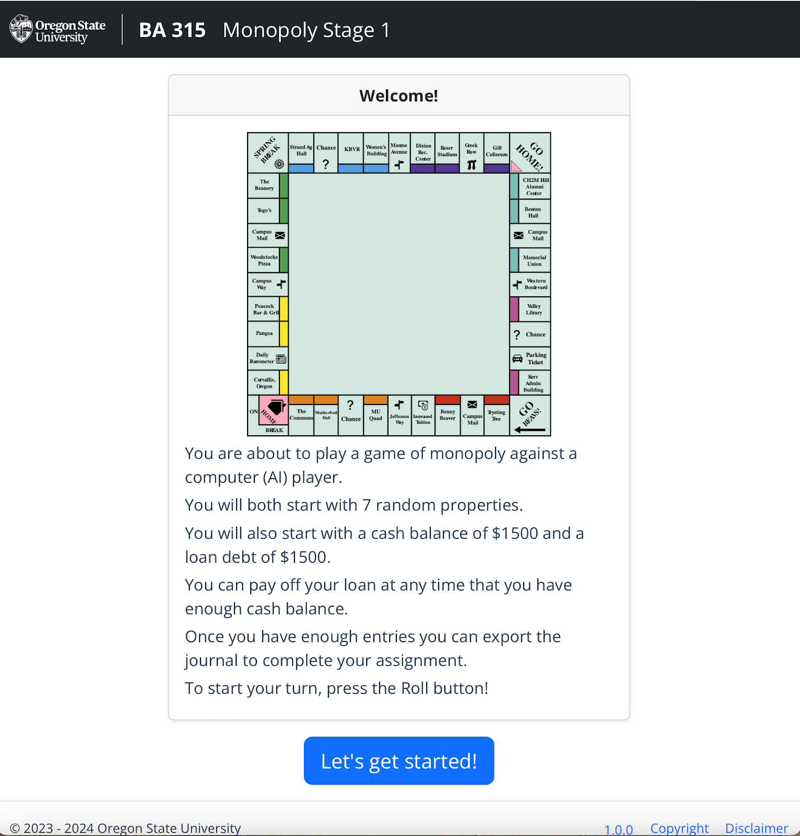
Online OSU-Themed Monopoly Game for Accounting Course

Slide 10

Design case 2
Math Course: Students lack motivation in learning and feel disconnected with abstract math content in first year college math.
Engaged Learning principle: Facilitating relationships, including substantive interactions with faculty/staff members and peers and development of diverse networks.
Engaged Learning principle: Offering feedback on both students’ work-in-progress and final products.
Engaged learning principle: Fostering reflection on learning and self.
Engaged learning principle: promoting integration and transfer of knowledge.

Slide 11
Design case 2
Design Solutions: The strategies used to build an inclusive and trusting learning community in MTH 112Z included the following:
In Start Here Module, the instructor made a video covering Artificial Intelligence (AI), academic integrity, honesty, and diversity, to explicitly explain the expectations for this course regarding academic integrity and why it is so.
Also in Start Here Module, the instructor built a "Name Tents 112Z" discussion board for students to introduce themselves, setting an example by introducing the instructor himself first.
There is a Diversity Forum where students can post comments that they would want the instructor to know about themselves to make learning more inclusive.
Short fun animation videos for each module to connect and motivate students to the challenging content.
Each unit has a “Just For Fun” discussion forum to bring students’ attention to learning and promote motivation.

Slide 12
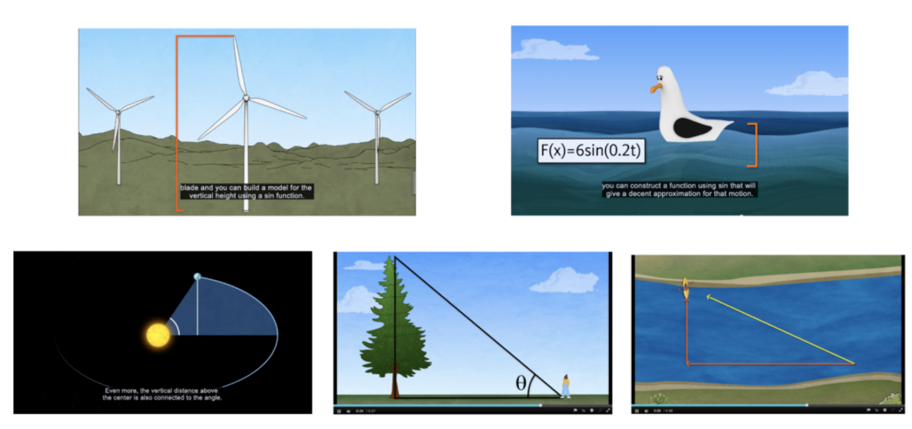
Animation Stories in Math Course 112Z

Slide 13

Design case 3
Engineering Course: Senior engineering students lack full access to construction sites, to get hands-on experience and understanding the fundamentals of construction site structures.
Engaged Learning Principle: Framing connections to broader contexts, including practice in real-world applications of students’ developing knowledge and skills

Slide 14
Design case 3
Engineering Course: Senior engineering students lack full access to construction sites, to get hands-on experience and understanding the fundamentals of construction site structures.
Design Solution: the instructor and instructional designer collaborated with media team to design interactive simulation called Clickable Structure to help students understand the most difficult concepts in the course: elements of structures and how various pieces relate to each other. The Clickable Structure simulation enables students to see layer by layer and each group of structures according to their functions, and the corresponding equations needed for calculations of weight bearing etc.

Slide 15
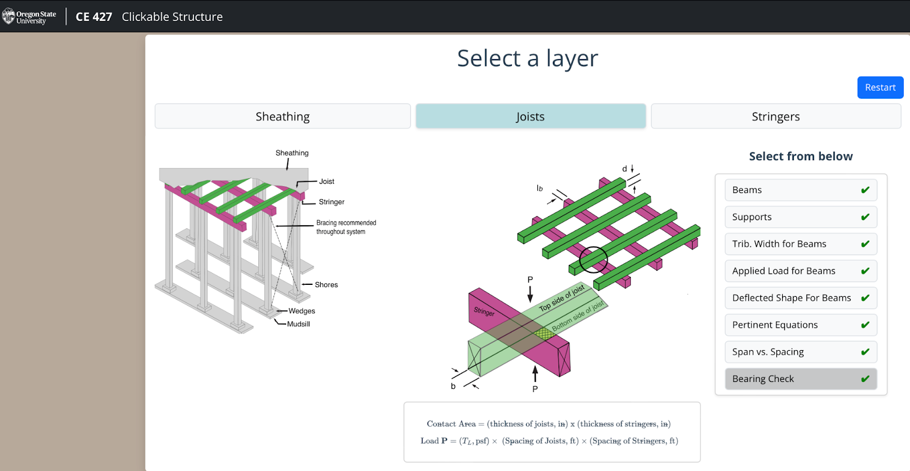
Clickable Structure Activity for CE 427 Temporary Structures

Slide 16
Hands-On Application
Your design challenge?
Engaged Learning Principle(s)?
Design Solution?

Slide 17
Sharing Your Design Solutions
Your design challenge?
Engaged Learning Principle(s)?
Design Solution?

Slide 18
Sharing Your Takeaways
Something new that interests me:
Something I want to follow up and learn more about:
Something I want to apply in my teaching immediately:

