Slide 1
Showcase QM Certified Online Courses at Your Institution!
Notes:
Samira

Slide 2
Who are we?
Zhetao Guo, PhD
Senior Instructional Design Specialist
QM Coordinator, Course Review Manager, APPQMR F2F Facilitator
Randi Kirkland, PhD
Instructional Design Manager, Instructor
QM Coordinator, Course Review Manager, APPQMR F2F Facilitator, Master Reviewer
Samira Laouzai, MS
Deputy Director/Manager of eLearning Services and Quality Assurance, Instructor, PhD student
QM Coordinator, Course Review Manager, APPQMR F2F Facilitator, APPQMR Online Facilitator, Master Reviewer, QM Rubric Review Committee, Contract Facilitator for APPQMR Online
Notes:
All

Slide 3
Objectives
Share ways to promote quality online course design at your institution.
Identify barriers to implementing a recognition system for high-quality online courses at your institution.
Discuss possible solutions to implementation barriers of a recognition system for high-quality online courses at your institution.
Notes:
Samira

Slide 4
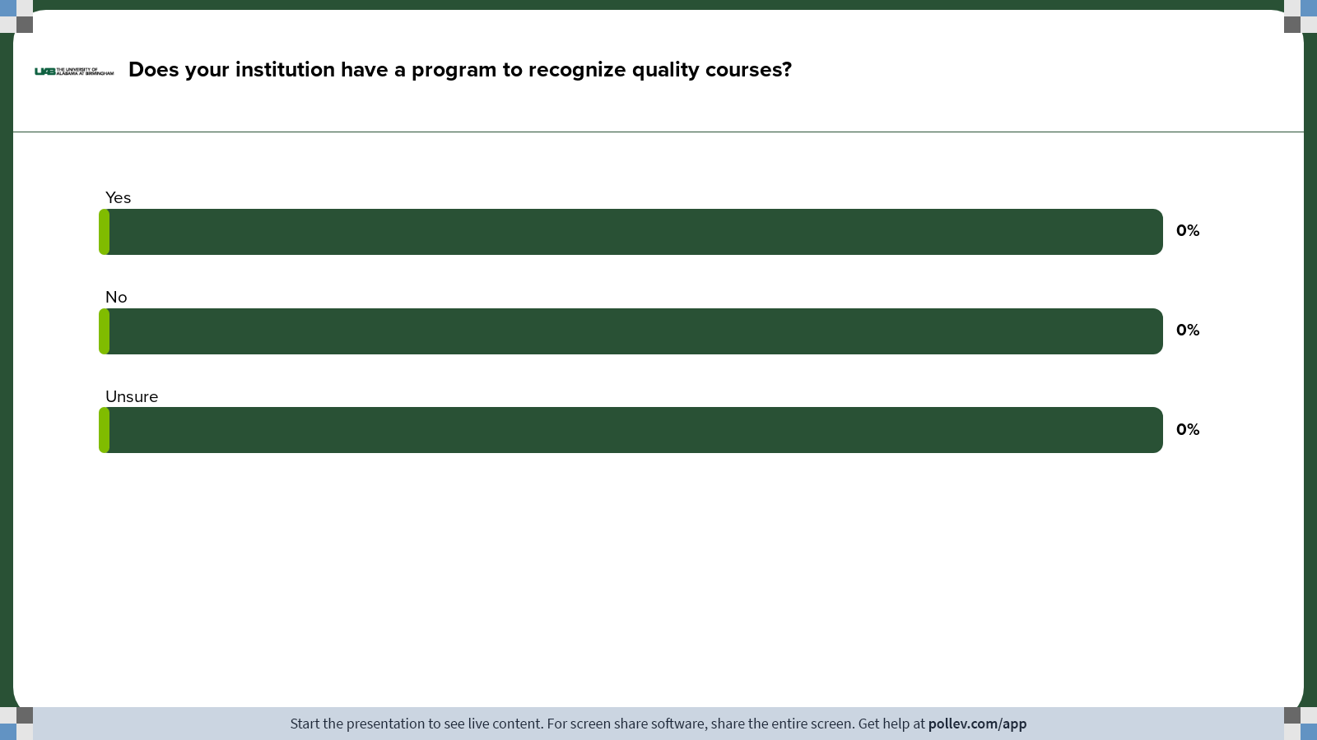
Notes:
Poll Title: Do not modify the notes in this section to avoid tampering with the Poll Everywhere activity.
More info at polleverywhere.com/support
Does your institution have a program to recognize quality courses?
https://www.polleverywhere.com/multiple_choice_polls/YoZq9c7oMNhV8yx76awEm?state=opened&flow=Default&onscreen=persist

Slide 5
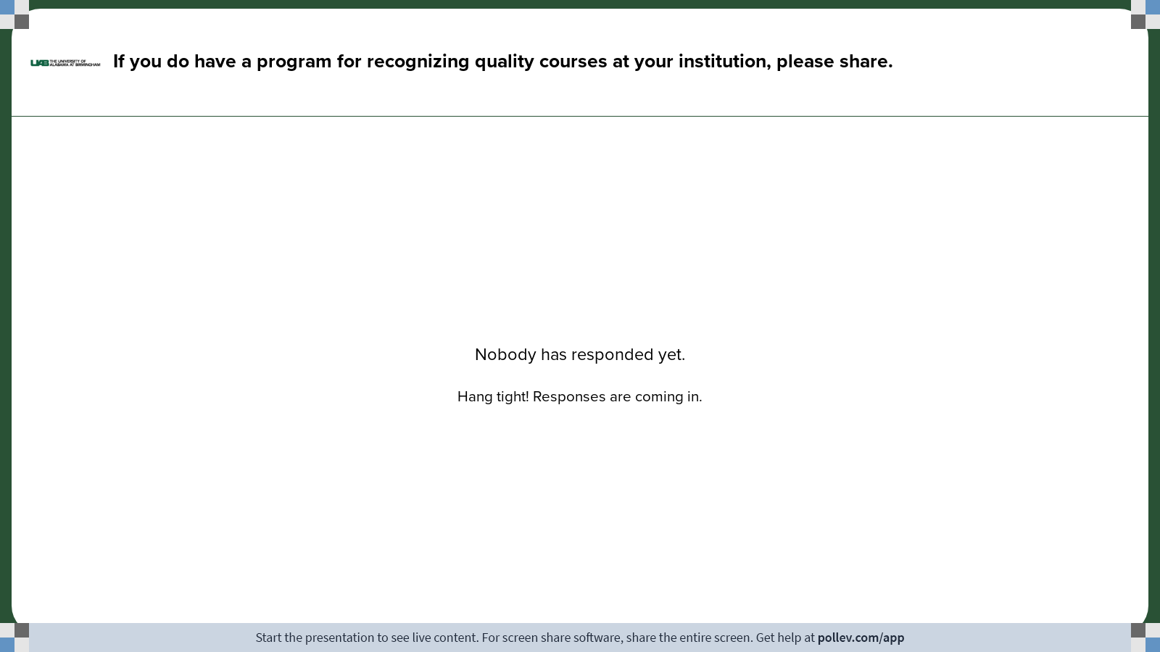
Notes:
Poll Title: Do not modify the notes in this section to avoid tampering with the Poll Everywhere activity.
More info at polleverywhere.com/support
How do you recognize quality courses at your institution?
https://www.polleverywhere.com/free_text_polls/GSUumXyqdv2tCZCBKPiWV

Slide 6
Background of UAB and eLearning
UAB is a four-year, public university in Alabama and a research institution
Division of eLearning and Professional Studies (eLearning)
  Instructional Design
  Media Production
  Academic Technology Training and Support
  Continuing Education
  State Authorization
  Quality Matters
Notes:
Samira

Slide 7
Why an Online Course Showcase?
Instructors requested examples
Staff requested examples for student recruitment
Highlight quality online courses
Incentive for creating quality online courses
Notes:
Randi

Slide 8
Course Selection
QM certified courses
Non-credit courses designed with the QM Rubric
Award-winning courses
Vary by discipline, assessment type, course level, design and content presentation
Continual process
Assess for gaps in courses represented
Notes:
Randi

Slide 9
Process for Each Course
Instructor approval
Create public-facing course shells and import approved content
“Convert” discussions and assignments
Update course links
Add disclaimer pages
Publish to website and review
Notes:
Zhetao

Slide 10
Coming Soon…
Showcase for resource and continuing education courses
Service-learning course
Prominent location on the website
Notes:
Samira

Slide 11
Thank you!
Questions?
Notes:
ALL

