Slide 1
“Expanding Possibilities”
November 6 – 9, 2022
Tucson, Arizona

Slide 2
Getting Better at Getting Better: The Role of Change Management in Quality Assurance

Slide 3

Keynote Speaker
Dr. MJ Bishop
Vice President for Integrative Learning Design, University of Maryland Global Campus, and QM Board Chair

Slide 4

Getting Better at Getting Better:
The Role of Change Management in Quality Assurance
Dr. MJ Bishop
Vice President for Integrative Learning Design
University of Maryland Global Campus
QM Connect
November 8, 2022
Notes:
Thanks for that introduction…

Slide 5
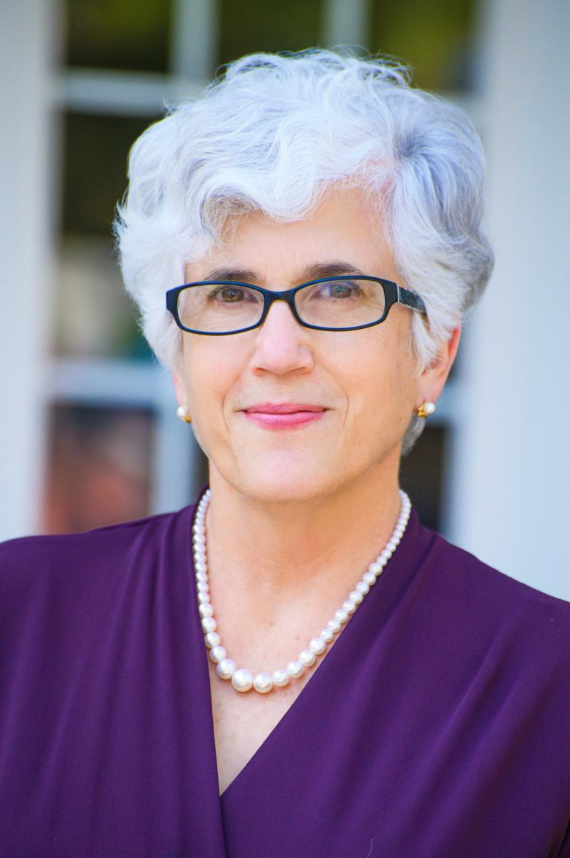
Notes:
Deb Adair, who is this woman right here in case you *haven’t* seen her photo in the conference app…
Deb asked me to spend my time with you today somehow weaving together the opening keynote panel… which was SO much fun to do with 3 amazing colleagues… what we’ve been learning and sharing over these last few days at QM Connect… along with my reflections on where we might need to be going moving forward as an organization.
NO SMALL FEAT…
But let’s see how I do.
I want to start with a couple of apologies… which they say you should never do at the start of a keynote…
But I do want to acknowledge for our K-12 colleagues in the room that this is going to be largely focused on higher education… but I do think the challenges faced by higher ed are rather different given our tuition-dependent model. It’s not that our challenges are bigger, they’re just different.
And I should also apologize to my higher education colleagues for the business focus of this presentation… I’m about to use a whole bunch of blasphemous terms like “customer,” and “product,” and “revenues”… but try to hang in there with me while I make my point…

Slide 6
Notes:
It has been just a little over 9 years since I gave up my tenured faculty position in Lehigh University’s College of Education where I taught and researched in the area of instructional design to become the inaugural director of the University System of Maryland’s William E. Kirwan Center for Academic Innovation…

Slide 7
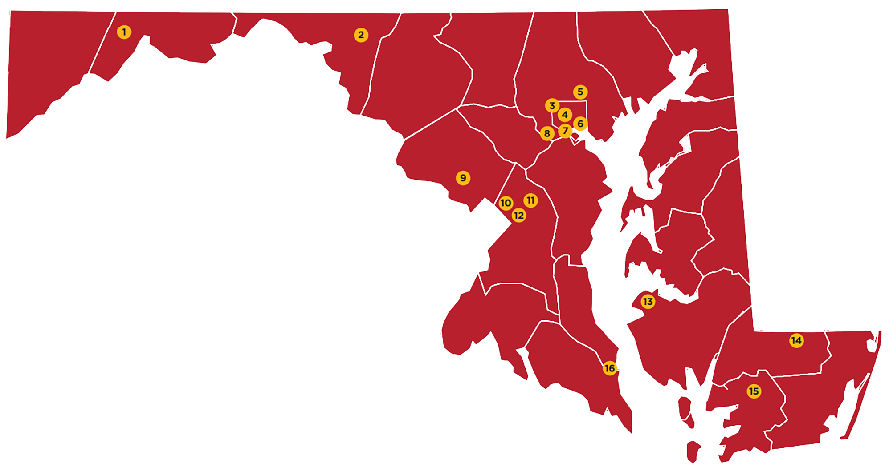
Frostburg State University
University of Maryland at Hagerstown
Coppin State University
University of Baltimore
Towson University
University of Maryland, Baltimore
University System Office Headquarters
University of Maryland, Baltimore County
Universities at Shady Grove
University of Maryland Global Campus
Bowie State University
University of Maryland College Park
University of Maryland Center for Environmental Studies
Salisbury University
University of Maryland Eastern Shore
University System of Maryland at Southern Maryland
Notes:
Where, up until this April, I worked with the 12 four-year public universities plus three regional centers that make up the University System of Maryland to help advance academic innovation work across the state.
USM is decentralized. It is a federated system, as opposed to flagship driven, and includes
research-intensive, including University of Maryland College Park
comprehensive institutions,
historically black universities,
specialty graduate institutions,
a degree-granting environmental research center, and
a standalone, fully online, adult-serving institution… UMGC, which is where I am now.
The system universities are diverse in mission, academic offerings, and student populations and differentially resourced… which has made it a really interesting place to do academic innovation work.

Slide 8
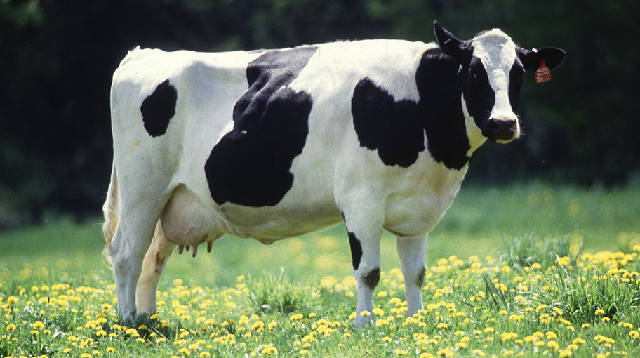
MOOC
Notes:
I started as inaugural director of the Kirwan Center in June of 2013, shortly after The New York Times declared 2012 as “The Year of the MOOC”—when the discourse around disruption was at a peak and academic leaders were predicting that “a tsunami” was coming with respect to technology’s impact on higher education.

Slide 9
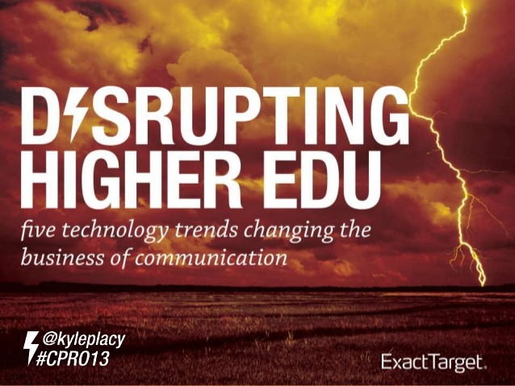
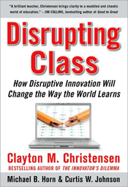
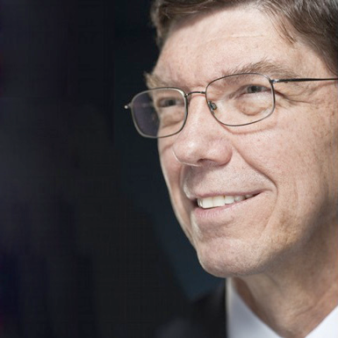
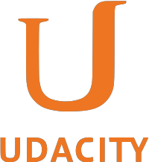

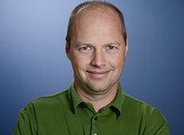


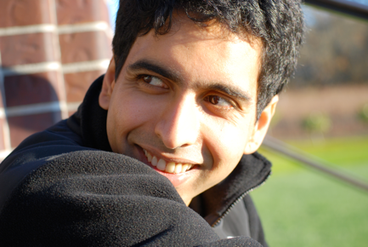

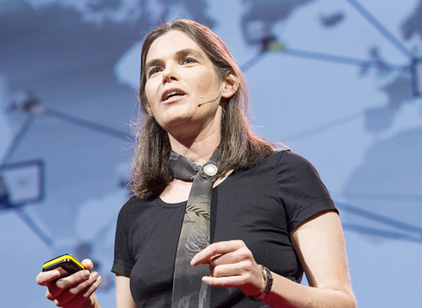
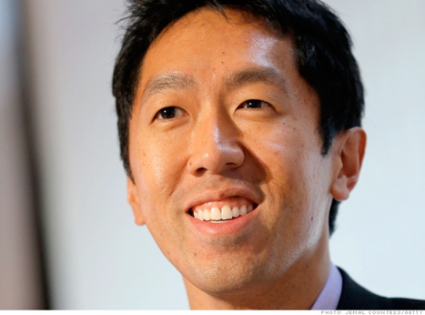
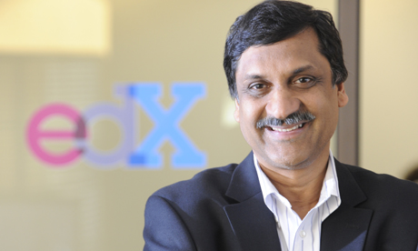

Notes:
At that time, much of the discussion in the media about innovation in higher education was premised on the idea that if faculty would just embrace technology and incorporate these new “bright shiny objects” into the classroom we could increase access, affordability, and achievement of high quality learning.
Unfortunately, a lot of our higher education leadership also bought into this rhetoric as well. And, who can blame them?

Slide 10
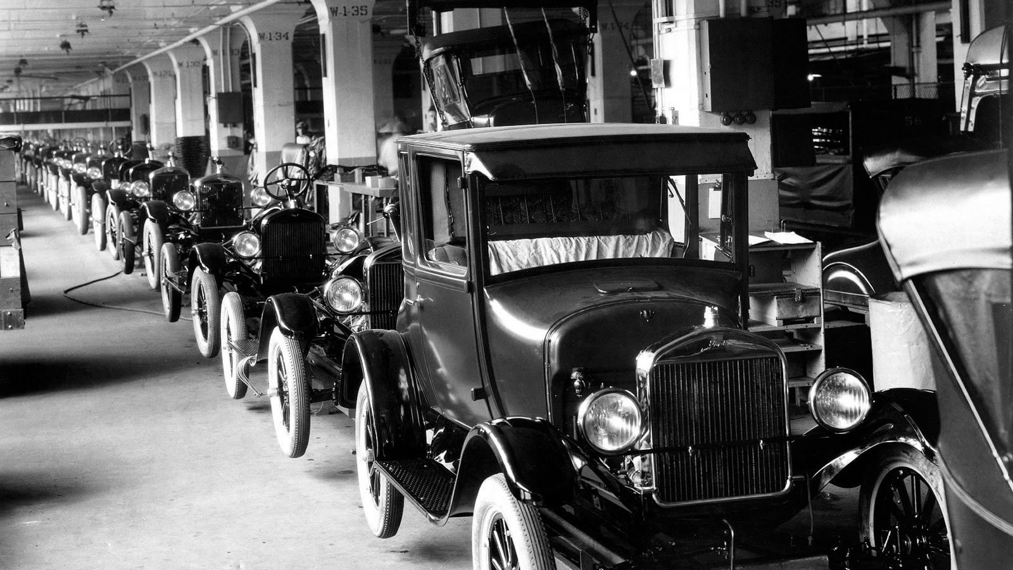
Notes:
After all… technologies have transformed a whole range of businesses, such as the car manufacturing sector and the retail sector… why wouldn’t they have the same, transformative impact on education?

Slide 11
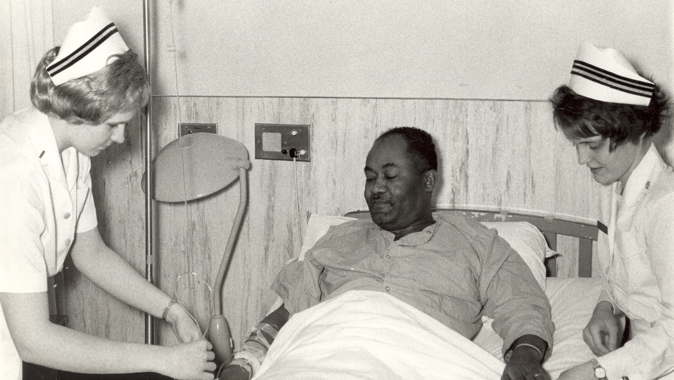
Notes:
But, unfortunately for education, like nursing and other labor-intensive sectors that rely on human interaction or activities, the technologies we have had available to us to date simply have not been capable of producing the kind of growth in productivity over time to transform the way we do business.
Stated differently… it takes nurses the same amount of time to change a bandage today as it did 50 years ago.
And the same largely holds true for education… it takes college professors the same amount of time to mark an essay today as it did 50 years ago.

Slide 12
Baumol’s “Cost Disease”
Productivity increase in industry group A
Rise in nominal wages in industry group A
Decrease in costs per unit of output in industry group A
Technological Innovation
Little or no effect on productivity in industry group B
Rise in nominal wages in industry group B
Increase in costs per unit of output in industry group B
Notes:
This “cost disease” was first discussed by William Baumol and Bill Bowen in the 1960s…
With technological innovations in some sectors, productivity increases at a rate similar to or even greater than the rise in wages for the workers in that sector. This results in a decrease in the cost per unit.
The problem is that, with the introduction of those same technologies in other industries –of which education is a part– the wages increase but the productivity does not…. Which results in an increase in costs per unit.
While I realize this is way more economics that you probably wanted to hear this late in the day… one of the really interesting observations that Baumol made in all of this was that when this happens, the industries in that upper row begin exerting serious pressure on that bottom row to become more productive.
Which, for higher education at least, translates into “you’re not producing enough graduates to meet the workforce needs of the 21st century… and the ones you ARE graduating don’t have the skills we need.”

Slide 13
“A seismic shift is underway. For the last two years, we’ve witnessed a great reassessment going on in the U.S. economy. It’s happening on many different levels – each with significant consequences for higher education.”
Selingo, 2022, Reimagining the University
Notes:
Fast forward to today and the pressures on higher education have become only greater post-pandemic. Jeff Selingo is calling it a “seismic shift” of change
[READ] For the last two years…
He cites the fact that
COVID upended our lives, habits, and traditions, including college as the default after high school;
The pandemic also afforded us options on where we wanted to live, how we worked, the ways we shopped – and how we learn; and
COVID exposed challenges for higher education’s financial stability and workforce that had been accumulating for years.

Slide 14




The "Gravitational Forces" at Play...
Internal pressures, market trends, and
environmental impacts
Environmental Impacts: Enrollment shifts
Demographics
COVID-19
Attitudes toward higher education
Market Trends: Workforce disruption
Bootcamps
Alt-credentials
In-house training
Institutions: Doing more with less
Well being
Equity and Inclusion
Articulation and Transfer
Notes:
And, as we know, there are many more gravitational forces at play as well…
Institutions: Being asked to do more with less...
Well being
Equity and Inclusion
Articulation and Transfer
Market Trends: Workforce disruption is facilitating emerging competition to the degree
Bootcamps
Alt-credentials
In-house training
Even the state of Maryland is re-evaluating how many state jobs really need bachelor’s degrees
Environmental Impacts: All pointing to fewer students... Already enrollment in higher ed has declined by nearly one million students since 2019
Demographic shifts
COVID-19
Attitudes toward higher education –
Americans are questioning the value of college. It’s not that they think a post-secondary education isn’t necessary. Rather, they’re asking whether a traditional, residential college is the right place after high school—or if there are other options.

Slide 15
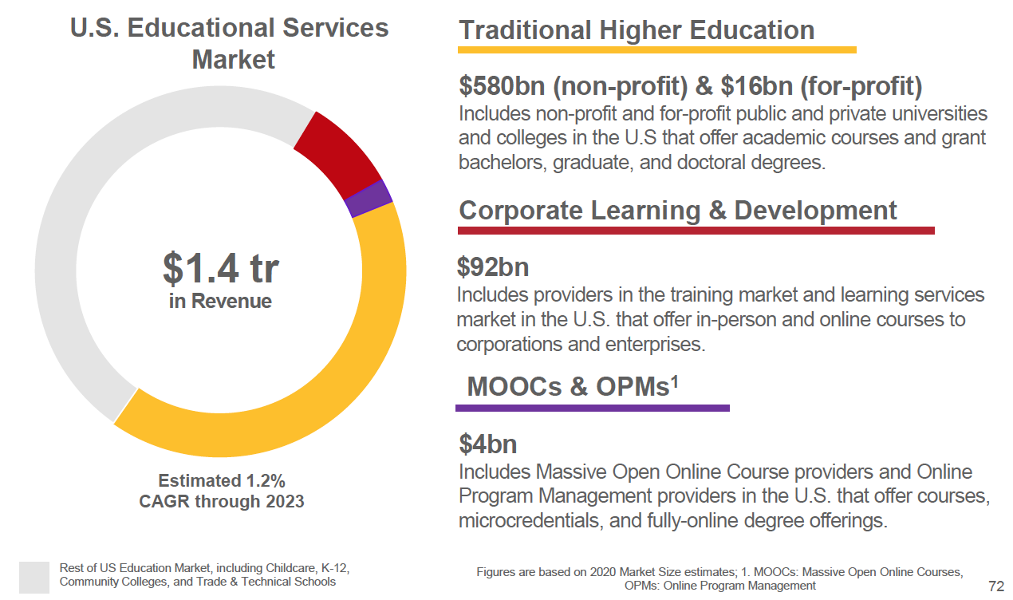
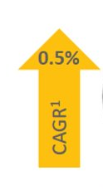
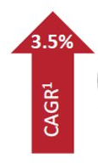

U.S. Educational Market Segments
Notes:
Even before the pandemic, we were seeing these shifts starting to play out in analyses of the U.S. Educational Market Segments…
Out of an overall $1.4 trillion market and estimated compound annual growth rate of 1.2% through 2023, traditional non-profit 4-year higher education accounts for $580 billion with for-profit providers making up an additional $16 billion. This segment is defined as that portion of the industry that is granting bachelors, graduate, and doctoral degrees... and we would add "certificates" as well.
The other two segments highlighted here are corporate learning and development, which includes providers offering in-person and online courses to corporations and enterprises, and MOOCs and OPMs (online program management providers), which offer courses, microcredentials, and fully-online degree offerings.
As you can see by the Compound Annual Growth Rates (CAGRs) on the right side of this slide, steady growth is projected in the Traditional Higher Education and Corporate Learning & Development markets over the next 3 years, with strong projected growth in the MOOCs and OPMs market.
But traditional higher education is still a huge part of this pie... even a fraction of a percent of $580 billion is better than a 15% share of a $4 billion market. It's clear that we need to get a whole lot better at exploiting the traditional market (and retaining those students) at the same time we're smartly investing in growth of these other areas.
And, in addition to the economic pressures on higher education…

Slide 16
“Non-traditional” student?
  Over 25.
  Dependents.
  First generation.
  Financially independent.
  Took time off before college.
  Went to a community college.
  Attends part time/works full time.
Notes:
Tragically, events in the first half of 2020 sparked a renewed urgency to address structural racism across our institutions and surfaced just how much work remains to increase access, affordability, and achievement for all students who seek a postsecondary education.
Unfortunately, too few of our institutions are adequately addressing these changes in demographics…Particularly with respect to their constant, competing tension between life obligations and educational obligations. This sends these students the message that “this place is not made for me.”
We need to rethink who today‘s postsecondary students are and figure out how to serve their needs.
But how do we do all of that while our budgets are shrinking?

Slide 17
“COVID-19 has thrust much of higher education into a liminal space, where norms and conventional wisdom no longer operate as they once did.
While recognizing the devastating societal effects wrought by the pandemic, viewing higher education’s ongoing response in this way invites us to consider how we can embrace this moment as an opportunity for transformational change.”
Bishop, O’Neill, Walsh (2021). Fostering a Culture of Academic Innovation in a Time of Crisis. Moving Horizontally: The New Dimensions of at-Scale Learning in the Time of COVID-19
Notes:
[READ]
Great challenge… but also great opportunity…
Ordinarily I wouldn’t directly cite something from one of my own papers in a talk like this… but this opening was actually written by my co-author, Dr. Nancy O’Neill and I think it’s so well stated…

Slide 18
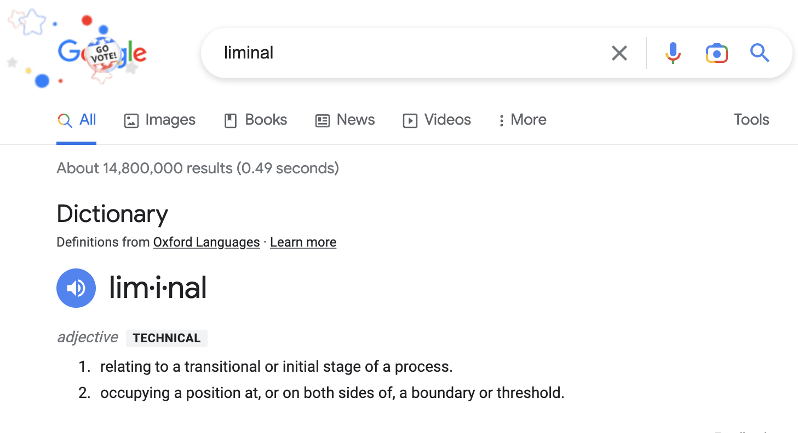
Notes:
You can tell I didn’t write it because I had to look up the word LIMINAL when I read it the first time!

Slide 19

Learner Centered
Notes:
So, I *do* think we’re starting to make the pivot.
We are, at least, talking about becoming more “learner centered”…
But it strikes me those are conversations that are still happening in academic and student affairs… how much are our entire universities engaged in these discussions?
And are we really sure we know what we mean by “learner centered?”

Slide 20
Learner-centered institutions…
Aspire to… | As compared to…
reach the students they have. | presupposing who their students should be.
value the experiences/prior knowledge learners come with. | assuming everyone is coming in with a “blank slate.”
help learners articulate their educational goals. | defining “student success” for learners as degree completion.
“connect the dots” between school and career. | providing little career support or curricular cohesion.
provide for both didactic and experiential learning opportunities. | assuming learning stops outside of the classroom.
measure what learners know and are able to do. | measuring recall of content covered in class.
clearly communicate the competencies learners acquire to all “downstream” stakeholders. | communicating what learners were taught.
support enduring learning and personal development across a lifetime. | simply opening doors to potential entry-level careers early in life.
Notes:
In preparation for a session I moderated for the QM President’s Forum in 2021, I put together this attempt at a definition…
Learner-Centered institutions aspire to...
[READ]
These are aspirational goals that are going to require engagement from our entire institutions not just academic and student affairs.
For example…
Reaching the students we have is going to involve a significant investment of resources in supporting students who may not be as well prepared for a college education.
Valuing prior knowledge is going to require we get a lot better at diagnostic assessments of student learning.
Helping learners articulate goals is really a whole new area for us… how much of this is being done as part of the matriculation process and orientation?
Connecting the dots… what sorts of investments are we making in career services and embedding it throughout the learning experience?
Experiential learning… who’s going to curate and cultivate these learning opportunities? And assess student learning from them?
And so forth…

Slide 21
Emerging Academic Innovations/"Products"
...to start serving both traditional and emerging markets
Credit for prior learning and prior learning assessment.
Innovative, friction-free pathways, articulations, and transfer.
Student-facing “store fronts” to market those pathway opportunities.
Competency-based learning records (CLR) that communicate outcomes.
Shared online courses (low-enrollment courses, inter-institutional registration).
New degree/certificate types and innovative programs (e.g., professional masters).
Modularized curricula and learning opportunities resulting in stackable credentials.
Notes:
And we seem to know the kinds of things we need to do… we’re talking a LOT these days about…
[read from list]
But how much progress are our institutions really making in these areas?

Slide 22
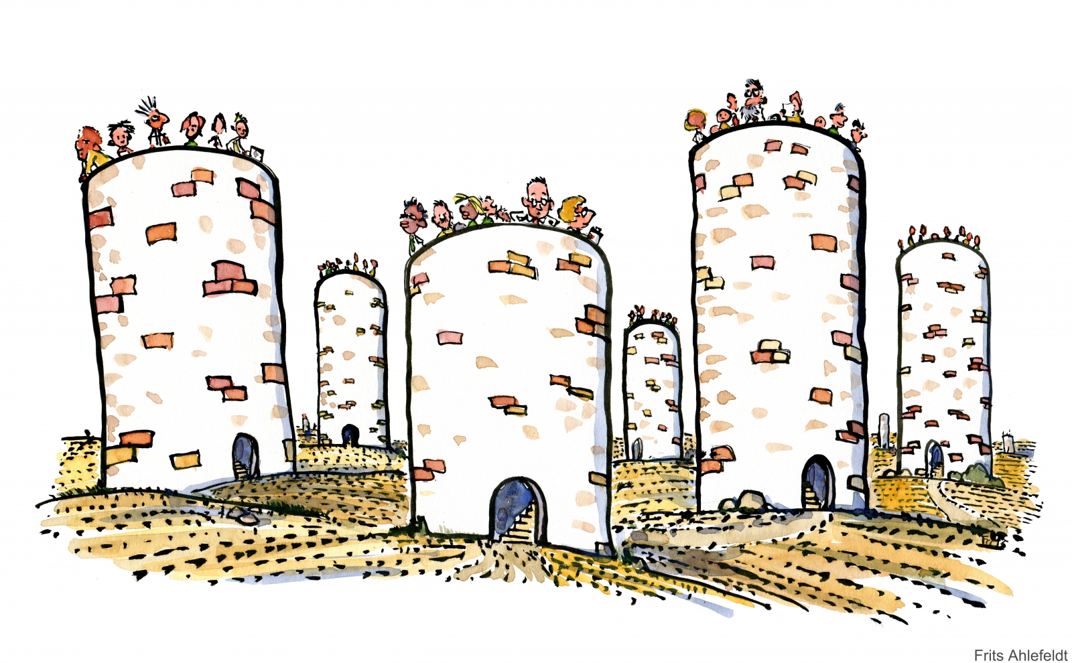
Higher Education Administration
Notes:
How much truly transformative innovating are we likely to be able to do from within our current, higher education administrative silos?

Slide 23
Customer
Technology
Innovation
Business
Notes:
If we asked business… they would tell us that the issue is, while we may innovate plenty at the course or program level, we’re not pulling together the right elements to truly innovate at the institutional level.
They would tell us that enterprise level innovation happens at the juncture of
understanding what your customers are trying to get done
capitalizing on the affordances of the available technologies to do things differently
and making smart investments in our futures.
They would start by asking us…

Slide 24
What are your customers trying to get done?
What are they hiring you to do?
Notes:
[READ]

Slide 25
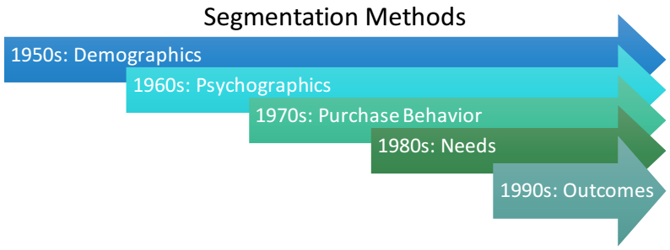
Tony Ulwick, Jobs to Be Done (2002)
Notes:
In the 1950s corporate America’s efforts to understand customers -- or “market segmentation” -- was based purely on demographic characteristics such as age, geographic location, or gender. This information was the only type of data that was easily collected and readily available, and marketers used it to create market segments.
In the mid-1960s marketers added psychographic data to their segmentation efforts. They gathered information about customer traits and attitudes toward products and services and used it to produce more specific customer profiles.
In the 1970s organizations installed large transaction databases and captured real-time point-of-purchase data. These technological advancements enabled marketers to create purchase behavior segments.
In the 1980s companies embraced needs-based segmentation. Powerful computers and sophisticated clustering techniques allowed researchers to classify customers into segments based on what product features and benefits were most appealing to them.
Today’s best market segmentation efforts have moved beyond demographic and psychographic factors to focus on the outcomes customers want to achieve. The model is based in part on the theory that customers “hire” products or services to get “jobs” done. By understanding what that job is and breaking down the discrete process steps required to get the job done, the service provider can gain a full view of all the points at which a customer might desire more help.
So, where is higher education on this chart? How are we currently defining our market segments?
Yep. That’s right… we’re still segmenting our customers demographically. And you know the danger there, right…?

Slide 26
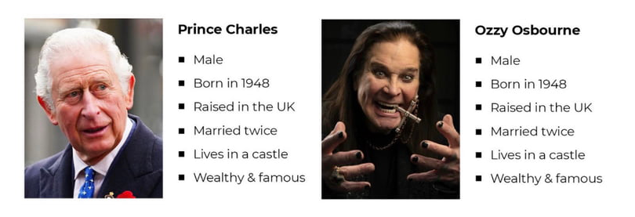
Notes:
Well, based on demographics alone these two Brits seem virtually interchangeable.
Our thinking about who our customers are needs to be focused on learners’ goals and emotions rather than immutable characteristics such as age, race, geography or gender.

Slide 27
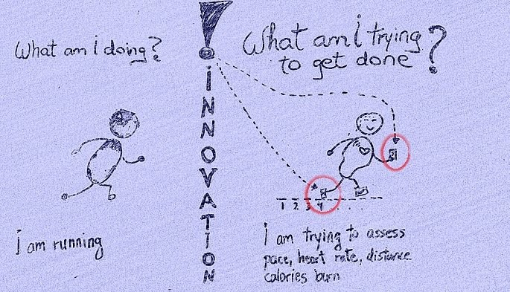
Notes:
They come to us for education, but do we really know what it is they’re trying to get done? Do we understand their goals? Or do we just assume we know what they need? When was the last time we challenged our assumptions about what we think they need?
And, I would argue there is one additional factor that WE need to address that is less often a conversation in business…

Slide 28
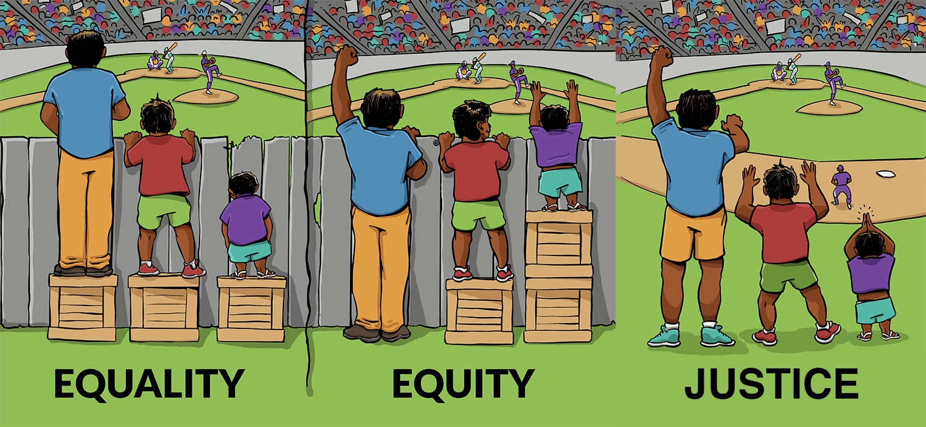
Notes:
Which is, to what extent are our very organizational structures throwing up barriers to access that actually prevent our customers from getting their job done?
I know all of you have seen variations on this illustration…
In the first image, it is assumed that everyone will benefit in the same way from the same supports… they are being treated equally.
In the second image, individuals are being given different supports to make it possible for them to have equal access to the game. They are being treated equitably.
In the third image, all three can see the game without any supports or accommodations because the cause of the inequity was addressed. The systemic barrier has been removed.
[Still don’t have a seat in the stadium, however!]
For us, because of the missions we serve, helping our customers get the job done involves innovations that both create new products as well as new processes and supports that remove barriers to education as well.

Slide 29
Students who want to master a
subject area of interest to them.
Students who want to gain marketable skills that appeal to potential employers.
Students who want to develop a
network of friends and colleagues.
Notes:
We have students from ALL walks of life…
who want to master a subject area of interest to them (the Academics).
who want to gain marketable skills that appeal to potential employers (the Careerists).
who want to develop a network of friends and colleagues (the Networkers).
In fact, in Fall of 2021, Accenture released a survey of 6,500 learners that identified 6 distinct segments of learners…

Slide 30
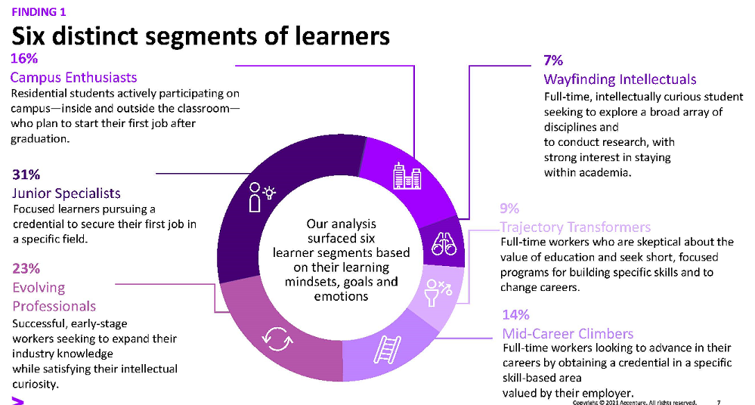
Notes:
[READ]
Note that the “Junior Specialists” and “Evolving Professionals” make up over 50% of the learners they surveyed. What are we doing to help them get that job done? And when are they going to fire us for non-performance?
The Different Types of Potential Learners and What They Want
https://www.insidehighered.com/news/2022/07/20/understanding-todays-and-tomorrows-learners-and-their-mind-sets?utm_source=Inside+Higher+Ed&utm_campaign=d19d218148-DNU_2021_COPY_02&utm_medium=email&utm_term=0_1fcbc04421-d19d218148-197372665&mc_cid=d19d218148&mc_eid=23cbbcdd80

Slide 31
How do you use the technology?
Are you using them to do things differently?
Notes:
The second question business would ask us is how, exactly, we’re making use of the tools available to us.
And whether we’re avoiding the temptation to use the tools to do things in the same way we’ve done them in the past… something psychologists call “functional fixedness”…

Slide 32
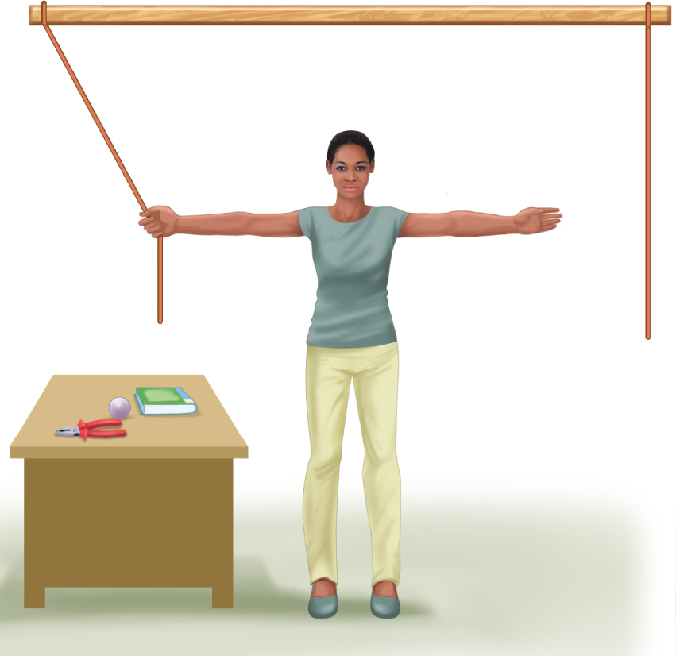
Notes:
…which was illustrated by Maier’s “Two string problem” (1931) research study.
In the study, participants were required to figure out a way to tie two strings together, even though when holding on to one string, the other was out of reach. A variety of objects were available in the room for use in the solution of the problem, including a pair of pliers.
As you can imagine, most participants grabbed the pliers and used them to try to extend their reach toward the other string… which didn’t work.
In fact, getting to an answer involved thinking about the other affordances of the pliers… like its weight.

Slide 33
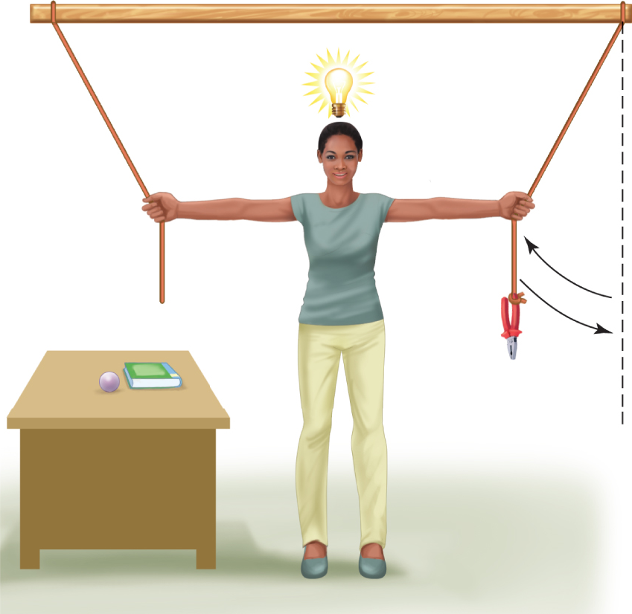
Notes:
The solution was to tie the pliers to the string and set it in motion like a pendulum so that it could be reached while holding onto other string.
While educators are certainly not the only people prone to this phenomenon… unfortunately, the story of technology use in education reveals a long history of this kind of “functional fixedness.”
I‘ll give you an example...
In the 1920s a school district in Los Angeles was given an extraordinary opportunity to innovate... A surplus military airplane was donated to the district to help the schools teach geography from the air.
The whole experiment was hailed as a clear demonstration of how “progressive education“ and „new technologies“ had influenced the city’s teacher corps...
But can anyone guess what they actually did with the plane??
Here’s the image that accompanied the press release….

Slide 34
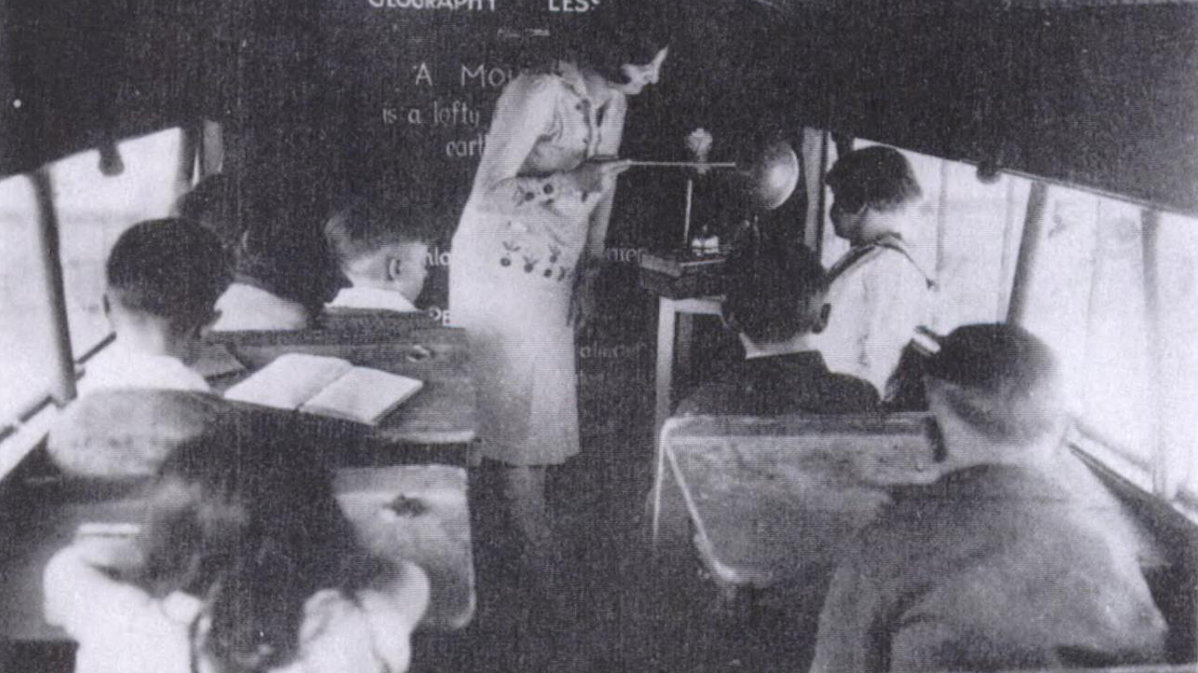
Notes:
[PAUSE]
The issue here is that we can’t stop at simply adopting the technology and assume we have innovated.

Slide 35
Implementation Model
Re-envisioning
Transformative
Integration Level
Redesigning
Replacing
Sporadic
Selective
Sweeping
Notes:
In fact, while I was at the Kirwan Center we were been playing with framing our innovation work using graphs like this…
that speaks to what “transformative use” of a technology looks like in terms of both
how much it has scaled, as well as
how we are qualitatively engaging with the new tool, system, or process.

Slide 36
Implementation Model
Re-envisioning
Continually improving instructional materials.
Transformative Use of OER
Redesigning
Teaching differently with OER.
Integration Level
Replacing
Swapping textbooks with OER.
Sporadic
A few interested faculty
Selective
Targeted programs
Sweeping
Pervasive across curriculum
Notes:
The reason we created this framework was because of what we were starting to recognize was happening with our statewide open educational resources (OER) initiative… we were paying lots of money in faculty grants for most recipients to simply swap their textbook with the OER and call it a day.
Great in terms of affordability, but misses the rest of OER’s affordances… like the “openly licensed” part that allows us to redesign courses and think differently about teaching with OER as well as to explore ways in which instructional materials might be continuously improved as we come to understand how students are interacting with them… potentially making them more culturally and context relevant, for example.

Slide 37
Implementation Model
Re-envisioning
Exploring new pedagogical
and curricular models (such as modular, competency-based, stackable approaches).
Transformative Use of Online
Redesigning
Addressing learner access needs while ensuring
optimally effective delivery
of learning experience.
Integration Level
Replacing
Moving traditional courses/
programs online to
increase access.
Sporadic
A few interested faculty
Selective
Targeted programs
Sweeping
Pervasive across curriculum
Notes:
We also explored how this same framework might be applied to our thinking about online.
Similar to OER… as pressure has been mounting on institutions to “go online” we are finding that many institutions are simply moving existing courses and programs online in the hope of growing enrollments… but without much real strategic vision about how the affordances of online can best serve genuine student needs.
How might the affordances of online be strategically applied to addressing learner access needs and to exploring new pedagogical and curricular models instead?

Slide 38
Implementation Model
Re-envisioning
Transformative Use of VR
Integration Level
Redesigning
Replacing
Sporadic
Selective
Sweeping
Notes:
And, as we begin exploring new technologies, like VR, are we working to understand the affordances they bring to help us do things differently?

Slide 39
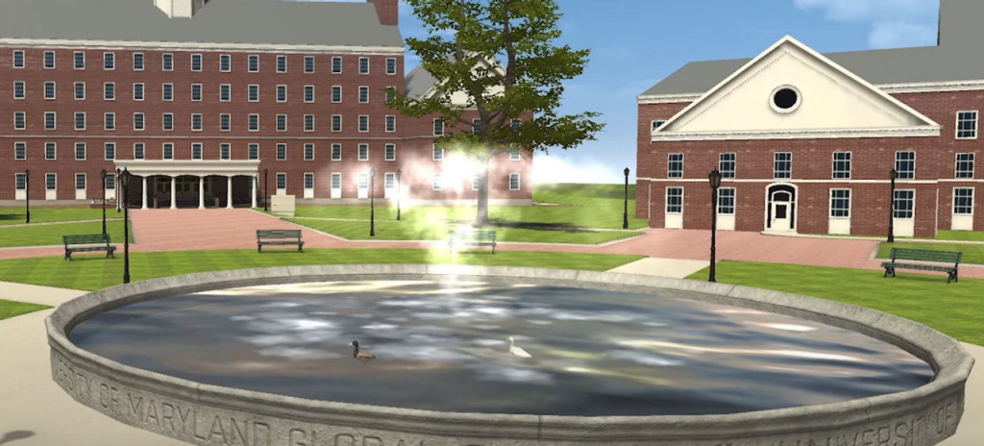
Notes:
Or are we simply replicating what we’ve always done in the past?
For those of you who are closer to my age… is all of this conjuring up Second Life flashbacks? Has anyone been in there lately to check on their avatars? I’m pretty sure mine is still flying around in there somewhere… I could never figure out how to get her to land.

Slide 40
Affordances
Learning Centered
Data Informed
Continuously improvING
Notes:
And, to a point Suzanne made in the opening panel about choosing our tools very carefully…
if in fact, our goal is to become more learning centered, data informed, and continuously improving shouldn’t we be staying focused on investing our precious resources on tools that
make learning visible and keep us focused on student success for all learners;
identify problems and whether our interventions are making a difference for all populations of learners; and
facilitate adaptation when we have identified problems of practice?

Slide 41
What is your business model?
Are you investing in your future?
Notes:
Along those same lines… the third thing business would ask us is “what is your business model?” And are you investing in your future?

Slide 42
R&D Spending as Percentage of Revenue
Industry | % of Revenue
Computing and Electronics | 24%
Healthcare | 22%
Auto | 15%
Higher Education | ??%
Notes:
Most industries understand this need to be “forever agile” in the face of external challenges and they address it by investing substantial portions of their revenues back into developing and rigorously researching new models of doing business.
In this way, research and development plays a vital role in the success and sustainability of most major industries, with sectors like technology and healthcare investing more than 20% of their revenues into exploring innovations that promise to help them adapt to future external market pressures.
But while universities contribute almost 42% of their own resources toward “funded” research for other sectors (like technology and healthcare), higher education is among the only major global industries that does not significantly invest in R&D on its own, core business model.
In fact, the very academic innovation centers engaged in these R&D efforts are among the first to lose funding when budgets are cut.
Instead of being viewed as “mission critical,” these academic innovation units are viewed as “nice to haves,” “peripheral,” and/or “expendable.”

Slide 43
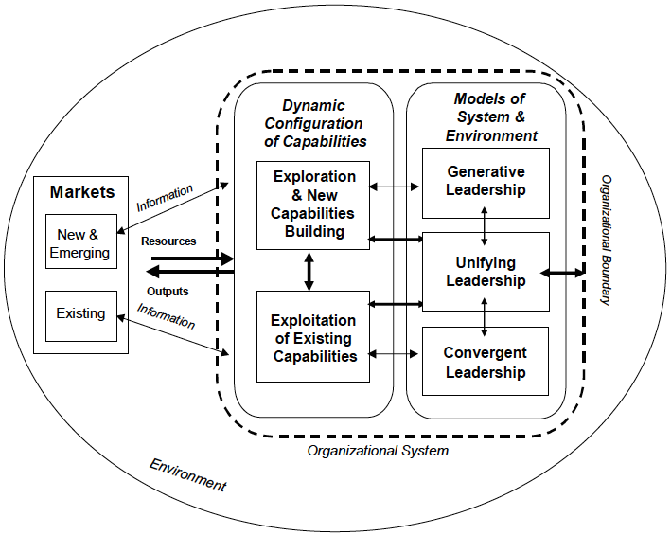
Virtuous Cycles
Dynamic Configuration of Capabilities
Models of System and Environment
Exploration and New Capabilities Building
Generative Leadership
Unifying Leadership
Exploitation of Existing Capabilities
Convergent Leadership
Hazy (2011)
Notes:
Now, granted, we are non-profit institutions… so “revenues” have a very different meaning for us than for-profit business. However, even within the non-profit space there are models for thinking about how various areas of our organizations might interact more effectively to make smarter investments in areas that generate innovations.
One such model that has been emerging from the complex adaptive systems theorists… illustrates how various leadership structures within a higher education complex adaptive system interact with the external environment to explore new possibilities while also exploiting existing certainties.
[DESCRIBE GRAPHIC]
Convergent achieves outcomes pre-established by the institution as efficiently and effectively as possible.
Generative invents responses to changes in the environment.
Unifying builds community, establishes balance, and manages the inevitable “entanglements.”
According to this model, when combined, these three leadership types regulate activity “by generating, using, and improving the system and the environment to guide decision and action” (Hazy, 2011, p. 174).

Slide 44
Customer
Technology
Innovation
Business
Notes:
So, for business, innovation happens at the intersection of these three things:
They would tell us that it is important to understand the learner experience and ensure that our customers have a role in product development and innovation. Then only customer centric products can be developed.
They would certainly tell us that technology can and does play a major role in the conversation, but simply introducing a technology into the mix is not innovation. Technology can be used to implement innovation --and sometimes even inspire innovation-- but the technology itself doesn’t produce innovation or change current practice.
And I believe they would also tell us that the only way to address external market pressures and prepare for our future is to do the opposite of what most of our institutions are doing now. Instead of belt-tightening across the organization in a non-strategic, broad strokes way… we need to find ways to continue investing in our own research and development.
So, where does this innovation live within a corporate environment? How do they tie all of these conversations together into a way that gets everyone pulling in the same direction?

Slide 45
Customer
Technology
Product
manager
Business
Notes:
They employ someone called a product (not project) manager
The product manager is an interdisciplinary role that reaches across teams to plan, design, and continuously bring better products to market.
The role evolved out of a set of responsibilities that traditionally fell to lead developers and engineers: scoping out user problems and making critical product decisions.
Since then, it’s become clear that successful product leadership – and shipping successful products – goes beyond the scope of a dev team. It’s a separate function that requires business acumen, a deep understanding of UX design, and product knowledge.
Product managers are responsible for setting a product vision, and defining a product strategy. They are also responsible for developing a roadmap that meets both company goals and user needs.

Slide 46
Product Life Cycle
Strategy | Concept | Deployment | Sustain | Decline
Understanding the customers and their needs. Business case Customers' requirements Product Roadmap Governance | Finding a solution that meets customers' needs. Market research Benchmarking Funding model Business model Contract | Creating, implementing, and deploying. Implementation plan Dependencies Technical design Disaster recovery Service policies | Measuring and continuously improving. Marketing Training End-user support Metrics Monitoring | Eliminating or replacing based on the roadmap. Rationale Communications Transition plan Postmortem
Notes:
Now whether this is an actual person or some shared leadership capacity that’s built, product management involves shepherding a product through its lifecycle, which include:
[READ]

Slide 47
Quality Planning
Quality Control
Quality Assurance
Quality Improve-ments
Components of Product Quality
Notes:
And, of course, when businesses think about ensuring product quality, their processes for that mirror the product life cycle…
Quality Planning: The method of deciding what’s most important, the critical factors to a successful project. This includes the resources needed to deliver the project, what steps to take and specifications that have to be met.
Quality Control: Involves the establishment of controls that help standardize production and the responses to any quality issues that emerge.
Quality Assurance: Are the after-production, systematic processes used to determine if a product or service meets quality standards.
Quality Improvement: Is the ongoing approach to the analysis of product performance and efforts to collect the data needed to either improve that performance… or make the decision to abandon the product.

Slide 48
Product Life Cycle
Strategy | Concept | Deployment | Sustain | Decline
Understanding the customers and their needs. Business case Customers' requirements Product Roadmap Governance | Finding a solution that meets customers' needs. Market research Benchmarking Funding model Business model Contract | Creating, implementing, and deploying. Implementation plan Dependencies Technical design Disaster recovery Service policies | Measuring and continuously improving. Marketing Training End-user support Metrics Monitoring | Eliminating or replacing based on the roadmap. Rationale Communications Transition plan Postmortem
Quality Planning
Quality Control
Quality Assurance
Quality Improvements
Notes:
So, when Mark talked about QM widening it’s aperture as part of supporting higher education’s future, this is how I interpret that statement…
From my perspective, and using these definitions (which I know can vary widely), Quality Matters has been pretty focused somewhere within the Quality Control and Quality Assurance areas and, as we know, only specific to online learning.
Is there a role for QM and our broader conversations about quality to help higher education in Quality Planning? in Quality Improvements? And for addressing the learning experience more broadly than just online? And how do these conversations eventually expand into K-12 as well?

Slide 49
Some parting thoughts.
Notes:
So, I offer this perspective as just one way to think about what is going to be necessary for higher education to begin addressing the many challenges we face and beginning to explore the broader role that discussions around quality might play.
As we’re widening that aperture… I have a couple of parting thoughts.

Slide 50
Quality is Equity
Equity is Quality
Notes:
First, we must never lose sight of the fact that equity and quality are connected, they are 2 sides of the same coin.
Equity is a cross-cutting component of quality. And we cannot possibly have quality without equity.
In this way, any aperture widening we’re doing of QM’s role needs to include equity be a cross-cutting component of our quality strategy.

Slide 51
Higher Education Administration
Notes:
And, second… I don’t want to leave you with the impression that I think these silos are impenetrable…
I’ve had recent experience with how aligned the various units on our campus actually are in terms of our job to be done…

Slide 52
Delphi Study
As you think ahead 5-10 years, what specific gaps exist in [CHALLENGE AREA] that will impede higher education’s ability to optimize existing markets and begin exploring new areas for growth going forward.
Campus Culture and Organization: To what extent are we ready in terms of “buy-in” and organizational structures to support new models of student success and financial sustainability?
Academic Offerings and Learner Supports: Are our academic offerings and support for new kinds of learners aligned to future demand?
Financial Sustainability and Business Model: What should the business model be to ensure financial sustainability moving forward?
Technology and Data Infrastructure: Are our current technology and data infrastructures well suited to support innovative growth in “traditional” as well as “non-traditional” markets?
Notes:
In January 2021, our Board of Regents charged an enrollment workgroup that I was part of staffing with exploring the answer the question [READ]
Rather than conduct a series of meetings to identify these gaps, we used a surveying technique called the "Delphi method" to collect this information from senior leaders across the USM institutions so that we could begin recommending and prioritizing solutions.
We initially asked each administrator to stay focused on the things we figured he/she would know best…
Campus Culture and Organization -> Presidents
Academic Offerings and Learner Supports -> Provosts and VPSAs
Financial Sustainability and Business Model -> CFOs
Technology and Data Infrastructure -> CIOs
But it was truly inspiring to see how united they were in their responses, even as we asked them through the survey to “stay in their lanes,” so to speak.
In addition to identifying the need to be more equitable, relevant, student centered, and outcomes focused… this cross section of senior leaders across our system institutions were very clear about the need to also get better at getting better…

Slide 53
We need to "get better at getting better" by embracing continuous improvement and data-informed decision making as a disciplined approach to identifying and solving problems on behalf of our students, our external constituents, and ourselves.
Notes:
[READ]
It was clear from the study that there is a lot of interest understanding more about how to do this.

Slide 54
Questions?
mj.bishop@umgc.edu
Notes:
Thanks for your attention…

