Slide 1
More than MET
Using Inclusive Pedagogy to Support QM Standards

Slide 2
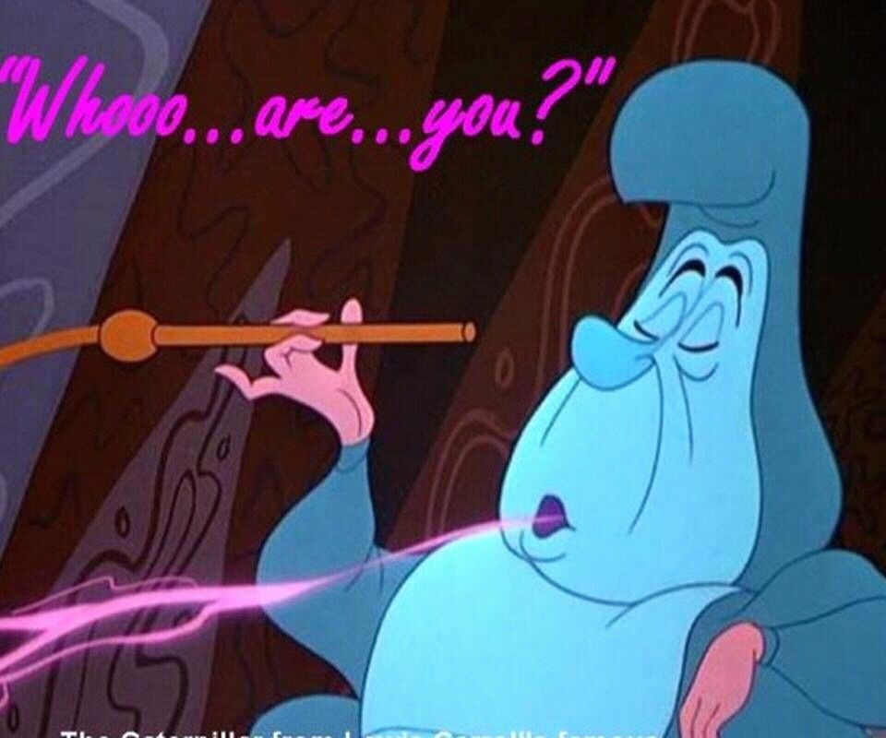





Toni DiMella, EdD
Since 2020: Director of Transformative and Inclusive Pedagogy and adjunct at USC-Upstate in Spartanburg, SC
Since 2009: Mathematics Instructor at Mitchell Community College in Statesville, NC.
Started out teaching 7th and 8th grade in NY in Jan. 2004.
Moved to NC in Aug. 2005 to teach at CCTL Early College.
Worked with NCVPS from 2008 to 2014 in various roles, primarily as Credit Recovery Algebra II teacher.

Slide 3



Learning Objectives
Define the key elements of Inclusive Pedagogy (IP)
Examine how the use of IP increases equity and access
Apply the key elements of IP to the QM Standards to improve course design

Slide 4
Inclusive Pedagogy
“the ways that courses, classroom activities, curricula, and assessments consider issues of diversity in an effort to engage all students in learning that is meaningful, relevant, and accessible”
Univ. of Chicago

Slide 5
Inclusive Pedagogy
“the ways that courses, classroom activities, curricula, and assessments consider issues of diversity in an effort to engage all students in learning that is meaningful, relevant, and accessible”
Univ. of Chicago
At its heart,
Everyone has a right to equal access to education.
All students have a right to feel they belong in their classroom.

Slide 6
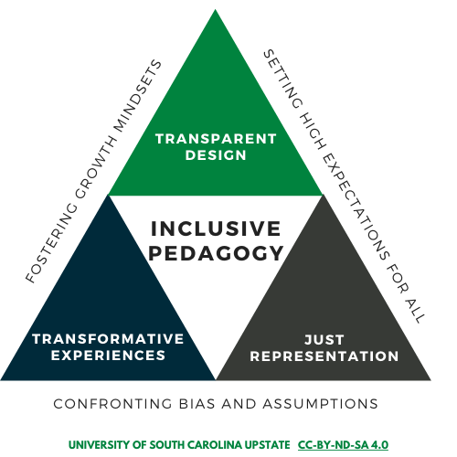
IP @ Upstate
Education for all that inspires a thriving and just society.
USC Upstate Vision

Slide 7
Transparent
Design
Explicitly focus on what students are learning, why they are learning it, and how they will learn it.

Slide 8
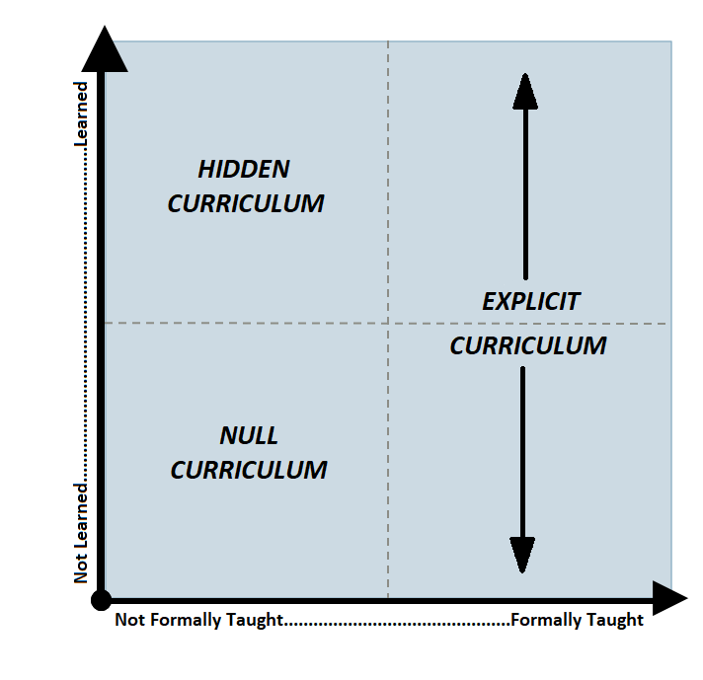
Hidden Curriculum
The implicit, unstated, and unacknowledged expectations of students both inside and outside of the classroom having to do with ‘ways of being’ that facilitate how they navigate, leverage and interact with educational spaces.

Slide 9

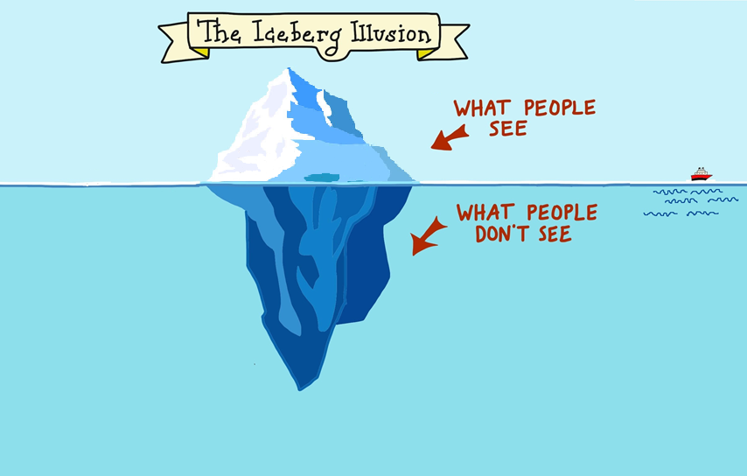
Iceberg illusion
NULL
Notes:
Think about your courses. What is something that is a part of your explicit curriculum and what is in the hidden? We’ll talk about the null later in the series. I’ll give an example and then a chance to think about. In my explicit curriculum, like many of you, I put the grade weightings. You know, tests are worth 40% and Hw is 10%...however, I never talked about how to calculate these things or why a HW average of 90 is not markedly different than an 80 when it’s worth 10. Now, I don’t know why I did this. I know, having taught math for a long time, I know people don’t understand percents, but I still never talked about and I should have.
Using the T, type an example on the image.
I know we’re not talking about the null today, I’ll give you an example there. In my stats classes we talked about hypo testing and how to do it and how to validate it, but for a long time I never talked about how there are a LOT of people pushing back on the use of the hypo testing. Anyone else have an example?

Slide 10
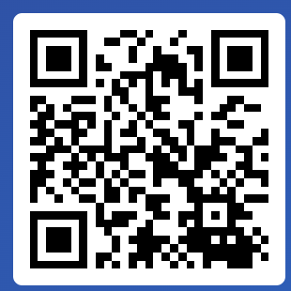
Iceberg illusion
NULL
Join at slido.com
#1692 345
Notes:
Think about your courses. What is something that is a part of your explicit curriculum and what is in the hidden? We’ll talk about the null later in the series. I’ll give an example and then a chance to think about. In my explicit curriculum, like many of you, I put the grade weightings. You know, tests are worth 40% and Hw is 10%...however, I never talked about how to calculate these things or why a HW average of 90 is not markedly different than an 80 when it’s worth 10. Now, I don’t know why I did this. I know, having taught math for a long time, I know people don’t understand percents, but I still never talked about and I should have.
Using the T, type an example on the image.
I know we’re not talking about the null today, I’ll give you an example there. In my stats classes we talked about hypo testing and how to do it and how to validate it, but for a long time I never talked about how there are a LOT of people pushing back on the use of the hypo testing. Anyone else have an example?

Slide 11

Three Key Tools
Before
During
After
First & most comprehensive tool you have
  Handbook for the Course
  Organized, Readable
  Tone matters!
  Accessible
Detailed Syllabus

Slide 12
Three Key Tools
Before
During
After
Detailed Syllabus
  Supportive Assignments
More than just “transparent”
  Clarity
  Connections
  Fosters Growth

Slide 13


Group activity 1
2022
Join at slido.com
#1692 345
Review one of the “before and after” assignments provided. Then share with a partner/group:
  What change from the “before” do you think is the most significant? (c)
  What would you add and/or change to improve the assignment? (a)
Notes:
https://emailuscupstateedu-my.sharepoint.com/:w:/g/personal/tdimella_uscupstate_edu/ERs8C4eFnQdMsDk_xfF6FxQBX13OPSRJjSjdfDk7rtiDFw?e=bXaaZQ
https://bit.ly/3rQjRVv
Ok, so now we have are assignments. We need to grade them and give students feedback. Not all feedback is created equal.

Slide 14
Three Key Tools
Before
During
After
Detailed Syllabus
  Supportive Assignments
Personal and Unique
Ties back to Purpose
Reflects on Task
Adds to the guidance in Criteria
Meaningful Feedback

Slide 15
Transparent
Design
Explicitly states directions and expectations
Clearly defines assessments and grading policies
Makes connections to career and world
Provides detailed and constructive feedback on assignments
Notes:
Explicitly focuses on what students are learning,
why they are learning it,
and how they will learn it.

Slide 16

Transparent
Design
1.2 Purpose and structure of the course.
1.3 Communication expectations interaction are clearly stated.
2.4 The relationship between objectives & activities is clear.
3.1 The assessments measure the achievement of the stated learning objectives.
3.2 Clear course grading policy.
3.3 Specific and descriptive criteria are provided for the evaluation of learners’ work.
4.2 The relationship between the use of instructional materials and learning activities is clearly explained.
4.4 The instructional materials represent up-to-date theory and practice in the discipline.
Explicitly states directions and expectations
Clearly defines assessments and grading policies
Makes connections to career and world
Provides detailed and constructive feedback on assignments
Notes:
Explicitly focuses on what students are learning,
why they are learning it,
and how they will learn it.

Slide 17
Transformative Experiences
A deep, structural shift in the basis of thought, feelings, & actions…a shift of consciousness that dramatically alters our ways of being…

Slide 18

Transformative Experiences
A deep, structural shift in the basis of thought, feelings, & actions…a shift of consciousness that dramatically alters our ways of being…

Slide 19
Explicit Curriculum
The written part of formal instruction of educational experiences. It may refer to a curriculum document, texts, films, and supportive teaching materials that are overtly chosen to support the intentional instructional agenda. It is usually confined to those written understandings and directions formally designated and reviewed by administrators, curriculum directors and teachers.
Notes:
The EC is your design, so it’s somewhat personal bc you curate all the experiences but it’s also a source of power. You, through the curriculum, get to tell students what to do for 15-16 weeks, about 30% of the year. And the nature of what we have students do can, and really should, vary quite a bit. We can grant them a lot of autonomy or no autonomy.

Slide 20
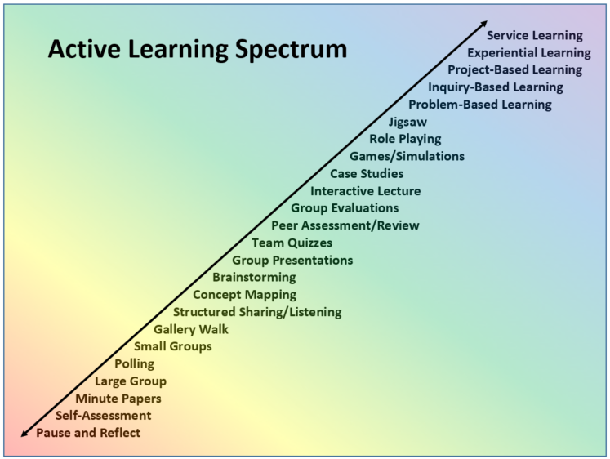
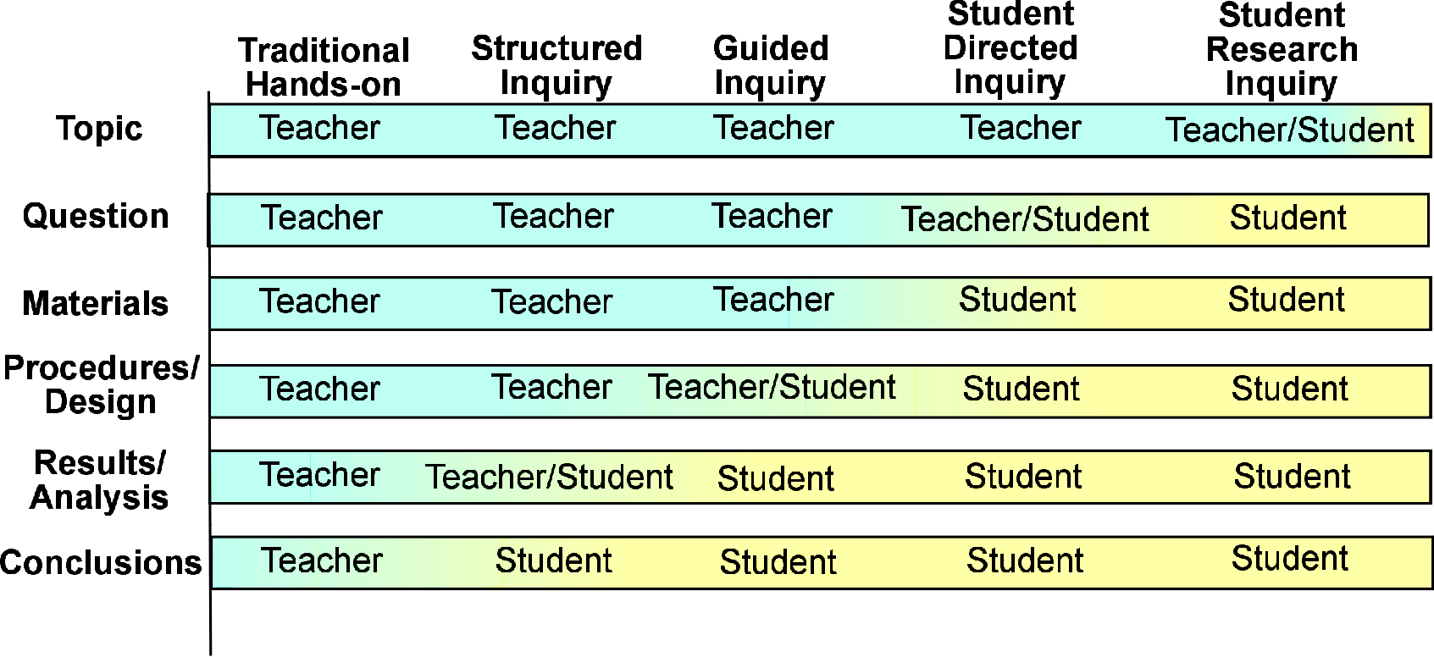
Who is doing the work?
Image taken from PB Works
Notes:
Bc as you reach the higher level of inquiry the students bare much more responsibility in the learning process. And you can see the levels on this one have different names and 5 levels but the story with all of the varying definition is always the same: as you working your way up the levels more the knowledge creation process is delegated to the students.
This does not mean level for 4 ‘good’ and level 1 or even ½ or 0 is ‘bad’ it just means that the student is activitly engaged in more pieces of the learning experience.
And now that’s good! But it’s somewhat a nagging myth that if you aren’t doing big projects, you’re not doing active learning. It’s a spectrum and it goes from simpler to complex not bad to good. As you move up the spectrum the activity gets longer or more involved or maybe needs more planning, but each one of these can and do play important role in creating transformative experiences. In fact, you often don’t see big projects without a lot of little projects to scaffold that experience.
AL over the past 3 years or so has really become apart of the culture at upstate. How often do you use methods like you see on the spectrum?
Poll: How often do you use active learning in your courses?
I try to have something interactive each class
Every week
Every unit/module/chapter
Only for large assignments
None

Slide 21
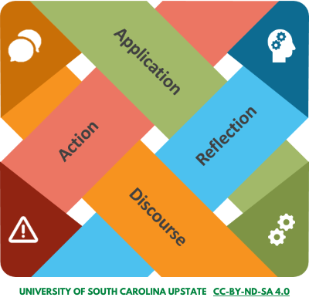
Four Components
Application
Disorienting dilemma, entry event, concrete experience, triggering event…
“Bump” up against taken-for-granted ways
  A new perspective
Doesn’t have to be a “big issue” to be transformative

Slide 22
Four Components
Reflection
Considered the “most important” element
Break in perspective
Different types
  Content reflection
  Process reflection
  Premise reflection
Relevant from work skills to social justice

Slide 23
Four Components
Discourse
Reflection in action
Not all dialogue is discourse
  Dialogue devoted to assessing reasons presented in support of competing interpretations, by critically examining evidence, arguments, and alternative points of view.
Reorganize meaning structures
Communication leads to community

Slide 24
Four Components
Action
Ties back to application
Constructivist
Action = Use Knowledge
The ‘graded’ part
  Voice and/or choice
  Creativity
Tool for Empowerment

Slide 25
Group activity 2
Watch video (6 mins)
Look for examples for one of the elements
  application, reflection, discourse, action.
Share what we saw
What can I use from this example?
What do you see? Think? Wonder?
Notes:
Water Quality: https://www.youtube.com/watch?v=0E_GYEaq5Xg&feature=emb_logo
Finance: https://www.youtube.com/watch?v=JMNwh-hWWzQ&feature=emb_logo

Slide 26
Group activity 2 share
Application | Reflection | Discourse | Action

Slide 27
Transformative Experiences
Balances skill development with personal growth
Inspires personal, meaningful connections to content
Develops social/personal awareness
Engages students in discourse
Fosters metacognitive skills

Slide 28
Transformative Experiences
3.4 The assessments used are sequenced, varied, and suited to the level of the course.
3.5 The course provides learners with multiple opportunities to track their learning progress with timely feedback.
4.5 A variety of instructional materials is used in the course.
5.1 The learning activities promote the achievement of the stated learning objectives.
5.2 Learning activities provide opportunities for interaction that support active learning.
5.3 The instructor’s plan for interacting with learners during the course is clearly stated.
6.2 Course tools promote learner engagement and active learning.
6.3 A variety of technology is used in the course.
Balances skill development with personal growth
Inspires personal, meaningful connections to content
Develops social/personal awareness
Engages students in discourse
Fosters metacognitive skills

Slide 29
Just Representation
Create a sense of belonging so students recognize themselves as members of the higher education community, grow intellectually and emotionally, & become more engaged learners and citizens.
Notes:
From present to empowered

Slide 30

Empowerment + Vulnerability
Belonging means more than just being seen. Belonging entails having a meaningful voice and the opportunity to participate in the design of social and cultural structures. Belonging means having the right to contribute to, and make demands on, society and political institutions.
-John A. Powell
Notes:
https://belonging.berkeley.edu/john-powell
Power and vulnerability right? Like not only am I empowered to speak up and push back but it’s ok if I’m wrong. I don’t have to take a stand for all of what my race or gender or any identity characteristic is.
https://www.npr.org/2015/09/28/444236895/how-poker-player-annie-duke-used-gender-stereotypes-to-win-matches
Just representation helps fight against stereotype threat.
Belonging means more than just being seen. Belonging entails having a meaningful voice and the opportunity to participate in the design of social and cultural structures. Belonging means having the right to contribute to, and make demands on, society and political institutions.

Slide 31
Null Curriculum
The null curriculum is what is absent, left out, and overlooked when curriculum is conceptualized, created, and/or enacted. It consists of “the options students are not afforded, the perspectives they may never know about, much less be able to use, the concepts and skills that are not part of their intellectual repertoire”
Eisner, 1985, p. 107
Notes:
The EC is your design, so it’s somewhat personal bc you curate all the experiences but it’s also a source of power. You, through the curriculum, get to tell students what to do for 15-16 weeks, about 30% of the year. And the nature of what we have students do can, and really should, vary quite a bit. We can grant them a lot of autonomy or no autonomy.

Slide 32
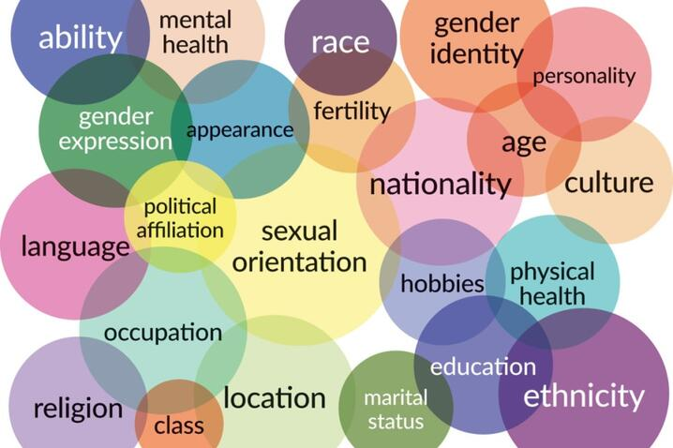
Intersectionality
The complex, cumulative way the effects of multiple forms of discrimination combine, overlap, or intersect especially in the experiences of marginalized individuals/groups.
Notes:
It can be hard to see what’s missing because of our lens, how we see the world which is shaped by our place in it.
Our position is created by intersecting identities. We are all more than one thing, both in the roles we play but just in how we exist. And those things that we don’t choose skew how we interact with the world.
Intersectionality and privilege is a deep well, so we will not jump in to there today, but we’re going to take a peek.

Slide 33
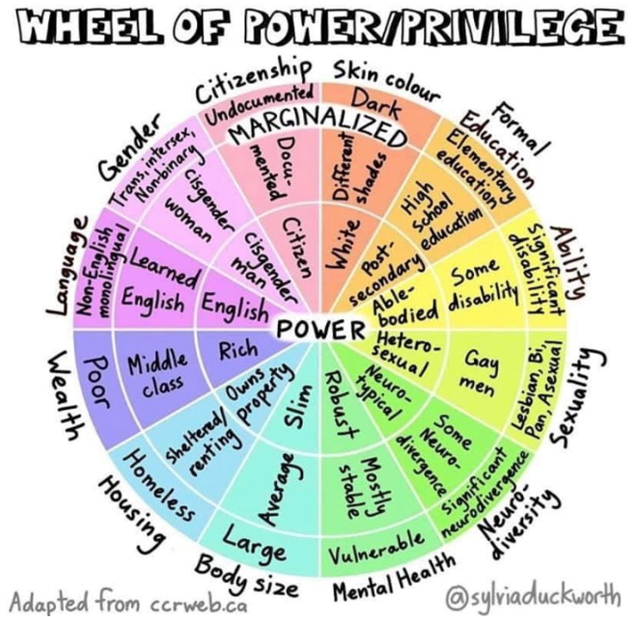
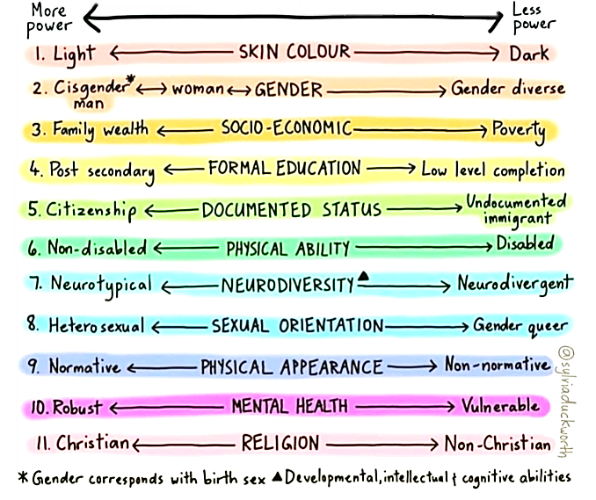
Range of power and idenities
Power and Privilege
Notes:
And how the world sees us.
These positions are not all equally distributed…you can’t talk about taking a simple average…because somethings are can be kept private. But somethings can’t. And when you have multiple “less power” identities…it’s not linear. The lack of power in multiple areas can really exasperate the negative experiences.
Now if you stop someone on the street and ask them if they are racist or sexist or ablest, you’re probably going to get a lot of Nos. But science doesn’t back that up most of the time…there are differences in how people treat others based on these different categories, even for those in the same positionality! It’s called implicit bias bc it’s hidden deep within us. All of us. So we need to consciously work fighting against those assumptions.

Slide 34
My Lens: +1 point for every ‘yes’
I am NOT the first person in my family to go to college.
I had help paying for my tuition.
I was able to purchase all the supplies I need for class.
I did not have to work while I was in school.
I was encouraged to excel in every subject in school.
I never have to worry about being recognized as the gender with which I identify.

Slide 35
My Lens: +1 point for every ‘yes’
I have could/can speak about my romantic relationships without worrying about how others will react.
I can assume that I will easily have physical access to any building.
I can do well in a challenging situations without being told I’m an inspiration because of my identity(ies).
If I apply for a job, my legal right to work in this country probably will not be questioned.
The majority people at the school(s) I attended looked like me.

Slide 36
My Lens: +1 point for every ‘yes’
When I watch television, there are a lot of people in positive roles that look like me.
I can take a job without people thinking I was hired only because of my identity.
I can assume that I will not have to work or go to school on my religious holidays.
If I have children and a successful career, few people will ask me how I balance work and home.
My intelligence is not questioned because of the way I speak.
Notes:
How many points did you have?
0-3
4-7
8-11
12-15

Slide 37
My Lens: +1 point for every ‘yes’
When I watch television, there are a lot of people in positive roles that look like me.
I can take a job without people thinking I was hired only because of my identity.
I can assume that I will not have to work or go to school on my religious holidays.
If I have children and a successful career, few people will ask me how I balance work and home.
My intelligence is not questioned because of the way I speak.
Join at slido.com #1692 345
Notes:
How many points did you have?
0-3
4-7
8-11
12-15

Slide 38
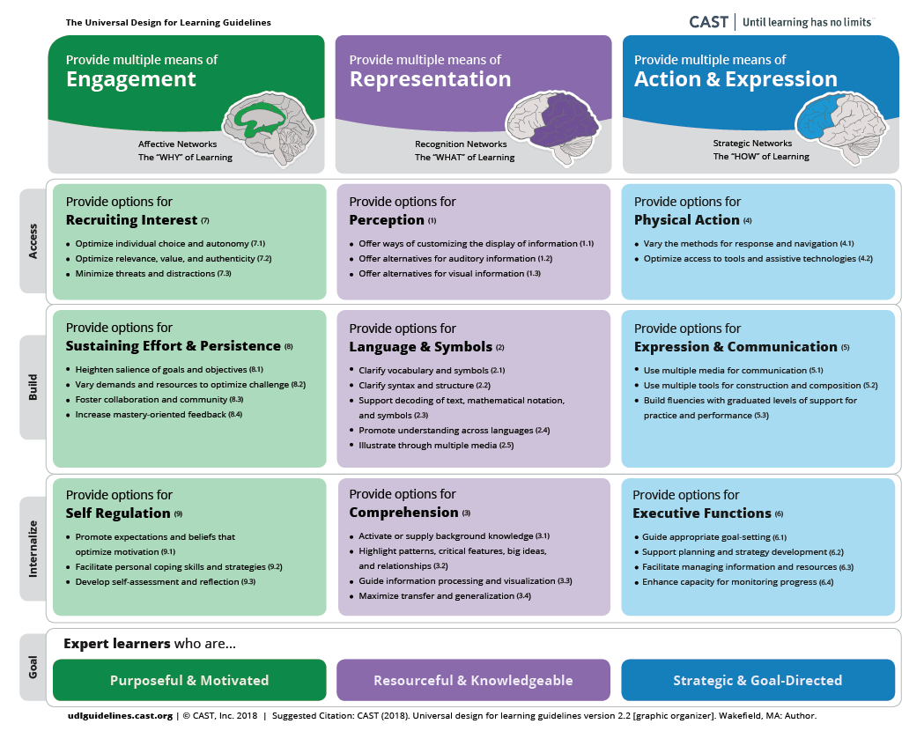
UDL
“A framework to improve and optimize teaching and learning for all people based on scientific insights into how humans learn… guidelines offer a set of concrete suggestions that can be applied to any discipline or domain to ensure that all learners can access and participate in meaningful, challenging learning opportunities.”
Notes:
“UDL is a framework to improve and optimize teaching and learning for all people based on scientific insights into how humans learn.. …[it] can be used by educators, curriculum developers, researchers, parents, and anyone else who wants to implement the UDL framework in a learning environment. [The UDL] guidelines offer a set of concrete suggestions that can be applied to any discipline or domain to ensure that all learners can access and participate in meaningful, challenging learning opportunities.”

Slide 39
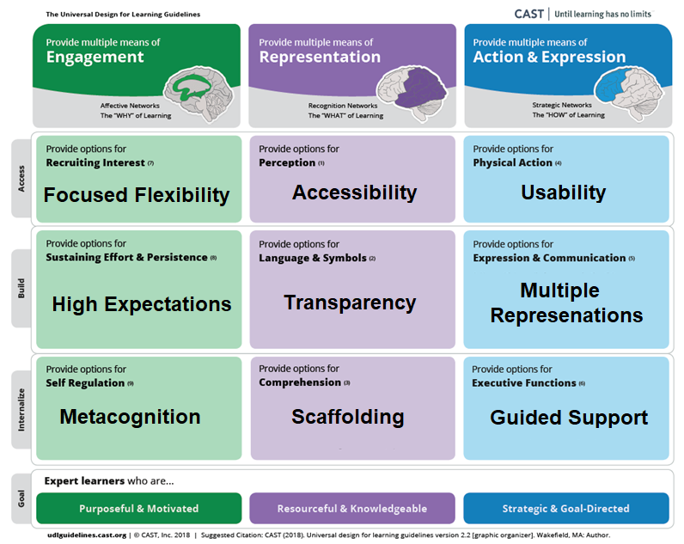
UDL
Representation
  The way information is presented
Action and Expression
  Participation or demonstration of knowledge and skills
Engagement
  How students are engaged and motivated
Notes:
“UDL is a framework to improve and optimize teaching and learning for all people based on scientific insights into how humans learn.. …[it] can be used by educators, curriculum developers, researchers, parents, and anyone else who wants to implement the UDL framework in a learning environment. [The UDL] guidelines offer a set of concrete suggestions that can be applied to any discipline or domain to ensure that all learners can access and participate in meaningful, challenging learning opportunities.”
Multiple Means of Representation (WHAT)
Recognition—the ways information is presented
Provide options for... Multiple Means of Action and Expression (HOW)
Strategic—participation or demonstration of knowledge and skills
Provide options for... Multiple Means of Engagement (WHY)
Affective—How students are engaged and motivated
Provide options for...

Slide 40
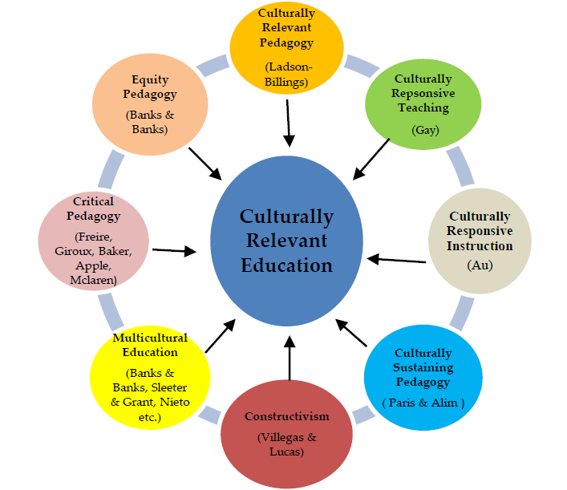
Culturally Relevant Teaching
Uses the students’ culture to empower students to be able to critically examine educational content and process and ask what role they have in creating a truly democratic and multicultural society. It uses students’ culture to help students create meaning and understand the world.
Ladson-Billings & Henry, 1990, p.82
Notes:
More than just academic success, it pushes students toward social and cultural success"

Slide 41
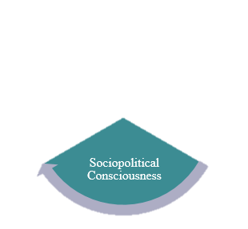
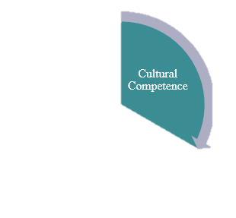
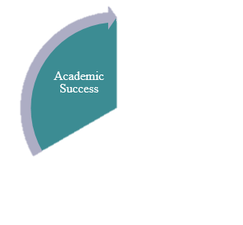
CRT
Academic Success
Overlap with UDL
The beginning, not the end
Cultural Competence
Shift from Deficit
“Mirrors & Windows”, sliding glass doors
Sociopolitical Consciousness
Same as Freire
Citizenship + Education
Notes:
More than just academic success, it pushes students toward social and cultural success"

Slide 42
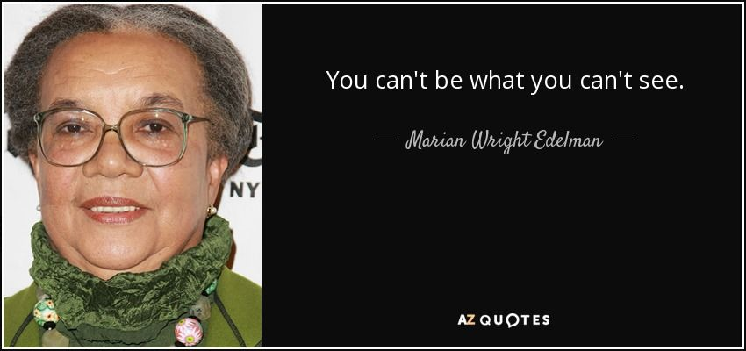
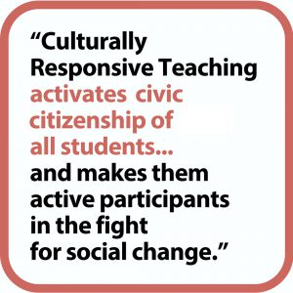
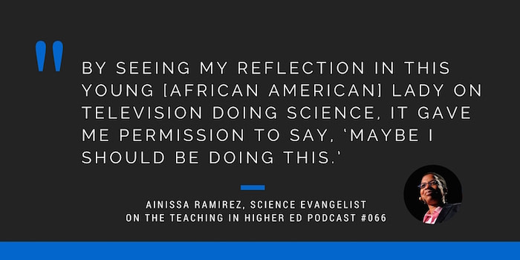
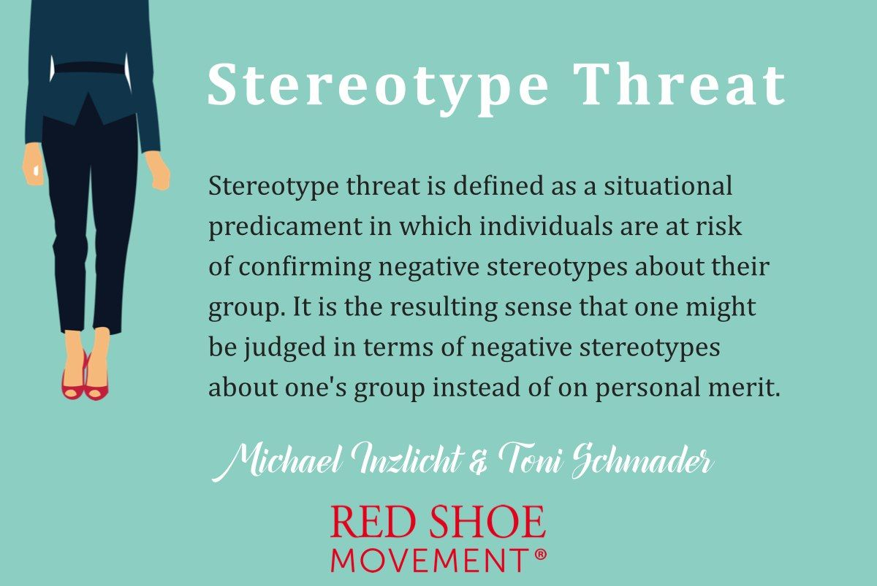
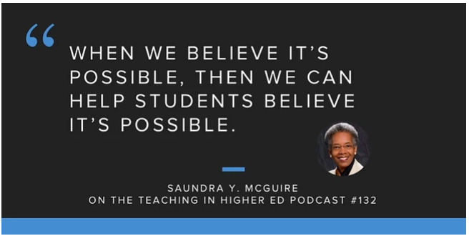

Various quotes of the importance of being seen and belonging
Notes:
https://www.youtube.com/watch?v=_4yYEW_fyJU
https://www.youtube.com/watch?v=PfVGd8Rh8tQ

Slide 43
Just
Representation
Considers and integrates the learning needs of all students
Allows for student voice and choice
Engages students in multiple methods of engagement
Focus on community and belonging

Slide 44
Just
Representation
7.1 Clear description of the technical support offered and how to obtain it.
7.2 Articulate or link to the institution’s accessibility policies and services.
7.3 Articulate or link to the institution’s academic support services and resources that can help learners succeed in the course.
7.4 Articulate or link to the institution’s student services and resources that can help learners succeed.
8.2 The course design facilitates readability.
8.3 Accessible text and images in files, documents, LMS pages, and web pages to meet the needs of ALL learners.
8.4 Alternative means of access to multimedia content in formats that meet the needs of diverse learners.
8.5 Course multimedia facilitate ease of use.
Considers and integrates the learning needs of all students
Allows for student voice and choice
Engages students in multiple methods of engagement
Focus on community and belonging.

Slide 45
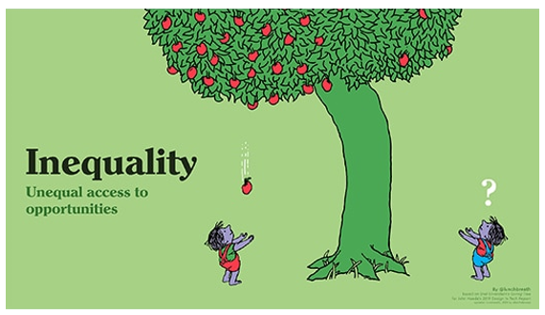
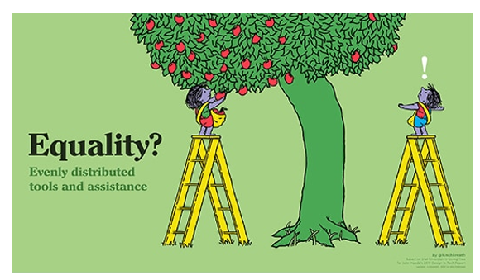
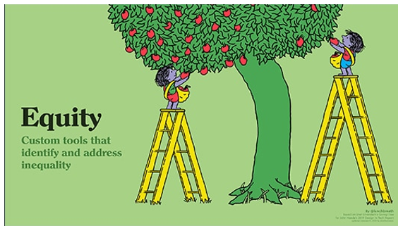
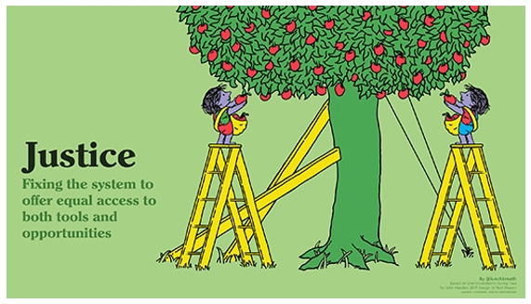
Inequality equity equality justice

Slide 46


More just?

Slide 47
ACUE Guidelines
Ensure your course reflects a diverse society and world.
Ensure course media are accessible.
Ensure your syllabus sets the tone for diversity and inclusion.
Use inclusive language.
Engage students in a small-group introductions activity.
Use an interest survey to connect with students.
Offer inclusive office hours.
Set expectations for valuing diverse viewpoints.
Notes:
The Association of College and University Educators (ACUE)

Slide 48
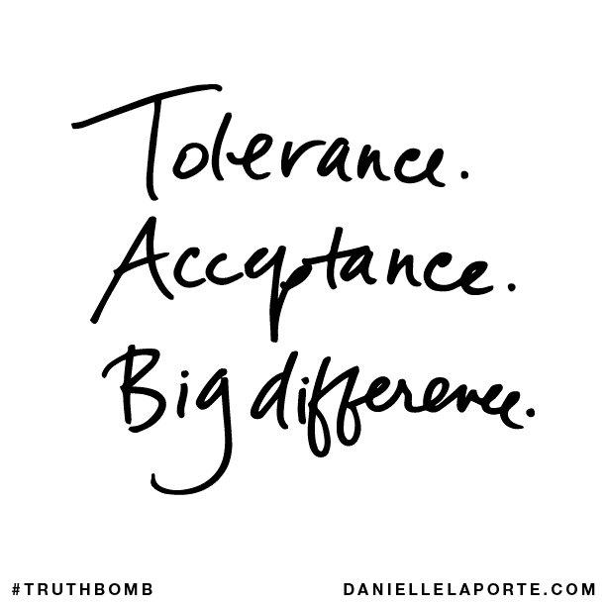
ACUE Guidelines
Ensure your course reflects a diverse society and world.
Ensure course media are accessible.
Ensure your syllabus sets the tone for diversity and inclusion.
Use inclusive language.
Engage students in a small-group introductions activity.
Use an interest survey to connect with students.
Offer inclusive office hours.
Set expectations for valuing diverse viewpoints.
Notes:
https://www.youtube.com/watch?v=_4yYEW_fyJU
https://www.youtube.com/watch?v=PfVGd8Rh8tQ

Slide 49

Thank you!
Please fill out the survey from QM and enjoy your day!

