Slide 1
Supporting Diverse Learners: Text, Images, Documents, PDFs, & Tables Oh My!!
Exploring SRS 8.3

Slide 2

Welcome and Introductions
Dr. Chris Smith
Instructional Designer
North Carolina Virtual Public School (NCVPS)
chris.smith@ncpublicschools.gov
While I introduce myself, please take a few minutes to share the following information in the chat:
Location
Professional role
Experience with QM
Prior knowledge of accessibility
Notes:
Hello, I am Dr. Chris Smith and I currently work as an Instructional Designer with North Carolina Virtual Public School (NCVPS). I began my career as an elementary school teacher 22 years ago where I taught kindergarten, 5th grade, 6th grade, and K-5 computers. Eventually, I went on to earn advanced degrees in web site development and educational technology which led me to go on to become a district-level technology facilitator, Director of Distance Education at a local community college, and eventually to my current role. I also teach community college and graduate computer, educational technology, and supporting diverse learner courses in higher education. I hold certification as a Master K-12 QM Reviewer, QM K-12 Peer Reviewer, Publisher Peer Reviewer, and Continuing Education Peer Reviewer. I am dual certified and hold the QM Higher Education Peer Reviewer certification as well. I have been studying and presenting on accessibility at the local, state, and national levels since 2012.

Slide 3
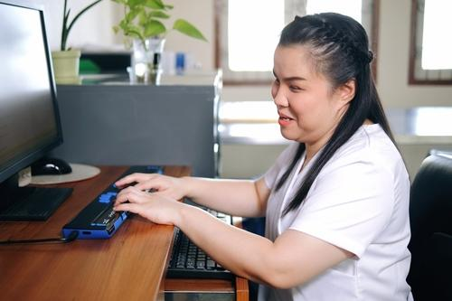
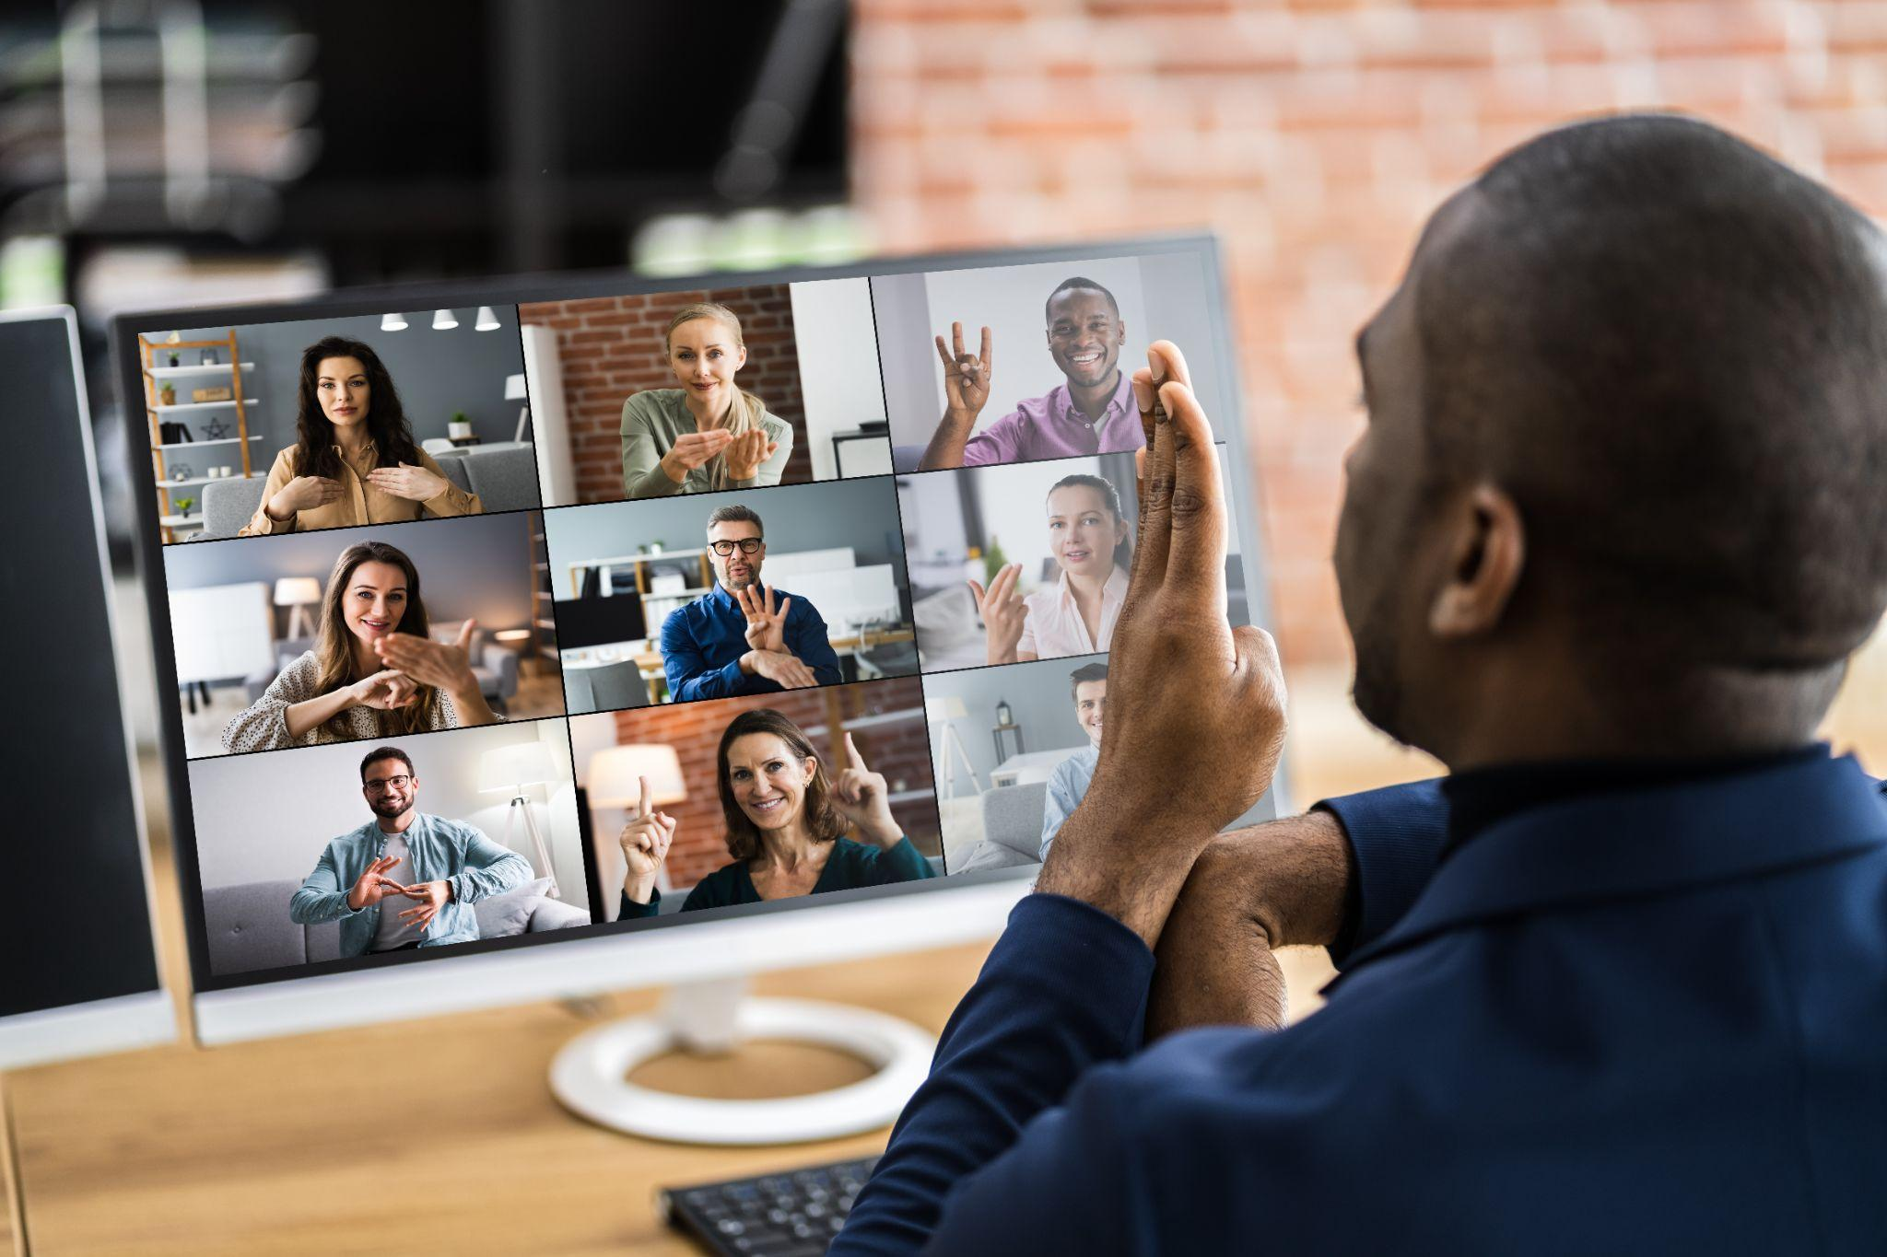
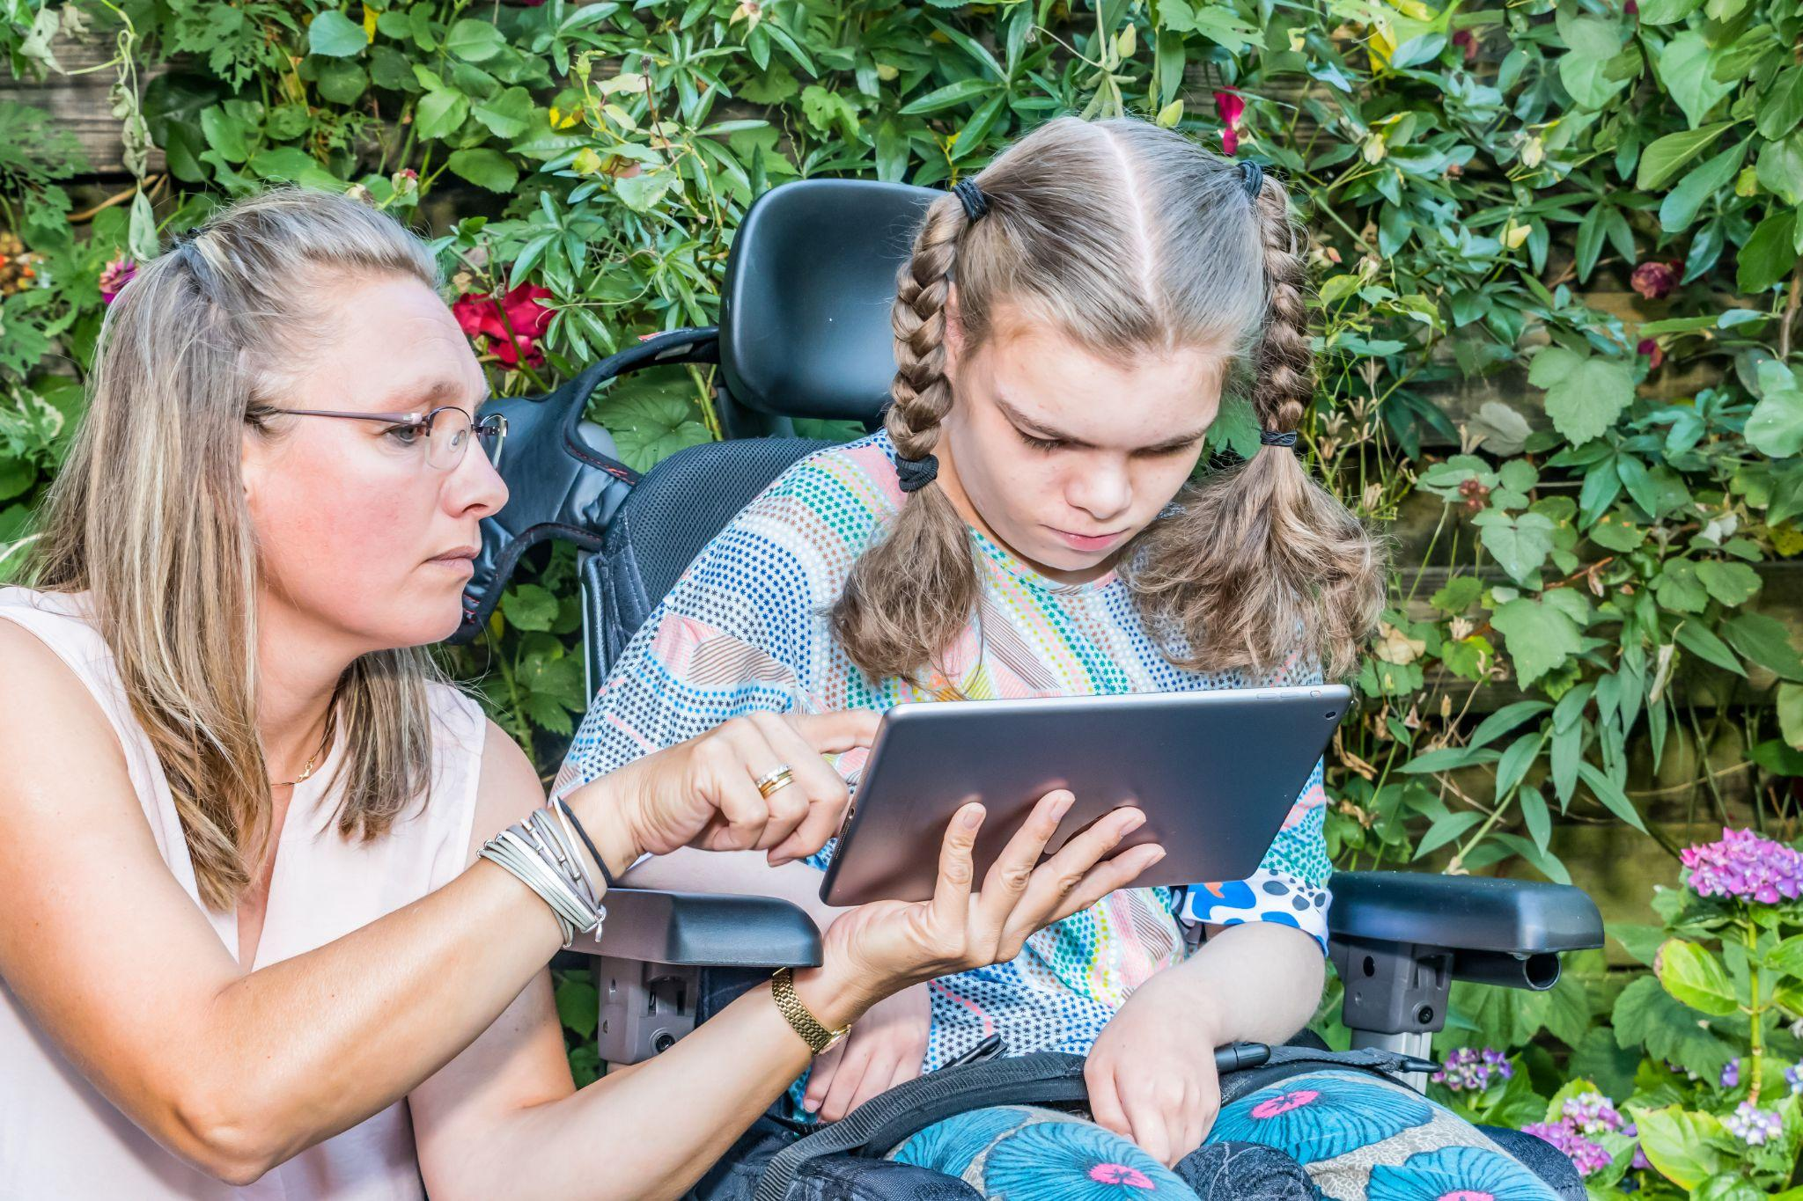
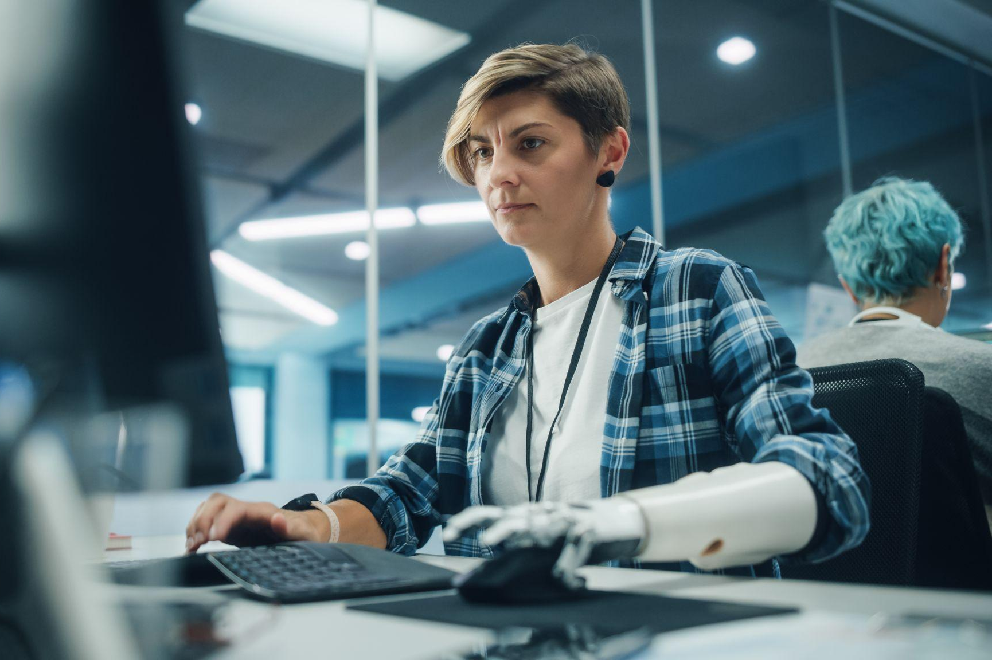
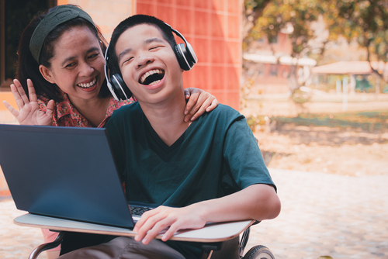
What is SRS 8.3?
Specific Review Standard 8.3
The course provides accessible text and images in files, documents, LMS pages, and web pages to meet the needs of diverse learners.
Notes:
Two of the most common types of individuals often associated with the need for providing accessible text and images are those with visual impairments or those who may be deaf or hard of hearing. However, there are many more considerations that should be kept in mind when designing and procuring digital instructional content to ensure it is accessible. Let’s investigate the diverse learners pictured on this slide. What do we know about each student based on visual cues in the images and what might we need to consider design wise when building instructional content to meet the needs of each learner?
Image citation: blind student (Shutterstock ID: 2158200539), deaf student (Shutterstock ID: ), I (Shutterstock ID: 787300732), prosthetic computer user (Shutterstock ID: 2083349509), boy with headphones (Shutterstock ID: 1910719234)

Slide 4

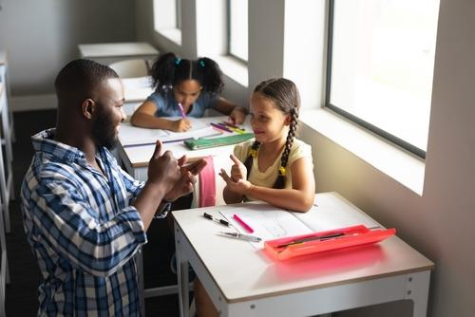
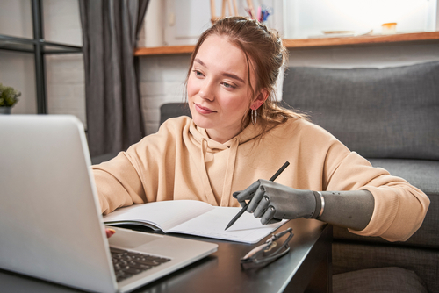
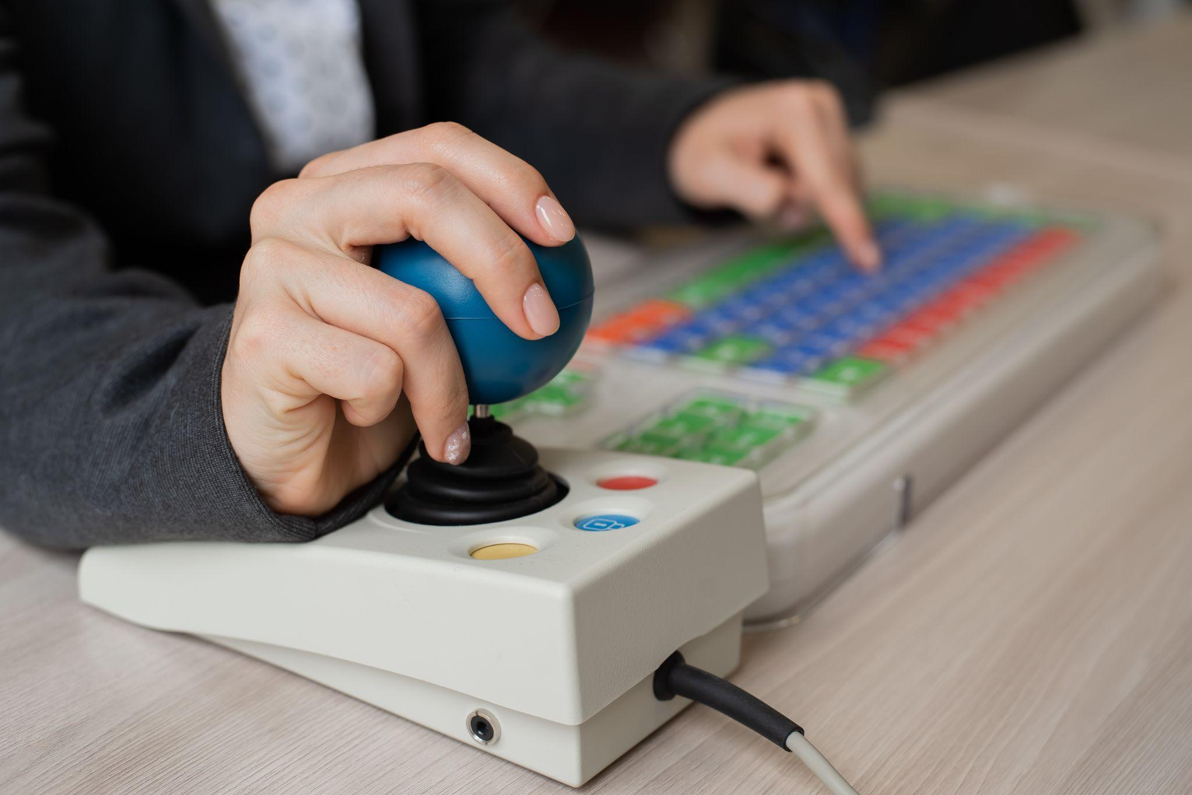
Achieving Accessibility Means…
Specific Review Standard 8.3
…that individuals with sensory, physical, and cognitive impairments can independently acquire the same information, engage in the same interactions, and enjoy the same learning experiences, with substantially equivalent easy of use.
Alternative content is “equally effective,” which means that the same information is as readily available as the original content.
Notes:
Image citation: sign language (Shutterstock ID: 2155324093), young teen in yellow jacket (Shutterstock ID: 1974822149), joystick with special keyboard (Shutterstock ID: 2132701563), prosthetic computer user (Shutterstock ID: 1896532957)

Slide 5
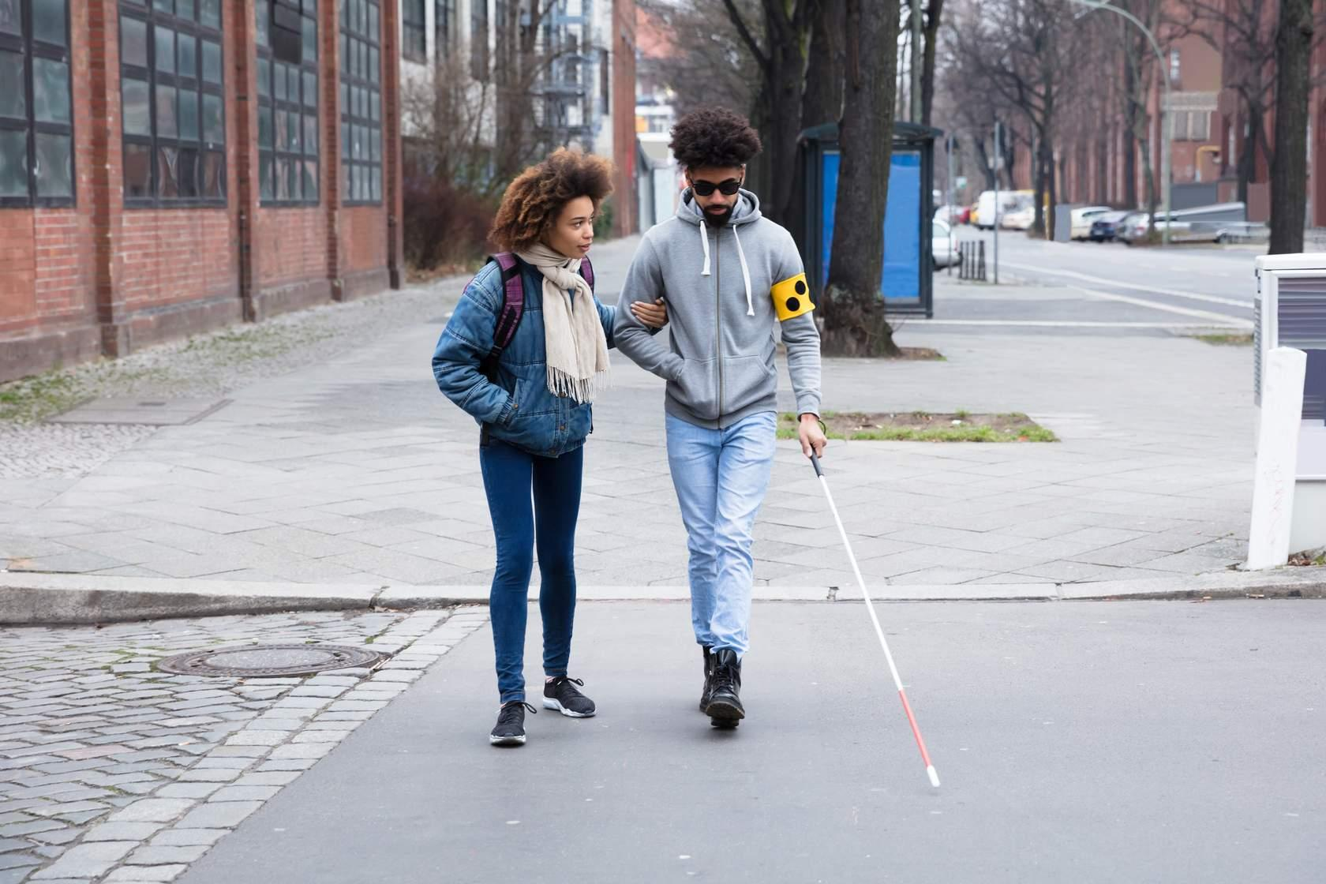
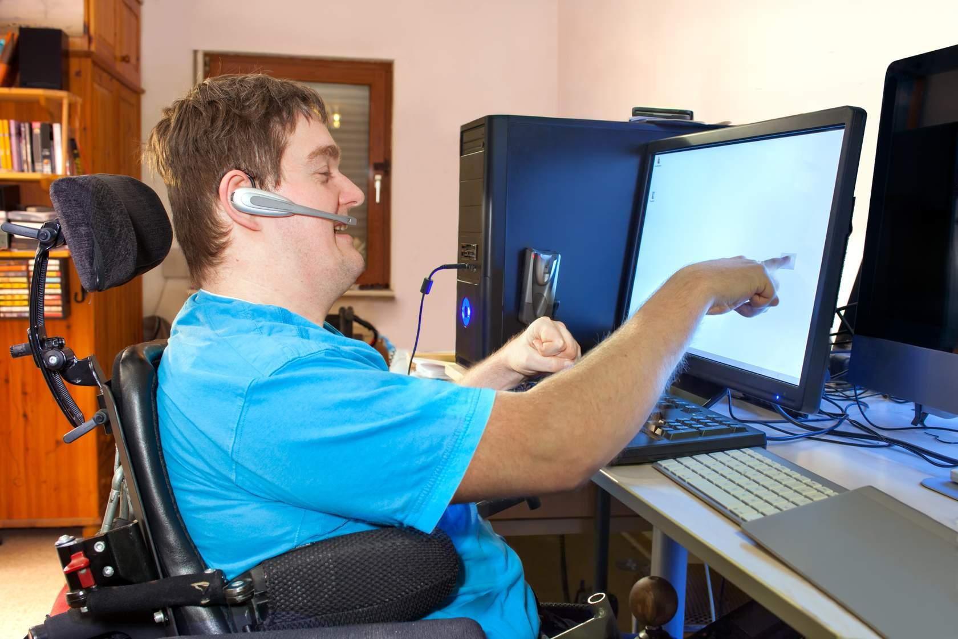


Accessibility- The Human Aspect
Micah
Visually impaired
Jeremy
Cerebral Palsy
Courtney
Deaf or hard of hearing
Gabriell
Traumatic Brain Injury
Course Development Training- Accessibility
Notes:
In order to introduce you to the human aspect of accessibility, we are going to look at the profiles of four unique individuals. Before I introduce you to our four individuals, please note that the intent behind personalizing this portion of the presentation is not to offend anyone. The profile pictures provided for the four individuals are stock images and the names are made up. The intention of the human aspect portion of this presentation is to introduce you to some of the students you might teach in your online courses. Now, let’s go meet Micah, Courtney, Jeremy, and Gabriella!

Slide 6
Introduction to Micah
is considered legally blind due to a childhood illness
struggles to view text that is too small or that uses color to emphasize different information
relies on screen reading technology to navigate online classes

Slide 7
Introduction to Courtney
was born with a degenerative hearing disorder that left her deaf as a young child
Does communicate through sign language but prefers the use of captions and transcripts over the use of an Interpreter when navigating online classes

Slide 8
Introduction to Jeremy
was born with cerebral palsy
has very minimal muscular movement of his hands and fingers which means he is unable to operate a standard keyboard
uses speech operated software to interact and control his computer

Slide 9
Introduction to Gabriella
was involved in a car accident in middle school which left her with a permanent brain injury
needs to have information broken out into chunks
can handle videos that are limited to about ten minutes or less

Slide 10
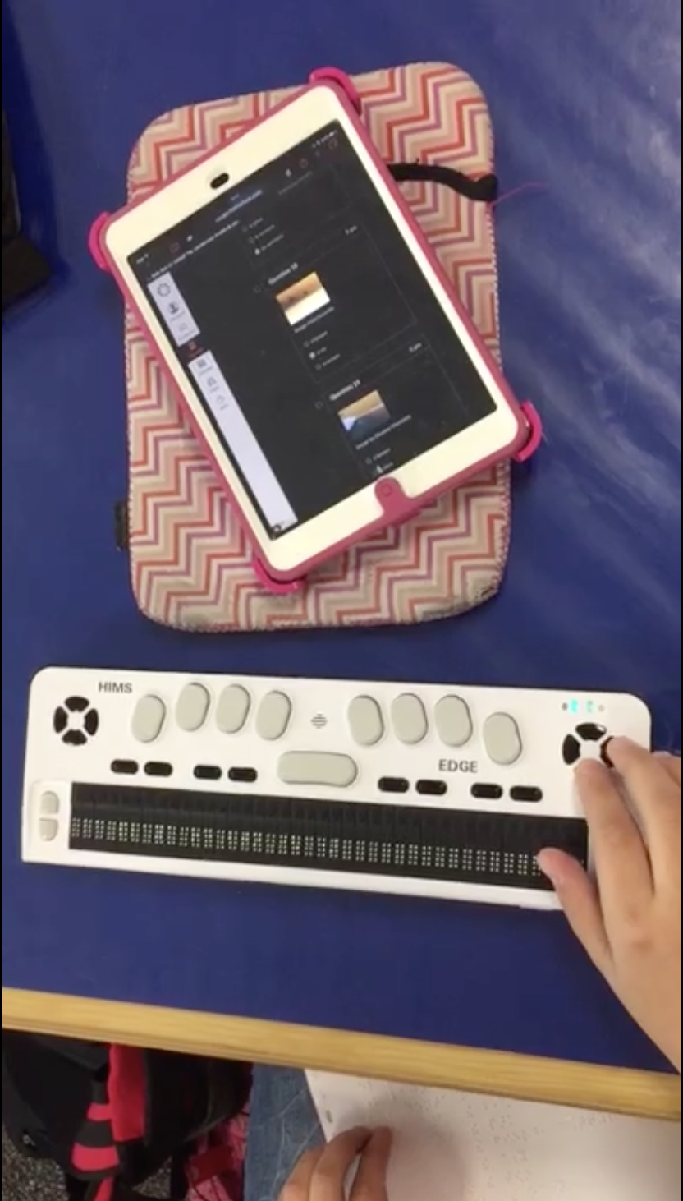
Promoting Independence
While there are legal implications associated with digital accessibility that we must adhere to, our main goal is to design our course content to promote the ability to interact with the course independently.
Braille device- video Example
Notes:
The following video is an example of a visually impaired student working with an iPad, a Bluetooth Braille display, and a paper Braille document to complete a Spanish 1 vocabulary quiz. The student uses the device controls along with screen reading technology to navigate and interact with the content on the page. In order for the process to work properly, there are several accessibility concerns that must be addressed during the course design process. Watch the video below to see how the student was able to complete the quiz independently.

Slide 11
SRS 8.3 Annotations Example One
Images and graphs are described via alternative text, long description, or audio description

Slide 12
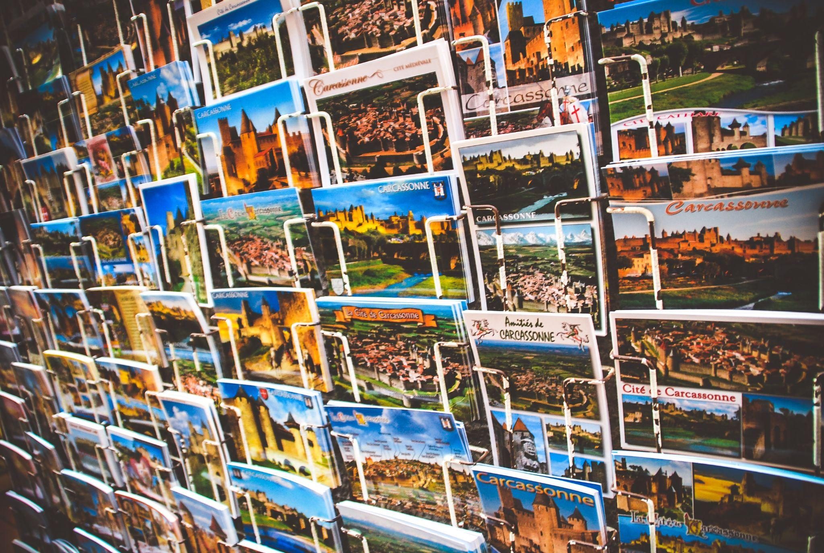
Image Accessibility
Non-text and non-video/audio elements (images) require alternative (alt) text (types of images- W3C Images Tutorial)
Alt text conveys how images relate to the information being displayed
Alt text is generally limited to ~140 characters
More complex images may require long descriptions or audio descriptions
Decorative images use “ “ (open quotes) for alt text
Determining when and how to provide alt text
(W3C alt Decision Tree)
Notes:
Image citation Photo by Héctor J. Rivas on Unsplash

Slide 13
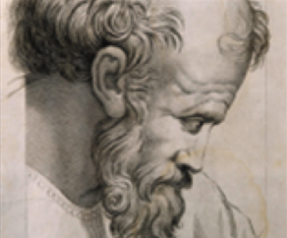
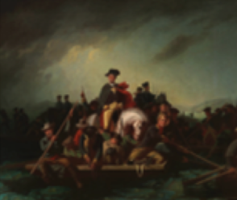

Practice Adding Alternative Text
Notes:
Now that we have discussed the concept of alt text, let’s look at four different examples. The first, on the left is a sketch of Pythagoras. While we did state on the previous slide that the phrases “picture of” or “image of” should not be used, in this particular example, we would say sketch of Pythagoras, because a sketch is a particular type of artwork.
The same would hold true for the image in the middle. It is a “painting of George Washington crossing the Delaware.” Again, the phrase “painting of” is used to further describe the image.
The image on the right is a little more difficult to identify, but it is just a fancy looking border that might be used to divide content on a page. Since the image is strictly for visual appeal and is decorative, it would just have open quotes for the alt text.

Slide 14
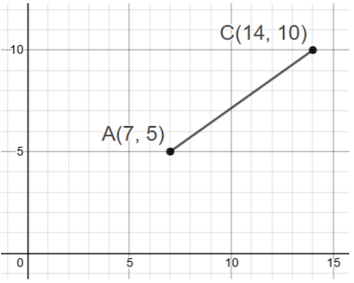
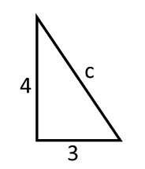
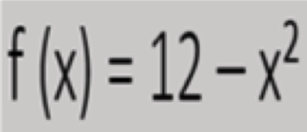
Providing Alt Text in Mathematics
Notes:
The middle example is a mathematical function. Sometimes, depending on the software that is being used, the only way to add math problems to course content is to insert them as images. If the software you are using does have accessible mathtype, you will want to use that to create text based problems rather than images. If you have to insert the problem as an image, then you would simply write the alt text as if you were reading the problem out loud. So for this example, you would say, “f of x equals twelve minus x squared.”

Slide 15
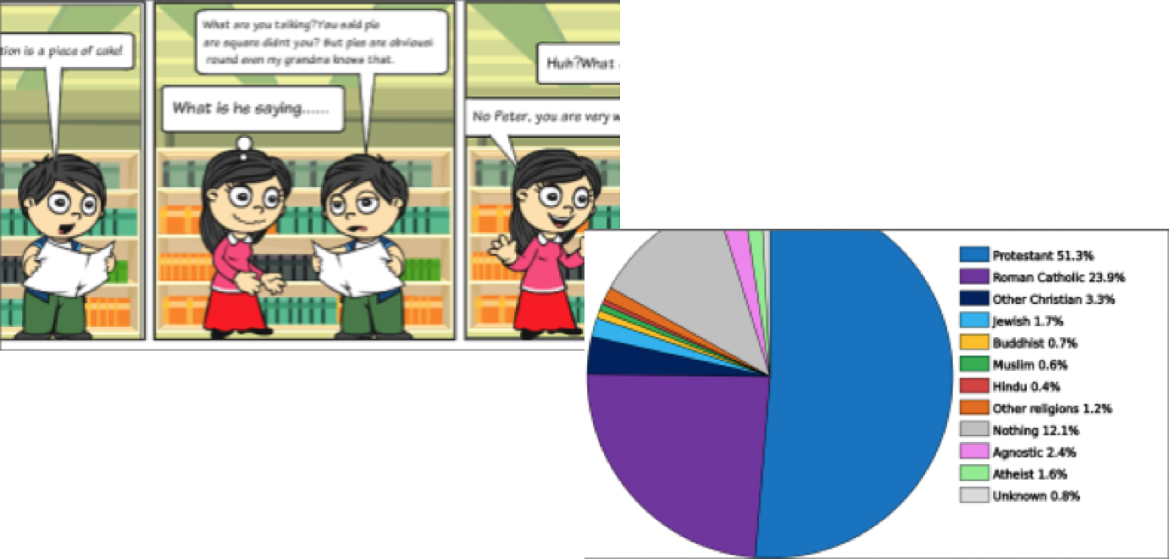
Complex Images and Embedded Text
Accessible Version
Google CopyFish Extension
Notes:
Text that is embedded in images can not be picked up or read by screen-reading technology. The use of text embedded in images should be limited to only certain essential situations. When images with embedded text are added to online content, all text content found in the images must be displayed in an alternative format.
For the two examples on this slide, the first is a comic strip with a boy and a girl speaking to each other. To make that image accessible, an additional document, in the form of a script, could be created and linked above the image.
The second image is a pie chart representing the different religions around the world. The percentages for each religion are what is important on the chart and not the different colors. To make the chart accessible, an additional document could be created that includes a list of the religions and their percentages from least to greatest or greatest to least depending on the purpose of the chart.

Slide 16
SRS 8.3 Annotations Examples Two and Three
Addressing accessibility concerns with tables

Slide 17
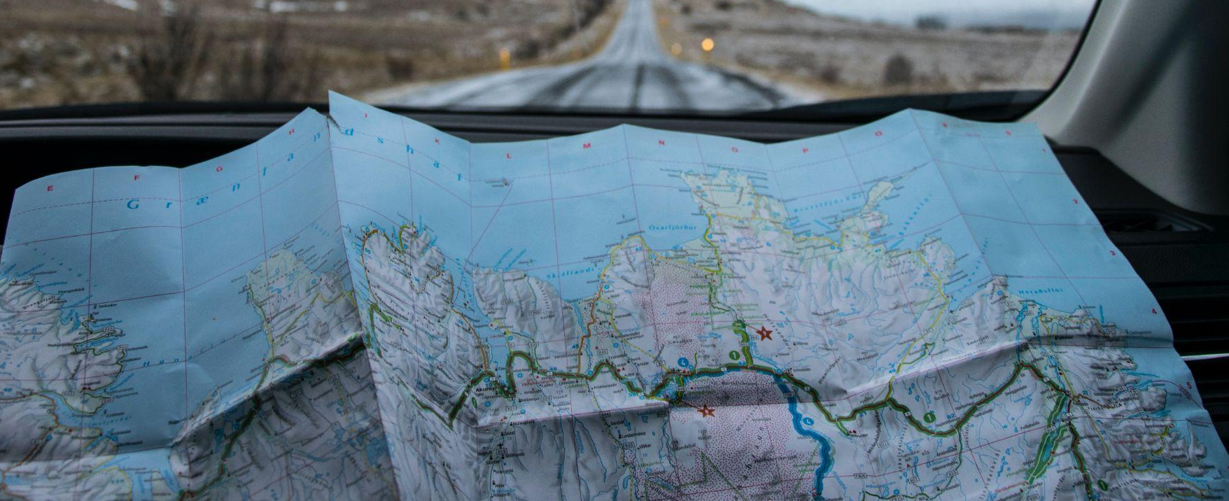
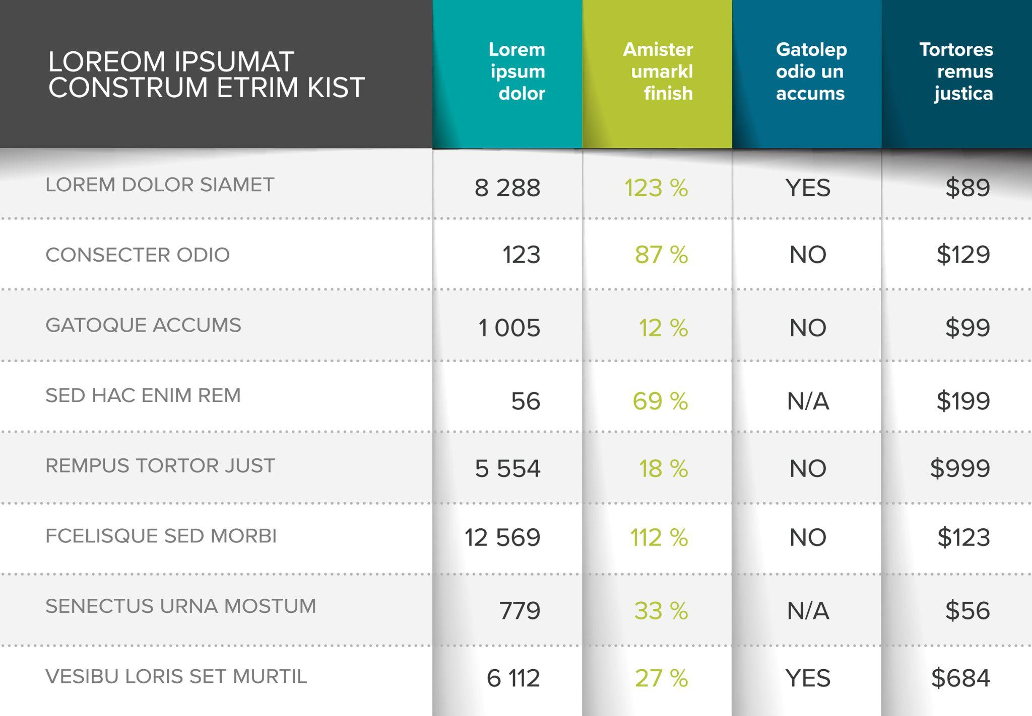
Creating Accessible Tables
Tables should be created in plain text not as images
Tables should not be used strictly for visual appeal
Table should have a caption/header along with column and row headers
Do not merge cells or leave cells blank
Notes:
Image citations: map (Photo by Tabea Schimpf on Unsplash), table (Shutterstock ID: 1507079288)

Slide 18
Testing Table Accessibility
Try to click in an individual cell of the table. If you cannot click in a cell, then the table was added as an image rather than in plain text, and it is not accessible.
If you can click in the cells, click in the top left of the table. Press the Tab key on the keyboard. You should be able to use the Tab key to navigate from left to right and Tab+Shift to navigate from right to left throughout the entire table.

Slide 19
SRS 8.3 Annotations Example Four
Documents or HTML use proper semantic structure formatting such as titles, headings, and lists.

Slide 20
Semantic Structure: Headings
Headings are used to create an outline for a page/document similar to a table of contents.
Heading 1 <h1> identifies the main focus- used once
Headings 2-6 used to organize content
Heading levels should not be skipped
SRS 8.3 <h1>
Images <h2>
Decorative <h3>
Instructional <h3>
Complex <h3>
Tables <h2>
Formatting <h3>
Notes:
Resource: https://webaim.org/techniques/semanticstructure/

Slide 21
Semantic Structure: Lists
There are two main types of lists (ordered <ol> and unordered <ul>)
  Ordered lists use letter or numbers (steps in a process)
  Unordered lists use bullets, icons, etc. (order does not matter)
Peanut Butter and Jelly Recipe
Ingredients <ul>
bread (2 slices)
jelly
peanut butter
Steps <ol>
Separate two pieces of bread and lay flat on a plate
Open the jelly and spread on one side of the bread
Notes:
Resource: https://webaim.org/techniques/semanticstructure/

Slide 22
SRS 8.3 Annotations Examples Five and Six
Addressing accessibility concerns with PDFs- Ensuring PDFs are text-based rather than image-based and that fillable PDFs have the correct tab order

Slide 23
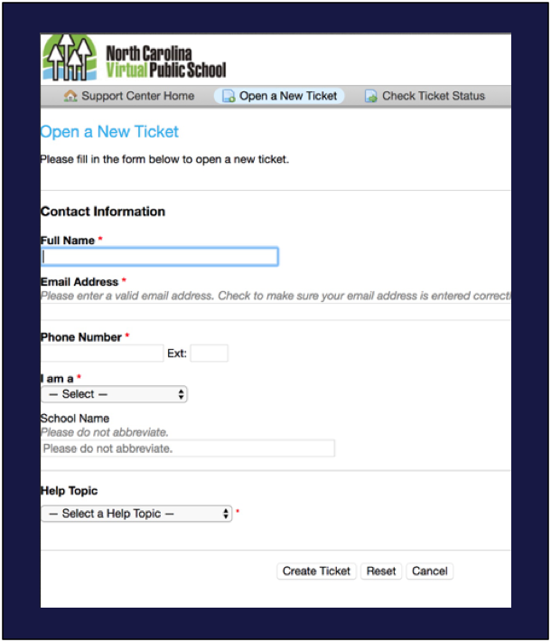
Creating Accessible PDFs
PDFs created with mobile apps are generally image based
Scanners have special software to create searchable/readable PDFs
Tab order is the order in which keyboard controls move from one text field to the next on a form
1
2
3
4
5
6
7
Notes:
When it comes to PDFs, there are two different types. Most PDFs that are created by taking pictures using phones or tablets are created as images. PDFs that are images are not accessible. If you use a scanner and the software that comes with a scanner to create the PDF, then there is generally an option to create a searchable PDF. Searchable PDFs are text-based and are readable. There is a simple trick that you can use to determine if a PDF was created as an image or as a readable document. If you try to highlight a section of text such as a sentence or paragraph and are able to do so, then the PDF should be readable. If you can not highlight the text then the PDF is an image and therefore it is not accessible.

Slide 24
Testing PDF Accessibility
Image vs. Text-Based PDFs
Try to highlight a sentence or paragraph of text.
If the text can not be highlighted the PDF is image-based
If text can be highlighted, the PDF is text-based
Fillable PDFs
Select the first fillable form field on the document.
Press Tab on the keyboard to move forward and Tab + Shift to move backwards
  If logital top to bottom and left to right- correct order
  If not logical- not correct order

Slide 25
SRS 8.3 Annotations Examples Seven and Eight
Formatting text properly to address accessibility concerns

Slide 26

Making Text Accessible
Color alone should not be used for emphasis (use bold and/or italics)
Maintain proper color contrast
Underlining is reserved for hyperlinks
Text can be resized without assistive technology up to 200% with no horizontal scrolling
Break up larger blocks of text with white space, images, etc.
Notes:
Image citations: map (Photo by Tabea Schimpf on Unsplash), table (Shutterstock ID: 1507079288)

Slide 27
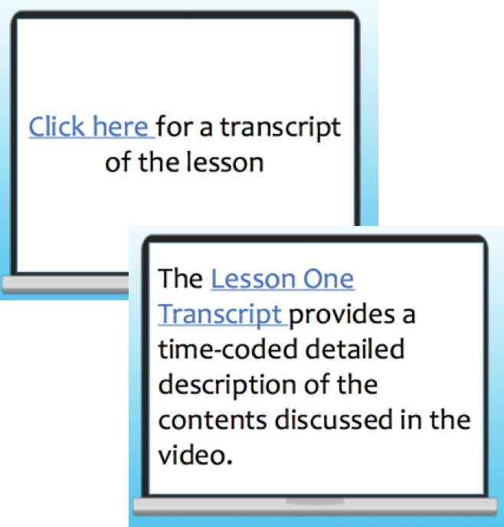
Accessible Hyperlinks
Hyperlinks should be set to open in a new window
“Click Here,” “Here,” “Click” should not be used as the hyperlink name
Actual file names should not be used for hyperlinks (Example: img0934.jpg)
Notes:
All too often, phrases like “Click Here” or “Here” are used for linking content in an email, on a document, or on a webpage. However, creating hyperlinks this way causes several different accessibility issues. Screen reading technology allows users to choose an option that pulls out a list of all the URLs or web links on a page. The software then reads the list of links out loud to users. If there were 10 links on a page and they were all set up as “Click Here,” the screen reader would read “Click Here” 10 times in a row and the user would not know what each link was nor would they know where each link led to.
Another issue that “Click Here” causes has to do with voice controlled software users. Again, if the phrase “Click Here” were used multiple times on the same page and a user said, “Open link Click Here,” then the computer would open all the different links at the same time on the screen. This would leave the user having to try to close all the unwanted pages before he or she could move forward.
Image citations: Image created internally by NCVPS instructional designers

Slide 28
Mathematics and Accessibility
Presenting mathematical content and other complex scientific notations such as chemical formulas is not something that the basic Internet protocols were designed to support (Hayes, 2009).
As a result, mathematical content often renders differently from one web-browser to another.

Slide 29

History of Accessible Math Design
The following strategies have been used to address accessible math design over time:
Mathematical content was captured and presented as images
LaTeX markup language
MathML markup language
Notes:
Image citation: Photo by Antoine Dautry on Unsplash

Slide 30

Adding Mathematical Content as Images
One strategy that has been used to address the differences in rendering math on the web has been to insert the expressions, equations, and/or functions as images.
While adding alt text can make the images more accessible, the bigger issue is that the content cannot be magnified without distortion.

Slide 31

The LaTeX Markup Language
A mathematical expression using the LaTeX Markup Language.
The LaTeX Markup Language used to generate the image displayed on the left.
\frac{x^{2}-8 x+12}{x^{2}-3 x-18}
Notes:
LaTeX is a markup languages that helps with displaying mathematical content correctly in a visual format on the web. The issue with LaTex is that the visual version of the math that is rendered is published as an image rather than text-based characters; therefore, it can not be properly read by screen readers. The example on the right shows the actual LaTex code and the example on the left shows how that code renders visually on a webpage.

Slide 32
The MathML Markup Language
A visual representation of what the code on the right generates as text rather than an image.
The following is a small sub-section of the MathML code:
<math xmlns=’http://www.w3.org/1998/Math/MathML’>
<mrow>
<msup>
<mi>x</mi>
<mn>2</mn>
</msup>
MathML Generator
Notes:
While most screen readers still struggle with being able to read mathematical type correctly, MathML is the most accessible option that is currently available. MathML is supported by the Mozilla Firefox and Google Chrome web browsers. Google Chrome only started supporting MathML within the past year. The example on the right shows the actual MathML code and the example on the left shows how that code renders visually on a webpage.

Slide 33
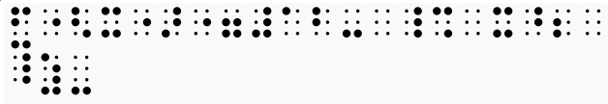
Lake Pines Braille
Lake Pines Braille is a free web-based tool that allows users to generate braille for mathematical content.
f(x) = 12-x²
Notes:
Image citation: Photo by Antoine Dautry on Unsplash

Slide 34
Testing for Accessibility and Locating Accessible Instructional Content
The resources on the following slides provide additional information on how to assess digital content for accessibility and where to locate accessible instructional content

Slide 35


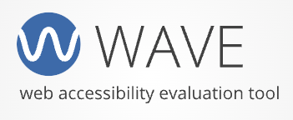
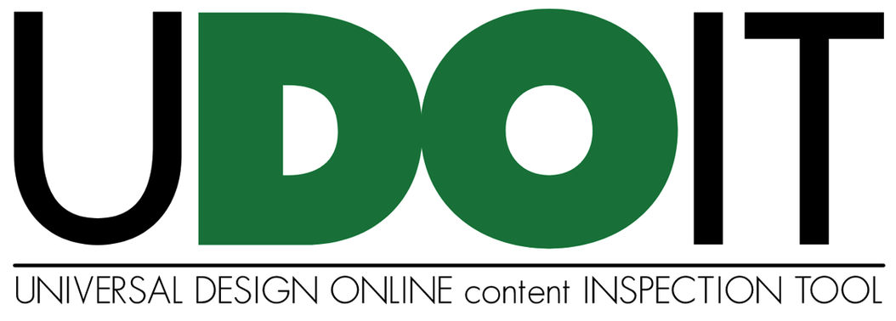
Automatic Accessibility Checker Tools
Notes:
Three tools that we use at NCVPS to check for and address accessibility issues throughout the design and revision process include the Canvas accessibility checker, UDoIT, and Grackle Docs. The Canvas accessibility checker is available as part of the rich content editor within each of the different Canvas content types such as pages, assignments, discussions, and quizzes. The built-in Canvas accessibility checker only scans content that has been added to an individual rich content editor box. UDoIT is a third-party add on tool that is part of CidiLabs design tools that scans entire Canvas courses and provides a detailed accessibility report. We use Grackle Docs to scan Google Docs and Slides presentations for accessibility issues. The WAVE tool can be used to scan most web-based content for accessibility concerns.

Slide 36
OER- Open Textbooks
OpenStax
OER Open Textbooks
Milne Open Textbooks
Open Textbook Library
Saylor Academy Open Textbooks
Lyryx Open Textbooks and Supplements
BCCCampus Open Textbooks
Notes:
There are a variety of open educational resource (textbooks) that are available which have been collaboratively developed with accessibility in mind. As you explore some of the resources available through the sites listed on this slide, you will find that complex images have been given detailed alternative text and that other accessible design strategies discussed in this presentation were used throughout the instructional design process.

Slide 37

Quality Matters Accessibility and Usability Resource Site (AURS)
Free and open to everyone, AURS provides the online community with important information on addressing key accessibility and usability concerns, including:
Universal Design for Learning
Alternative text
Video captions and audio descriptions
Hyperlinks
Accessible Microsoft Office products
Readability: Color Choice and Contrast
Accessible PDFs
Accessible design in LMSs
Cognitive Accessibility
Inclusive teaching practices
Notes:
Image citations: Shutterstock ID: 1832716423

Slide 38
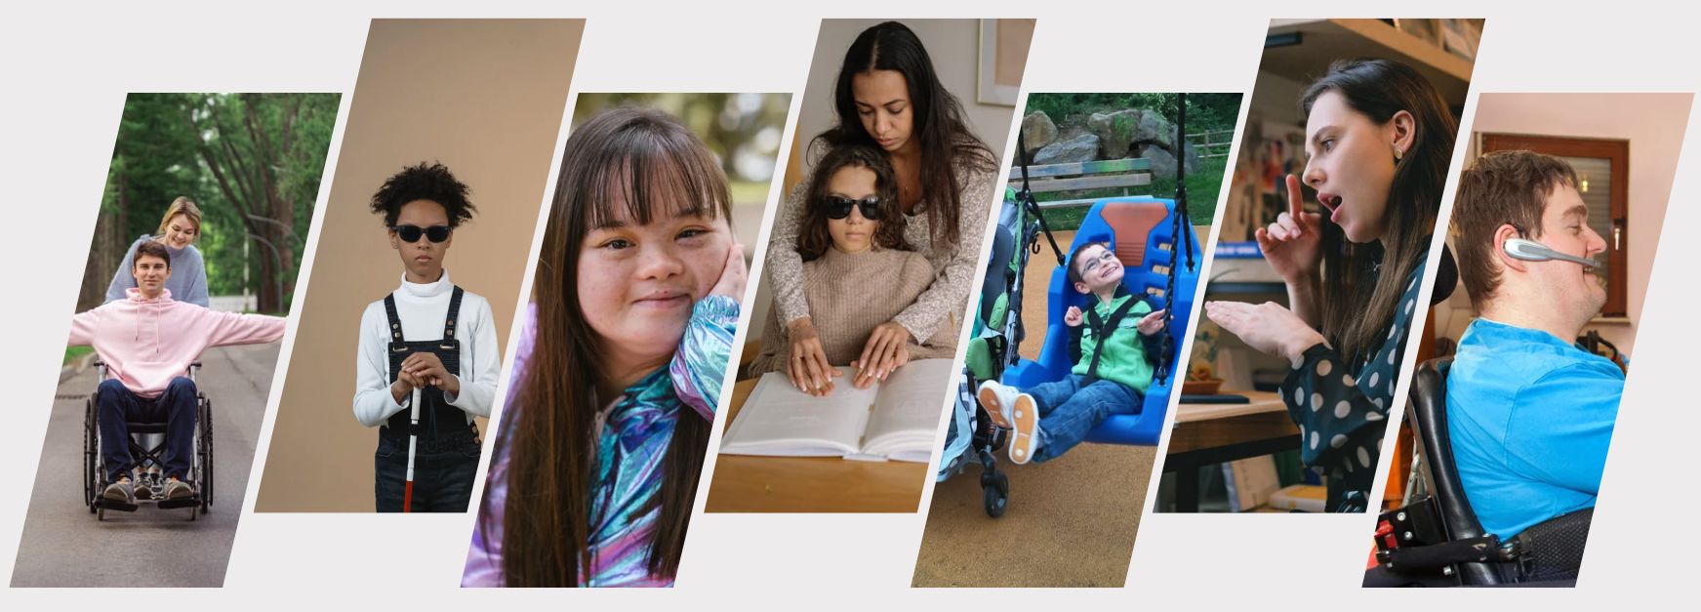
#A11Y: EC Summer Institute on Accessibility
Five colleague from NCVPS and the North Carolina Department of Public Instruction (NCDPI) teamed up to present an publish a comprehensive lesson plan on designing accessible learning experiences. The article is open source and is available through the JTILT journal.
Notes:
Image citations: Shutterstock ID: 1832716423

Slide 39
Questions?
Dr. Chris Smith
Instructional Designer
North Carolina Virtual Public School (NCVPS)
chris.smith@ncpublicschools.gov
Notes:
I have provided my contact information on this slide. What questions do you have about the material that was presented. Please feel free to use my email address (chris.smith@ncpublicschools.gov) to contact me with any questions you might have after this presentation has concluded.

