Slide 1
QM’s QA Continuum of Excellence
Where Are You and Where Are We?

Slide 2
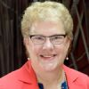

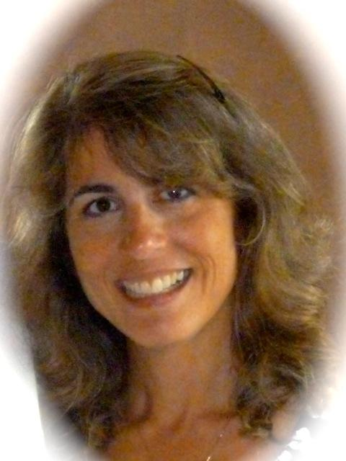
Presenters
Dr. Barbara W. Altman
Associate Professor,
Texas A&M University - Central Texas
Dr. Bethany Simunich
Director of Online Pedagogy and Research
Kent State University
Barbra Burch
Manager of Research and Development
Quality Matters

Slide 3
Background – Continuum of Excellence Study
Rollout at last year’s Conference
  Initial anecdotal reactions, generally model is useful
Refining of model
Pilot survey in Spring
  Low response rate, findings inconclusive
This Summer:
  More intense qualitative interviews with expert adopters

Slide 4
Why Do Interviews?
Elicit information from respondents
Goal of obtaining qualitative data, letting themes emerge
Achieves goal of validating model, along with clues to exemplars’ milestones along the continuum

Slide 5
Who to Interview?
Individuals who have seen QM implementation over time
Individuals who have a keen sense of the institutional culture and history
Individuals from a variety of institutions chosen by QM staff and Research Colleagues

Slide 6
Interview Methodology
Same interviewer/same questions
Open ended questions with some prompts along the way
Reveal model at the end
Use model to evoke any added input

Slide 7
Interview Questions
Think back to when your institution was first introducing QM and describe what was done.
If you were to introduce QM at an institution, what would you do and how would you do it?
To take a next step and be a little more systematic in your use of QM, describe what you would do and how you would do it.
Would you use data to make improvements, and what would those be?
Do you have or do you envision any activities that are examples of comparing organizational units or your institution to external peer group standards?
How would you describe a comprehensive, institution-wide use of QM and quality assurance as a long-term strategy?

Slide 8
Some Preliminary Themes
Key conditions for successful implementation:
context awareness, champion, leadership
support, attention to who & how as well as what
Risk aversion - official QM reviews seen as
risky
ID support, templates, professional development

Slide 9
More Potential Themes
Systems of institutions helpful
Build onto existing initiatives, goals
APPQMR and IYOC
Certification as a differentiator
Incorporating QM into the P&T system

Slide 10
And the Latest from Atlas . . .
Other aids
  Having individuals familiar with QM from previous institutions
  Training faculty as to both what QM is and is not
  Allowing for specialized work arrangements in the case of unionized faculty
  Spreading the news internally about exemplars
  Acknowledging accreditors’ positive view of QM as a lever for change
Of note – the process of implementation is not linear: includes stops and starts along with some “back sliding”

Slide 11
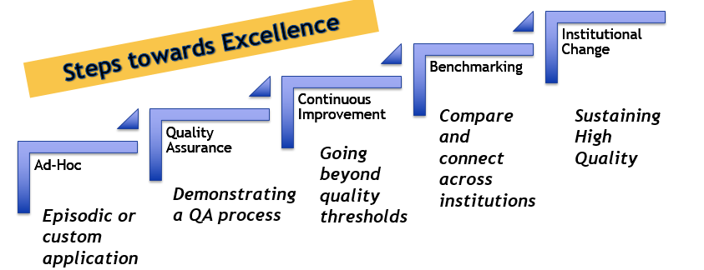
QA Continuum of Excellence

Slide 12
Your Input
Grab your phone
Type: PollEv.com/barbraburch284
Text: BARBRABURCH284 to 22333 to join

Slide 13
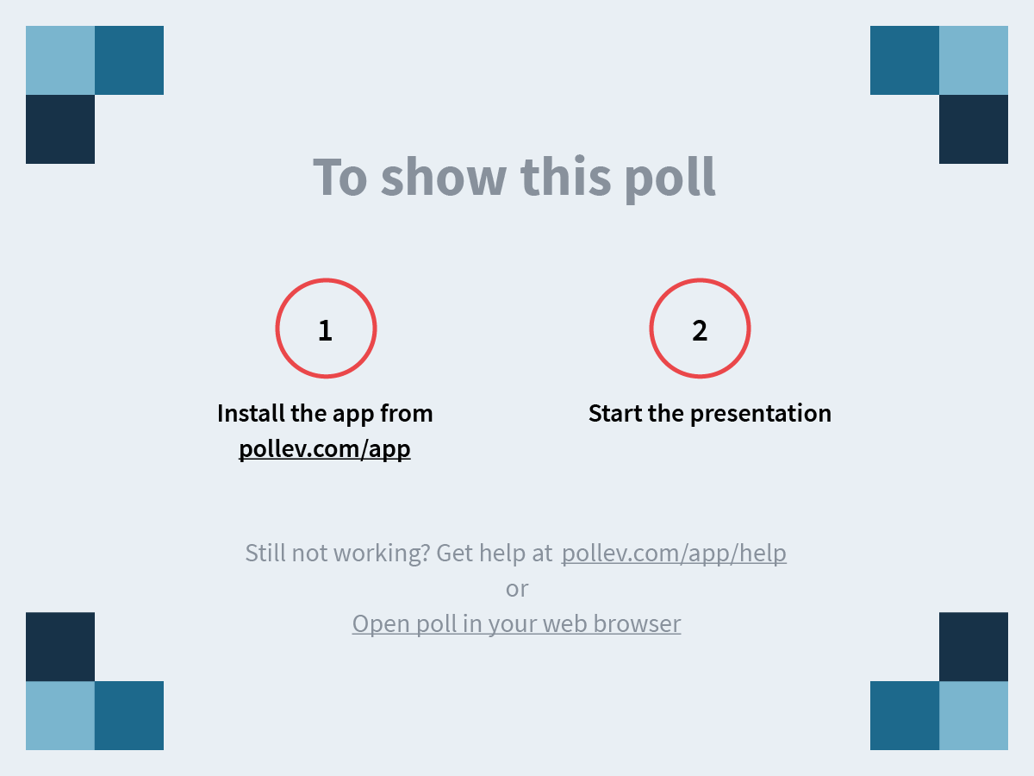

Slide 18
Next steps for research
More detailed analysis of interviews by research team
Tweaking of model based on findings
Drafting of article based on findings
Dissemination of information to QM community

