Slide 1


Exploring Faculty Perceptions of Online Course Design after
Quality Matters Training
Candace Ryder
Faculty Development Professional
College of Business
cryder2@uwyo.edu
Oksana Wasilik
Associate Lecturer
Ellbogen Center for Teaching & Learning
oksana@uwyo.edu

Slide 2

QM Workshop: Designing Quality Online Learning Research
  Research question
  Stakeholders
  Confounding variables
Background

Slide 3
Have faculty perceptions of quality designed online courses changed after attending workshops on designing online courses with quality in mind?
Research Question

Slide 4
What kind of reactions do you get when you introduce QM to faculty?
Audience Question

Slide 5
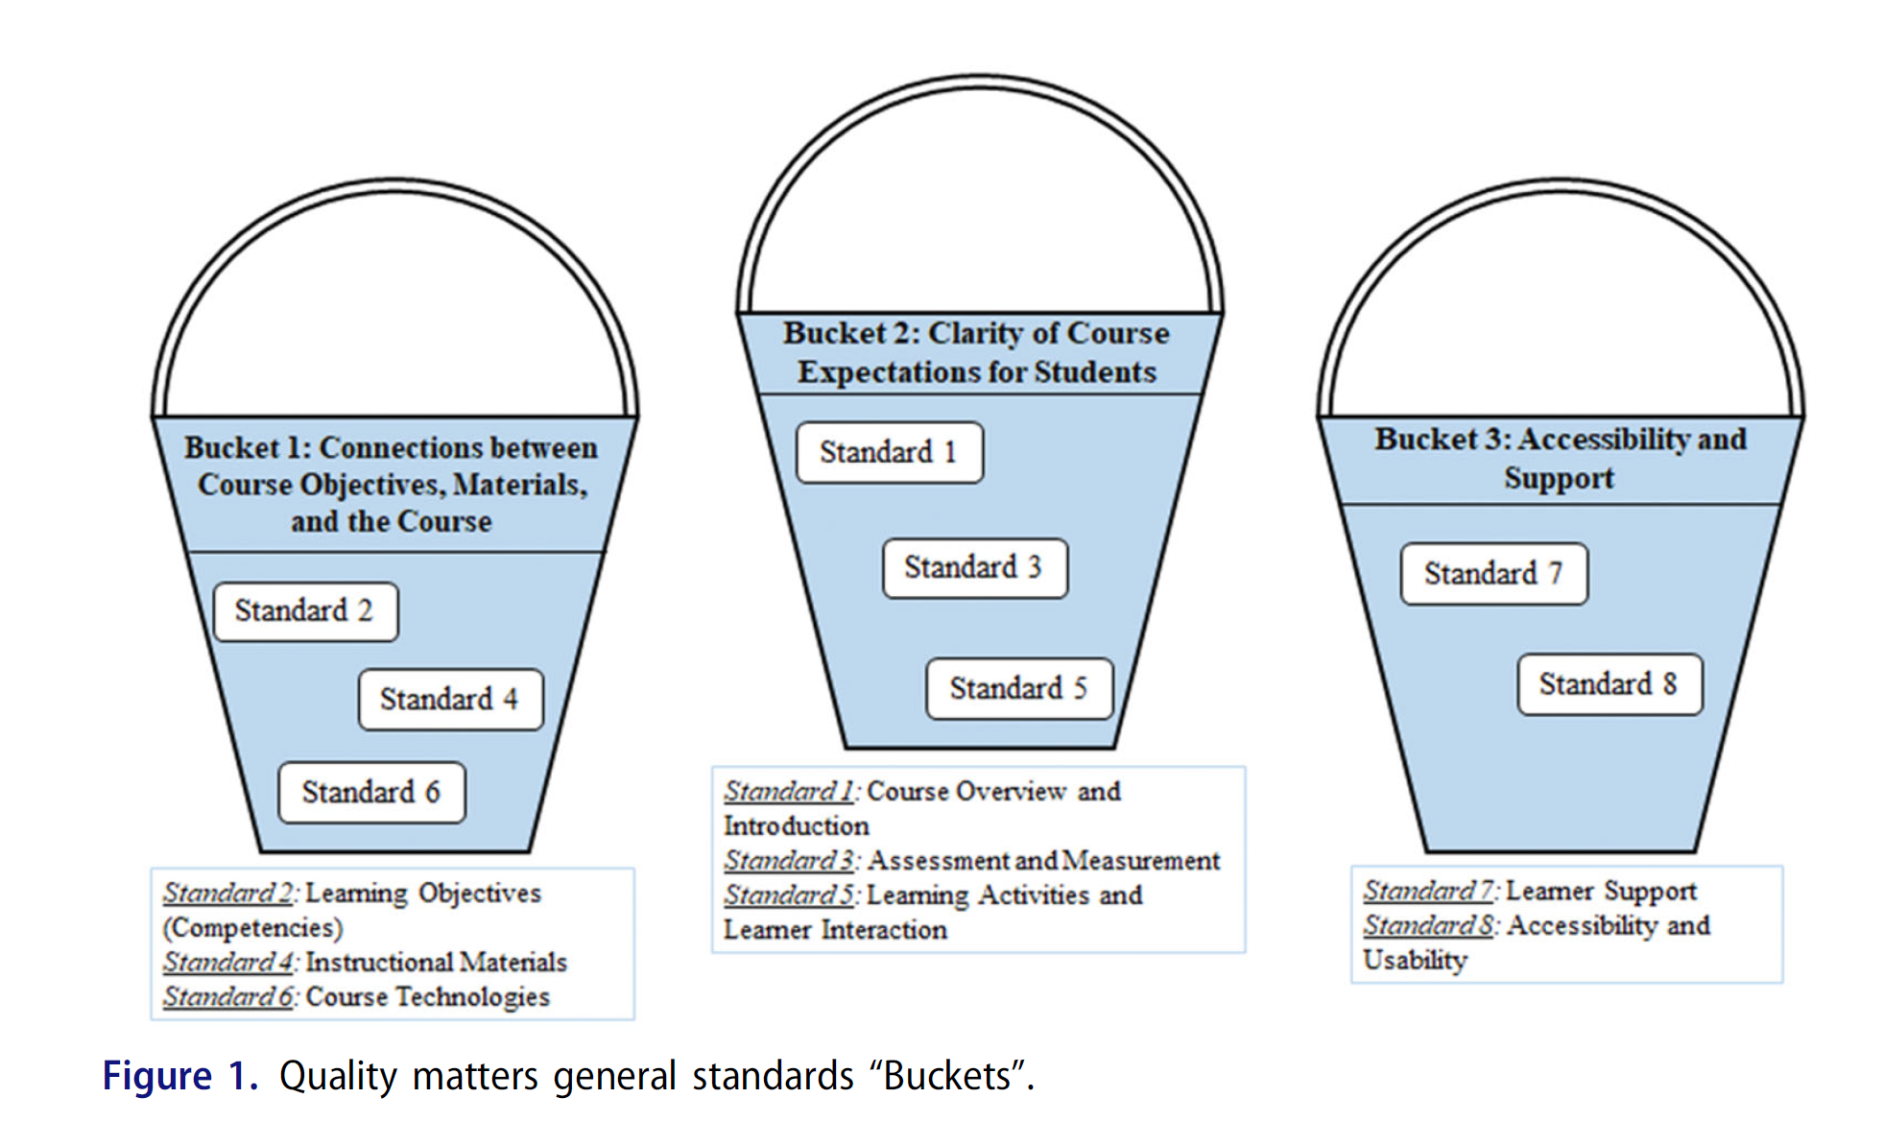
“Bucket” Approach (Chand & Garbryszewska, 2021)
Bucket Approach

Slide 6
Revised “Bucket” Approach (Ryder & Waslik, 2023)
Clarity of Course Expectations for Students
Standard 1
Standard 3
Standard 5
Learner Activities and Learner Interactions
Accessibility and Support
Standard 7
Standard 8
Accessibility and Usibility
Connections between Course Objectives, Materials, and the Course
Course Overview and Introduction
Assessment and Measurement
Standard 2
Learner Support
Standard 4
Standard 6
Learning Objectives
Instructional Materials
Course Technologies
Revised Bucket Approach

Slide 7
Workshop #1 - Introduction to Quality Matters
Welcoming Learners to Your Course
Workshop #2 - Enhancing Learner Experiences
Through Active Learning and
Authentic Assessments
Workshop #3 - Ensuring Accessibility and Usability
in Your Online Course
Workshop #4 - Reviewing Learning Objectives and Aligning Your Online Course
Intervention

Slide 8
8 participants: 2 tenured, 6 teaching faculty
Experience with online teaching:
<4 years: 4
5–10 years: 2
>10 years: 2
Previous QM training: none
Participant Demographics

Slide 9
Prior online teaching experience
Previous course design iterations based on student feedback,
Involvement in non-workshop professional development activities
Confounding Variables

Slide 10
To learn about best practices.
I would like to improve my online teaching.
To learn about the latest methods and approaches.
Make the best experience for online students.
Interested in learning more about effectively teaching online.
There's always something to learn from someone.
Reasons for Participation

Slide 11
Who are the stakeholders who can benefit from this research study?
Audience Question

Slide 12



Candace Ryder
Faculty Development Professional
College of Business
cryder2@uwyo.edu
Oksana Wasilik
Associate Lecturer
Ellbogen Center for Teaching & Learning
oksana@uwyo.edu

