Slide 1


Join at slido.com
#818057
ⓘ Start presenting to display the joining instructions on this slide.
Notes:
Throughout pandemic, as a result of stress, some undergraduate students have indicated that they feel disengaged with online coursework while others struggle in silence. Mental health concerns and best practices focused on social emotional learning (SEL) for a healthy, engaged classroom will be examined and discussed. In this interactive session, participants will be able to learn about strategies that can be immediately implemented in their teaching practice.

Slide 2



Struggling in Silence
Students’ Mental Health and Social Emotional Learning (SEL)

Slide 3


Heather Burke, M.A.
  Associate Professor, English, Hondros College of Nursing
  Professional Development Coordinator (Co-Chair), Quality Matters Ohio Executive Board
  Quality Matters Coordinator, Hondros College of Nursing
  Master Reviewer (Higher Education, K-12, & K-12 Publisher)
  Peer Reviewer (Higher Education, K-12, & K-12 Publisher)
  Teaching since 2008, online since 2010, and fully online since 2017

Slide 4

Part I
Depression and Anxiety
Part II
Mental Health Care
Student Coping Strategies
Part III
Social Emotional Learning (SEL)
Benefits
COVID-19 Impact
Student Mental Health Care Access
Implementation Strategies for Faculty
Part IV
Discussion
The REDFlags Model for Faculty and Staff
Student Risk Factors
Faculty Perception, Impact, and Preparation

Slide 5

Since the start of your career, do you believe students' mental health has:
ⓘ Start presenting to display the poll results on this slide.

Slide 6

87.1% of faculty believe that students’ mental health has declined since the pandemic; 65.3% said it has declined since the start of their career.
    Only 2% said it had improved since the pandemic; only 9.2% said it has improved since the start of their career.
79.3% of faculty have had one-on-one conversations with students about mental health (during a 12-month period); 22% reported speaking with 6 or more students.
51% of faculty felt that they knew how to recognize distress in students.
21% of faculty reported that addressing students’ mental health has negatively impacted their own mental health.
Only 28.8% have participated in training; 55.8% do not know if training exists.
Source: Boston University School of Public Health, Mary Christie Foundation, & Healthy Minds Network, 2021

Slide 7
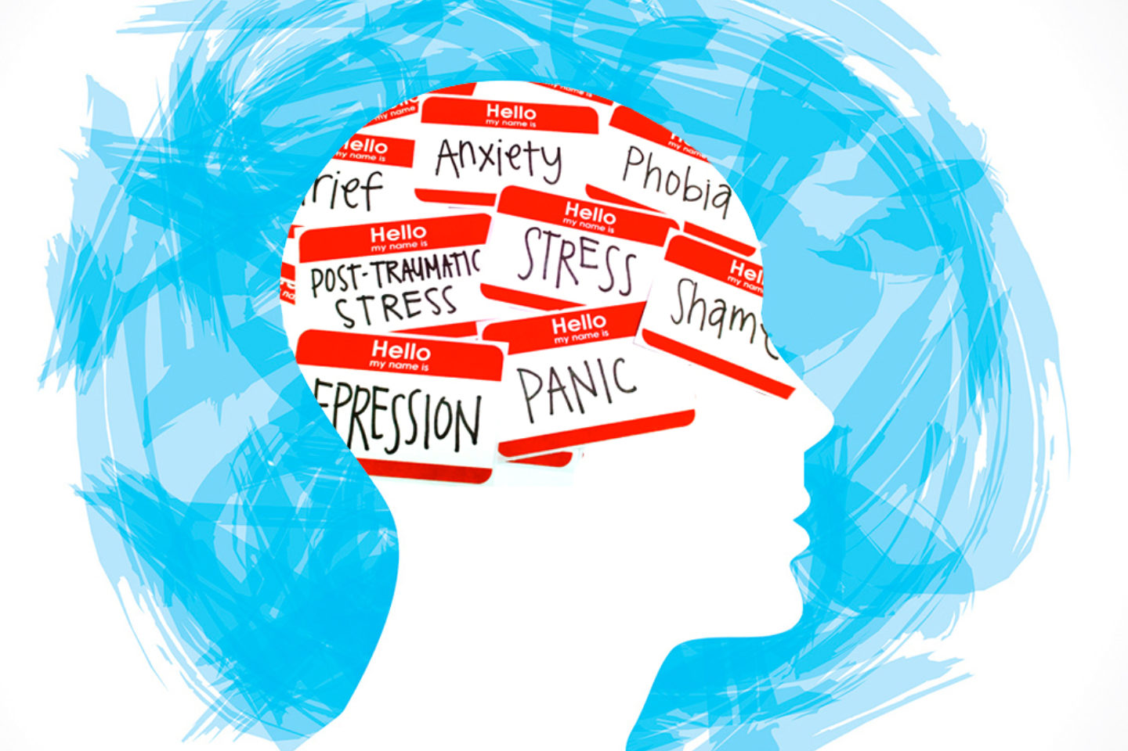
Why Does Mental
Health Matter?
Only 62.2% of students complete their degree within 6 years (NSC, 2022).
“Student retention is influenced by a variety of social, cognitive, behavioral, and interpersonal factors” (Thomas et al, 2021, p. 14).
“Regarding optimism and pessimism, students who reported higher levels of optimism also reported higher levels of satisfaction with all three basic psychological needs as well as higher levels of academic engagement, whereas students who reported higher levels of pessimism reported lower levels of psychological need satisfaction” (Teuber et al, 2021, p. 7-8).

Slide 8
What is the greatest risk factor for anxiety and depression?
ⓘ Start presenting to display the poll results on this slide.

Slide 9



Two Important Questions
Q: Who is at the greatest risk for anxiety and depression?
A: Students . . .
    with lower levels of educational attainment (Padron et al, 2021; Rudenstine et al, 2020; Wang et al, 2020),
    women (Padron et al., 2021; Rudenstine et al., 2020; Wang et al., 2020), AND
    with low levels of household income (Hui, 2021; Rudenstine et al, 2020).
Q: What does the data show about the impact of COVID-19?
A: Based on recent literature . . .
    Anxiety
      71% of participants had increased anxiety (Son et al., 2020).
      38.8% of students had moderate anxiety, and 22.4% had severe anxiety (Padron et al., 2021).
    Depression
      23.4% of students had moderate depression while 25.2% had moderately severe, and 17.2% had severe depression (Padron et al., 2021).
      50.3% of participants met standard for depression, and 41.3% met the standard for anxiety (Rudenstine et al, 2020).

Slide 10


Do students feel like they can cope?
Based on studies, less than half said yes.
Negative Coping Strategies
alcohol consumption
crying
self-harm/suicide
Positive Coping Strategies
engaging with family and friends
pets
living at home
smoking
no method
listing to music
being outdoors
Source: Active Minds, 2020; Jed Foundation, 2020; Son et al, 2020; Wang et al, 2020

Slide 11

According to one study, what was the primary reason students did not receive mental health care?
ⓘ Start presenting to display the poll results on this slide.

Slide 12

Mental Health Care: Accessible for All?
Limited/No Access
48.15%
Lack of Information
54.11%
Cost
70.61%
Social Stigma
58.79%
71% reported that they would like access to
telehealth (Jed Foundation, 2020).
Only 5% of study participants utilized mental health services (Son et al, 2020). Other studies report up 30% utilization (Jed Foundation, 2020).
Source: Wang et al, 2020

Slide 13

How do you know students are struggling with mental health? Which red flag(s) do you look for?
ⓘ Start presenting to display the poll results on this slide.

Slide 14

The REDFlags Model
Recurrent class absences that are sudden and/or uncharacteristic of the student
Extreme and unusual emotional reactions
Difficulty concentrating
Frequent display of anxiety and/or worry
Late and/or incomplete assignments turned in with increased frequency
Apathy towards personal appearance and hygiene
Gut feeling that something isn’t right
Sudden deterioration in quality of work and/or work becomes dark/negative
Source: Kalkbrenner et al, 2019

Slide 15
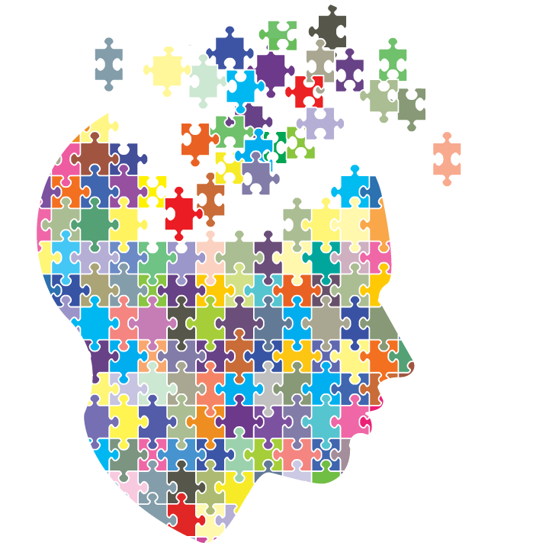
“Teaching goes beyond concepts and skills; it is the daily
imparting of lifelong lessons and tools that will influence
students in every aspect of their lives” (Wilcher, 2020).

Slide 16
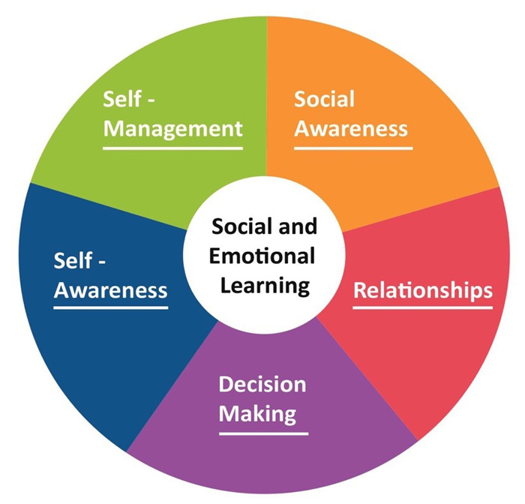
Q: How is SEL defined?
A: “[Social Emotional Learning] SEL competencies refer to: self-awareness, self-management, social awareness, relationship skills and responsible decision making” (as cited in Walker, 2019, p. 102).

Slide 17

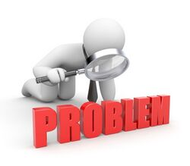
SEL in Higher Ed
Q: What are the benefits?
A: The benefits of SEL are . . .
Q: Is SEL common in higher education?
A: No, according to Cole (2017) institutions often focus on ”programs that address mental health, financial concerns, homesickness, adjustment to the academic demands of college, changes in career goals, campus culture and climate and more” (as cited in Reinert, 2019, p. 114).
Why is this a problem? According to Reinert (2019), these approaches are “focused on symptoms, rather than root causes” (p. 115).
academic achievement
job performance
organizational contributions
physical and mental health
empathy
inclusiveness
conscientiousness
DECREASED
harmful behaviors
risky decisions
INCREASED
Source: Reinert, 2019; University of California – Berkeley, n.d.

Slide 18

How can I incorporate SEL into my classroom?
General Approaches (Dougan, n.d., p. 3)
“Classroom” Environment
  Establish and maintain a safe, supportive learning environment that emphasizes positive instructor-student relationships belief in students’ success and promote a sense of ownership
    Live, interactive dialogue NOT recorded one-way lecture
    Early and frequent check-ins
    Don’t be afraid to call
  Establish high, clear standards and promote student self-evaluation and self-refection
    Reflections/journals to be shared with the instructor (strengths, areas of improvements, hopes, fears, etc.)
  Promote cooperative learning (small group projects, papers, research activities, presentations, help them to create peer-peer relationships)
  Appeal to varied learning styles (video, audio, images, text)
  Implement active learning (discussions, role play, problem-solving, case studies)

Slide 19

Specific Approaches (Dougan, n.d., p. 3-7)
Self-Awareness
  Explore barriers to asking for help, including the perception that it makes the student look “stupid” or that the student would be bothering the instructor (reach out, don’t assume students “get it”)
  Use growth mindset oriented language when giving feedback to students (“learning is a process, and you’re headed in the right direction” instead of “you tried your best” – indicates there is no room for growth)
Self-Management
  Invite successful former students back to make videos or “visit” live sessions to talk about the challenges they faced and how they successfully overcame them
  Share your “favorite wrong answer” to encourage effort and de-stigmatize mistakes (eliminates barriers and establishes the instructor as approachable)
  Ask students to come up with multiple ways to find the solution. Facilitate discussion on the different approaches and ask students to identify and explain what worked best

Slide 20

Specific Approaches (Dougan, n.d., p. 3-7)
Social Awareness/Relationship Skills
  Ask frequent questions to continually engage students in what they are learning.
  Have students teach back a concept covered or specific steps to a problem.
    Group project
    Discussion lead
    Individual project
  Call on students randomly (in a “live” lecture or through discussion forums)
  Acknowledge racism, sexism and other bias as it exists in your subject area and allow students to share their reactions
  Choose a couple students each week and try to strengthen your relationship by connecting with them individually for feedback, follow up, and support
  When referring students to campus services, provide a personal reference and consider walking them to, if possible, or calling ahead to the service to help them make the connection

Slide 21

Do you use SEL in your courses? How?
How do you plan to use SEL in your courses?
What questions do you have about students’ mental health and SEL?
Are there strategies that we can implement across the ADN program?

Slide 22
References
Active Minds. (2020, October). Student mental health survey (September 2020). https://www.activeminds.org/wp-content/uploads/2020/10/Student-Mental-Health-Data-Sheet-Fall-2020-1.pdf
Boston University School of Public Health, Mary Christie Foundation, & Healthy Minds Network. (2021, April). The role of faculty in student mental health. https://marychristieinstitute.org/wp-content/uploads/2021/04/The
-Role-of-Faculty-in-Student-Mental-Health.pdf
Dougan, R. (n.d.). Social emotional learning (SEL) guidebook: Ideas for incorporating SEL activities into your classroom. Diablo Valley College. https://www.dvc.edu/faculty-staff/pdfs/SEL-Guidebook.pdf
Hui, L., Hafeez, H., & Asif Zaheer, M. (2021, January). COVID-19 and pretentious psychological well-being of students: A threat to educational sustainability. Frontiers in Psychology, 11. doi: 10.3389/fpsyg.2020.628003
Jed Foundation. (2020, October). Survey of college student mental health in 2020. News and Views. https://jedfoundation.org/news-views/survey-of-college-student-mental-health-in-2020/
Kalkbrenner, M. T., Brown, E. M., Carlisle, K. L., & Carlisle, R. M. (2019, October). Utility of the REDFLAGS model for supporting community college students’ mental health: Implications for counselors. Journal of Counseling and
Development, 97(4). doi: 10.1002/jcad.12290
National Student Clearinghouse. [NSC]. (2022). Completing college national and state reports. https://nscresearchcenter.org/completing-
college/#:~:text=The%20national%20six%2Dyear%20college,completion%20rates%20over%20last%20year.
Padron, I., Fraga, I. Vieitez, L., Montes, C., & Romero, E. (2021, January). A study on the psychological wound of COVID-19 in university students. Frontiers in Psychology, 2. doi: 10.3389/fpsyg.2021.589927
Reinert, P. (2019). Social-emotional learning: A model for higher education. Journal of Research in Innovative Teaching and Learning, 12(2). doi: 10.1108/JRIT-02-2019-0039
Rudenstine, S., McNeal, K., Schulder, T., Ettman, C., Hernandez, M., Gvozdieva, K., & Galea, S. (2020, October). Depression and anxiety during the COVID-16 Pandemic in urban, low-income public university sample. Journal of
Traumatic Stress, 34(1). https://onlinelibrary.wiley.com/doi/full/10.1002/jts.22600_
Son, C. Hegde, S., Smith, A., Wang, Z., & Sasangohar, F. (2020, September). Effects of COVID-19 on college students’ mental health in the United States: Interview survey study. Journal of Medical Internet Research, 22.
Sun, Y., Lin, S., & Kien Hoa Chung, K. (2020, December). University students’ perceived peer support and experienced depressive symptoms during the COVID-19 pandemic: The mediating role of emotional well-being.
International Journal of Environmental Research and Public Health, 17. doi: 10.3390/ijerph17249308
Teuber, Z., Jia, H., & Niewohner, T. (2021). Satisfying students’ psychological needs during the COVID-19 outbreak in German higher education institutions. Frontiers in Education,6(679695). doi: 10.3389/feduc.2021.679695
Thomas, N., Barr, P., Hottell, D., Adkins, A., & Dick, D. (2021). Longitudinal influence of behavioral health, emotional health, and student involvement on college student retention. Journal of College Student Development, 62(1). doi: 10.1353/csd.2021.0001
University of California – Berkeley. (n.d.). SEL for students: Social awareness and relationship skills. Greater Good in Education. https://ggie.berkeley.edu/student-well-being/sel-for-students-social-awareness-and-relationship-
skills/#tab__1
Walker, G. (2019). Social and emotional learning and studies on fostering synergistic development: Editorial comment. Journal of Research in Innovation in Teaching and Learning, 12(2). 102-105. doi: 10.1108/JRIT-08-2019-048
Wang, X., Hedge, S., Son, C., Keller, B., Smith, A., & Sasangohar, F. (2020, September). Investigating mental health of US college students during the COVID-19 pandemic: A cross-sectional survey study. Journal of Medical
Internet Research, 22(9).
Wilcher, T. (2020, February). Supporting the “whole” student: Social emotional learning (SEL) and the flipped classroom. Center for Faculty Development News.
https://www.odu.edu/facultydevelopment/news/2020/2/supporting_the_whole

