Slide 1

Using Panopto Data to Improve Teaching
Robin Albright
Pitt Online
ralbright@pitt.edu
Notes:
Welcome to Using Panopto Data to Improve Teaching. Panopto is a video lecture capture software tool that I will discuss my experiences with, but the principles and findings that I cover today may apply to whatever video lecture capture solution you are using at your institution.
The goals of the presentation are to show you ways that I view and download select video data, ask questions and make informed instructional decisions based on the data, and then apply best practices for using video recordings in courses, specifically for lecture capture and distribution.
What is Panopto?
Panopto is the University of Pittsburgh’s secure video hosting and lecture capture recording platform. Faculty create a video on Panopto that lives on a server that they or I, as an instructional designer, can access within or outside of CourseWeb, our learning management system. Video presentations hosted on Panopto can be shared independently of CourseWeb, either through URLs for your viewers, embedded videos, podcasts, or other outputs suitable to online learning.
Panopto is hosted at pitt.hosted.panopto.com. This is where videos are directly created, uploaded, and hosted. This is also where you can access the data on your videos.
Why should we analyze data?
Imagine that you’ve just finished teaching a course online. It has 14 modules, and each module has lecture videos. Some are interviews, some are video capture of your face-to-face classes, and some are you speaking directly to a camera in a professional studio on campus. You’d like to know whether there are any trends in your student viewership that might indicate which the preferred type is for your students, or see which videos the students watch most—that way, you can take some of the strategies of that video and apply them in the new ones you’ll be recording for next term.
Or imagine that you have a colleague who is teaching online. Unlike you, she has noticed that after every week of the course, her students’ discussion posts seem to decrease in depth. Your colleague thinks that students may not be watching her lectures and thus not absorbing the information they need to inform their discussion posts. And she wants to identify whether there is a trend in lecture viewership to support the disappointing discussions. She’d like to see the specific viewership numbers so that she can address her students constructively.
With Panopto, I can analyze data that will help faculty and I reach conclusions about students’ viewership.

Slide 2


An Example Video in Panopto
Example Recording from NURSP 2095:
https://pitt.hosted.panopto.com/Panopto/Pages/Viewer.aspx?id=d66a4205-4b76-45a2-a9c3-ba4e92ff444a
Notes:
An Example Video in Panopto
Let’s briefly see the look and feel of an introductory video in Panopto. This is a one-minute welcome video by Nursing faculty member Rose Hoffman.
. . .
While we were watching this recording, Panopto was gathering info about our viewing behaviors—capturing learning analytics, which will allow us to gather and use data to make informed decisions.

Slide 3
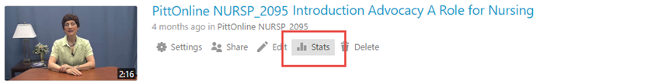
Where do we go to get the data?
Where do we go to get the data?
Notes:
Where do we go to get the data?
Panopto will collect analytics about videos from the time that they are created. Pitt’s faculty and administrators have access to this information at a glance on the website and in a downloadable Excel format, a CSV file.
[Switch to browser to follow Stats retrieval sequence]
Let’s go into more detail about what you’re seeing on the Panopto stats pop-ups.

Slide 4
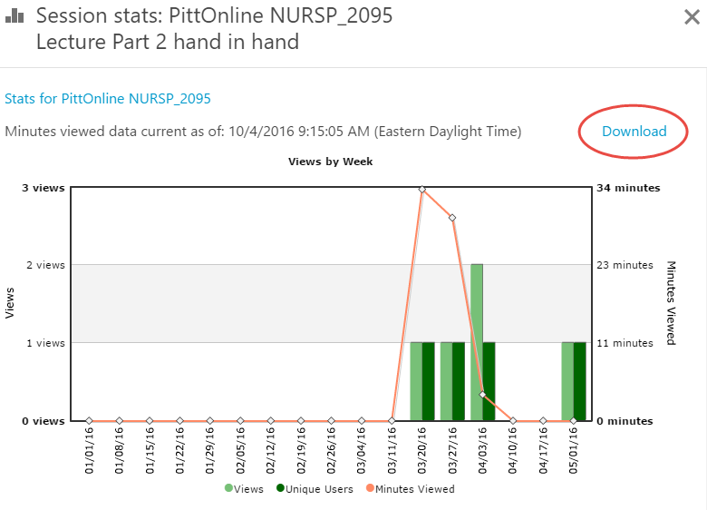
Features of Panopto’s Stats
Notes:
Features of Panopto’s Stats
There are three data outputs that Panopto produces for the single video.
The top image in the Stats view is Views by Week. The orange line graph is showing minutes viewed for each week by total students, faculty, and administrators accessing this video. The light green bar graph shows the number of views (that is, the number of times the video was accessed by anyone, total), and the dark green bar graph shows the number of unique users accessing the video (so if I viewed this video four times, I would only be measured as one unit for this metric).
Panopto will automatically populate this graph with data for one month prior to today. So for today, April 21, we can see data from March 21 until today automatically. But I can adjust the range according to my needs.

Slide 5
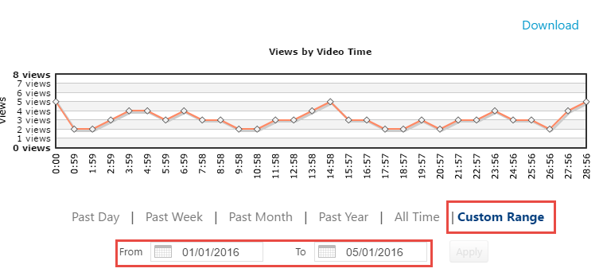
More on Panopto’s Stats
Notes:
More on Panopto’s Stats
The second stat is Views by Video Time. It shows me how many views are taking place at a specific timestamp. This is interesting, but there are a lot of variables taking place here. For instance, we can see that five student views start out in the beginning of the video, but by 59 seconds we drop to two views. But we jump back up and down throughout the total elapsed time of this video. This could have a lot to do with students entering and exiting parts of the video at different times, and students using the video slider to navigate to different portions of the video. It doesn’t tell me anything concrete except number of views. There is too much to guess about as for the why students aren’t watching the video.
But right under this line chart is one of the most important parts of Panopto’s Stats feature: The Custom Range function. You might recall that I said earlier that Panopto will automatically give us one month’s data. But to us, a term’s data would be more important, or even the All Time information.
When I gather data, for instance, to gather the data to make the Excel charts I just showed you, I used the Custom Range and input term dates. For the spring 2016 data, I was using the range pictured, January 1, to May 1, 2016, which I needed to manually enter for all of the videos’ stats pages.

Slide 6
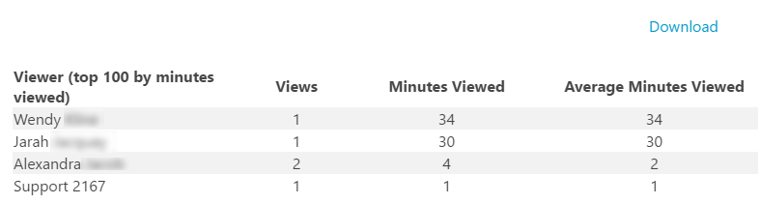
Last Portion of Stats
Notes:
Last Portion of Stats
The last part of the Stats page shows Viewers, Views, Minutes Viewed, and Average Minutes Viewed. This is great to see—in my Views spreadsheets that I downloaded from Panopto, I could only see the user’s Pitt IDs, but here I can see full user names and the identification of a Pitt Online support account that is used in the process of building or revising this course. This is the same information that I get in that views downloadable Excel spreadsheet, but at a glance. If I want to see how long Alexandra elapsed for each of her two views, I can go deeper in the views spreadsheet.

Slide 7
Data Analytics and Panopto
What do analytics tell us? There are numerous data points related to media, which offer indicators regarding video viewership.
Minutes viewed
Viewers present at the timestamp of the video
Viewership numbers (by date or date range, by video time)
Viewership identity
Notes:
Data Analytics and Panopto
The content of this presentation today is about the data analytics available to me from Panopto and how I can retrieve and use them to work with faculty to improve videos. So let’s summarize what the built-in analytics can tell us. Panopto specifically can tell us:
Minutes viewed. This means each time a user views the video, Panopto will track the user name, the length of the view, and the iteration of the view. In reports I’ll be able to see some information such as my student Robin viewed this video three times, one time for zero minutes, one time for 4 minutes, and one time for 16 minutes.
Viewers present at the timestamp of the video. I can see that in my 14-minute video, there were 5 viewers present at the seven-minute mark, but no viewers made it to the 14-minute mark. I’ll get more into that analytic metric later.
Viewership numbers: I can see for a specific day, week, month, term, or lifetime of the video how many viewers viewed, and who they were.
Viewership identity: I can see which viewers viewed my video. This is critically important when determining true data to evaluate, because this is how you can identify who are your students and take your own viewership (and that of administrators) out of the equation. I’ll show you what I mean by that shortly.

Slide 8
Handling Assumptions
Handling Assumptions
We can only analyze data on Panopto videos.
Video analytics are collected at the video level, not course level.
Notes:
Handling Assumptions
Before I download and assemble the data from Panopto, I want to clear up some assumptions that you may or may not have.
First, Panopto is built to give you information for the individual video, not for the folder or course level. So each piece of information you are getting is at the single-video level. To gather analytical information about your course as a whole would require a few other steps. When I do this, I determine the sequential order of the videos in the course: listing the videos from the first through the last module in an Excel spreadsheet, and then entering data evaluated from individual videos one by one.
Also, a common assumption behind examining video analytics is that higher play-through rates and higher view numbers of videos are more "positive," in that students were compelled enough to watch the video in its entirety, and/or students watched the video many times. We’ll revisit this at the end of my presentation, but it is important to mention now as we think about how we want to interpret information.
The play-through rate is the amount of time the average viewer watches a video. (For most online videos, the average viewer does not watch 100% of the video to completion, although this does not mean no one watches it to completion. For instance, if one viewer watched 20% of a video, and another watched 100%, the average view time would be 60%).

Slide 9

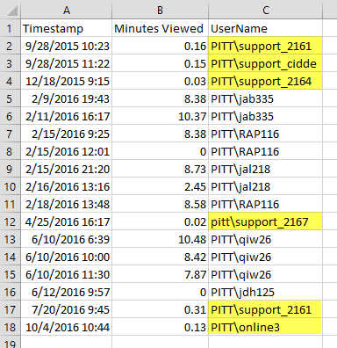

Views By Week: Download
Notes:
Views By Week: Download
Using the Download option from the Views by Week graph will let you download a “Views” zip file. Unzipping that folder will extract an Excel CSV spreadsheet called “views” as well. When you open this spreadsheet, you can see timestamps of your viewers, the minutes viewed in decimal format, and the user name of the viewer.
Here we can see that there are a few support accounts that Pitt Online uses during course development. We can delete those rows because they’re not important in the evaluation. In addition, if you saw your own user account listed here, you could remove that as well so that you’re only seeing the information for your student viewers. If I do that for this data, I can see that there are only five unique students that have viewed this video, and four of them have viewed it in segments for multiple times, and one student opened the video and closed it before it could begin playing.
When I want to evaluate videos, I collect this “views” spreadsheet for each video in the order that they are presented in the course. I remove these support accounts, and I can draw important information out. I can easily determine
average minutes viewed
how many unique viewers are viewing
how many total minutes were viewed
how many full viewings of the video occurred
If I collect this info for each video of the course and combine them into a separate spreadsheet, I can see powerful, course-wide information.

Slide 10
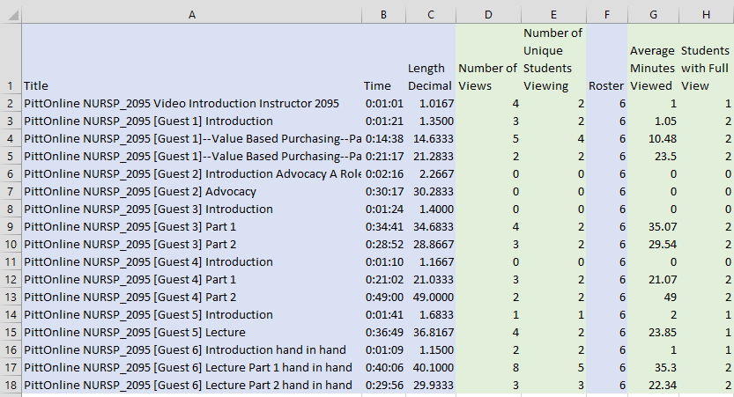
Spreadsheet Example
Notes:
Spreadsheet Example
Here is an example that I completed using only those views spreadsheets for each video in the NURSP_2095 course for the 2164 term. The first step is to collect the order of the videos as they occur in the course, which is what you see in column A; I do this manually by going through each module of the course, and I also collect the timestamp, or the length of the video. The length decimal column (column C), is a conversion column that I do so that the format from the views spreadsheets will be meaningful in this spreadsheet. You can do this by multiplying a timestamp by 1440, so I used a formula for each of the rows in column C.
Everything that you see in blue is information that I gather myself from the course. Everything in green is information that I acquire through the Panopto Excel reports that I download and record here in the organized spreadsheet.

Slide 11
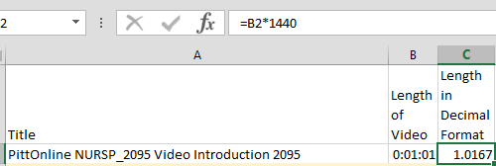

Converting a Time Stamp to Decimal Format
One minute and one second = 1.0167
.0167 = $\frac{1}{60}$
of a minute
The simplest way to convert a time to a number of minutes is to multiply the time by 1440, which is the number of minutes in one day.
Notes:
Converting a Time Stamp to Decimal Format
Let’s take a closer look at these units for a moment, just to make sure that we all understand the conversion from timestamp to decimal units. All I have to do to convert the timestamp column B to a decimal format in column C is to multiply it by 1440. I can do this by multiplying a timestamp by 1440 (which is the number of minutes in one day), so I used a formula for each of the rows in column C and dragged the formula down the column. In this example, one minute and one second does equal 1.0167, as the .0167 is one sixtieth of a minute.

Slide 12
Spreadsheet Example Continued
Spreadsheet Example
Notes:
Spreadsheet Example Continued
Back to the Spreadsheet, using each of the views spreadsheets that I downloaded for the videos, I can add number of views and number of unique views of students. Then I add a column for the number of student in the course. This is important to evaluate the percentage of students viewing versus the total enrollment for the course. I can also evaluate average minutes viewed and students with full, uninterrupted view from the views spreadsheets.
Now with this info, I can use the charts wizard in Excel and create some interesting data visualizations, so here are a few that I generated based on some questions I have.

Slide 13
Chart 1: Unique Views
Notes:
Chart 1: Unique Views
Let’s say I want to know how many unique views occurred for my videos in the Spring 2016 term. That is, I know I have 6 students enrolled in my course; how many of those six have watched each of those videos? I can see right away that almost all of them watched the Debra Thompson Hand in Hand Part 1 lecture. I can see that there are some that no students watched. I can see that there are no videos that all students watched. If there had been, a blue bar would reach the horizontal orange line.
What this doesn’t tell me is why, and that is important to talk about right now. There are so many variables to think about, and you know them intimately about your own courses. For example, maybe some of these were added late to the course. Maybe some of them did not have direct alignment to assignments, or were labeled as optional videos. Maybe the other supporting instructional materials for that module were satisfactory from the students’ point of view, and they didn’t feel a need to get into the videos. There are many other explanations as well. The only information here is objective; the subjective why of the information can be interpreted by you.

Slide 14
Chart 2: Video Length vs. Average View Time
Notes:
Chart 2: Average Video Time vs. Average Viewing Time, Overall
In the past few graphs, you notice that there are some videos that students didn’t watch. I don’t want to focus on those in this metric, so what you’re seeing here is the average time for all of the videos that were watched by students in this course for Spring 2016—their elapsed time as an average in the orange bar, and the average watch time by students in the blue bar.
This is a really interesting metric. It says to me that when the students were watching videos, they were on average highly engaged—they were watching most if not all of the video. We could surmise as much from the previous graph, but that gave us a video by video bar chart that may have taken longer to evaluate. Here we have a visual with a low grade between the bars.
For the maximum in the y-axis I have the longest video time, which is 36 minutes and 49 seconds, and the minimum at one minute and one second.
If the grade between the two bars was much higher, I might think that my videos were problematic at keeping students engaged. But in this case I think that we have engaging videos that keep students focused. I know the chart is giving me objective information. I might subjectively analyze that students know that the video in full will give them critical information for their assignments and their field of study overall.

Slide 15
Chart 3: Average Video Time vs. Average Viewing Time, Overall
Notes:
Chart 3: Average Video Time vs. Average Viewing Time, Overall
In the past few graphs, you notice that there are some videos that students didn’t watch. I don’t want to focus on those in this metric, so what you’re seeing here is the average time for all of the videos that were watched by students in this course for Spring 2016—their elapsed time as an average in the orange bar, and the average watch time by students in the blue bar.
This is a really interesting metric. It says to me that when the students were watching videos, they were on average highly engaged—they were watching most if not all of the video. We could surmise as much from the previous graph, but that gave us a video by video bar chart that may have taken longer to evaluate. Here we have a visual with a low grade between the bars.
For the maximum in the y-axis I have the longest video time, which is 36 minutes and 49 seconds, and the minimum at one minute and one second.
If the grade between the two bars was much higher, I might think that my videos were problematic at keeping students engaged. But in this case I think that we have engaging videos that keep students focused. I know the chart is giving me objective information. I might subjectively analyze that students know that the video in full will give them critical information for their assignments and their field of study overall.

Slide 16
More Questions About Analytics
More Questions Follow Analytics
Why aren’t all of the students watching the videos?
If students aren’t watching my videos, are my videos poor?
What makes some videos more watched than others?
How can I get students to watch the videos?
Notes:
More Questions About Analytics
Now that you’ve seen the power of Panopto’s Stats feature for analytics, and you’ve seen what I can do to interpret those figures visually with some self-generated Excel charts, you may naturally have questions about what the data is telling you.
Why aren’t all of the students watching the videos?
There are any number of reasons for this, and it will be different for each course, instructor, and student. It’s important to look critically at your own course overall to make some assumptions as to why. But there are a few reasons that students may not be watching the videos.
Some students may be dissatisfied with videos that they did not perceive as a value-add over text.
Some students may not absorb information as well from videos as from reading.
Some students may only resort to watching videos if they are at a loss when completing required assignment work.
If students aren’t watching my videos, are my videos poor?
The answer is not always. I’ll talk about some ways you can ensure your videos are produced with high quality, or how to improve upon what you have already created.
What makes some videos more watched than others?
I touched on this a little earlier in the presentation, but a video will be more frequently watched by students if
It is a prototype of a key course assignment.
A discussion forum is associated with the video (and discussion posts are also tied to a participation grade).
The video highlights how media can convey information that text or imagery alone cannot, by demonstrating presentation techniques such as timing, body language, vocal delivery, or other simulations.
How can I get students to watch the videos?
You can coach your students to watch videos by referring to them in communication with your students, whether by talking about them in your weekly announcements, referring individual students to them in your discussion feedback, contextualizing them in the module (for example, please watch this lecture video before attempting this week’s assignments), or recommending them to struggling students in private emails.

Slide 17
Strategies for
Video Engagement
Notes:
Now let’s focus on planning and delivering recordings. The literature on instructional videos measures “video engagement” or “compelling video” by the amount of time that students watch the video. Engagement is a prerequisite for learning, but certainly not the ONLY prerequisite.
Students can have the video running while they are on the phone or in the shower, but we going to make the assumption that our students are actively, attentively watching. So let’s take a look at some ways to incorporate video into your courses.

Slide 18
Studio Video
Notes:
The analytics that I just showed you include Panopto videos stored on the Panopto server. But there are several different types of video that we find in Panopto. There’s no right or wrong for any type—it really depends on the faculty’s purpose and resources.
This screen capture image is from a video recorded in a production studio. These types of videos are direct instruction and tend to be the shortest and highest quality videos. They are usually scripted in advance and edited after the recording to remove gaps or errors, so the presentation is very professional. From our experience, these videos typically have the highest viewership. One of our videographers believes that the viewership is high not just because the videos are shorter – he credits the pre-production work that makes for a very tight, succinct message – no wasted words. The faculty member is talking directly to the students and they like when they are the primary audience for the recording. Instructors who make the trip to Pitts’ production studio like that they can walk in, focus on the delivery of their content, and then leave. There’s a teleprompter for their scripts and two cameras for different camera angles for the final product. The technicians are patient and professional and create a polished final product. They may record your presentation 2 or 3 times and create a final product with the best section from each video.
The final video doesn’t have to be just a talking head - we can add an overlay beside the faculty member’s shoulder to incorporate images, photographs, or key terms.
There’s also a technique that incorporates what the videographers called “B-roll video.” This is related video that plays as the instructor talks, but the instructor is off-screen and the related video is playing. For example, in a course about disabilities, we have b-roll video that shows a student using a wheelchair, assistive technology, or accessible ramps through doorways on campus. The video switches from the instructor’s face to the B-roll video while the instructor explains what the students are seeing. We see this type of video treatment every night on the evening news. We hear the newscaster but see video from the live news story.
The down side of these recordings is the time involved in planning the session, but the professional recordings are portable and might be used in another course, on your website, or at a conference presentation.
One quality that is consistent across types of video is students’ preference for a fairly fast speaking pace and enthusiast in tone. I know you can speed-up the pace of a speaker, but you can’t change the energy or enthusiasm.

Slide 19
Classroom Video
Notes:
Another popular type of video is the classroom lecture. Classroom lectures or presentation are popular for courses that have guest speakers. Faculty are respectful of the speaker’s time and try to capture the recording for online students. A weakness of these presentations is that the speaker is engaged with the classroom students and is not necessarily aware of the online students. The speaker might also be talking about things that date the material or alienate the online students; for example, if the faculty member starts by talking about the crazy Pittsburgh winter weather for two minutes, an online student in Florida in September several months later watching the video might feel that this content is second rate.
If the speaker moves off-camera, the student just hears a voice with no one on camera. If classroom students ask questions, the online student doesn’t hear them. The acoustics in the room are poor because you record all the background noise. If you are recording guest speakers in a live classroom setting, consider taking a few minutes to orient them to the online student audience and request a separate copy of the PPT file to post in the course. Sometimes students review a PPT file or a transcript, but do not watch the accompanying video.
No matter what type of video recording you create, be sure to watch it—at least the first few minutes. When reviewing a random selection of Panopto recordings with low viewership, we noticed this recording that started with 5 minutes of the students entering the classroom. When the instructor added a note to students to begin watching an the time stamp of 5:10, their engagement with the video increased. And when the instructor scrutinized the video more closely, she gave us at Pitt Online a total of almost 20 minutes to edit out of a 60 minute video. It was dead-time or non-essential information for online students. She said that not everything that happened in her classroom was necessary for her online students to view, and she wanted to be respectful of students’ time. Students are very sophisticated consumers of video – if they don’t believe it is worth their time, they won’t watch it.

Slide 20
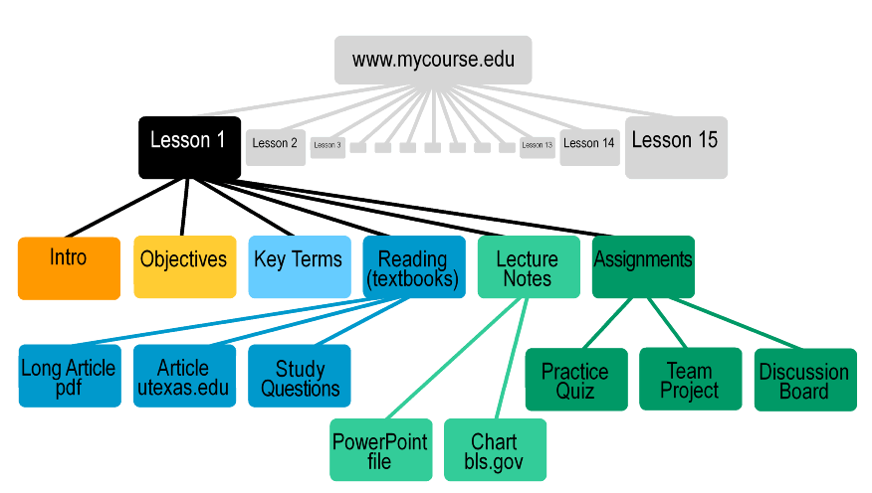
Narrated PowerPoint
Notes:
A third type of video we frequently see is narrated PowerPoints slides. Power Point is a valuable teaching tool, and experienced online faculty have come to recognize that the online delivery of PowerPoint sessions requires a different style than their f2f classes.
In a face-to-face classroom, there are minor details such as other students’ reactions or your appearance that keep students engaged. Live classroom students can interrupt you with questions or comments. You can see and react to their faces and monitor their understanding. In an online course, students are sitting in front of their computers with their mouse in their hands – they are prepared to DO something. So, consider how you can capture and hold your students’ attention during an online recording.
The research on the ideal length of video sessions recommends 4-8 minutes. I know this probably seems impossible for your course and the volumes of information that you need to cover. So what else can you do to capture students’ attention? You will probably want to chunk information into several parts based on the subtopics or themes. Can you periodically incorporate a multiple choice question – perhaps from the reading? One professor removed summary information from the textbook readings and had students work with a partner to create a wiki chapter summary for each week. Then, he created review quizzes to emphasize the key points from each chapter.
In your narration, keep your tone informal and friendly. Create a script or detailed outline for each slide – it is amazing how much more concise a presentation is when the speaker has detailed notes. In the MOOC (massively open online courses) research, researchers found student engagement was enhanced when the slides had motion or a continuous visual flow that captured attention. You might circle or star a key point as your are talking. You might release bullet points one by one.
PPT is a wonderful visual medium to share images, charts, and photographs. If your entire presentation is text without any images, consider why it is presented in a PPT format. Could it be just as effectively presented as a text document? Or if student don’t need to view your presentation when they hear it, consider posting it as a mp3 audio file.
One more final point before I move on – when you plan your video, consider the shelf life of the information. It is a massive amount of work to develop online materials and the semesters fly by so quickly, so think about how you can make your videos last for a couple years. Avoid putting dates or page numbers from a textbook into your slides. Avoid putting URLs into the slides because they break and the whole presentation has to be re-done. Avoid comments about the weather or current events. “Old” information alienates students and their definition of old seems to be one semester. We want the students you have this semester to think all of this information and work was done just for them.

Slide 21
Video Discussion
Palliative Care: Just Talk About It
Discussion to Accompany Laura Fennimore's Lecture
The Cancer Center’s Palliative Care Team is comprised of a nursing director of palliative care, nurse practitioner, social worker, a clinical nurse leader, and a spiritual care counselor who are all integrated into the oncologist’s practice. The team met with Ms. T. following her first office visit for newly diagnosed pancreatic cancer. Ms. T. is 70 years old, is a retired school teacher, lives alone and her only family is a son who lives out of state.
At the team’s first visit, Ms. T. says, “What do I need a team like this for? I am here at the cancer center to be cured?” How does the team introduce the concept of palliative care to a patient with newly diagnosed advanced stage cancer?
Notes:
One strategy to motivate students is to have them DO something with the video information. In one nursing course, students view a video presentation from a guest speaker, Laura Fennimore, then they use the information to participate in a case study discussion. And notice how the title of the discussion makes it very clear that the discussion is designed to accompany Laura’s lecture.

Slide 22
Video Commentary
Notice the information presented at the timestamp 6:10 directly relates to your final case study assignment. After you view the video, post your assignment questions in the General Q&A forum.
In the following video, I highlight key information that every consumer should know about the Affordable Care Act. In particular, there is a good summary towards the end of the 40-minute video.
What would you say to a withdrawn 6-year old girl who has witnessed violence within her family? We are fortunate to have Dr. XXXX as a guest speaker in this module. Her research as a child psychologist specializing in domestic abuse will build your awareness of the warning signs and help you enhance your communication skills with abused children.
Notes:
Releases one bullet at a time.
Commentary can be a High impact – low effort strategy for student engagement
Adding a personal note beside a link to an existing video is the probably fastest and easiest way to increase student engagement. This is something you are use for videos this semester.
Is there something you can say to motivate students to watch the video? Write a bit of commentary to accompany the video. For example, ….
In a f2f classroom, there are 6 words that grab students’ attention – “This will be on the test.” Telling students information is on the test or needed for a graded assignment may work as a motivator in your online course, too.

Slide 23
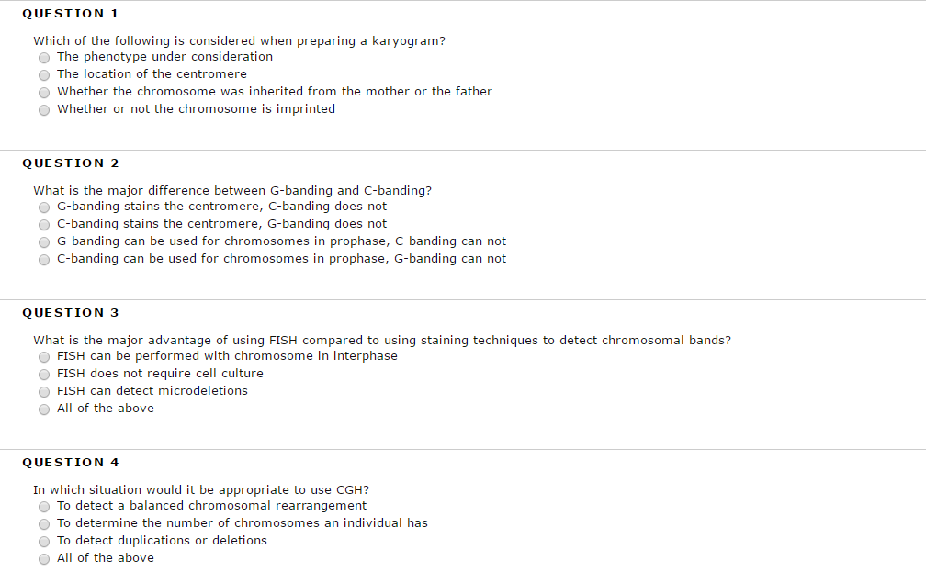
Video Quiz
Notes:
Many instructors use quizzes to check students comprehension of reading materials. It is a good way to reinforce key points. So why not use this same strategy for a video?
For lectures that provide a significant amount of important information, consider following the presentation with a quiz. The quiz can be a graded, practice, or knowledge-building quiz that students can take once or multiple times. You can include the quiz score in your grading schema or incorporate it into the participation grade.
The feedback students get after completing the quiz can be much more useful than correct / incorrect. You can refer them back to a specific point in the video or direct them to another resource.

Slide 24
Conclusion
Be aware that shorter videos are more engaging than longer videos
Consider pre- and post-production strategies to enhance quality of succinct presentations
Incorporate images, questions, and movement into presentations
Develop active and direct connections between the videos and course assignments
Develop an informal, enthusiastic presentation style
Strive to make videos with a shelf life of several years
Notes:
Final takeaways
The literature supports the notion that shorter videos are more engaging than longer videos. If you’d like your effort and your students’ success to be more impactful, consider this.
Also consider pre- and post-production strategies to enhance quality of succinct presentations. Think about the resources available to you and how you can create something highly impactful.
Incorporate images, questions, and movement into presentations to keep students engaged and learning.
Develop active and direct connections between the videos and course assignments.
Develop an informal, enthusiastic presentation style—for online students this may one of the most meaningful ways to have a connection with you.
Strive to make videos with a shelf life of several years.

Slide 25
How do you engage students
with videos?
Notes:
We have a few examples of how faculty have included video in active learning strategies for their courses, but what about you? Does anyone have an example of how you have directed students to use your videos? Please share your ideas in the chat box. Watching video is a passive activity and we’d appreciate your strategies to make it more engaging.

