Slide 1
Human resources slide 1
Using Technology to Ensure Business
Continuity
Hanna Howell, Ph.D.
Assistant Professor
The University of North Alabama
Department of Teaching, Learning and Leadership

Slide 2
Human resources slide 2
AGENDA
Crisis Events
Research on Hybrid/Hy-Flex Environments
Crisis Management Cycle
Common Issues
Practical Implications
Overcoming Obstacles

Slide 3
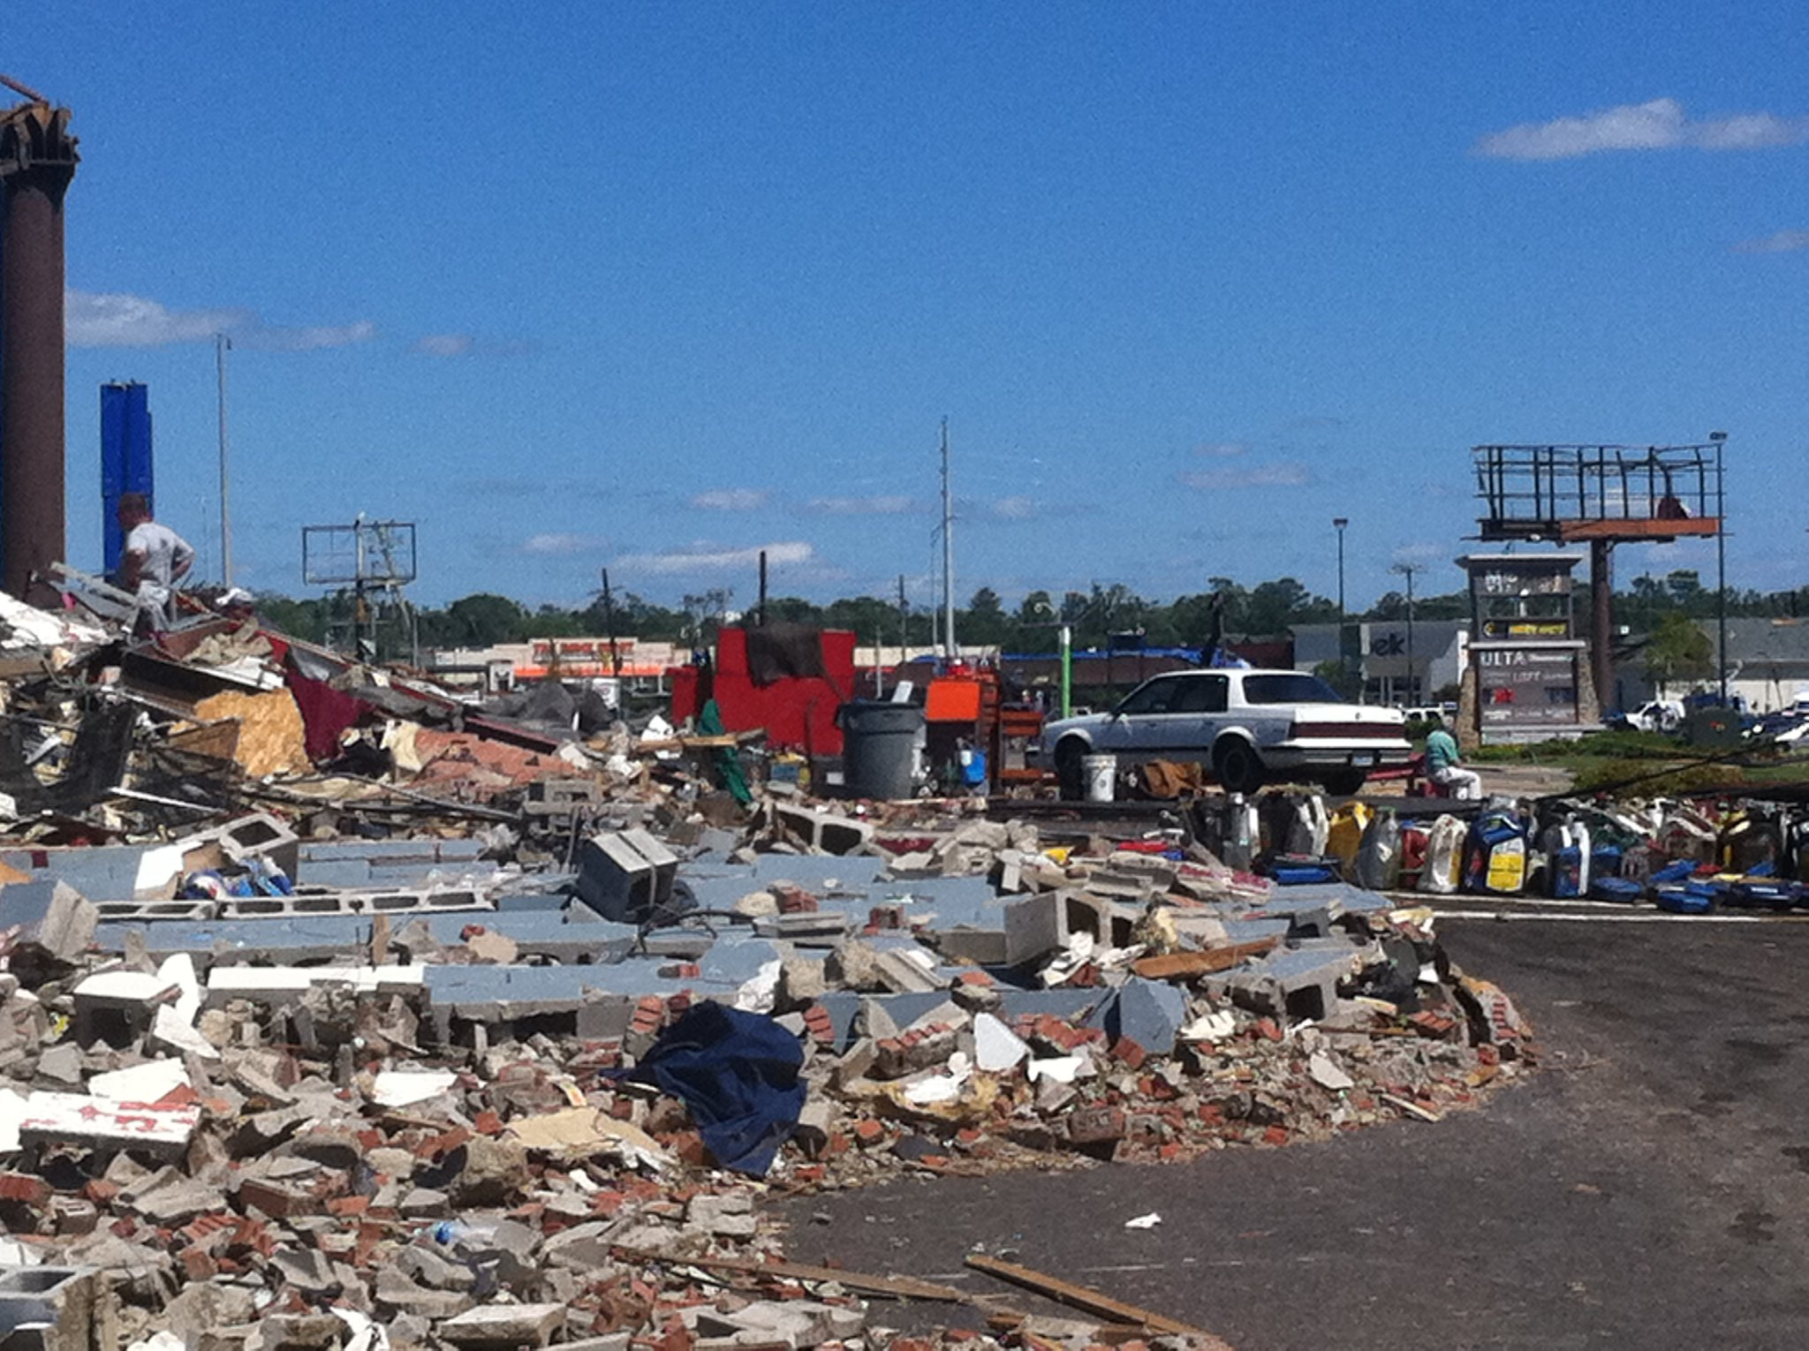
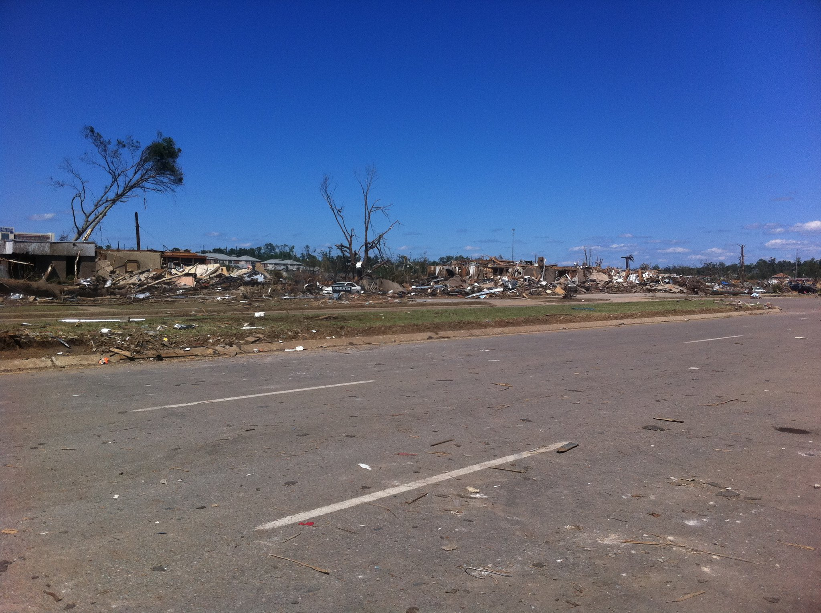
April 27th, 2011
EF-4 Tornado Struck less than one half mile from campus
Resulted in early end to the Spring 2011 semester and finals moved online
53 people killed (6 UA students) and 5,300 buildings destroyed (Weber & Lichtenstein, 2015)

Slide 4
March 13, 2020
Entire campus moved to remote learning and operations due to the COVID-19 pandemic.
Students would remain off campus until August 2020 and alternative instructional methods would continue through Fall 2021

Slide 5
Research on Hybrid/Hyflex Environments
New forms of work organization such as hybrid and hy-flex environments require for a reconfiguration of how we work and communicate (Deschenes, 2024)
Hybrid/Hy-Flex work arrangements have increased by 29% since 2020 (Charpignon et al., 2023)
This type of environment promotes flexibility, increased productivity, and a better work life balance (Innstrand et al., 2022)

Slide 6
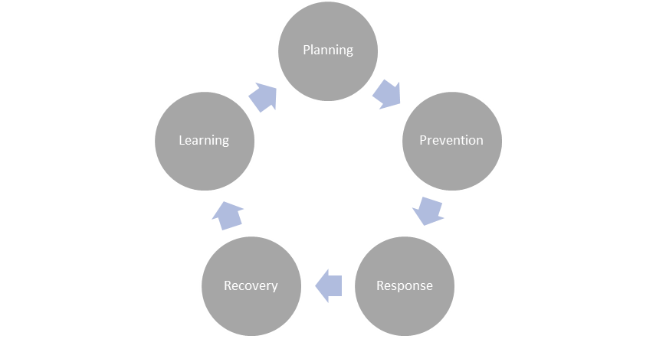
Human resources slide 4
Crisis Management Cycle
Zdziarski et al.’s (2007) Crisis Management Cycle

Slide 7

Human resources slide 8
Common Issues with Continuity Planning
Reactive vs. Proactive Approach
Instructional Technology Implementation
Instructional Technology Training
Instructional Technology Support/Staffing Needs
Communication Issues
Continuity Exercises
Research Operations
Issues Outside of Instructional Technology

Slide 8

Human resources slide 3
Create a plan and make it detailed
Be proactive about training!
  Zdziarski’s Crisis Management Cycle is a great place to start!
Remember employees are humans!
Practice it often and make it a surprise
Your faculty/staff/students are humans and have needs outside of the workplace. Do not forget to consider factors outside of the office.
  Be sure to meet and reflect after each continuity drill to make changes to the plan.
Practical Implications
Incorporate technology in normal operations
Don’t forget Research!
Be sure to include any mission critical technologies into normal operations
Research labs with face to face component might need special consideration
Create templates for all to use!
Provide Clear Expectations

Slide 9
Human resources slide 5
Overcoming Obstacles
Communication
Crises can happen to anyone at anytime. The best way to avoid disruptions is to have a plan and set expectations.
Make sure you include all staff levels in continuity planning (not just leadership!)
Reflection
Planning
If certain operations cannot participate in a drill, have alternative exercises to ensure thought is given to ensuring continuity of operations.

Slide 10
Human resources slide 10
Questions?
Thank you!

