Slide 1

Implementing
Team-Based Learning to Promote Deep Learning and Foster Community
Sarah A. Arrington, PhD
Appalachian State University
QM Quality In Action
April 29, 2022

Slide 2
Agenda
Login to Poll Everywhere and InteDashboard
Situational factors and the Pandemic
What is Team Based Learning (TBL)?
Creating Effective Teams and learner buy-in
A sample course
Preliminary results & Student Feedback
Your Turn to Try TBL
Q&A / Resources

Slide 3
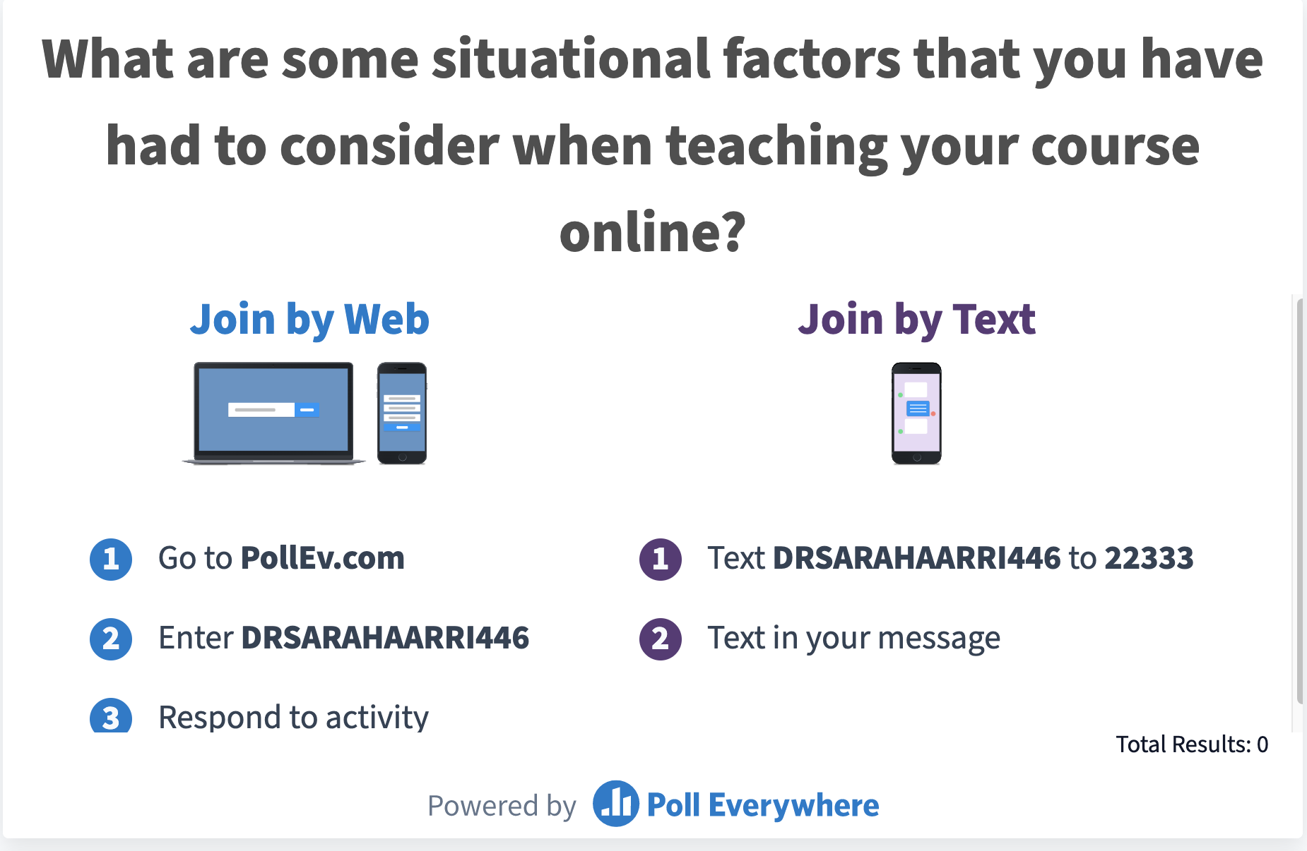
Please Join My Poll Everywhere

Slide 4
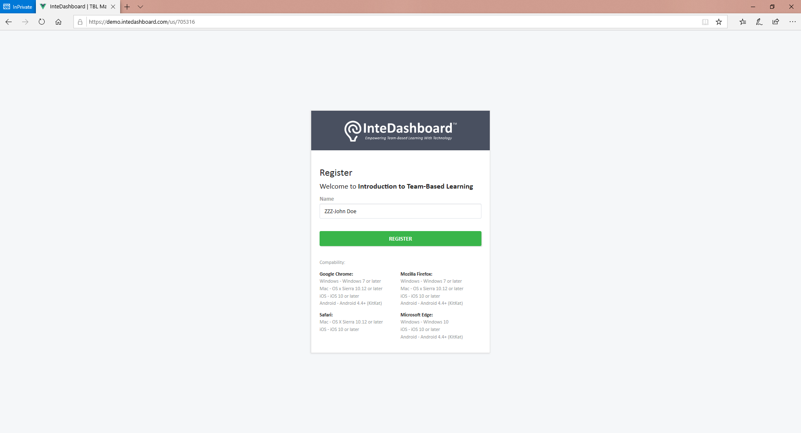
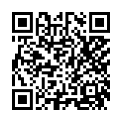
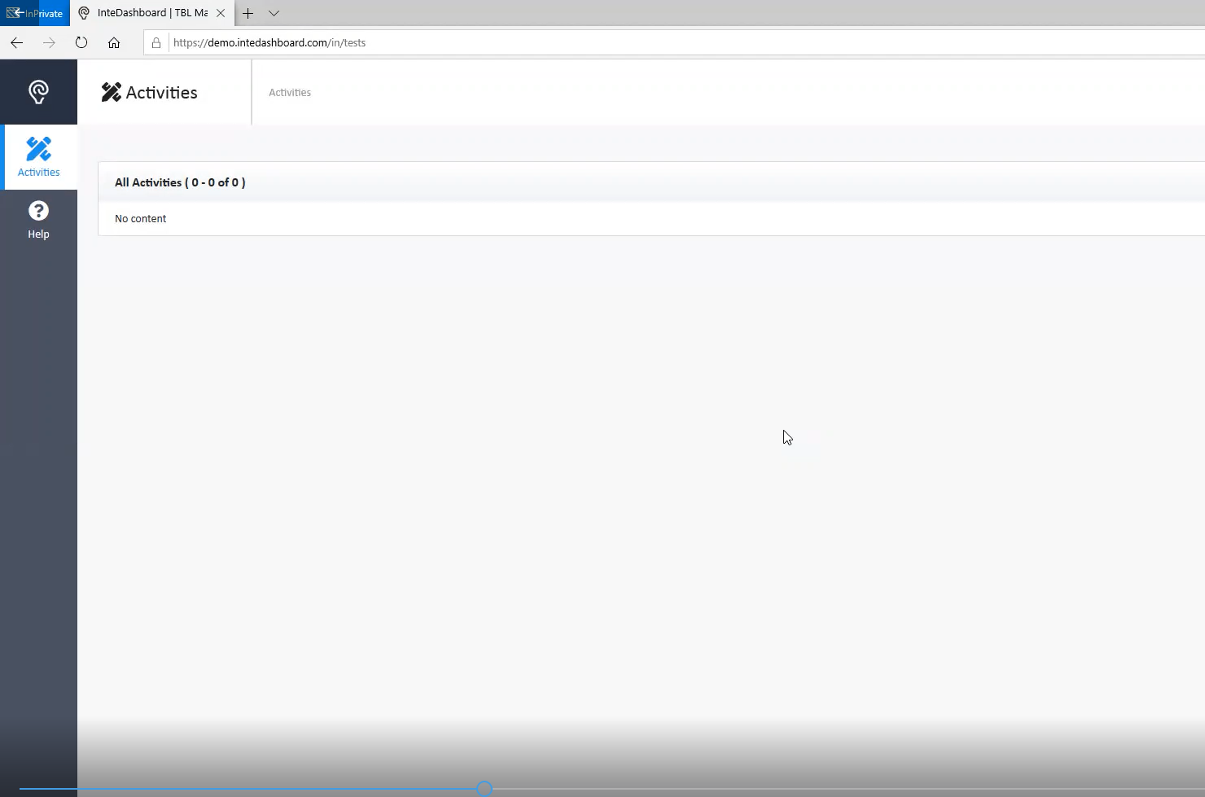
Log in to InteDashboard
Open the link (available in the chat window) in your web browser: https://auth.intedashboard.com/express-sign-in/23725348
Enter your name
If your browser closes or restarts, type in the same exact name again
Notes:
COURSE ID: 23725348

Slide 5



Getting ready for fall 2020
Isolation
https://www.who.int/health-topics/coronavirus#tab=tab_1
https://www.govtech.com/education/k-12/hawaii-schools-to-spend-72m-on-devices-online-learning
Covid -19
Everyone
Online
https://media.wfmynews2.com/assets/WFMY/images/f6eca663-1f1e-441a-bd02-92fb15989a0e/f6eca663-1f1e-441a-bd02-92fb15989a0e_1920x1080.jpg

Slide 6
Situational Factors
Complex Content
Large Lecture
Fully Online
>30
100+
250
synchronous
asynchronous
connectivity
participation
Diverse Learners
multiple majors
multiple class years
pre-college exp.
study skills
new vocabulary
lots of content
not enough time
Launch Poll Everywhere
Pollev.com
drsarahaarri446
Notes:
https://pollev.com/drsarahaarri446

Slide 7
What is Team Based Learning?
“TBL is an extraordinary form of small-group learning – both effective and fun.”
“It harnesses the power of teams and social learning combined with accountability structures and systematic instructional sequences to let you achieve powerful results.”
“TBL can and will transform you as a teacher, transform your students, and bring more fun, energy, and deep learning to your classroom than you may have every thought possible.”
Quotes from Chapter 1: Introduction to Team-Based Learning; Getting Started with Team-Based Learning by Jim Sibley and Peter Ostafichuk

Slide 8
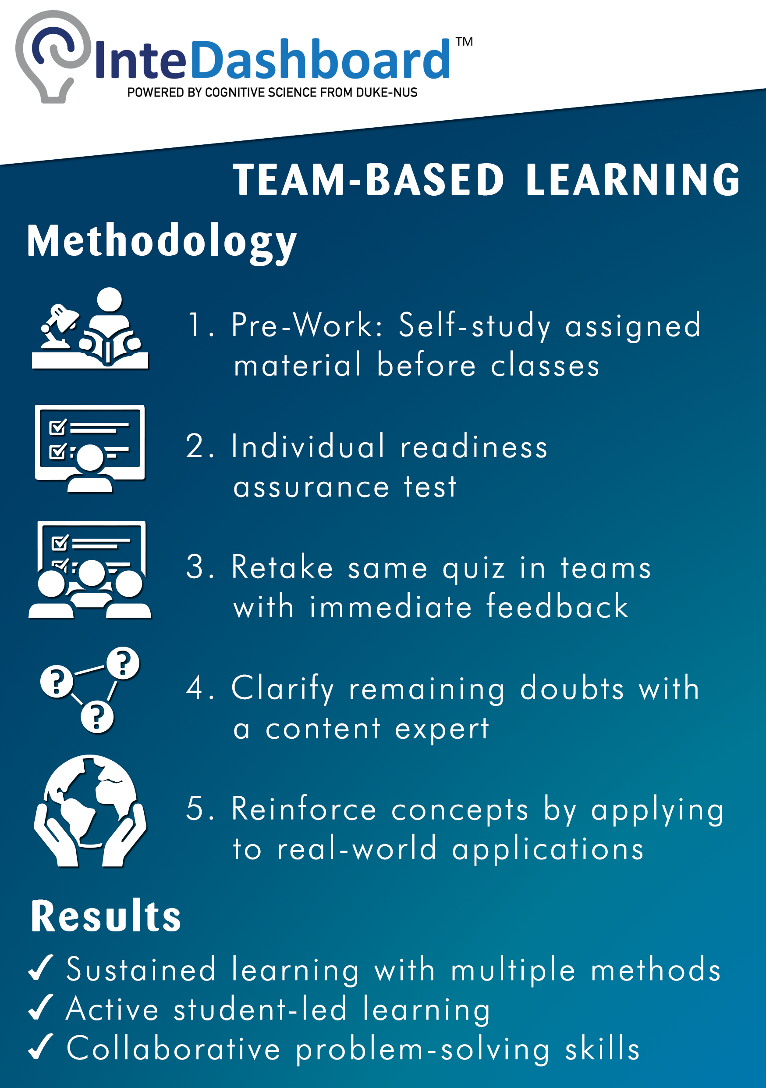
What is Team Based Learning?
In class: theory
In class: apply
1. Pre-work
2. Individual Readiness Assurance Test (iRAT)
3. Team Readiness Assurance Test (tRAT)
4. Clarify
doubts
5. Team applications
360° teammate peer evaluation
https://trainingmag.com/sites/default/files/soapbox-janesengraphic2_0.jpg

Slide 9
Creating Effective Teams
What is the optimal team size?
What’s the best way to structure a team?
  Student selected
  Random assignment
  Intentionally constructed
Intentionally Constructed Diverse Teams
Prior college experience
Major
Class year
Socioeconomic status/background
Race
Gender
Extracurricular involvement
Launch Poll Everywhere

Slide 10
Team Introductions, Week 1 Day 2
Team Contract
Team Accountability Form
Each team works through a series of questions to get to know each other and to set expectations for every member of the team.
Jamboards are great for creating space for students to share their thoughts.
A representative from each team will then come together and create a single evaluation form that will be used by everyone in the course.
Google forms are a great tool for this.

Slide 11
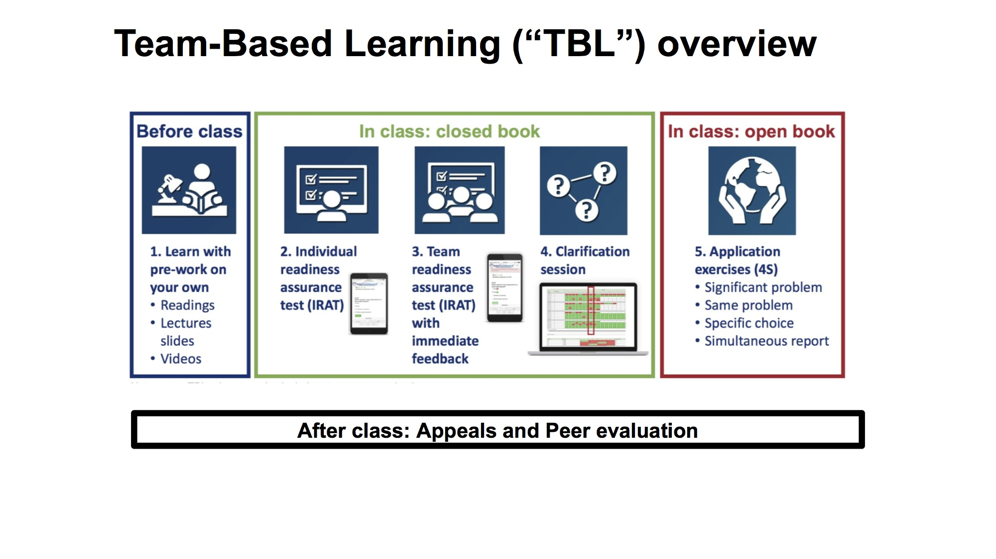
TBL: Step 1 - preparation
Guiding students to become independent learners is the goal of this step.
Instructors need to be mindful to not over assign “before class work” as this can cause students to become overwhelmed and lose confidence in their ability.
These learning assignments should focus on introducing the key concepts.

Slide 12
Pre-Class Preparations
Traditional TBL
Modified Version
Students are assigned readings, pre-recorded lectures, and/or homework problems to introduce new material
NOTE: no formal live lecture is given.
At the start of a new unit I give a live lecture on Zoom, focusing on topics where students routinely struggle.
Pre-recorded lectures are provided to cover the topic in full.
Assigned reading and homework are also provided.

Slide 13
TBL: Step 2 – Readiness Assurance Tests

Slide 14
TBL In-Class Work Day 1
iRAT/tRAT
AsULearn Setup for iRAT/tRAT
RAT – Readiness Assessment Test
  i = individual
  t = team
10 – 15 multiple choice questions
Question level should assess that the student has read the material and has a basic understanding of the key concepts.
Tool = quiz feature
Timed to 10 minutes
All students receive the same questions in the same order
Copy the iRAT to create the tRAT
Put student teams in breakout rooms.
Assign a “scribe” to submit the team’s answers for the quiz

Slide 15
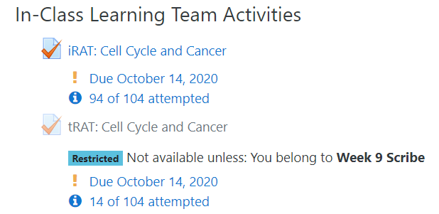
TBL In-Class Work Day 1
To set up scribes for a given week, simply create a new group under “users” in AsULearn.
For the tRAT set the restrictions so that only the scribe for that week can access the quiz.
Using the breakout rooms in Zoom, the students have the opportunity to work with a specific group of students each week. They build trust amongst each other and the goal is that as the semester progresses they will engage in deeper discussions.

Slide 16
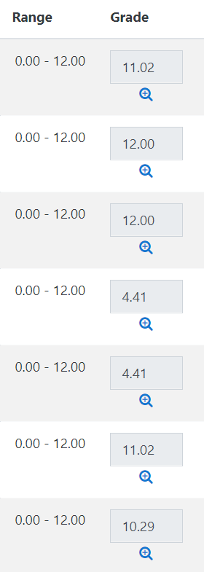
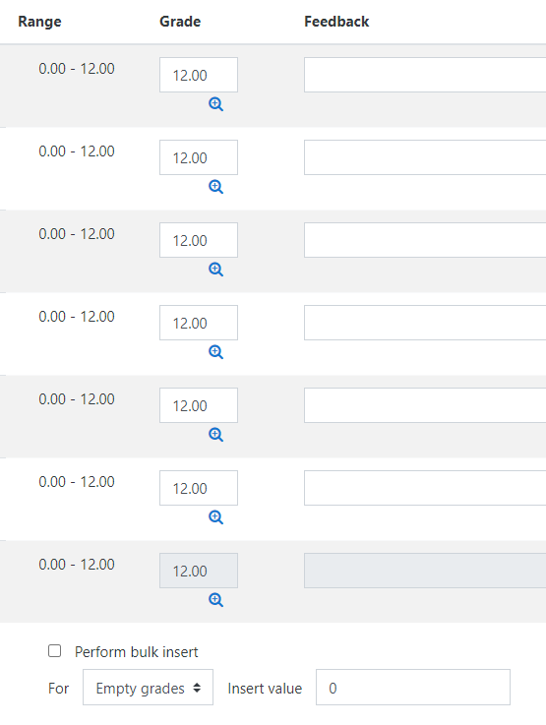
TBL In-Class Work Day 1
Example of iRAT Scores
Example of tRAT Scores
This team’s average was a 77.6% if we look at the individual scores.
Working together, they earned a 100% on the same quiz.
The hope is the students who grasp the material assist those who were struggling.
Once all teams have completed the tRAT, we all meet back in the main room in Zoom and we go over the tRAT together and clear up any misconceptions.
I’ve learned that all teams earning a 100% doesn’t mean they fully understand the material.

Slide 17
TBL: Step 3 – Application Exercises
This is the heart of TBL!
Case studies are great for this exercise.
Challenges: keeping the activities connected to the content/learning objectives in a way that the students see the connection and benefit of doing the exercise.
Benefits: deep learning and exchange of ideas between students.

Slide 18
TBL In-Class Work Day 2
The 4S Approach (the ultimate goal…I’m not fully here yet)
The application problem has to be significant
All teams get the same problem
Each team has to make a specific choice to solve the problem
All teams report their results simultaneously
Have fun with this and allow students to see themselves as professionals in the field solving real problems.

Slide 19
TBL In-Class Work Day 2
AsULearn Tools
Resources for Application Problems
Book – great for presenting information in a way students can easily navigate.
H5P – also great for presenting information; does report to the grade book.
Quiz – allows each team to submit their answer, set up is the same as for the tRAT
National Center for Case Study Teaching in Science
HHMI|Biointeractive
Some textbooks

Slide 20
So, have we had fun, deep learning, & powerful results??? You bet!!
We have been NASA scientists exploring if life is possible on Mars.
We have determined the impact of our cell membrane transporters going on strike.
We have investigated the role of p53 in cell cycle regulation and its role in cancer development.
“I really like that we work in small teams. It’s nice to be able to talk to other students in the class and discuss what we are learning.”
- Student, F’20
“I feel like a part of the classroom community even if I am on zoom. I feel safe sharing my thoughts and I feel supported in my learning by you and some of my classmates.” Student, Sp’22

Slide 21
So, have we had fun, deep learning, & powerful results??? You bet!!
Summative assessments to date show that the reduction in live lecturing on material has not had a negative impact on student scores.
Time will tell if TBL will lead to a higher test score averages over the course of the semester.

Slide 22


Implementing TBL in the Classroom
 | Apps Needed | Ease of Use | Cost
LMS | Many: Quiz Tool, Assignment Tool, Google, VT, Etc. | Depends: lots of set up, difficult to update in real time Students: easy to use, familiar with tools | No cost to students, everything is within the LMS
InteDash-board | One, this is an all-in-one platform: iRAT, tRAT, Application, 360 evaluation | Moderate, learning curve for faculty, most students pick up pretty quickly | Cost about $26/student; covers all courses in that semester

Slide 23
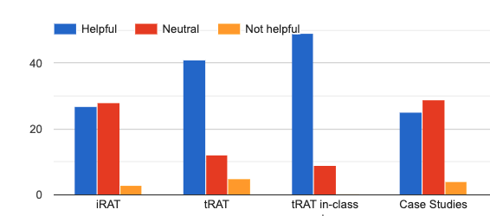
Here Is What The Students Have To Say
Mid-Semester Survey Sp’22 (n=58)
Question Posed:
Indicate how useful you have found the following TBL activities in your learning of the material this semester.

Slide 24
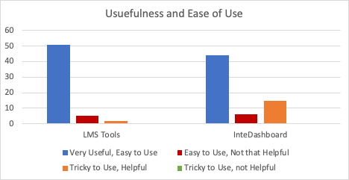
Here Is What The Students Have To Say
Mid-Semester Survey Sp’22 (n= 58)
“I do feel like I am apart of the classroom community, our conversations and my conversations with my team are always nice!”

Slide 25
This all sounds great, right?
But how do I fit this into my course?
I’m glad you asked. Let’s talk about that.

Slide 26
How I have fit TBL into BIO1801
 | Tuesday | Thursday | Sunday
Weekly Schedule Opt. 1 | Independent learning: Assigned chapter readings Pre-recorded lectures In-Class Activities: iRAT/tRAT Review “RAT” as a class | Independent Learning: Homework due In-Class Activities: TBL Significant Problem | Learning Assessment: Weekly KDA due (open Thursday after class) Prep Work: Readings, pre-recorded lectures
Weekly Schedule Opt. 2 | Independent learning: Assigned chapter readings Pre-recorded lectures In-Class Activities: Lecture on challenging concepts | Independent Learning: Assigned chapter readings In-Class Activities: iRAT/tRAT Review “RAT” as a class OR TBL Case Study | Learning Assessment: Weekly KDA due (open Thursday after class) Prep Work: Readings, pre-recorded lectures

Slide 27
Now It’s Time for YOU to Experience Team-based Learning with InteDashboard
Readiness Assurance Tests

Slide 28
Getting Help
Two windows: Zoom and InteDashboard
Refresh: Click on the link and refreshing browser solves most issues
Browsers: Chrome preferred
Help: Type in a request for help in the chat
If the iRAT doesn’t work: You can still join the team activities

Slide 29
Login to InteDashboard
Open the link (available in the chat window) in your web browser: https://auth.intedashboard.com/express-sign-in/23725348
Enter your name
If your browser closes or restarts, type in the same exact name again
Notes:
COURSE ID: 23725348

Slide 30
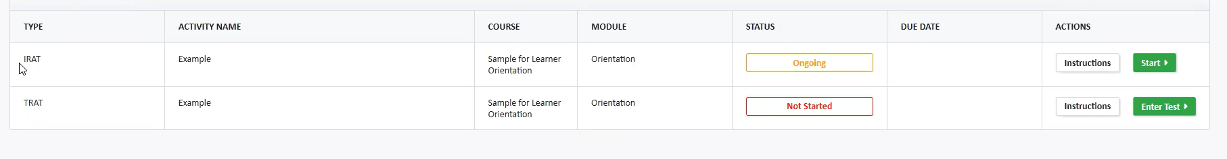
IRAT 1: Click ‘Start’ to start the IRAT
Once I start the iRAT, you will have 2 minutes to complete it.

Slide 31
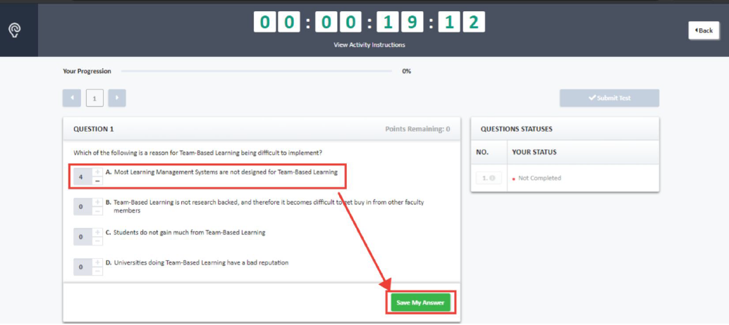
iRAT 2: Allocate all the points to a single answer choice by clicking the + button if you are 100% confident of your answer choice and then click ‘Save My Answer’

Slide 32
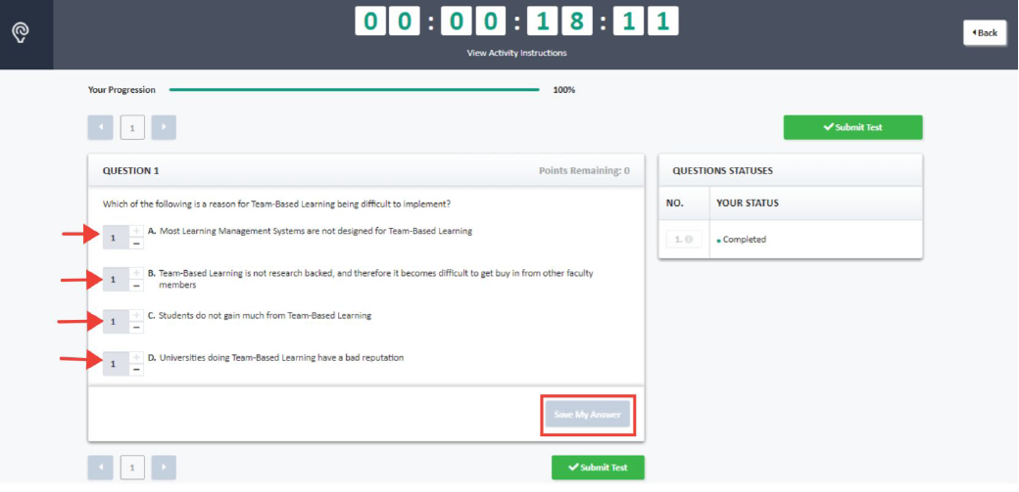
iRAT 3: If you are not sure of your answer choice, spread your points among the answer choices that you are deciding between

Slide 33
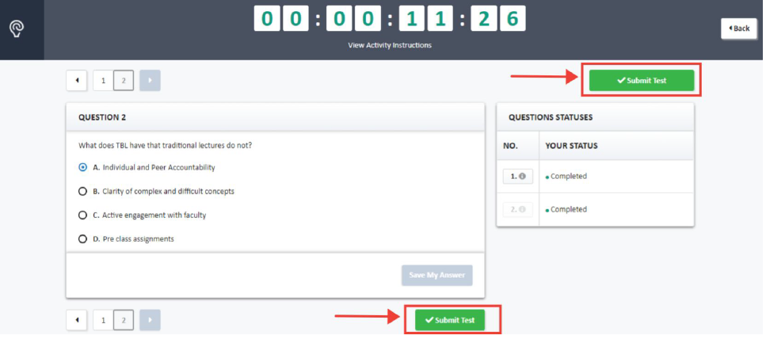
iRAT 4: Click Submit when finished

Slide 34
Now Let’s Try a tRAT
We will be using the Zoom breakout rooms. Please join when prompted.
You will have 5 minutes to complete the tRAT with your team.

Slide 35
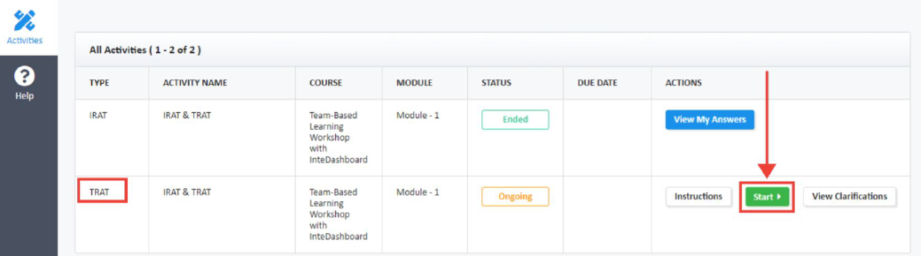
tRAT 2: Click the ‘Start’ to start the tRAT

Slide 36
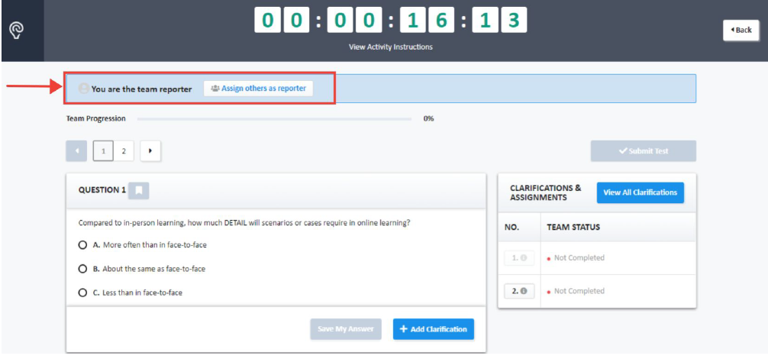
tRAT 3: Assign a team reporter to respond on behalf of the team

Slide 37
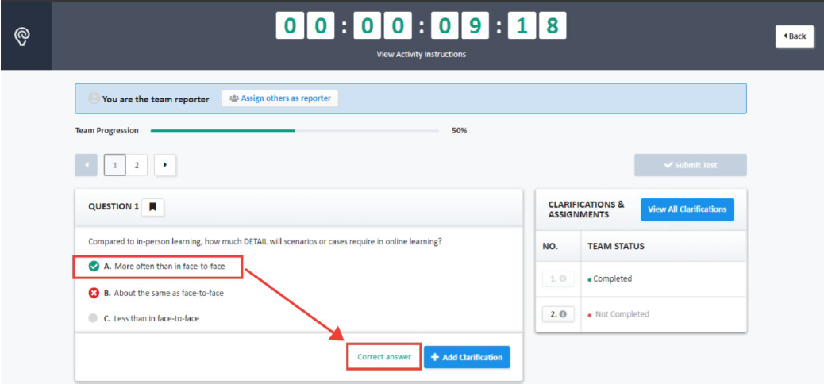
tRAT 4: Agree on a common team answer and have the team report respond for the team
Continue to attempt answers until you arrive at the correct answer.

Slide 38
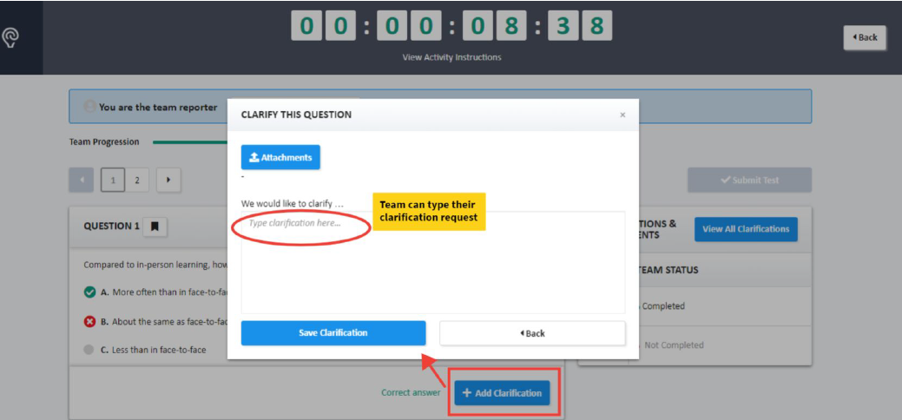
tRAT 6: Click ‘+ Add Clarification’ to request clarifications if needed

Slide 39

tRAT: Enter Zoom breakout rooms and introduce yourself to your team members
Please have your cameras turned on and unmute so you can interact with your team.
Hint:
If you don’t see the invite – try minimizing other apps, sometimes the box gets hidden OR you can always exit the Zoom meeting and come back in

Slide 40
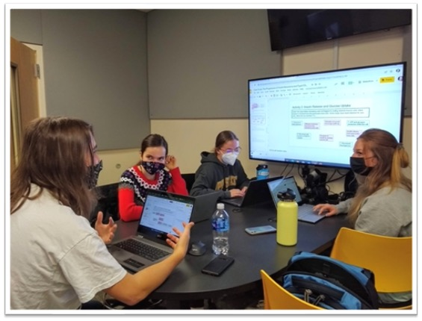
Thank You for Joining Us Today!
Questions and Feedback Welcome
Presenter Contact Information
Sarah A. Arrington
arringtonsa@appstate.edu
Appalachian State University

Slide 41

Additional Resources
Team Based Learning Collaborative
InteDashboard
Recommended Books
  Getting Started with Team-Based Learning, by Sibley and Ostafichuck 2014
  Team-Based Learning: A Transformative Use of Small Groups in College Teaching, by by Larry K. Michaelsen, Arletta Bauman Knight, et al. 2004

