Slide 1

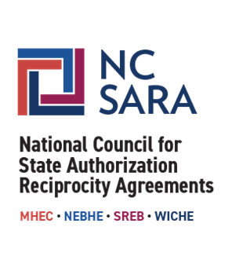
SARA: Updates and Resources
For SARA-Participating Institutions
Marianne Boeke, PhD, President, NC-SARA
Rachel Christeson, PhD, Director, Research & Data Analysis, NC-SARA
November 5, 2024
Notes:
MB

Slide 2
What is SARA & NC-SARA
NC-SARA Resources
SARA Policy Modification Process
SARA Developments
SARA Data & Changes for 2025
U.S. Department of Education
AGENDA
Notes:
MB

Slide 3
What is SARA & NC-SARA
Notes:
MB

Slide 4
What is SARA?
State Authorization Reciprocity Agreements (SARA) is an agreement amongst member states, districts, and territories that establishes comparable national standards and streamlines regulations, fees, and approvals for institutions offering interstate distance education programs. More than 2,400 institutions in 49 member states, the District of Columbia, Puerto Rico, and the U.S. Virgin Islands all voluntarily participate in SARA.
What is NC-SARA?
The National Council for State Authorization Reciprocity Agreements (NC-SARA) is a private nonprofit organization [501(c)(3)] that in partnership with the four regional compacts coordinates the implementation of SARA nationally. NC-SARA supports, facilitates, and serves the regional compacts, the regional steering committees, the State Portal Entities, and SARA participating institutions.
Notes:
MB

Slide 5
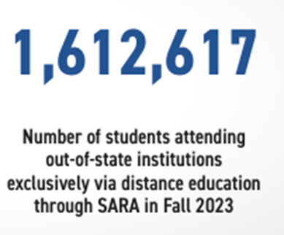
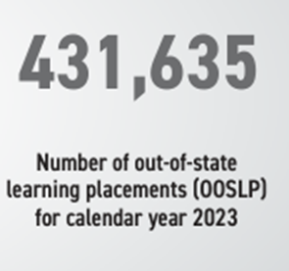
SARA Partners and Impact
Regional Compact Partners Students Served by SARA
MHEC – NEBHE – SREB - WICHE
States
52 States are members of SARA
State Portal Entities (SPE)
One SPE for each SARA member state
Regional Steering Committees (RSC)
One RSC for each Regional Compact
Institutions
More than 2,400 institutions participate in SARA
Notes:
MB

Slide 6
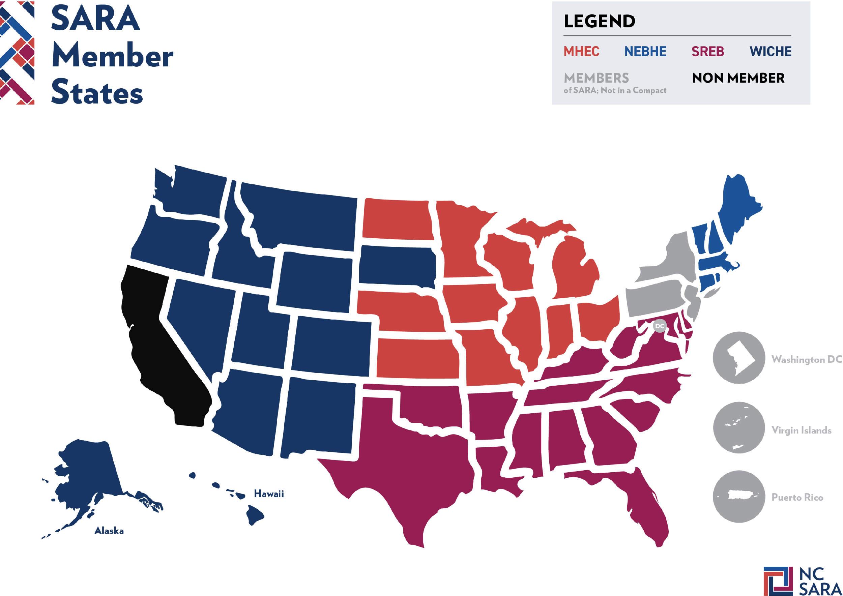
Notes:
MB

Slide 7
The Critical Role of the States
Oversight of education is a function of the state
  States have the authority to regulate institutions offering education within the state's boundaries
  The approval process is part of consumer protection for learners in the state
  Regardless of modality
Institutions must follow the state laws of the state where an institution’s activity takes place
Notes:
MB
State Portal Entity is the agency – you can find SPE on NC-SARA directory; always check with your SPE for state-specific guidance

Slide 8
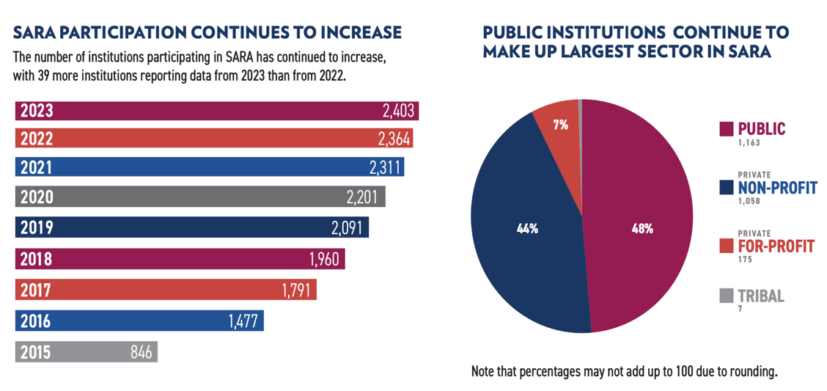
SARA Participating Institutions
Notes:
MB

Slide 9
NC-SARA Resources
Notes:
MB → RC

Slide 10
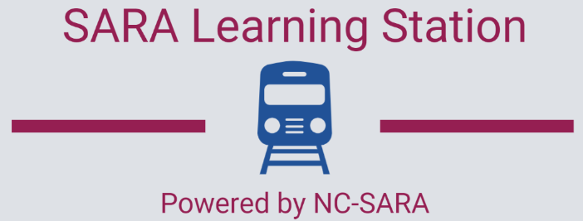
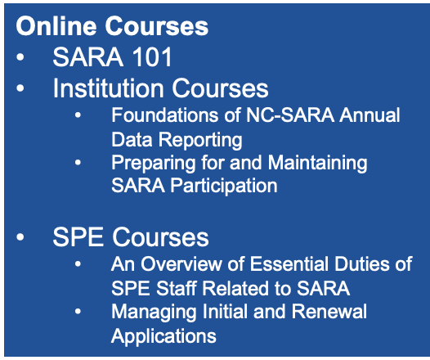
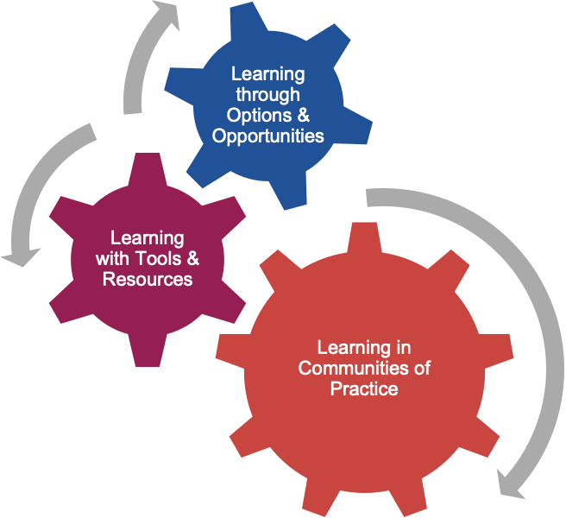
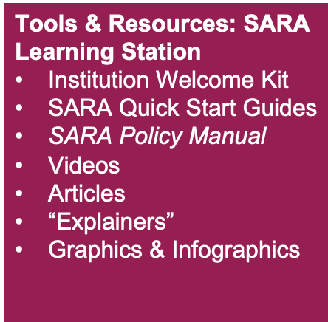
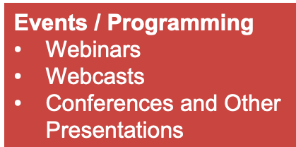
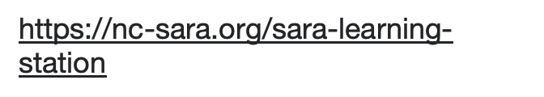
Notes:
RC

Slide 11
Recent and Upcoming Webinars
2024 SARA Policy Modification Process Wrap-Up: Results of NC-SARA Board Voting and Implications for SARA-Participating Institutions and State Portal Entities (November 19)
Department of Education Negotiated Rulemaking – Fall 2024 Update for the SARA Community
NC-SARA Annual Data Report Release
Specialized/Programmatic Accreditation: Ensuring Educational Quality
SARA's 10-Year Anniversary: A Decade of Opportunity
Visit our website to register in advance or to access the recording and materials afterward:
Webinars | NC-SARA
Notes:
RC

Slide 12

Annual Data Reporting
California Students
Field Trips
Institution Applications
Military Bases
Overseas Students
SARA Policy Modification Process
8. Professional Licensure
9. SARA Fees
10. SARA Late Fees
11. Short Courses
12. Student Complaints
13. Third Party Contracts
Notes:
RC

Slide 13
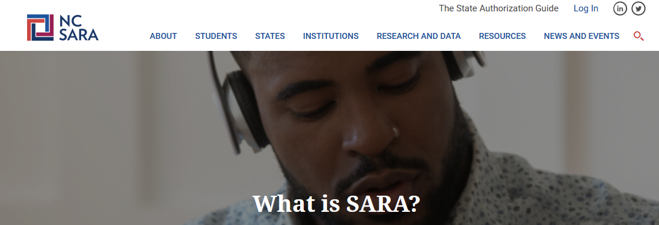
NC-SARA provides:
Professional Licensure Directory
State Authorization Guide
SARA Student Complaint information
SARA Cost Savings Calculator
SARA Participating Institution Directory
Notes:
RC
SARA Source!!!

Slide 14
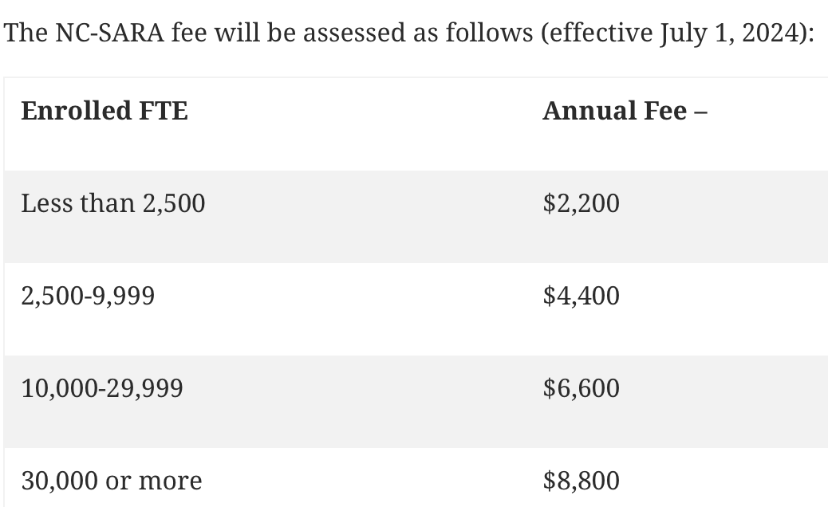

NC-SARA Participation Fees
Note – this is separate from and in addition to any fees
charged by the states for SARA participation
Notes:
RC

Slide 15
SARA Policy Modification Process

Slide 16

The process is - by design - open, transparent, and collaborative:
Supports strong public engagement by encouraging all stakeholders to propose policy changes and comment on proposals.
Provides a high level of transparency: policy proposals, comments, and voting results are all posted on a public portal.
Facilitates discussion and compromise through the amendment periods.
Notes:
MB

Slide 17
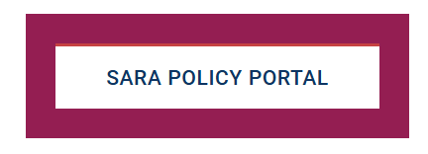
How to be more involved:
Submit a proposal – January 21, 2025
Review all proposals in the SARA Policy Portal
Participate in the SARA Public Forum
Participate in the Public Comments
Complete surveys on improvements to the process
Notes:
MB

Slide 18
SARA Policy Modification Process – Approved Proposals (2024)
Student Consumer Protections
  Clarifies that institutions that lose SARA participation must meet state-specific authorization requirements
  Aligns SARA policy with federal requirements regarding professional licensure
State Oversight
  Increases options for a state to place a SARA-participating institution on provisional status
  Requires public sharing of reason for a SARA-participating institution placed on provisional status
SARA Student Complaints
  SARA-participating institutions must provide SARA student complaint resolution policies on their website and in their catalog
  Improves SARA student complaint data collection and reporting to include complaint type and student location
Notes:
MB

Slide 19

Webinar!
2024 SARA Policy Modification Process Wrap-Up: Results of NC-SARA Board Voting and Implications for SARA-Participating Institutions and State Portal Entities
Date: Tuesday, November 19, 2024
Time: 11:00 AM to 12:30 PM Mountain Time
Register Today!
Notes:
MB

Slide 20
SARA Developments
Notes:
MB to RC

Slide 21

Current Areas of Work
Converting to eForms - starting with initial and participation renewal extension (AF1 & AF2)
SARA Institution Application
  new versions - 7/1/24, 1/1/25, 7/1/25 (expected)
  new policies require updates
  1/1/25 also includes updates to institution
“contact roles”
NC-SARA Institutional Advisory Committee
Notes:
RC

Slide 22

Future Areas of Work
CSV Upload Feature for Data Reporting
  Data is saved in a table structured format
SARA Portal Access for Institutional Contacts
Institutional Engagement
  Newsletter (late 2024 or early 2025)
  Survey (Q1 2025)
  Timely webinars
  Updated learning resources
Notes:
RC

Slide 23

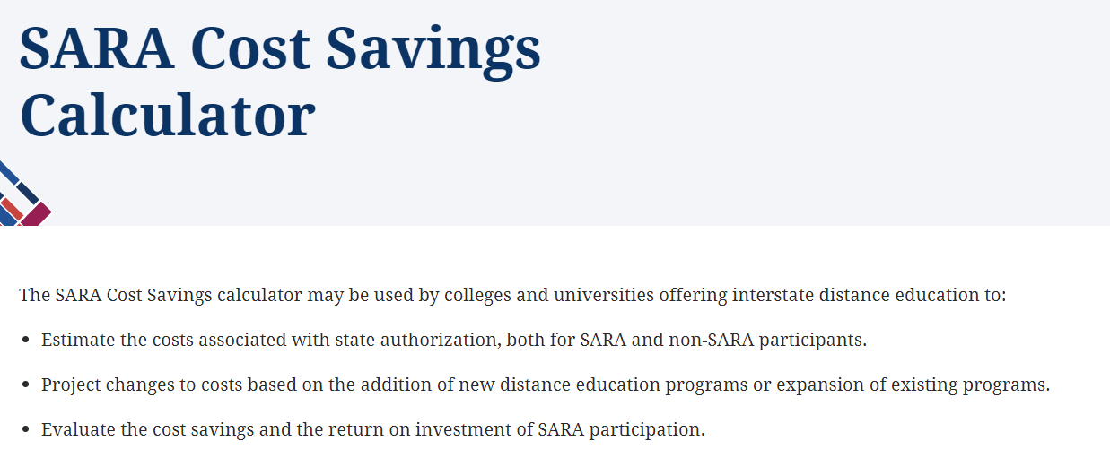
SARA Institution Cost Savings
2023 Estimated Renewal Savings by Region:
State | Number of SARA Member Institutions | Estimated Costs | State and NC SARA Costs | SARA Affiliation Fee | Estimated Savings
MHEC | 644 | $39,197,355 | $2,912,100 |  | $36,285,255
NEBHE | 344 | $35,764,100 | $2,683,563 | $100,000 | $32,980,538
SREB | 1,067 | $73,354,450 | $5,408,000 | $160,000 | $67,786,450
WICHE | 275 | $18,217,525 | $1,328,000 |  | $16,889,525
Grand Total | 2,330 | $166,533,430 | $12,331,663 | $260,000 | $153,941,768
https://nc-sara.org/sara-cost-savings-calculator
Notes:
RC - Update coming in 2025!

Slide 24
SARA Data
Notes:
RC

Slide 25

What is the SARA Data?
Exclusively Distance Education Enrollment (EDEE)
  Institutions report their exclusively distance education enrollments
  Report enrollments as you do to IPEDS (Fall EF report) – but disaggregated by state
  Includes in-state and out-of-state
Out-of-State Learning Placements (OOSLP):
  Report on-ground and online student OOSLP
  OOSLP Does NOT include In-State
Notes:
RC

Slide 26
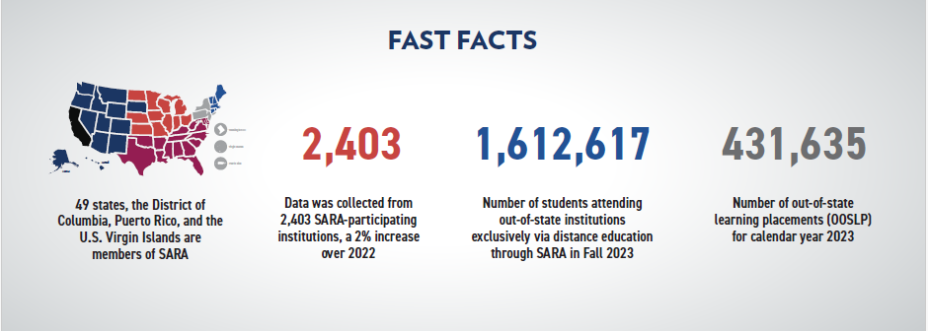
2023 Data Reporting
Explore the interactive data dashboards: https://nc-sara.org/data-dashboards
Notes:
RC

Slide 27
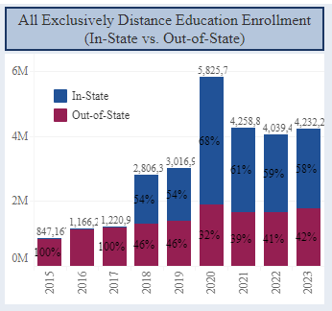
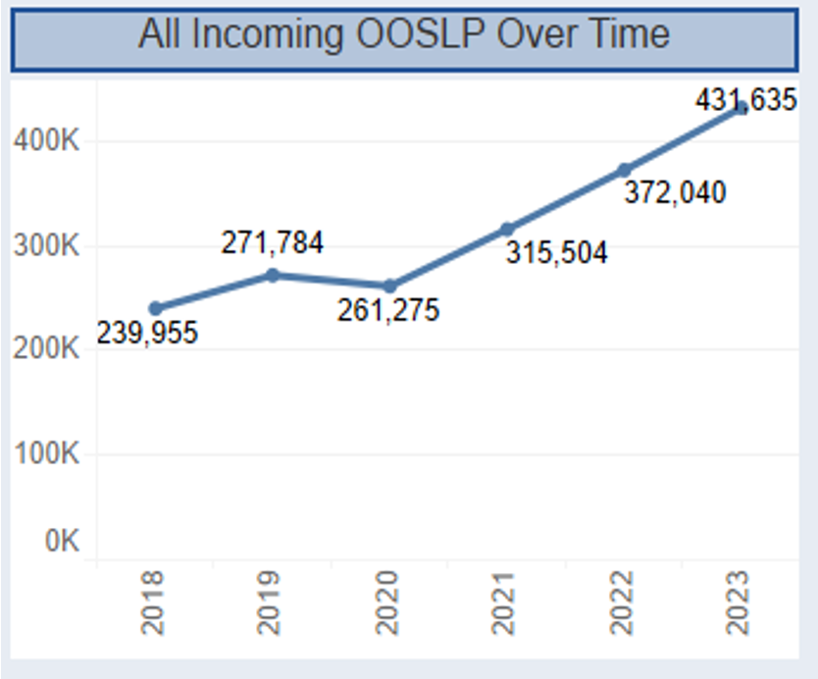
SARA Enrollment & Placement Trends
Notes:
RC

Slide 28
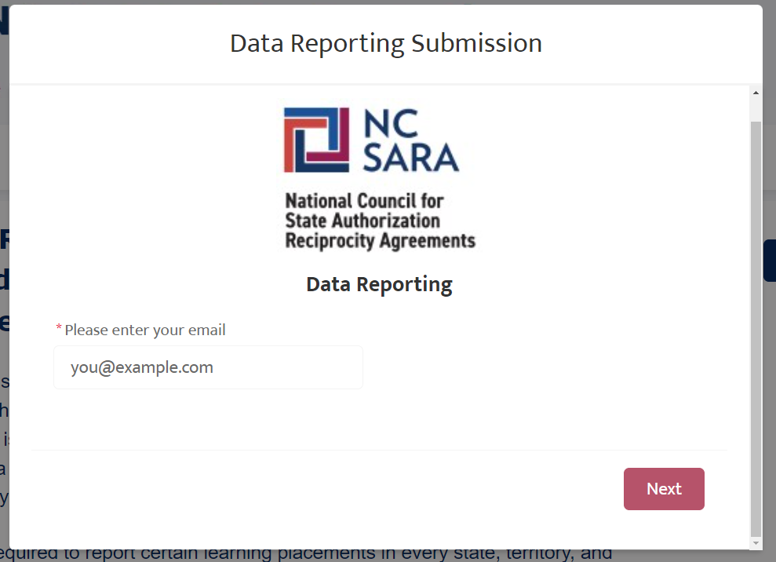
Changes for 2025 Data Collection
Contact Verification
  Only users assigned as an institutional contact in Salesforce will be able to upload data.
  Users not in Salesforce will need to be verified by a current Salesforce contact for their institution (then entered by NC-SARA staff).
  Data reporting portal will be one public link, rather than individual institution links.
  Contacts for multiple institutions will be able to select the institution to submit for.
Notes:
Rachel
UPDATE YOUR CONTACTS NOW!!

Slide 29
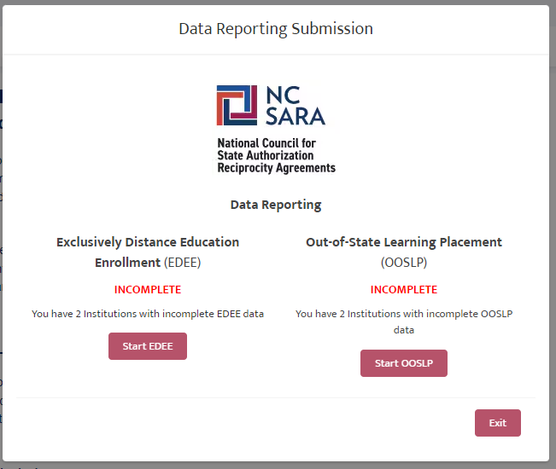
Changes for 2025 Data Collection
File Upload vs. Manual Entry
  Users will be provided with two templates to compile their EDEE and OOSLP data.
  Data will be upload in a .csv file, rather than manually entered in the web form.
  Institutions will be given the chance to confirm data and resubmit a file in case of errors.
  Confirmation emails will include counts and submitter name.
  Users will easily see when they have a submission outstanding.
Notes:
RC

Slide 30

























Huge Thanks to Our Pilot Institutions
Notes:
RC

Slide 31
Important Annual Data Reporting Dates
2023 Data Release: October 3 2024 webinar
2024 Annual Data Handbook Available: January 2025
2024 Annual Data Collection Webinar: February / March 2025
2024 Annual Data Collection Window: May 15 – June 15, 2025
Notes:
RC

Slide 32

U.S. Department of Education
Negotiated Rulemaking
Still on our radar
Notes:
RC → MB

Slide 33
Who is Working on Neg Reg?
Regional Compact Presidents (WICHE, SREB, NEBHE, MHEC)
NC-SARA Board & the Neg Reg Working Group
  Board Officers, regional compact president, regional compact staff, board members (attorney, SPEs), and NC-SARA staff
  Meet twice a month for the last year; review documents and discuss strategy
  This work may move to the NC-SARA Board Committee - Consumer Protection & Policy
White Board Advisors
A communications, research, and strategic consulting firm
Penn Hill
Extensive knowledge of what is happening in Washington, DC and the US Department of Education. Helping us strategize and inform our work around Federal Policy
Notes:
MB

Slide 34
What is the SARA Community Doing?
Working Group – Institutional Closures
  Teach out plan / teach out agreement
  Financial arrangements
  Records retention
SARA Narrative (White papers/blogs on a variety of topics)
  One pager on student consumer protections - New
  What is SARA Blog with SAN (November 2024)
  SARA Myth busting (February 2025)
  The Value of SARA (April 2025)
Collect, Review, and Disseminate Information
  Collect/share exclusively distance education enrollments trend data with SPEs - New
  Continue to gather data and information from SARA states and institutions on issues related to Neg Reg
Notes:
MB

Slide 35
Conversations, Communication, and Collaboration
  NC-SARA Board, regional compacts, SPEs, SARA participating institutions, HED organizations, and ED
  Webinars, attending meetings, e-blasts…
  Continue to share information, data, evidence with SARA Community (including ED).
Stay Informed!
SARA Call to Action Page - https://nc-sara.org/sara-neg-reg-call-action
Sign Up for SARA Updates - https://formstack.io/71987
Stay Tuned!
Notes:
MB

Slide 36

Questions and Discussion

Slide 37
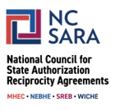
Thank You!
For NC-SARA questions please email:
info@nc-sara.org
NC-SARA Website: www.nc-sara.org

