Slide 1
Welcome to Pasta 401!
Bring your appetite for creating course alignment

Slide 2



Instructional Designer Team
University of Southern Indiana
Laura Cole
Online Learning Consultant
Larissa Cremeens
Instructional Designer
Yuhan Li
Instructional Designer

Slide 3
Introduction/Overview
At the end of this workshop, participants will be able to;
  Create and align measurable course and module learning objectives
  Discuss possible assessments aligned with identified objectives
  Discuss possible instructional materials aligned with identified assessments and objectives
Brief Context
  Online Course Development Program
  Phase 1: Curriculum Blueprint
  Faculty across colleges & disciplines

Slide 4


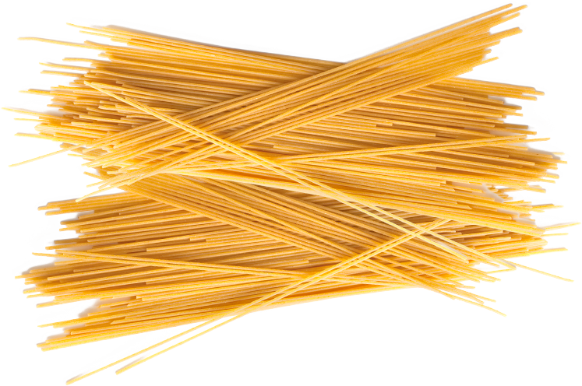
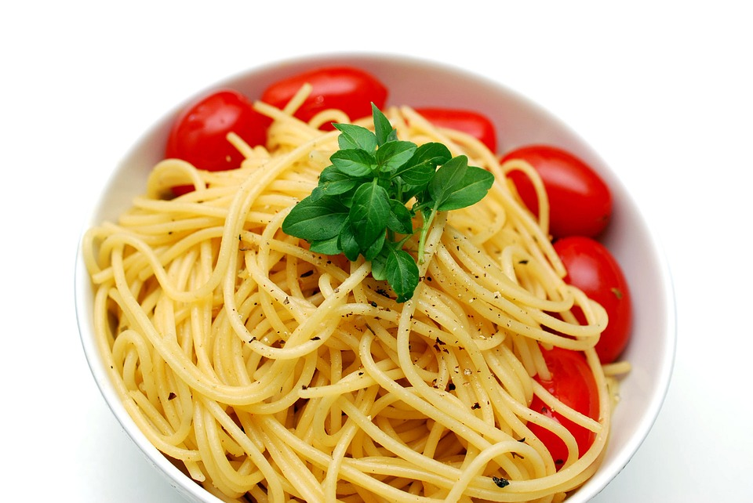
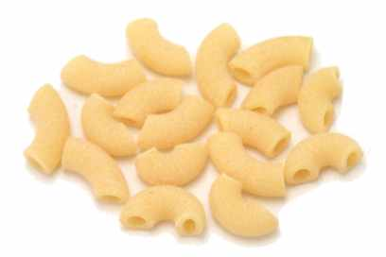
PASTA 401
This course introduces the fundamental aspects of pasta; its history, variety, production processes, and cooking instructions. Students will acquire basic knowledge about pasta, sauces, and cooking techniques. They will also demonstrate the acquired knowledge by making a pasta dish at the end of the course.
Notes:
So, imagine you are a professional chef who teaches in culinary school. You have been asked to teach the course PASTA 401. Take a moment to read the course description.
This course has not been taught before, so there is not previous syllabus, and nothing has been developed.
How would you get started developing the course?

Slide 5
Course Objectives
Notes:
If your first thought was to start writing the things you would like student to get out of this course, you are on the right track. Before you start driving, you usually determine your destination, and this is what we’ll do right now by drafting the objectives for your course.
I know some of you already have course objectives drafted already, and if that is the case, we would like to ask you to reflect on those objectives? Is that really want you want students to be able to do or know at the end of the course? Are those objectives updated? Is there anything missing?

Slide 6
Benefits of Starting with Learning Objectives
Faculty
Narrow your scope & focus
Guide your selection of instructional activities/ assessments/ materials/ technologies
Students
Clear purpose/ expectations
Direct & monitor their learning
Notes:
Before we wrap this up, I wanted to emphasize additional benefits you will find when you start the development process with the course objectives.
First, as a developer, having a clear outline of what you want to achieve will help you focus on what is important. You will be able to determine the things that you must have in your course, vs. what is good to have? For example, sometimes we let a textbook dictate what we are teaching, when instead we could select only the chapter that are aligned with our course objectives, and then add supplemental materials from other sources, and maybe use the rest of the textbook as optional materials. Sometimes you end up using a different book because you
Also, starting with the course objectives will guide your selection of instructional materials, assessments, practice activities, and even technology. For example, if one of your objectives is for students to deliver a professional presentation on a specific topic, then you want to include technologies in your course that will allow students to present professionally to an audience. If your objective is for students to be able to cook a specific pasta dish, then a quiz may to be the best assessment for this objective. It might be an assessment you will use to help students remember tips and techniques; but at the end of the day, you still need to have an assessment where students are actually going to be cooking.
And finally, learning objectives are also beneficial to your students, specially when you integrate the objectives throughout the course, because it clarifies the purpose of the activities for your students and your expectations as the instructor. It also helps students monitor their learning as they complete the course, because they can go back to make sure that they are learning what they are supposed to be learning.

Slide 7
Formula
Upon completion of this course, students will be able to
+
Action Verb
(avoid “know/ understand/ learn”)
+
Description of a behavior that can be measured or evaluated
Notes:
Also, here is a quick formula that will help you write or edit your course objectives. Again, you first want to think about what you would like students to be able to do or know at the end of the course. You got it? Great!
Now, try describing this it using an action verb. And the reason is because we want to be able to measure or evaluate all your objectives at the end of the course. In other words, if you say that students will be able to do x, y, and z after they complete the course, we need to be able to provide evidence that student did or did not do x, y, and z.
And that is why verbs like, know, understand, learn, are verbs that you want to avoid, since these are subjective. How can you be sure that your students understood what you explained to them? Well, they were able to explain it to me. Then, if that’s the case, “explain” is the verb you want to use here.

Slide 8
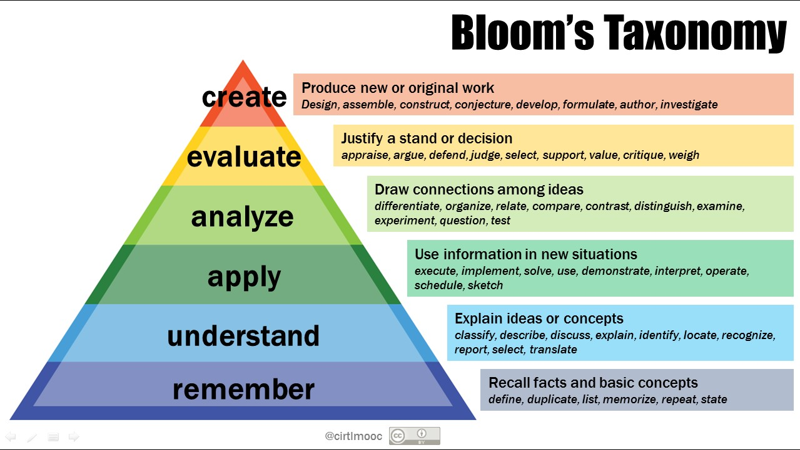
Blooms Taxonomy
Notes:
Something that might help you come up with action verbs for your objectives is Bloom’s taxonomy. This taxonomy was created by Dr Benjamin Bloom in 1965 to promote higher forms of thinking in education. He described different cognitive levels that students can achieve, starting from the lower levels, which are easier to teach, and usually easier to do, and going up to the higher levels that tend to be a little bit more complex, and hence require more time to teach and learn.
Whenever you are writing your learning objectives, try to think about the cognitive level you would like your student to reach, and use the action verbs included in that level. For instance, if you are teaching an introductory course, it is possible that you just want students to be able to talk about basic concepts, and maybe apply it. So it is recommended to use action verbs included in the apply, understand, and remember level.
Also remember that even though the taxonomy is organized by complexity, you don’t need to follow a particular order. If you want students to analyze something, and based on that analysis draw conclusions and come up with the basic concepts you want them to learn, you can do that. Remember that you are the learning designer here.

Slide 9
PASTA 401
This course introduces the fundamental aspects of pasta; its history, variety, production processes, and cooking instructions. Students will acquire basic knowledge about pasta, sauces, and cooking techniques. They will also demonstrate the acquired knowledge by making a pasta dish at the end of the course.
Notes:
Ok, so now let’s do a practice run! What would be a course objective for Pasta 401? Post a comment with your response
Group work: design course objectives and share

Slide 10

Other Tips
Clear
Allows learners to easily grasp the meaning
Avoid educational or discipline jargon
Notes:
Now, if we are using the objectives to also clarify for the students the purpose of the activities and your expectations as the instructor, make sure that whenever you write your objectives you use words that will allow students to easily grasp the meaning. Try to write your objectives as clear as possible, and avoid the use discipline related terms that have not been explained.
It is usually a good practice to have somebody who is not in your field of study, read the objectives and give you feedback.

Slide 11
Your Turn
As a group, draft your Course Objectives
Share
Notes:
So, what’s next?
Now you are going to start drafting the objectives for your course, and once you have a good draft, you can go ahead and submit those to the “Practice Course Objectives Discussion Board”. And the idea is for you to, not only submit those objectives, but take a look at other participants’ objectives and maybe provide feedback.
And please remember that if you feel ...umm..if you get stuck and you need help, we (your instructional designers) are here to help you, so feel free to contact us

Slide 12
Module Objectives
Notes:
If your first thought was to start writing the things you would like student to get out of this course, you are on the right track. Before you start driving, you usually determine your destination, and this is what we’ll do right now by drafting the objectives for your course.
I know some of you already have course objectives drafted already, and if that is the case, we would like to ask you to reflect on those objectives? Is that really want you want students to be able to do or know at the end of the course? Are those objectives updated? Is there anything missing?

Slide 13




Course Objectives
Notes:
After drafting your course objectives, you might be tempted to start developing the content for your class right away, but before you do too much, we would like you to identify, not only what a successful completion of your course would look like (in other words, your course objectives), but also, how you are going to get there. This is what we call module objectives.
Module objectives are the steps you need to take to get to your destination. These objectives are also measurable, but a lot more specific than your course objectives

Slide 14
Course Objectives Module Objectives
General
Describe what students will be able to do if they successfully complete the course
Specific
Describe what students will be able to do at regular intervals throughout the course.
Contribute to the achievement of the course objectives
Consistent
What
How
Notes:
Course: general overarching goals of the course
Module objectives: break down each major objectives into smaller components
Another way of looking at this is, the course objectives describe what you will do, and the module objectives describe the how you will do it. The how, always needs to be consistent with the what.

Slide 15
Example: PASTA 401
This course introduces the fundamental aspects of pasta; its history, variety, production processes, and cooking instructions. Students will acquire basic knowledge about pasta, sauces, and cooking techniques. They will also demonstrate the acquired knowledge by making a pasta dish at the end of the course.
Course Objective:
Differentiate various types of pasta and its cooking techniques
Notes:
Going back to our original example about the pasta course, I came up with this course objective.
Since the course description says that students will acquire basic knowledge about pasta, sauces, and cooking techniques, one of my course objectives is for them to be able to “Differentiate various types of pasta and its cooking techniques”
Now, if this is one of the course objectives, what are the steps students need to take to get there?
Post a comment to respond

Slide 16
Example: PASTA 401
Course Objective:
Differentiate between various types of pasta and its cooking techniques
Steps:
know different types of pasta according to the shape and color
know the different types of pasta based on the consistency, ingredients, cooking time, and flavor
know how to cook the pasta.
Notes:
In my case, these are some of the steps I identified. For students to be able to “Differentiate between various types of pasta and its cooking techniques” I want them to know different types of pasta according to the shape and color, they should also know the different types of pasta based on the consistency, ingredients, cooking time, and flavor; and they need to know how to cook the pasta.
Remember, these are not objectives, i am just brainstorming. Whenever you are trying to come up with these steps, just write whatever comes to your mind

Slide 17
Example: PASTA 401
Module Objectives
Identify five different types of pasta based on their shape and color
Compare five types of pasta based on its consistency, ingredients, cooking time, and flavor.
Describe the appropriate cooking process and techniques for five types of pasta.
Steps:
know different types of pasta according to the shape and color
know the different types of pasta based on the consistency, ingredients, cooking time, and flavor
know how to cook the pasta
Notes:
If I translate these steps into module objectives, i just need to make them measurable and specific. To do this I used action verbs, reworded some of my steps, and added a specific measure on the number of pasta types I would like students to learn.

Slide 18
Formula
Upon completion of this course/module/unit/week,
students will be able to
+
Action Verb
(avoid “know/ understand/ learn”)
+
Description of a behavior that can be measured or evaluated
Notes:
Again, whenever you write your module objectives, don’t forget the formula.

Slide 19
Blooms Taxonomy
Notes:
And you can always look at Bloom’s taxonomy to use actions verbs that align with the cognitive level you would like your students to practice or achieve.

Slide 20
Your Turn!
As a group, draft your module objectives
Align those module objectives to the course objectives
Share

Slide 21
Course Assessments & Instructional Activities
Notes:
If your first thought was to start writing the things you would like student to get out of this course, you are on the right track. Before you start driving, you usually determine your destination, and this is what we’ll do right now by drafting the objectives for your course.
I know some of you already have course objectives drafted already, and if that is the case, we would like to ask you to reflect on those objectives? Is that really want you want students to be able to do or know at the end of the course? Are those objectives updated? Is there anything missing?

Slide 22

Why Assess?
Where we want students to be
(Learning Objectives)
Where students are

Slide 23



Formative Assessment Summative Assessment
Monitor student learning
Provide ongoing feedback--improve the quality
Continuously throughout the course---low stakes
Check for understanding &
identify areas for improvement
Measure student learning
Evaluate the effectiveness of instruction--judge the quality
At the end of the instruction--high stakes
Gauge outcome toward learning objectives & benchmarks

Slide 24

“When the cook tastes the soup, that's formative assessment. When the guests taste the soup, that's summative assessment."
Paul Black

Slide 25
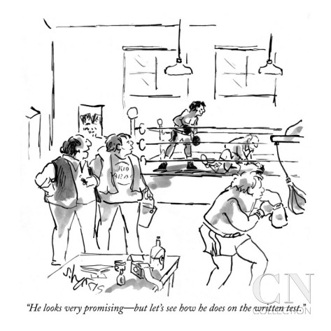
Apply To Your Course Design
Align Assessments with Objectives
“He looks very promising--but let’s see how he does on the written test.”
Balance Challenge and Support
Challenge
GROWTH
Support

Slide 26
Alignment
All module and course objectives must be assessed
Course Objective: At the end of this course students will be able to write a concrete, detailed, and realistic business plan based on a selected product or service.
Module Objective: At the end of this module students will be able to explain different ways of conducting comprehensive market research for their business plan
Final Project: Present & Submit Business Plan
Discussion 3: Way to learn about your target audience
Notes:
While you develop your course and determine your course assessment, please remember that all your module and course objectives need to be assessed. If you say that by end of the course students will be able to “write a concrete and detailed business plan, based on a selected product or service”, then you should have an assessment where students submit a business plan. A multiple choice test about the components of a business plan will not work in this case. You could use this test to see if students can list the components of a business plan, but to be able to assess this course objective, they need to actually write one.
If one of your module objectives is that students will be able to “explain different ways of conducting comprehensive market research for their business plan”, then you could have discussion where students talk about and explain the strategies they will use to learn about their target audience.
If you look at it from the accreditation perspective, if somebody asks you, show me that students “explained the different ways of conducting a market research”, you need to have the data available to prove that student met that objective.
Now, I have a question for you? Do you think the final project is also measuring the module objective in this case? Pause this presentation, and take a moment to think about this.
Ok, I also thought about it and I think it really depends on the assignment description. If as part of the business plan the instructor requires students to explain the methods they used to conduct their market research, then yes, the final project is also measuring the module objective. But if the students are only required to mention the methods they used and go straight to present their results and conclusions, then it is not aligned because they are not really explaining how they conducted the research.

Slide 27


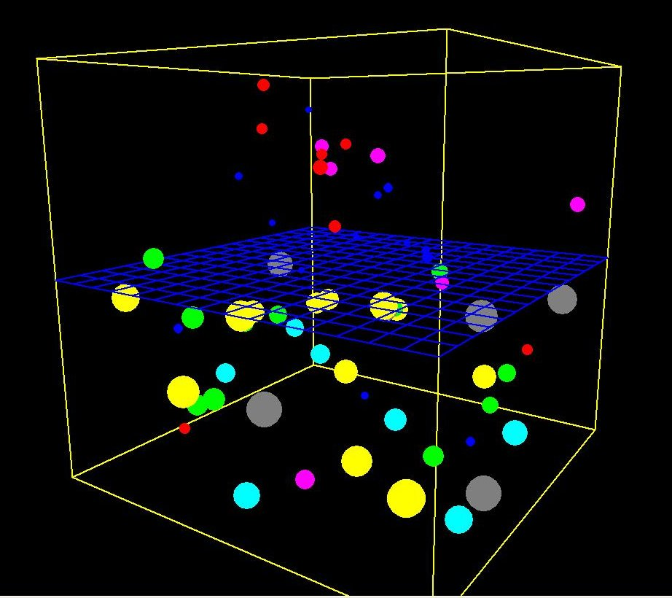



Instructional Activities
Notes:
The Instructional activities help students acquire new knowledge and practice the skills that will be assessed by the instructor later on. A few examples of instructional activities are when you ask students to read a chapter of a book, watch a lecture or a video, play with a simulation, play a game, complete a study guide, go on a virtual field trip, and so on.
Sometimes there is some overlap between formative assessments and instructional activities. For instance, a class discussion can be used to help student learn new content and also to give you an idea of whether or not they are understanding the new concepts you just introduced. But a chapter reading is an instructional activity but not a formative assessment because you are not providing feedback to students. If you add a quiz that is based on the reading, then the quiz itself, not the chapter reading, can be both an instructional activity and a formative assessment.

Slide 28
Additional tips
Include formative and summative assessments
Give students opportunities to practice without being penalized (Standard 3.5)
Include traditional and alternative assessments (Standard 3.4)
Make sure your instructional materials are current (Standard 4.4)
Provide a variety of instructional materials (formats, authors) (Standard 4.5)
Differentiate between required and optional materials (Standard 4.6)
Notes:
One of the things you will do for this module, is to start thinking about the assessments and instructional activities you will include in your course, and I wanted to give you a few additional tips before you start identifying them.
As we just mentioned, you want to have a good mix of formative and summative assessments
For the formative assessment and instructional activities, make sure that you give students enough opportunity for students to practice without being penalized. For example, you can include in your course non graded homework with answer keys, quizzes that they can take multiple times, a non graded draft for a major paper that they can submit to you for feedback, or a peer review activity. The point being that you create the opportunity and the environment for them to experiment and check for understanding, without having the fear that they are going to fail the class. You can refer to Standard 3.5 for more information.
You also want to mix it up a little bit. Sometimes we teach the same way we were taught when we were in school and get stuck with the same types of traditional assessments. Meaning, multiple-choice tests, true/false tests, short answers, and essays. I am not saying that these are not appropriate, but sometimes we do these because that’s what we think about when we hear the word assessments. Depending on the subject you teach, Alternative assessments such as projects, portfolios, exhibits, simulations, scenarios, experiments, group activities, are more suitable. QM suggest that you mix alternative and traditional assessments in your course. I am not going to go to deep on this, but I’ll post some optional articles if you are interested in the differences between traditional and alternative assessment. Also, you want to refer to standard 3.4 of the Quality Matters rubric.
Make sure the instructional materials you use for all the activities are current and updated. You know more than us, how fast your field changes. For some subjects, for example, a history course, it is appropriate to have old instructional materials, but in some fields you need to be changing your information almost every year. You can find more information on standard 4.4
You also want to have your instructional materials in a variety of formats, so not everything needs to be text based. Try to also include podcasts, or videos. And make sure that if possible, again, depending on the subject, you include different authors to give students different perspectives. You can find more information on standard 4.5
Finally, you always want to be very clear on what instructional activities and materials are required and which ones are optional. If all the materials are required, this should be stated. You can find more information on standard 4.6

Slide 29
Your Turn!
Think about the assessments and course activities that you will use for your pasta course
Map within the Course/Module Objective Table
Example
Notes:
What are your formative assessments and summative assessments?
What instructional activities will you provide to support students?

Slide 30
Wrap-Up
Reflect on Workshop Objectives
Create and align measurable course/module objectives
Discuss possible assessments aligned with identified objectives
Discuss possible instructional materials aligned with identified assessments and objectives
How can you apply what you’ve learned today?

