Slide 1

Harnessing the Power of Quality Matters in Crisis Transformation!
Channell Cook, M.S., M.S.
and
Laura Lane-Worley, Ph.D., LMSW, M.Ed.

Slide 2
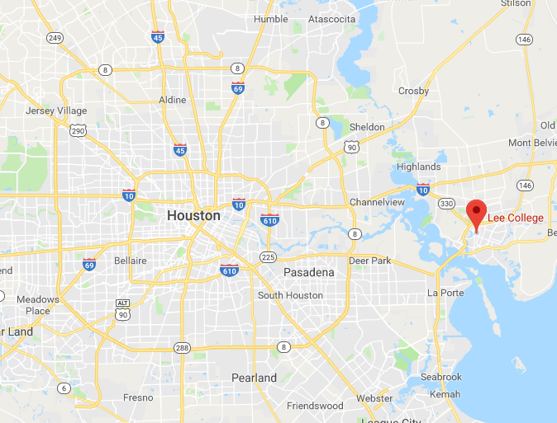
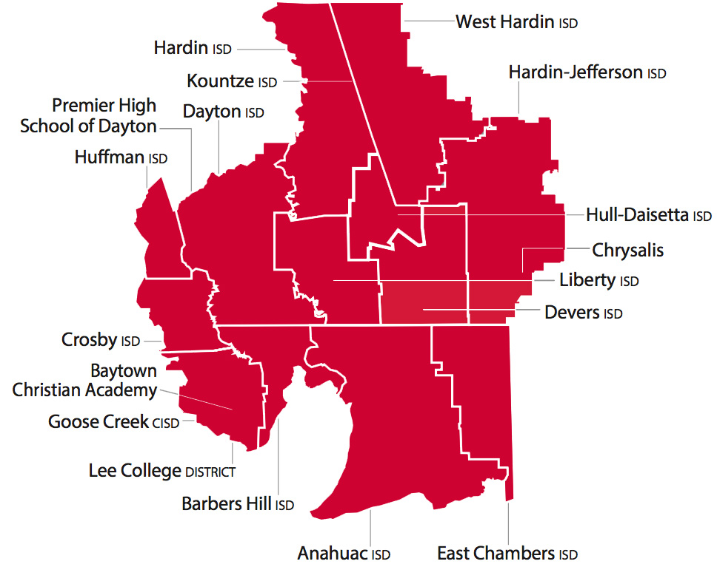
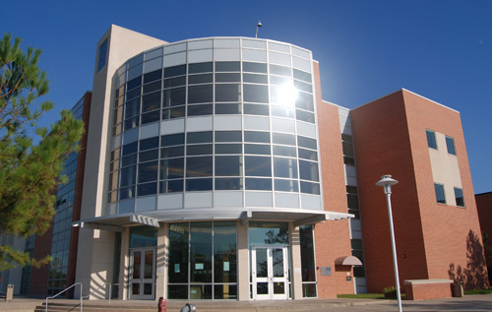

Lee College of Baytown Texas
Middle size comprehensive community college (8,000+ enrollment)
Offers Associate degree and certificate programs
  Associates in Arts
  Associates in Science
  Associates in Applied Science
  Certificates
Hispanic Serving Institution (H.S.I.)
Geographic Service Area of more than 220,000 residents

Slide 3
Pandemic Pandemonium
Emergency Training
Present
Future
On-Going Training
TOC Redevelopment
March 11, 2020
Five Days
80 hours
291 Faculty trained
33 TOC cohorts
55 Webinars
Countless individual training sessions
280 LC TOC Faculty
81 QM TOC Faculty
3 PRC
Cohort 5 QM TOC
15 PRC
Phase 2 TOC
Ongoing PD
Course evaluation
Distance Education (DE) Committee Recommendations
Timeline Acceleration
Adaptation for a Variety of Learners

Slide 4
Prior to the Pandemic
Community of Online Learning and Teaching
  Four Cohorts of QM Teaching Online Certified faculty
  Course redesign requirement
Vacant Instructional Designer position since August 2019
New College President January 2020
75% face to face classes
Requirement of class syllabi and gradebook for all classes in LMS
Instructional Continuity Planning Taskforce – March 11, 2020

Slide 5
Prior to the Pandemic
81 Quality Matters Teaching Online Certification
28 Locally trained – Teaching Online Certified
50 Blackboard trained only
300 faculty (dual credit, adjunct, Huntsville, full-time) with no training

Slide 6
Emergency Training
5 days, 80 hours, 291 faculty trained.
Essential training topics
  Blackboard Basics
  Blackboard Collaborate Ultra
  Advanced Blackboard Skills
Open Labs with QM-TOC facilitators
Adopted the Whatever it Takes Mantra

Slide 7
TOC Redevelopment
  Distance Education (DE) Committee and DE Handbook
    Changes were needed.
  Teaching Online – Voluntary with best practice recommendations
    Inconsistency in training.
  Emergency Response Taskforce Created
  Timeline Acceleration
  Adaptation for a Variety of Learners
  Increased focus on QM best practices

Slide 8
New TOC
  6 Week Timeline
  Team Facilitation
  Real Time Goals and Feedback
  Topics:
    Introductory and Course Expectations
    Learning Objectives
    Activities, Tools, and Technology
    Instructional Materials
    Assessment and Measurements
    Learner Support, Accessibility, and Usability.
  Campus Wide Mandate

Slide 9
On-Going Training
55 Webinars
  Training Team Included
    Librarians – QM TOC
    LMS Administrator
    Advising Team – QM TOC
33 Lee College Teaching Online Certification Cohorts
  Training Team Included
    14 Quality Matters Teaching Online Certified Faculty

Slide 10
On-Going Training
YouTube Channel
TOC Facilitator Training
Applying the QM Rubric
Quality Matters Peer Reviewer Course
Instructional Designers Join the Team September 2020

Slide 11
Present
Cohort 34 begins October 26th
Building relationship between faculty and new IDs
Continuing individual support for faculty
Significant administrative support for Distance Education
Faculty Professional Development Task Force

Slide 12
Future
5th Cohort of Quality Matters TOC faculty - Spring 2021
Team of 12+ Peer Reviewers
Internal Peer Review Process
Piloting Online at Huntsville
Ongoing professional development webinars
All Lee College teaching faculty must have an internal or nationally recognized Teaching Online Certification

Slide 13
Questions?

Slide 14
Contact Us
Channell Cook, M.S., M.S.
Faculty and Community of Online Learning and Teaching Coordinator
ccook@lee.edu
Laura Lane-Worley, PhD, LMSW, M.Ed.
Faculty and Distance Education Coordinator
llaneworley@lee.edu

