Slide 1

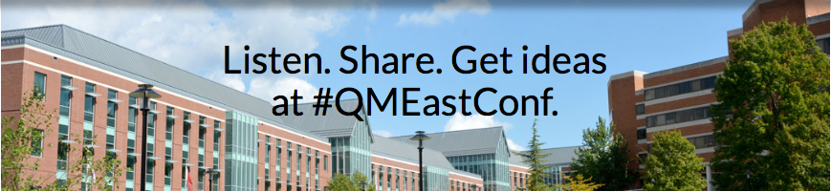
From 30 to 300 or 30,000 –
Scaling Up Does Not Bring Me Down
Notes:
Images Courtesy of Quality Matters Regional Conference Website

Slide 2

Notes:
Speaker’s Notes:
The University System of Maryland – edX Team
Paul Walsh
Julie Halick
Andy Cizek
edx.org/school/USMx
MicroMasters
Professional Certificates
MOOCs
Small, private
online courses
Image Courtesy of edX and USMx. URL Location: https://www.edx.org/school/usmx

Slide 3

Notes:
Speakers Notes:
Models for Quality at Scale: Traditional approach
One designer
One faculty member
Negotiated level of
responsibility
Unclear on quality
responsibility
Free Image Courtesy of: https://www.flickr.com/photos/wocintechchat/25926634151

Slide 4
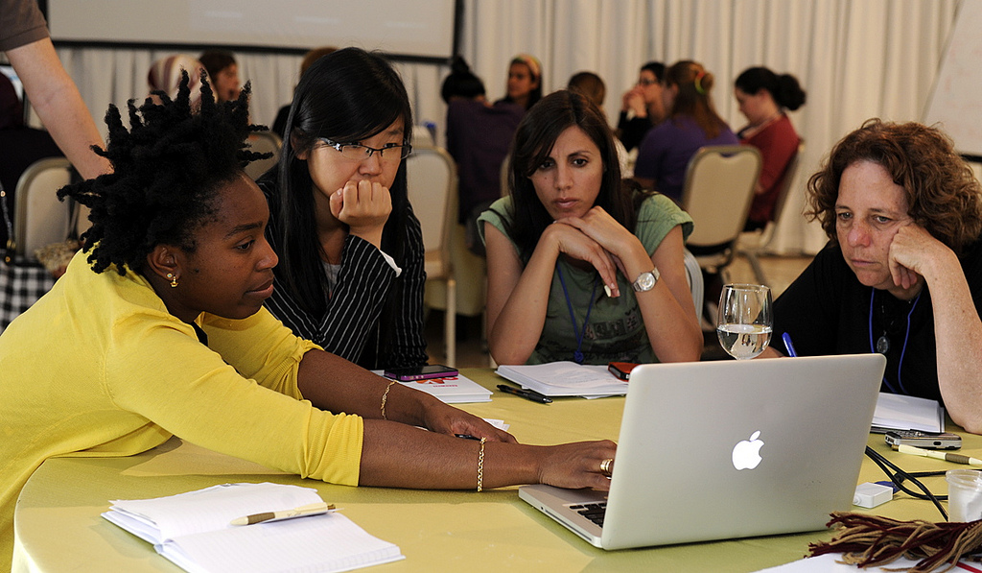
Notes:
Speaker’s Notes:
Models for Quality at Scale
Faculty
Department
Program
Full-time faculty
Adjunct faculty
Point-person?
Quality responsibility still unclear
Image: https://www.flickr.com/photos/usembassyta/7131937261

Slide 5
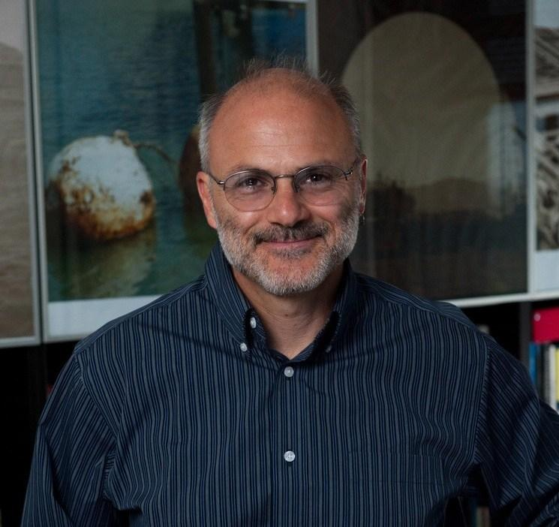
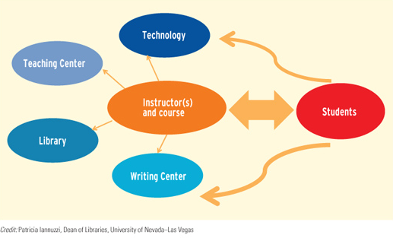
Notes:
Speaker’s Notes:
RANDALL BASS
EducauseReview, March 21, 2012
Disrupting Ourselves: The Problem of Learning in Higher Education
Images: https://er.educause.edu/articles/2012/3/disrupting-ourselves-the-problem-of-learning-in-higher-education
https://futures.georgetown.edu/team/randy-bass/

Slide 6
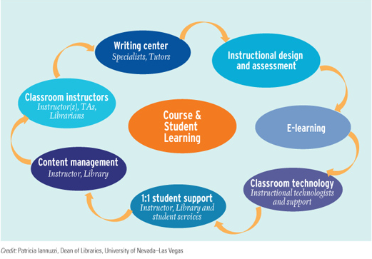
RANDALL BASS
Notes:
Speaker’s Notes:
RANDALL BASS
EducauseReview, March 21, 2012
Disrupting Ourselves: The Problem of Learning in Higher Education
Images: https://er.educause.edu/articles/2012/3/disrupting-ourselves-the-problem-of-learning-in-higher-education
https://futures.georgetown.edu/team/randy-bass/

Slide 7
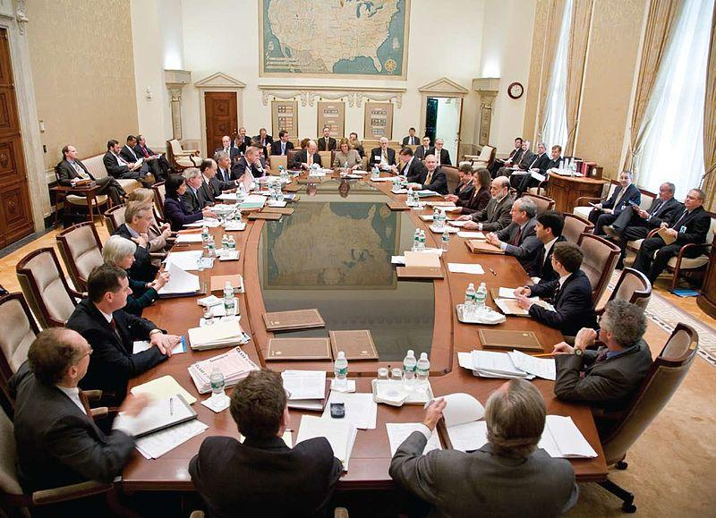
Notes:
Speaker’s Notes:
What we’re trying to avoid is decision by committee.
Image: https://commons.wikimedia.org/wiki/File:Federal_Open_Market_Committee_Meeting.jpg

Slide 8
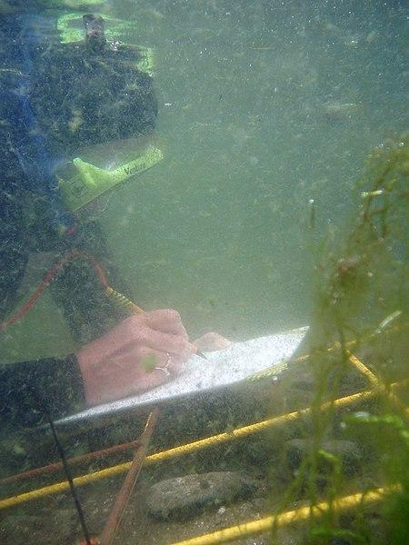
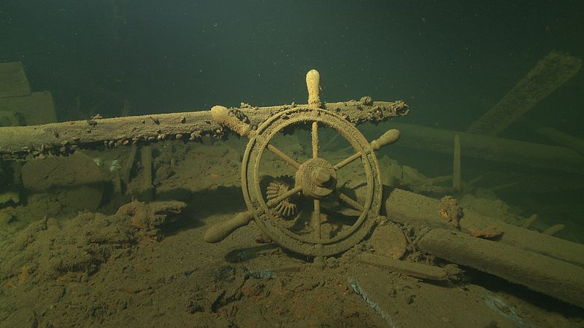
UNDERWATER ARCHAEOLOGY
Notes:
Speaker’s Notes:
Dream Team: who goes into your ideal overall course development team?
At your table, discuss what each of your roles would be if your institution was tasked with designing an underwater archaeology course.
(5 minutes for group discussion)
Images: https://commons.wikimedia.org/wiki/File:Kaubalaeva_%22E._Russ%22_vrakk.jpg
https://commons.wikimedia.org/wiki/File:Scale_drawing_underwater.jpg

Slide 9

Notes:
Speaker’s Notes:
When discussion responsibilities….Whose course is it anyway?
Who is responsible for content?
…for design?
...for accessibility?
...for marketing?
...for quality?
Image: http://thebluediamondgallery.com/r/responsibility.html

Slide 10
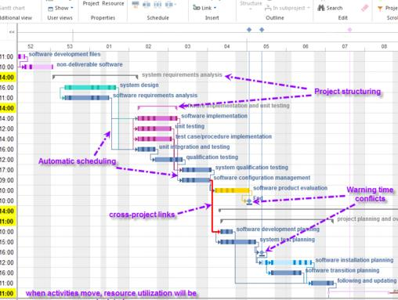
Notes:
Project Approach:
What are deliverables that the course team needs to prepare and document for?
Image: https://commons.wikimedia.org/wiki/File:Rillsoft-multi-project-gantt-chart.png

Slide 11

Notes:
Speaker’s Notes:
Don’t Let Quality Be Last:
With a larger Course Team and a more formal, project-approach, Quality Assurance should be at the table from the start.
Develop a quality process that is
everyone’s responsibility.
Image: https://www.pexels.com/photo/brown-rope-tangled-and-formed-into-heart-shape-on-brown-wooden-rail-113737

Slide 12
DECISION MAKING MODELS
Faster
Cheaper
Scale
Quality
Better
Interaction
VS
TRADITIONAL
COURSES AT SCALE
Notes:
Speaker’s Notes:
Comparing Business Quality model and Courses at Scale model.
Image created in PowerPoint

Slide 13
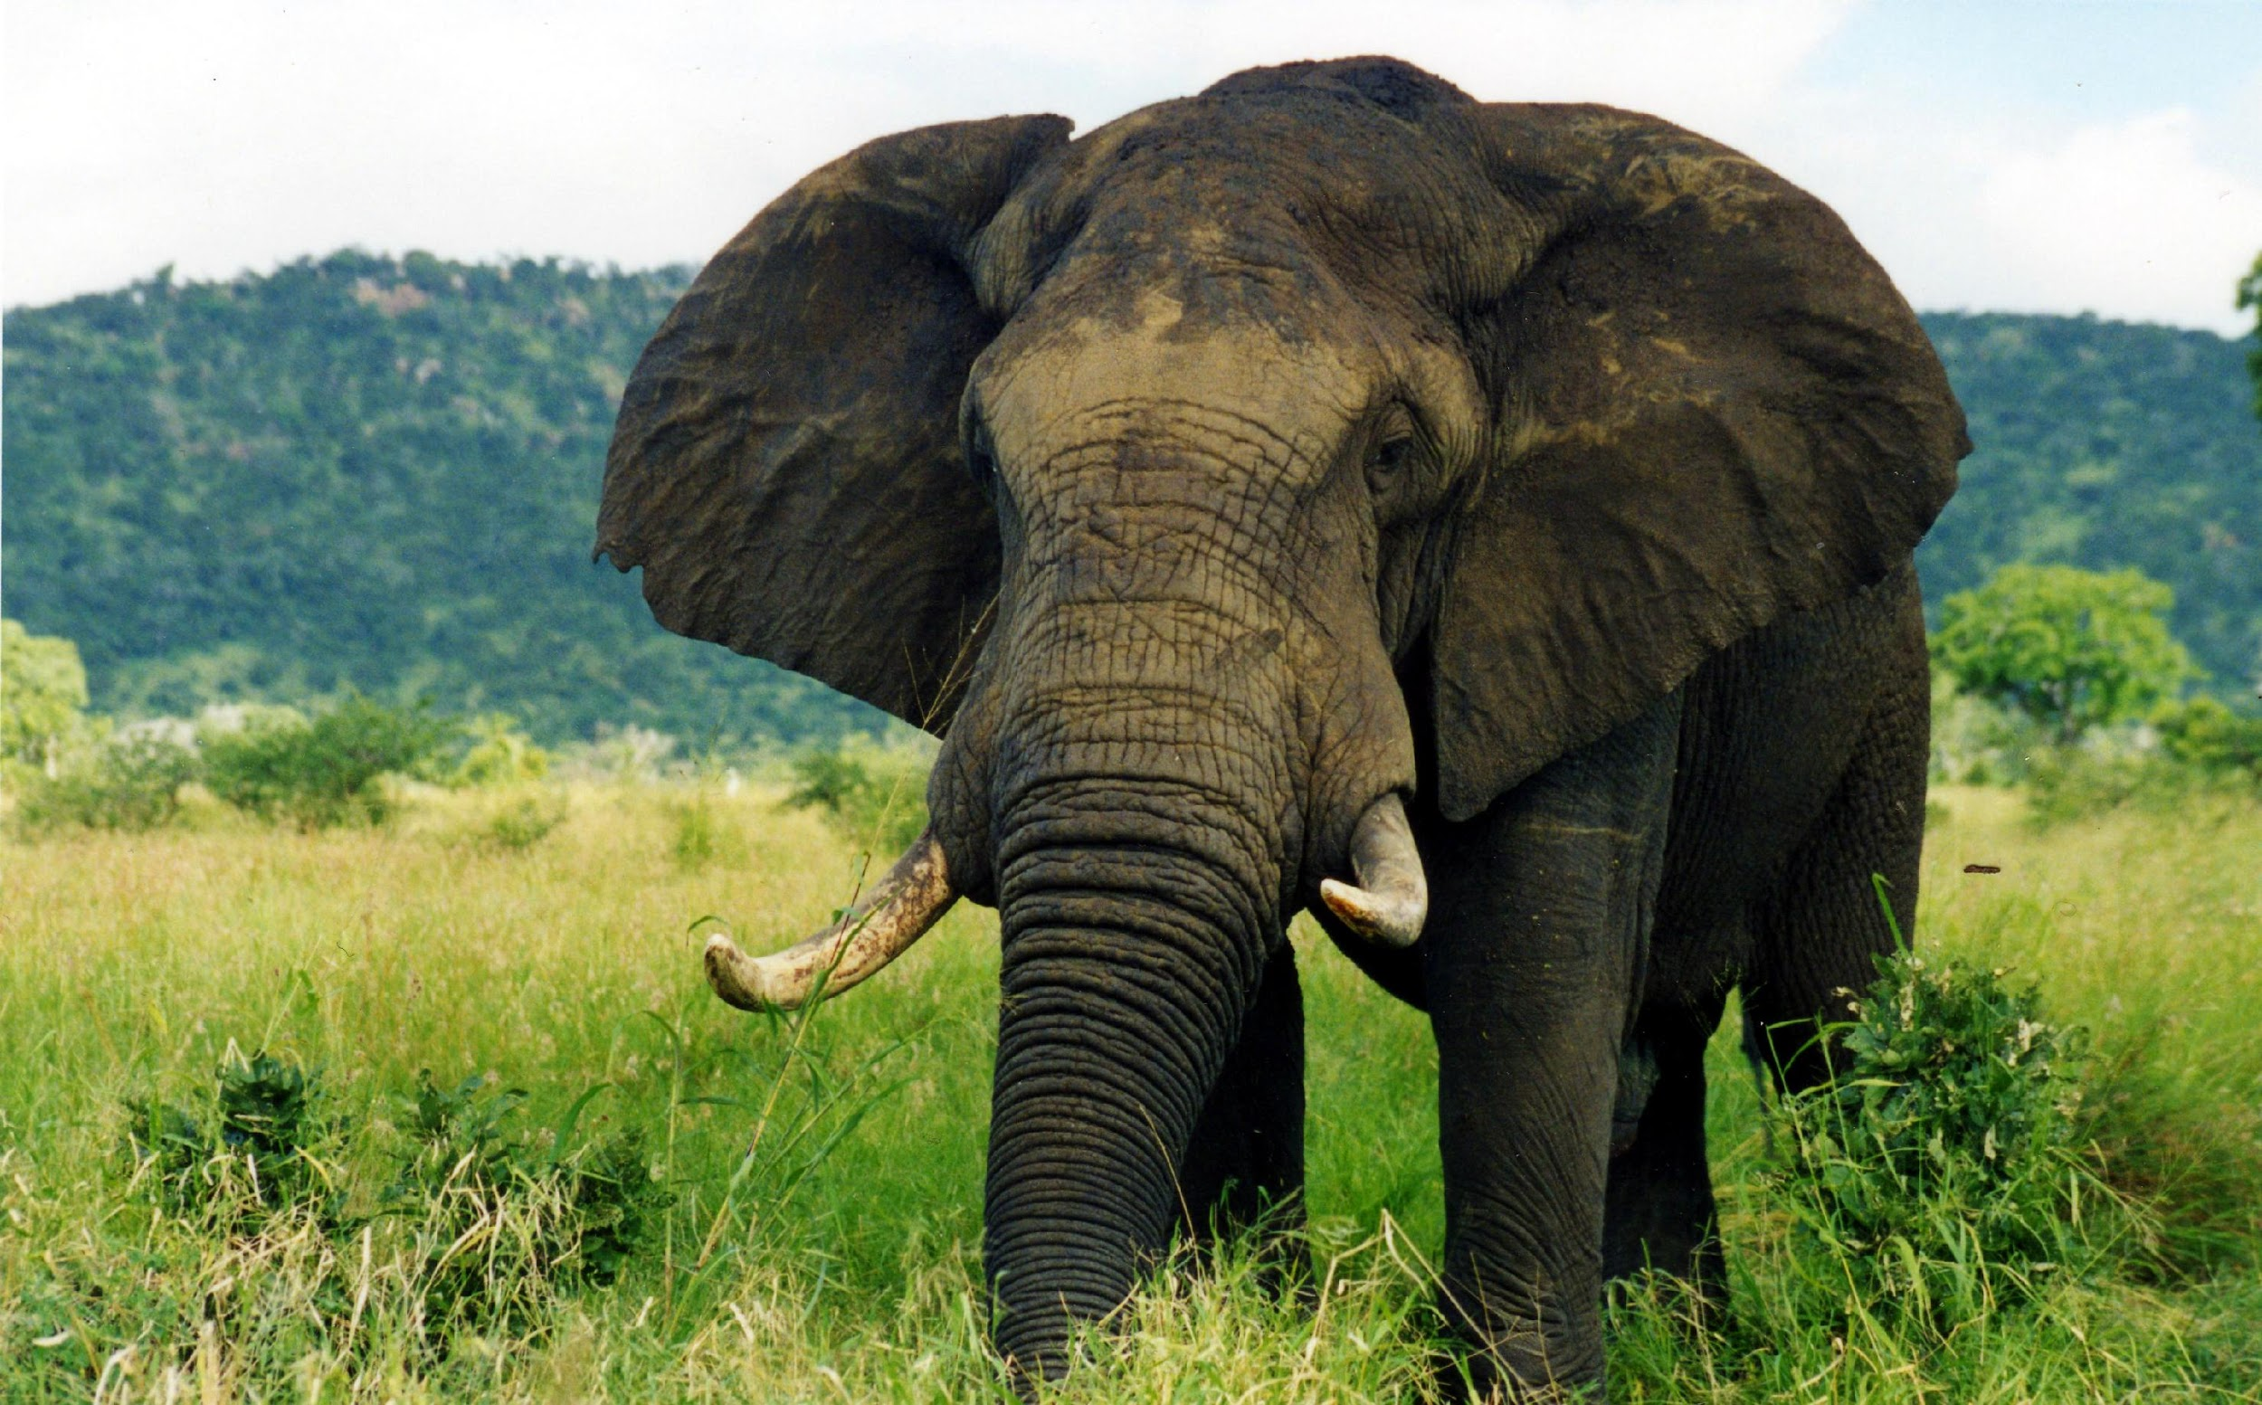
Notes:
Speaker’s Notes:
Can Interactivity Exist at Scale?
[Ask audience for ways to keep interaction]
[Insert ways to create interaction in courses at scale]
Image: https://commons.wikimedia.org/wiki/File:Elephant_(1).jpg

Slide 14
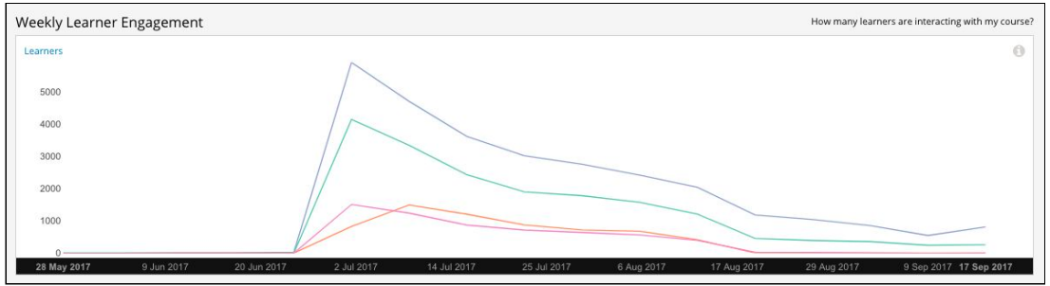
Notes:
Speaker’s Notes:
Data on Video Engagement
quality improvements must be data driven
video viewership data example
Image from data screenshots, courtesty of edX and USMx.

Slide 15
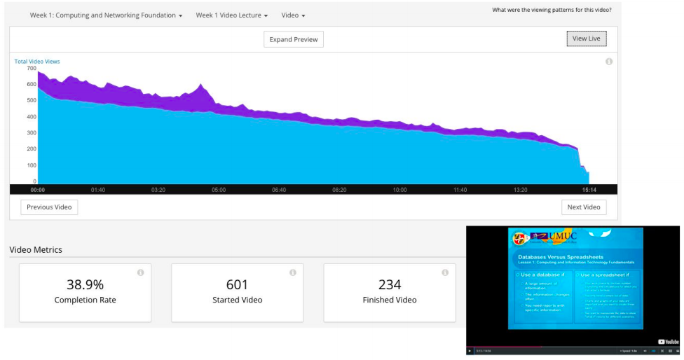
Notes:
Speaker’s Notes:
Data on Video Engagement
quality improvements must be data driven
video viewership data example
Image from data screenshots, courtesty of edX and USMx.

