Slide 1
Quality Matters Connect 2018
St. Louis, Missouri
Creative Alternatives for Fiscally Responsible Quality Assurance
A Conversation that Matters
Dionne Thorne, Director of Instructional Design and Online Learning
Sarah Barnhardt, Associate Professor and Online Learning Coordinator
The Community College of Baltimore County

Slide 2

Session Format
A Conversation that Matters
Overview of Quality Assurance
Description of a Four-tiered Quality Assurance Approach
Guided Conversation with Questions
Sharing of Fiscally Responsible Quality Assurance Ideas

Slide 3
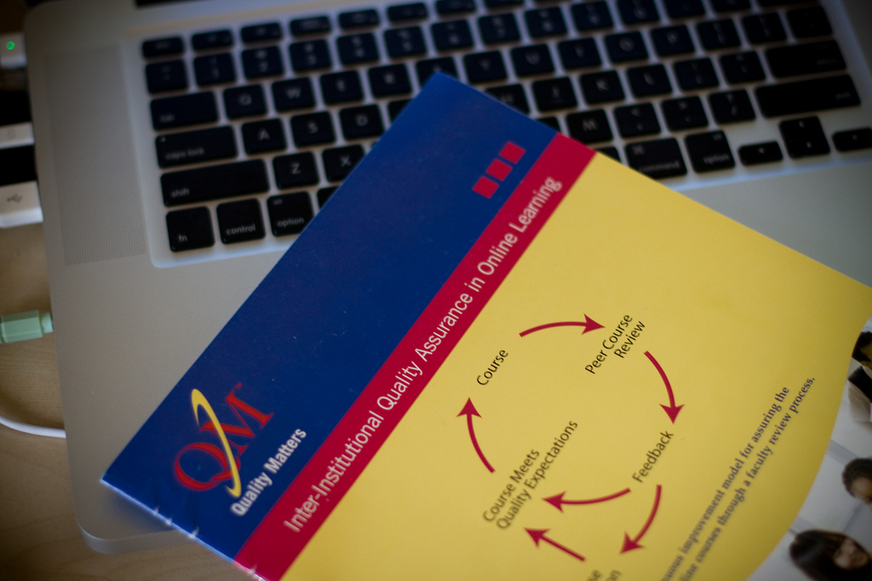
Quality Assurance based on Quality Matters Standards
Alignment
  Objectives
  Activities
  Assessments
  Technologies
Accessibility
Navigation
Support Services
Institutional Standards

Slide 4


Fiscally Responsible Quality Assurance

Slide 5
A Four-tiered Approach
Quality Matters Review
CCBC Internal Quality Assurance
Second Generation Review
Eyes Review

Slide 6
How does your school institute optimal quality assurance on a budget?
What ideas do you have?

Slide 7
Six Talking Points
How to…
Create different tiers of reviews
Incentivize faculty to participate
Recruit reviewers
Train faculty/staff as reviewers
Manage the reviews and the review process
Create faculty ownership in the process

Slide 8

Let’s share our conversations

Slide 9
Thank you!

