Slide 1
ReadSpeaker: Accessibility Tools Supporting YOU and YOUR Students
Ginger Dewey, Educational Development Manager
Paul Stisser, Business Development eLearning

Slide 2

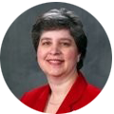

Speakers
Ginger Dewey
Educational Development Manager
ginger.dewey@readspeaker.com
Paul Stisser
Director of Business Development
paul.stisser@readspeaker.com
Paul works with ReadSpeaker to enhance the online learning experience with eLearning and LMS integration. Paul has 14 years of secondary education teaching experience, specializing in Special Education, Assistive Technologies, and At-Risk Students.
Ginger Dewey works to help clients get the most use out of the ReadSpeaker Suite of Learning Tools. With over 35 years as an educator in both K-12 and higher education, Ginger is an advocate for accessibility and the Universal Design for Learning (UDL).

Slide 3
Agenda
Who we are and who benefits
Assessments
Learner Interaction and Accessibility Tools
  Press, Click, Listen
  Page Mask
  Enlarged Text
  Other Tools
Why personalization of tools is important

Slide 4
Who We Are
Text-to-Speech product that includes several accessibility tools
20+ years of experience
Used by 1500+ institutions globally
TextAid helps with disability staff challenges
Helps everyone – not just a few
Study Tool
Products are easy to implement

Slide 5
Who benefits from ReadSpeaker (Slide 1)
Accessibility and Accommodations (Testing & Program Mods)
  15% of the world’s population experience some form of disability.
  World Bank: https://www.worldbank.org/en/topic/disability
  60-80% of those don’t disclose their disabilities.
  http://files.eric.ed.gov/fulltext/EJ941729.pdf
  Barriers to Access.
    Mental Illness, ADD, Mobility, Hearing, Visual, Brain/PTSD, Developmental, Speech and Learning not in 1st Language.
Inclusive Learning: Every Learner Matters and Matters Equally.
Dr. Trish Trifilo ReadSpeaker/Blackboard Ally/Blackboard World April 2019 Presentation
Notes:
CDC 26% of people in the US have some sort of disability

Slide 6
Who benefits from ReadSpeaker (Slide 2)
UDL: Universal Design for Learning
  Multiple Means of Representation
  Multiple Means of Action and Expression
  Multiple Means of Engagement
Convenience:
Mobile Learners
Learning on the Go
Multi-Taskers
Learning Preference

Slide 7
What Our Customers Say
  “Northeast Iowa Community College provides equal opportunity and resources for each individual student. By providing ReadSpeaker access to all students within our College, we are taking the step beyond fairness working towards dismantling the barriers that get in the way of individual success. All students have access to having their course materials accessible to avoid having to overcome obstacles and enjoy a robust educational experience.”
  ~ Anna Stamat, Disability Services Coordinator NICC

Slide 8
Testing Information
Proctored?
  Respondus LockDown Browser
  HonorLock (add proctor notes)
  Proctorio (TextAid extension)
Not Proctored?
  Blackboard, Brightspace (coming this fall), Canvas, Moodle and Open LMS use the webReader.
  Other LMSs use either TextAid Bookmarklet or Extension.

Slide 9
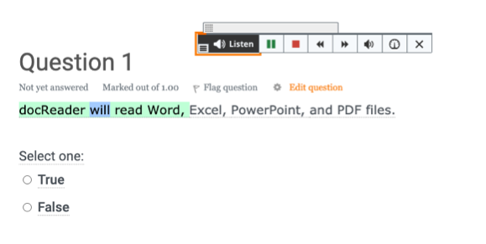
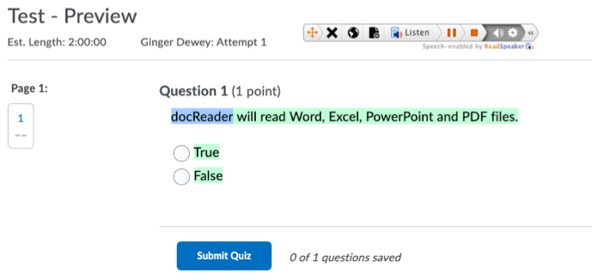
Testing Examples

Slide 10
Oral Presentation
Easy as clicking on Listen
  Can also highlight and stream material
Benefits
  Bimodial Presentation:
    Oral presentation instead of only reading
  Promote Engagement:
    Change voices to break up the asynchronous presentation
    Use various tools for the “reading” of the screen, changing frequently to reduce screen burnout.
  Adjust the Reading Speed and Other Settings to YOUR preferences
  Increase Vocabulary
    Reading while streamed highlights the words so that students are
    pronouncing the words correctly –making connections between
    oral and written presentations.

Slide 11
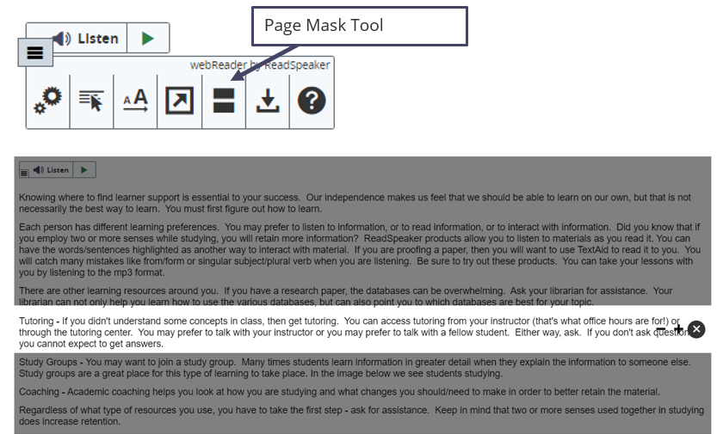
Page Mask
The icon looks like an “equals” sign.
Customizable window height.
Scrolls with you.

Slide 12
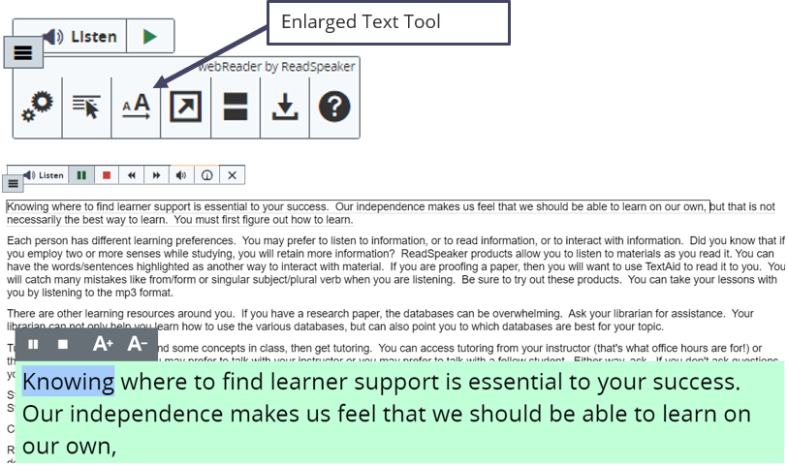
Enlarged Text
The icon is a small and a large uppercase “A” over an arrow.
Shows the text at the lower part of the screen in the enlarged text.
Can enlarge or shrink the font, play/pause/stop the reading.

Slide 13
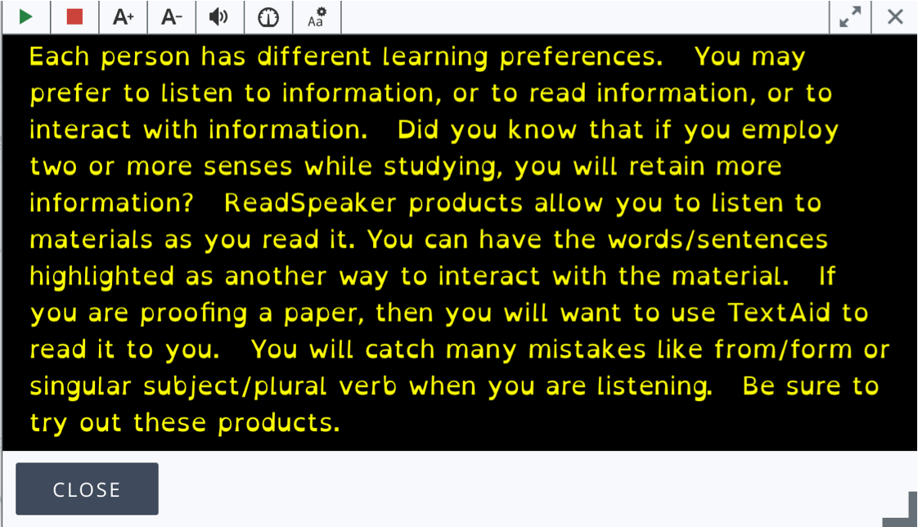
Text Mode
Text Mode
  Reduces distractions while reading.
  Adjustable font size, font, and text/background colors.
  Left justified document.
  No decorative images.

Slide 14
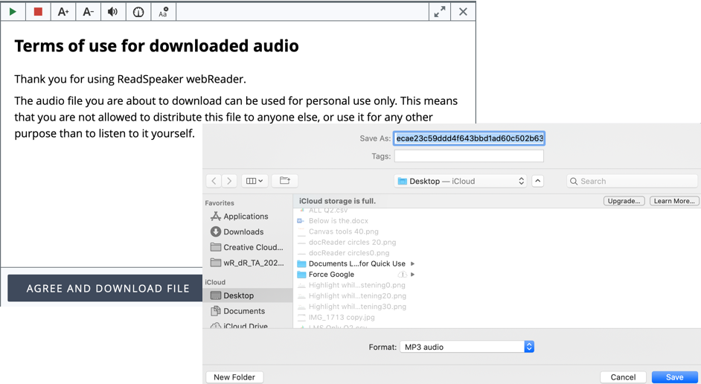
Download as mp3
Listen on the go
Take a break from reading
Notes:
Professional development learners
On the bus or subway
Taking advantage of down time or when they don’t have a larger device
At night
Creates a podcast-like experience

Slide 15
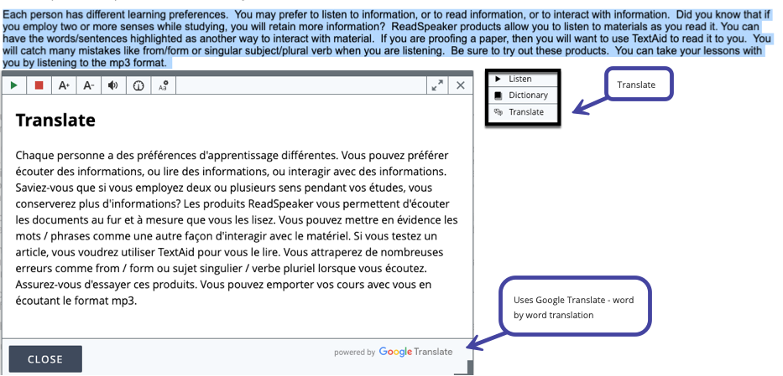
Translate
Translate to your native language
Increase your vocabulary
Learn key words in a foreign language to increase communication
Notes:
Translate- LEARNERS

Slide 16
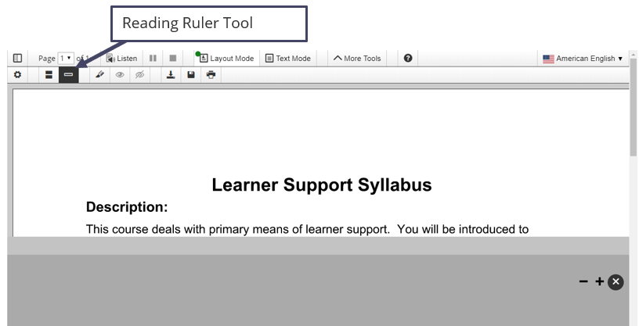
Reading Ruler
Reading Ruler
  Icon is a ruler.
  Works like a notecard.
  Covers the lower part of the screen.
  Customizable height of covered area.
  Scrolls with you.

Slide 17
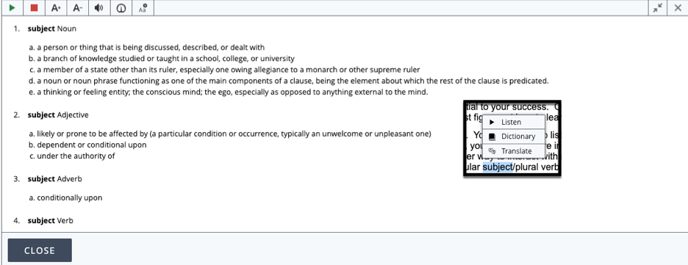
Dictionary
Learn new definitions
Uses online dictionaries
Notes:
Professional development learners
On the bus or subway
Taking advantage of down time or when they don’t have a larger device
At night
Creates a podcast-like experience

Slide 18
Personalization
Have things set the way YOU like it
  Builds engagement
  Builds focus
  Builds vocabulary
  Builds word recognition

Slide 19
Q&A
?

Slide 20
Speakers and Contact Information
Ginger Dewey
Educational Development Manager
ginger.dewey@readspeaker.com
Paul Stisser
Director of Business Development
paul.stisser@readspeaker.com
Paul works with ReadSpeaker to enhance the online learning experience with eLearning and LMS integration. Paul has 14 years of secondary education teaching experience, specializing in Special Education, Assistive Technologies, and At-Risk Students.
Ginger Dewey works to help clients get the most use out of the ReadSpeaker Suite of Learning Tools. With over 35 years as an educator in both K-12 and higher education, Ginger is an advocate for accessibility and the Universal Design for Learning (UDL).

