Slide 1

Reimagining the 5 Ws
Online Course Quality
and Alignment

Slide 2
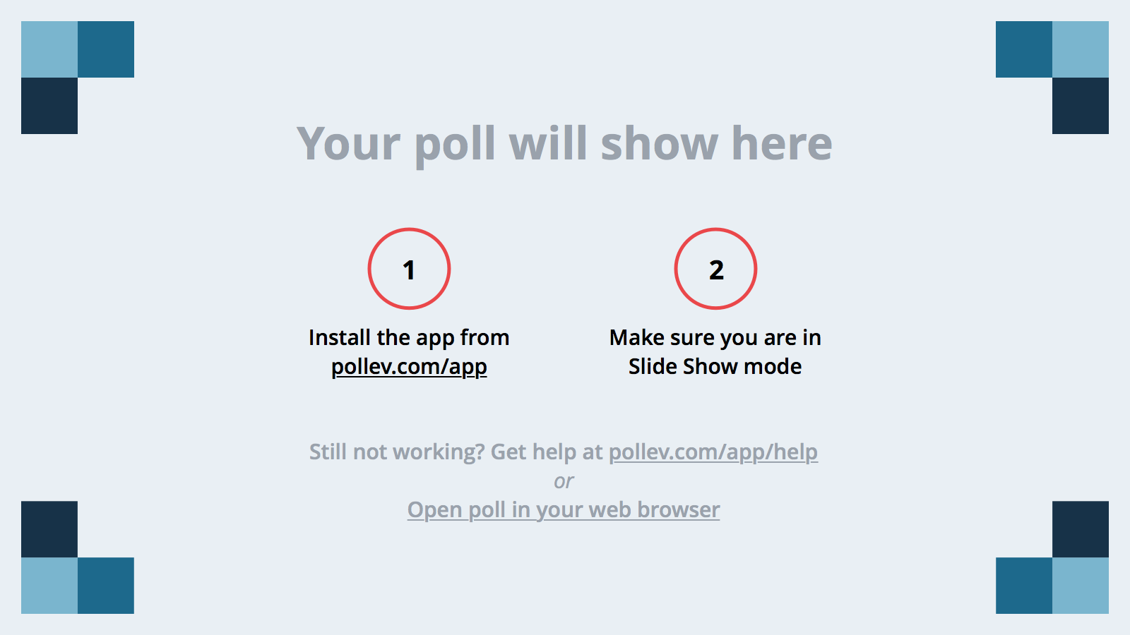
Notes:
Poll Title: Where did you come from to be here?
https://www.polleverywhere.com/free_text_polls/W2ly01rKSaBg1Na

Slide 3
Introductions
Northwestern University, School of Professional Studies Distance Learning Department
Reba-Anna Lee, Ed.D
Director of Online Program Development
Elizabeth Lemke
Learning Designer

Slide 4
Notes:
Poll Title: What is your role at your institution?
https://www.polleverywhere.com/multiple_choice_polls/ffAteZUr1zo0frZ

Slide 5
Session Outcomes
Recognize the correlation between alignment and quality online courses.
Identify effective design strategies to ensure alignment.
Discuss alignment strategies you have implemented in the courses you design/teach.

Slide 6
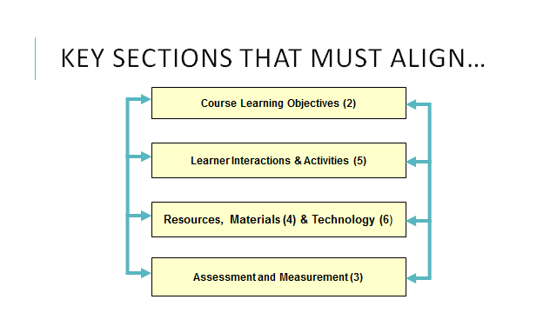
Quality Matters & Alignment

Slide 7
Notes:
Poll Title: What are some practices that are used at your institution to assure alignment (outcomes/assessments) in courses/ programs? ( In a word or two)
https://www.polleverywhere.com/free_text_polls/uZrd9rmj6Xkkaet

Slide 8
How Do We Help Students Recognize the Connections?

Slide 9
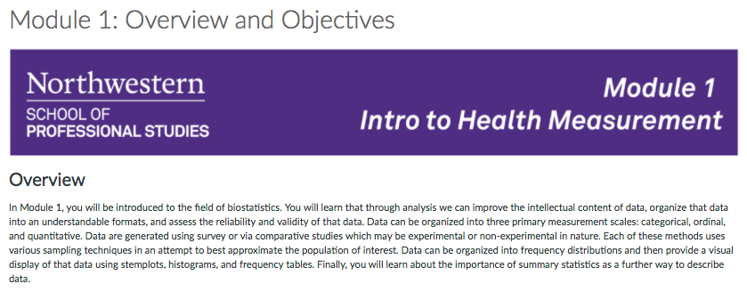
Weekly Overviews

Slide 10
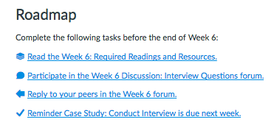
Weekly Roadmaps

Slide 11
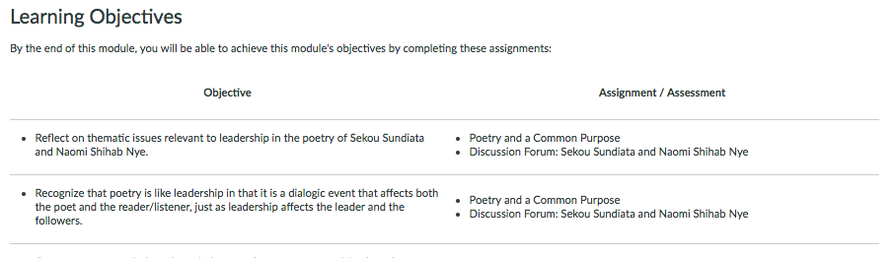
Alignment Table

Slide 12
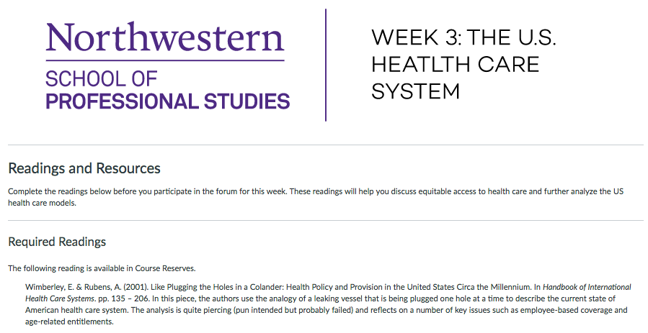
Reading/Media Annotations

Slide 13
Small Group Work

Slide 14
Discussion & Questions

Slide 15
Contact Information
Reba-Anna Lee
reba-anna.lee@northwestern.edu
Twitter: RebaAnna2
LinkedIn: https://www.linkedin.com/in/reba-anna-lee-08526817

