Slide 1

Reimagining the 5 Ws
Online Course Quality
and Alignment

Slide 2
Introductions
Northwestern University, School of Professional Studies Distance Learning Department
Reba-Anna Lee, Ed.D
Director of Online Program Development
Elizabeth Lemke
Learning Designer

Slide 3
Session Outcomes
Recognize the correlation between alignment and quality online courses.
Identify effective design strategies to ensure alignment.
Discuss alignment strategies you have implemented in the courses you design/teach.

Slide 4
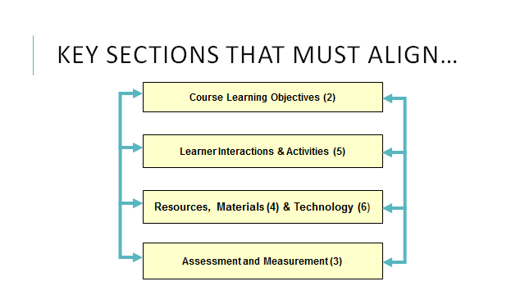
Quality Matters & Alignment

Slide 5
How Do We Help Students Recognize the Connections?

Slide 6
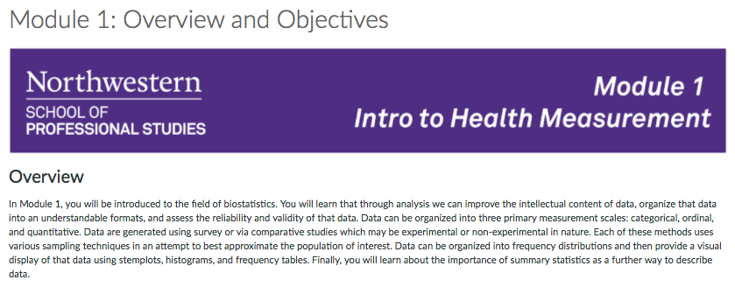
Weekly Overviews

Slide 7
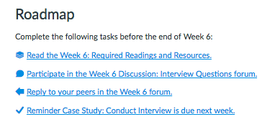
Weekly Roadmaps

Slide 8
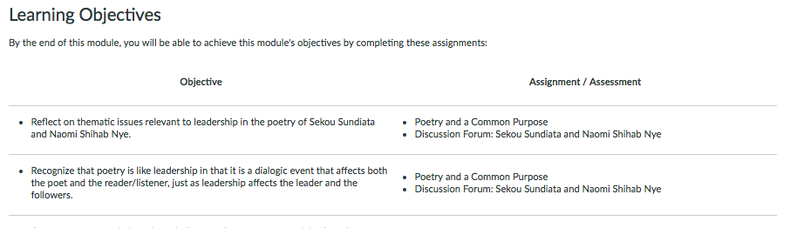
Alignment Table

Slide 9
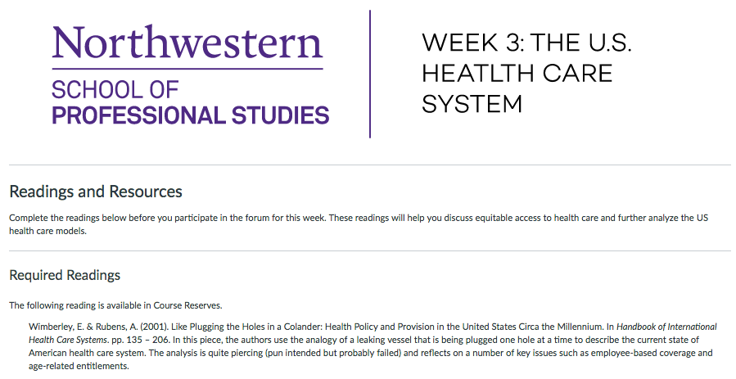
Reading/Media Annotations

Slide 10
Small Group Work

Slide 11
Discussion & Questions

Slide 12
Contact Information
Reba-Anna Lee
reba-anna.lee@northwestern.edu
Twitter: RebaAnna2
LinkedIn: https://www.linkedin.com/in/reba-anna-lee-08526817

