Slide 1


The Computer Assisted Language Learning (CALL) Rubric:
A 21st Century Tool for
Emergent Bilinguals
Dr. Ricardo Lumbreras, Jr.
Dr. Deborah Banker

Slide 2
What the research says about the need to evaluate online learning tools…
Duarte & Barros (2018) suggest that “although it is relatively simple to implement a surface approach to learning, it is not easy to encourage a deep approach” (p. 4).
Nix & Wyllie (2011) as cited in Bahari (2021) further suggest interactive assessment “makes it possible to offer learners a choice on entering the assessment environment, greater engagement and control of the learning experience and instant feedback” (p. 65).
We have moved beyond the four language acquisition domains of listening, speaking, reading, and writing to include viewing and representing visually (Sehlaoui, 2018).
Rogerson-Revell (2021) suggests the increasing attractiveness and availability of CALL tools is more technology driven as opposed to being pedagogy-led. Therefore, it lacks the pedagogic tools to ensure effective language acquisition.
So, what is the framework for this rubric?

Slide 3
The ELPS & WIDA
Language Proficiency Standards
Initially, the framework was designed & aligned with the English Language Proficiency Standards (ELPS) from the State of Texas.
The ELP standard categories are as follows: Beginner, Intermediate, Advanced, Advanced-High.
The researchers expanded the framework proficiency standards to include the nationally recognized World-Class Instructional Design and Assessment Consortium (WIDA) language proficiency standards.
The intent was to broaden the scope of the framework to include language proficiency levels that better represented Emergent Bilingual students language acquisition abilities.

Slide 4
The CALL Rubric Descriptors

Slide 5
Source
EXEMPLARY
The tool is prepared and maintained by an accredited, verifiable, and contactable source. It is usable, accessible, and findable.

Slide 6
Content
EXEMPLARY
The tool allows students to practice targeted grade-level math, reading, science, and social studies objectives.

Slide 7
Accuracy
EXEMPLARY
The tool allows users to practice sentence structure, vocabulary, and grammar within the chosen content area.

Slide 8
Comprehensibility & Pronunciation
EXEMPLARY
The tool allows users to understand all contextual cues, respond to those content-specific cues, and practice responding appropriately.

Slide 9
Feedback
EXEMPLARY
The user is provided specific, content area, and language domain feedback.

Slide 10
Customizable Learning
EXEMPLARY
The tool allows flexibility in altering content and settings to meet individual linguistic needs, including diagnostic capabilities, measurement of language level, and proficiency level movement.

Slide 11
Engaging
EXEMPLARY
The user is self-directed and highly motivated to use the tool.

Slide 12
Allows students to engage the six language domains:
(L,S,R,W,V,R)
EXEMPLARY
Users can practice listening, speaking, reading, writing, viewing, and representing in specific and targeted content areas.

Slide 13
Allows students to engage the six language domains (L, S, R, W, V, R)
Listening
Speaking
Reading
Writing
Viewing
Representing Visually

Slide 14
The Rubric
Online Language Learning Tool Rubric
Points | 4 – Exemplary | 3 – Sufficient | 2 – Inadequate | 1 – Inadvisable
Source | The tool is prepared and maintained by an accredited, verifiable, and contactable source. It is usable, accessible, and findable. | The tool is missing one of the following: accreditation, verifiability, contactability, usability, accessibility, or findability. | The tool is missing two of the following: accreditation, verifiability, contactability, usability, accessibility, or findability. | The tool has only one of the following: accreditation, verifiability, contactability, usability, accessibility, or findability.
Content | The tool allows students to practice targeted grade level math, reading, science, and social studies objectives. | The tool is missing one of the targeted grade level choices for math, reading, science, and social studies objectives. | The tool is missing two of the targeted grade level choices for math, reading, science, and social studies objectives. | The tool has only one of the targeted grade level choices for math, reading, science, and social studies objectives.
Accuracy | The tool allows users to practice sentence structure, vocabulary, and grammar within the chosen content area. | The tool does not allow practicing one of the following: sentence structure, vocabulary, and grammar within the chosen content area. | The tool does not allow practicing two of the following: sentence structure, vocabulary, and grammar within the chosen content area. | The tool only allows practicing one of the following: sentence structure, vocabulary, and grammar within the chosen content area.
Comprehensibility & Pronunciation | The tool allows users to understand all contextual cues, to respond to those content specific cues, and to practice responding appropriately. | The tool is missing one of the following: allows users to understand all contextual cues, to respond to those content specific cues, and to practice responding appropriately. | The tool is missing two of the following: allows users to understand all contextual cues, to respond to those content specific cues, and to practice responding appropriately. | The tool only allows one of the following: allows users to understand all contextual cues, to respond to those content specific cues, and to practice responding appropriately.
Feedback | The user is provided specific, content area, and language domain feedback. | The user is not provided one of the following: specific, content area, language domain feedback. | The user is not provided two of the following: specific, content area, language domain feedback. | The user is provided no feedback.
Customizable Learning | The tool allows flexibility in altering content and settings to meet individual linguistic needs, including diagnostic capabilities, measurement of language level, and proficiency level movement. | The tool allows some flexibility to alter content and settings to meet individual linguistic needs, including diagnostic capabilities, measurement of language level, and proficiency level movement. | The tool allows limited flexibility to alter content and settings to meet individual linguistic needs, including diagnostic capabilities, measurement of language level, and proficiency level movement. | The tool allows no flexibility to alter content and settings to meet individual linguistic needs, including diagnostic capabilities, measurement of language level, and proficiency level movement.
Engaging | The user is self-directed and highly motivated to use the tool. | The user uses the tool as directed by the teacher. | The user is off task when using the tool and views it as a “must do” for school. | The user is not self-directed with the tool use, avoids it, and complains when instructed to do so.
Allows students to engage the six language domains (L, S, R, W, V, R) | Users can practice listening, speaking, reading, writing, viewing, and representing in specific and targeted content areas. | Users can practice four of the six language domains in specific and targeted content areas. | Users can practice three of the six language domains in specific and targeted content areas. | Users can practice two of the six language domains in specific and targeted content areas.

Slide 15

QR CODE TO THE RUBRIC

Slide 16
References
Bahari, A. (2021). Computer-assisted language proficiency assessment tools and strategies. Open Learning: The
Journal of Open, Distance and e-learning, 36(1), 61-87. https://doi.org/10.1080/02680513:2020.1726738
Duarte, A., & Barros, A. (2018). A computer assisted intervention on learning strategies. Australian Educational
Computing, 33(1).
Rogerson-Revell, P.M. (2021). Computer-assisted pronunciation training (CAPT): Current issues and future
directions. RELC Journal, 52(1), 189-205. https://doi.org/10.1177/0033688220977406
Sehlaoui, A.S. (2018). Teaching ESL and STEM content through CALL: A research-based interdisciplinary critical
pedagogical approach. Lexington Books.

Slide 17
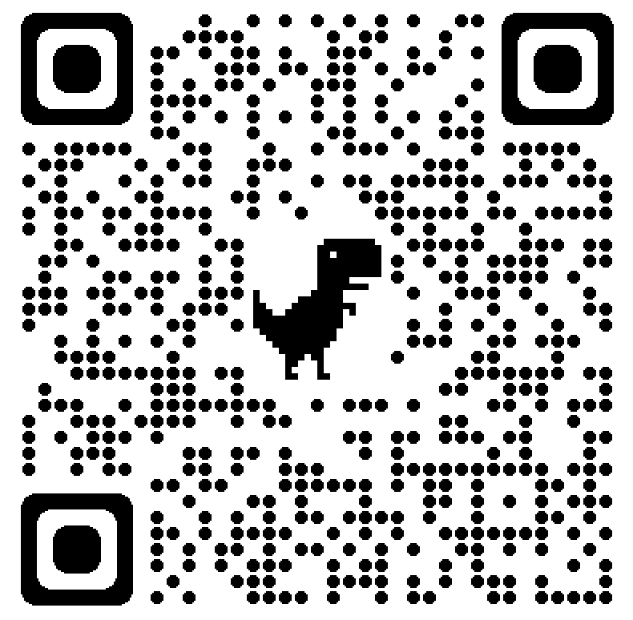
QR CODE TO LANGUAGE TOOLS WEBSITE

Slide 18

Suggested tabs to examine
DAVE’S ESL CAFÉ
ESL GOLD
MANY THINGS SPELLING
ESL CYBER LISTENING LAB

Slide 19
Contact Information
Dr. Ricardo Lumbreras, Jr.
254-968-9231
  lumbreras@tarleton.edu
Dr. Deborah Banker
254-968-9941
  banker@tarleton.edu

