Slide 1

Running with the COLT Course to Maintain Quality Across the Board
Certificate for Online Learning & Teaching
Salisbury University – (SU)

Slide 2
Instructional Design Team at: SU
Instructional Design and Delivery Office
  Manager
  Instructional Designer
  Instructional Technologist
Three Dedicated Instructional Designers
  Social Work
  Nursing
  Perdue School of Business
Notes:
Explain the structure and roles of team members

Slide 3
In the Stable: How COLT Started ?
Distance Education at SU - Overview:
Three Online Programs
Four Hybrid Programs
Two Blended (hybrid + online)
Satellite – Distance education via IVN classrooms

Slide 4
Distance Education at SU - Fall 2018
 | ONLINE | HYBRID
SU Total | 137 | 366
Business | 30 (22%) | 39 (11%)
Nursing | 16 (12%) | 93 (25%)
Social Work | 59 (43%) | 145 (40%)

Slide 5
In the Stable: How COLT Started ?
Large number of SOWK and NURS online/hybrid sections in are taught by part-time faculty.
The need for part-time faculty training was identified (even beyond these two departments)
Initial developers:
Dr. Becky Anthony
Assistant Professor, MSW Online Coordinator
rsanthony@salisbury.edu
Deborah Turner
Instructional Designer, Social Work
daturner@salisbury.edu

Slide 6
Sources for the COLT course content
Canvas Commons & Textbook
Peer Reviewed Articles
Videos from Online Instructors
COLT – v.1.0
Thank you to North Central Texas College for sharing their "Preparing to Teach Online" course in the Canvas Commons. Materials from that course were used to help build COLT.

Slide 7
Included in the COLT course
Five modules
Orientation
Technology Skills
Online Pedagogy
Instructor Presence & Student Engagement
Quality Matters & Best Practices

Slide 8
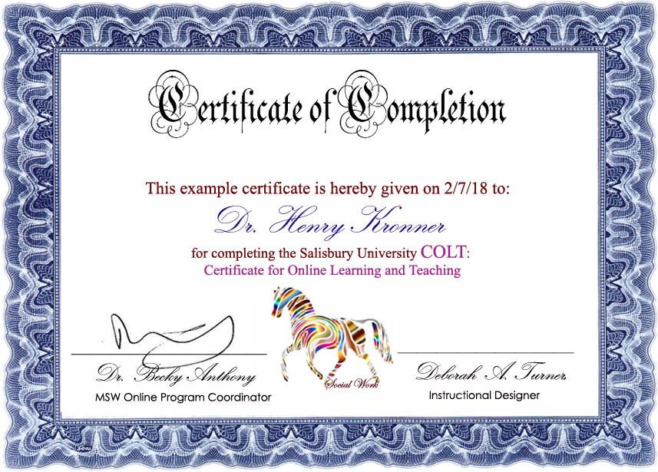
Out of the Gate!
Social Work COLT Pilot was offered to adjunct and full-time instructors.

Slide 9
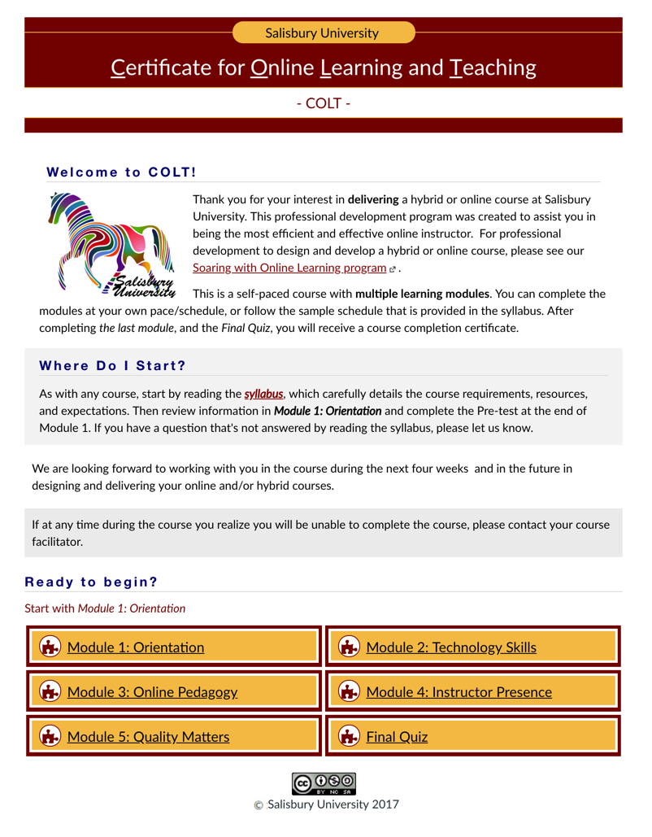
COLT is turned into a “Blueprint”
COLT – v2.0

Slide 10
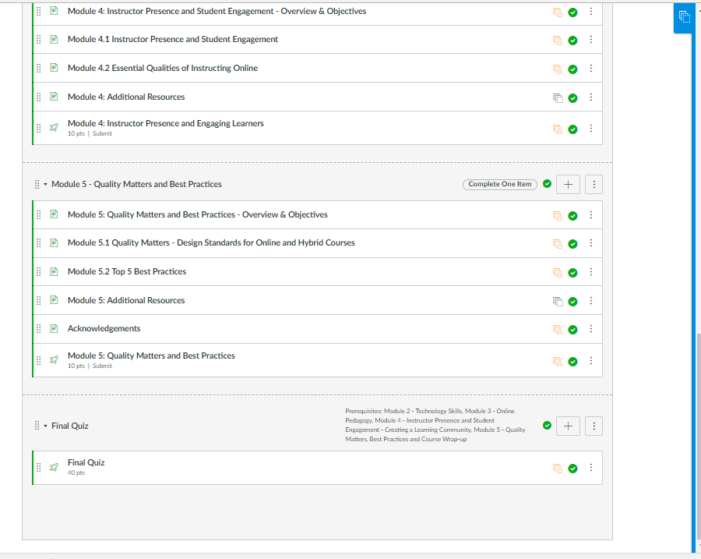

Slide 11
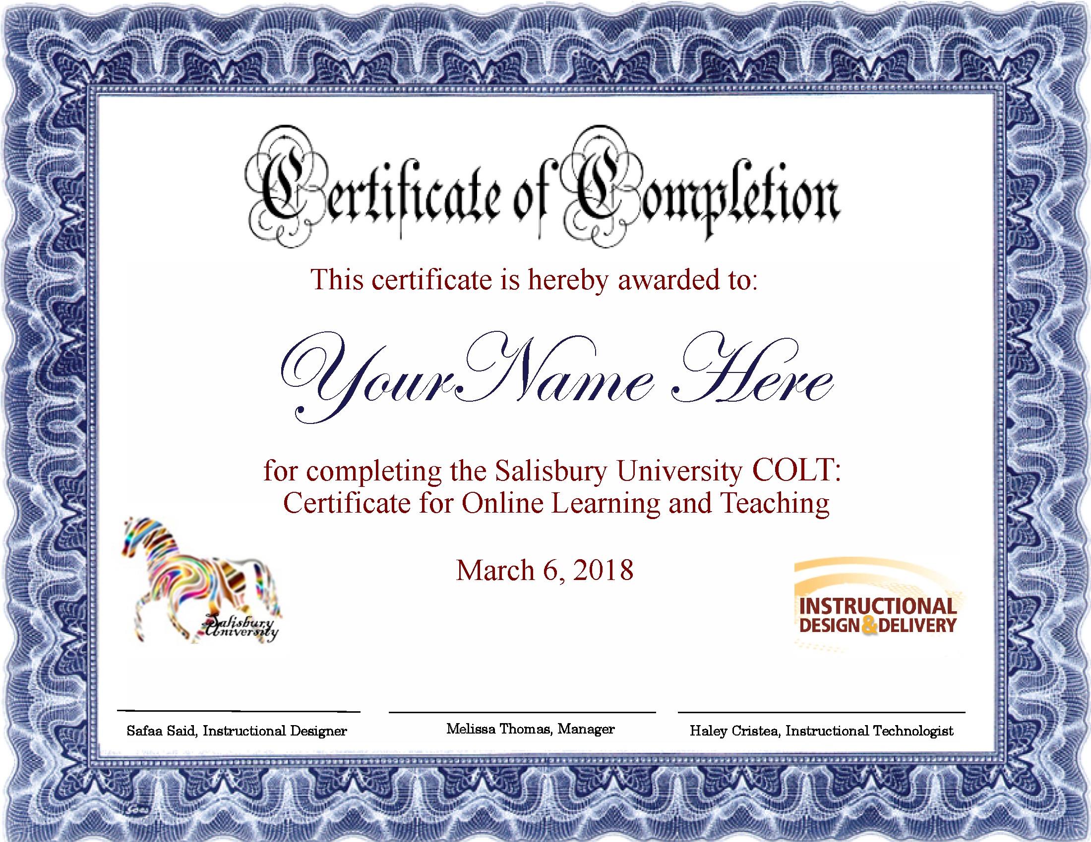

Slide 12
Scaling Support for University Faculty
Need for training was identified
Certificate for Online Learning & Teaching COLT training course created
COLT turned into a customizable “Blueprint” course in Canvas and adopted by Salisbury University
COLT is available as an open enrollment course to all SU faculty
The Social Work Department now requires all adjuncts to complete COLT to teach any courses

Slide 13
Questions?

