Slide 1
Impact of QM Professional Development and Course Certification on Teaching Performance and Student Success
Ashley Skylar, Ph.D.
Quality Assurance Blended-Online Program
CSU Office of the Chancellor
Jianjun Wang, Ph.D.
Professor, Statistics & Research
CSU Bakersfield
Mary Bennett
Instructional Designer
Center for Faculty Excellence
Fresno State University
Sinjini Mitra, Ph.D.
Associate Professor, Information Systems and Decision Sciences
CSU Fullerton
Notes:
Required Slide

Slide 2
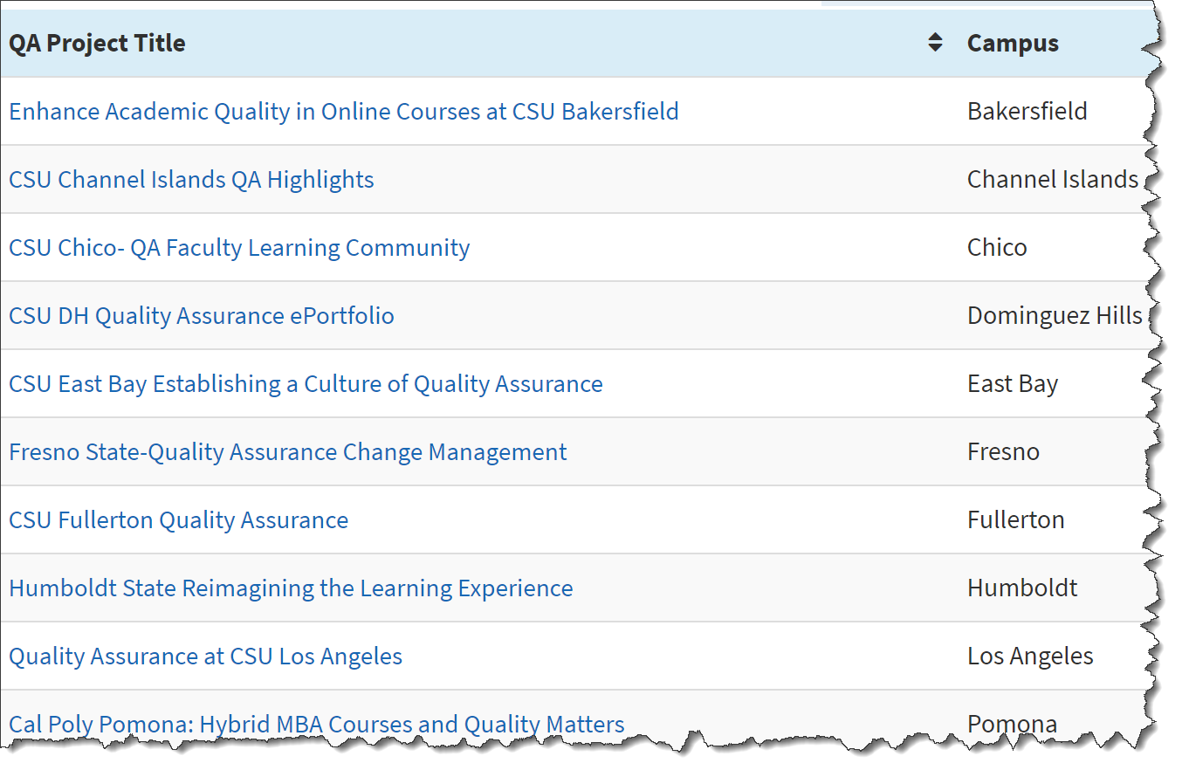
Supporting Quality Assurance Systemwide
Annual RFP $12,000-$15,000 (June 30-July 1st)
20-21 of 23 campuses participating annually
Showcased ePortfolio
http://tiny.cc/csu-qa.eports
QA PLC
http://tiny.cc/qa-plc

Slide 3
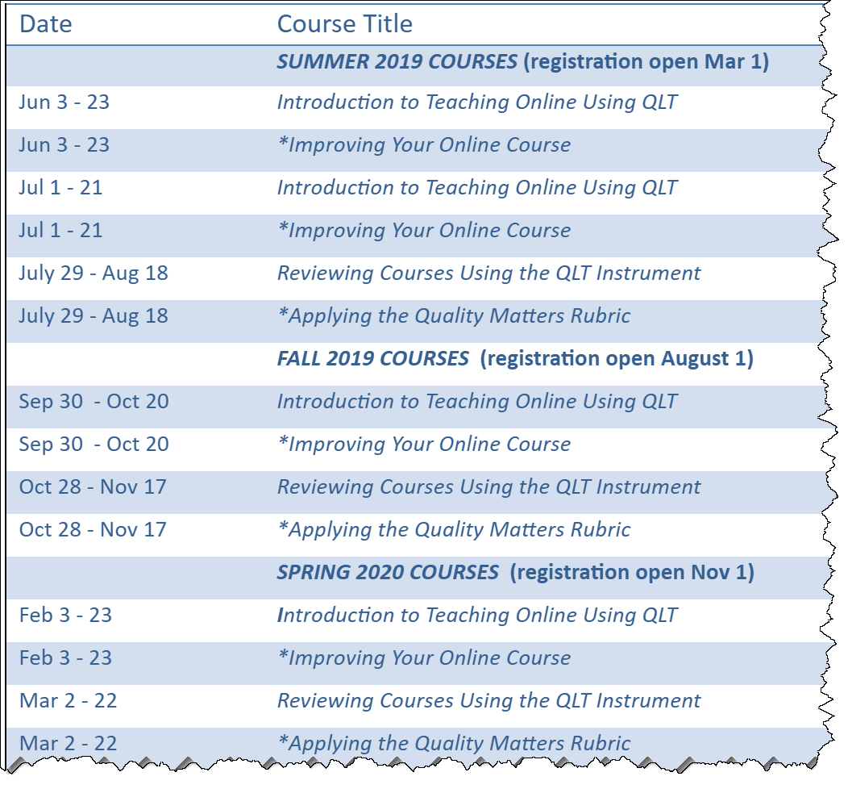
Offer CSU Systemwide Training
Offer system-wide training
Register on a “central” website with link to enroll
$50 per enrollment
Grow and manage a pool of 28 facilitators
  Paid $750 per course facilitated
Most campuses use system training to support their faculty and offer FLC/1-on-1 mtgs/ID support at the campus level

Slide 4

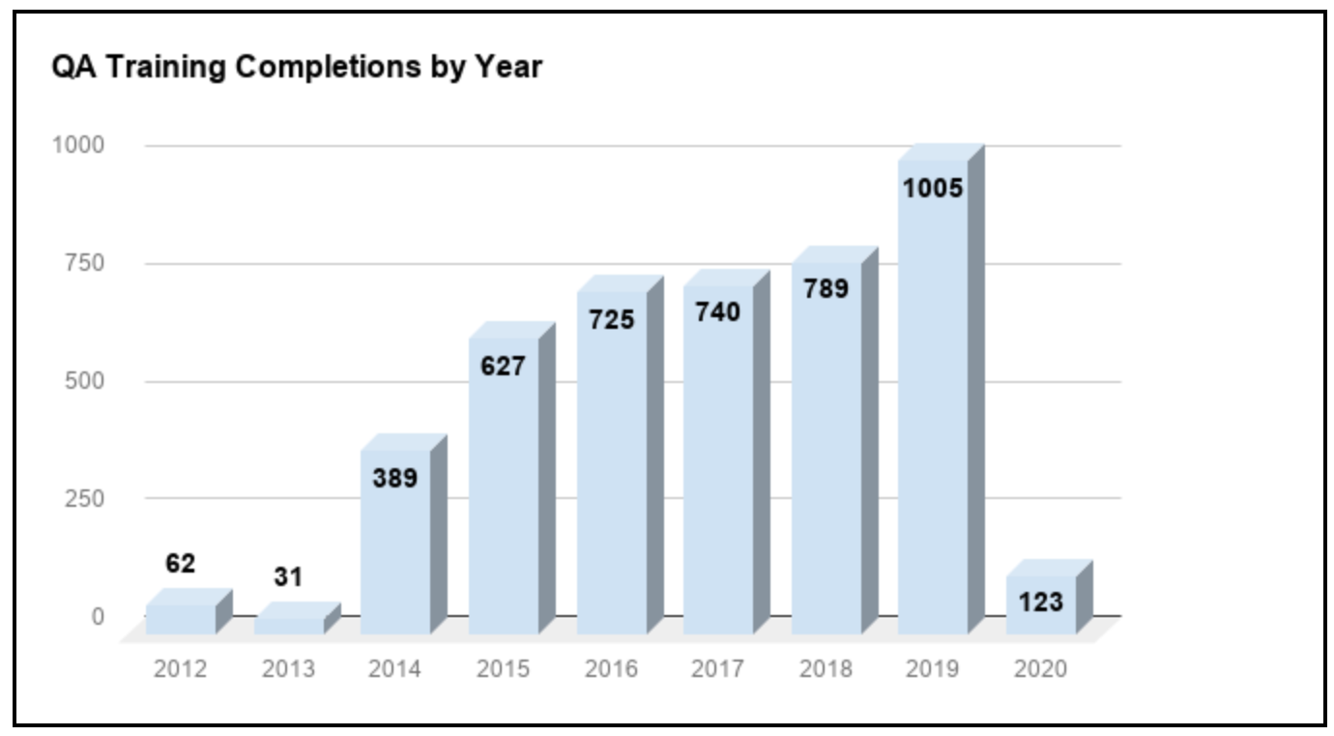
Progress Made Since 2012
Robust adoption and implementation of CSU Quality Learning & Teaching (QLT) and Quality Matters
All 23 campuses involved in QA activities (community, professional development, course reviews)
Approximately 5,000 QA training completions through today.
4,491 Completions

Slide 5
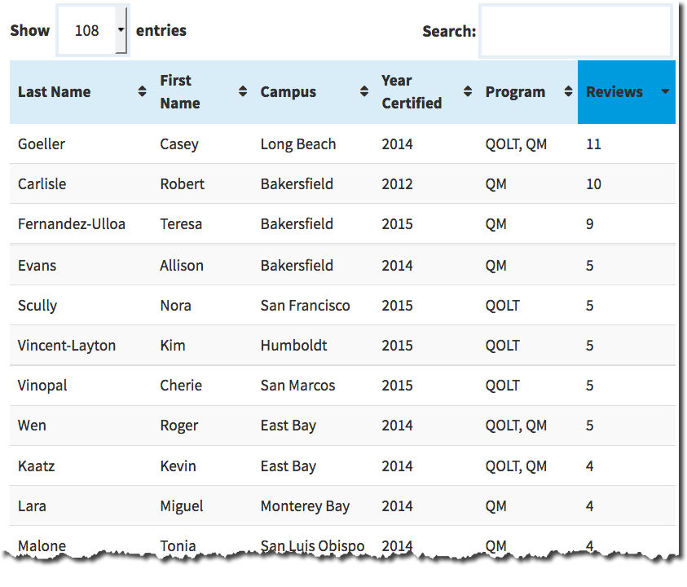
Certified Peer Reviewers:
Individual letter plus recognition on QA website
Benefits:
Stimulates reviewers to
enhance their courses
Network with CSU faculty in similar disciplines
Opportunity for stipends
Contribute to RTP service
160+
Awesome

Slide 6
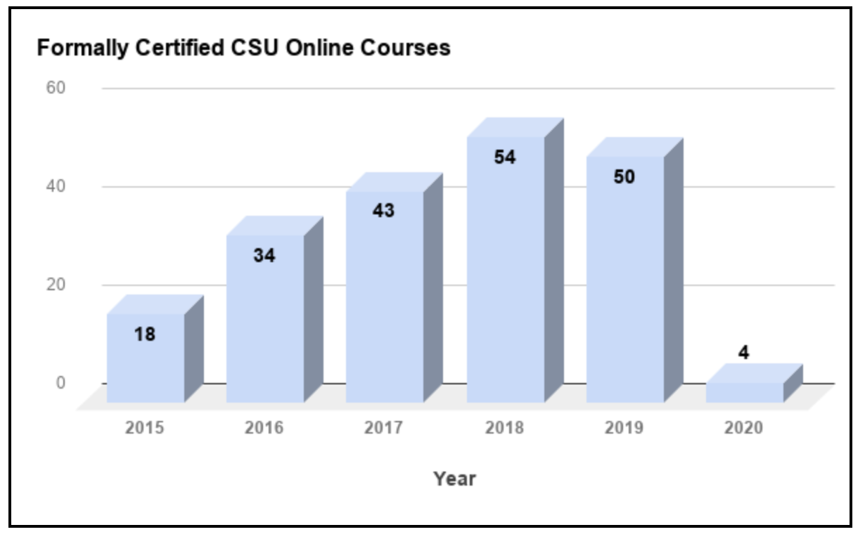
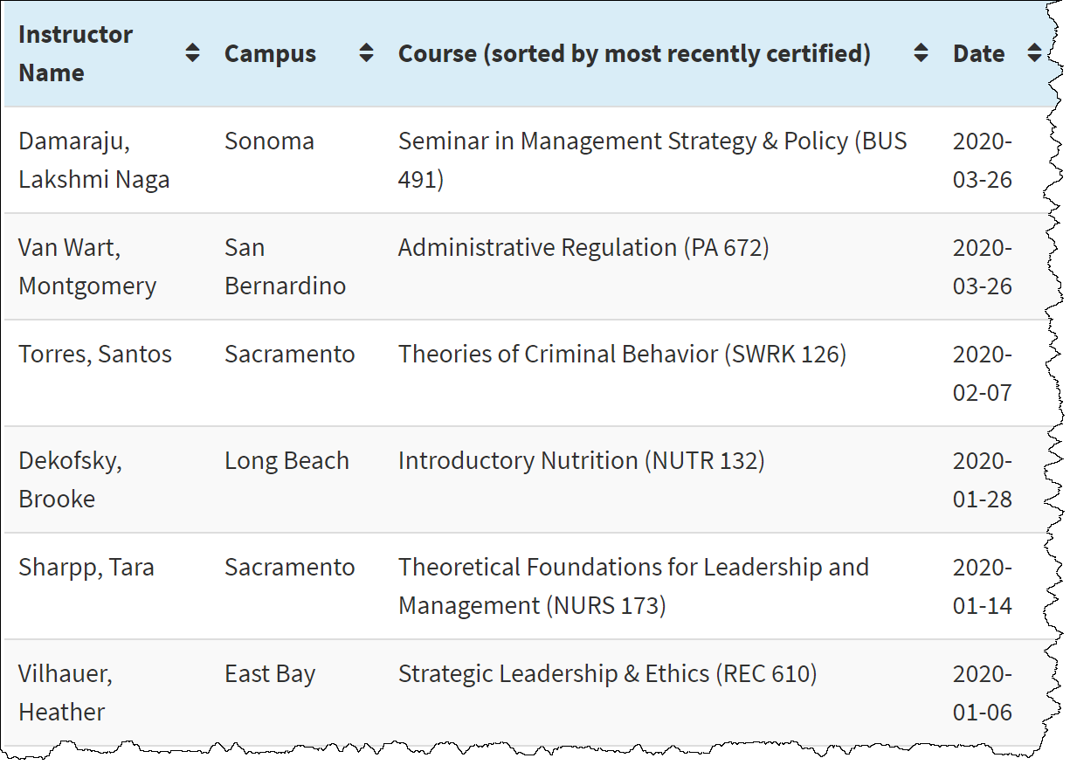
200+
CSU Certified Courses
Thorough review by a team of three
Must meet all Core/Essentials
Must meet 85%+ of all objectives
Extensive feedback from reviewers
http://tiny.cc/certified-courses

Slide 7
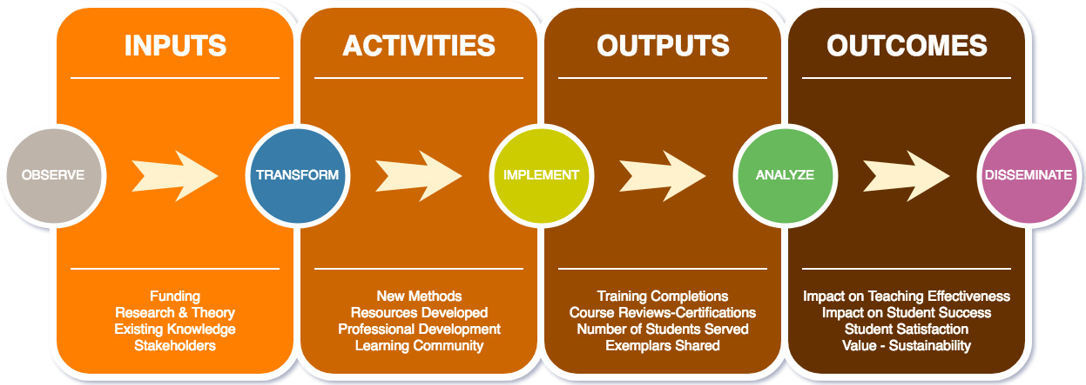
Brett Christie, Ph.D., 2016

Slide 8
Two Main Hypotheses
Instructors completing CSU QA professional development are able (than non-trained peers) to design and deliver online courses more effectively
Courses taught by instructors obtaining formal course certification (versus informal or non-certified) result in higher grades, improved course completion rates, higher student satisfaction, and ultimately a reduction in equity gaps.

Slide 9
Student Quality Assurance Impact Research
SQuAIR group of 15 campuses meets monthly
  QA Lead and Faculty Research Associate
  Group focused on common efforts; Allowed to augment
Student Feedback Survey: 25-item survey aligned with the QLT Core-24 and QM 23 Essentials. Also, provides opportunity for students to give qualitative feedback regarding online courses taught by CSU QA-trained faculty.
Faculty Perception Survey: Distributed to over 1,500 CSU faculty who have completed at least one CSU QA training course and/or successfully completed online course certification.
Institutional Data: Campus partners with IR to obtain student outcomes data (e.g., course GPA, course completion rates, grades distribution) to analyze the impact that QA training/certification ion student success in online courses.

Slide 10
Student Feedback Survey Aligned with Essential CSU QLT & QM Standards
COURSE OVERVIEW & INTRODUCTION | 4.53 | OBJECTIVES & ASSESSMENT | 4.44
(1) Detailed instructions for getting started | 4.52 | (5) Measurable course level & module objectives | 4.46
(2) Detailed information about the instructor | 4.48 | (6) Relationship between objectives & activities | 4.31
(3) Purpose of course & prerequisite knowledge | 4.54 | (7) Descriptive criteria provided for assessments | 4.43
(4) Academic integrity & institutional policies | 4.58 | (8) Course grading policy clearly defined | 4.55
MATERIALS, FACILITATION, INTERACTION, | 4.38 | TOOLS, SUPPORT RESOURCES, ACCESSIBILITY | 4.41
(9) Feedback from instructor & self-check progress | 4.39 | (19) Variety of technology tools to engage students | 4.23
(10) Adequate notice to acquire course materials | 4.55 | (20) Clear info. to acquire or access technologies | 4.3
(11) Variety of course material types | 4.49 | (21) Instructions for accessing technical support | 4.4
(12) Material supported the course content/topics | 4.49 | (22) Instructions for accessing academic support | 4.44
(13) Explanation show how materials align to objectives | 4.37 | (23) Campus policy provided for students with disabilities | 4.46
(14) Students introduce themselves | 4.4 | (24) Course materials in accessible formats | 4.52
(15) Activities encouraged engagement with peers | 4.32 | (25) Course navigation | 4.5
(16) Learning activities promote real-world scenarios | 4.22
(17) Feedback in a timely manner | 4.33
(18) Instructor sent reminders of due dates | 4.26
 |  | OVERALL AVERAGE = | 4.42
N=3,746 Students enrolled in a course that is QA certified and/or has a QA trained instructor
Notes:
link to google sheet

Slide 11
Faculty Ranking of Quality Assurance Topics
Rank | QA Training Topic | Rank-Weight
1st | Facilitation and Instruction | 4.48
2nd | Student Interaction and Community | 4.62
3rd | Assessment and Evaluation of Student Learning | 4.69
4th | Instructional Materials and Resources Utilized | 4.69
5th | Technology for Teaching and Learning | 4.71
6th | Course Overview and Introduction | 5.01
7th | Learner Support and Resources | 5.94
8th | Accessibility and Universal Design | 5.95
9th | Course Summary and Wrap-Up | 7.22
10th | Mobile Platform Readiness | 7.70

Slide 12
Influence of CSU QA Training on Pedagogical Implementation
Pedagogical Method/Strategies Further Used to Improve Student Success (N = 147) | Count | Percent
Active Learning | 89 | 60.5
Discussion Topics/Forums | 83 | 56.5
Rubrics | 83 | 56.5
Instructional Materials Accessibility | 63 | 42.9
Online (Fully) Course Design | 62 | 42.2
Student Reflections | 62 | 42.2
Blended Classroom/Course Design | 61 | 41.5
Cooperative-Collaborative Assignments or Projects | 46 | 31.3
Flipped Classroom/Course Design | 46 | 31.3
Universal Design for Learning | 43 | 29.3
Authentic Assessment | 27 | 18.4
Knowledge Surveys | 19 | 12.9

Slide 13

SQuAIR Faculty Lead:
Sinjini Mitra
Program Coordinator:
Shelli Wynants

Slide 14
QA Training at CSUF
Type of QA training | Number of faculty/staff
APPQMR (faculty) | 148 (53 online & 95 F2F)
APPQMR (staff) | 13 (5 online & 8 F2F)
QOLT | 13
PRC (QM) | 15
Master Reviewer (QM) | 1
Other QM (re-certification, rubric update, facilitator) | 7
QOLT Reviewer | 1
Other (e.g. Accessibility training, IYOC, An introduction to online delivery) | 13
226 total trainings
156 total faculty trainings
11 QM-certified course
  Nursing (6), Education (1), History (1), Mathematics (2), CAS (1)
8 QOLT-reviewed courses
Notes:
A total of 226 QA-related trainings at CSUF as of March 2020. This includes 156 faculty members (both lecturers and tenure-track/tenured). There are 15 Certified peer reviewers for QM and 1 Master Reviewer. 11 courses have been formally QM-certified till now. The CSU system offers a QOLT program for assisting with the design and delivery of online, hybrid and blended courses. 8 courses at CSUF have gone through the QOLT review.

Slide 15
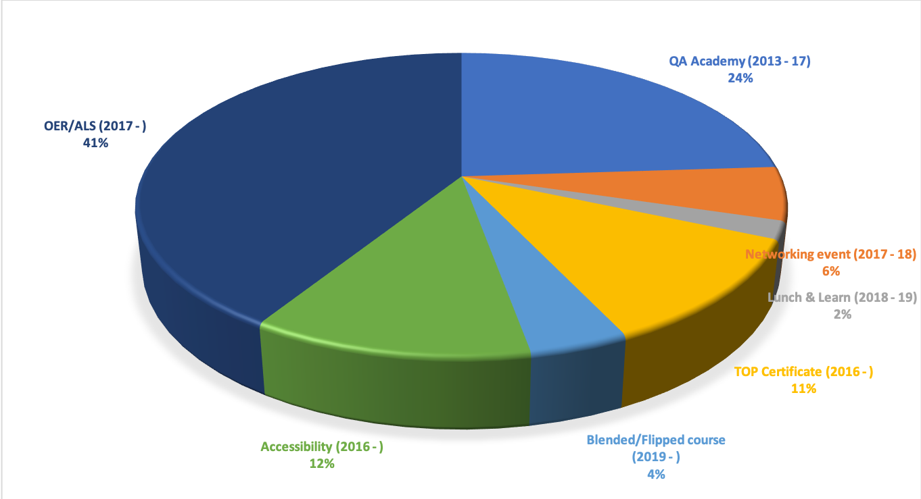
Other Professional development at CSUF
263 faculty and staff participated in these trainings and workshops over the past few years focused on online and blended courses
Notes:
Beside QA trainings, many other professional development training workshops are held at CSUF through OET which are focused on online, hybrid and blended courses. There are working groups of faculty who have completed any QA training to meet regularly and share ideas, networking events, Lunch & learn events. TOP - Teaching Online certificate program (4 modules), OER, blended/flipped, accessibility offered through OET. There are also certification programs focused on accessibility/UDL and OER/ALS.

Slide 16
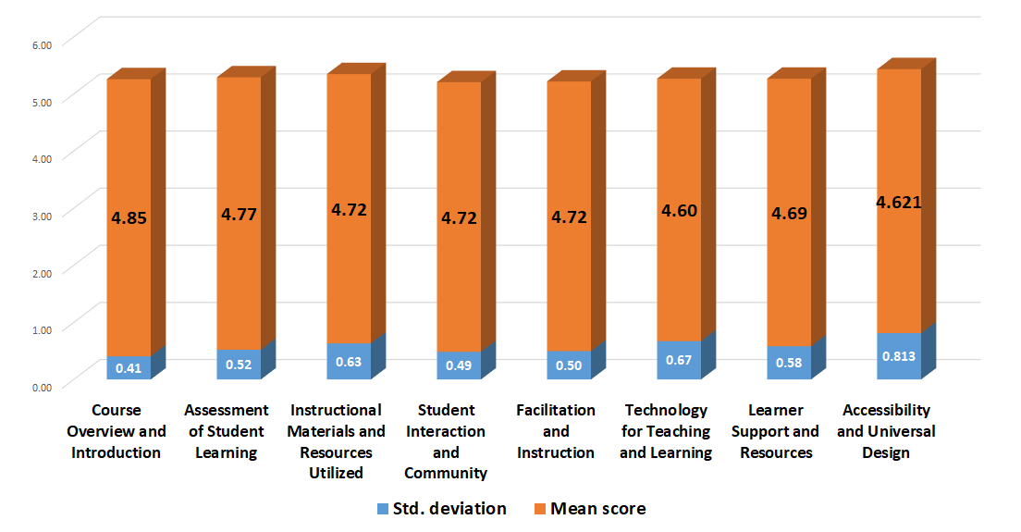
Student Survey Results – 2017-18
N = 27; Overall mean = 4.71
Notes:
Results are generally positive (6-point Likert scale) from the 25-item student survey that are administered through the CSU CO. Highest mean: Course overview and introduction; Lowest mean: Technology for teaching and learning. The overall mean score was 4.71 from a sample of 27 students.

Slide 17
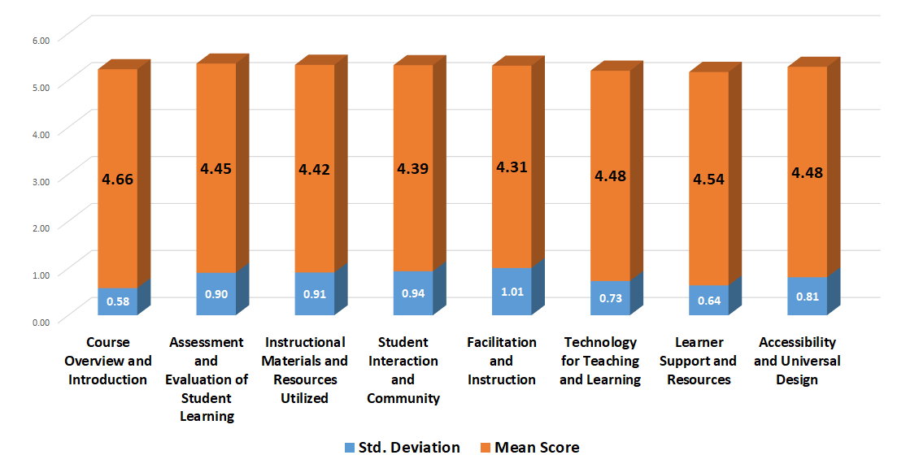
Student Survey Results – 2018-19
N = 66; Overall mean = 4.48
Notes:
Results are generally positive (6-point Likert scale) from the 25-item student survey that are administered through the CSU CO just like the previous academic year. Highest mean: Course overview and introduction (same as before); Lowest mean: Facilitation and Instruction (different). The overall mean score was 4.48 from a sample of 66 students. The mean values are generally lower from last year although still shows significant positive feedback from students.

Slide 18
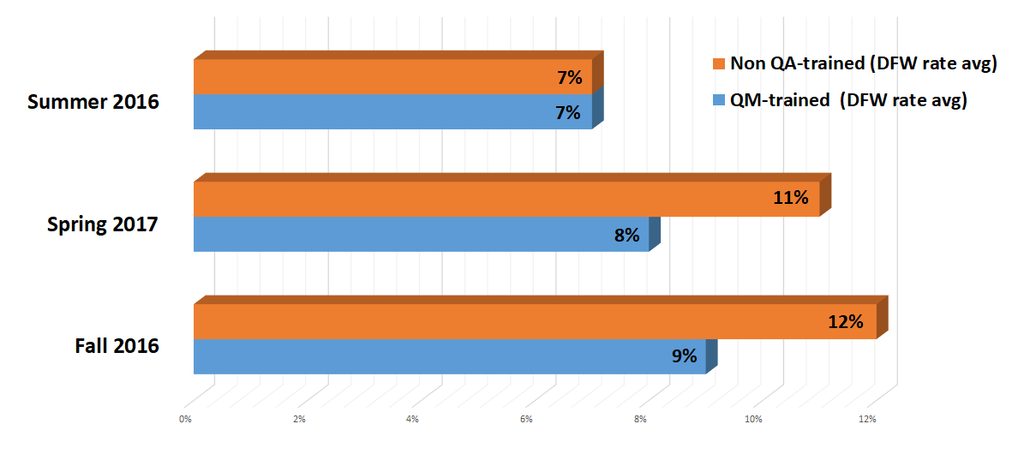



Student Outcome Findings: DFW Rates
Notes:
These are data collected from our first campus study done in 2017 and it covered data collected from courses offered in Summer 2016 - Spring 2017. We compare the DFW rates (students who obtained D, F, W grades in courses and will need to repeat them) across courses taught by faculty with QM training and those taught by faculty with no QA-related training. It is seen here that these rates are lower for faculty with QM training. A statistically significant difference (p-value < 0.0001) was observed for Fall 2016 and Spring 2017 data; however, the sample sizes were quite different and hence the difference effects were seen to be only moderate.

Slide 19
DFW Rates: Fall 2018 - Fall 2019
DFW Rates categorized by the number of QA trainings completed by their course instructor (0 - 3)
 | 0 | 1 | 2 | 3
Fall 2018 | 1739 (11%) | 371 (11%) | 36 (10%) | 12 (6%)
Spring 2019 | 1552 (9%) | 332 (8%) | 53 (11%) | 17 (8%)
Fall 2019 | 1968 (12%) | 430 (10%) | 78 (13%) | 8 (10%)
Typically average DFW rates are lower for those courses which are taught by instructors who completed more QA trainings except for a few exception cases - Spring 2019 and Fall 2019 (instructors with “2” trainings)
Notes:
These are data collected from Fall 2018 - Fall 2019 (we don’t collect summer data anymore). Data from campus were not collected in Fall 2017 and Spring 2018.
[Read what’s on the slide mainly]. Sometimes, the type of course plays a bigger role in determining the course grades, so different trends are observed.
Additional info (will mention if needed/asked):
F18 totals: 16184, 3433, 365, 188
S19 totals: 16370, 4004, 461, 209
F19 totals: 17062, 4555, 592, 77

Slide 20
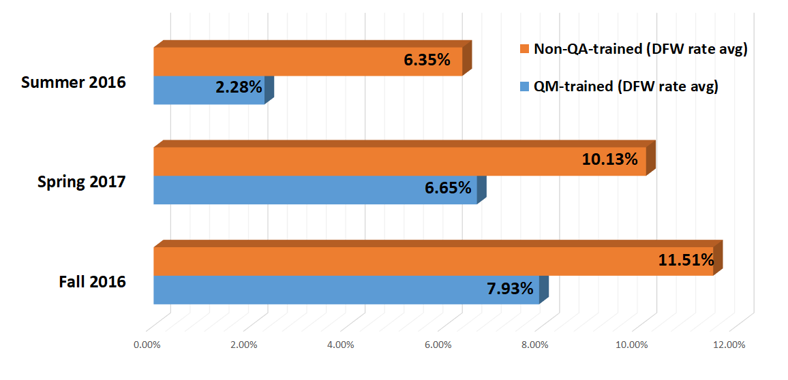
Student Outcome Findings - URM
All the differences were statistically significant at the 5% level of significance (p < 0.01)
Nf = 26 Nf = 202
Ns = 68 Ns = 543
Nf = 38 Nf = 301
Ns = 193 Ns = 1734
Nf = 37 Nf = 290
Ns = 162 Ns = 1700
Notes:
This graph demonstrates the DFW rates for URM students which are compared across courses taught by QM-trained faculty and non-QA-trained faculty between Summer 2016 and Spring 2017. It is seen here that these rates are lower for faculty with QM training. A statistically significant difference (p-value < 0.0001) was observed for all the three semesters; however, the sample sizes were quite different and hence the difference effects were seen to be only moderate.

Slide 21
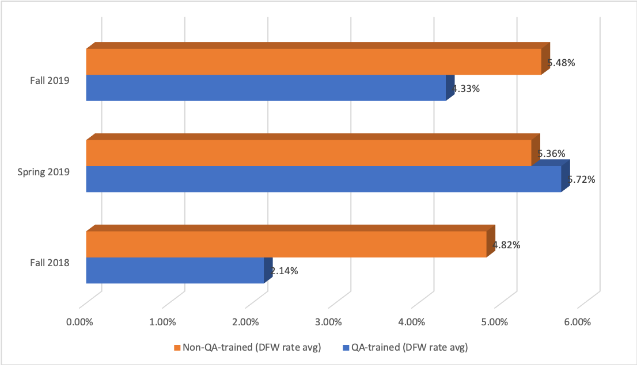
Student Outcome Findings - URM
Notes:
This graph demonstrates the DFW rates for URM students which are compared across courses taught by QM-trained faculty and non-QA-trained faculty between Fall 2018 and Fall 2019 (excluding summer). Only the Fall 2018 data showed statistically significant difference at the 5% level of significance. in Spring 2019, the rates were slightly higher for QM-trained faculty; however, the difference was not statistically significant.

Slide 22
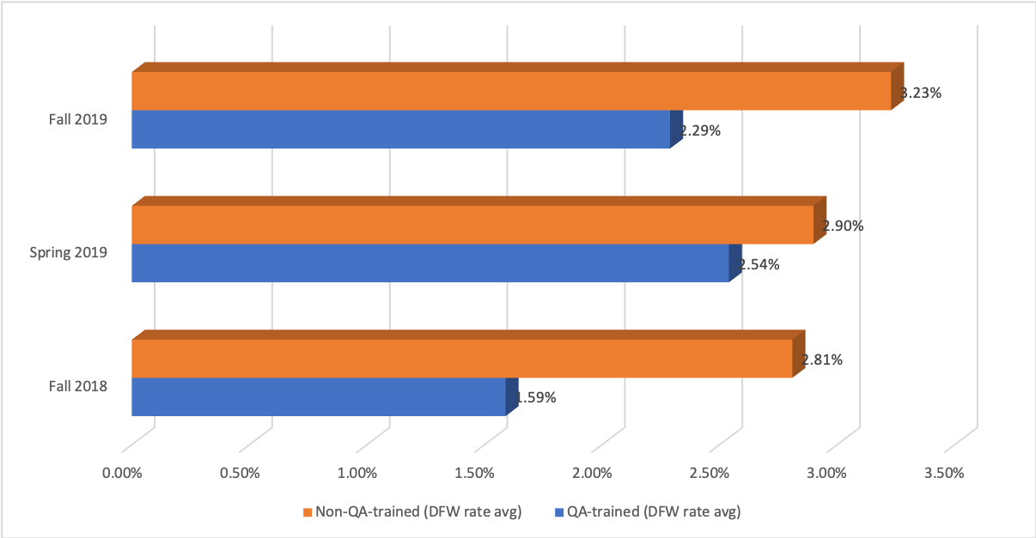
Student Outcome Findings - First gen
Notes:
This graph demonstrates the DFW rates for first generation students which are compared across courses taught by QM-trained faculty and non-QA-trained faculty between Fall 2018 and Fall 2019 (excluding summer). The Fall 2018 and Fall 2019 data showed statistically significant differences at the 5% level of significance.

Slide 23
Faculty Survey – QM Certified Course Experience (17-18)
Three faculty members reported:
a significant increase in their self-confidence and satisfaction teaching the same online course post QM-certification
that the QM experience made their courses more rigorous, improved ease of navigation for students, and resulted in observed improvement in student perceptions of the course delivery
that QM was the most impactful professional development experience at CSUF in terms of teaching, which helped improve their online course delivery method considerably
Notes:
In 2017-18, a small group of faculty who had a QM-certified course on campus participated in a campus study where they responded to a detailed questionnaire on their whole QM experience, the changes they have made to their courses, and general reflections about their own professional development in the process. This is what 3 members (who responded to the survey) said: [read from the slide].

Slide 24
Faculty Survey – 2018-19
N = 13
Usefulness of QA professional development opportunities to teaching (scale 1- not at all useful to 3 – very useful)
      Mean = 2.69 (69% very useful; 31% somewhat useful)
How beneficial was QA training to student learning in online course (scale 1- not at all beneficial to 3 – very beneficial)
      Mean = 2.69 (69% very beneficial; 31% somewhat beneficial)
Notes:
In 2018 - 19 the survey developed by the CSU CO was used to obtain faculty feedback. 13 faculty participated in the academic year. Two of the questions on the survey were these - [Read from the slide].

Slide 25
Top 3 Faculty Ranking of QA Topics (1 - Most, 10: Least)
Top 3 Pedagogical Methods Implemented by Faculty
Rank | QA training topics | Rank - weight
1 | Assessment and Evaluation of Student Learning | 3.38
2 | Student Interaction and Community | 3.62
3 | Instructional Materials and Resources Utilized | 3.69
Pedagogical methods | Count | Percent
Discussion Topics/Forums | 10 | 76.9
Rubrics | 9 | 69.2
Active Learning Strategies | 7 | 53.8
Notes:
These are the top QA topics that faculty found useful and the top pedagogical methods they implemented after the QA training.
Since one of the main QA topics was “student interaction”, it seemed logical that most faculty made use of Discussion Topics/Forums to further improve their online teaching practice
Similarly more faculty focused on developing rubrics properly to facilitate student learning and assessment
Active learning strategies are also important in an online learning environment - the more resources and materials the instructor can provide for this purpose, the better the learning experience will be for students

Slide 26
Faculty Survey – Teaching Experience
 | # of years teaching at college-level | # of years teaching at CSUF | # of years teaching online
QA-trained faculty | Mean = 15.4 Median = 15 SD = 9.9 | Mean = 11.5 Median = 11 SD = 6.7 | Mean = 6.5 Median = 5 SD = 3.9
Non QA-trained faculty | Mean = 16.3 Median = 14 SD = 9.5 | Mean = 12.4 Median = 11 SD = 8.4 | Mean = 5.6 Median = 5 SD = 3.7
N = 28 (60% response rate)
N = 128 (32% response rate)
Notes:
This is a snapshot of the background of faculty who taught at least one online course in AY 2018-19. There were over 300 such faculty members; however, only 156 responded. These data were obtained via a separate survey sent out by me through campus IT.

Slide 27

CSU Bakersfield
SQuAIR Research Associate
Jianjun Wang
Notes:
CSU Bakersfield is one of the first 4 CSU campuses that participated in the Quality Assurance project led by our CO.

Slide 28
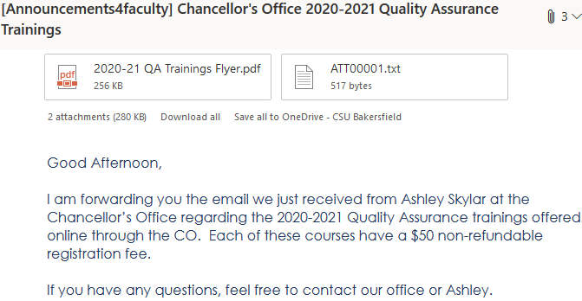
System-wide Leadership on the QA Initiative
Notes:
Thus, we acted together as a university system. As shown in this slide, faculty announcement was made for online QA training from CO.

Slide 29
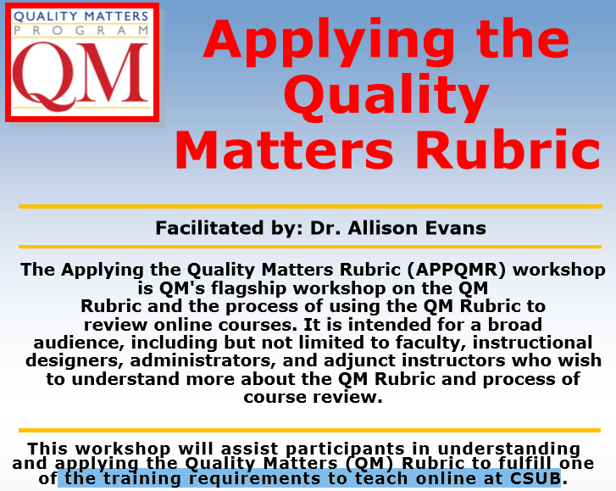
Campus-wide QM Learning Opportunities
Notes:
In addition, workshops are offered locally at CSUB to facilitate adoption of the QM rubric.

Slide 30
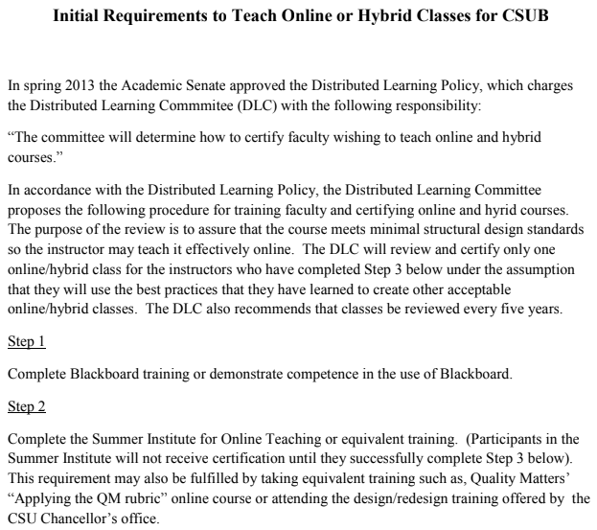
Senate Resolution https://docs.google.com/viewerng/viewer?url=http://www.csub.edu/tlc/_files/_Spring_2014_PDFs/Requirement%2520to%2520Teach%2520Online%2520or%2520Hybrid%2520Classes%2520for%2520CS.pdf
Notes:
The campus authority is designated by online senate resolution for online and hybrid courses. -- We are also engaged in ongoing improvement. For instance, we are about to update the stipulation to reflect transition of the LMS from Bb to Canvas

Slide 31
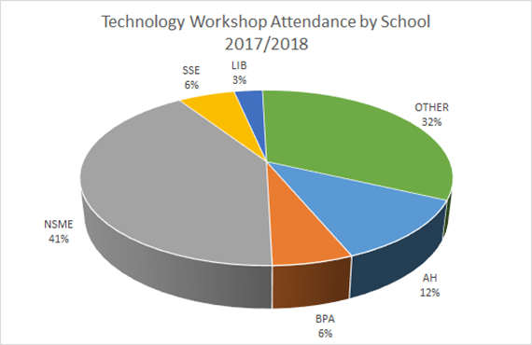
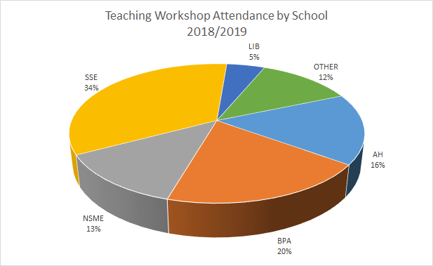
Ongoing Effort in Faculty Professional Development
Notes:
At the school level, due to subject competency, NSME faculty were more familiar with technology, and they have more attendees at the initial workshops in 2017. Eventually, by 2019, the number of attendees is proportional to the student enrollment figures in each school. Hence, the policy has filtered through instructor preparation over time.

Slide 32
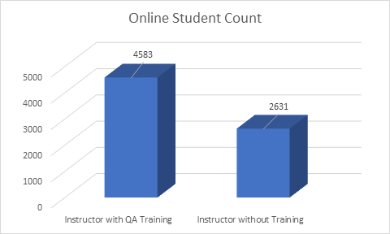
Quality Assurance on the Alternative Delivery of Academic Programs
Impact of QM Training on Online Instruction
To date, 430 instructors completed QM (N=408) and QLT (N=22) training. In Academic Year 2019-2020, the majority of online students are enrolled in courses taught by instructors with QM/QLT training.
Notes:
To date, a total of 430 instructors completed QA training. In Academic Year 2019-2020, the majority of online students are enrolled in courses taught by instructors with the training.

Slide 33
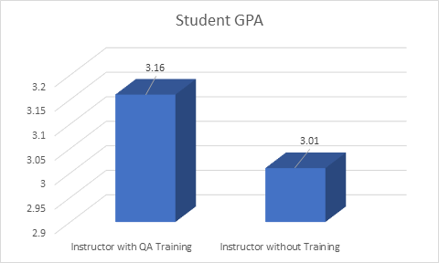
Instructors completing CSU QA professional development are more able (than non-trained peers) to design and deliver online courses more effectively
2. Significant difference has been found in student GPA outcomes between QA-trained and yet-to-be-trained instructors [t(5255.3)=5.53, p<.0001]
Notes:
As a result, significant difference has been found in student GPA outcomes between QA-trained and yet-to-be-trained instructors. The decimal point in df was caused by rejection of the null hypothesis in Levene’s equal variance test

Slide 34

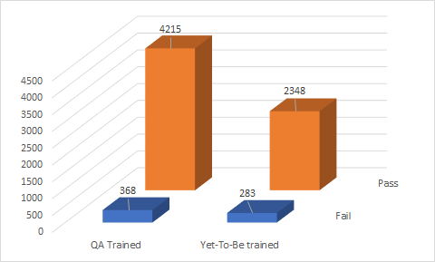
Fewer students received DWF grades
Instructor’s support for course completion (DWF grade reduction)
Notes:
The result also confirmed significant reduction of DWF grades in Chi-Square test.

Slide 35
Improvement of Student Satisfaction Toward Online Learning
Student Engagement (Pertaining to Rating Questions 1-9)
Course Overview and Introduction; Assessment and Evaluation of Student Learning
Online Education (Pertaining to Rating Questions 10-18)
Instructional Materials and Resources Utilized; Student Interaction and Community; Facilitation and Instruction
Support Platform (Questions in Final Comments)
Technology for Teaching/Learning; Support/Resources; Accessibility/Design
Notes:
Altogether, we found that instructors completing CSU QA professional development are more able (than non-trained peers) to design and deliver online courses more effectively.

Slide 36
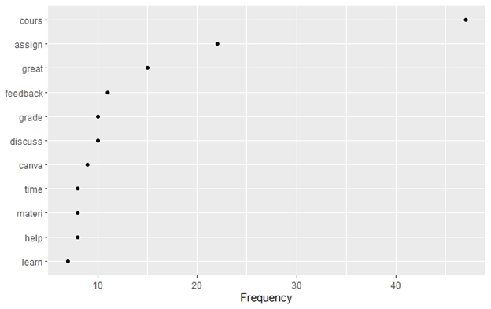
Most frequently-used words in the 2019 survey of CSUB students
Notes:
We used a new R package, quanteda, to handle the text analytics. Most frequently-used words in the 2019 survey of CSUB students show more focus on learning tasks, such as course assignment, grading, discussion, canvas setting, and learning materials. Students also expressed positive sentiments, including great feedback and timely help from online learning.

Slide 37
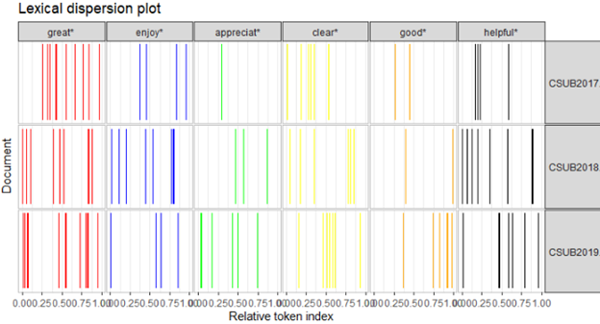
Lexical dispersion plot of student positive word choice at CSUB
Notes:
Lexical dispersion plot was created to document the relative location in the student responses that contains these positive words, such as great, enjoy, appreciate, clear, good, and helpful.

Slide 38
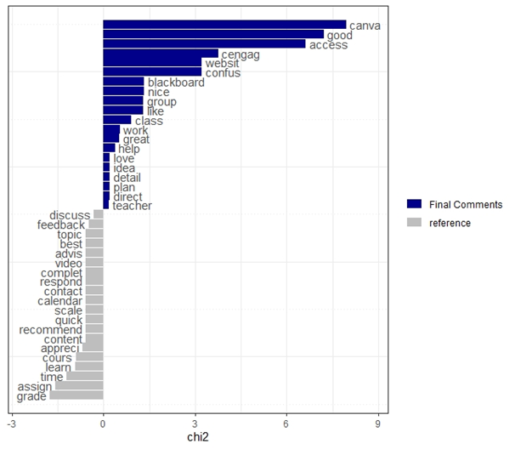
New Findings from Text Analytics of Open-Ended Items in Student Survey
Keyness
Plot
Notes:
We also contrasted the results on time dimension to reveal new findings. In particular, the keyness plot included a keyword canvas, which was never mentioned in the baseline reference data from past.

Slide 39
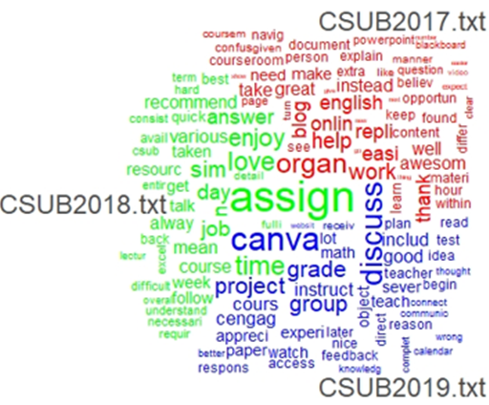
Word cloud plot on the share of words across three years
Notes:
With the quanteda software to stem the key word to reduce the data sparsity, we examined the word cloud plot on the share of words across three years. In 2017, not all faculty had the QM training, which highlighted the factor of course organization; In 2018, students considered assignment as an important component. In 2019, respondents more frequently mentioned the LMS change to canvas!

Slide 40
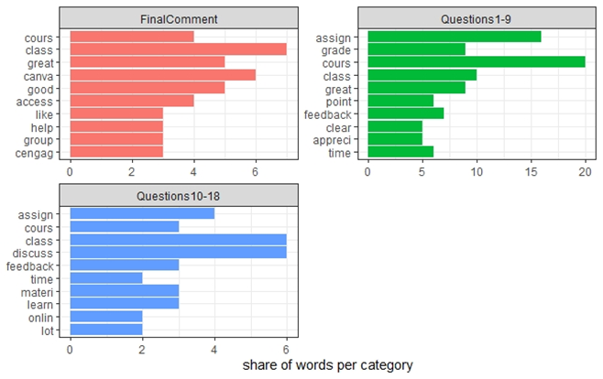
.Distribution of frequently-used words in three survey categories.
Notes:
Distribution of frequently-used words also varied across three survey categories. The first category on Student Engagement pertains to Questions 1-9 on Course Overview and Introduction of Evaluation; The second category deals with Questions 10-18 on Online Education. The final comment part is focused on supporting resources. In comparison, a great course overview or introduction is reflected by clarity (see the plot for Q1-9). Detailed instruction features, such as discussion, feedback, online materials, and class access, are more reflected in Q10-18 and final comment sections.

Slide 41
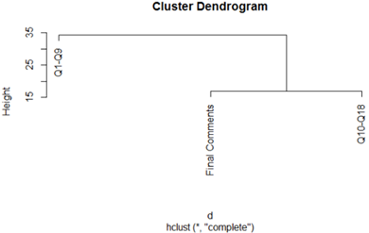
Cluster dendrogram of student responses across the three survey sections
Notes:
The response clustering is also confirmed by dendrogram. The responses in Q10-18 and final comment are clustered with less distance than the responses from Questions 1-9.

Slide 42
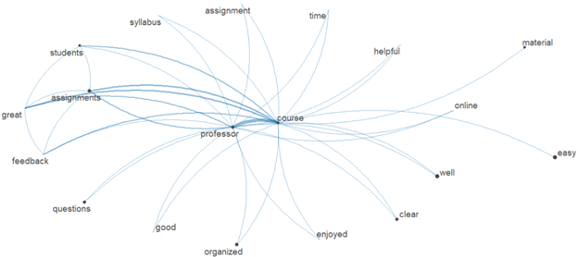
Aggregated macro structure of word connections
Notes:
We further aggregated macro structure of word connections across the survey sections. Because teaching is under faculty control, the plot shows the strongest connection between professor and course. Student great feelings are also linked to these core components in the plot. Instead of claiming what works, we should emphasize on what works for whom and in which context. Thus, assignments, feedback, and students are related to relatively thick links to the course component. In this regard, our results echoed importance of the eight general standards of QM, particularly standard 3 on Assessment, Standard 5 on Interaction, and standard 7 on Learner Support.

Slide 43

Mary Bennett, MA
Instructional Designer
Center for Faculty Excellence
QLT Program Manager
CSU Office of the Chancellor
Notes:
Introduction
Focus on policy that drove training and the results

Slide 44
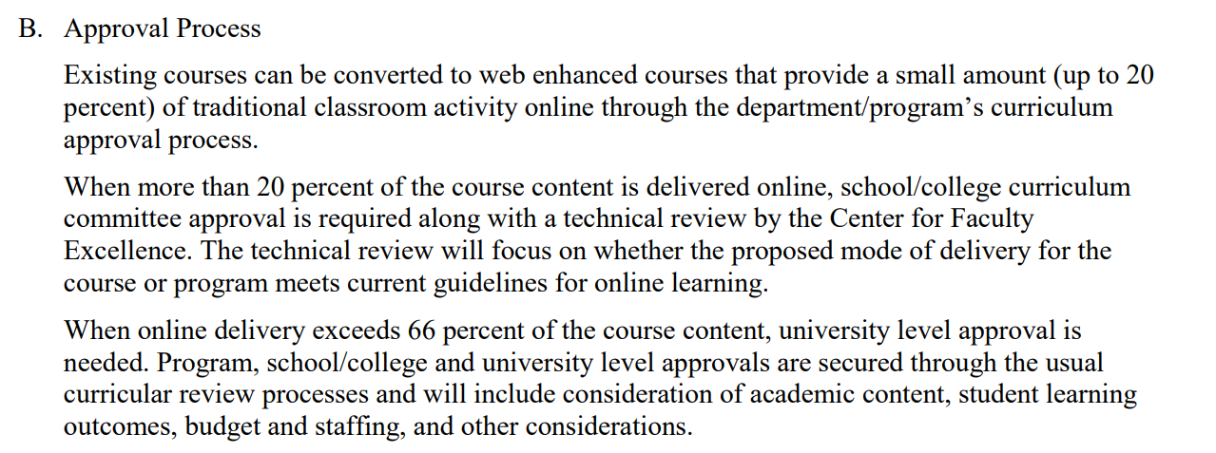
APM 206: Policies and Procedures on Technology Mediated Courses and Programs
Approved Spring 2018
  Faculty who will be teaching online or blended courses (beyond 20% of the entire course) must successfully complete the required online training
Course Categories
  Blended I (20 - 66%)
  Blended II (67 - 99%)
  Online (100%)
Adoption of the QLT Instrument
Notes:
Policy that drove training
B is the section of the policy that defines course categories
Tagged in PeopleSoft

Slide 45
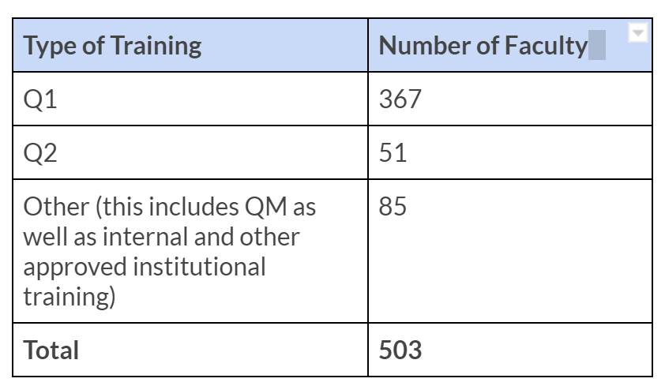
QA Trainings at Fresno State
Since Spring 2018
73 faculty participated in QLT Training
Notes:
Fresno State specific trainings
Reach out to faculty who have online courses tagged and have not been trained

Slide 46

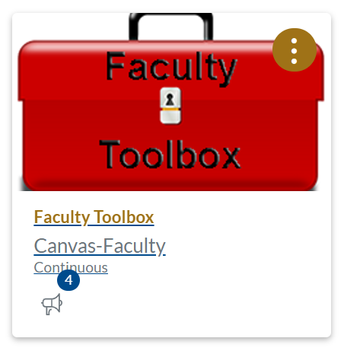

Notes:
Just in time resources
Brief desctiption of the templates
Aligned to the QLT Rubric

Slide 47
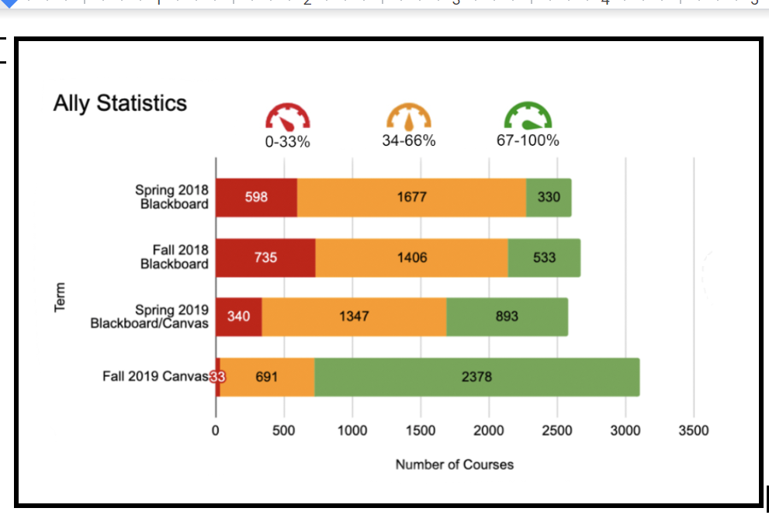
Addressing Accessibility
Notes:
Accessibility integrated into all training
Ally numbers

Slide 48


Other Training Opportunities
Canvas
UDL Certificate
DISCOVERe
OER
Notes:
Move from Canvas to Blackboard - Canvas Certificates
number of trainings
UDL
OER
DISCOVERe

Slide 49
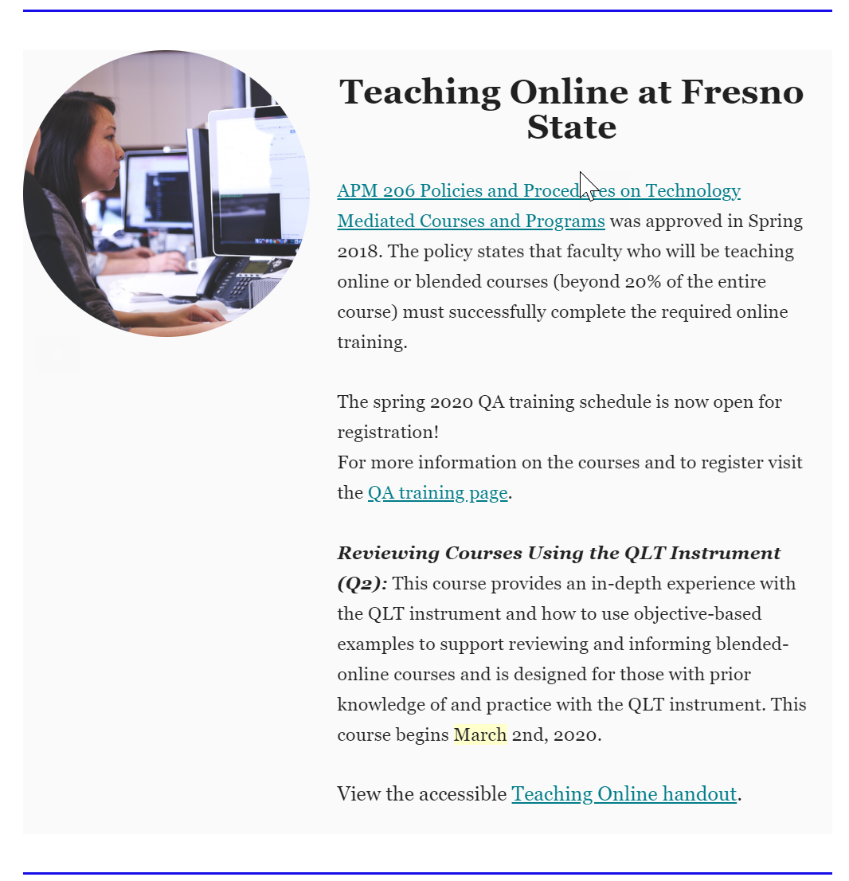
Monthly Newsletter
Google Calendar Invites
Department Meetings
Notes:
Communication
Number of department trainings

Slide 50
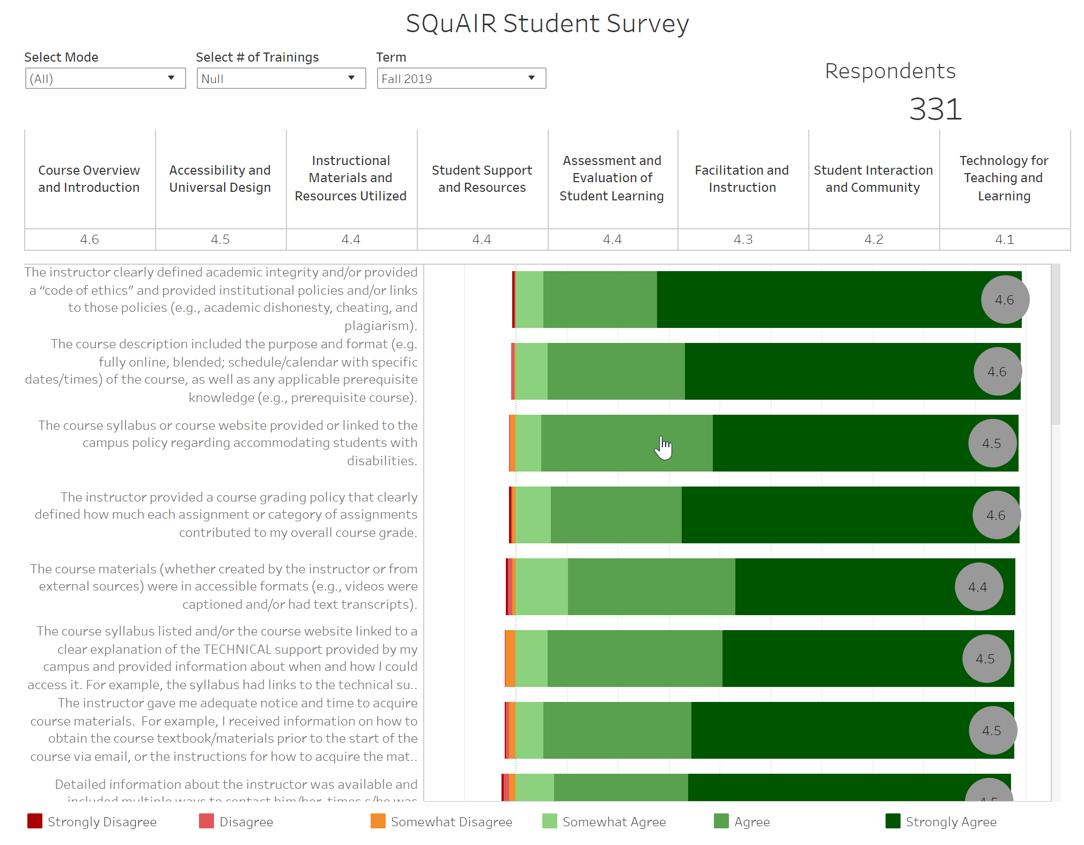
Institutional Dashboard SQuAIR Data Fall 2019
Notes:
Rise in number of trained faculty/resulting in participation in SQuAIR
Looking at Fall 2019

Slide 51
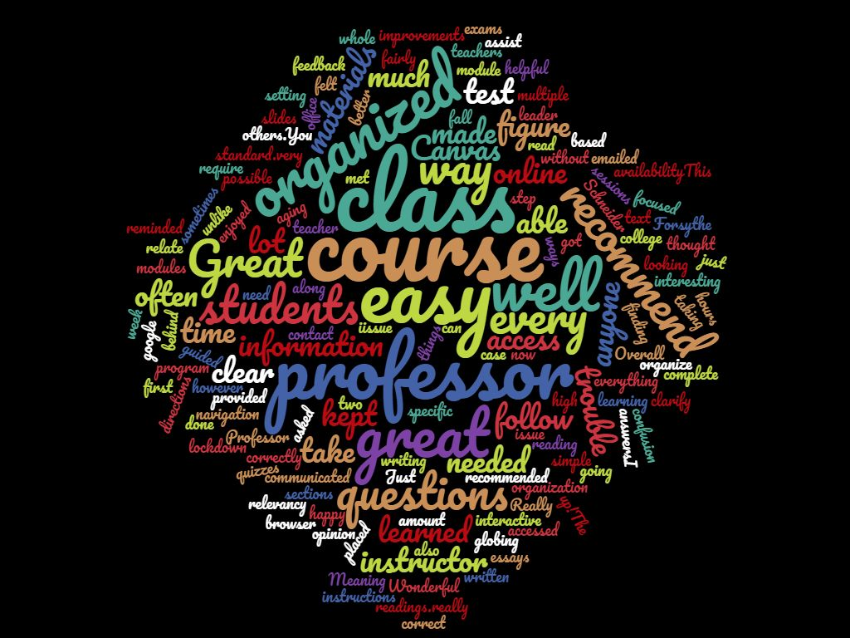
Notes:
Fall 2019 Student Comments
How the comments are an indicator of training and align with SQuAIR data

Slide 52

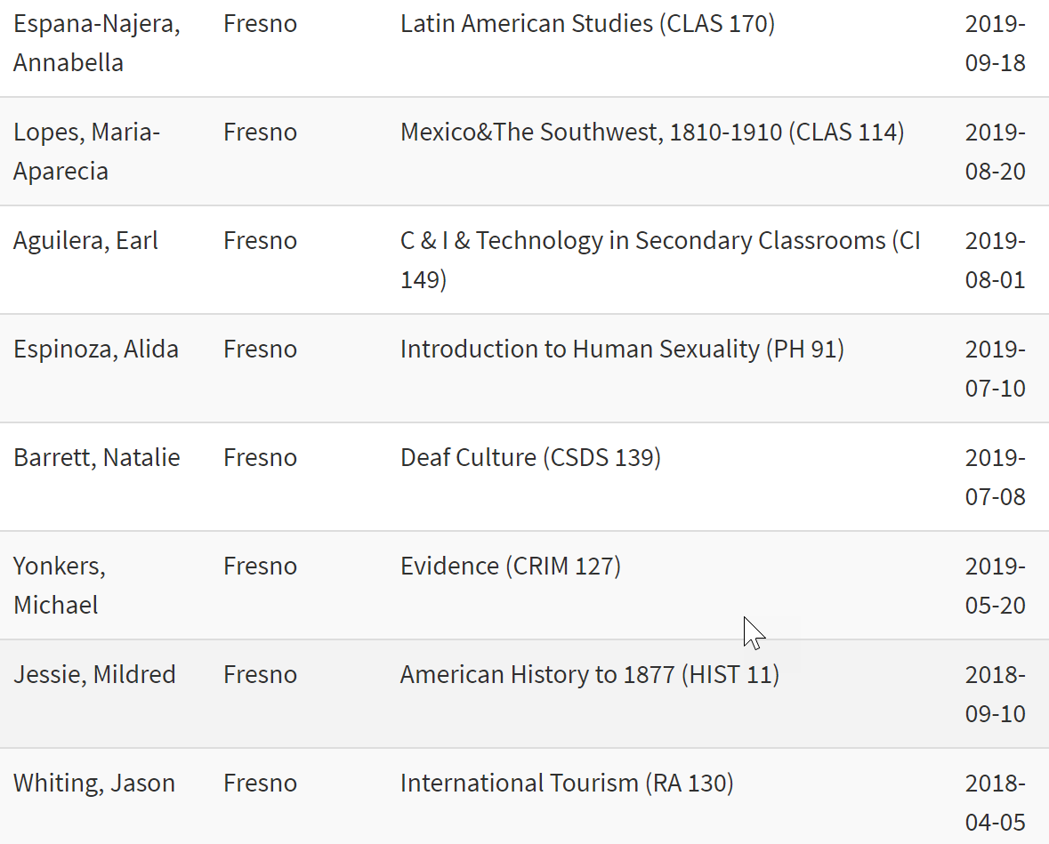

SQuAIR Data as an Indicator for Course Reviews
Notes:
Current data on formal course reviews at Fresno State
3 courses identified based on SQuAIR data

Slide 53
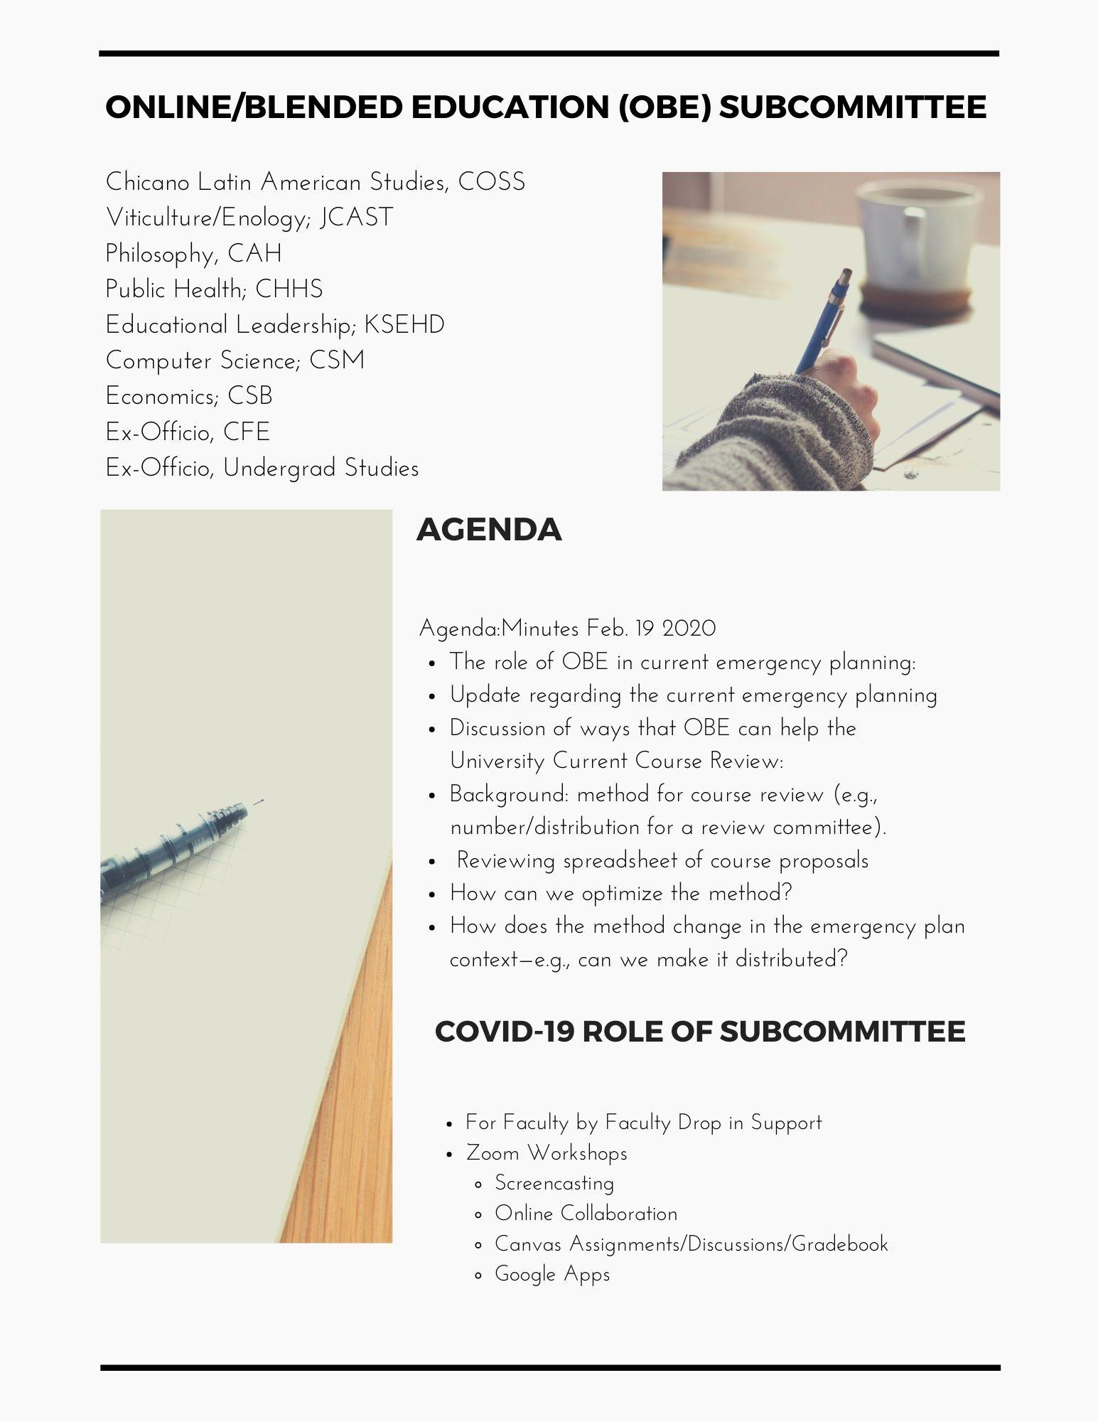
Notes:
Brief description of course review process and new subcommittee
Faculty Fellow and ID’s
APM 206 Sub-committee
One Faculty from each College
QLT trained

Slide 54
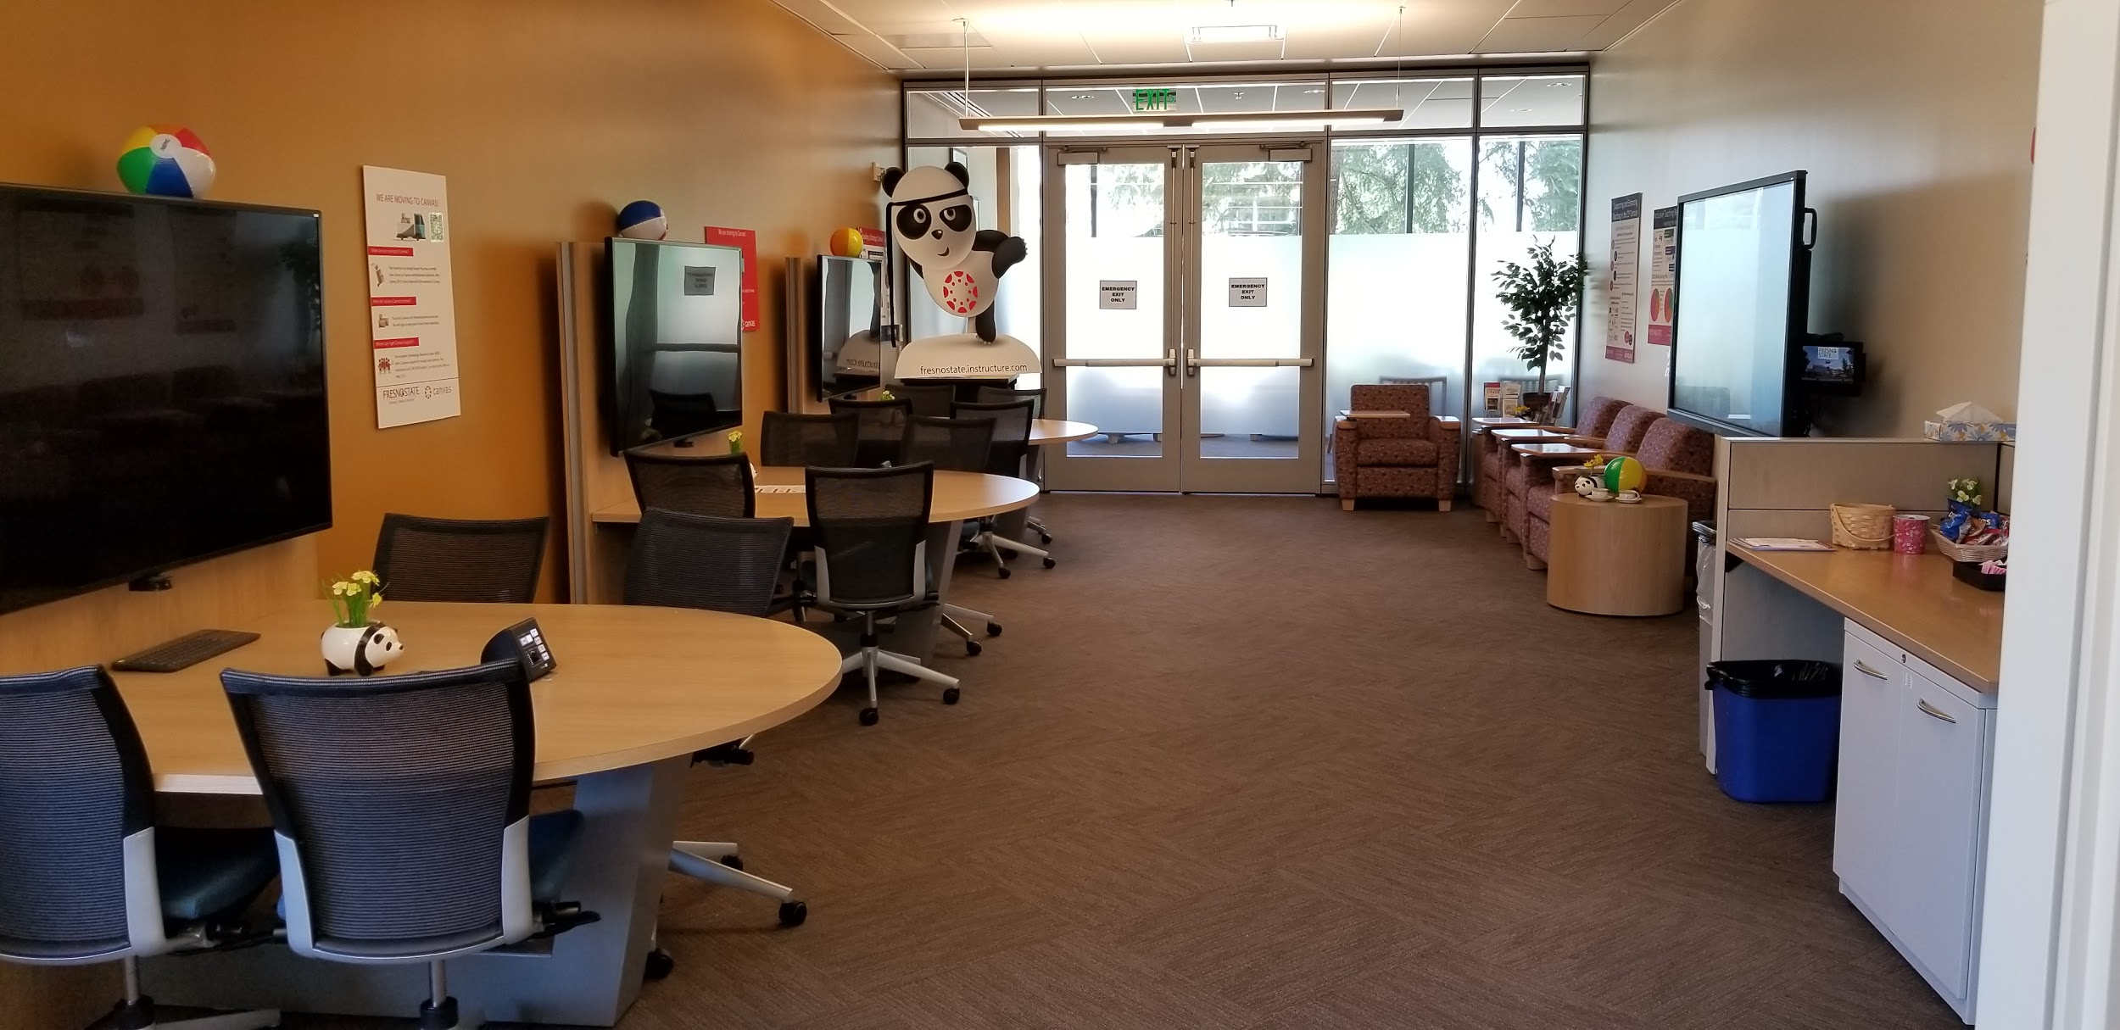
Notes:
Culture Shift
Collaboration and networking in the CFE as a result of trainig

Slide 55
Hypotheses #1: “Instructors completing CSU QA professional development are able (than non-trained peers) to design and deliver online courses more effectively”
“This training really helps especially in a time like this! I would feel much more stressed right now if it was not for taking this course.”
“All of a sudden, it all became very real, and so I am "feeling" the Q1 and Q2 work in a more urgent and immediate way. I will say this: watching so many of my colleagues panic at the prospect of a new online reality has made me grateful for the training I have received and eager to share it with others"
Notes:
Quotes
Next steps/ data driven from OIE

Slide 56
Closing - Contacts
Ashley Skylar, CSU Office of the Chancellor, askylar@calstate.edu
Sinjini Mitra, CSU Fullerton, smitra@fullerton.edu
Mary Bennett, Fresno State, mbennett@mail.fresnostate.edu
Jianjun Wang, CSU Bakersfield, jwang@csub.edu
http://qa.csuprojects.org

