Slide 1
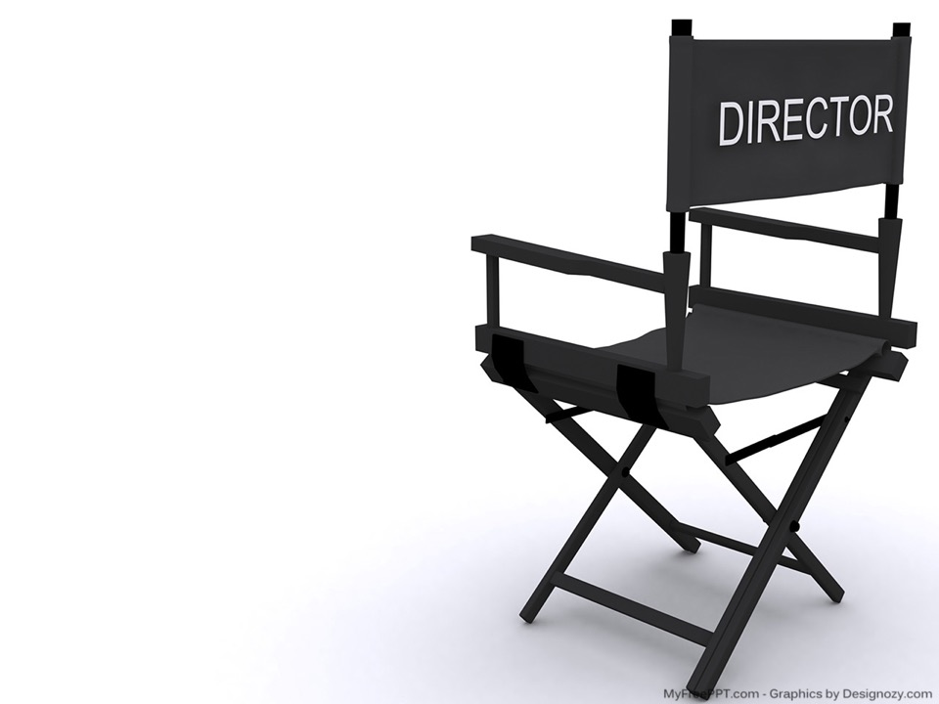
Screen Time with Standard 8

Slide 2

About Us.
Dr. Avila Hendricks
Bachelor of Liberal Studies,
Department Chair
Lincoln University of MO
Dr. Rachel Sale
Division of Educationanl Innovation and Extended Studies

Slide 3


Learning Objectives
Apply QM Standard 8 Guidelines
1
Identify and discuss accessible alternatives to text-based course formats using video tools.
2
Create a plan for a personalized "Welcome to the Course" video.
3
Notes:
Let's face it! Course design with QM Standard 8 in mind can take time! We'll show options to make your job easier, such as Screencast-0-matic. Prepare a brief script and bring your own device. Once you use a video option, it'll become a way of engaging with your students through short lectures.

Slide 4
Accessibility is not an option
The United States Workforce Rehabilitation Act of 1973 (29 U.S.C. § 794d) and it’s related Amendment Section 508, are the federal laws requiring that all electronic and information technology be accessible to people with disabilities.

Slide 5
Get the terms straight!
Whereas Title III of the Americans with Disabilities Act (ADA) primarily established design requirements and standards for the construction and alteration of facilities, Section 508 laws relate to access to Information and Communications Technology (ICT). Known as the Accessibility Compliance Regulations, Section 508, ensures that digitally published material, including websites and multimedia, are available to people with visual, auditory and other sensory challenges.
What’s the difference between the Americans with Disabilities Act (ADA )and Section 508?
For more information on the Accessibility Laws refer to: The Federal Register, published on January 18, 2017 and amended on March 23, 2018.

Slide 6
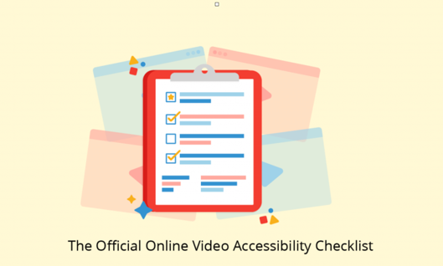
Closed Captioning
Audio and Video Transcription
Audio Descriptions
Choosing a place to host my video that facilitates accessibility
Notes:
Even if you do everything correctly (Captioning, transcriptions, descriptions), hosting in the wrong environment can ruin your intended product.

Slide 7
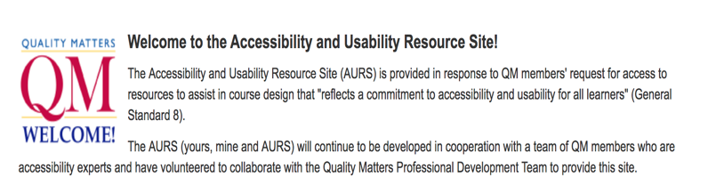
QM is always your Resource point
Melissa Poole is the QM contact for this page
Register on the QM site

Slide 8

www.freepik.com/free-vector/business-woman-giving-a-speech-showing-sales_1311610.htm
Notes:
Let's face it! Course design with QM Standard 8 in mind can take time! We'll show options to make your job easier, such as Screencast-0-matic. Prepare a brief script and bring your own device. Once you use a video option, it'll become a way of engaging with your students through short lectures.

Slide 9





It’s a video world!
What are some of your favorites?
Notes:
Audience Participation: Identify and discuss accessible alternatives to text-based course formats using video tools.

Slide 10
If it wasn’t…
8.4 The course provides alternative means of access to multimedia content in formats that meet the needs of diverse learners.
8.5 Course multimedia facilitate ease of use.

Slide 11
The key is to get it right for everyone, not just because it’s the law
Universal Design
"Rather than designing your instruction for the average student, you should design for potential students with a broad range in ability, disability, learning style, native language, and other characteristics." (Burgstahler 2010)

Slide 12
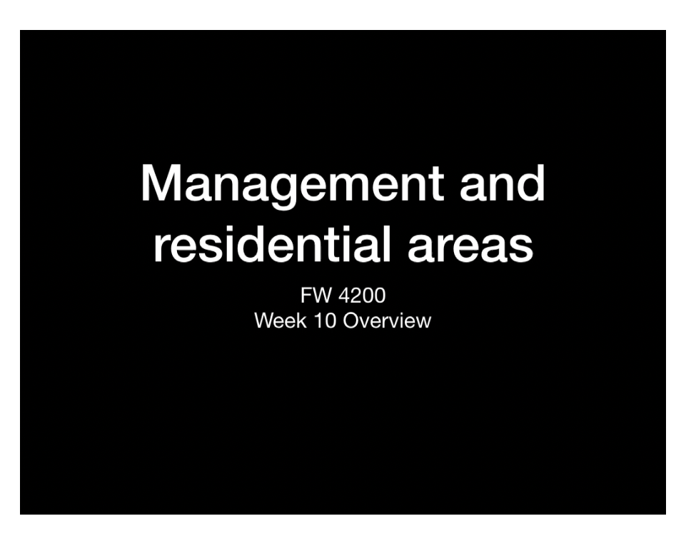
It’s not the tool… it’s the user!
Reasons to use a tool that is designed for accessibility
Sample here, to play for 30 sec-1 hour
Notes:
This is a fairly standard video developed by an instructor to introduce a unit of instruction. After watching it, what do you see that we would suggest the instructor add to improve the content and accessibility?

Slide 13

Notes:
Sometimes, you just never know. Higher ed students are not required to register. Or if you are an adjunct, maybe the student thinks you know his/her situation, when you really don’t.
For example, This is your student, as you see her during chats and other engagements…..

Slide 14
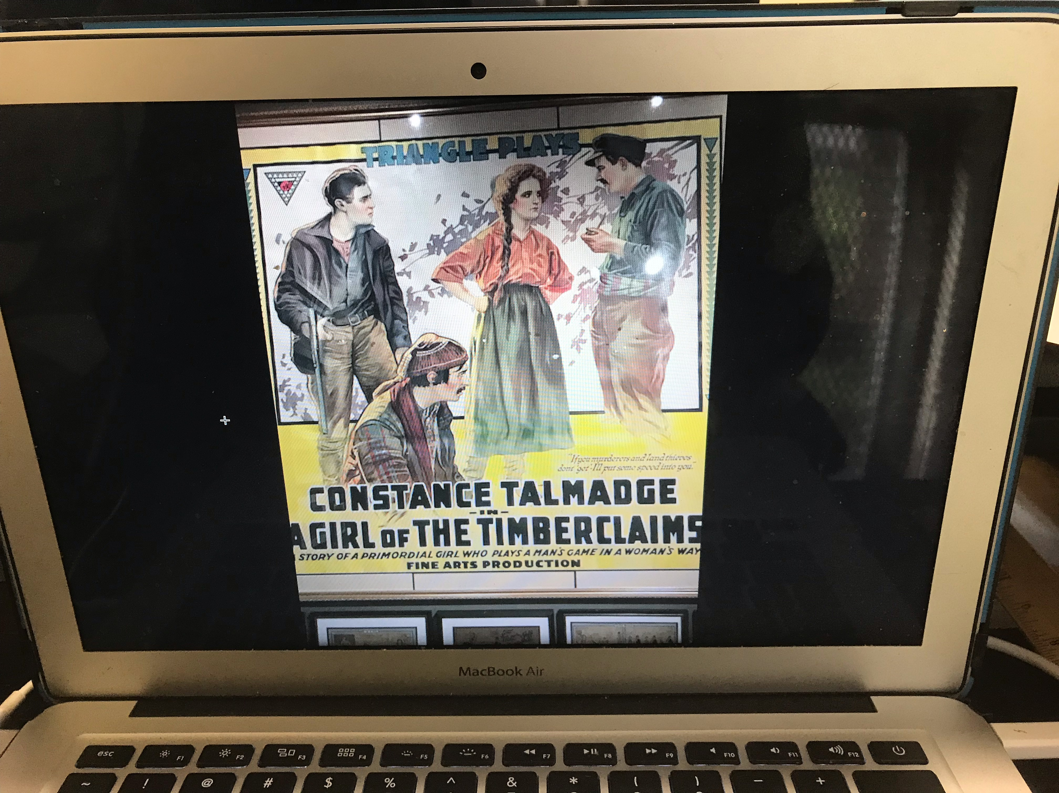
Notes:
This old movie poster is what you want her to use in a discussion prompt.

Slide 15


Slide 16

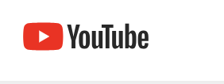
Small steps, Big Changes
Notes:
While we are not advocating any one company, software, or process, the rest of this presentation will look at how one small instructional design office handles multiple video options over a semester and make every attempt to meet expectations.

Slide 17

Simple
Easy free
Visit the Screencast-o-Matic website

Slide 18

Begin at the Beginning…Your Welcome to class message
Notes:
Although the recording is fun and rewarding, like all good work, the end result is the product of good planning. For the rest of this session, we will be working in groups to create a script and plan for your video. Not only will you be confident and prepared after this process, you will have the basic parts of your transcription complete.

Slide 19

Screencast o matic workstations
Brainstorm intro ideas
Script creation
Try it out

