Slide 1
Self-Determination Theory and Pandemic Era Instruction

Slide 2
Objectives:
Identify one assignment that can be modified to increase student autonomy.
Describe the concept of relatedness in online, blended, hybrid, and fully online learning environments.
Draft a rubric that allows for flexibility in how learning outcome mastery is demonstrated.

Slide 3

An article in The Chronicle of Higher Education (Supiano, 2022) focuses on the new conceptualization of rigor and how the Pandemic Era has stimulated an ongoing debate about what rigor actually looks like and for whom.
It is possible to ensure rigor while also providing students opportunities to improve course flexibility and student support.
How do YOU conceptualize rigor?

Slide 4
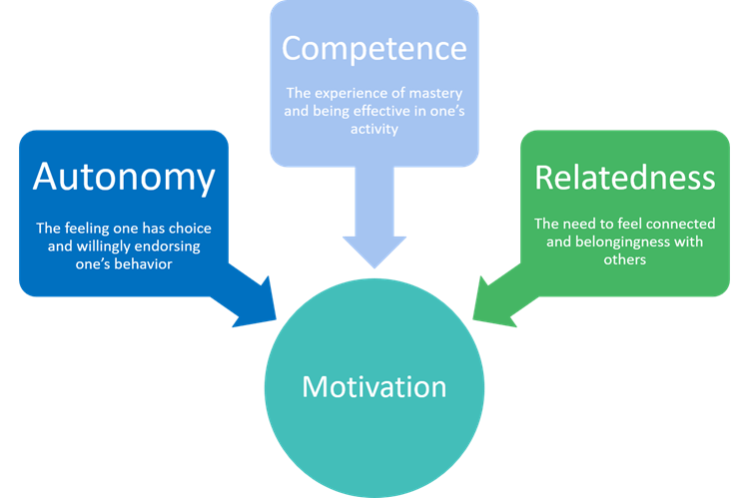
Background
Self-Determination Theory
SDT has been used to explain student motivation, especially when autonomy or control is a characteristic of the social context. The foundations of SDT consists lie in three constructs: (a) relatedness, (b) competence, and (c) autonomy (Deci & Ryan, 2004). When evaluating d course design and how it might affect student motivation, the SDT framework provides a simple and appropriate model with which to work. The self-system model of motivational development (SSMMD) builds on SDT by breaking down each of the three constructs into binary components applicable to educational settings (Dupont et al., 2014).
Relatedness
Competence
Autonomy
Relatedness refers to a sense of belonging, connection and security in the environment in which work takes place and is not dependent on either outcome or extrinsic motivating factors.
Competence refers to the student's perceived ability to meet the demands of assignments and receive rewards such as increased knowledge or insight and praise, higher grades, and other forms of feedback.
Autonomy refers to a sense of control over one's behavior, motivated by values, goals and personal interests.
Relatedness, competence, and autonomy are essential for student engagement.
According to Dupont et al. (2014, p. 10):
“students’ need for competence is satisfied when the environment provides structure; their need for autonomy is fulfilled when the environment leaves them responsibilities and choices, and their need for relatedness is fulfilled when they experience concern and affection from the environment.”

Slide 5
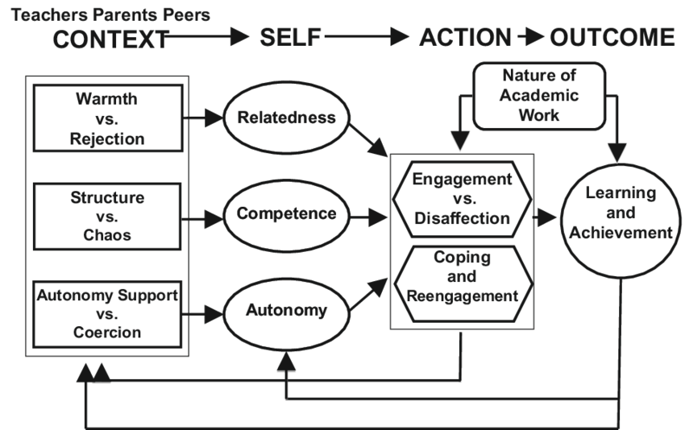
The Self-System Model of Motivational Development (SSMMD):
A Comprehensive Model

Slide 6
The Self-System Model of Motivational Development
Autonomy Support vs. Coercion
Educational Context
The need for autonomy is fulfilled when the educational environment allows for both responsibilities (e.g., due dates, specific criteria, rigor) and choices.
Do you have any assignments or activities in mind that:
Allow students to pick the topic or lens through which they demonstrate mastery of the learning outcomes?
Allow students to select the means in which they demonstrate mastery of the learning outcomes?
Allow students to share responsibility in decision-making?
Allow students to engage with the assignment without external risk (penalties) or reward (grades)?
When autonomy is supported, students are more engaged and achieve higher levels of proficiency.
Identify one assignment that can be modified to increase student autonomy.

Slide 7
The Self-System Model of Motivational Development
Warmth vs. Rejection
Educational Context
The need for relatedness is fulfilled when the educational environment includes for both concern (e.g., genuine interest in student improvement) and affection (e.g., encouragement and support).
Do you describe or approach assignment in a way that:
Directly or indirectly involves the instructor during the process? (not just the start and end)
Incorporates checkpoints for support and feedback?
Describes the assignment and its criteria in a way that are enthusiastic and encouraging rather than penalty-focused?
Relatedness encourages student enthusiasm and improves student perceptions of the learning environment.
Describe the concept of relatedness in online, blended, hybrid, and fully online learning environments.

Slide 8
The Self-System Model of Motivational Development
Structure vs. Chaos
Educational Context
The need for competence is fulfilled when the educational environment is structured in student-centered ways (e.g., meets their needs academically and is navigable without being overwhelming).
Can you design an assignment that:
Contains clear information and expectations
Involves cognitive guidance about where to find information and how to practice skills (alignment)
Incorporates constructive, timely feedback
Rubrics provide students structure (competence) and when designed with flexibility (autonomy), are fully aligned with preceding learning opportunities (relatedness) and contain opportunities for meaningful feedback (competence/relatedness), students engagement is supported.
Draft a rubric that allows for flexibility in how learning outcome mastery is demonstrated.

Slide 9
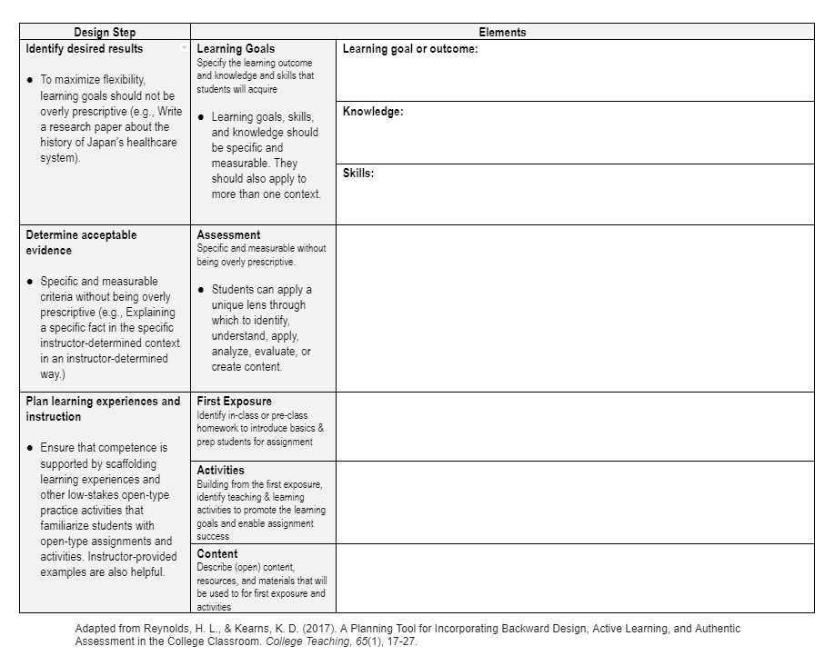
Identify one assignment that can be modified to increase student autonomy.
Draft a rubric that allows for flexibility in how learning outcome mastery is demonstrated.
Backward Design Strategies
“Backward design” ensures that assessments are aligned with learning outcomes and learning activities.
Backward design naturally supports competence, but can be adapted to support autonomy when designing assignments that are flexible and open.

Slide 10
Draft a rubric that allows for flexibility in how learning outcome mastery is demonstrated.
What’s wrong with this rubric?
 | Excellent | Satisfactory | Unsatisfactory | Points
Assignment criteria | All criteria were met with critical thinking. | Some criteria was not met or it was lacking critical thinking. | Criteria were not met and there was insufficient critical thinking. | _______/5
Timeliness | On-time. | One or two days late. | Three or more days late. | _______/5
Professionalism | Submission was neat and complete with adequate scholarly references. | Submission was sloppy, incomplete or was missing scholarly references. | Submission was sloppy, incomplete and missing scholarly references. | _______/5
______/15

Slide 11
Draft a rubric that allows for flexibility in how learning outcome mastery is demonstrated.
What’s wrong with this rubric?
 | 3 Points | 2 Points | 1 Point | 0 Points
Learning Outcome A | Student has a strong understanding of Learning Outcome A. | Student has a weak understanding of Learning Outcome A. | Student does not understand Learning Outcome A. | Missing/no attempt.
Learning Outcome B | Student included Learning Outcome B. | Student indirectly included Learning Outcome B | Student included Learning Outcome B incorrectly. | Missing/no attempt.
Learning Outcome C | Student incorporated the main concepts for Learning Outcome C. | Student did not include all of the main concepts of Learning Outcome C. | Student incorporated main concepts for Learning Outcome C incorrectly. | Missing/no attempt.
______/9

Slide 12
Draft a rubric that allows for flexibility in how learning outcome mastery is demonstrated.
What’s wrong with this rubric?
Criteria |  |  |  | Score
Learning Outcome A: Sub-level outcome 1 All criteria are included All criteria are accurate or used accurately All criteria are included with creativity All criteria are included with critical thinking. |  |  |  | _____/25
Learning Outcome A: Sub-level outcome 2 All criteria are included All criteria are accurate or used accurately All criteria are included with creativity All criteria are included with critical thinking. |  |  |  | _____/25
Dispositions Appropriate formatting is used Submission is on-time Submission is complete Submission is free of spelling or grammatical errors |  |  |  | _____/50
______/100

Slide 13
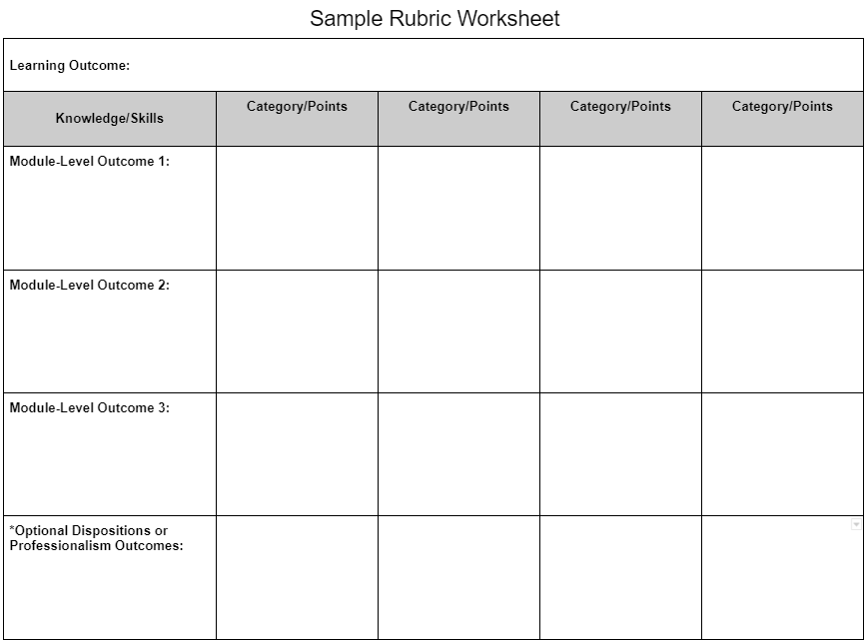
Identify one assignment that can be modified to increase student autonomy.
Draft a rubric that allows for flexibility in how learning outcome mastery is demonstrated.
Rubric Design Strategies
Rubrics must be aligned with learning outcomes and specific skills or knowledge.
Quality rubrics provide students with a transparent scoring guide and instructors with a valid and reliable assessment instrument.

Slide 14
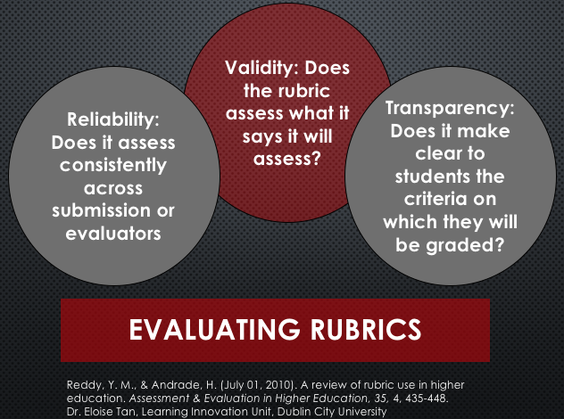
Rubric score categories with a fixed set of specific and measurable criteria aligned with learning outcomes.
Score categories communicate a level of proficiency or mastery for a specific task.
A fixed set of criteria serves as a checklist for success, assuming the criteria are met with accuracy.
Criteria should be measurable and objective so that:
  Score categories provide feedback and not just a score.
  Expectations for success are communicated with transparency.
  Objectivity in scoring criteria increases the assessments reliability.
Alignment with the learning outcomes ensures that the assessment is valid.
Rubric Elements to Consider

Slide 15
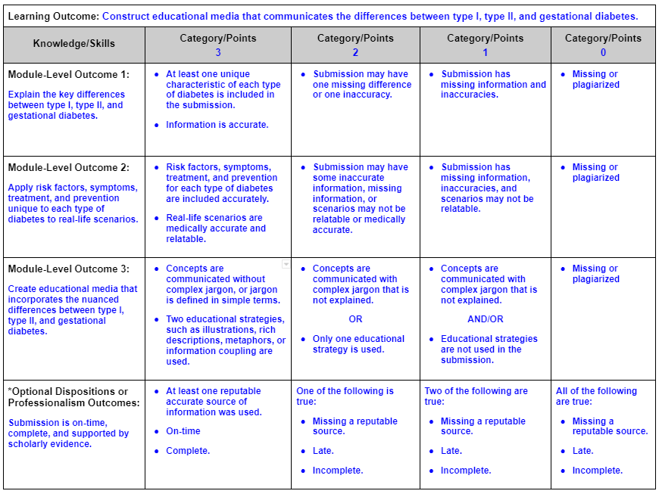

Slide 16
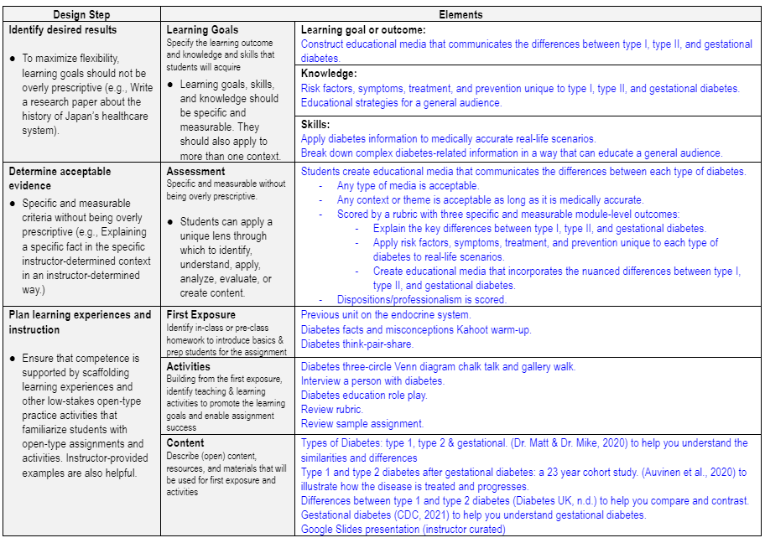

Slide 17
Identify one assignment that can be modified to increase student autonomy.
Draft a rubric that allows for flexibility in how learning outcome mastery is demonstrated.
Describe the concept of relatedness in online, blended, hybrid, and fully online learning environments.
Share your rubric and backward design sheet with another attendee!
Explain your assignment.
  What are students asked to do? (competence)
  How is the assignment flexible? (autonomy)
  How is the criteria for success both specific and measurable? (competence)
What’s the educational context?
  How is learning scaffolded to ensure student success? (competence)
  How is “relatedness” achieved in the educational context?
  How are students prepared to tackle a flexible assignment? (competence and autonomy)
Engage in dialogue:
  Ask questions.
  Provide feedback.

Slide 18
References
Armal, J. (2020, July 23). Backward design worksheet. CUNY Open Pedagogy. https://docs.google.com/document/d/1Qez64tGe8mFex1NhzJKfvpxWDkm2hqa-aOeMDC96Ns8/edit#
British Columbia Ministry of Education. (2018). A framework for classroom assessment [PDF]. https://curriculum.gov.bc.ca/sites/curriculum.gov.bc.ca/files/pdf/assessment/a-framework-for-classroom-assessment.pdf
Black, A. E., & Deci, E. L. (2000). The effects of instructors' autonomy support and students' autonomous motivation on learning organic chemistry: A self-determination theory perspective. Science Education, 84(6), 740–756. https://doi.org/10.1002/1098-237X(200011)84:6<740::AID-SCE4>3.0.CO;2-3
Deci, E. L., & Ryan, R. M. (Eds.). (2004). Handbook of self-determination research. University of Rochester Press.
Dupont, S., Galand, B., Nils Frédéric, & Hospel, V. (2014). Social context, self-perceptions and student engagement: a sem investigation of the self-system model of motivational development (ssmmd). Electronic Journal of Research in Educational Psychology, 12(1), 5–32. http://dx.doi.org/10.14204/ejrep.32.13081
Supiano, B. (2022, March 29). The redefinition of rigor: The pandemic has amplified the debate over how professors should challenge their students. What’s it really about?. The Chornicle of Higher Education. https://www.chronicle.com/article/the-redefinition-of-rigor?utm_source=Iterable&utm_medium=email&utm_campaign=campaign_3977178_nl_Academe-Today_date_20220330&cid=at&source=ams&sourceid=
Williams, G. C., & Deci, E. L. (1996). Internalization of biopsychosocial values by medical students: A test of self-determination theory. Journal of Personality and Social Psychology, 70, 767-779. http://dx.doi.org/10.1037//0022-3514.70.4.767
Williams, G. C., Wiener, M. W., Markakis, K. M., Reeve, J., & Deci, E. L. (1994). Medical student motivation for internal medicine. Journal of General Internal Medicine, 9, 327-333. http://dx.doi.org/10.1007/BF02599180
For more information, please reach out to:
Amanda Blaisdell DHEd, MAT, MCHES
HPE Graduate Program Director
Health Education Minor Coordinator
Assistant Professor of Health Education, Health Promotion, and Public Health
Department of Health, Recreation & Kinesiology

