Slide 1
Implementing QM, Developing Effective Processes, and Motivating Reluctant Faculty: A True Story!
Wendy McKibben, MEd
Adrianna Lancaster, PhD

Slide 2
A True QM Story!
Background
Implementation 2.0
Implementation 3.0
Implementation 1.0
Notes:
Objectives:
Discuss QM implementation and processes
Define levels of training
Develop communication plan

Slide 3

ECU At-a-Glance
Notes:
East Central University is a Regional University. The average student population is 4,400 and the class size is 22 students. This allows our professors to communicate and collaborate effectively with our students. East Central University’s mission is educate and empower students to understand and transform our world. In the past, ECU’s Quality Matters Program was very small scale. We began with signing our online faculty up for QM’s IYOC two-week training course for certification. Also, we asked a select group to develop courses that we would take through the QM Internal Review process. We used only the QM Rubric Workbook and CETL helped design a Couse Map Template Series that the faculty would use to create their own course maps. Along with their course maps they created their QM Course in a development shell which was used during the QM Internal Review Process.
Recently, we made a change in our QM Program. The change has improved our Quality Matters Program here at East Central University. The change involves our training sequence, communication plan, and formation of a committee to involve faculty from the campus to help support faculty teaching online.

Slide 4
In the Beginning…
IYOC for online faculty
Select internal reviews
1.0
QM rubric & course maps
Notes:
QM Training was given to all of our online faculty. We asked for several QM facilitators from Oklahoma to sign on to take the faculty through a number of two-week online IYOC trainings. The main concerns were still... What does the program look like at ECU, what kind of timeline should we put together for faculty going through the new program? Who goes through and when? How do we communicate this message to the faculty? How do we come up with a plan to support faculty going through the QM Program?

Slide 5
Defined Training Level Policy: https://ecok.libguides.com/faculty/policy
CETL’s Online Training for Faculty (in Blackboard)
Quality Matters IYOC/APPQMR training
Quality Matters Course Review
Notes:
Optional F2F Training: Between IYOC and QM Course Reviews.

Slide 6
Implementation 1.0
Training
For ALL online faculty
IYOC facilitators from OK
Committee
To advise CETL on internal reviews
Began 2015
Notes:
In order to help CETL answer these questions... We got a team together at ECU. This team consisted of faculty out of each college. We met and crafted a plan to implement QM at our University going forward. They advised that we start with internal reviews. These began in 2015 with a couple of gen ed. courses and a couple of our fully online courses out of the dept. of education.
The reviews were Internal Reviews but they proceeded just like “Official Reviews.” We used the QM Website and found reviews from the search tool.
This process took all of 2015 because we had only one QM Coordinator overseeing the reviews.

Slide 7
Implementation 2.0
F2F Seminars
Hands-on help for faculty
CETL Website
Libguides
Communication Plan
Flowchart
ATAC Committee
To promote buy-in
Notes:
One issue we faced with Implementation 1.0 was that progress was slow. CETL and the Advisory Committee really wanted to get the program off the ground. Another issue we faced was faculty preparation for the QM Reviews. Faculty needed more support in order to complete the QM Program. Finally, we really needed to get some buy-in to the program. We wanted to created a way to communicate effectively and positively about the QM Program on our campus. This lead to QM Implementation 2.0.

Slide 8
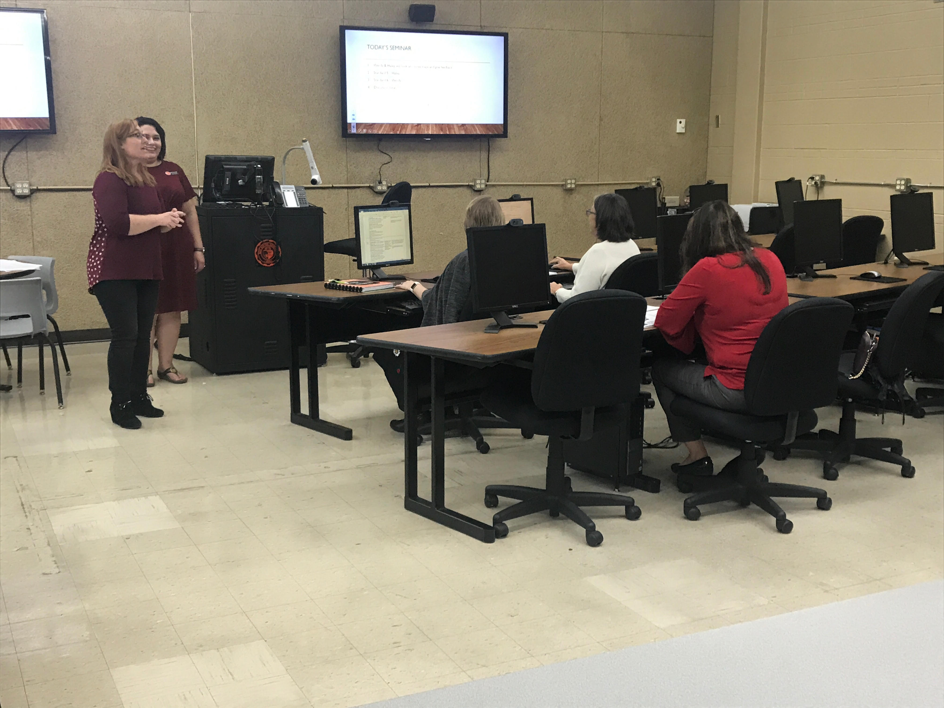
F2F Seminars
Notes:
1) CETL created seminars to help faculty create QM Course Maps and answer questions about QM Standards.

Slide 9
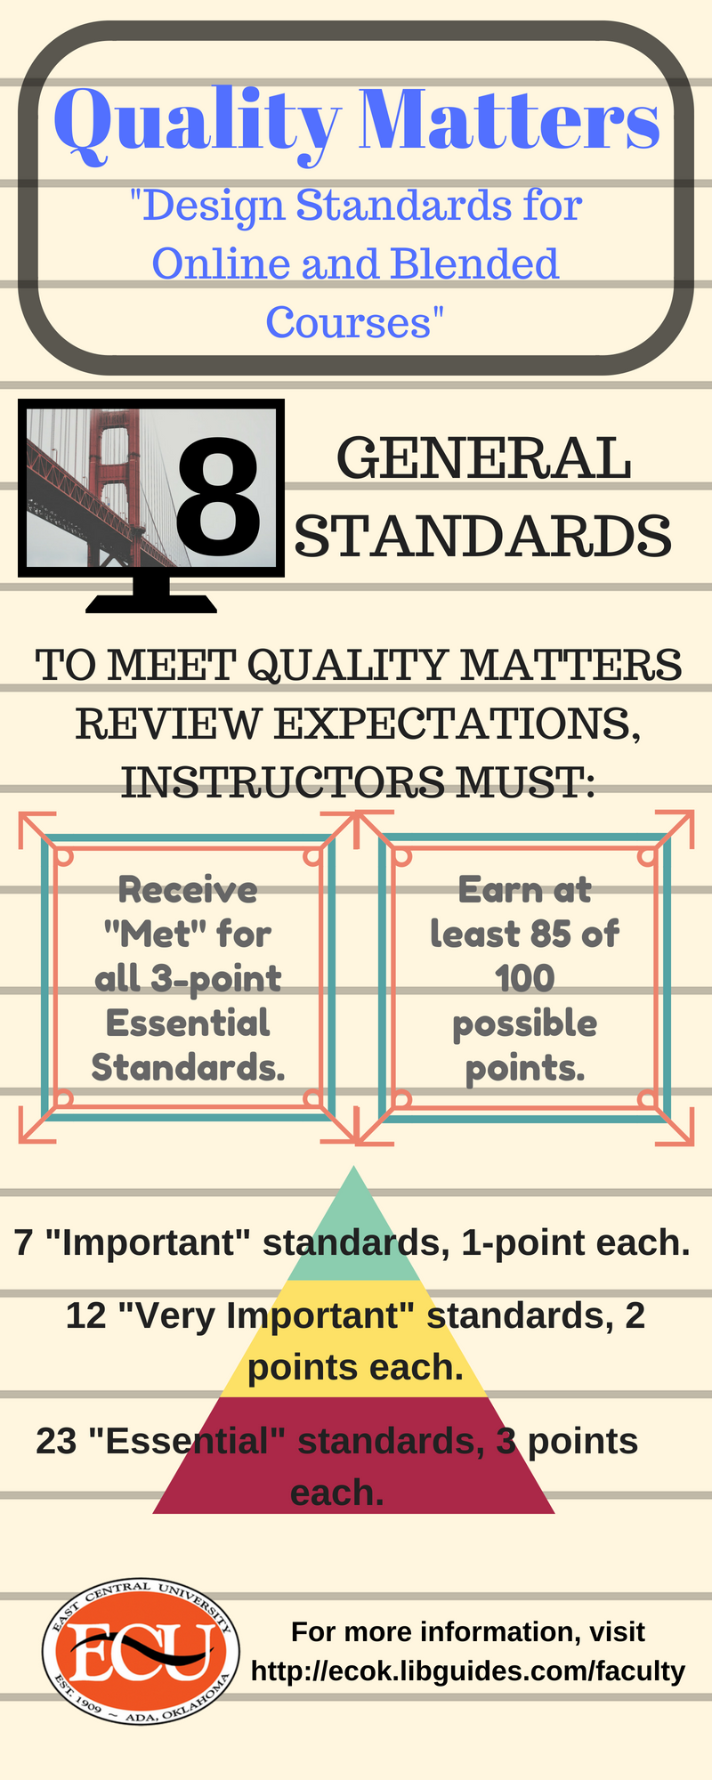
CETL Website
https://ecok.libguides.com/faculty/QM
Notes:
2) We created special tabs on our CETL Pages that contained important information plus tips & tricks about how to prepare for QM maps and reviews.

Slide 10
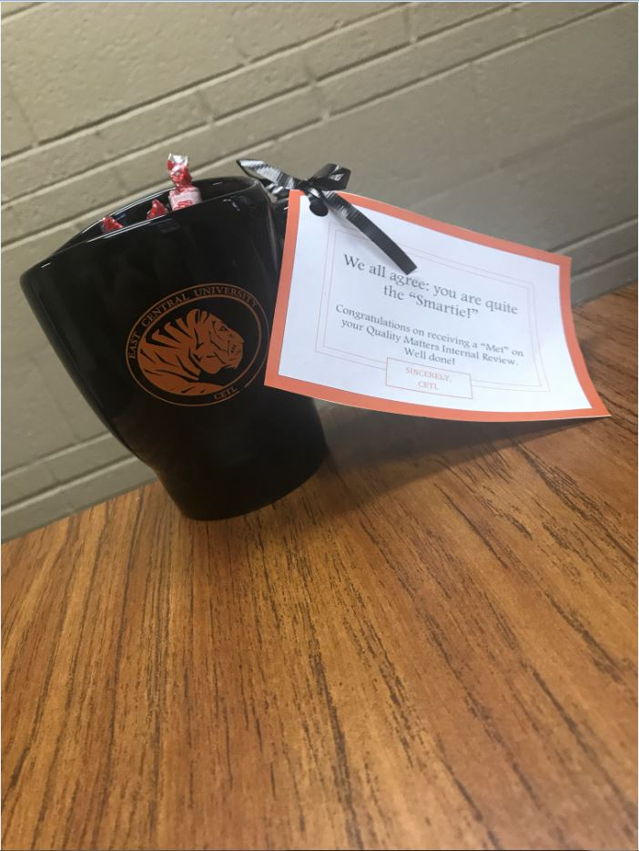
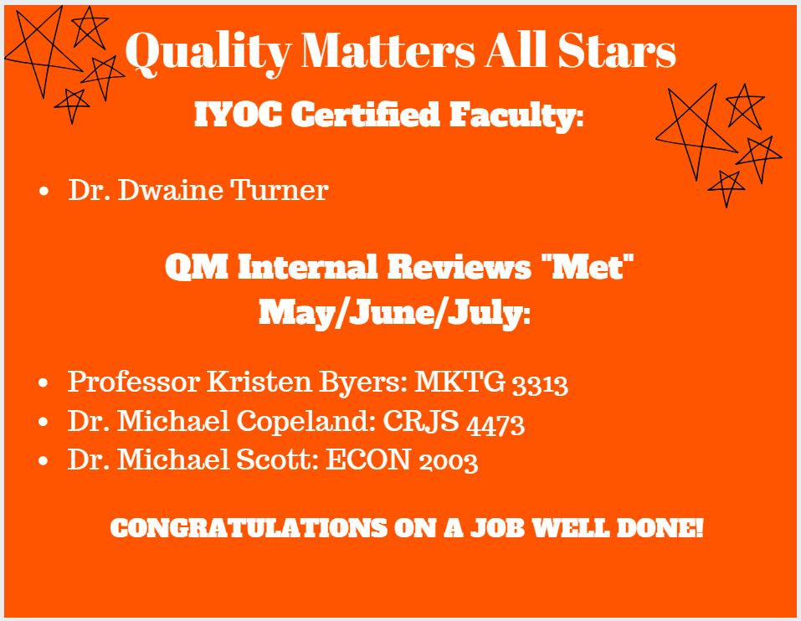
Communication Plan: Positive Support
Notes:
4) We put together a Communication/Policy Plan for faculty so they could better understand how and when they needed to complete parts of the Quality Online Program. New faculty start with LMS Training. Then, they get signed up for IYOC/APPQMR. Next, CETL offers QM Course Map and Standards training every semester to faculty preparing to take a course through the review process. Then, CETL facilitates the review and helps faculty through amendment phase. Finally, faculty become “QM ALL STARS.”
5) The Ad Hoc Advisory Committee was made a Standing Committee called ATAC. This committee has helped create a plan to promote buy in of the program. One example, just this last year we gave out awards to our faculty who got a MET.

Slide 11
Implementation 3.0
3.0
Incentives for faculty
Move from internal to subscriber-managed reviews
Mentoring program
Notes:
We are still asking important questions about our QM Program. How can we continue to support our faculty moving forward? How will we manage to get all of our Program Courses through the QM Review Process? We want to move from Internal Reviews to “Official” Reviews soon because this will create more buy-in with the QM Seal. It would be great to start a Mentoring Program at ECU to support our new online faculty... How would we get that started? Is there a way to use incentives to recruit ECU Faculty to become Peer Reviewers? So it is all about supporting your faculty!
What are your thoughts? What are your Institutions doing to implement the QM Program and create faculty buy-in? What will be your Implementation 3.0? Please share with your neighbor to the right of you what you are doing at your organization to create buy-in to the QM Program? In a few minutes, be prepared to share with the whole group what two things you will take back to your institution to try from today’s discussion?

