Slide 1



Quality Matters: Your Friend for Accreditation and Compliance
David Shulman, Campus President
Broward College Online
Broward College, Florida
Notes:
Presentation on Quality Matters as a valuable friend in support of distance learning programs that meet the expectation of accreditors.

Slide 2
Topics…
Institution
State/Consortia
OMG
1. Quality Matters as an Institutional Accreditation & Compliance Strategy
2. Quality Matters as a State/Consortia Compliance & Accreditation Strategy
3. OMG – Look What’s Coming Down the Pike
Notes:
Three related topics. Two involve QM as a strategy and framework for institutional online programs and broader adoption by states or consortia.
The last topic discusses the challenges of future technologies practices that will impact the instructional design and delivery of online learning, and by extension the role of frameworks like QM to support quality and continuous improvement.

Slide 3
Topics…
Institution
State/Consortia
OMG
Quality Matters as an Institutional Accreditation and Compliance Strategy
      “…the implementation of QM reviews in an institution or program
      can serve as a major element of the quality assurance process for
      online education that accreditation requires.”
      Comparison of the Quality Matters Rubric to Accreditation Standards for Distance Learning, Ron Legon (2006)
Notes:
A history and framework for QM in quality assurance of online education.
This portion will draw on the experience of Broward College Online over the past five years of our accreditation reaffirmation and interim 5-year review.

Slide 4

Topics…
Institution
State/Consortia
OMG
Application of Quality Matters
Initial or reaffirmation accreditation review
Interim review
Substantive change review
Notes:
Within the accreditation lifecycle, QM can be applied to demonstrate quality and a process for continuous improvement.

Slide 5


Topics…
Institution
State/Consortia
OMG
Distance Learning Principles – An Example from the Age of the Dinosaur *
Principle 1: Curriculum and Instruction
Standards
Learning outcomes
Clarity and completeness of programs
Interaction between faculty and students
Faculty oversight of programs
* Principles of Good Practice for Electronically Offered Academic Degree & Certificate Programs, WICHE (1995)
Notes:
Let’s go back to the early to mid-1990’s to see an antecedent of today’s accreditation standards for distance learning.
WICHE Principles (2 of them)
2008 HEA – online the same set of standards

Slide 6


Topics…
Institution
State/Consortia
OMG
Distance Learning Principles – An Example from the Age of the Dinosaur
Principle 2: Institutional Context and Commitment
Standards
    Role and Mission
    Faculty Support
    Resources for Learning
    Student Services
    Evaluation and Assessment
Notes:
Second principle: role of the distance learning program within the insitution

Slide 7


Topics…
Institution
State/Consortia
OMG
Common Distance Learning Principles of Regional Accreditors
Mission Governance Institutional Effectiveness Curriculum & Instruction Faculty | Library & Learning Resources Student Affairs Services Facilities & Finance Evaluation & Assessment Federal Requirements
Notes:
Fast forward to 2017, and these same principles are found in all regional accreditation guidelines for distance learning.

Slide 8
Topics…
Institution
State/Consortia
OMG
Common Distance Learning Principles of Regional Accreditors
Mission Governance Institutional Effectiveness Curriculum & Instruction Faculty | Library & Learning Resources Student Affairs Services Facilities & Finance Evaluation & Assessment Federal Requirements
Notes:
Fast forward to 2017, and these same principles are found in all regional accreditation guidelines for distance learning.

Slide 9
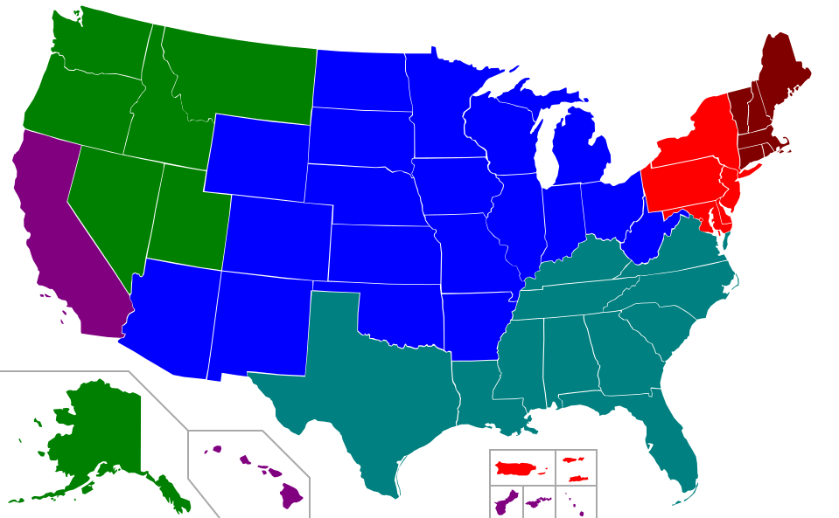
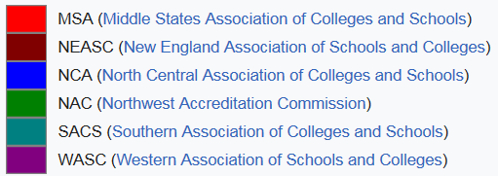
Topics…
Institution
State/Consortia
OMG
Regional Accreditor Guidelines – They All Have Them
Notes:
Each of these bodies have guidelines for effective distance learning programs.

Slide 10
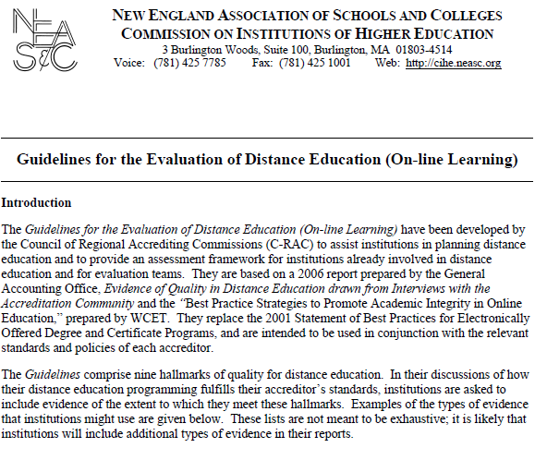
Topics…
Institution
State/Consortia
OMG
Regional Accreditor Guidelines: an Example
NEASC - Curricula for online learning offerings are comparable to programs offered in traditional instructional formats.
Examples of evidence:
Course design & delivery support regular, substantive faculty-student and student-student interaction
Course and program structures provide support known to be effective in helping online learning students persist and succeed
Notes:
New England Association of Schools and Colleges

Slide 11
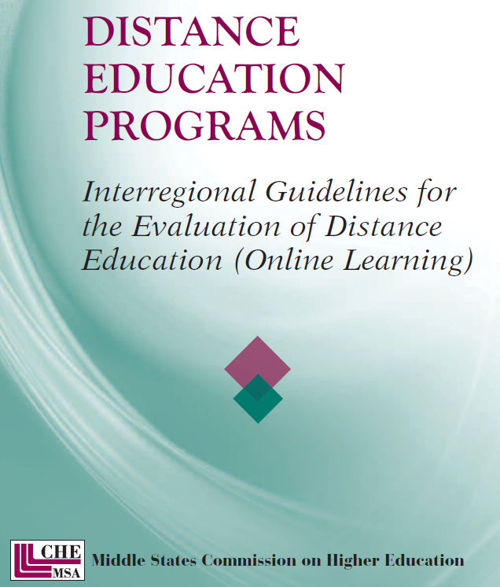
Topics…
Institution
State/Consortia
OMG
Regional Accreditor Guidelines: an Example
MSA - Faculty delivering the online curricula and evaluating the students’ success are qualified and supported.
Examples of evidence:
….persons responsible for online learning programs have the competencies to accomplish the tasks, including knowledge of the specialized resources and technical support available to support course development and delivery.

Slide 12

Topics…
Institution
State/Consortia
OMG
Examples of SACS-COC Guidelines
Curriculum & Instruction
  Faculty assume responsibility and oversight of distance education,
  ensuring the rigor of programs and the quality of instruction
Library and Learning Resources
  Students have access to and can effectively use appropriate library resources
Student Services
  Students are able to use the technology employed, have the equipment necessary to succeed, and are provided assistance in using the technology employed

Slide 13

Topics…
Institution
State/Consortia
OMG
BC Online Focus Area & QM Evidence (SACS)
Example: Curriculum and Instruction
How do you ensure compliance with copyright law?
Are goals and competencies comparable with campus programs?
Do faculty in online programs develop curricula, syllabi, assessments?

Slide 14
Topics…
Institution
State/Consortia
OMG
BC Online Focus Area & QM Evidence (SACS)
Example: Student Services
How do you retain students in online classes and programs?
How do online students connect with institutional support services?
Do online students have access to library and learning resources?

Slide 15
Topics…
Institution
State/Consortia
OMG
BC Online Focus Area & QM Evidence (SACS)
Example: Faculty Support
What support services are available to faculty course developers?
How do faculty develop courses that ensure accessibility?
How does course design support effective pedagogy?

Slide 16
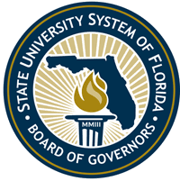
Topics…
Institution
State/Consortia
OMG
2. Quality Matters as a System Compliance and Accreditation Strategy
      “…well-prepared faculty members, modern learning technologies, and well-designed online courses and programs create opportunities to improve pedagogies, engage faculty in the scholarship of teaching and learning, increase student academic success, and accelerate time-to degree.”
      2025 Strategic Plan for Online Education, Florida Board of Governors Innovation and Online Committee

Slide 17
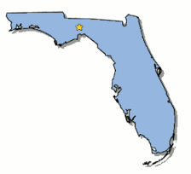
Topics…
Institution
State/Consortia
OMG
Why Does Florida Care?
20% of all instructional activity is now online
It is anticipated to rise to 40% by 2025
Florida ranked second for the number of students taking online courses
Strategic approach was desirable for advancing online education

Slide 18
Topics…
Institution
State/Consortia
OMG
What has Florida done?
2014 BOG established the Innovation and Online Committee
Charged to investigate policies and best practices for transformative,
innovative approaches to the delivery of higher education
Further charged to explore initiatives for system-wide cost efficiencies and effectiveness for programs and services and that will meet workforce needs through online education
Three dimensions for planning included:
          Quality
          Access
          Affordability

Slide 19
Topics…
Institution
State/Consortia
OMG
Quality Dimension
Instructor
Best practices for quality design, development, and delivery of courses and the professional development
Program
Best practices for high success rates, low withdrawal rates
Institution
Best practices for technology infrastructure, resources for course design and delivery, student support services, and ongoing assessment

Slide 20
Topics…
Institution
State/Consortia
OMG
Access Dimension
Access to fully online degree programs across diverse disciplines
Access to online degree programs be in areas of strategic emphasis
Affordability Dimension
Shared Services
Educational Content
Instructional Innovations and Efficiencies

Slide 21
Topics…
Institution
State/Consortia
OMG
QUALITY: Sample Goal, Strategy, Tactics
Goal 1. The State University System will create a culture of quality for online education.
Strategy 1.1 Recognize the development of high quality online education statewide.
Tactic 1.1.1 Create a statewide award system for exceptional online courses.
Tactic 1.1.2 Create a coding system that allows students to identify QM- or QS-certified, President’s Award, Florida’s Quality Award, and Chancellor’s Quality Award courses.
Tactic 1.1.3 Implement a Quality Scorecard, Quality Matters Course Rubric, and/or course certification processes for all universities offering online education.

Slide 22
Topics…
Institution
State/Consortia
OMG
QUALITY: Sample Goal, Strategy, Tactics
Goal 1. The State University System will create a culture of quality for online education.
Strategy 1.2 Expand Support for Professional Development
Tactic 1.2.4 Integrate the Quality Matters Course Rubric, the Online Learning Consortium Quality Scorecard, and/or similar rubrics into the professional development processes for instructional designers, professional development staff, and faculty who teach online courses.

Slide 23
Topics…
Institution
State/Consortia
OMG
AFFORDABILITY: Sample Goal, Strategy, Tactics
Goal 1. The State University System will enhance shared services to support online program development and delivery costs.
Strategy 1.2 Develop a common toolset for online course design and delivery to minimize the cost of online education without reducing quality of the instructional experience.
Tactic 2.2.1 Using Quality Scorecard or a similar process, ensure that each institution has the technology to provide quality online education.
Tactic 2.2.3 Using Quality Scorecard or a similar process….review infrastructure to confirm that students, including students with disabilities, can easily access their online instruction.

Slide 24

Topics…
Institution
State/Consortia
OMG
3. OMG – Look What’s Coming Down the Pike
The Coming Years of Disruption
      “More employers and business and industry
      associations now see the need and opportunity
      to explore an employer-led solution during
      a time of growing debate on the role of government
      in higher education, career and technical education,
      and workforce development.
      Changing the Debate on Quality Assurance in Higher Education, U.S. Chamber of Commerce (2016)
Notes:
It’s not just technological change. The foundations of accreditation that we have known are and will be impacted, with interesting consequences for the development of quality online courses and online programs of study.

Slide 25
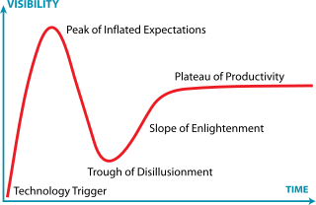
Topics…
Institution
State/Consortia
OMG
Gartner Hype Cycle Phases
Innovation Trigger: potential technology
breakthroughs ….often no commercial use case
Peak of Inflated Expectations: Early success stories
Trough of Disillusionment: Interest wanes as the
innovation fail to deliver
Slope of Enlightenment: More benefits start to materialize, most institutions remain cautious
Plateau of Productivity: Mainstream adoption takes off and broader market use cases

Slide 26
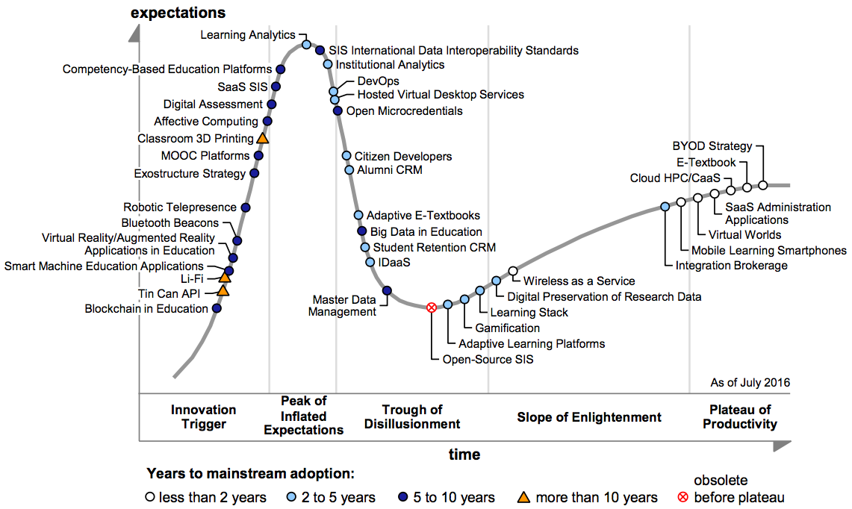
Topics…
Institution
State/Consortia
OMG
Hype Cycle for Education
Gartner (July 2016)
Notes:
So, here’s what the cycle portends for education, and by extension the creation and delivery of online/blended education.
Notable is the disaggregation of credentialing, interoperability of learning technologies, and the importance of cloud computing
Example: Tin Can api that can integrate multiple platforms to draw assessment data.

Slide 27
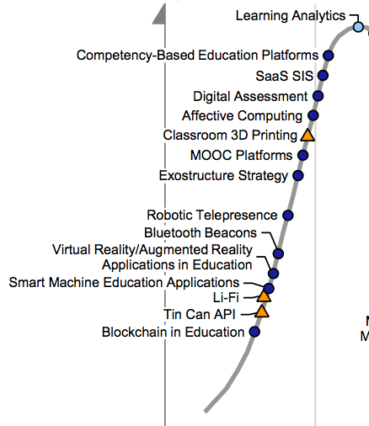
Topics…
Institution
State/Consortia
OMG
What’s on the Rise?
Blockchain in Education
Open Microcredentials
Exostructure Strategy
Smart Machine Education Applications
Tin Can API
Notes:
Here’s are a few of Gartner's picks for transformational technologies

Slide 28
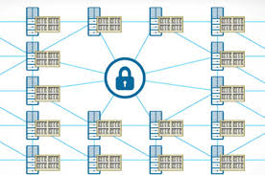
Topics…
Institution
State/Consortia
OMG
What’s on the Rise?
Blockchain in Education
What does it do?
Securely record badging, microcredentials, course credits, proof of competences, etc.
Where does it impact accreditation principles?
    Curriculum & Instruction
    Evaluation & Assessment
    Facilities & Finance
    Faculty Library & Learning Resources
    Federal Requirements
    Governance
    Institutional Effectiveness
Notes:
Here’s are a few of Gartner's picks for transformational technologies

Slide 29
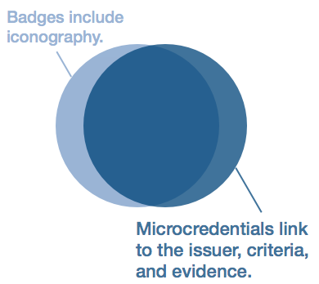
Topics…
Institution
State/Consortia
OMG
What’s on the Rise?
Open Microcredentials
What does it do?
Securely record badging, microcredentials, course credits, proof of competencies, etc.
Where does it impact accreditation principles?
    Curriculum & Instruction
    Evaluation & Assessment
    Facilities & Finance
    Faculty Library & Learning Resources
    Federal Requirements
    Governance
    Institutional Effectiveness
Notes:
Here’s are a few of Gartner's picks for transformational technologies

Slide 30
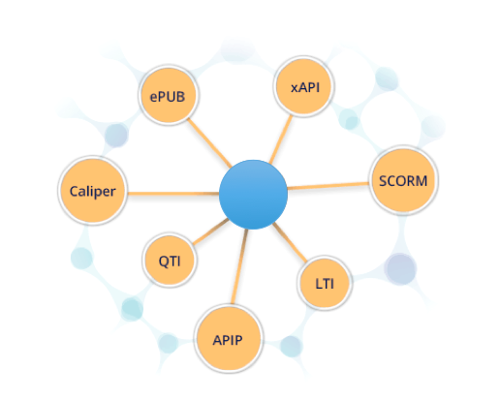
Topics…
Institution
State/Consortia
OMG
What’s on the Rise?
Exostructure Strategy
What does it do?
An interoperability strategy to achieve critical mass for technology tools and services in education
Where does it impact accreditation principles?
    Curriculum & Instruction
    Evaluation & Assessment
    Facilities & Finance
    Faculty Library & Learning Resources
    Federal Requirements
    Governance
    Institutional Effectiveness
    Mission
    Student Affairs Services
Notes:
Here’s are a few of Gartner's picks for transformational technologies

Slide 31

Topics…
Institution
State/Consortia
OMG
What’s on the Rise?
Smart Machine Education
Applications
What does it do?
Machines learn independently
Where does it impact accreditation principles?
    Curriculum & Instruction
    Evaluation & Assessment
    Facilities & Finance
    Faculty Library & Learning Resources
    Federal Requirements
    Governance
    Institutional Effectiveness
    Mission
    Student Affairs Services
Notes:
Here’s are a few of Gartner's picks for transformational technologies

Slide 32
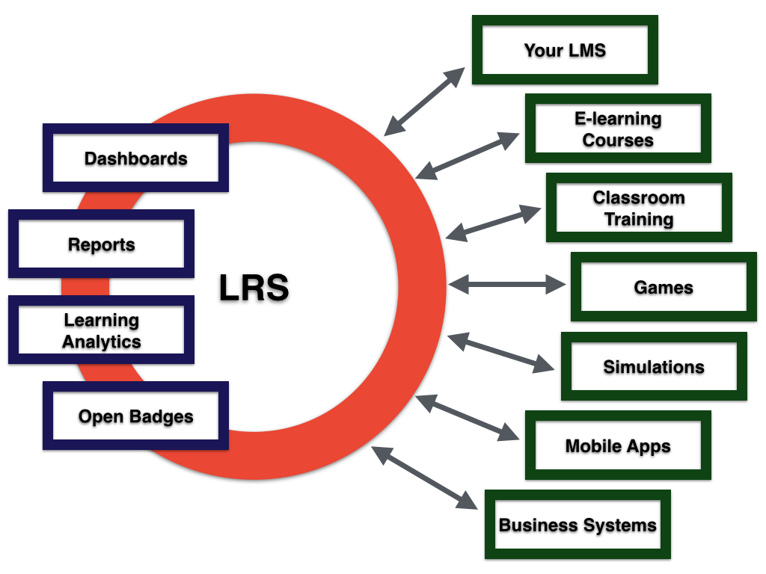
Topics…
Institution
State/Consortia
OMG
What’s on the Rise?
Tin Can API
What does it do?
Records learning activity in from multiple applications
Where does it impact accreditation principles?
    Curriculum & Instruction
    Evaluation & Assessment
    Facilities & Finance
    Faculty Library & Learning Resources
    Federal Requirements
    Governance
    Institutional Effectiveness
    Mission
Notes:
Here’s are a few of Gartner's picks for transformational technologies

Slide 33
Topics…
Institution
State/Consortia
OMG
Wrap-up
Quality Matters as a Compliance and Accreditation Strategy
Quality Matters as a System Compliance and Accreditation Strategy
OMG – Look What’s Coming Down the Pike

Slide 34
Thank you.
David Shulman, Campus President
Broward College Online, Broward College, Florida
Email: dshulman@broward.edu

