Slide 1

Simple Tools That Make Alignment Easy
Judy Meier Penn and Livia Marly Sa’
Shoreline Community College

Slide 2
Why Alignment?
SOCIETY
COLLEGE
FACULTY
…expects members to be productive, to have mastered knowledge & skills for their professions
Programs
Courses
Course
Course Description
Instructional Materials
Course Activities

Slide 3


Why We Struggle with Alignment
Public Perception of My Course
My Personal Beliefs About My Course

Slide 4
Steps in Alignment
1. Look at your course description.
This is what the public sees about your course.
Ask others to look at it!
What Bloom’s category best fits this description?
  Is this course mostly about understanding, knowledge?
  Or, is it more hands-on application of information?
  Or, is it mostly philosophical, analytical?

Slide 5
Activity 1. At what level is this course taught?
BIOL 124. Northwest Flora. Plant classification, field study, and laboratory identification of common Pacific Northwest plant families and investigating the ecology, cultural uses & conservation of plants at the local & global level. Laboratory.
Knowledge | Comprehension | Application | Analysis | Synthesis | Evaluation
Remember previously learned information. | Demonstrate an understanding of the facts. | Apply knowledge to actual situations | Break down objects or ideas into simpler parts; find evidence to support generalizations. | Compile component ideas into a new whole or propose alternative solutions. | Make and defend judgments based on internal evidence or external criteria

Slide 6
Activity 1. At what level is this course taught?
HIIM 235 Health Information Technology Capstone Course. Student teams research and present business plans for a new clinic health information department. Investigate, select and present department functions, job descriptions, supplies/ equipment list, policies, procedures, flow charts, layout, and budget according to team-developed planning time table.
Knowledge | Comprehension | Application | Analysis | Synthesis | Evaluation
Remember previously learned information. | Demonstrate an understanding of the facts. | Apply knowledge to actual situations | Break down objects or ideas into simpler parts; find evidence to support generalizations. | Compile component ideas into a new whole or propose alternative solutions. | Make and defend judgments based on internal evidence or external criteria

Slide 7
Steps in Alignment
2. Next, look at your Course Activities
Activities = Learning Activities (readings, assignments, exams, what students are DOING in your course)
Do these activities mostly fall under the Bloom’s category that you selected for the course description?

Slide 8
Activity 2: Do Activities Match Bloom’s Level?
PHIL 240. Introduction to Ethics. Examination of historically significant philosophical theories of right and wrong, good and bad, human rights, and ideals of freedom emphasizing classic writers such as Plato, Confucius, Aristotle, Augustine, Aquinas, Hobbes, Locke, Hume, Kant, Mill, Marx, Nietzsche, and Rawls.
Course Activities:
  8 Multiple Choice Quizzes
  Reading assignments
Daily Lectures
Comprehensive Multiple Choice Final Exam
Knowledge | Comprehension | Application | Analysis | Synthesis | Evaluation
Remember previously learned information. | Demonstrate an understanding of the facts. | Apply knowledge to actual situations | Break down objects or ideas into simpler parts; find evidence to support generalizations. | Compile component ideas into a new whole or propose alternative solutions. | Make and defend judgments based on internal evidence or external criteria

Slide 9
Steps in Alignment
3. Module Objectives
Do you have them?
If not, create them from your Course Activities

Slide 10
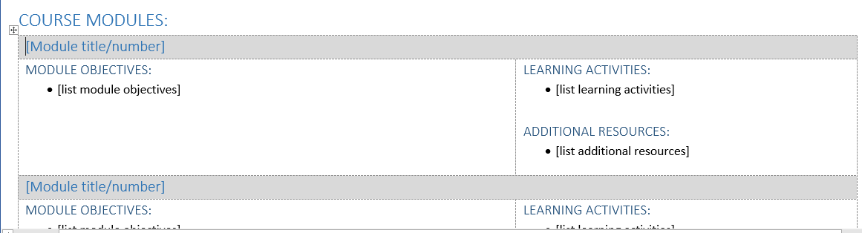
Steps in Alignment
4. Compare Module Objectives & Activities
QM Alignment Table by Livia Marly Sa is licensed under a Creative Commons Attribution-NonCommercial 4.0 International License.

Slide 11
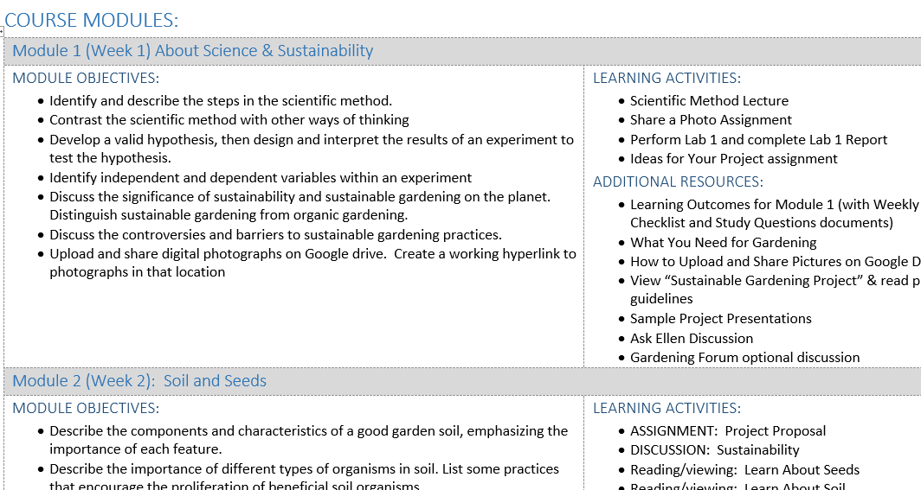
Steps in Alignment
4. Compare Module Objectives & Activities
?

Slide 12
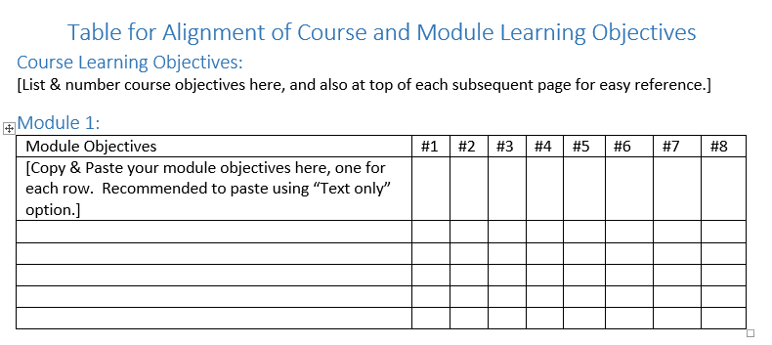
Steps in Alignment
5. Compare Module & Course Objectives
Alignment Table by Judy Meier Penn is licensed under a Creative Commons Attribution-NonCommercial 4.0 International License.

Slide 13
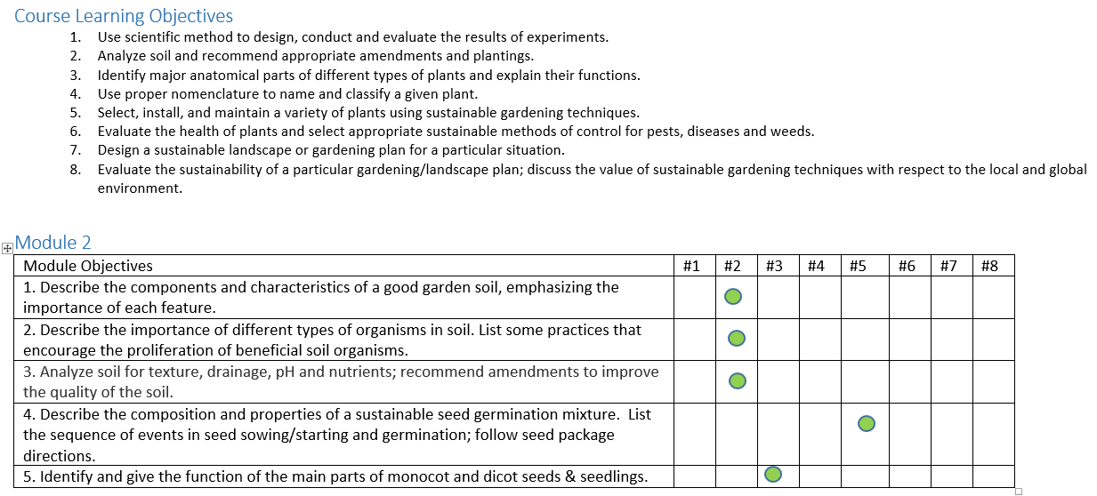
Steps in Alignment
5. Compare Module & Course Objectives

Slide 14

Summary of Steps in Alignment
Review Course Description and assess “dominant” Bloom’s level.
Do Course Activities (as a group) mostly fit that same Bloom’s level?
Create Module Objectives from Course Activities (if needed)
Check Alignment of Module Objectives and Course Activities
Check Alignment of Module Objectives with Course Objectives
WOO-HOO! Your Course is Aligned!

Slide 15

Questions?
Resources (Posted on Conference Site)
Copy of Presentation Slides
Bloom’s Taxonomy Verb List
Templates:
  Table for Alignment of Course & Module LOs
  BIOL 126 Table for Alignment of Course & Module LOs
  QM Alignment Table Template
For More Information: jpenn@shoreline.edu
Thanks for attending!

