Slide 1

Research-Driven, Student-Informed
Shaping Quality Assurance in Online Education
Notes:
Student Perspectives of Quality

Slide 2
Samantha Maxwell
Michelle Vonie
Instructional Technologist
Instructional Designer
QM Coordinator

Slide 3
BACKGROUND & CONTEXT
Student Advisory Board for Instructional Technology
  Board Composition
    8 student representatives
    2 student government representatives
    4 administrative advisors
  Hours of Work Requested: Each member is expected to commit 8 hours per academic year.
    (4 hours) Consists of 1-hour meetings, twice in the spring and twice in the fall.
    (4 hours) Outside of meetings: review technologies and faculty presentations.
  Compensated at $31.25/hour ($250/AY)
Quality Matters
  Internal Peer Reviews
  In-house QM Professional Development
Notes:
Grew the board from 12 members to 14 (2 additional student representatives)
An iCourse is any class that is taught fully online for students enrolled in traditional, on-campus degree programs.
This course fee (charged at $50 per course) supports the full-scale build-out and maintenance of online degree programs, major clusters, and general education requirements, and the accessibility of those courses, and relevant learning tools, to students enrolled in traditional, face-to-face programs.
Instructors gain access to resources dedicated specifically to creating quality online learning experiences.
These fees also fund customized student services related to online courses for things like tutoring, advising, tech support, and enhanced electronic learning tools.
The course fee helps to cover UA investments into instructional design efforts and digital learning tools that benefit students in all locations when taking courses with a modality of fully online. It also replaces the need for students to pay for proctoring services a la carte, as those costs are now covered centrally with revenue from the iCourse Fee.

Slide 4

SABIT GOALS
Fiscal Responsibility
Allocate iCourse Fee Efficiently
Monitor Fee Usage
Educational Quality
Quality Assurance in Online Learning
Tech Support and Learning Tools
Eliminate Proctoring Fees
Professional Development
Continuous Learning
Notes:
Responsibility of the Board
It is the duty of this Board to serve as the deliberating body on the use of the iCourse fee.
Representing all students of The University of Arizona regardless of a member’s constituency
Maintaining an unbiased approach to all deliberations and decisions
Familiarity with technology uses at the University of Arizona
Reading, understanding and deliberating on the amount of money available through the iCourse Fee
Communication with the other members of the Board regarding the current and future use of the iCourse Fee
Monitoring the current spending of the fee to ensure it is being used faithfully to accomplish the goals of the iCourse Fee
Recommendations to the AVP for UCATT on the use of the fee, alterations to funded programs, terminations of funded programs, etc.

Slide 5

ESTABLISHING A CONNECTION
Quality Matters had previously been situated to aid teachers and course developers. Now, we amplified student voices through direct connection between the Student Advisory Board and the Quality Matters standards.
Notes:
An iCourse is any class that is taught fully online for students enrolled in traditional, on-campus degree programs.
This course fee (charged at $50 per course) supports the full-scale build-out and maintenance of online degree programs, major clusters, and general education requirements, and the accessibility of those courses, and relevant learning tools, to students enrolled in traditional, face-to-face programs.
Instructors gain access to resources dedicated specifically to creating quality online learning experiences.
These fees also fund customized student services related to online courses for things like tutoring, advising, tech support, and enhanced electronic learning tools.
The course fee helps to cover UA investments into instructional design efforts and digital learning tools that benefit students in all locations when taking courses with a modality of fully online. It also replaces the need for students to pay for proctoring services a la carte, as those costs are now covered centrally with revenue from the iCourse Fee.

Slide 6
OUR PROCESS IN FOUR STEPS
Introduce Tool to the SABIT:
In the Spring meetings, we introduced educational technologies to pilot within UArizona. Over the course of the semester, students would explore these tools and watch faculty videos on how the tool was implemented in courses.
Analyze the Data:
To utilize the student feedback, we first performed some basic quantitative analysis on the closed questions. Then, we separated the open-ended questions and open-coded for themes.
Requests for Feedback:
We designed questionnaires with Likert scales and open-answer feedback. These questionnaires were designed to have students evaluate the tool based on QM standards, such as the tool's level of accessibility.
Apply the Findings:
We used these themes to inform our recommendations of how instructors integrate technology into their course, build out a tech inventory, and inform instructor training.
Notes:
Example: students are crying out for interaction – their #1 choice for type of technology
Influenced our recommendations for existing technologies and informed our current pilots (Feedback Fruits)
Struggles: purpose and lack of instructor awareness/support
- targeted trainings
- compilation of resources

Slide 7

OUR MISTAKES, YOUR TIPS!

Slide 8
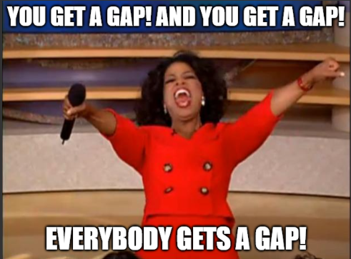
MIND THE GAP
The Great Gap Expedition: At the outset, our journey through student feedback and course evaluations resembled an archeological dig, uncovering gaps far and wide.
Discovery of gaps in student engagement and interaction within online platforms.I
Identification of gaps in accessibility and inclusivity for diverse learners.
Unearthing gaps in the alignment of course content with real-world applicability.
Gap Overload: The realization hit us – we were standing at the edge of a vast landscape filled with gaps, big and small. It was clear that a map was needed to navigate through this terrain.

Slide 9


THE ULTIMATE INTERSECTION
Student Voice and Perspectives
Technology
Quality Matters

Slide 10

THIS LED TO ONE QUESTION…
Notes:
What Quality Matters elements mattered to our students most? Additionally, how can we BRIDGE the gap between what the SAB used to be, and what we want it to be? Bridge between old and new… bridge was the technology tools.

Slide 11

DATA COLLECTION
In previous years, a lot of the data collected was coming out organically in live conversations with the students…
Which is great, but doesn't lend itself well to future application. This was an opportunity for growth in our process.

Slide 12
DESIGNING OUR DATA COLLECTION
In year two, we expanded our data collection to:
  Surveys
  Meetings
    Now always recorded!
  Padlets
Questions to ask:
  What is the use for your data?
  What methods should you use?
    If you’re using data to develop new programs, you may want to focus on qualitative data collection.

Slide 13
IDENTIFYING PRIORITY AREAS
Each semester, we engaged in a strategic selection process to identify one or two critical areas where student feedback indicated the greatest need for improvement or innovation in our online courses.
  Example 1: "Enhancing Interactive Components" - Focused on evaluating and improving interactive elements within online courses to foster engagement and participation.
  Example 2: "Accessibility and Inclusivity" - Concentrated on assessing and enhancing the accessibility features of online platforms to ensure equitable learning experiences.

Slide 14







APPLYING THE DATA
20XX
Sharing
Student Reviews
Internal Review Reports
Marketing
Templates
Trainings
Notes:
Sharing the results of the student data with faculty and IDs
How do the courses measure up for students?
Add the “why” to internal QM Review Reports
How QM certifications meet student needs
Creating and updating templates
Targeted training

Slide 15

JUST ONE PIECE OF THE PUZZLE
Student Experience Initiative
Student Advisory Board
Institutional Data
Course-Specific Student Feedback
Collaboration with the Student Data Network

Slide 16
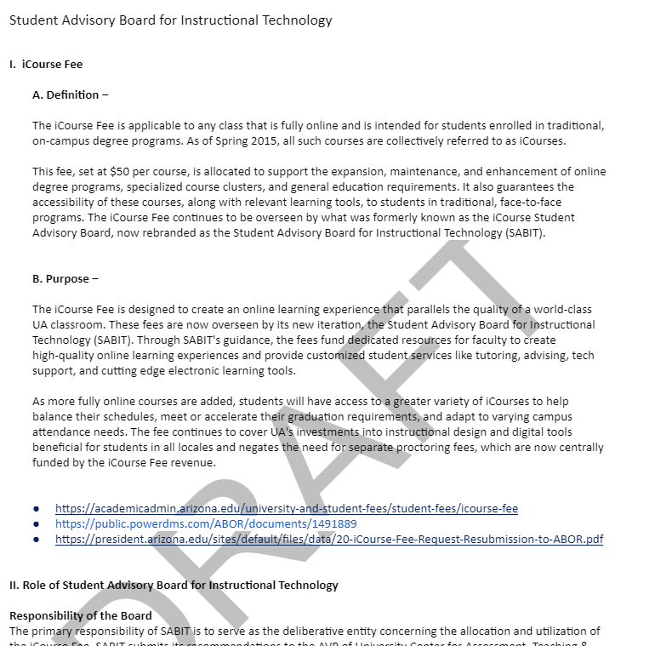
STEPS TO SETTING UP YOUR OWN BOARD
Secure funding
Create bylaws
Recruit student applicants
Determine questions and collection methods
Create materials
Run it!!
Notes:
Can you work it into your department’s budget? Do you have a version of the iCourse fee? Do you have Provost Investment funds? If absolutely no money, are there student boards that you can get in on?
Be thoughtful about your recruitment – our first semester, we only got domestic, high-achieving, high-participating students (from student gov, honor’s college, etc.)
This semester, we diversified our recruitment channels – DRC and International Student Services
Future plans – tiered participation
Questions
- What do students want out of a course or an online learning experience?
- How well does this align with our current QM practices?
- What do students value the most out of the QM standards?

Slide 17
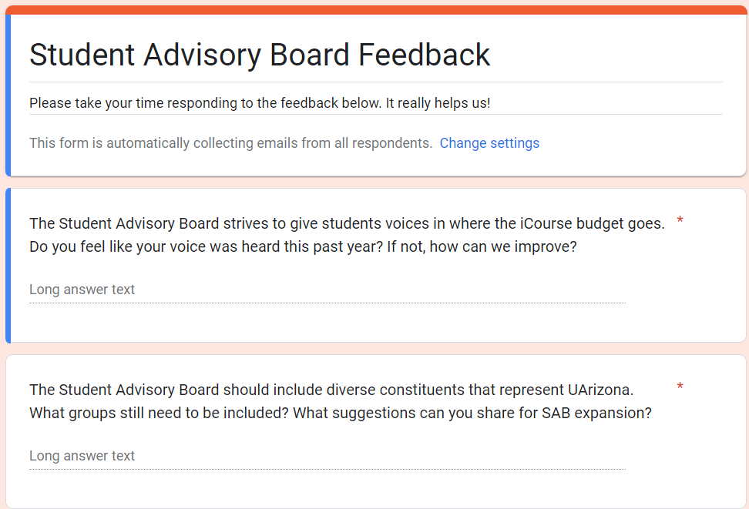
FEEDBACK INCEPTION
Students are encouraged to give feedback on how we hear them
This is still in progress; all very iterative
Notes:
Students have opportunity to give feedback for the actual system; meta feedback? Be flexible!
This is still in progress for us… our thoughts, our conception of how all of this works, and it's very iterative…

Slide 18
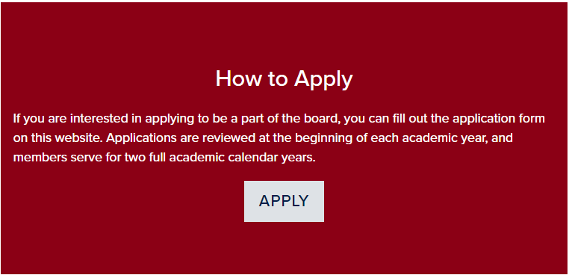
WHERE TO LOOK FOR RECRUITMENT
Make Applying Accessible
Veterans' Center or Services
African American Student Affairs
Asian Pacific American Student Affairs
Disability Resource Center Staff
Fostering Success Program
Office of Diversity & Inclusion
Jewish Student Organization
International Student Services
LGBTQ+ Affairs
Indigenous or Native American Student Affairs
Any other cultural resource centers
Academic Advisors or Advising Resource Center
Consider adding a sweet application button on the most appropriate webpage(s).

Slide 19
CONTACT
Michelle Vonie
vonie@arizona.edu
Samantha Maxwell
samkm@arizona.edu

