Slide 1
The Use of Generative AI to Support Inclusivity and Design Deliberation for Online Instruction
Jill Stefaniak
University of Georgia
STEPHANIE MOORE
UNIVERSITY OF NEW MEXICO

Slide 2
Goals for Session
Explore a conceptual framework for instructional designers to leverage generative AI while addressing ethical considerations.
Participants will engage in collaborative activities to analyze AI-generated content, identify potential biases, and apply inclusive design strategies.
Evaluate the ethical considerations and potential risks of generative AI in instructional design.
Discuss ways we can apply an inclusive design framework to mitigate bias and enhance equity in AI-assisted learning experiences.

Slide 3
A need for design decision-making
There has been an increase in research exploring how instructional designers make decision, engage in reflection-in-action, and navigate design judgments (Boling et al., 2017; Tracey et al., 2014).
Context (learners’ prior knowledge, culture) significantly influences design decisions
Designers must consider both their own context and the learner’s (Baaki & Tracey, 2022)
Localization strategies are key for online learning environments

Slide 4
Generative AI as design support
AI tools can aid in personalization, accessibility (e.g., auto-captioning), and inclusive design.
Designers can use AI to optimize time, enhance innovation, and support deliberative, learner-centric design processes.
Generative AI can serve as both a tool for design and as an objective of thoughtful design practice.

Slide 5
Generative AI in Instructional design
Core Functionality
Key Learning Affordances
Adaptability and Personalization
AI systems that generate content (text, images, video) often indistinguishable from human-created materials (Hodges & Kirschner, 2024; Hsu et al., 2023)
Large Language Models (LLMs), like GPT-4, are a key example
Rapid, automated development of written and multimedia instructional materials (Bozkurt, 2023; Trust et al., 2023)
Scalability and efficiency in content creation for diverse learning contexts
Learner-specific content and assessment paths through data-driven customization (Firat, 2023; Kuhail et al., 2023)
Supports differentiated learning and responsiveness to varied educational backgrounds

Slide 6
A Conceptual Framework to support design deliberations
We propose a conceptual framework that supports instructional designers’ use of generative AI for inclusivity in design deliberations.
We placed on emphasis on exploring how generative AI can be used to instructional designers’ abilities to conduct a more in-depth learner analysis and engage in recursive design deliberations that prompt designers to address inclusivity and other ethical considerations in their online instructional design processes and designed artifacts.

Slide 7
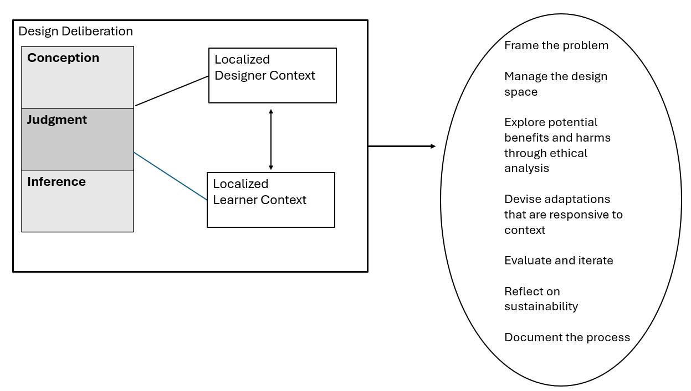
Conceptual framework of Design Deliberation

Slide 8
What is deliberative design?
Draws from definitions of “deliberate,” “deliberation,” and “deliberative” — all grounded in careful thought, reflection, and judgment (Cambridge Dictionary; Merriam-Webster)
Goes beyond traditional design by emphasizing intentional, cognitive, and ethical engagement with design decisions

Slide 9
Deliberative design is an intentional act of exercising care in design.

Slide 10
Why Deliberation is needed when using generative Ai
Generative AI tools, like ChatGPT, rely on massive datasets—some of which include outdated or debunked learning theories
Example: Hodges (2024) found an AI-generated lesson plan based entirely on learning styles theory, which has been discredited by educational researchers (Reiner & Willingham, 2010; Kirschner, 2017)
AI does not evaluate source quality—it predicts text based on frequency and patterns, not accuracy
Leads to “garbage in, garbage out” situations: flawed inputs → flawed outputs
Risk of reinforcing misconceptions, biases, and ableist assumptions in instructional design

Slide 11
Deliberation in Action
Designers must engage in reflection-in-action — a term from Schön (1983) describing a “conversation” with the problem as it unfolds
This involves ongoing evaluation and adjustment during the design process
Tracey & Baaki (2014) describe iterative ID behaviors:
  Questioning assumptions
  Deciding on a design action
  Reflecting on its consequences
  Adapting based on insights
Notes:
Effective use of generative AI demands deliberation, reflection, and professional judgment
Whether working alone or with others, designers must:
Recognize flawed or biased outputs
Revisit and revise design plans
Hold themselves accountable for inclusive and ethical outcomes

Slide 12
Challenges with learner analyses
Conducting a thorough learner analysis is vital for creating effective, personalized learning experiences (Stefaniak, 2024; Tracey & Baaki, 2022)
Designers often must make assumptions about learners, especially when limited information is available (Boling & Gray, 2015; Stefaniak et al., 2023)
These assumptions can oversimplify learner diversity, leading to designs that do not meet the needs of all students

Slide 13
Design tensions
Risk of Assumptions | Design Tensions
Homogenizing learners can result in content that is either too advanced or too basic, leading to disengagement or frustration (Gurjar & Bai, 2023) Overlooking varied needs can perpetuate biases related to gender, race, and socio-economic status, undermining inclusivity (Gunawardena et al., 2018; Rao, 2021) | Instructional designers often balance the need to advocate for learner data with the pressure to maintain project momentum, risking assumptions that impact the quality and inclusivity of their designs

Slide 14
Shifting to a Localization of Context
Localization
Contextual Adaptation
Challenges with Knowledge Transfer
Localizing Contextual Analysis
Role of Technology
Instructional designers must adapt to changing learner and instructional needs throughout the design process (Baaki et al., 2017; Baaki & Tracey, 2022)

Slide 15
Conceptual framework of Design Deliberation
Notes:
In this framework, deliberation is the starting point. It evokes the role of a designer as one who devises a plan or idea (conception), exercises decisions that are carefully considered (judgment), and draws conclusions based on evidence and reasoning (inference). Given Baaki and Tracey's (2022) definition of localization of context, we can see how conception, judgment, and inference are exercised through recognizing the complexities of context, engaging in intentional and thoughtful interpretation and meaning-making, and making decisions on how to move forward. Localizing design deliberations into designer and learner contexts allows for the instructional designer to negotiate and prioritize decisions from different perspectives. This is particularly important when attending to careful design practices and prioritizing learners' needs.

Slide 16

Early deliberation activities
Problem Framing: Defined by Svihla (2020) as an iterative process where designers take ownership of a problem, making judgments on what is included or excluded in the design solution (Svihla, 2020)
Ethical Analysis: Designers conduct ethical analysis to identify potential benefits and harms, influencing the problem framing process (Moore et al., 2024)
Framing from Multiple Perspectives: The same problem can be framed in different ways, such as focusing on technical competencies (e.g., prompt engineering) or the impact on learning and systemic issues (Moore & Tillberg-Webb, 2023)
Ethical Influence: Ethical perspectives may be latent or explicit, guiding decisions on what is prioritized in the design, influencing both the technical and systemic considerations (Svihla, 2020; Moore et al., 2024)

Slide 17
Ongoing Deliberate Design activities
Non-linear Design: Design outcomes are revisited throughout the project as environments, constraints, and learner needs evolve (Lomellini et al., 2023).
Navigating Dual Contexts: Designers balance professional expectations with learner-centered customization, managing tensions between these lenses.
Design Space Surveillance: Ongoing evaluation of time, budget, tech, and learner context helps identify constraints and opportunities.
Generative AI Support: AI enables rapid prototyping and the creation of contextualized, adaptive content that reflects both designer and learner needs.

Slide 18
Reflective deliberate activities
Sustainable Design Thinking: Reflecting on efficiency, effectiveness, and ease of learning helps guide ethical AI use (Morrison et al., 2013; McDonald, 2022)
Addressing AI Concerns: Designers must remain aware of AI’s limitations and biases, including risks of reinforcing stereotypes (Bozkurt et al., 2023; Hodges & Kirschner, 2024)
Beyond Technical Reflection: Consider economic, social, and systemic impacts, including accessibility, inclusivity, and scalability (Asino et al., 2017)
Documenting the Process: Maintain transparent, iterative records of design decisions and AI interactions to support future refinement and ethical accountability (Moore et al., 2024)

Slide 19
Activity:
Framing accessibility as a learning problem

Slide 20
Early deliberation activities
Problem Framing:
Accessibility often framed as a technical or legal problem
  Check that a feature is present (technical problem)
  Compliance with legal requirements such as 508
What happens when we re-frame accessibility as a learning problem?
We can apply different learning theories to accessible design and decision making
For example – accessible learning and cognitive theories
  Information processing
  Cognitive load
  Selection, integration, and organization
  How can we facilitate active learning processes of acquiring new information / knowledge, organization, and constructing new understandings?
Notes:
Accessible design drawing upon cognitive principles suggests multiple ways in which information, content, and guidance that are often presented visually may be communicated more intentionally through accessibility features. For example, while testing an interface with a nearly-blind user on a project I worked on several years ago, I observed that the user was repeatedly re-processing header and navigational elements that would not change in the site features. As a result, it was taking the user almost twice as long to work her way through content, and she was splitting her attention between making sure nothing in the interface or navigation changed and focusing on the content to be learned. The lack of accessible message design was inducing unnecessary cognitive load. We decided to embed a message in the interface design that a screen reader picks up that communicated that the header and navigation would not change.
Implications for generative AI – not just a need to generate text, but need to overlay deliberative design to consider what the learning and learner needs are, whether the output supports or interferes with learning, and then modify accordingly

Slide 21
Early deliberation activities
Problem Framing:
Socio-cognitive theories and accessibility
  Interactions are necessary to learning
  Technical or legal accessibility solutions can cut learners out of the active meaning making process
  Non-example – transcripts of chats or live discussions
Online / digital environments – types of interaction / Community of Inquiry framing
  Learner-content interaction
  Learner-learner interaction
  Learner-instructor interaction
Other ways we might frame accessibility as a learning problem?
What might be the implications for the use of generative AI for learning?
Notes:
Accessible design drawing upon cognitive principles suggests multiple ways in which information, content, and guidance that are often presented visually may be communicated more intentionally through accessibility features. For example, while testing an interface with a nearly-blind user on a project I worked on several years ago, I observed that the user was repeatedly re-processing header and navigational elements that would not change in the site features. As a result, it was taking the user almost twice as long to work her way through content, and she was splitting her attention between making sure nothing in the interface or navigation changed and focusing on the content to be learned. The lack of accessible message design was inducing unnecessary cognitive load. We decided to embed a message in the interface design that a screen reader picks up that communicated that the header and navigation would not change.
Implications for generative AI – not just a need to generate text, but need to overlay deliberative design to consider what the learning and learner needs are, whether the output supports or interferes with learning, and then modify accordingly

Slide 22
Early deliberation activities
Ethical Analysis:
Potential harms AND potential benefits (adapted from Moore et al., 2024 – “the change we work”)
GenAI – potential benefits | GenAI – potential harms | Related ethical and legal principles
 |  | Power Consent Control and Agency Privacy, safety and security Copyright Bias and wrongful discrimination Academic integrity Trust
Notes:
I’ve started us off with a list of some considerations. Let’s think specifically in terms of potential benefits to using GenAI for accessibility and potential harms to using GenAi for accessibility (STAY FOCUSED IN THE PROBLEM SPACE THAT WE’RE IN, NOT *ALL* THE PROBLEMS EVERYWHERE ALL AT ONCE)

Slide 23
Deliberative and Reflective Practice for GenAI in
Learning design

Slide 24
Reflective Practice
Schön (1983) – the reflective practitioner is one who continuously incorporates lessons learned from past decisions and experiences to improve future outcomes and processes
Tracey & Baaki: “When a designer is presented with a complex problem or situation, the designer shows a series of questioning, making a decision, reflecting on the consequences of the decision, then making another move” (2014, p.4)

Slide 25
Forms of reflection in practice
Reflection-in-action
  Occurs in the middle of design and development processes or stages
Reflection-on-action
  Occurs after a project is completed; after-action review or evaluation
Designers frequently use reflection throughout their processes (Moore et al., in press)
  Example: “As we have engaged in our learning design process, we ‘paused’ (Patel, 2015) when we encountered what we recognize as ‘productive discomfort’ (Litts et al., 2023) in our design choices around (re)presentation. Because our process centers relationality as a value over, say, efficiency or production, we opted to give ourselves space to sit in these ethical tensions with a reflexive posture.” (Litts et al., 2024)

Slide 26
Design Practices for Reflection
“A method of design in which a designer reflects on a problem or need, engages in a reflective process throughout of pausing to consider or contemplate, and then use that reflective process to inform their next steps” (Moore et al., in press)
Example: “Through our process of working through (re)presentation, we generated three guiding considerations for our prototyping that served to anchor us to the story itself and our shared values.” (Litts et al., 2024, para 43)
Strategies: Team and individual reflection strategies
  Front-end problem framing – what is the problem you’re actually working on? Is it a technical problem? Or is it a learning problem? (or something else? Both or all?)
  Devising explicit reflective questions
  Identifying moments when it’s necessary to pause and reflect
  Journaling
  “Gathering” (Litts et al., 2024)
Notes:
“Gathering” - As part of this move, we have begun to explore the iterative and reflexive design process we have come to know as Gathering (Authors, 2023). The idea of Gathering is guided by “Hui,” an ʻŌlelo Hawaiʻi Hawaiian language word translated as: to band together, assemble, organize, unite. Hui is an invitation to join together as a whole, which became a core practice to mark the beginning of our design work. We conceptualized Gathering (Authors, 2023) as a design process characterized by: doing work in real life, using physical materials, centering values of designers and communities, embracing a (w)holistic rhythm, and recognizing the generative nature of critical reflexive pauses. (para.15)
Problem framing – Svihla – we solve the problems that we define or frame

Slide 27
Example of reflection-in-action
Ingraham & Boyd (2020, presentation) – designing virtual worlds and simulations for training
Articulated a central question to reflect on their design process and products: how do we support social justice for learners?
Tool: problem framing – they framed their problem not merely as a learning or technical or development problem but also included racial disparity as part of their problem framing (we are working to address BOTH learning AND other needs or problems)
Selected three ethical concerns they wanted to address:
whitewashing / normalizing whiteness, racial stereotyping, and digital blackface
Developed explicit questions they used to reflect on and question their process and products throughout brainstorming, idea generation, prototyping, and production:
  Does it include people of color?
  Do those characters include racial stereotypes?
  Who is performing that character?

Slide 28
Activity: Problem Framing and Reflective Questions
Take some time individually to jot down your thoughts for each of these:
Articulate a central question (e.g., “how do we support social justice for learners?”)
Problem framing – not merely technical – what is the actual problem you are trying to solve? What does it mean to you – from a learning perspective – that your materials are accessible?
Develop explicit questions you can use to reflect on and question your process and products throughout brainstorming, idea generation, prototyping, and production:

Slide 29
Activity: Devising Reflective Questions
In our Goggle Doc (create link), let’s quickly list some questions you can ask yourself about the output from these tools that can support you in making critical decisions about and improvements to the quality, accuracy, etc. of the output.
For example:
Is this actually more accessible to learners?
Is it explaining too much detail, or not enough?
Is it conveying this visual accurately?
Can all learners participate in the meaning making process of learning?

Slide 30
Thank You
Jill Stefaniak
University of Georgia
Jill.Stefaniak@uga.edu
Stephanie Moore
University of New Mexico
stephaniemoore@unm.edu

