Slide 1
Small But Mighty: Creating Inclusion through Small Changes to Course Design
Marisa Wier
Instructional Design Manager

Slide 2
Outline
Inclusive Language Framework
  Examples
Inclusive Image Framework
  Examples

Slide 3
Introduction

Slide 4
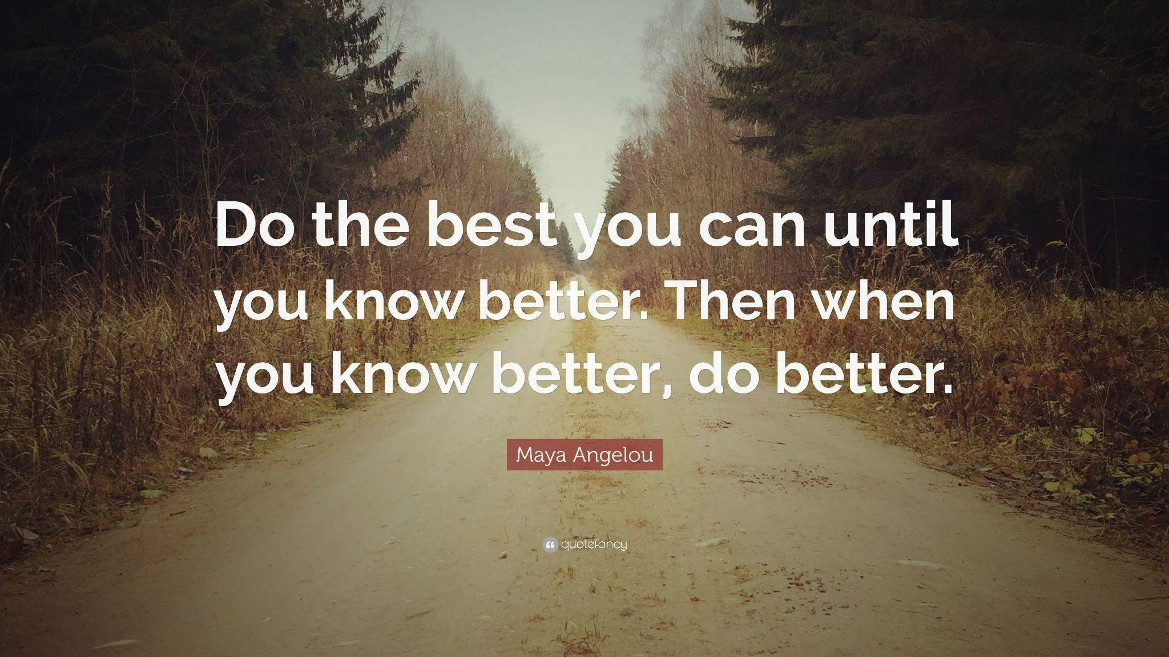

Slide 5
Inclusive Language
What is it, really?

Slide 6
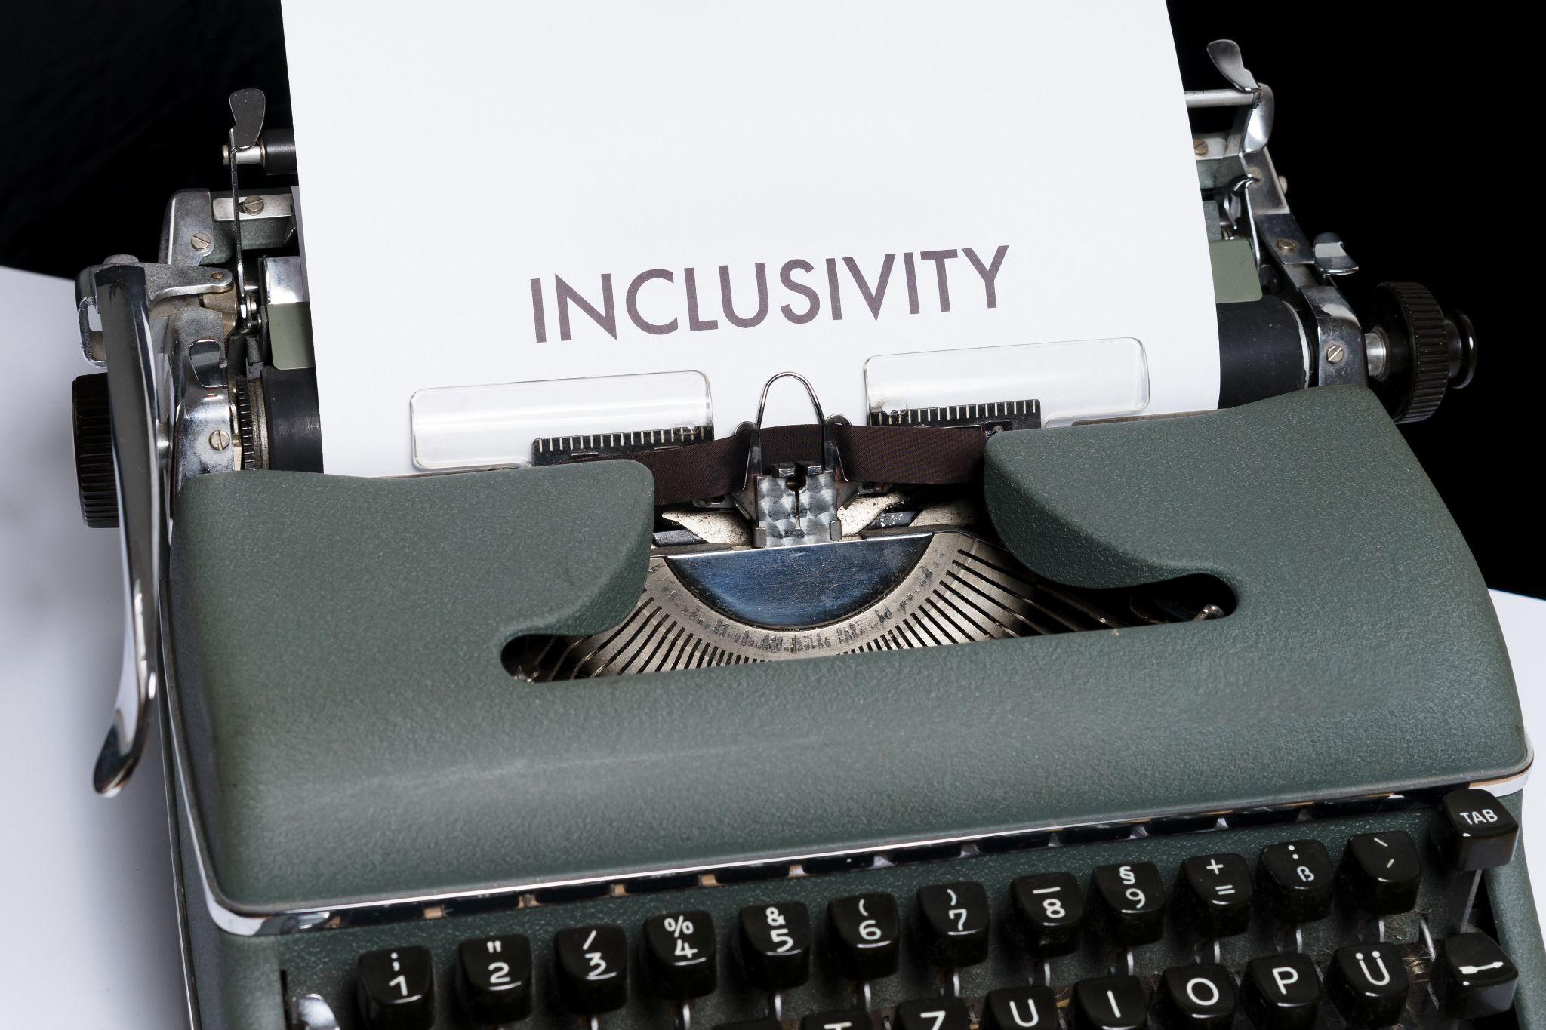
“Inclusive language is not about memorizing a fixed list of "good" and "bad" words. Rather, it’s about centering compassion in how we communicate and recognizing that inclusive language and communication is an ongoing process.”
Understanding Inclusive Language: A Framework

Slide 7
Guiding Principles of Inclusive Language

Slide 8
Guiding Principle 1
Inclusive language conveys respect to all people.

Slide 9
Guiding Principle 2
Inclusive language communicates a message effectively through precise language.

Slide 10
Guiding Principle 3
Inclusive language recognizes diversity.

Slide 11
Guiding Principle 4
Inclusive language involves continual improvement.

Slide 12
Key Questions in Assessing Terms

Slide 13
Key Questions
Does this term center dominant groups as the default and/or perpetuate harmful stereotypes?
Does this term have a harmful history or association?
Does this term contribute to communication in which everyone feels respected and seen?
Does this term convey the intended meaning to all people precisely and effectively?
Can we find an alternate term that does a better job?

Slide 14
Example Text

Slide 15
Inclusive Language Framework Summary
Inclusive language conveys respect to all people.
Inclusive language communicates a message effectively through precise language.
Inclusive language recognizes diversity.
Inclusive language involves continual improvement.
Does this term center dominant groups as the default and/or perpetuate harmful stereotypes?
Does this term have a harmful history or association?
Does this term contribute to communication in which everyone feels respected and seen?
Does this term convey the intended meaning to all people precisely and effectively?
Can we find an alternate term that does a better job?

Slide 16
What term might we want to reconsider for this passage?
If a student is at-risk for suicide, it is important to notify parents. Counselors, teachers, administrators, and other school staff must use care not to assure a student that any discussion regarding suicide will remain confidential. Even in sensitive situations, schools have a legal obligation to contact parents.

Slide 17
What term might we want to reconsider for this passage?
If a student is at-risk for suicide, it is important to notify parents. Counselors, teachers, administrators, and other school staff must use care not to assure a student that any discussion regarding suicide will remain confidential. Even in sensitive situations, schools have a legal obligation to contact parents.

Slide 18

“Instead of focusing on policing language use, we invite you to approach language with a mindset of being open to learning and unlearning, recognizing that context matters and language changes, and being willing to change behaviors and strive to do better. Ultimately, inclusive language is a choice that each of us can make: a choice to act in a more compassionate and thoughtful way towards our colleagues, friends, neighbors, and community members.”
Understanding Inclusive Language: A Framework

Slide 19
Inclusive Imagery
What is it, really?

Slide 20

“When people ‘cannot find themselves reflected in the books they read’, or in the images they see ‘they learn a powerful lesson about how they are devalued in a society of which they are a part,’ (Sims-Bishop, 1990)”
Enhancing Inclusion, Diversity, Equity, and Accessibility in Open Educational Resources

Slide 21
Aims & Considerations

Slide 22
Aims
Illustrations and photos are reflective of diverse populations, and the intersectionality and context of the depiction are considered.
Imagery does not perpetuate stereotypes.

Slide 23
Actions & Considerations
Assess the number of images and illustrations and the individuals and populations represented therein. Are all populations equitably represented throughout the resource?

Slide 24
Actions & Considerations
Assess the role, depiction, connotation, expressions of authority, and purpose of the people represented in the image. Are any stereotypes perpetuated? Does the background or setting of the image indicate anything negative?

Slide 25
Actions & Considerations
Include images of people in a variety of actions where the context of the image does not relate to their identity. For example, showing a person in a wheelchair can be included in images not directly related to disability.

Slide 26
Examples

Slide 27
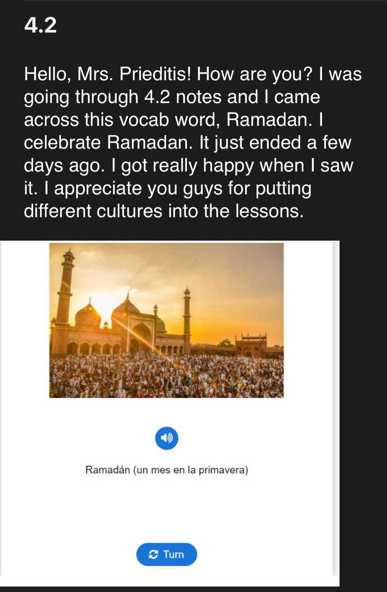
“Hello Mrs. Prieditis! How are you? I was through 4.2 notes and I came across this vocab word, Ramadan. I celebrate Ramadan. It just ended a few days ago. I got really happy when I saw it. I appreciate you guys for putting different cultures into the lessons.”

Slide 28
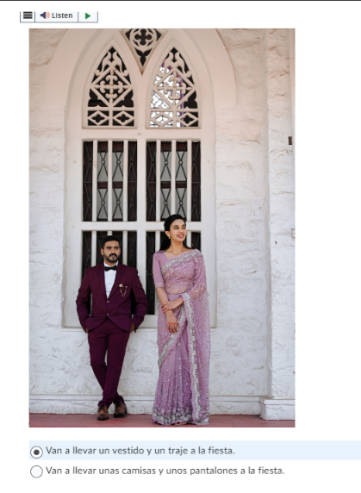
“Hello Mrs. Prieditis! How are you?
I was doing the 3.1 quiz and I am across this question and the picture of it was so nice. It was related to my culture. I really liked the image. I got really excited when I saw it. Thank you for putting this beautiful picture in there😍!”

Slide 29

“Hello Mrs. Carroll!
How are you? So, I was doing vocab for 2.2 and I saw this picture and it is the best. I love how you guys are putting pictures of my culture like this girl was wearing a hijab which they wear in my religion. So, thank you! I appreciate it!”

Slide 30
Questions?
Marisa Wier: mwier@mivu.org
Thanks for listening!

Slide 31
Citations
University of Southern Queensland. (2022). Enhancing Inclusion, Diversity, Equity and Accessibility (IDEA) in Open Educational Resources (OER).
Berkeley Hass. Understanding Inclusive Language: A Framework.

