Slide 1

Small College–Big Possibilities:
Fresh Ideas for Quality Assurance
Dr. Marcea Seible
Hawkeye Community College
marcea.seible@hawkeyecollege.edu

Slide 2
Fresh Ideas for Quality Assurance
Session Description: Quality matters in higher education, but what if your Teaching and Learning Center does not have the resources needed to address today’s teaching and learning needs? You get creative! Come learn how one community college reinvented faculty development, creating a new plan for quality assurance.
Session Goals - 1, 2, 3:
Write 1 quality assurance goal for your institution.
Identify 2 ways of working toward that goal.
Create a 3-step plan for assessing completion of that goal.

Slide 3
Hawkeye Community College
Degrees and Awards
AA and AAS
Diploma
Certificate
Workforce Education Certificate
Apprenticeship
Programs:
Liberal Arts Transfer Majors
Agriculture
Arts & Humanities
Automotive & Transportation
Business
Construction
Education
Health Science and Services
Information Tech
Manufacturing & Engineering
Science & Mathematics
Social Sciences and Public Services

Slide 4
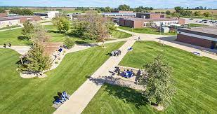
Hawkeye Community College
Fall 2022:
Student Enrollment: 4,787
Full-Time Faculty: 121
Adjunct Faculty: 123
(+77 credentialed HS faculty
teaching concurrent courses)

Slide 5
Brobst Center for Teaching and Learning (est. 1995)
Overview: We provide resources and on-going support for faculty development and innovation to enhance student learning.
We strive to:
Engage faculty as full partners in the learning process.
Shift focus from the process of teaching to the results of learning.
Understand the impact of teaching so that we get better results in the classroom.
Provide learning opportunities based on faculty needs and student learning data.
Coach, consult, and provide tools and strategies to engage learners.
Maximize use of classroom technology.
Create media resources to complement instruction.
Enhance online instruction and distance-learning courses.

Slide 6
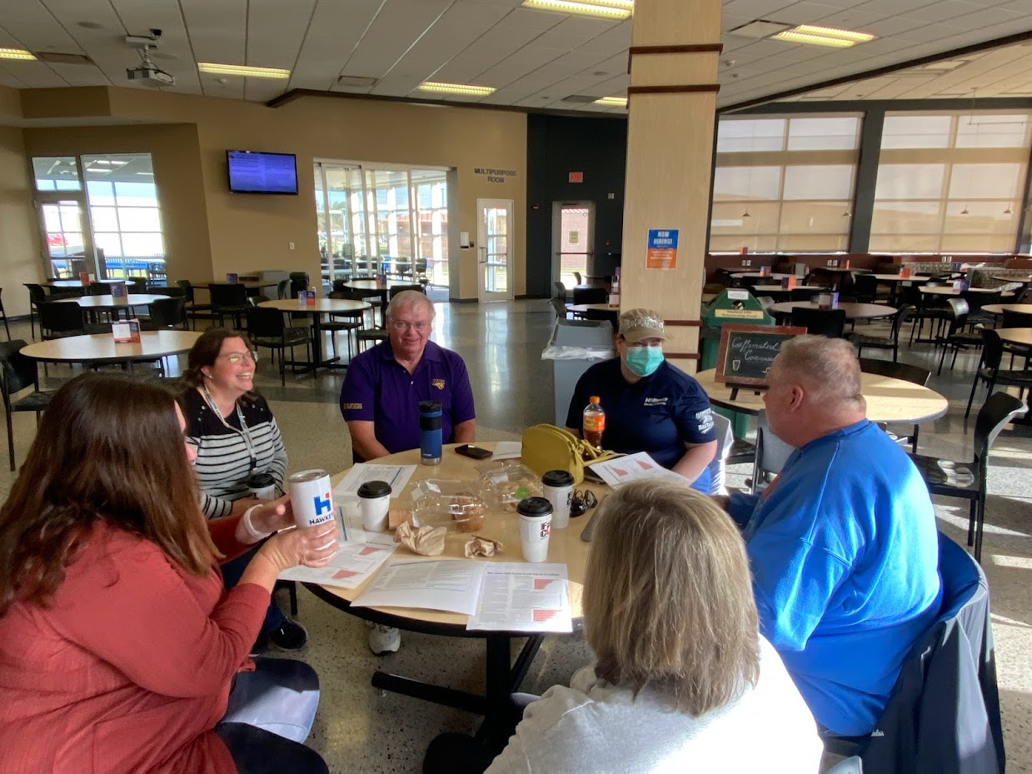
Brobst Center for Teaching and Learning
Technology Instruction:
Canvas: New Features, Key Elements and the Basics
Google Sites for Quality Faculty Plan
Panopto 1: The Basics
Quality Matters:
APPQMR (Iowa College Consortium)
Improving Your Online Course (Web)
Instructor Support
LMS development and support
New Faculty Induction & Mentoring
Two-Year Induction Program
Faculty Mentoring Program

Slide 7
Brobst Center - Change Timeline
2005 - 7 Full-Time Employees
  Director, Administrative Secretary, Educational Technology Specialist, Instructional Media Specialist, Instructional Media Technologist, Distance Learning Coordinator, Broadcast Engineering Specialist.
2010 - Moved from Bremer Hall to Tama Hall
  Lost dedicated space for offices and professional development. Gained one tech classroom for prof. dev. events in Tama Hall.

Slide 8
Brobst Center - Change Timeline
2013 - 6 full-time; 2 part-time employees:
  Director, Admin. Secretary, Ed. Tech Specialist, Distance Learning Coordinator, 2 Broadcast Engineering Specialists, 1 part-time position and 1 student employee assistant. [Note: Center Changes: ICN to Online learning, better LMS software, QM initiatives, program support, and Broadcast Engineering Specialists moved to CIS.]
ca. 2013 - Brobst Center Steering Committee Disbanded
  No faculty group on campus to propose ideas for professional development.
2019-2020 - 3 Employees Retired and Were Not Replaced
  Distance Learning Coordinator (retired Dec. 2019).
  Instructional Design Specialist (retired April 2020).
  Administrative Assistant (retired April 2022).

Slide 9
Brobst Center - Change Timeline
2020 - 3 full-time employees, 1 Faculty Fellow
  Director, Instructional Design and Technology Specialist, Administrative Assistant; 1 part-time Faculty Fellow.
2021 - Center Relocated within the Building
  Health Sciences moved out of their building for renovations and took all of the Brobst Center space for offices and classrooms.
2021 - Brobst Center Director Added Role of Dean of Business and Technology
  Split his time between Brobst Center and School of Business and Technology.
  Administrative Assistant from this area doing both Brobst and School of Bus & Tech.

Slide 10
Brobst Center - Change Timeline
2022 - Down to 2 full-time employees (with shared responsibilities):
  Director (now also serving as Dean of Business and Applied Technology)
  Administrative Assistant (shared with School of Business and Applied Technology)
  - Plus-
  1 full-time Instructional Design and Technology Specialist
  1 part-time Faculty Fellow

Slide 11
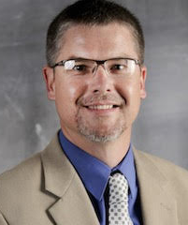
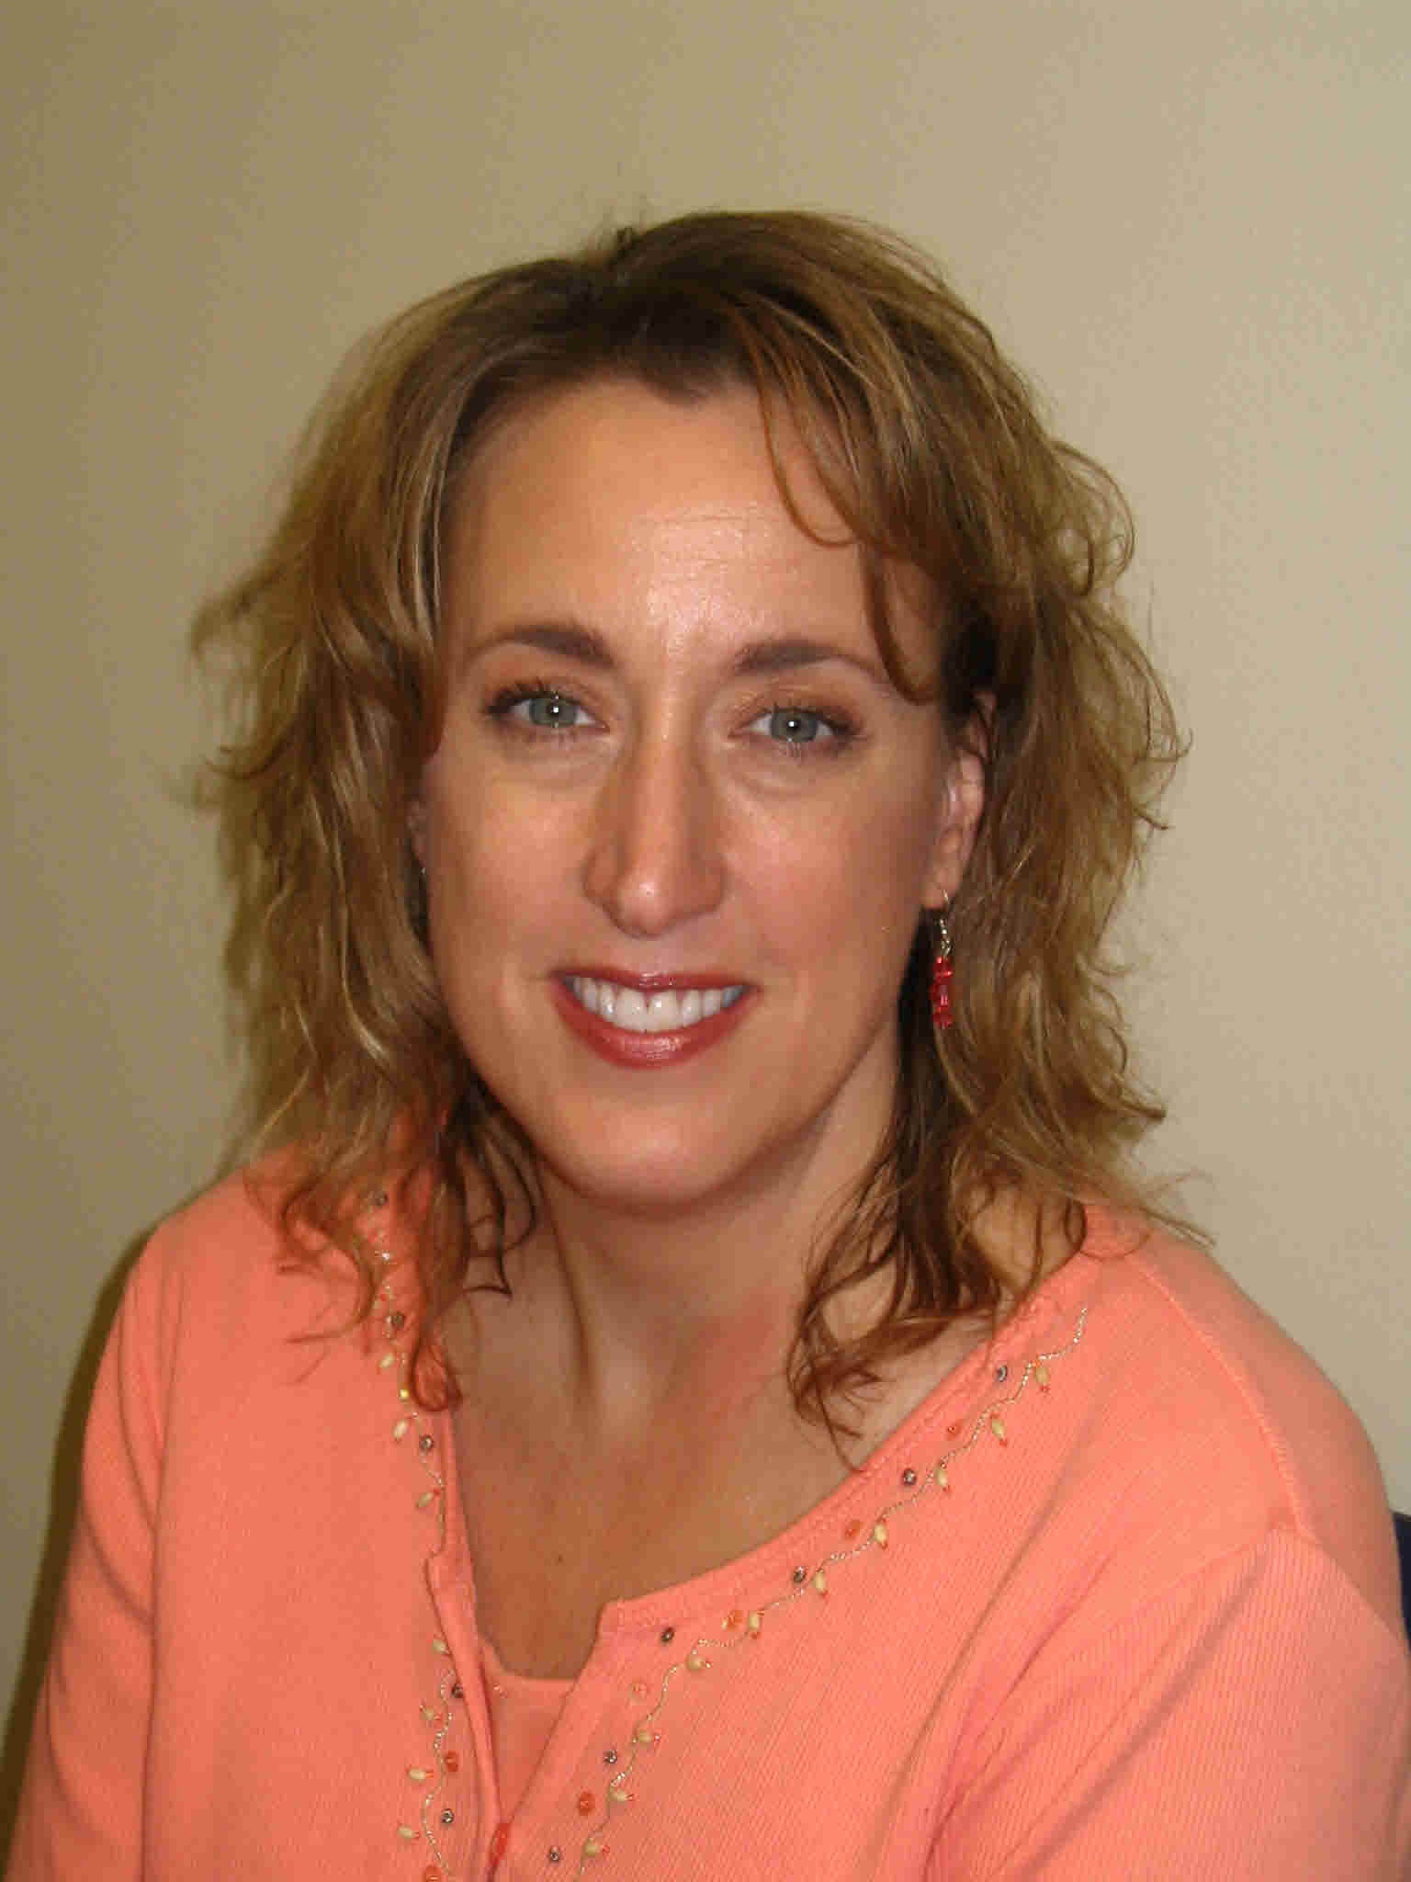
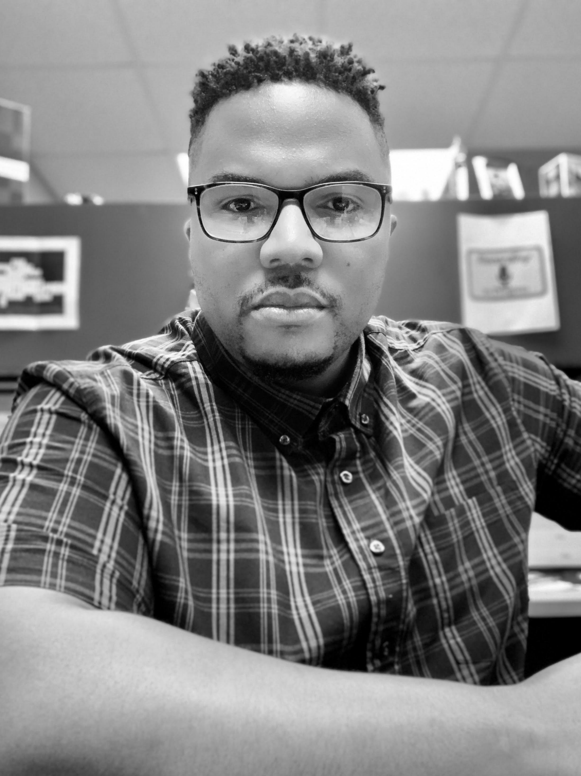
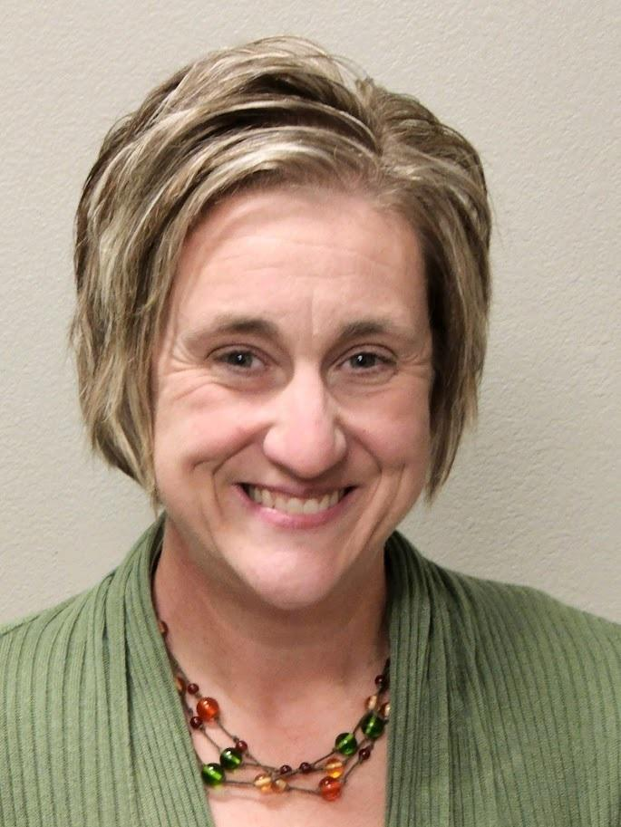
Brobst Center for Teaching and Learning - Current Staff
Robin Galloway
Director of Brobst Center for Teaching & Learning and Dean of Business and Applied Technology
Cindi Clark
Administrative Assistant Brobst Center for Teaching & Learning and School of Business and Applied Technology
Dr. Marcea Seible
Professor, English
Faculty Fellow Supporting Online Instruction, Brobst Center for Teaching & Learning
Joshua Mitchell
Instructional Design and Technology Specialist, Brobst Center for Teaching & Learning

Slide 12
Brobst Center for Teaching and Learning
Challenges:
Lack of staff and space.
Lack of professional development programs.
Lack of faculty and greater campus input.
Less communication about teaching initiatives or changes (Ex: LMS integrations).
Little-to-no oversight of LMS use by faculty (full-time, adjunct, and concurrent).
Few professional development opportunities.
Lack of Quality Matters training or implementation by instructors.

Slide 13
Fresh Ideas for Quality Assurance
1: Established Faculty Fellow in Assessment
Worked with adjuncts to assist them with the college’s Assessment Plan requirements.
Offered a few Professional Development opportunities (Canvas Showcase, Rubrics Workshop)
Morphed into more responsibility with college Assessment Plan, and the Assessment and Curriculum Committees.
2: Established Faculty Fellow in Online Learning
Started as a QM faculty fellow to work with instructors on implementing QM standards.
Became a resource when COVID forced online instruction
Morphed into support role for online, face-to-face, and hybrid instructors.
Became combination of QM facilitator (online and in-person), online learning support, resource for teaching issues and teaching with technology issues.
3: Will Advertise for a Second Instructional Designer (Spring 2023)

Slide 14
Fresh Ideas for Quality Assurance
Finding Some Success
Instructional Design & Technology Specialist has a little more time to devote to technology workshops and training.
One more person available for general assistance or teaching-related concerns.
More faculty signing up for internal QM Course Reviews and asking for QM help.
Teaching-focused professional development sessions have been popular.
Caffeinated Conversations is bringing people together again.
More interaction is spurring more collaboration across campus.

Slide 15
Your Turn – Quality Assurance: 1-2-3
Write 1 quality assurance goal for your institution.
  What is one area that needs attention?
  Example: Syllabus or LMS course reviews needed.
Identify 2 ways of working toward that goal.
  What can your institution do on a small scale to make it happen?
  Examples: (Identify and communicate expectations for LMS requirements. Appoint 1-2 people who can serve as liaisons and make personal connections with instructors.)
Create a 3-step plan for assessing completion of that goal.
  How much time do you need to make this happen? List the steps needed to pursue it.
  Example:
    Step 1 - Hold forums/create an online survey to determine needs of faculty/institution
    Step 2 - Form a small committee to address identified needs.
    Step 3 - Plan one event or task to see progress.

Slide 16
Share Your Ideas
Write 1 quality assurance goal for your institution.
Identify 2 ways of working toward that goal.
Create a 3-step plan for assessing completion of that goal.

Slide 17
The End – Big Possibilities
Thank you for choosing this session!
Dr. Marcea Seible
Hawkeye Community College
marcea.seible@hawkeyecollege.edu

