Slide 1

Smarter Not Harder
Efficiently and Effectively Meeting Standards
Using Your LMS
Brandy Ermis
Victoria Fowler
Linda Reed
Jaime Schroeder
Amy Winningham
Notes:
Introductions: (Wear hats) You will notice we are wearing hat. This group wears a lot of different hats (job responsibilities). We are faculty, division leadership, program director, instructional design and leaders in distance learning for our college! Introduce ourselves.

Slide 2
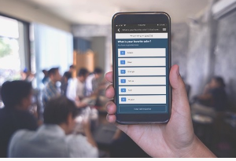
Directions for Poll Everywhere
JSCHROEDER113 to 37607 to join then test response.
Notes:
During our presentation, we would like to ask questions and get your in put. We are going to be using Poll Everywhere. The directions are on the screen. Please answer the first question.

Slide 3

Notes:
Poll Title: #1. Which state did you travel from?
https://www.polleverywhere.com/free_text_polls/mogivnVruz9EL3r

Slide 4

Overview
Set up Poll Everywhere
Identify the problem
Complete Survey
Review Standards 1,7, & 8
Review Alignment Standards 2-6
Q & A
Notes:
Hopefully everyone has their Poll Everywhere working and started answering the questions. Let’s look at the features the LMS might offer to provide assistance meeting QM standards. If you have questions, please raise your hand and we will call on you. Thank you!

Slide 5

Learning Objectives
Identify standards that can be addressed using the LMS
Discuss various methods of meeting standards using LMS features
Articulate the benefits of using prebuilt modules to meet QM standards
Notes:
During this presentation our goal is to:
Identify standards that can be addressed using the LMS.
Discuss various methods of meeting standards using LMS features.
Articulate the benefits of using prebuilt modules to meet QM standards.

Slide 6

Survey Questions
Do you use an LMS?
If so which one?
  Blackboard
  Desire2Learn (Daylight)
  Canvas
  Moodle
  Other

Slide 7
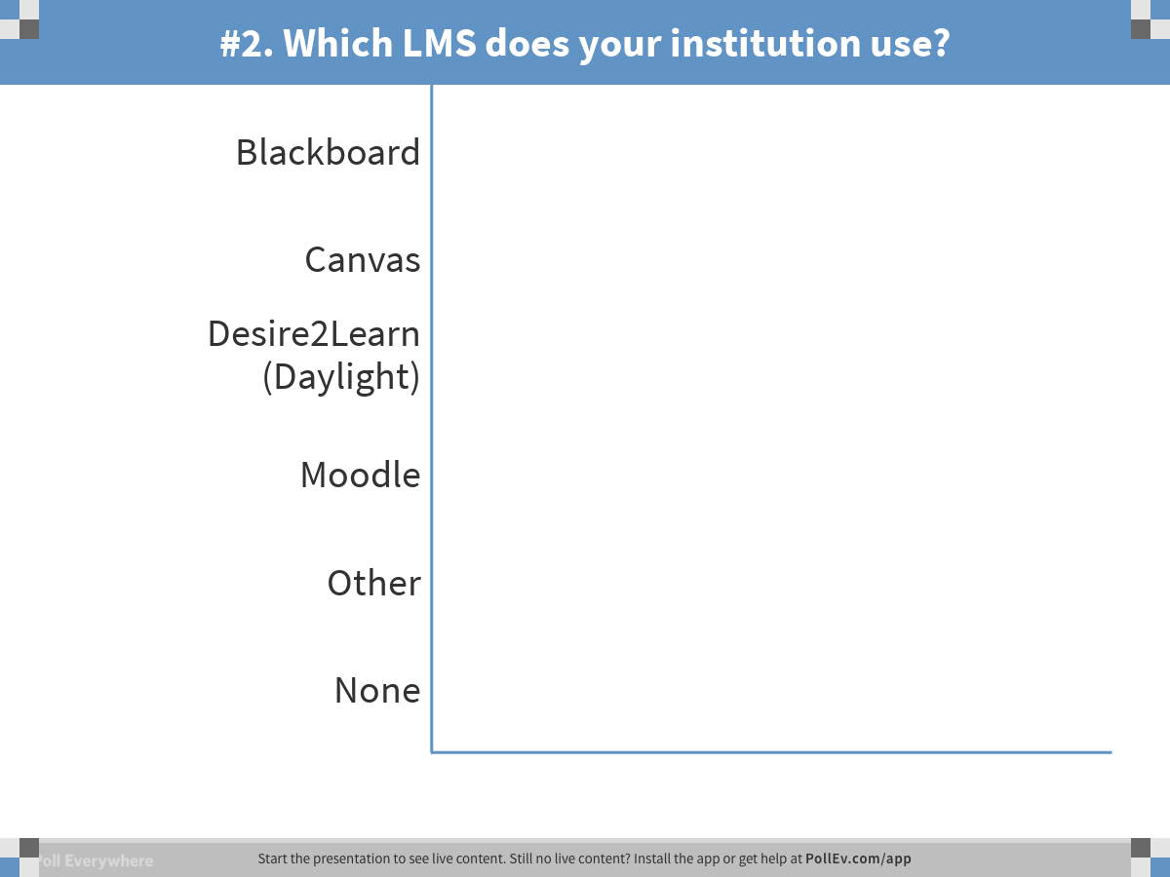
Notes:
Poll Title: #2. Which LMS does your institution use?
https://www.polleverywhere.com/multiple_choice_polls/e4afLl0vyij2lQA

Slide 8

Survey Questions
Have you taken a QM training?
Which one?
Are you:
  Faculty
  Staff
  Administrator
Do you teach: (Choose all that apply)
  online
  blended/ hybrid courses
  Face to face

Slide 9
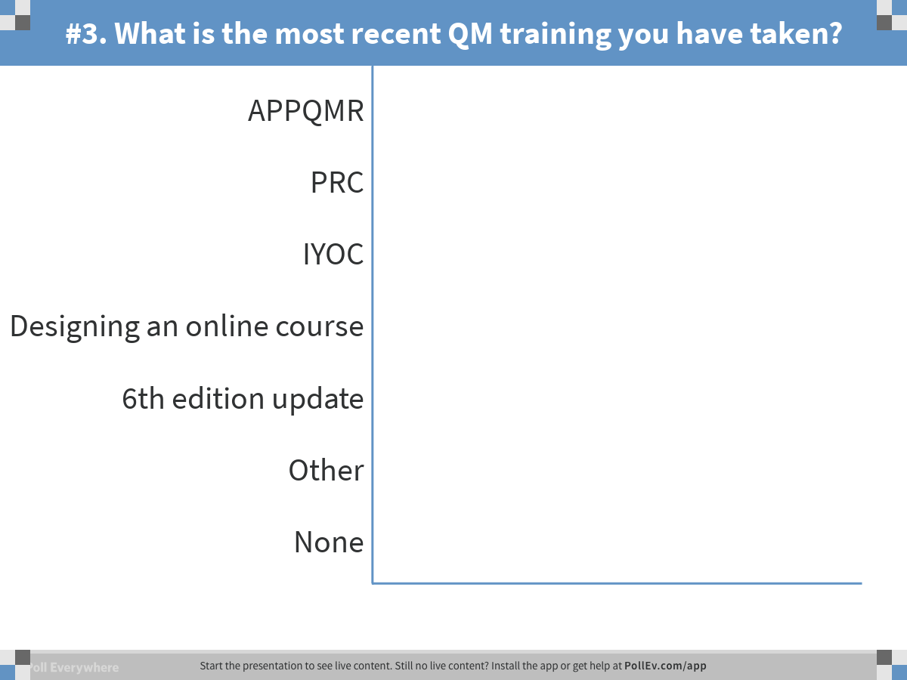
Notes:
Poll Title: #3. What is the most recent QM training you have taken?
https://www.polleverywhere.com/multiple_choice_polls/PQ5BMob4ogw3L6y

Slide 10
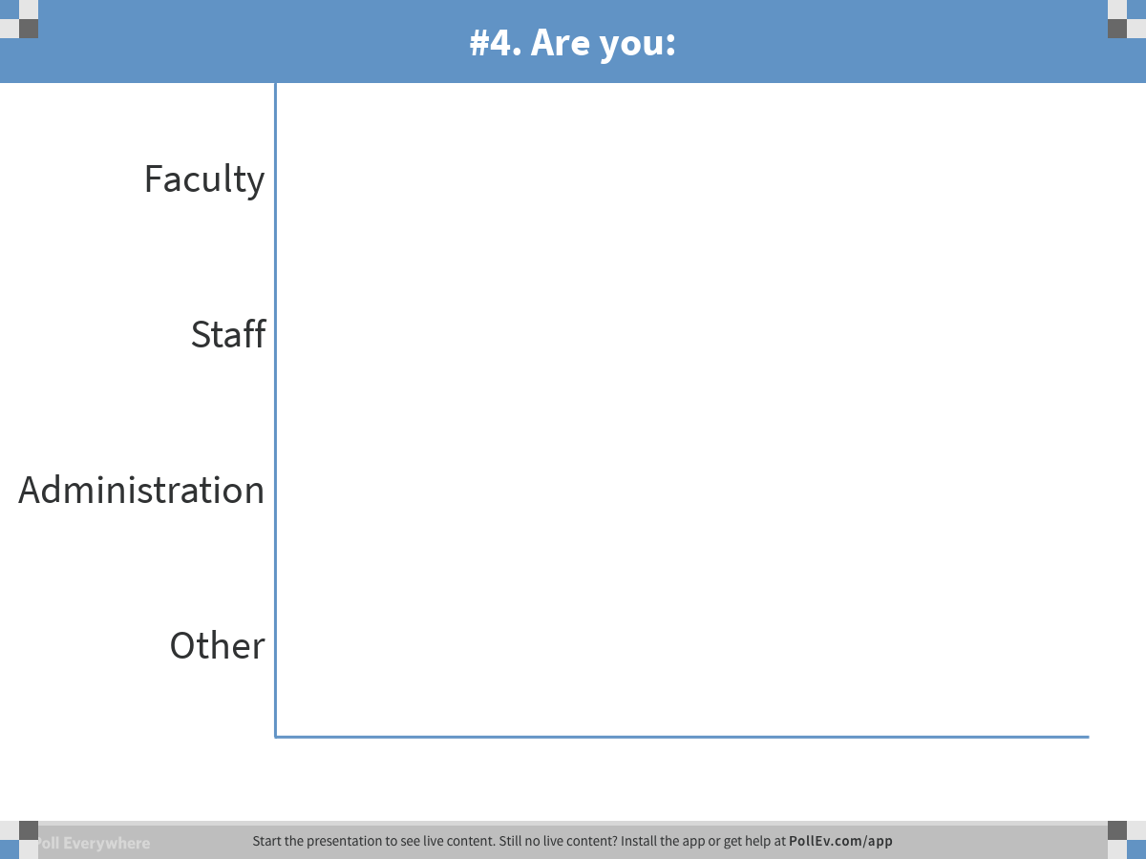
Notes:
Poll Title: #4. Are you:
https://www.polleverywhere.com/multiple_choice_polls/uSkuVmBoHEqHU5J

Slide 11
Survey Questions
Are you provided a template to help design a course?

Slide 12
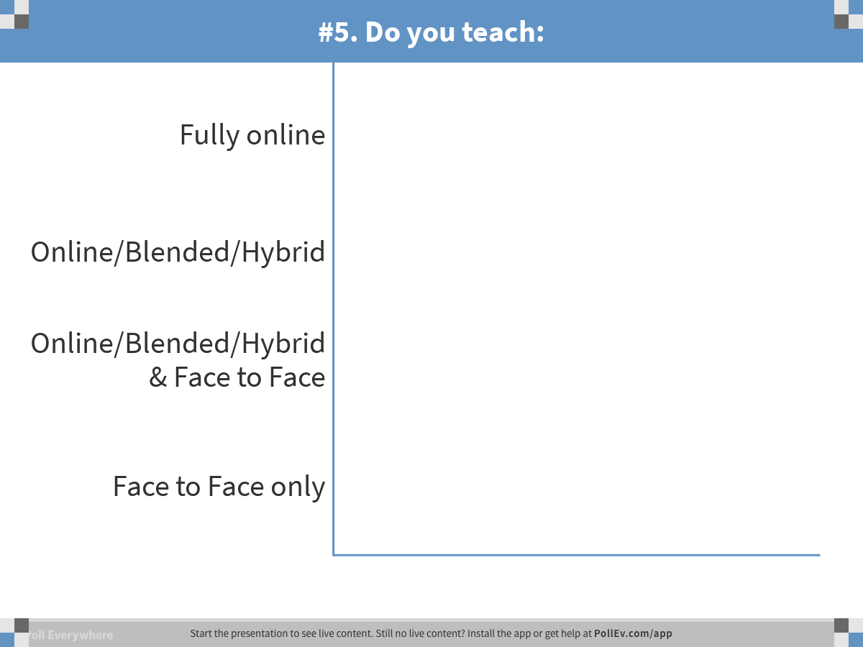
Notes:
Poll Title: #5. Do you teach:
https://www.polleverywhere.com/multiple_choice_polls/11Z3hIomkVuOz6L

Slide 13
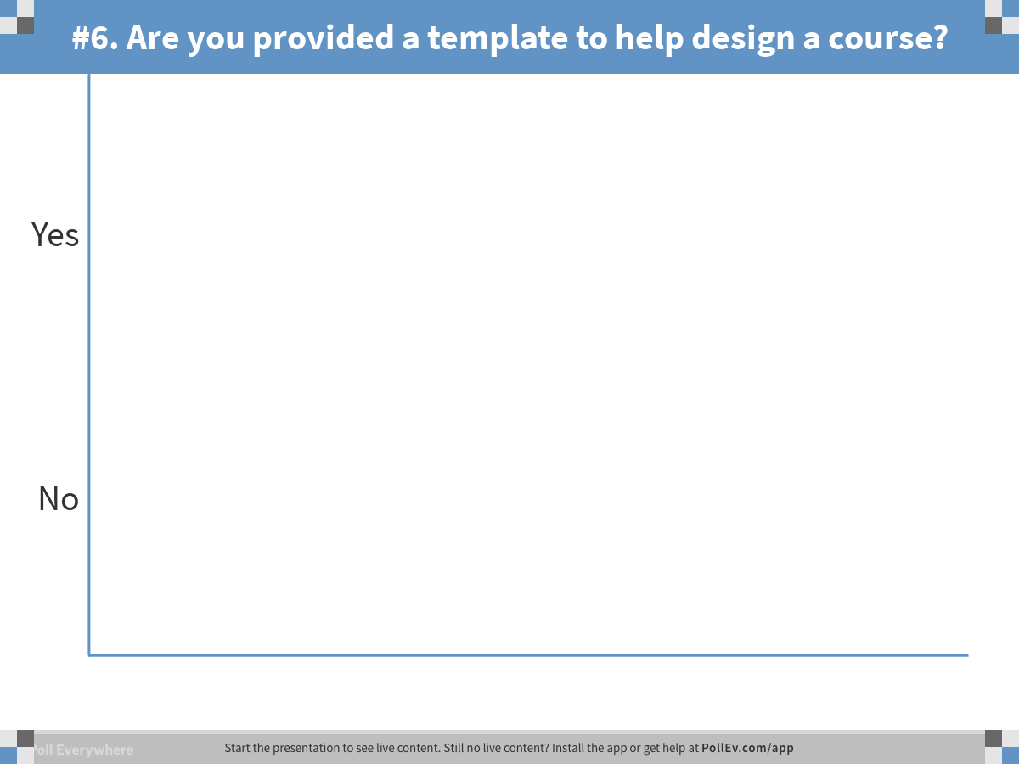
Notes:
Poll Title: #6. Are you provided a template to help design a course?
https://www.polleverywhere.com/multiple_choice_polls/uzMId6WrkAcMxuq

Slide 14

Survey Questions
Does your college use any type of course review process for online/ blended courses?
If so which type:
  Formal QM
  Internal

Slide 15
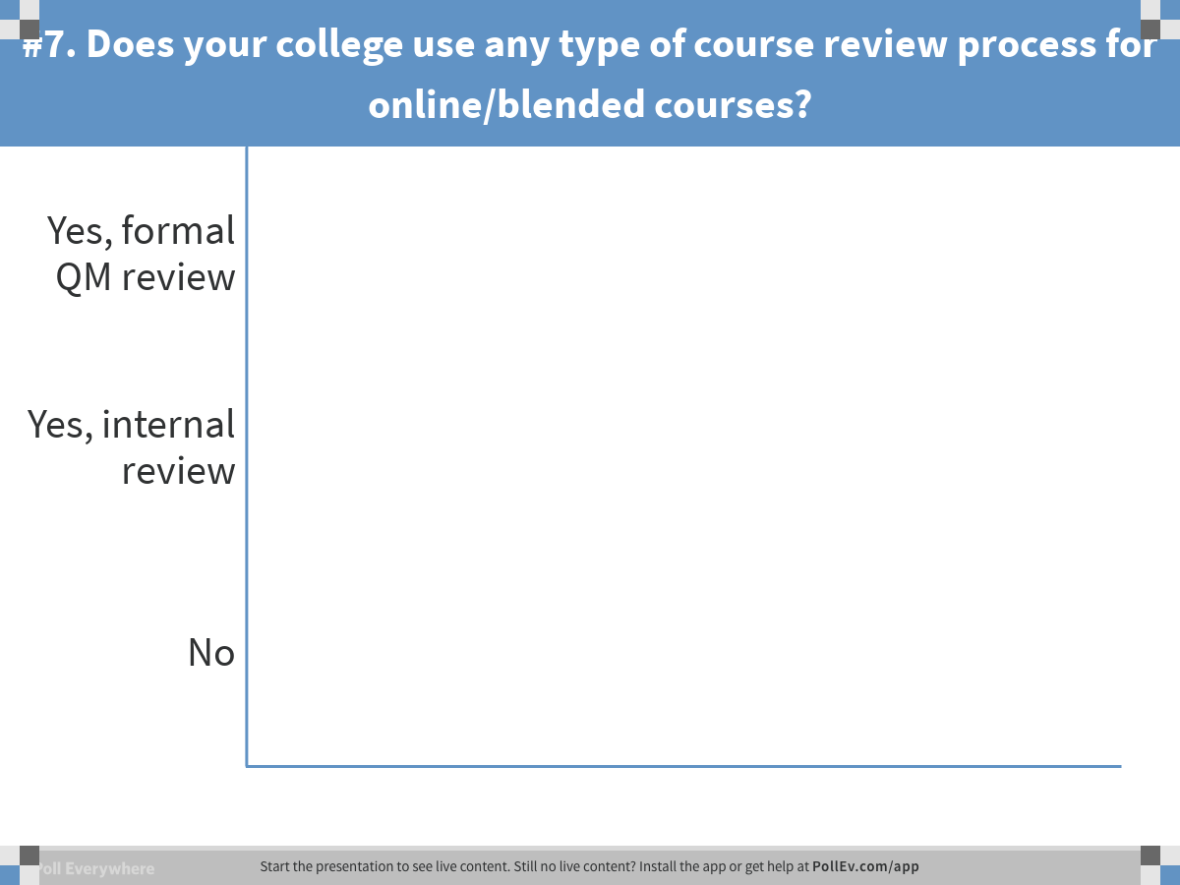
Notes:
Poll Title: #7. Does your college use any type of course review process for online/blended courses?
https://www.polleverywhere.com/multiple_choice_polls/Ei4CX2EhW23M1eQ

Slide 16
Survey Questions
How many standards do you think you can meet through your LMS or template?

Slide 17
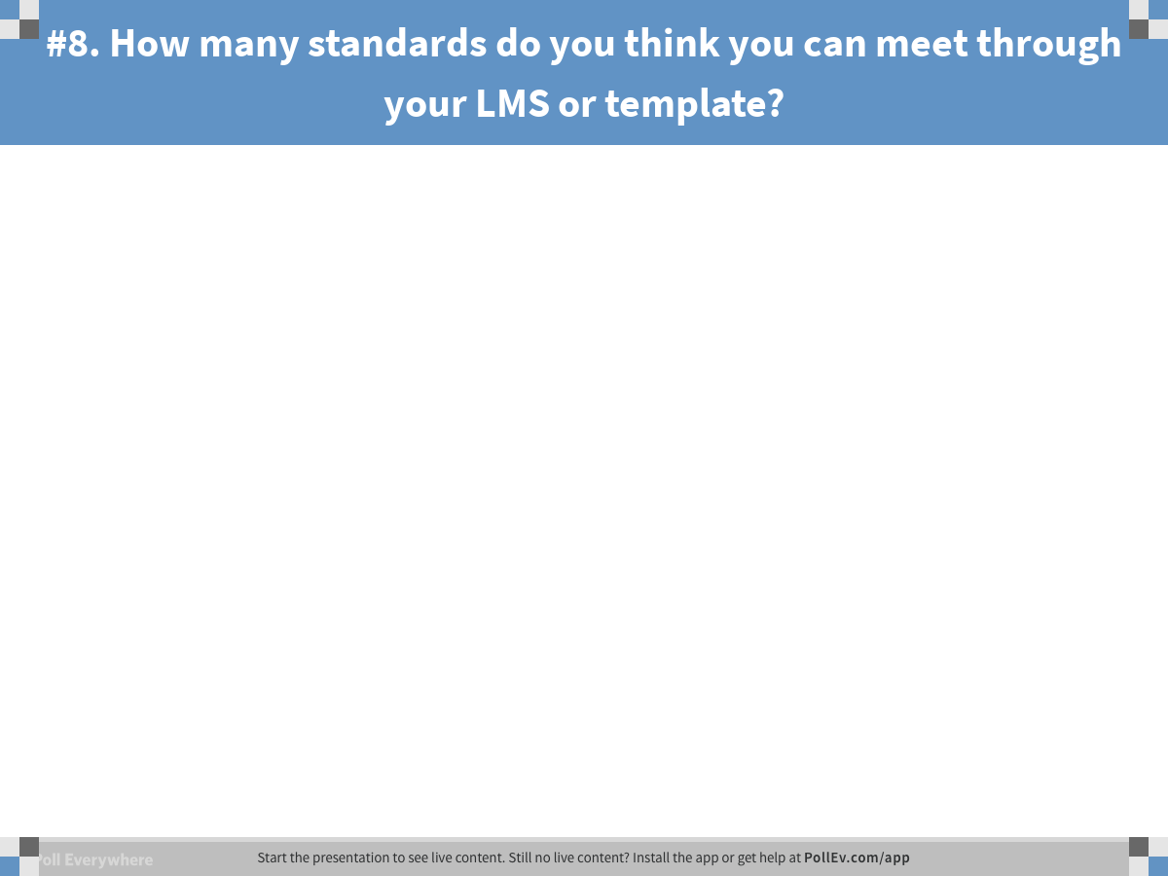
Notes:
Poll Title: #8. How many standards do you think you can meet through your LMS or template?
https://www.polleverywhere.com/free_text_polls/rIxemjtbtLXCj3R

Slide 18

Problem
How do we take an institutional approach to meet QM standards to avoid faculty recreating the same required materials, allowing faculty to focus on content development while providing students with a consistent design?
Notes:
As Blinn College begin to develop distance learning standards, it became necessary to find a detailed rubric and software system to conduct internal reviews. This lead us to Quality Matters. As we moved forward faculty, ”If each person must meet these standards, why can’t you do something that helps all of us and allows us to focus on content development?” Blinn College has two instructional designers and 800+ faculty. The instructional designers looked at the standards and the LMS and begin to create an Orientation module allowing some customization by faculty.
Each online and blended course had an individual look. Students found it difficult to find information.

Slide 19
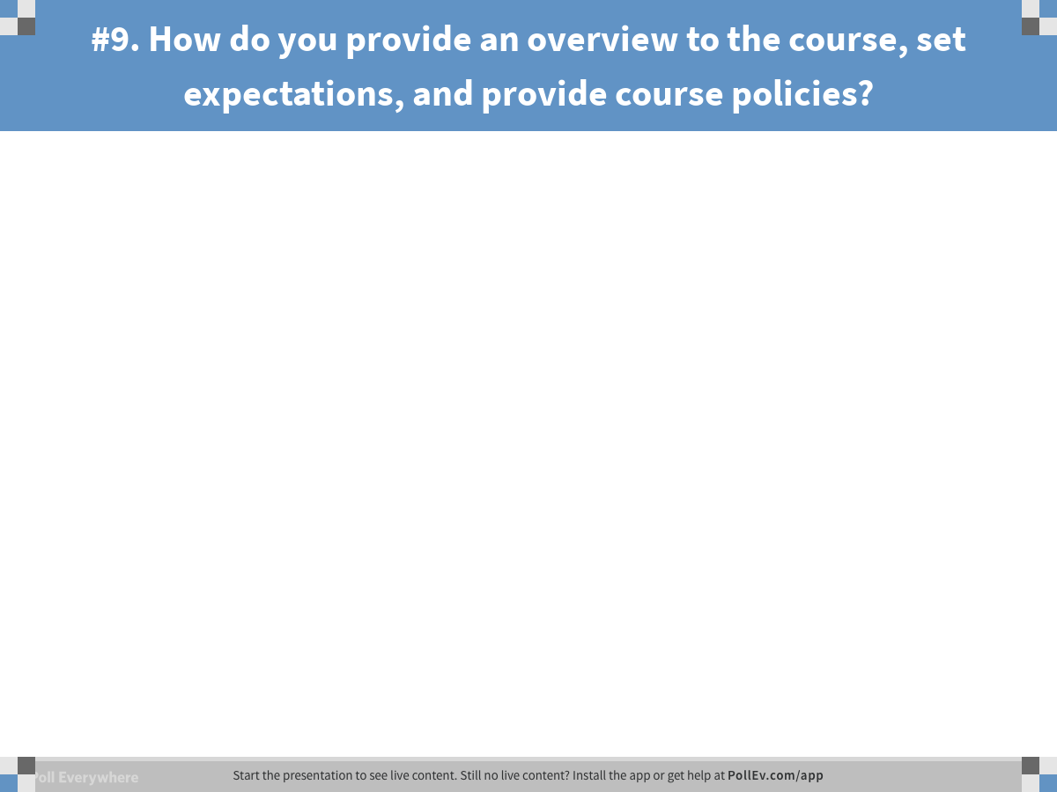
Notes:
Poll Title: #9. How do you provide an overview to the course, set expectations, and provide course policies?
https://www.polleverywhere.com/free_text_polls/TuOpDhULFBn7jPs

Slide 20
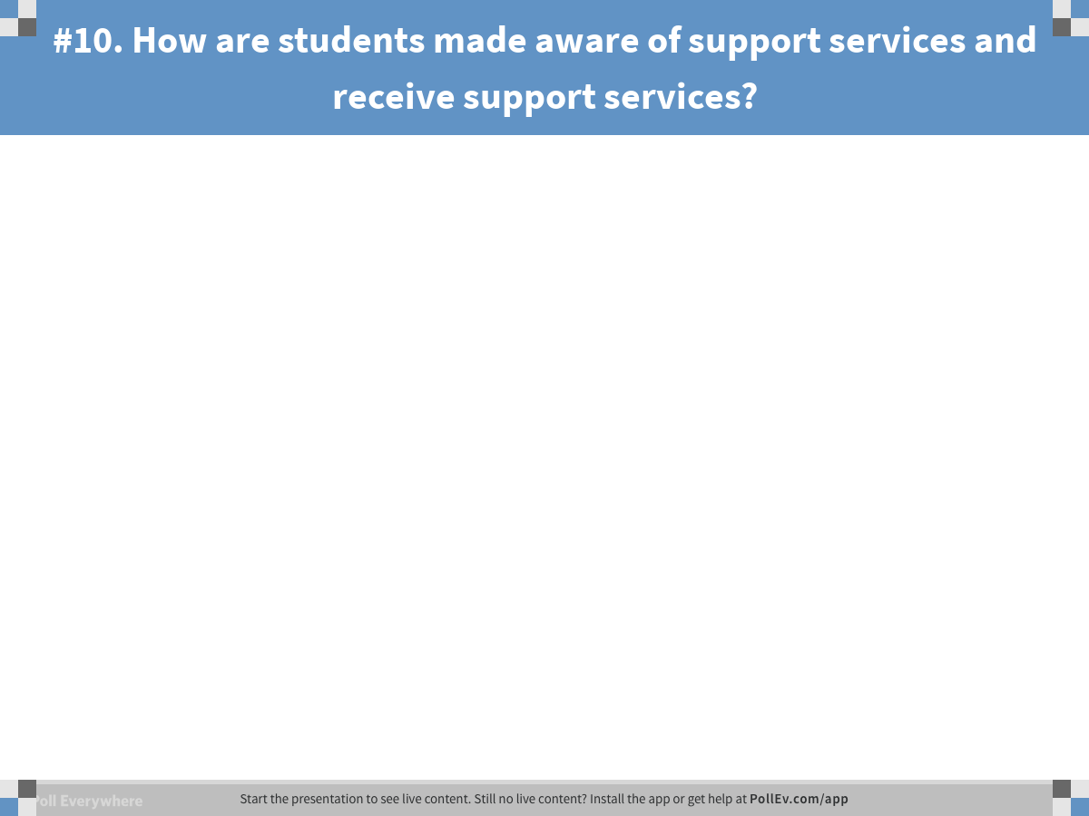
Notes:
Poll Title: #10. How are students made aware of support services and receive support services?
https://www.polleverywhere.com/free_text_polls/w6rbEIj9yhPSC1v

Slide 21
General Standard 1 Question
How do you provide an overview to the course, set expectations, and provide course policies?

Slide 22
General Standard 7 Question
How are students made aware of support services and receive support services?

Slide 23

What did we do? Standards 1 & 7
Notes:
We created an orientation module with links and areas to be customized by the instructor.
A navigation bar customized to fit specific standards department specific grading rubrics
1.4 Jaime selective release
Standard LMS General standard 1
1.1
News announcement, content page
1.2
Purpose of course- orientation
1.3
Communication policy
1.4
Course / institutional policies, orientation & syllabus, resources
1.5
Min. tech. – orientation
1.6
Prerequisite skills – course materials – orientation
1.7
Prerequisite knowledge and courses – syllabus and orientation
1.8
Self-introduction by instructor - orientation
1.9
Student self-introduction (first week, first assignments, orientation)
Standard LMS
7.1
Technical support, Resource tab, syllabus, Orientation
7.2
Accessibility policies – syllabus, accessibility module, Resource tab
7.3
Academic support, syllabus, orientation, Resource tab
7.4
Student services and resources, syllabus, orientation, Resource Tab

Slide 24
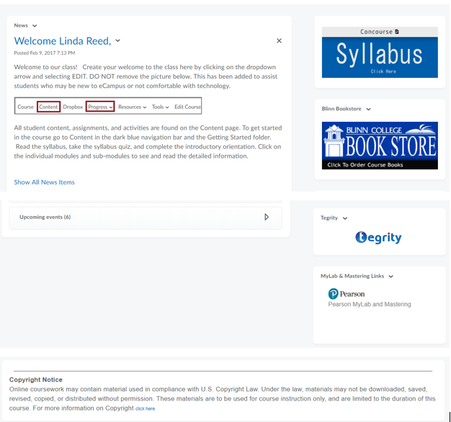
Home Page

Slide 25
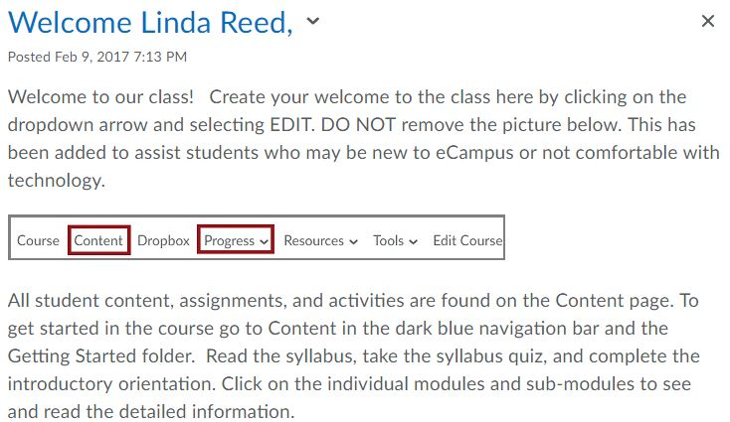
1.1
Notes:
Example of News announcment

Slide 26
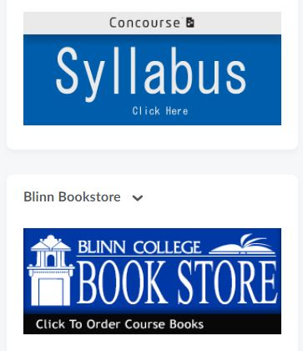
1.2
Notes:
Purpose and structure of class listed in syllabus

Slide 27
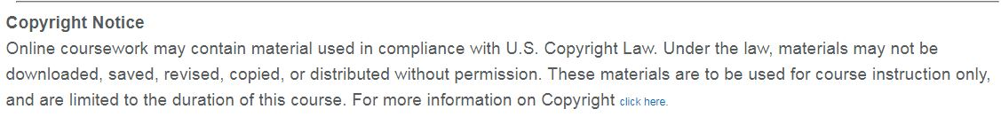
4.3
Notes:
Consistent copyright notice.

Slide 28
Meet your Instructor
Communication Policy

Slide 29
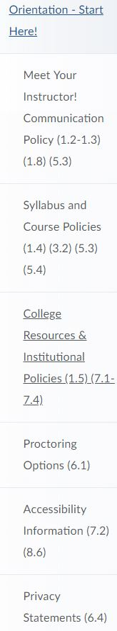
1.1
Notes:
Table of Content for START HERE module

Slide 30
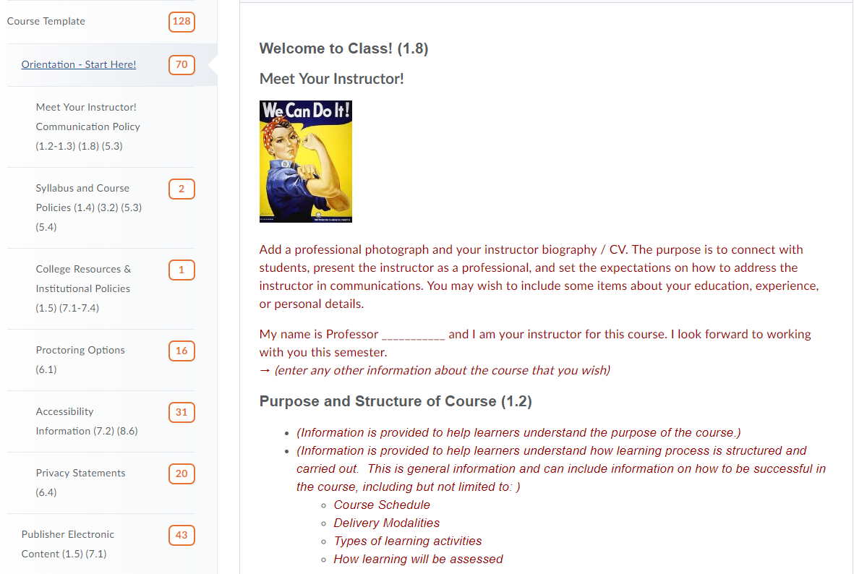
Notes:
First submodule: Communication

Slide 31
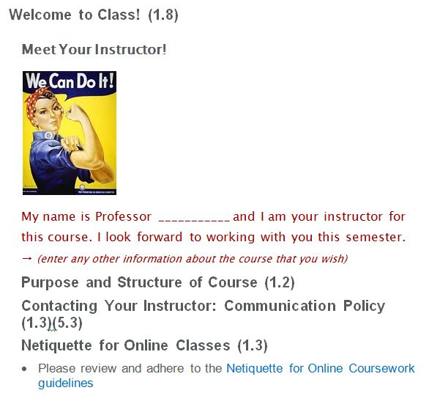
1.2-1.3-1.8-5.3

Slide 32
Syllabus and Course Policies

Slide 33
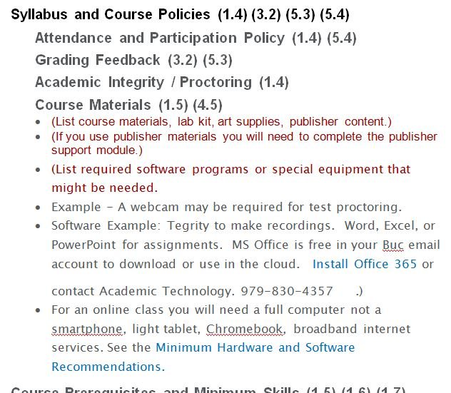
1,3,5
Notes:
Second submodule includes Syllabus and course policies

Slide 34
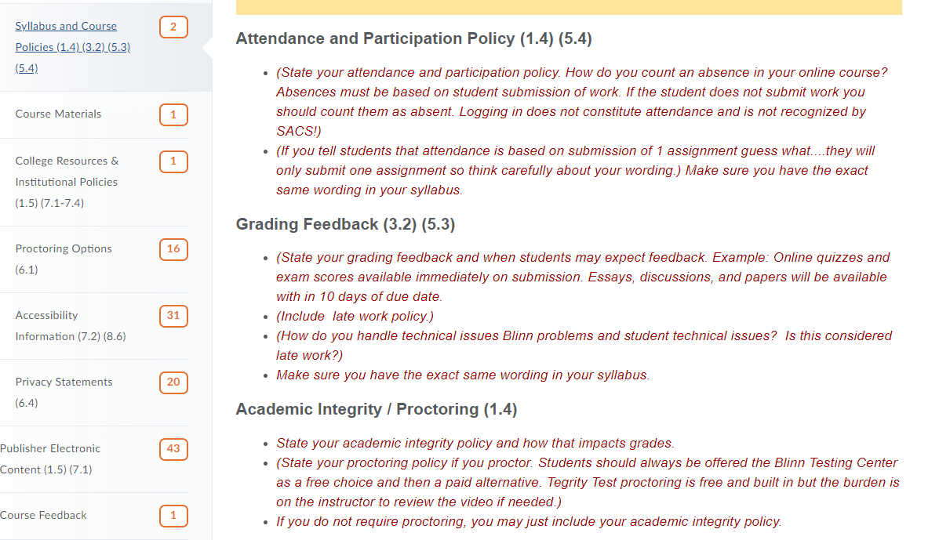
Notes:
Second submodule includes Syllabus and course policies

Slide 35
1,3,5
Notes:
Second submodule includes Syllabus and course policies

Slide 36
1,3,5
Course Materials cont.
Notes:
Second submodule includes Syllabus and course policies

Slide 37
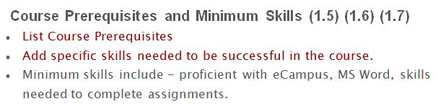
1.5-1.7
Notes:
Second submodule includes Syllabus and course policies

Slide 38
Course Resources and Institutional Policies
Notes:
Institutional Policies also support

Slide 39
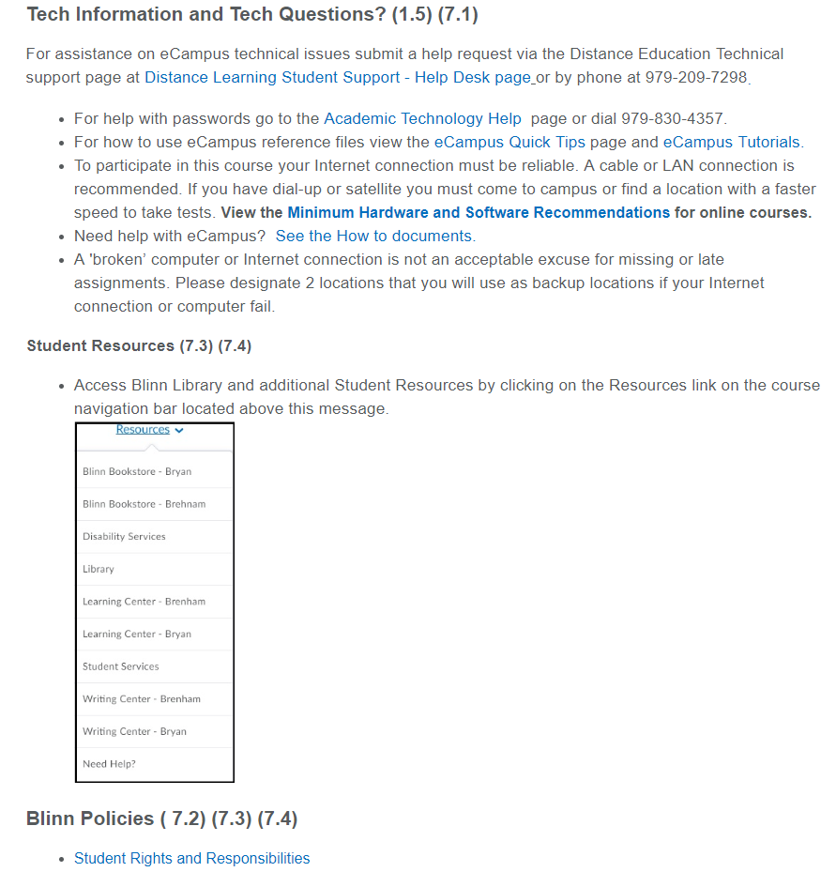
Notes:
Listed are links to:
technical and LMS support, and
tips and tutorials for the LMS.
Minimum Hardware and Software Recommendations
Student Resources which are linked in the navigation bar and an image of the navigation bar.
Last are Blinn College Institutional Policies with links to:
Student Rights and Responsibilities
Academic Affairs Website – Student policies including printing, recording lectures, copyright, makeup exams, tobacco use, incivility and expulsion protocol, Commencement, etc.
Academic Regulations including academic honors, attendance, excused absence, dress code, etc.
Disability Services

Slide 40
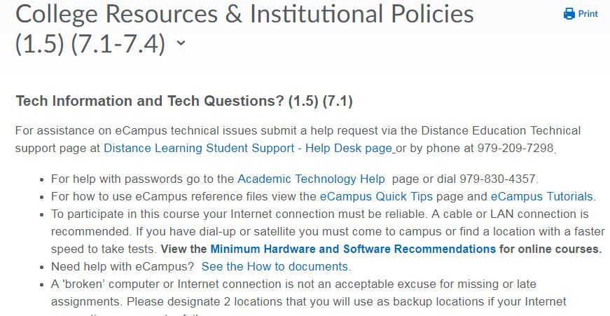
1.5, 7.1
Notes:
Listed are links to:
technical and LMS support, and
tips and tutorials for the LMS.
Minimum Hardware and Software Recommendations

Slide 41
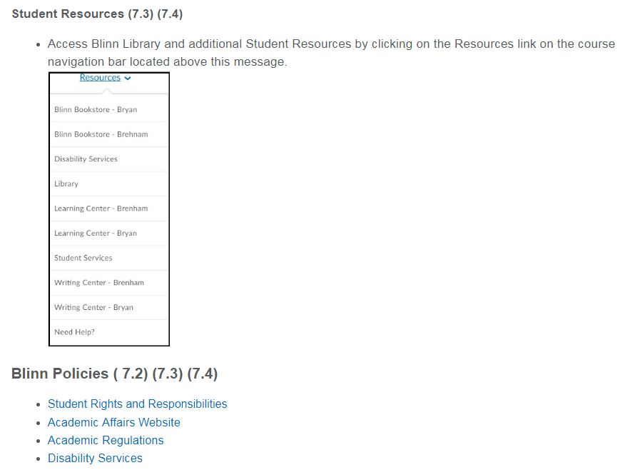
7
Notes:
Student Resources which are linked in the navigation bar and an image of the navigation bar.
Last are Blinn College Institutional Policies with links to:
Student Rights and Responsibilities
Academic Affairs Website – Student policies including printing, recording lectures, copyright, makeup exams, tobacco use, incivility and expulsion protocol, Commencement, etc.
Academic Regulations including academic honors, attendance, excused absence, dress code, etc.
Disability Services

Slide 42
Privacy Statements

Slide 43
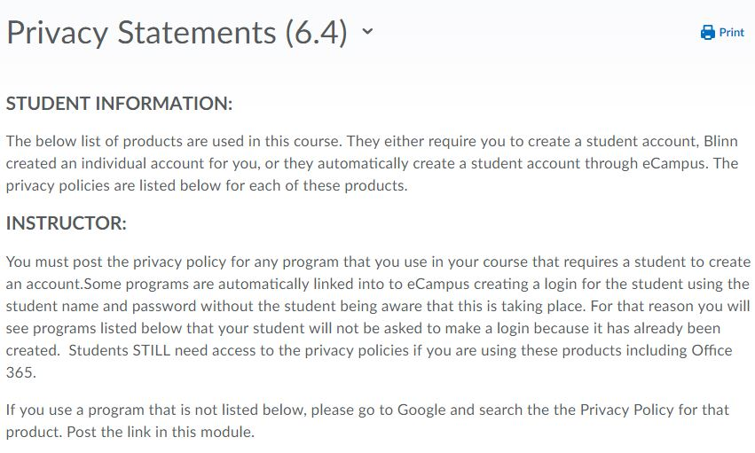
6.4
Notes:
Included in the START HERE module is a submodule with Privacy policies with a statement and list of links. Instructors select their links and delete the rest.

Slide 44
7.3
Notes:
Included on the course home page is a widget connecting to the college bookstore. Allowing students to easily purchase instructional materials to help students be successful in the course.

Slide 45
Proctoring Policies

Slide 46
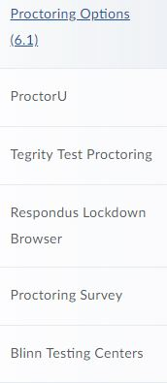
7.1
Notes:
Blinn has instituted a proctoring policy for online courses. To provide consistent student information, prebuilt modules with instructions and support for students and faculty are included in a submodule for the START HERE module.

Slide 47
Publisher Support

Slide 48
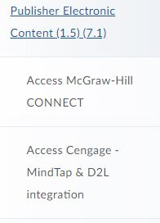

7.1
Notes:
Publisher Materials: To provide consistent student information, prebuilt modules with instructions and support for students and faculty are included in a submodule for the START HERE module.

Slide 49
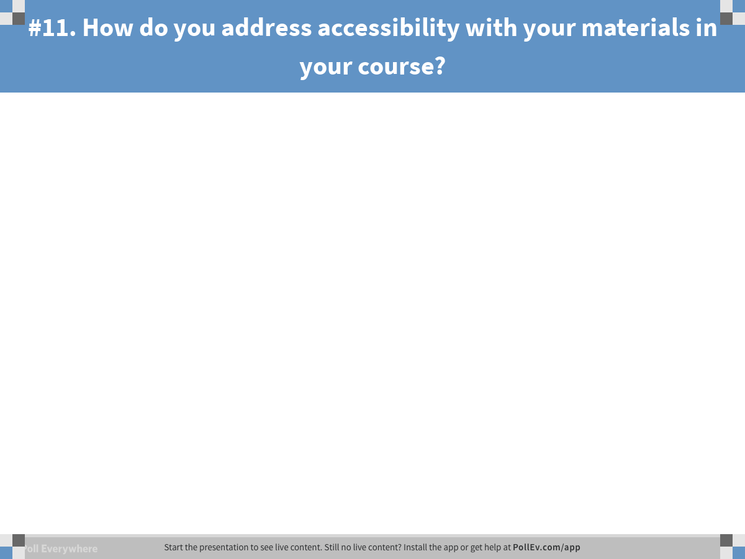
Notes:
Poll Title: #11. How do you address accessibility with your materials in your course?
https://www.polleverywhere.com/free_text_polls/FkKWdL82PNXztoD

Slide 50
General Standard 8 Question
        How do you address accessibility with your materials in your course?

Slide 51
What did we do? Standards 8
Notes:
Standard 8
8.1- Navigation bar customized by the college.
8.2 Readability – Default set on LMS; also has Open Dyslexic font which can be set by the student with font size.
8.3 Accessibility checker in LMS, Word and PDF
8.4 Tegrity with auto-generate captions
8.6 Accessibility statements in a module

Slide 52
Accessibility Statements

Slide 53
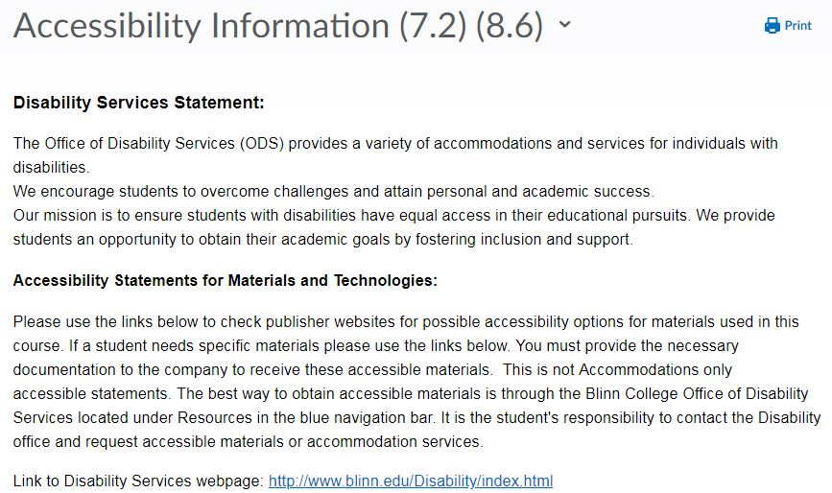
7.2 & 8.6
Notes:
Also in the Start Here module is a submodule on Accessibility. This module includes a statement from the college and a statement on accessible materials. Included are links to the LMS, integrated software and publisher materials.

Slide 54
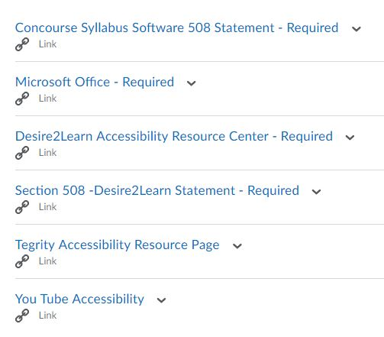

8.6- Accessibility Links
Notes:
Accessibility Links to the LMS and modules with college software resources and publisher materials. Instructors customize select their links and delete the rest.

Slide 55

Standards 1,
7 & 8
Turn to your neighbor and share one idea that you would like to implement.
Would you need assistance to implement this? If so, who?
Notes:
We have discussed many ways to meet Standards 1, 7, 8, and 6.4 using the LMS. Select one idea that you would like to implement and share with the person next to you. Could you do this yourself or would you need assistance of others in your college? Take about 2 minutes to share.

Slide 56
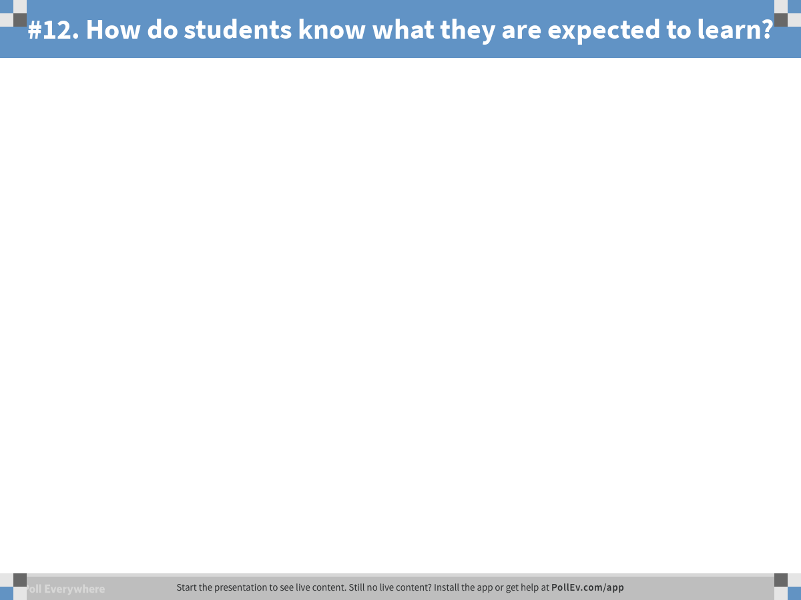
Notes:
Poll Title: #12. How do students know what they are expected to learn?
https://www.polleverywhere.com/free_text_polls/qweLQP2Kr0ICHmN

Slide 57
General Standard 2 Questions
How do students know what they are expected to learn?
How do they know what they are expected to learn for each major assessment?

Slide 58
What did we do? Standard 2
Notes:
Screen shots of the Accessibility checker in the LMS
Readability
Tegrity
Accessibility statements from orientation (module examples)
Template – Linda
Math –
Humanities-
Workforce –
Art – Sunil’s course template
Doug – course template for units. Use an LTI integration to connect syllabus to the course with course outcomes.
Alignment map template required for master courses
Some departments are creating their own template.
Standard LMS
2.1
SLO- Syllabus,
2.2
Module –NA
2.3
Level and prominently displayed /
Chart in modules
2.4
Relationship – table or chart in each module, unit, chapter
2.5
Suited to level of course

Slide 59
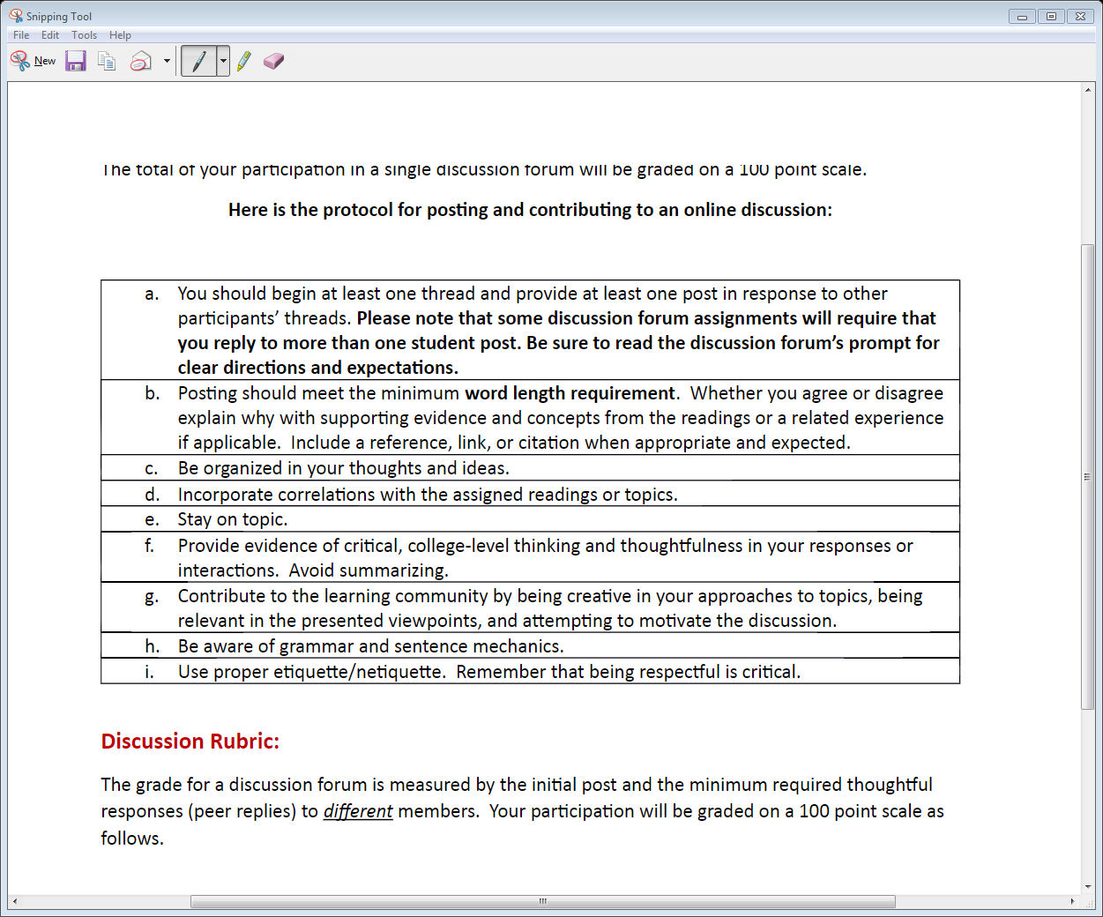
Notes:
This is a rubric for discussion forums in ENGL 1302. This is posted in Week 3 before their first major discussion forum so students know the expectations of the assignment.

Slide 60
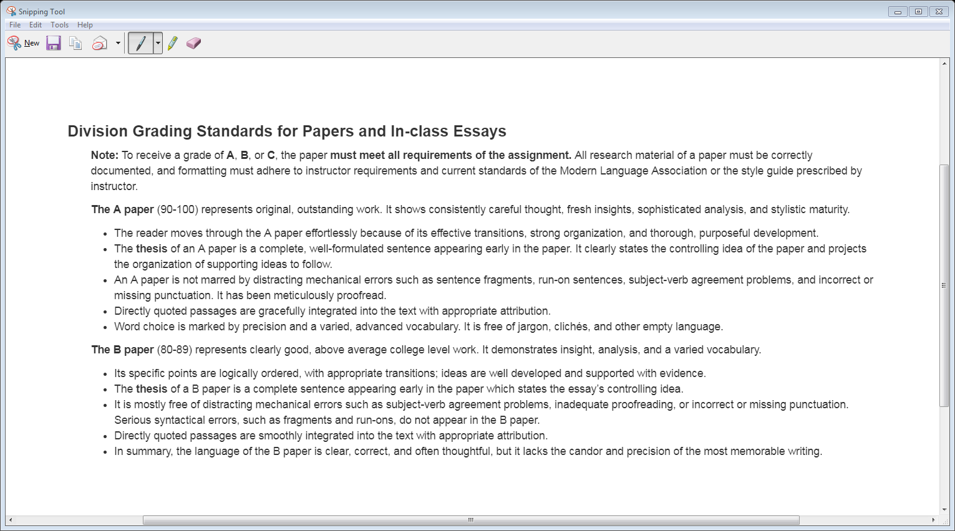
Notes:
The Humanities Division Grading Policy for papers is included in the course syllabus.

Slide 61
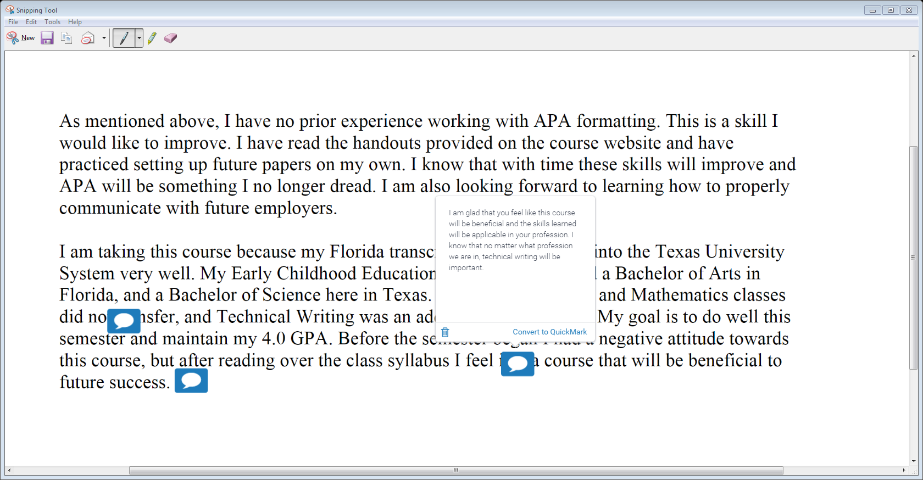
Ways for Learners to Track their Progress in eCampus
Notes:
The Humanities Division requires papers be submitted to Turntitin and then feedback is given on the paper using the GradeMark feature. Then the grade on the paper with feedback is published for students to view.

Slide 62
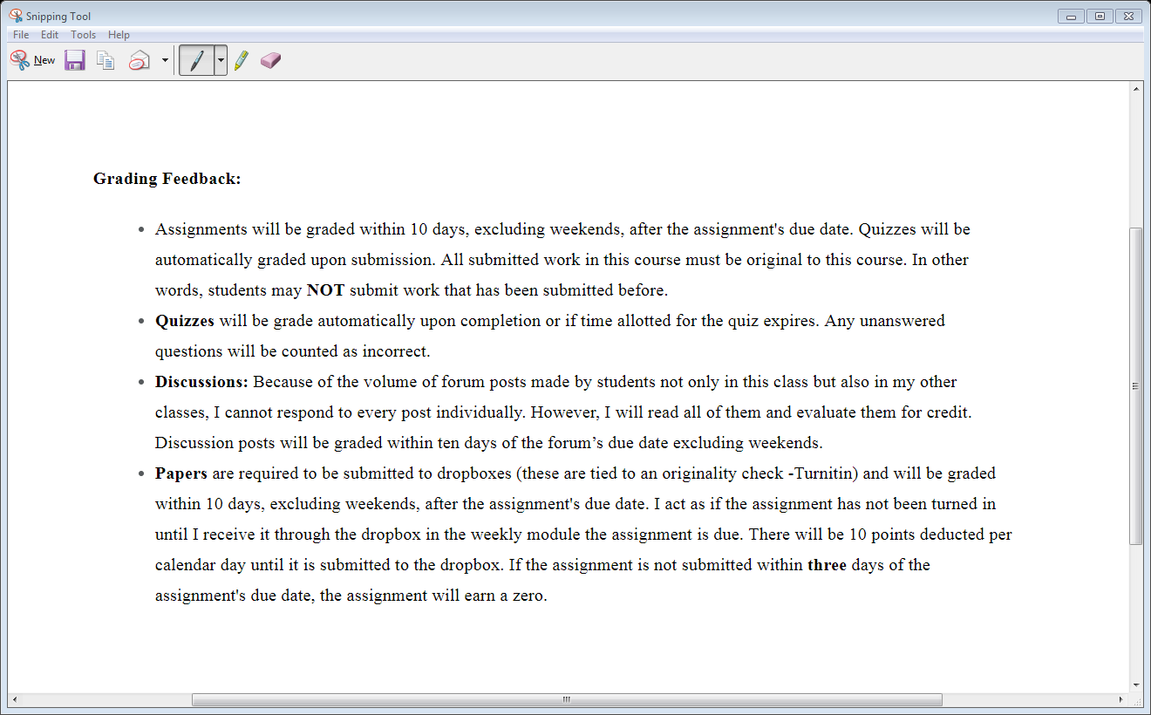
Notes:
Grading Feedback Policy is posted in the Start Here Orientation module and also in the course syllabus.

Slide 63
Quizzes are graded upon completion.
Audio comments using Turnitin and inside eCampus with the dropbox assignment.
For Fun and For Help Discussion Forums
Notes:
Amy and I provide audio comments on Research Paper Proposal and Formal Outline assignments.
For fun and for help discussion forum-open for students to ask the instructor or peers questions about assignments. They can also post the books they are currently reading or give recommendations for “good reads.”

Slide 64
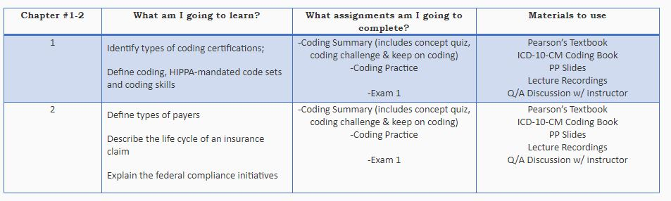
2.4 & 4.2 Chart version
Notes:
To connect the learning outcome to the learning activities and instructional materials, some instructors use a chart.
To explain the purpose of materials, instructors may include in the purpose of the class an explanation for the materials and how they are to be used. . Example: The Pearson Textbook will provide coding information, practice and apply coding skills.
The Coding Book provides specific current coding information necessary to complete the coding practice.
The Coding Practice provides application and formative feedback.

Slide 65
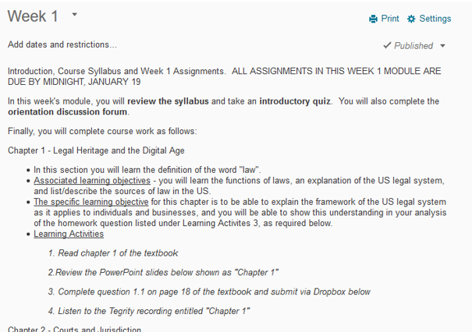
2.4 & 4.2 Text Version
Notes:
To connect the learning outcome to the learning activities and instructional materials, some instructors use a chart.
To explain the purpose of materials, instructors may include in the purpose of the class an explanation for the materials and how they are to be used. . Example: The Pearson Textbook will provide coding information, practice and apply coding skills.
The Coding Book provides specific current coding information necessary to complete the coding practice.
The Coding Practice provides application and formative feedback.

Slide 66
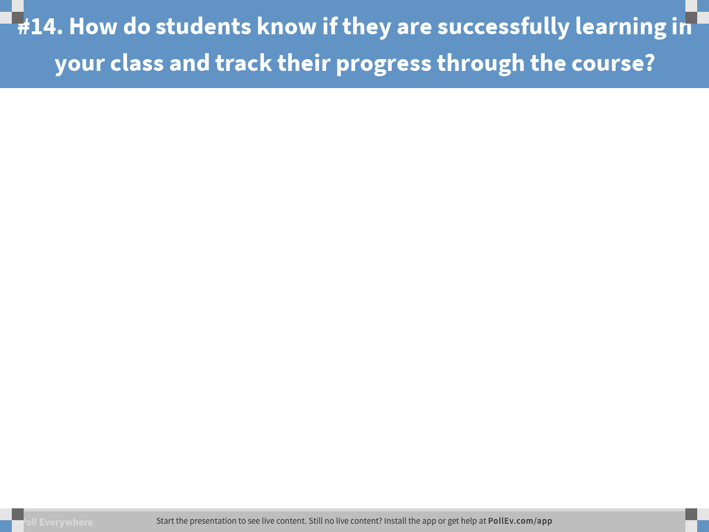
Notes:
Poll Title: #14. How do students know if they are successfully learning in your class and track their progress through the course?
https://www.polleverywhere.com/free_text_polls/igpTjXZQRzl2B7o

Slide 67
General Standard 3 Question
How do students know if they are successfully learning in your class and track their progress through the course?

Slide 68
What did we do? Standard 3
Notes:
LMS
3.1
Assessments aligned / alignment map
3.2
Grading policy – syllabus and orientation
3.3
Specific criteria for grading & connection to grading policy (rubrics, etc.)
3.4
Varied and sequenced assessments
3.5
Multiple opportunities – grades, class progress, instructor feedback, peer review using discussion, Turnitin, publisher content with gradebook and feedback
book example and Class progress example

Slide 69
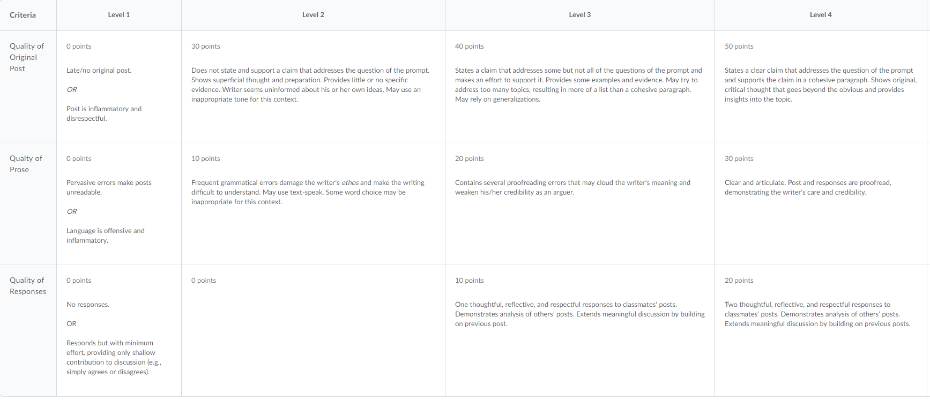
Notes:
Rubrics are prebuilt and shared across the division

Slide 70
Standards 2-3
Turn to your neighbor and share one idea that you would like to implement.
Would you need assistance to implement this? If so, who?

Slide 71
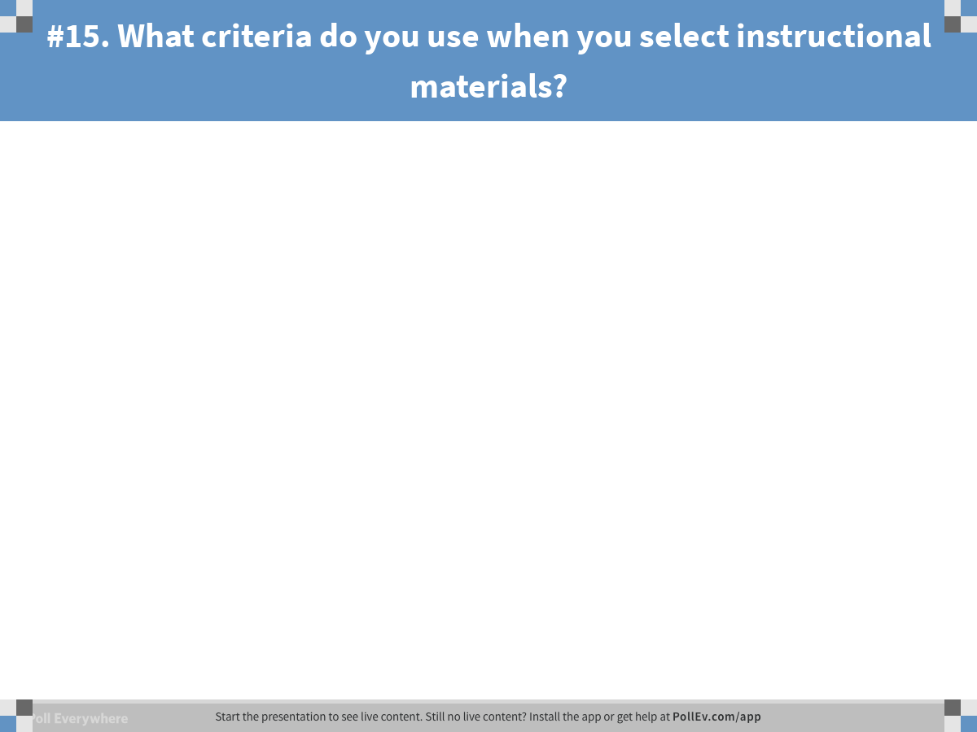
Notes:
Poll Title: #15. What criteria do you use when you select instructional materials?
https://www.polleverywhere.com/free_text_polls/mud23fF849JvGP1

Slide 72
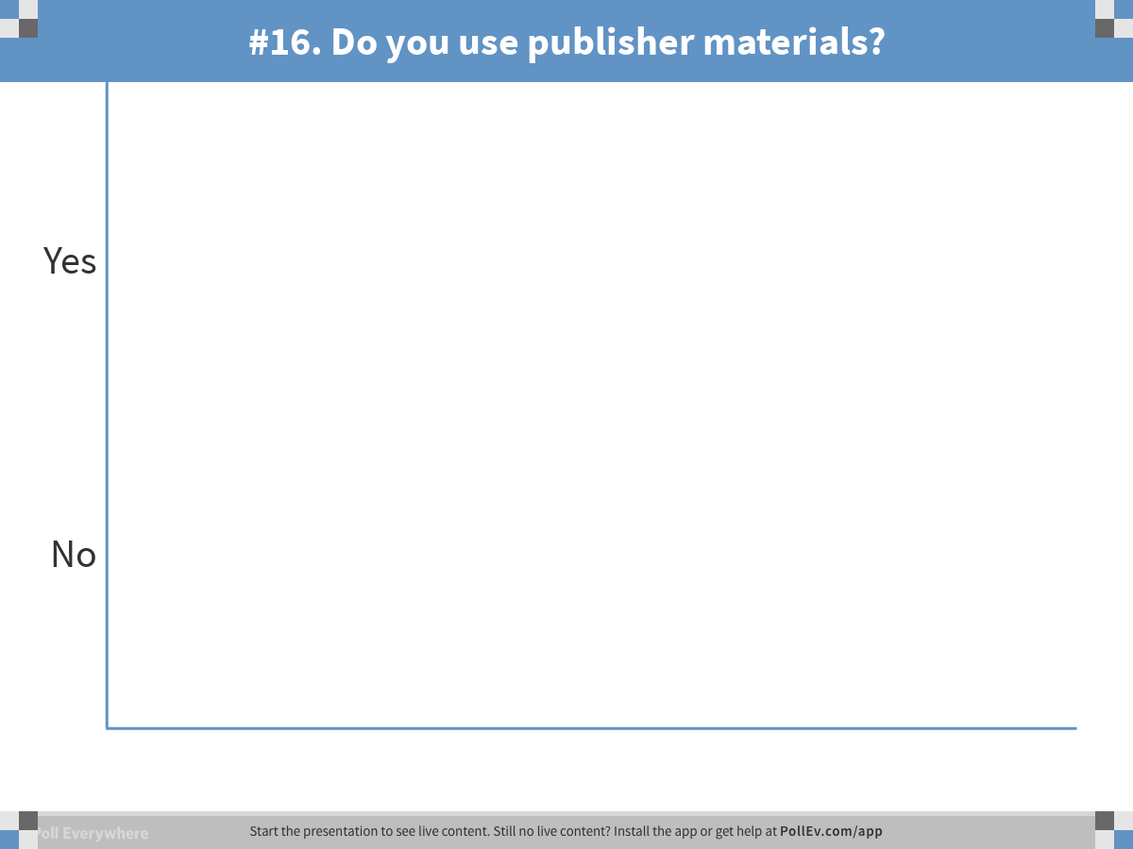
Notes:
Poll Title: #16. Do you use publisher materials?
https://www.polleverywhere.com/multiple_choice_polls/BBwhyDiY4i1MGxP

Slide 73
General Standard 4 Questions
What criteria do you use when you select instructional materials?
Do you use publisher materials?

Slide 74
What did we do? Standard 4
Notes:
Discussion division 4.4 and 4.5
The orientation template contains course materials including materials specific to an online courses such as publisher materials that might not be used in a face-to-face class.
The alignment map or versions of it are used to help meet standard 4.2. (Examples)
Instructors are expected to model academic integrity.
Standard 4
4.1 Instructional materials aligned NA
4.2 Purpose and structure of class is explained Listed in orientation Alignment map
4.3 Model academic integrity NA How do you get credit to use student papers?
4.4 Up-to-date theory and practice are taught NA The division will check.
4.5 A variety of instructional materials are used. The division will check.

Slide 75
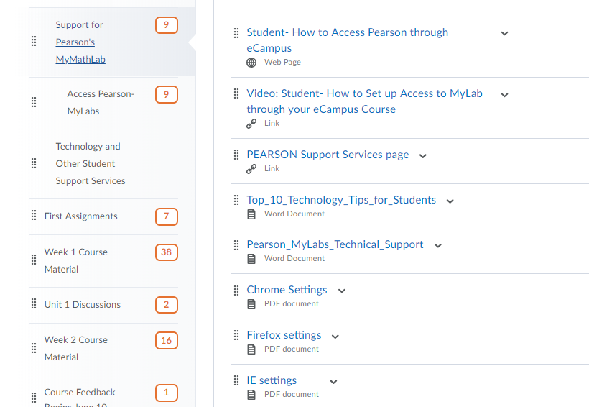
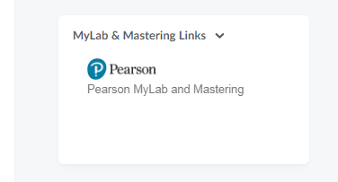
Integration with Publisher
Products
Notes:
Publisher integration with instructions and support listed in START HERE.

Slide 76
General Standard 5 Question
Do your students interact: select all that apply
  Learner –to- learner
  Learner – to- materials
  Learner –to- instructor?

Slide 77
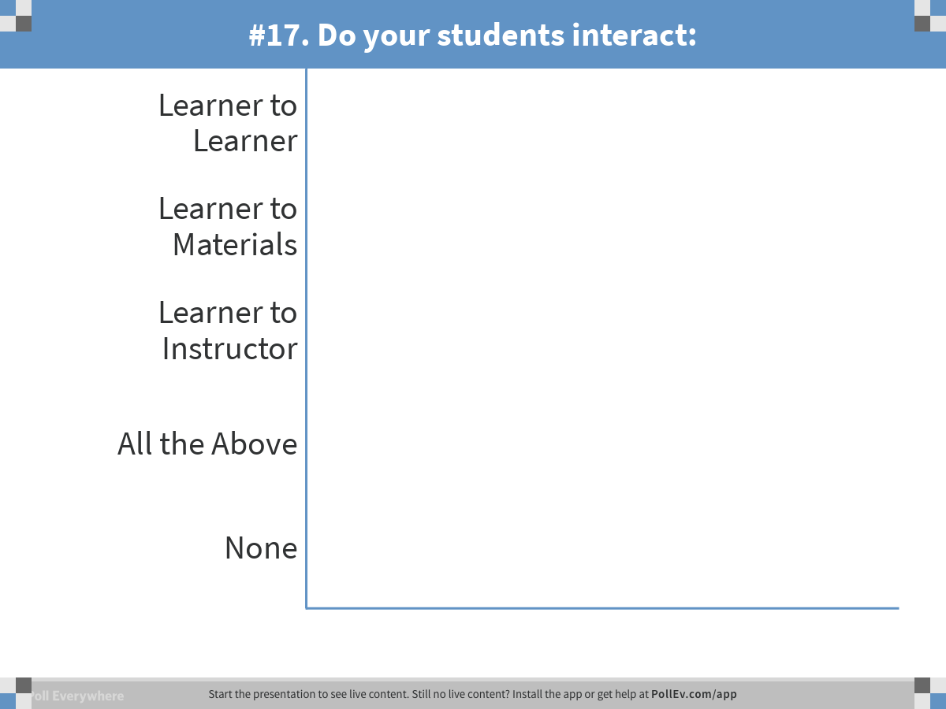
Notes:
Poll Title: #17. Do your students interact:
https://www.polleverywhere.com/multiple_choice_polls/UGtDpssAYWvFJV6

Slide 78
General Standard 5 Question
How do your students know the expectation for interaction in the course?

Slide 79
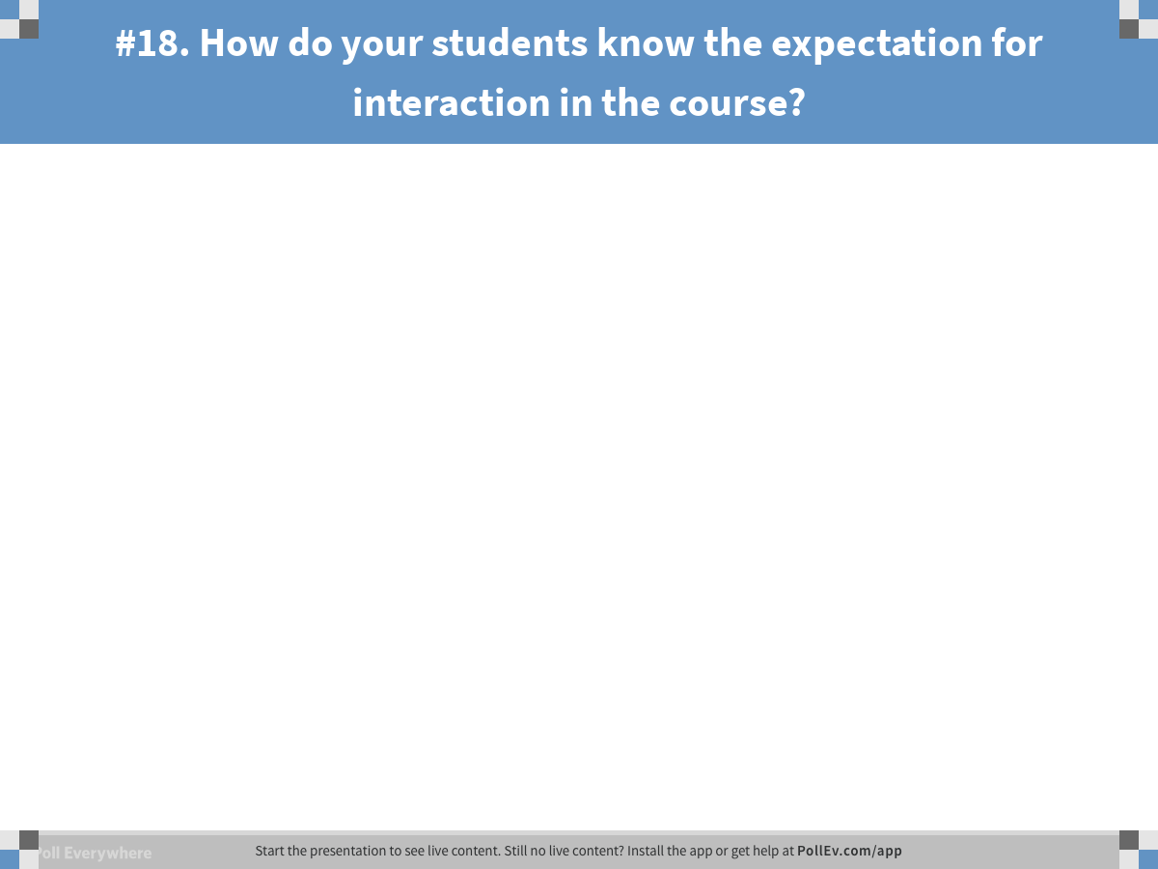
Notes:
Poll Title: #18. How do your students know the expectation for interaction in the course?
https://www.polleverywhere.com/free_text_polls/c9yYLOZUs3AdArC

Slide 80
What did we do? Standard 5
Notes:
Gradebook example and Class progress example
Template helps create a consistent user experience.
Standard 5
5.1 Learning activities are aligned.
5.2 Interaction to learner, content, and instructor
5.3 Plan for response time – Orientation
5.4 Clear requirements for learner interaction – rubric

Slide 81
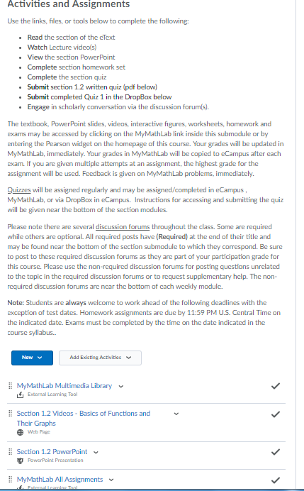


Publisher direct links are available in the LMS's Existing Learning Activities

Slide 82
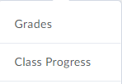
Notes:
Grade book, Class progress, feedback from the instuctor

Slide 83
General Standard 6 Question
What tools do you use from the LMS or outside of the LMS to facilitate student learning?

Slide 84
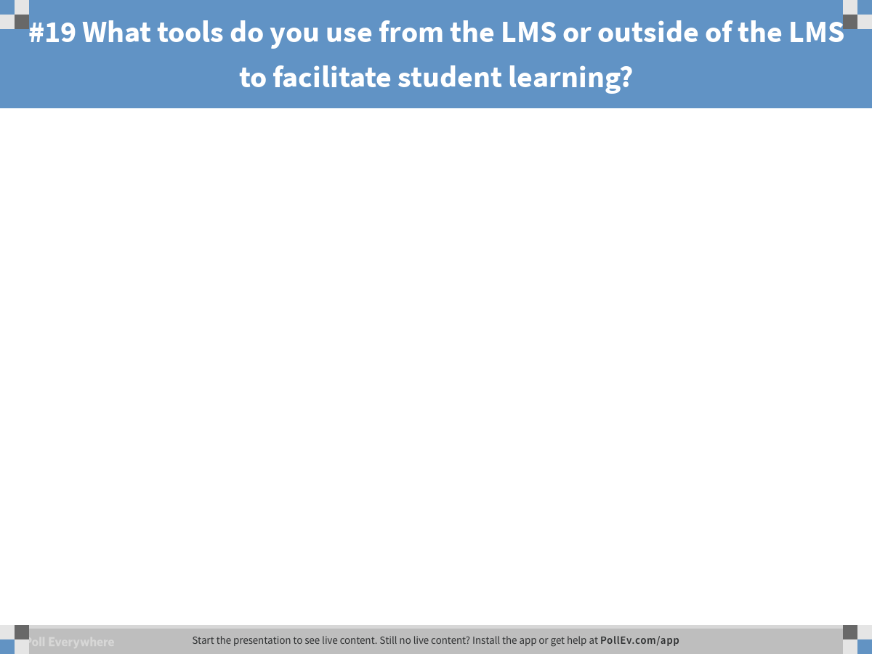
Notes:
Poll Title: #19 What tools do you use from the LMS or outside of the LMS to facilitate student learning?
https://www.polleverywhere.com/free_text_polls/ILAVX3I1lkUmfxj

Slide 85
What did we do? Standard 6
Notes:
Gradebook example and Class progress example
Template helps create a consistent user experience.
Standard 6
6.1 Tools aligned
6.2 Tools promote active learning
6.3 – Variety of technology
6.4 Privacy policies - Orientation

Slide 86
Standards 4- 6
Turn to your neighbor and share one idea that you would like to implement.
Would you need assistance to implement this? If so, who?

Slide 87
Learning Objectives
Identify standards that can be addressed using the LMS
Discuss various methods of meeting standards using LMS features
Articulate the benefits of using prebuilt modules to meet QM standards
Notes:
During this presentation our goal is to:
identify standards that can be addressed using the LMS.
discuss various methods of meeting standards using LMS features.
articulate the benefits of using prebuilt modules to meet QM standards.

Slide 88
Activity
Using your checklist, what three items did you find most beneficial?
Find the sticker at the top of your handout. Locate another individual with that sticker and share and discuss your three items.

Slide 89

Questions or Comments?

Slide 90
Contact Us
Linda.reed@blinn.edu (Instructional Design)
Brandy.ermis@blinn.edu (Humanities-Depart. Head)
Amy.Winningham@blinn.edu (Humanities Asst. Dean)
Victoria.fowler@blinn.edu (Math Department Head)
Jaime.Schroeder@blinn.edu (HITT Program Dir)

