Slide 1
Within and Across:
Cultivating a Culture of Presence in an Asynchronous Online Program
Kris Mickelson, PhD
Kim Christopherson, PhD
Morningside University - Sioux City, IA

Slide 2
Learning outcomes
Learn new online presence structures and strategies to build a consistent culture of presence across an entire program area
Develop consistent expectations and practices for teacher, social, and cognitive presence by exchanging ideas across institutional settings
Identity and problem-solve unique institutional challenges to building a program culture of presence.

Slide 3



THE Context: our Program
Asynchronous Master’s Program for Teachers
5 Course Research Sequence w/ Action Research Project
Lots of Students, Sections, Adjuncts

Slide 4



The concept: online presence
Teaching
Social
Cognitive

Slide 5

The Challenge:
How do we cultivate programmatic presence?
What is a program area in your professional setting that would benefit from programmatic thinking?

Slide 6
Responding to the Programmatic Challenge
Collaborative Design and Continuous Improvement
Design Process
Community of Inquiry Survey
Threaded Learning Tools
Research Journal
Culminating Performance Assessment
Faculty Mentoring and Development
Instructor Notes
Student Work Sample Review

Slide 7
Collaborative design and continuous improvement

Slide 8
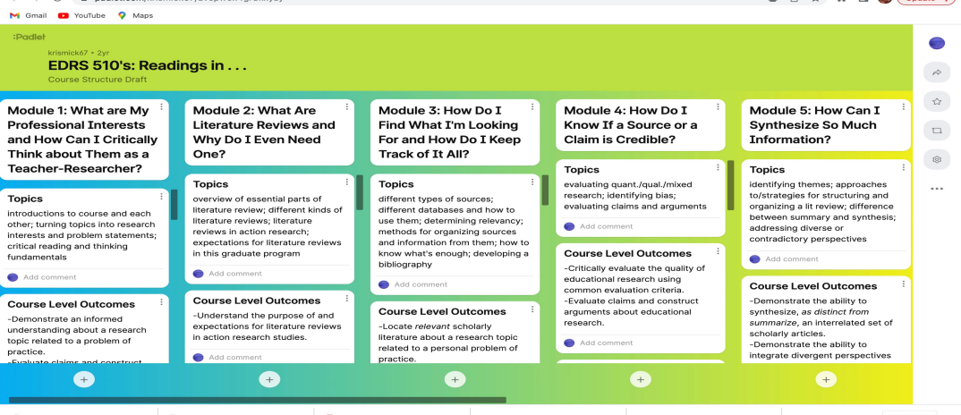
Example 1: Collaborative Backwards Design of Courses

Slide 9
EXAMPLE 2: CROSS-COURSE STUDENT SURVEY ABOUT PRESENCE
TEACHING
THE INSTRUCTOR HELPED KEEP COURSE PARTICIPANTS ENGAGED AND PARTICIPATING IN PRODUCTIVE DIALOGUE.
THE INSTRUCTOR PROVIDED FEEDBACK IN A TIMELY FASHION.
SOCIAL
I WAS ABLE TO FORM DISTINCT IMPRESSIONS OF SOME COURSE PARTICIPANTS.
COGNITIVE
ONLINE DISCUSSION HELPFED ME DEVELOP A SENSE OF COLLABORATION.
COURSE ACTIVITIES PIQUED MY CURIOUSITY.
I CAN APPLY KNOWLEDGE CREATED IN THIS COURSE TO MY WORK OR OTHER NON-CLASS RELATED ACTIVITY.

Slide 10
THREADED LEARNING TOOLS

Slide 11
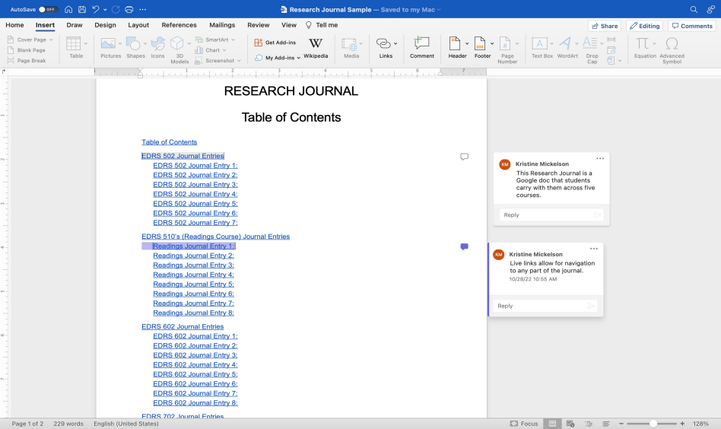
EXAMPLE 1: RESEARCH JOURNAL

Slide 12
EXAMPLE 2: SHARED CULMINATING PERFORMANCE ASSESSMENT
SHARON WALKER SCHOOL OF EDUCATION
Spring 2023 Initial Licensure Educators
Action Research Conference
Saturday, April 22
Facilitator: Dr. Kris Mickelson
Saturday 1B Zoom Link
12:00 pm - 1:00 pm
A Study of Specially Designed Instruction on Math Probe Scores for
Special Education Students ____________________________________________________________________________Student A
The Impact of Building Meaningful Relationships on Students’ Academic
Performance in Class __________________________________________________________________________ _________Student B
Taking Charge of My Own Goals: How Self-Reporting Reading Comprehension
Scores Affects Students’ Reading Comprehension Scores ____________________________________________Student C
Impact of a Daily Assigned Task List on Assignment Completion ______________________________________Student D

Slide 13
FACULTY DEVELOPMENT AND MENTORING

Slide 14
EXAMPLE 1: INSTRUCTOR NOTES
TOPIC: | NOTES:
WRITING CENTER SUBMISSION | A. STUDENTS ARE SUBMITTING THEIR DRAFT APPLICATION ASSIGNMENT 1’S TO THE WRITING CENTER. AFTER THEY HAVE RECEIVED AND INTEGRATED FEEDBACK FROM THE WC . . .
3.1 – QUANT VS. QUAL | A. THE HARDEST PART OF THIS ASSIGNMENT FOR STUDENT IS USALLY PART 2: ASSUMPTION BEHIND RSEARCH PARADIGMS. WE WANT TO CULTIVATE THE IDEA THAT . . .
3.2 – PROBLEM STATEMENTS | A. THERE IS AN EXERCISE IN 3.2 WHERE THEY DISSECT AN EXISTING PROBLEMS TATEMENT AND THERE IS AN “ANSWER KEY” FOR THIS ASSIGNMENT BECAUSE IT IS MORE . . .
WHAT’S NEW IN MODULE 3 | A. FOR THE VETERANS IN THE GROUP . . . THIS ENTIRE MODULE USED TO BE ONE HALF OF A MODULE SO WE’VE STRATCHED IT OUT TO ALLOW MORE TIME FOR PROCESSING BOTH . . .
WHEN RESPONDING TO MODULE 2 STUDENT WORK | A. IF YOU AREN’T SEEING SUBSTANCE GIVE A “0/DOES NOT MEET EXPECTATIONS” FOR THE CONTRIBUTIONS TO THE LEARNING COMMUNITY PIECE AND GIVE THEM A . . .

Slide 15
EXAMPLE 2: STUDENT WORK SAMPLE REVIEW ACTIVITY
SUBMIT INDIVIDUAL FEEDBACK
REVIEW AND REFLECT ON GROUP’S FEEDBACK
MEET TO DISCUSS AND PLAN ACTION

Slide 16

CONVERSATION STARTERS
AT MY SCHOOL, THE TYPE OF PRESENCE WE WOULD MOST BENEFIT FROM DEVELOPING ACROSS A PROGRAM/SEQUENCE/MAJOR IS . . .
THE GREATEST CHALLENGE WE EXPERIENCE TRYING TO ENSURE CONSISTENCY IN PRESENCE IN A PROGRAM/SEQUENCE/MAJOR IS . . .
AN EFFECTIVE STRATEGY MY INSTITUTION HAS USED TO COLLABORATE ACROSS A PROGRAM, SEQUENCE, MAJOR IS . . .

