Slide 1


Standardizing the Standards!:
A One-Stop-Shop for General Standard 7 and More!
Quality Matters CONNECT 9th Annual Conference
Track: The Power of QA; Quality Talk
September 26, 2017
Notes:
Quality Talks are 5-minute presentations of 20 slides set to forward automatically every 15 seconds. This will require rehearsal for timing before the conference.
Providing information about learner support services in a template for an LMS course
shell for all courses at an institution is not a new idea, yet it does have some major drawbacks. What happens
when 10,000+ course shells are created with support descriptions and links, and then the description and links
change? There is no way to update a template that has already been used for creating all those courses. This was
the major problem we faced twice in a calendar year! Our solution was to set up a website with all the support
information for technical support, accessibility and disability services, academic support services, advising
services, and student services in a one-stop-shop format. The web page is linked in all LMS course shells and
provides information for all five of our related campuses for meeting all four standards in General Standard 7
Learner Support, plus a few more. Our original design proved to be useful for some students, but problematic for
others and for QM reviewers. This Quality Talk will highlight the process, the original design, the issues, and the
new solutions. Take a peek at how we are continuously improving this support resource for all of our students and
making it easier for our faculty to provide this information in all of our courses. This is a follow up to last year's
presentation "Th

Slide 2
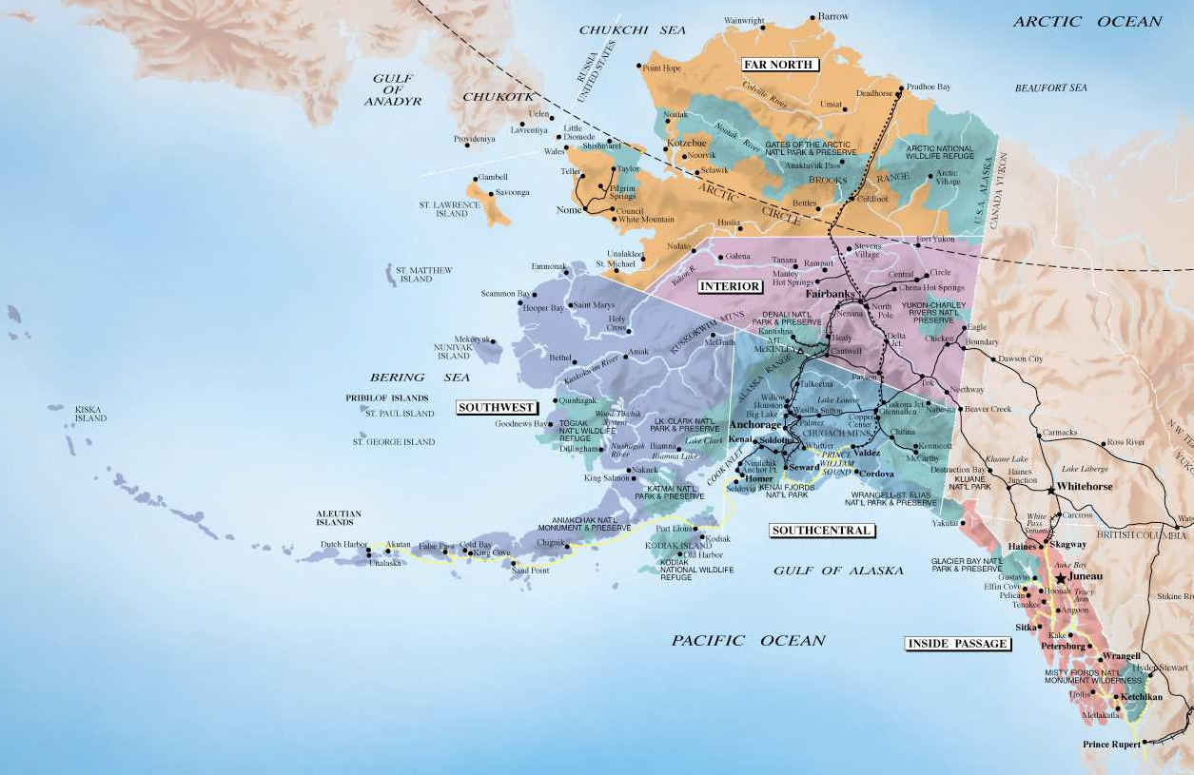
Cama’i – Hello
Debbi Canavan
Kodiak College & UAA
dacanavan@alaska.edu
Kodiak College is a rural community campus of the University of Alaska Anchorage.
Kodiak Island, Alaska
http://www.travelalaska.com/Destinations/~/media/Images/Travel%20Alaska/Maps/AlaskaMap.ashx
Notes:
The journey from a "No Template LMS Template" to a "One-Stop-Shop": the trials, errors, and progress in continuous
improvement for meeting General Standard 7 Learner Support standards, plus a few others, in all courses in a
multi-campus institution.

Slide 3
Previously…
2014 QM Annual Conference =
QM 411: Providing a Shared Directory Approach
2015 Success Stories (reprise) = QM 411: A shared Directory for Design and Best Practices
2016 QM 8th Annual Conference =
The “No Template” Template

Slide 4
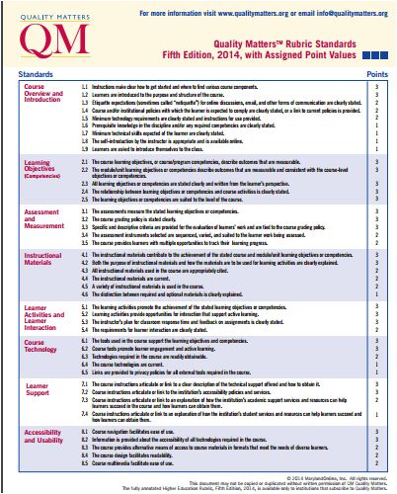
Which SRSs?
Not a “personal” preference item
Not a “content” item
Not a “department” item
Works for ALL faculty
Notes:
What would faculty TOLERATE or APPRECIATE??

Slide 5
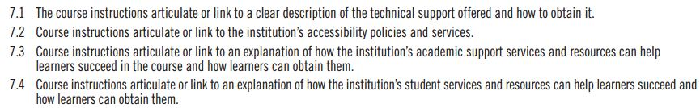
8 SRSs: 1.4, 6.4, 6.5, 7.1, 7.2, 7.3, 7.4, 8.2
Notes:
Standards 6.4, 6.5, & 8.2 might need “tweaking”
(custom or other specific functional software or online tools)

Slide 6
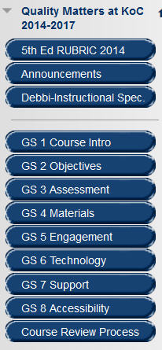

Directory Model
Files, ideas, and resources are shared among users
        Items developed to meet QM standards are posted in a shared Blackboard directory and can be “rolled” for use in any course by any member.

Slide 7
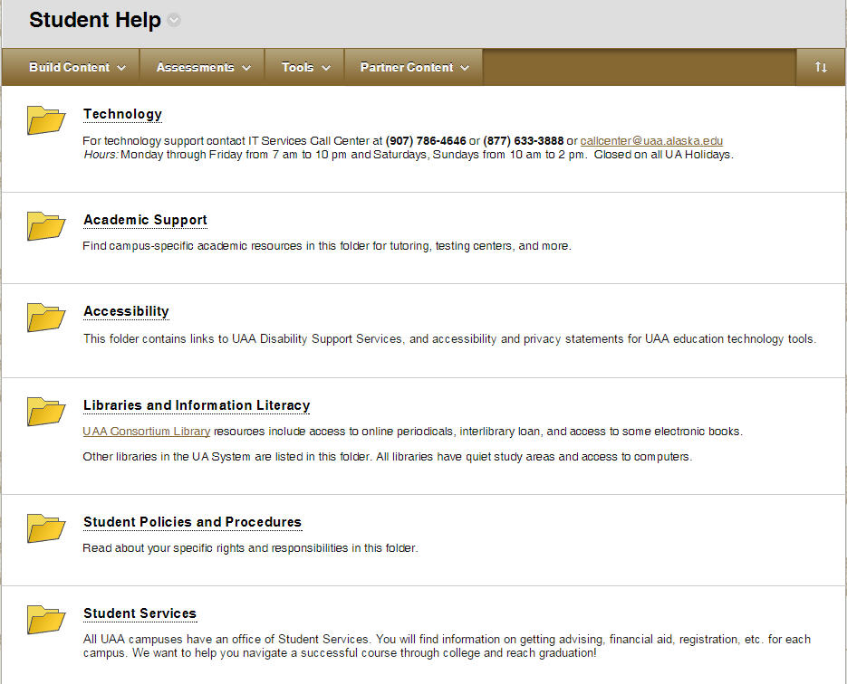
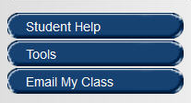
Student Help
Content

Slide 8
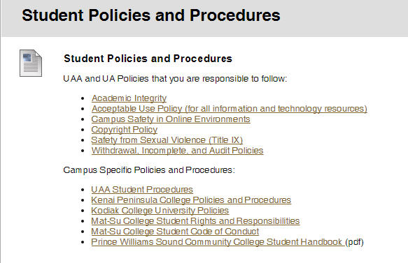
SRS 1.4
Policies

Slide 9
Issues?
“Rolled” courses
  Deleted “new” Student Help; kept old one!
  Remember to add course links again!
Website/URL updates after shells created
Revised items need to be copied from our shared directory (updates needed each semester)

Slide 10

IT did WHAT? A new CMS!!!!
New language (code)
New structure
All new URLS!
https://pixabay.com/en/man-despair-problem-null-one-65049/

Slide 11
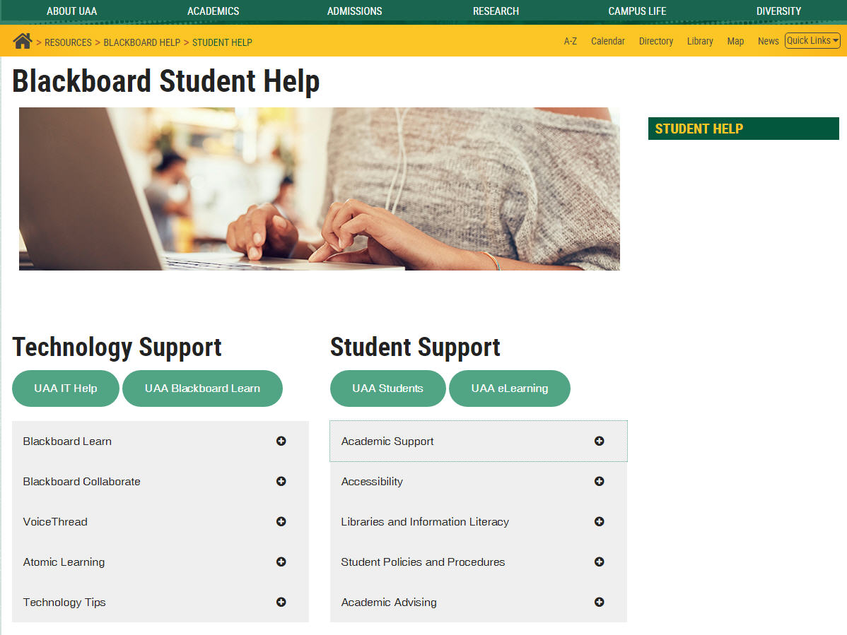
Student Help
Content
https://www.uaa.alaska.edu/academics/institutional-effectiveness/departments/academic-innovations-elearning/resources/blackboard/student-help/index.cshtml?

Slide 12
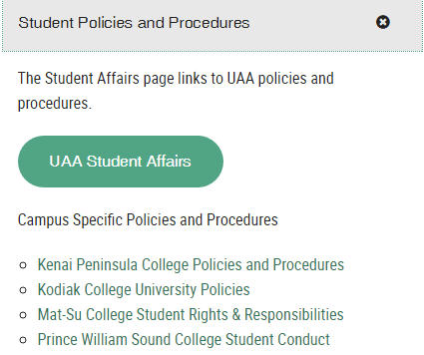
SRS 1.4
Policies

Slide 13
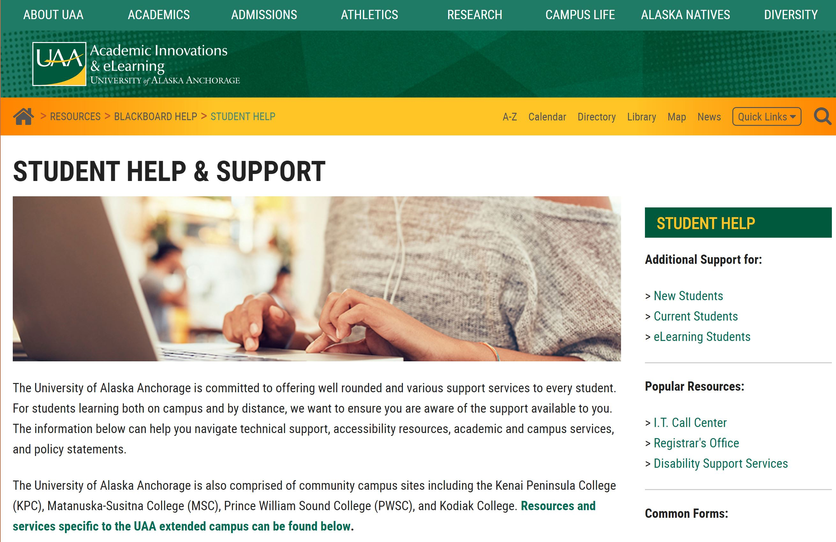
Student
Help
https://www.uaa.alaska.edu/academics/institutional-effectiveness/departments/academic-innovations-elearning/resources/blackboard/student-help/index.cshtml?

Slide 14
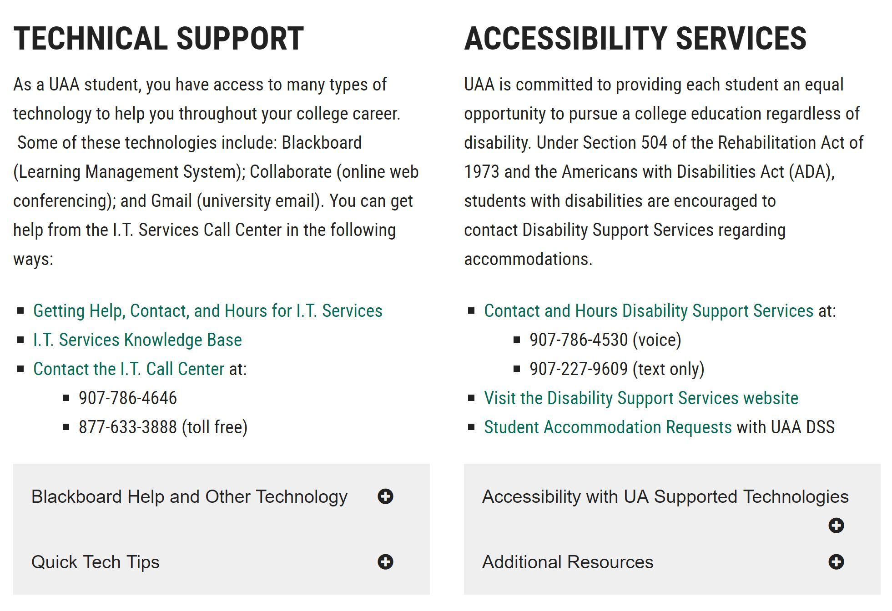
SRS 7.1
& 7.2

Slide 15
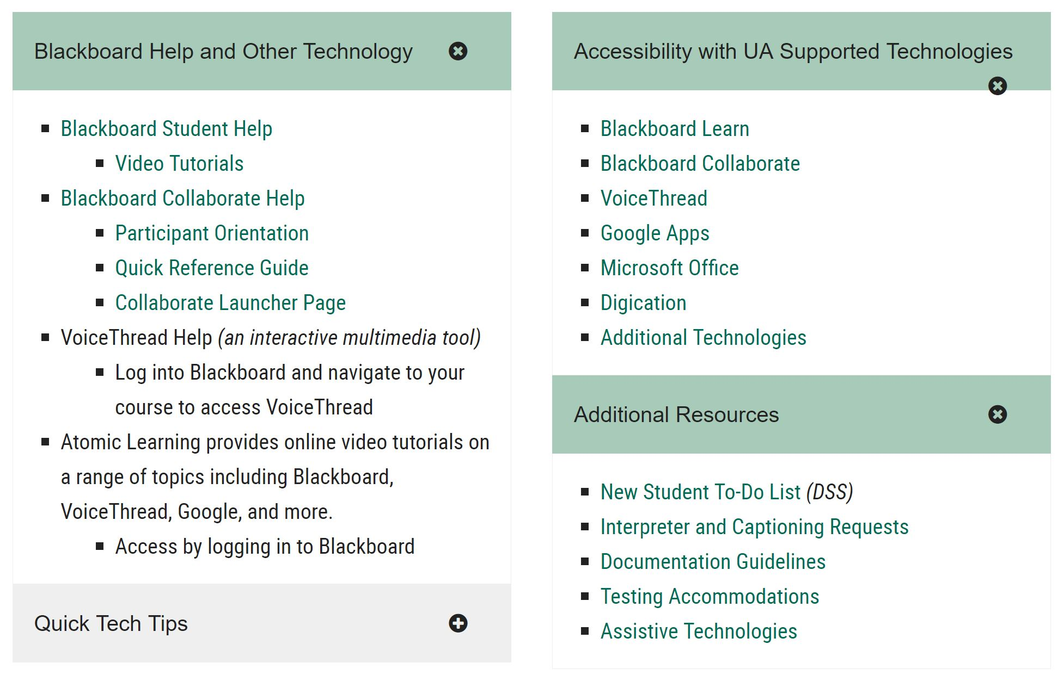
7.1
7.2

Slide 16
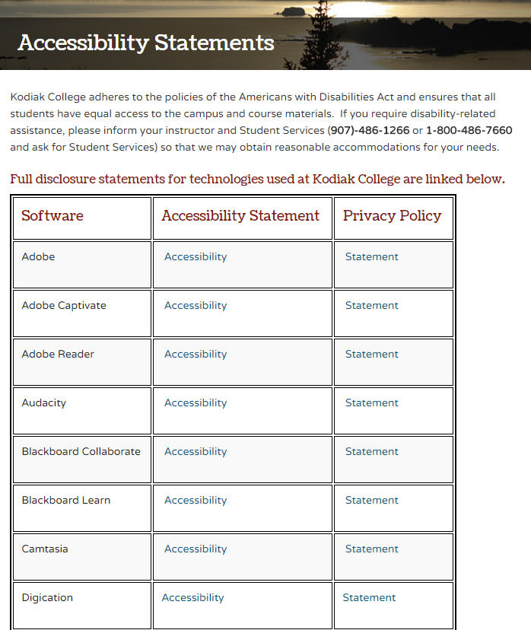
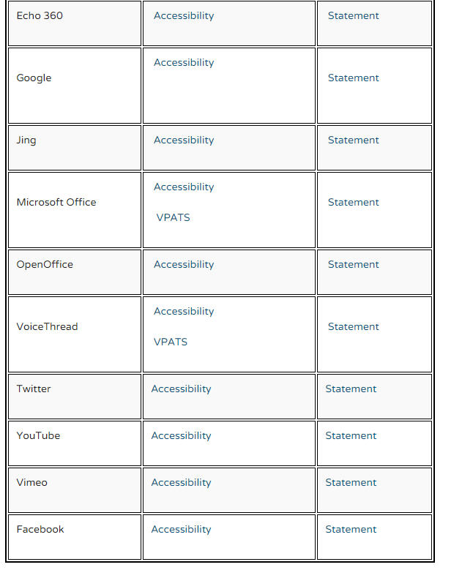
http://www.koc.alaska.edu/elearning/ accessibility-statements.cshtml

Slide 17
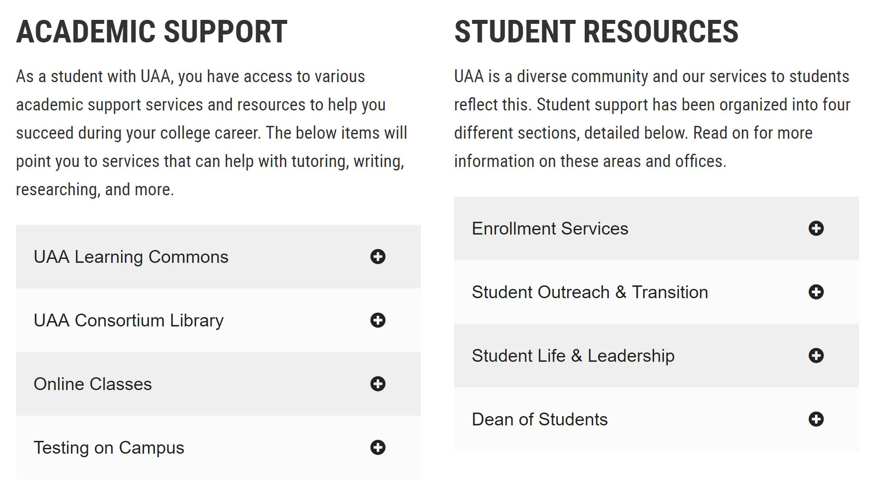
SRS 7.3
& 7.4

Slide 18
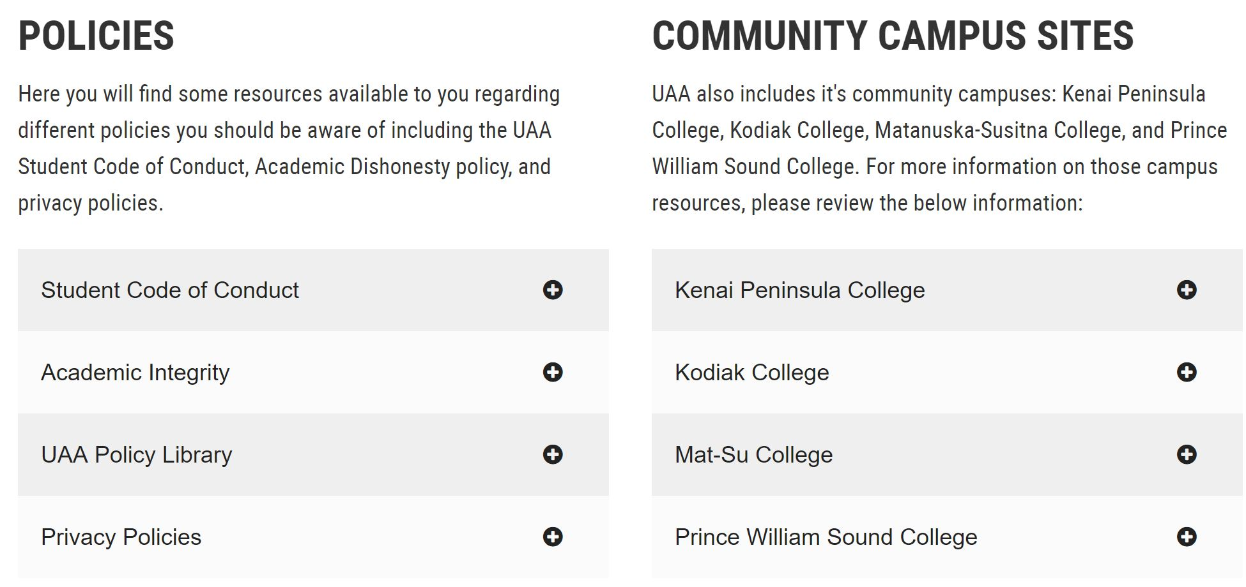
1.4 AND…

Slide 19
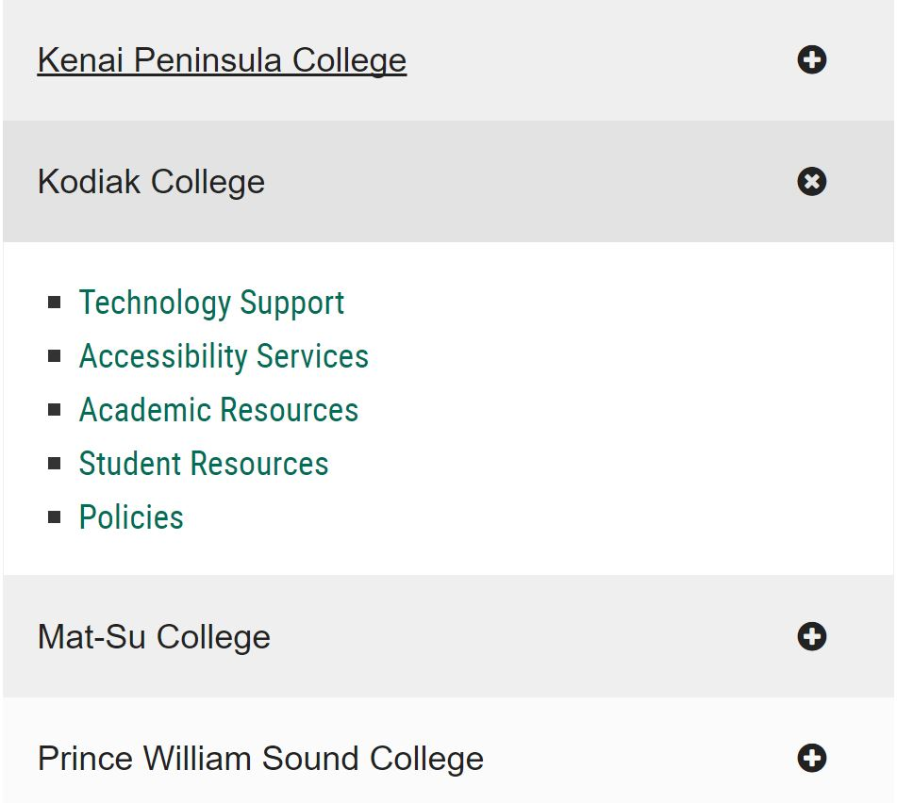
Unique
Campuses

Slide 20
Benefits…
Web pages updated = continuous maintenance
ALL courses contain main link
Information outside LMS for anyone
Centralized and decentralize information
Meets multiple QM standards (1.4, 6.4, 6.5, GS 7, 8.2)
Stay tuned for more next year…?

