Slide 1

Engaging Learners Through Storytelling
Once Upon a Time . . .

Slide 2




Once upon a time
there were three IDs...
Julie Messner Allen
Instructional Designer, Sr
Dajana Radosavljevic
Instructional Designer
Mary Chaaban Arcuria
Instructional Designer, Sr

Slide 3
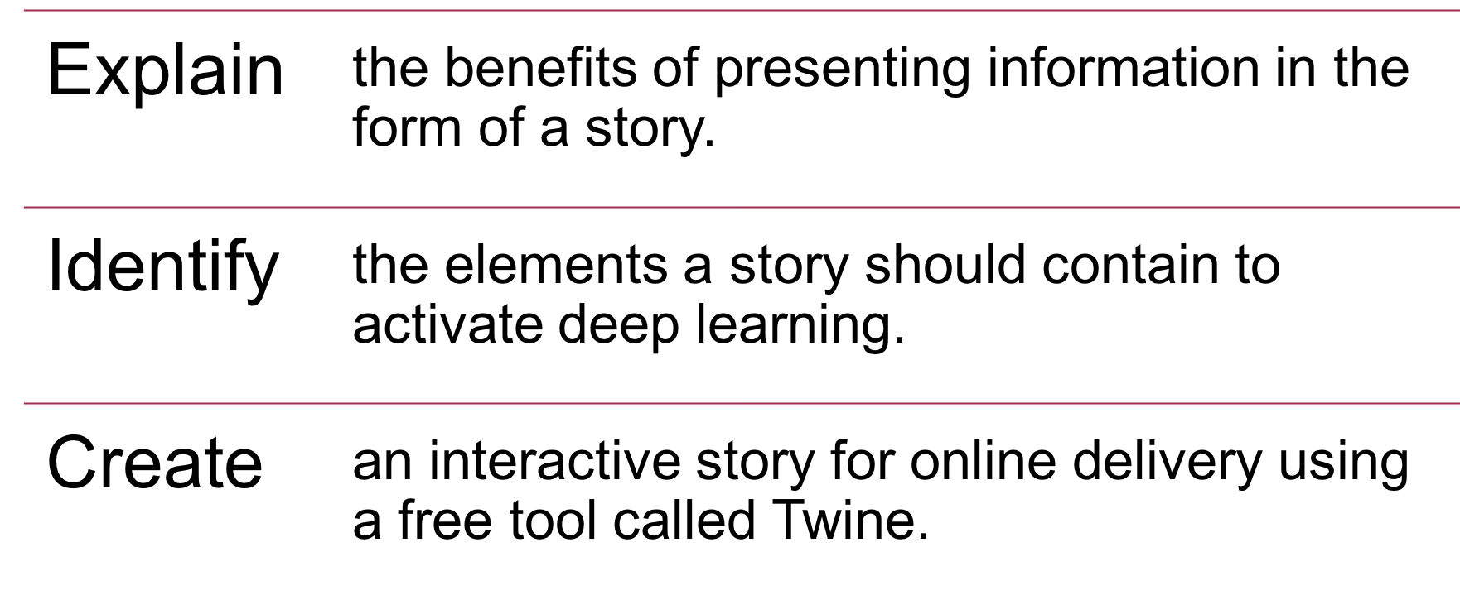
Objectives

Slide 4

What are the benefits of presenting information in a story?

Slide 5
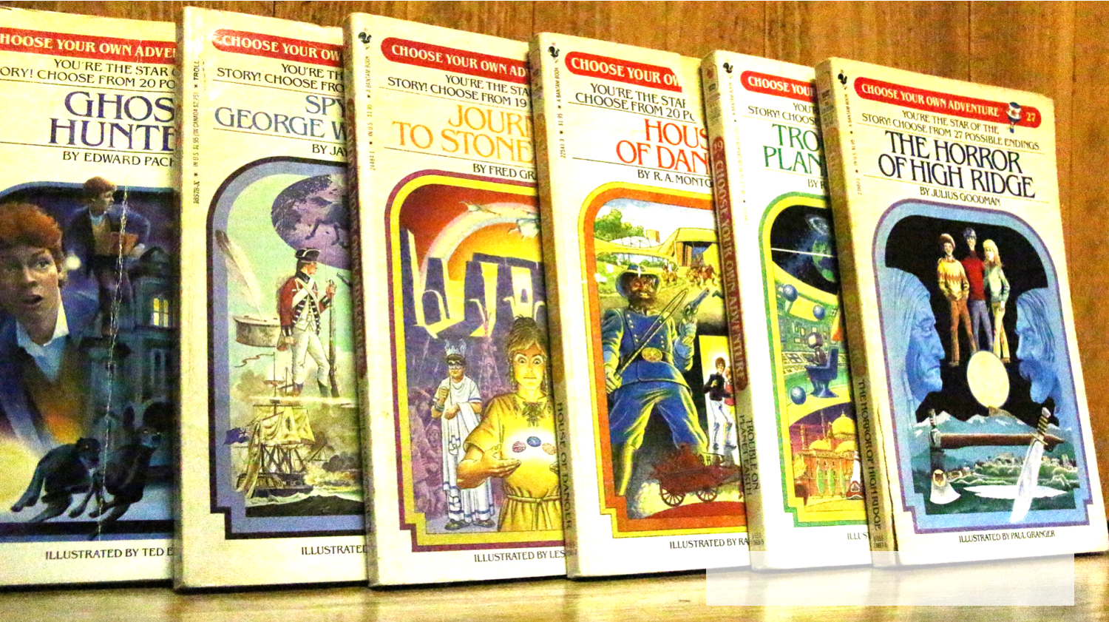
Anyone remember these?
“choose your own adventure books” by tim putala via Flickr. https://flic.kr/p/e3jLVq

Slide 6

Increase Empathy and Responsibility

Slide 7

“Interactive narratives may also evoke some psychological responses that are not typical of traditional narratives; in particular, the role of the self may differ from traditional narrative engagement, and readers of interactive narratives may have increased feelings of responsibility for a character's actions.”
(Green & Jenkins, 2014)

Slide 8
“As medicine becomes more scientific and technical, and care becomes more fragmented and specialist (even in the community),
what remains is the patient’s own narrative
- the story of how their illness or misfortune affects their life, their families and hinders their ambitions.”
(Pearson, 2015)

Slide 9
“Through purposeful distancing of learners from actual events, narratives can be viewed and analyzed from multiple perspectives, allowing learners to explore what it means to be a teacher and how teachers engage in teacher practice (Garbett & Tynan, 2007).”
(Hoffman, Marlowe, Scharf, Disney, Macer, Poling, & Queen, 2015)

Slide 10

Practice + Application = Change

Slide 11
“Among the most promising outcomes of these efforts is a growing understanding that people tend to
change their safety-related behavior after hearing compelling stories about others who have suffered injuries and illnesses. Indeed, safety stories seem to have a remarkable power to convey the
personal relevance of this information.”
(Ricketts, 2015)

Slide 12
“We now recognise that theoretical knowledge is affected by context and ‘a significant proportion of the learning associated with any change in practice takes place in its context of use' (Eraut, 1994:37).”
(McDrury, Alterio, & Ebrary, 2003)

Slide 13
What elements should a story contain to activate deep learning?

Slide 14
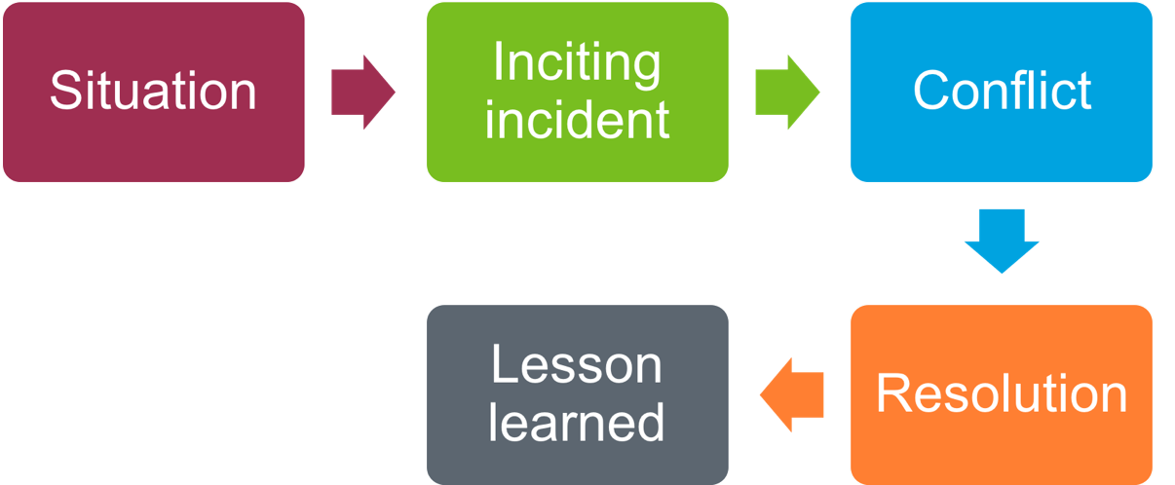
A Framework for Storytelling
(Coates, 2017)

Slide 15

Let’s Have Some Fun!

Slide 16


http://twinery.org/

Slide 17
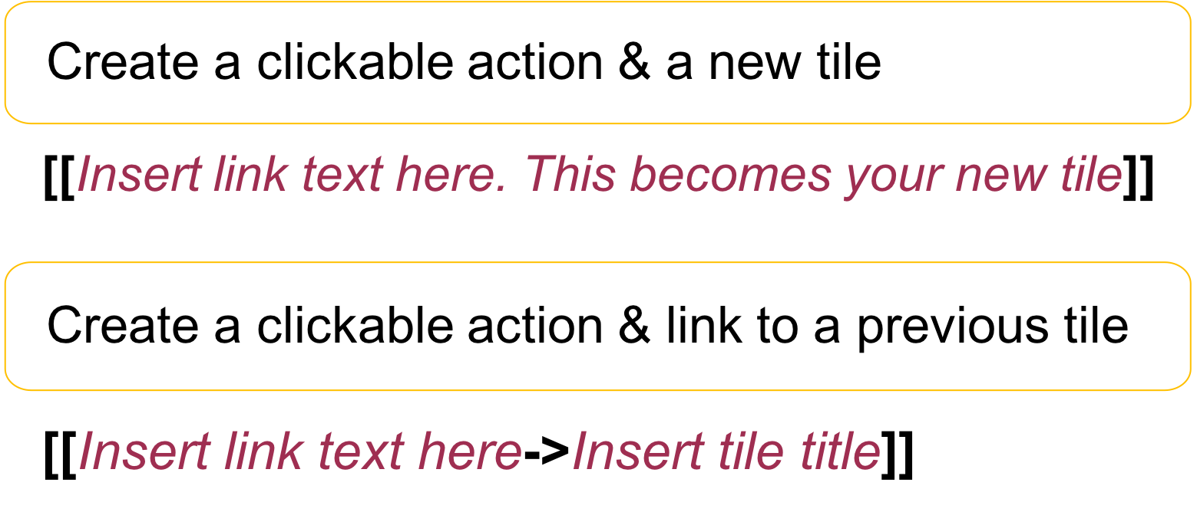
Twine Shortcuts

Slide 18

Examples

Slide 19

The End!
“And They Lived Happily Ever After on Snow White's Scary Adventure” by Loren Javier via Flickr. https://flic.kr/p/6k6NAE

Slide 20
References
Coates, N. (2017). Learning from storytelling. Research World, 2017(62), 46-49.
Green, M., & Jenkins, K. (2014). Interactive narratives: Processes and outcomes in user‐directed stories. Journal of Communication, 64(3), 479-500.
Hoffman, E. M., Marlowe, M. J., Scharf, K. H., Disney, G. H., Macer, A., Poling, D., & Queen, A. (2015). Using Torey Hayden's teacher stories to teach relationship skills in special education teacher preparation. Teacher Education Quarterly, 42(2), 65-85.
McDrury, J., Alterio, M., & Ebrary, I. (2003). Learning through storytelling in higher education using reflection & experience to improve learning. London; Sterling, VA: Kogan Page.
Pearson, D. (2015). Using patient stories in primary care education. Education for Primary Care, 26(3), 201-202.
Ricketts, M. (2015). Using stories to teach safety. Professional Safety, 60(5), 51-57.

