Slide 1
Enhancing Student Learning Outcomes and Assessment through Alignment and LMS Delivery
Elizabeth Crawford
The University of Tennessee at Chattanooga

Slide 2
Campus wide Curriculum Mapping
Preparing for Accreditation
All Colleges, Departments, and Programs
Curriculum Mapping Team
Review all core program requirements
  Map to Courses
  Identify/Create/Refine Course Learning Outcomes

Slide 3
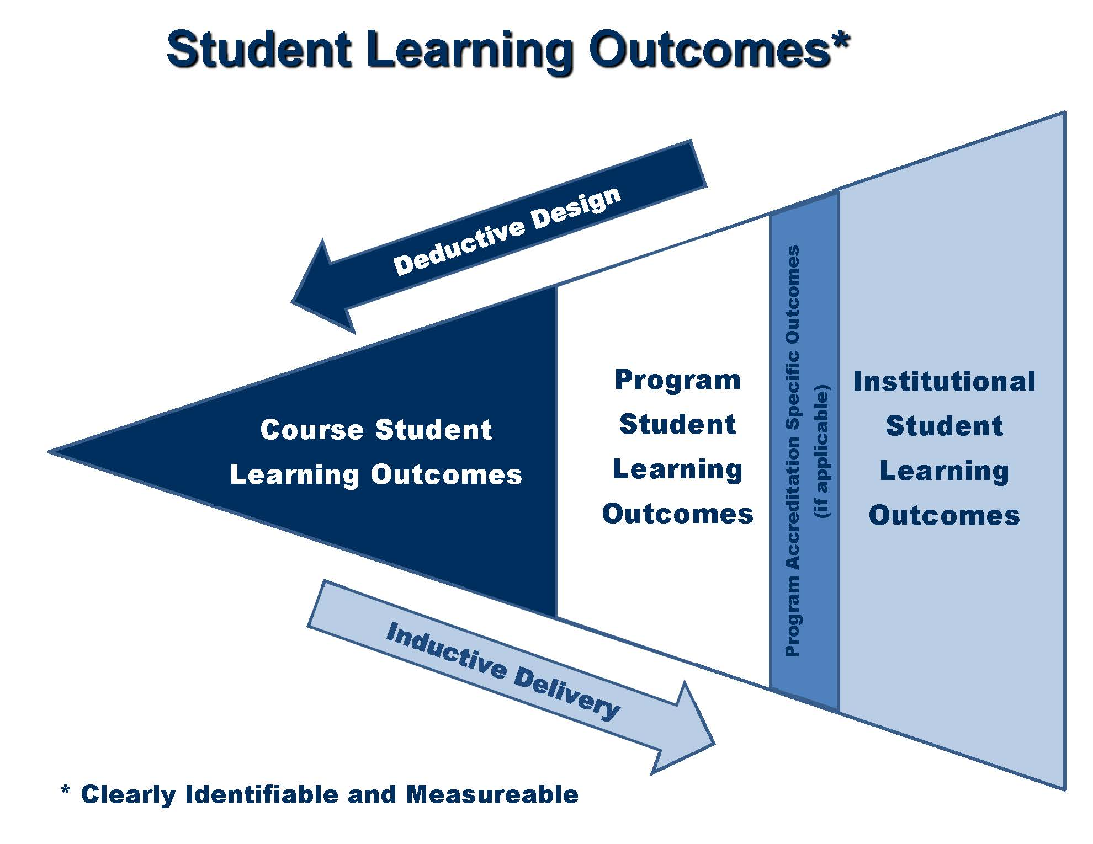

Slide 4
Curriculum Mapping Activity
Please work in small groups (3-5) to examine your own curriculum mapping processes
  Identify how you align between program and course learning outcomes
  Explain how you utilize the QM standards in this process

Slide 5
Curriculum Maps, Assessment, and QM
Curriculum map identifies level of skill expected for student learning and work products
  Ongoing assessment may be used in interpreting patterns to evaluate curriculum coherence
QM General Standard 2 assists faculty identify measurable outcomes

Slide 6
Quality Matters Process at UTC
Adopted QM in 2015 with soft roll-out
Provost champion
Deans and Department Heads involved
Requiring QM certification of all online and hybrid courses by Fall 2019
  Priority on general education and high enrollment courses.

Slide 7
Challenges
In your small groups, provide examples of challenges faced at your institution
  Faculty
  LMS
  Curriculum process

Slide 8
Online – Hybrid – and more
Syllabus template
  UTC’s syllabus template, when completed fully and correctly, meets 13 QM standards.
LMS course template
  Links to Privacy Policies, Accessibility, and Academic Support and Student Services, meeting 5 additional QM standards.

Slide 9
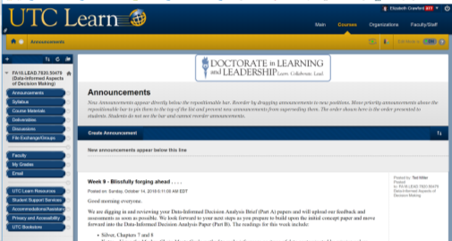
LMS
Assessment
SLOs

Slide 10
Next steps
Develop a brief outline for potential next steps at your institution
  Include 3-5 items
  Identify key stakeholders

Slide 11
Contact Information
Dr. Elizabeth Crawford
Beth-Crawford@utc.edu

