Slide 1

Templates and Goals:
Positioning Faculty Members for Success
Presenters
Ms. Deborah McDaniel – Deborah.McDaniel@bridgevalley.edu
Dr. Calisa Pierce – Calisa.Pierce@bridgevalley.edu
Dr. Sherri Ritter – sherri.ritter@bridgevalley.edu

Slide 2


BridgeValley Community and Technical College
2-year CTC
Offers over 90 degree and certificate programs
Over 1700 students
2 campuses - So. Charleston & Montgomery

Slide 3
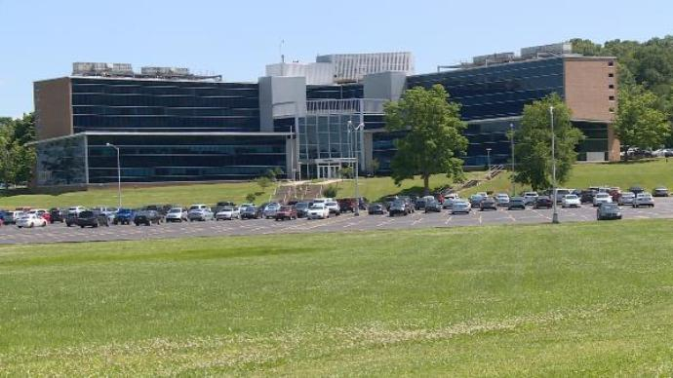

Slide 4
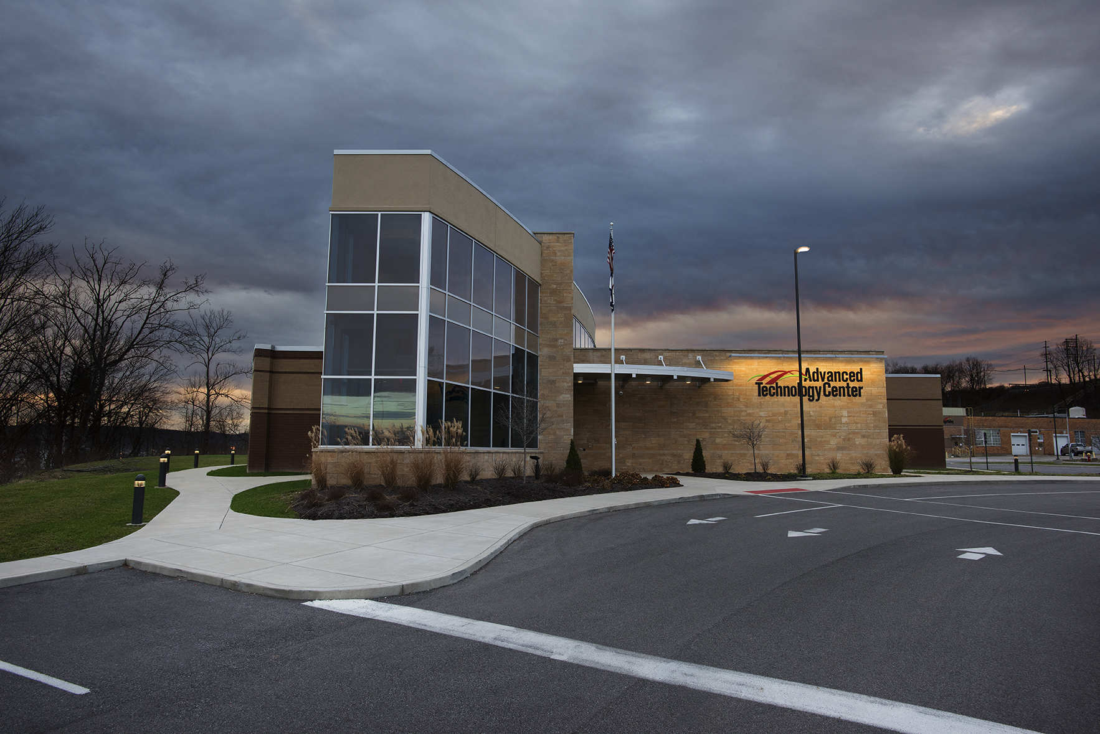

Slide 5
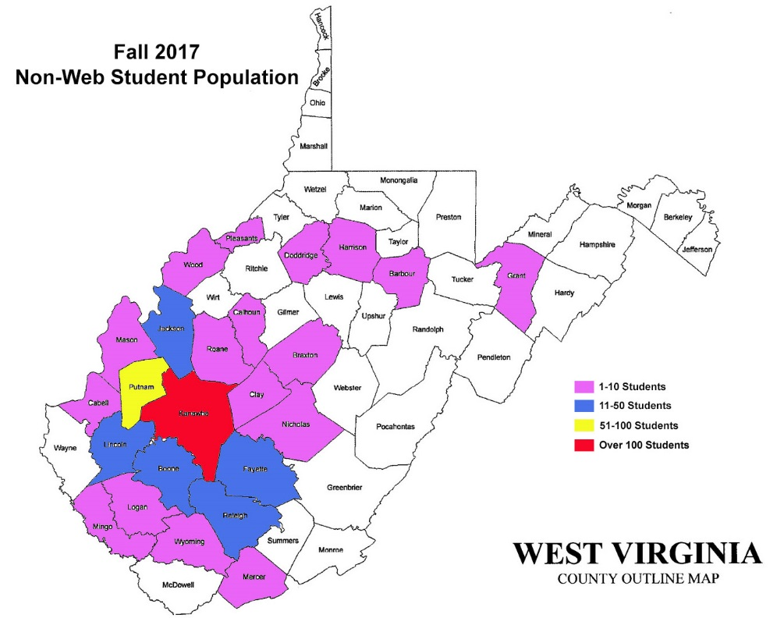
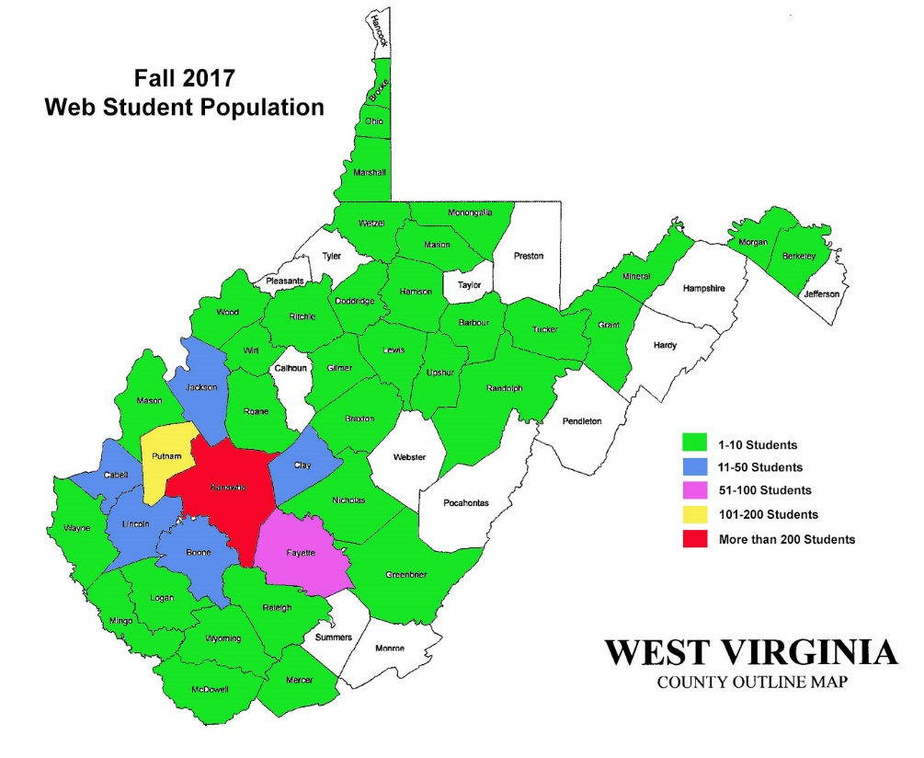
Non-Web and Web Student Locations
Fall 2017
Additional Students from: CA, FL, OH, & PA
Additional Students from: KY, OH, & PA

Slide 6
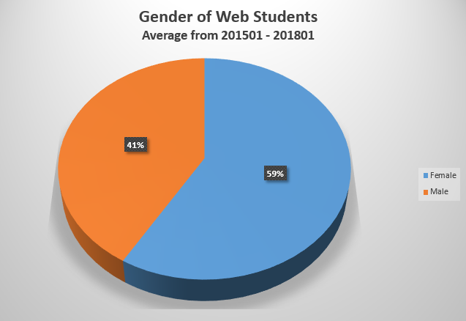
Demographics of BV Online Students
Age
Web 17 - 68
Non-Web 14 - 75

Slide 7
Web Classes by Division
Total of 133 Web Courses

Slide 8
Active/Inactive Courses Spring 2018
Total506
Total
385

Slide 9
10 Most Active Courses with Enrollments

Slide 10
10 Most Active Web Courses with Enrollments

Slide 11
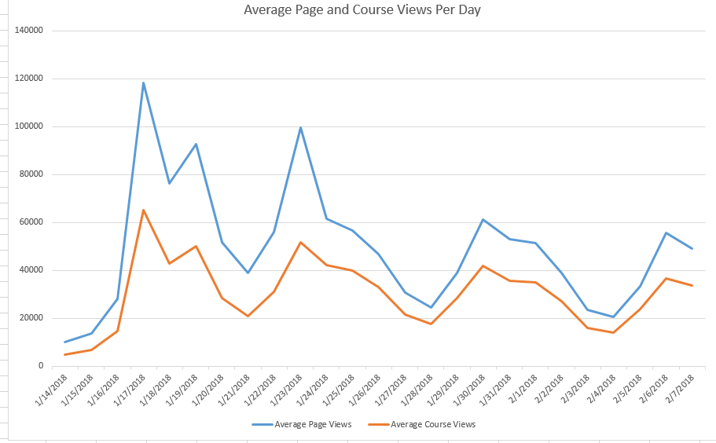
Average Page and Course Views Per Day

Slide 12
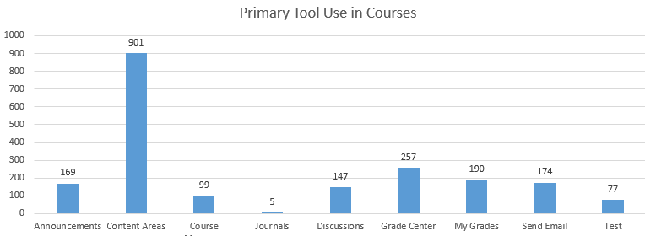
Tools Used in Courses

Slide 13
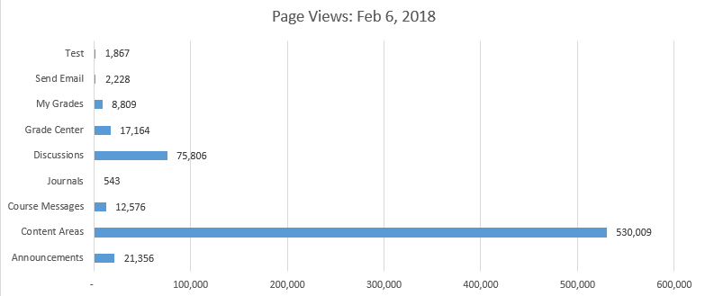
What Students/Faculty Access

Slide 14
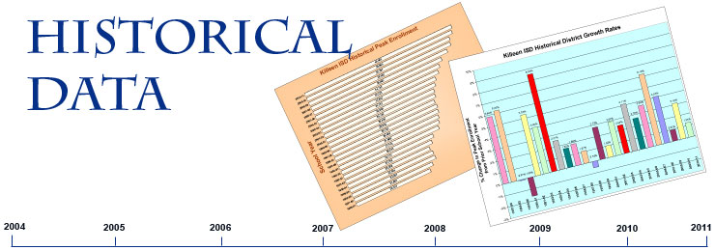
201501 - 201801

Slide 15

3,220 Students have successfully completed the SOOL class

Slide 16
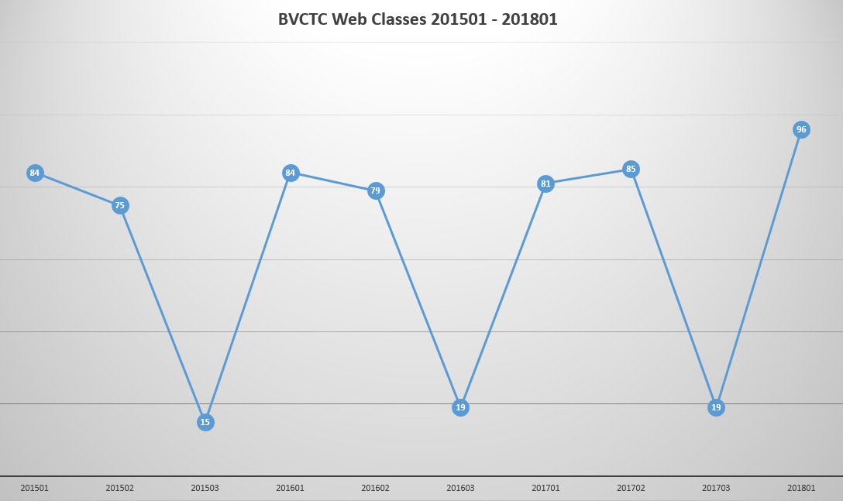

Slide 17
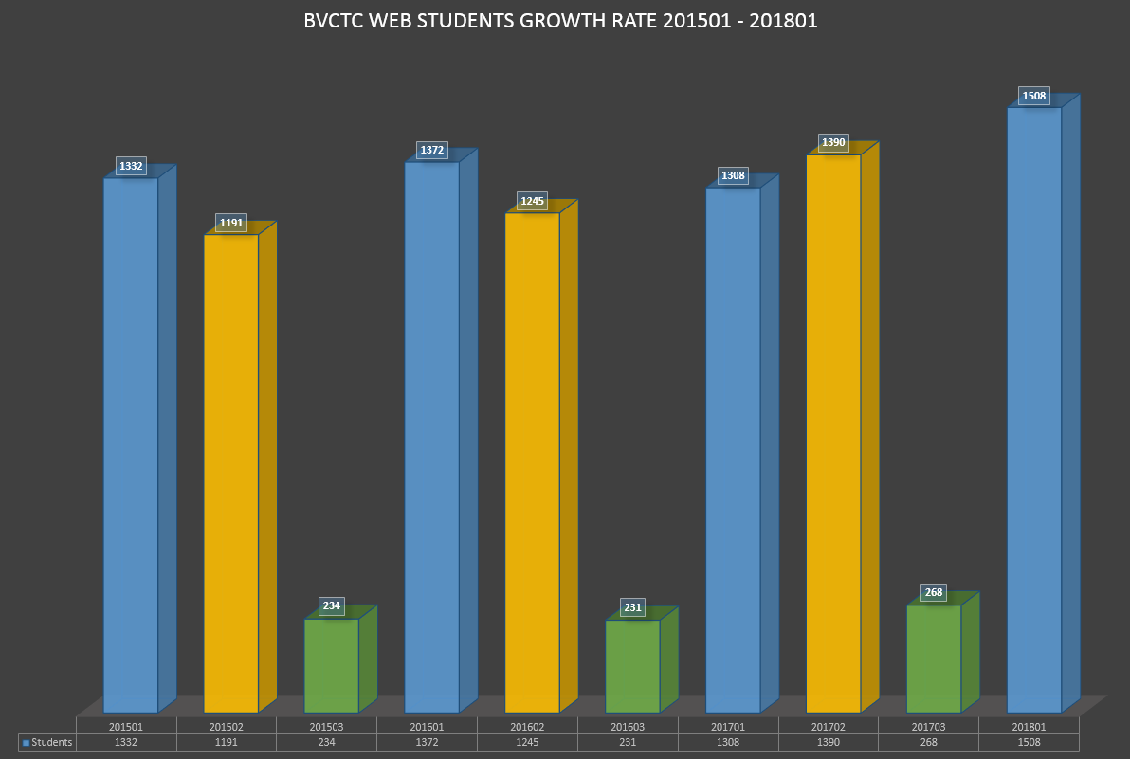

Slide 18
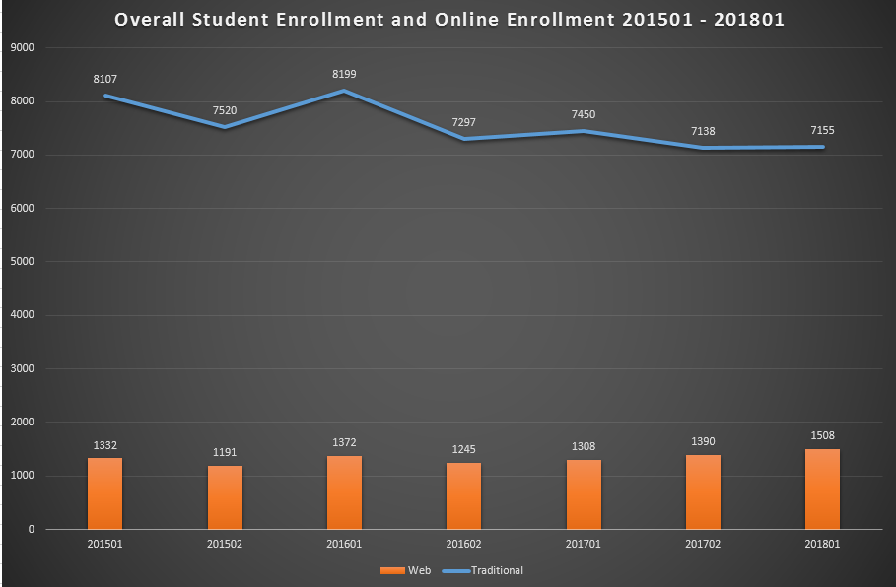

Slide 19
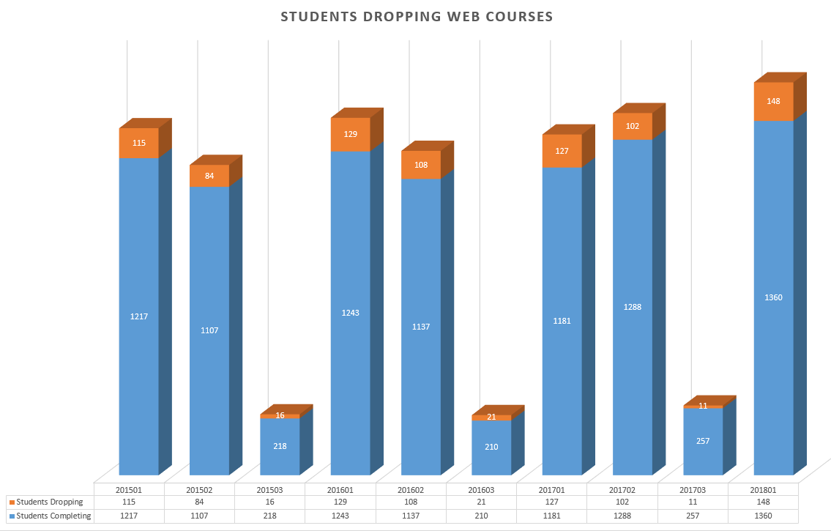

Slide 20
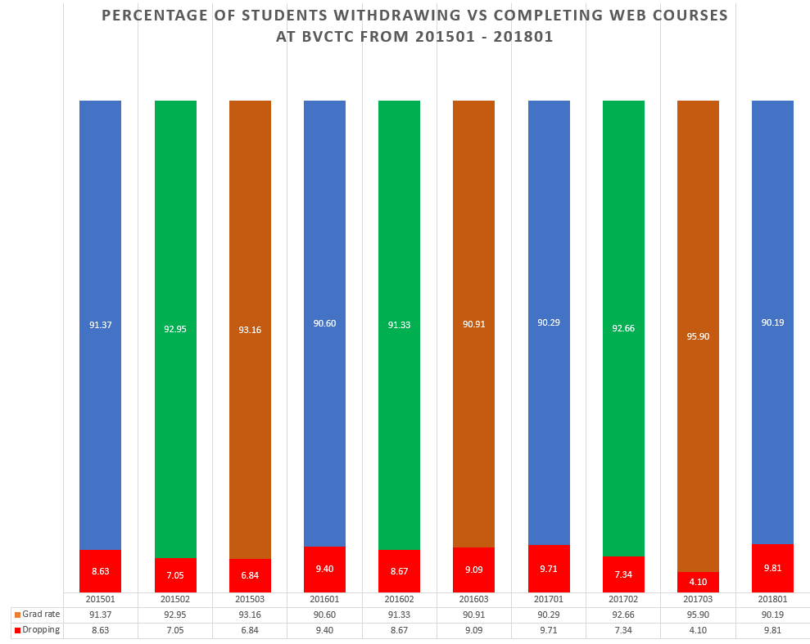

Slide 21
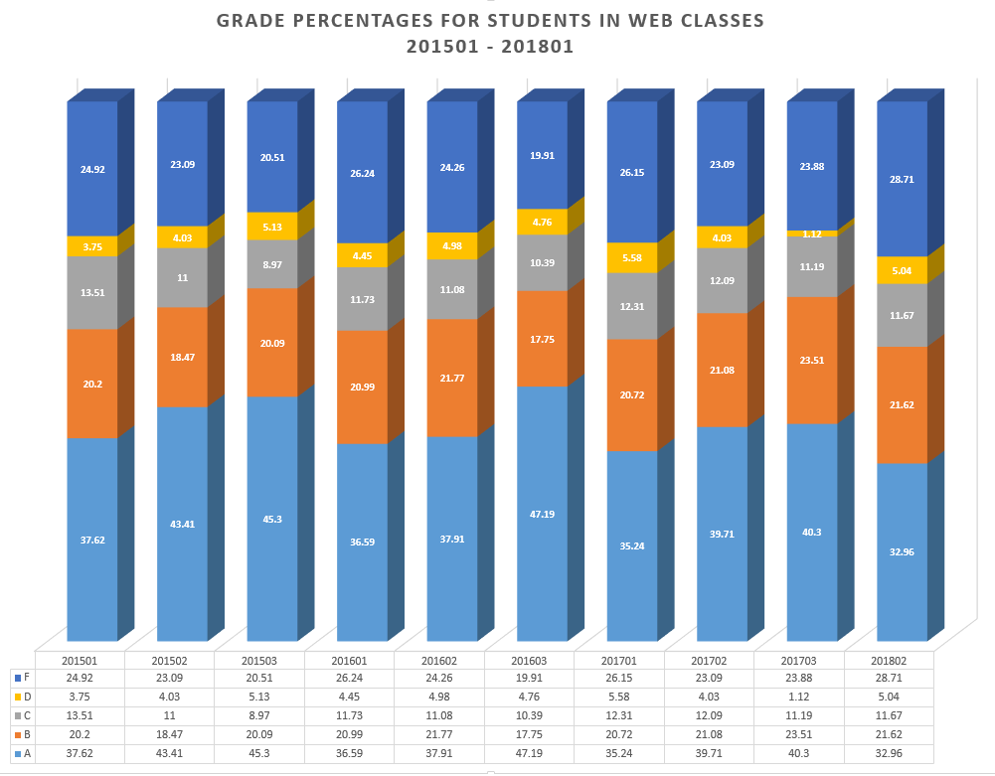

Slide 22
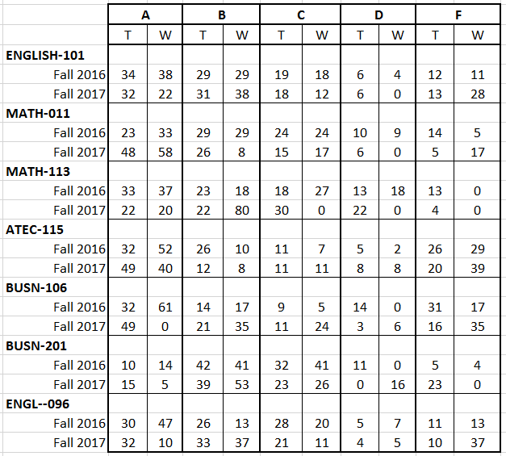
Grades: Traditional vs Web in Percentages

Slide 23
Templates
For Blackboard

Slide 24
Template Setup
Create an area in content collection to store files needed in the template.
  We use a Default Files folder, this make updates possible.
  Make sure Permissions are set within the default folder to “Read” for everyone.
Do not store files in the default template.
Name the default template with the year it was created.
Have a blank default shell for future semesters, and include only bare essentials.
  The first year, use the full template to automatically deploy the content.
  All other years, use the blank template; it saves a lot of cleanup for the faculty.

Slide 25
Things to Include in the Template
If you have a default course menu, include that menu in the default shell.
Suggestions to include in template:
  Start Here – A message to all students. This message can be modified by instructor to include QM goals.
  Syllabus - Include Overview, Sample Syllabus, Netiquette and Discussion Expectations, Instructor Biography, and Syllabus Quiz.
  Course Content - Include a Course Overview and Sample Module

Slide 26
Things to Include in the Template (Communication Tools)
Communication Tools
  My Grades
  Announcements
  Discussions
  Course Messages
  Email
  Calendar
  Water Cooler
  Goal Performance (Optional)

Slide 27
Things to Include in the Template (Technical Support)
Module Overview
  Sample Module with Module Overview
Technical Support information
  Help line, online help, & after hours help
Link to a file in Content Collection (Default File Folder) for easy update.

Slide 28
Things to Include in the Template
(Technical Requirements)
Module Overview
Technical Requirements information
  Technical Requirements
  Learning Management System Competencies
  Minimum Technology Skill Requirements
  Necessary Software
  Blackboard Browser and Operating Systems Support
Link to a file in Content Collection (Default File Folder) for easy update.

Slide 29
Things to Include in the Template (Policies)
Module Overview and Policy information
  Institutional Policies – Academic Integrity, Grade Appeals, Academic Standings, Class Cancellation and College Closures, Computer Use and Abuse, Distance Delivery of Instruction, Electronic Communication Usage, Final Exams, Grades, Proctoring of Online and Web Courses, Tuition and Fees, and Student Handbook.
  Software Privacy Policies – Blackboard, McGraw Hill Connect, YouTube, Respondus and Lockdown Browser, and any other common software.
  Software Accessibility Statements – Blackboard, Big Blue Button, McGraw Hill, YouTube, Respondus, and any other common software.
Link to a file in Content Collection (Default File Folder) for easy update.

Slide 30
Things to Include in the Template
(Proctor & Additional)
Proctoring Overview
  On-campus Proctoring
  Off-campus Proctoring
  Online Proctoring
Additional Resources
  Library Services
  Computing Services
  Student Success Center
  Student Services
  Office of the Registrar
  Veteran Affairs
  Financial Aid
  Counseling, Disability
  Career Services

Slide 31
Goals
For Blackboard

Slide 32
Goals
Institutions can demonstrate that their programs and curriculums are effective with goal alignment to course content and activities.
Goals can be aligned with
  Content
  Discussions
  Blogs, Journals, and Wikis
  Tests and Individual Questions Within the Tests
  Assignments
  Rubrics
https://help.blackboard.com/Learn/Instructor/Performance/Goals

Slide 33
Administrator Goals
Make sure Goals are available in the system
Administrators add Goals (System Admin> Tools & Utilities> Goals)
  Create Quality Matters Goal Set
  Add a Category for each QM Standard
  Add Goals for each Standard
Have a Numbering System (Goals must be unique)
Include Essential, Very Important, and Important

Slide 34
Default Template Goals
Go to Control Panel> Course Tools> Goals to associate QM Goals to shell
Go to various Content Areas to add Alignments
To run Reports
  Go to Control Panel> Evaluation> Course Reports> Course Coverage Report to run reports on the coverage areas
  Sample Course Coverage Report
Once the template is deployed, faculty can add Alignments to the course content that they add for the remaining QM goals.
Report can be run at any time to see coverage areas.
  It takes up to 3 or 4 hours after the goals have been aligned for the aligned goals to activate for the reports.
  Sample Student Report

Slide 35
Questions
Contact Information
Ms. Deborah McDaniel – Deborah.McDaniel@bridgevalley.edu
Dr. Calisa Pierce – Calisa.Pierce@bridgevalley.edu
Dr. Sherri Ritter – sherri.ritter@bridgevalley.edu

