Slide 1
The 3 R’s of QM: Reading, Research & Rubrics
Reading, Research, Rubrics
Dave Meabon & Wade Lee

Slide 2

The 3R’s of QM: Reading, Research & Rubrics

Slide 3
The 3R’s of QM: Reading, Research & Rubrics

Slide 4

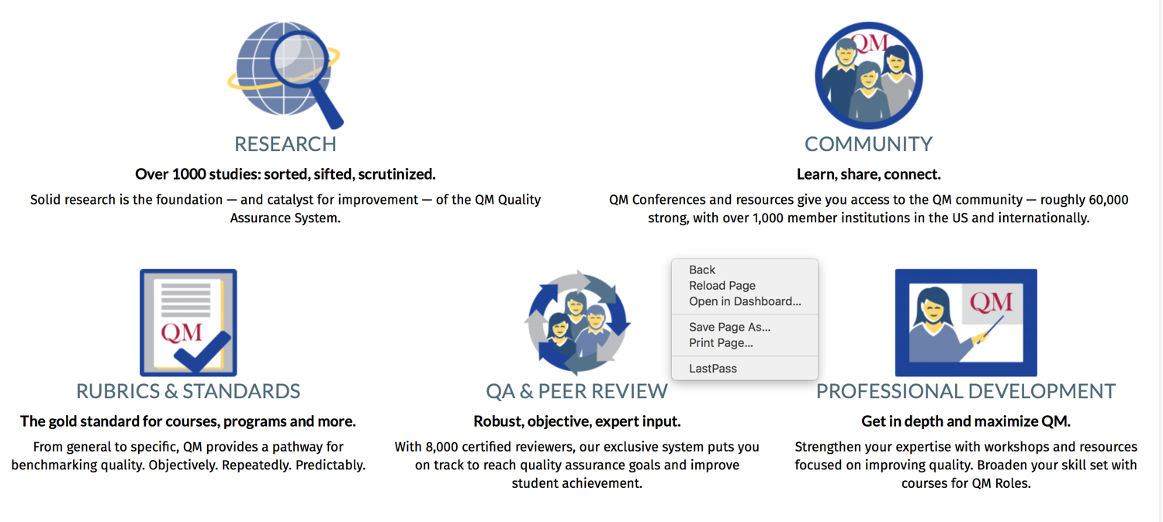

Slide 5
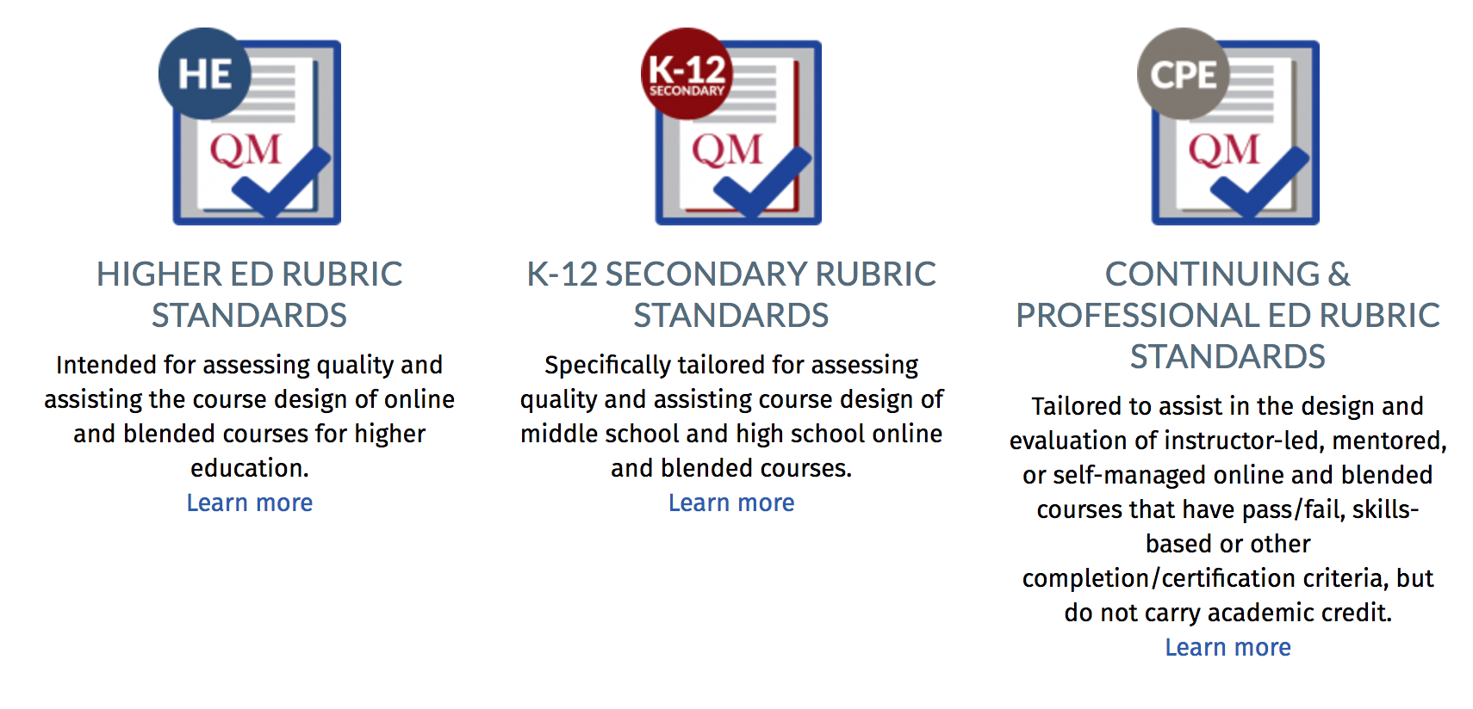
QM Standards
The 3R’s of QM: Reading, Research & Rubrics

Slide 6
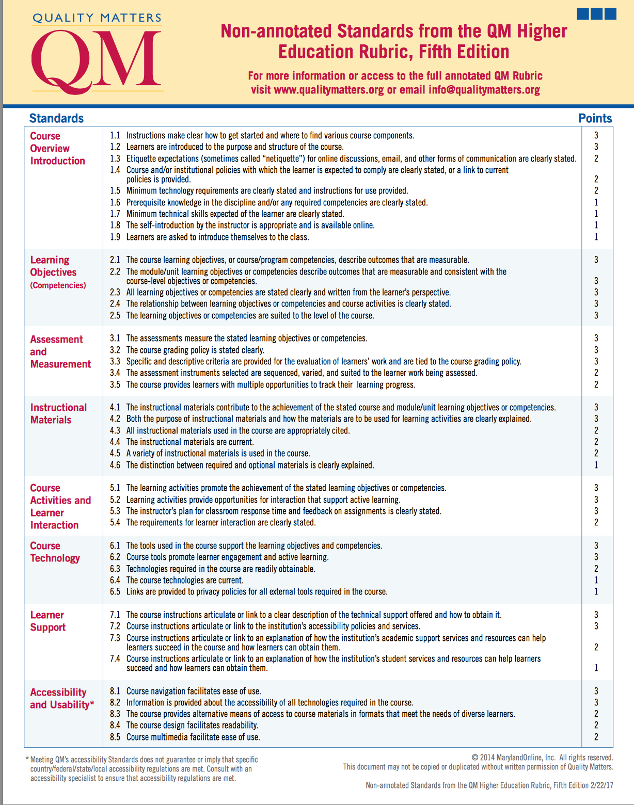
5th Ed.
2/22/17
The 3R’s of QM: Reading, Research & Rubrics

Slide 7
Validating QM Standards: Rubric Review Process
Research & Analysis
Broad Literature Review
Rubric Committee Selection
Nomination Letters & Application
Review Process
QM Research Review
User Surveys & Feedback
Course Review Data Analysis
Revise Entire PD Curriculum
Prepare Facilitators
Create Rubric Update Workshop
Create Other New PD as Needed
Professional Development (PD)
Criteria: Experienced users, broadly representative
Legacy Committee
Adhoc "Special Topic" Committees
Revise Review Management System
Revise Course Worksheets
Revise Review Policies as Needed
Communication
Update all Online Information
Ensure all QM Role Holders are Updated
Publish New Workbooks and Rubric-Related Documents
https://www.qualitymatters.org/research
Literature
Review
The 3R’s of QM: Reading, Research & Rubrics
Notes:
Kay

Slide 8
The Team
Higher Education Faculty
QM Trained & Certified
Instructional Design & Online Professionals
Librarian
Doctoral Students
Assigned to Each Standard
Higher Education - Process
Director – Russel Center for Educational Leadership
HIE- Faculty Member
Assistant Director of Law Career Services
HIE- Doctoral Student
Standard |  | Team Assignments and Contact Information
No.1 | Course Overview and Introduction | Rachel Barnes 419-530-2332 Rachel.Barnes@UToledo.edu
No.2 | Learning Objectives | Shannon Neumann 419-530-1234 Shannon.Neumann@utoledo.edu Phoebe Ballard Phone: 419-530-4379 Phoebe.ballard@utoledo.edu
No.3 | Assessment and Measurement | Dr. Mingli Xiao 419-530-4390 Email: mingli.xiao@utoledo.edu Shujuan Wang 419-530-8835 Shujuan.Wang@rockets.utoledo.edu
No.4 | Instructional Materials | Dr. Dave Meabon Phone: 419-530-2666 UT Email: david.meabon@utoledo.edu
No.5 | Learner Activity and Learner Interaction | Silvia Lucaschi-Decker Phone: 614-421-8007 (cell) UT email - Silvia.LucaschiDecker@rockets.utoledo.edu Dr. Silvia Suh Phone: 419-530-4016 Sylvia.Suh@UToledo.edu
No.6 | Course Technology | Dr. Jeff Jablonski Phone: 419.530.4079 UT Email: Jeffrey.Jablonski@utoledo.edu
No.7 | Learner Support | Dr.Claire Stuve Phone: 419-530-4383 Claire.Stuve@utoledo.edu
No.8 | Accessibility and Usability | Kirsten Winek Phone: 419-530-4712 Email: kirsten.winek@utoledo.edu Dr. Lei Song Phone: 419-530-2149 UT Email: Lei.Song2@UToledo.edu
Library Support Wade Lee 419.530.4490 Wade.lee@utoledo.edu
Electronic Information Services and
Science Research Librarian
In
Collaboration
with
Instructional Designer
Doctoral Student
Assistant Director of Educational Technology and Research Supervisor.
QM Annotated Bibliography Project Team
Assistive Technology Specialist and Instructional Designer
Director of Learning and Academic Technology
Doctoral Student
Instructional Designer and Coordinator for Quality Assurance Librarian
Director Instructional Designer
Barbra Burch
Manager of Research & Development
Doctoral Student
Kay Shattuck, D.Ed.
Director of Research
3 Doctoral Student
Library Support , EndNote, and Research Analysis

Slide 9
The Team
Higher Education Faculty
QM Trained & Certified
Instructional Design & Online Professionals
Librarian
Doctoral Students
Assigned to Each Standard
Higher Education - Process
Director – Russel Center for Educational Leadership
HIE- Faculty Member
Assistant Director of Law Career Services
HIE- Doctoral Student
Standard |  | Team Assignments and Contact Information
No.1 | Course Overview and Introduction | Rachel Barnes 419-530-2332 Rachel.Barnes@UToledo.edu
No.2 | Learning Objectives | Shannon Neumann 419-530-1234 Shannon.Neumann@utoledo.edu Phoebe Ballard Phone: 419-530-4379 Phoebe.ballard@utoledo.edu
No.3 | Assessment and Measurement | Dr. Mingli Xiao 419-530-4390 Email: mingli.xiao@utoledo.edu Shujuan Wang 419-530-8835 Shujuan.Wang@rockets.utoledo.edu
No.4 | Instructional Materials | Dr. Dave Meabon Phone: 419-530-2666 UT Email: david.meabon@utoledo.edu
No.5 | Learner Activity and Learner Interaction | Silvia Lucaschi-Decker Phone: 614-421-8007 (cell) UT email - Silvia.LucaschiDecker@rockets.utoledo.edu Dr. Silvia Suh Phone: 419-530-4016 Sylvia.Suh@UToledo.edu
No.6 | Course Technology | Dr. Jeff Jablonski Phone: 419.530.4079 UT Email: Jeffrey.Jablonski@utoledo.edu
No.7 | Learner Support | Dr.Claire Stuve Phone: 419-530-4383 Claire.Stuve@utoledo.edu
No.8 | Accessibility and Usability | Kirsten Winek Phone: 419-530-4712 Email: kirsten.winek@utoledo.edu Dr. Lei Song Phone: 419-530-2149 UT Email: Lei.Song2@UToledo.edu
Library Support Wade Lee 419.530.4490 Wade.lee@utoledo.edu
Electronic Information Services and
Science Research Librarian
Instructional Designer
Doctoral Student
Assistant Director of Educational Technology and Research Supervisor.
QM Annotated Bibliography Project Team
Assistive Technology Specialist and Instructional Designer
Director of Learning and Academic Technology
Doctoral Student
Instructional Designer and Coordinator for Quality Assurance Librarian
Director Instructional Designer
Doctoral Student
3 Doctoral Student
Library Support , EndNote, and Research Analysis

Slide 10
Higher Education - Process
Director – Russel Center for Educational Leadership
HIE- Faculty Member
Assistant Director of Law Career Services
HIE- Doctoral Student
Standard |  | Team Assignments and Contact Information
No.1 | Course Overview and Introduction | Rachel Barnes 419-530-2332 Rachel.Barnes@UToledo.edu
No.2 | Learning Objectives | Shannon Neumann 419-530-1234 Shannon.Neumann@utoledo.edu Phoebe Ballard Phone: 419-530-4379 Phoebe.ballard@utoledo.edu
No.3 | Assessment and Measurement | Dr. Mingli Xiao 419-530-4390 Email: mingli.xiao@utoledo.edu Shujuan Wang 419-530-8835 Shujuan.Wang@rockets.utoledo.edu
No.4 | Instructional Materials | Dr. Dave Meabon Phone: 419-530-2666 UT Email: david.meabon@utoledo.edu
No.5 | Learner Activity and Learner Interaction | Silvia Lucaschi-Decker Phone: 614-421-8007 (cell) UT email - Silvia.LucaschiDecker@rockets.utoledo.edu Dr. Silvia Suh Phone: 419-530-4016 Sylvia.Suh@UToledo.edu
No.6 | Course Technology | Dr. Jeff Jablonski Phone: 419.530.4079 UT Email: Jeffrey.Jablonski@utoledo.edu
No.7 | Learner Support | Dr.Claire Stuve Phone: 419-530-4383 Claire.Stuve@utoledo.edu
No.8 | Accessibility and Usability | Kirsten Winek Phone: 419-530-4712 Email: kirsten.winek@utoledo.edu Dr. Lei Song Phone: 419-530-2149 UT Email: Lei.Song2@UToledo.edu
Library Support Wade Lee 419.530.4490 Wade.lee@utoledo.edu
Electronic Information Services and
Science Research Librarian
Instructional Designer
Doctoral Student
Assistant Director of Educational Technology and Research Supervisor.
QM Annotated Bibliography Project Team
Assistive Technology Specialist and Instructional Designer
Director of Learning and Academic Technology
Doctoral Student
Instructional Designer and Coordinator for Quality Assurance Librarian
Director Instructional Designer
Doctoral Student
3 Doctoral Student
Library Support , EndNote, and Research Analysis

Slide 11
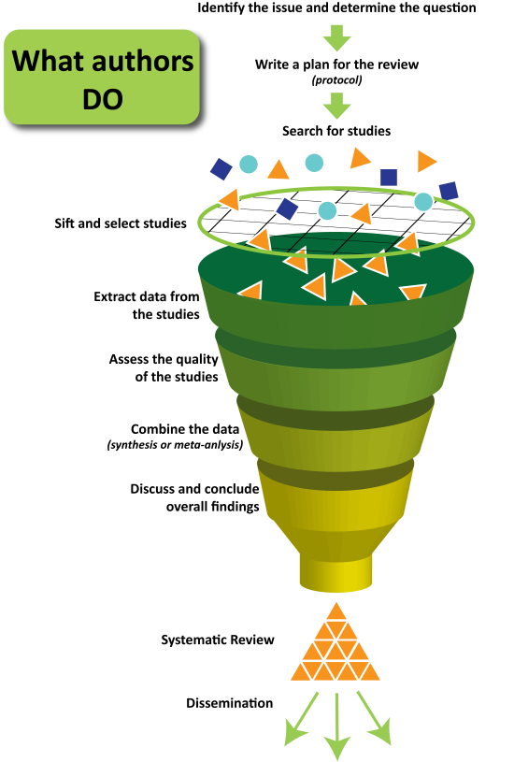
Overview of Team Review Process
Identify research areas, inclusion & exclusion criteria
Design & Conduct search of literature
Initial sifting by Title & Abstract
Obtain Full Text & re-assess
Annotate & Format for inclusion in QM Research Library
Designed by Jessica Kaufman, Cochrane Consumers & Communication Review Group, Centre for Health Communication & Participation, La Trobe University, 2011
The 3R’s of QM: Reading, Research & Rubrics
Notes:
Adapted from best practice guidelines for Systematic Reviews & Meta-Analyses used in the clinical medicine disciplines

Slide 12
Search Strategies Employed
ProQuest Dissertations & Theses A&I Database
Search:
all("computer assisted instruction" OR "web-based instruction" OR "online courses" OR "online education" OR "online learning" OR "online teaching" OR "e-learning" OR "elearning" OR "electronic learning" OR "learning management systems" OR "course management systems" OR "courseware" OR "Blended learning" OR "distance learning" OR "distance education" OR "virtual classrooms" OR " internet in education" OR "mobile communication systems in education" OR " computers in education") AND all((instruction* n/3 design* OR course* n/3 design*))
Additional limits - Date: After December 31 2012
Note: n/3 means ‘within three words of’
EBSCO Search: ERIC, Academic Search Complete, Education Full Text, Education Research Complete, Professional Development Collection, Psychology and Behavioral Sciences Collection, PsycINFO
Search:
(instruction* design* OR course design*) AND ("computer assisted instruction" OR "web-based instruction" OR "online courses" OR "online education" OR "online learning" OR "online teaching" OR "e-learning" OR "elearning" OR "electronic learning" OR "learning management systems" OR "course management systems" OR "courseware" OR "Blended learning" OR "distance learning" OR "distance education" OR "virtual classrooms" OR " internet in education" OR "mobile communication systems in education" OR " computers in education") NOT TI Proceedings
Limits:
Publication Type: Articles, Dissertations, Reports, Years: 2013-2016
The 3R’s of QM: Reading, Research & Rubrics

Slide 13
Results of Search by Database
Database Name | Platform | # of Results
Education Research Complete | EBSCOhost | 484
ERIC | EBSCOhost | 378
Academic Search Complete | EBSCOhost | 319
Education Full Text (H.W. Wilson) | EBSCOhost | 237
PsycINFO | EBSCOhost | 192
Professional Development Collection | EBSCOhost | 164
Psychology and Behavioral Sciences Collection | EBSCOhost | 25
ProQuest Dissertations & Theses A&I | ProQuest | 401
Total |  | 2200
Total after removing duplicate items |  | 1232
The 3R’s of QM: Reading, Research & Rubrics

Slide 14
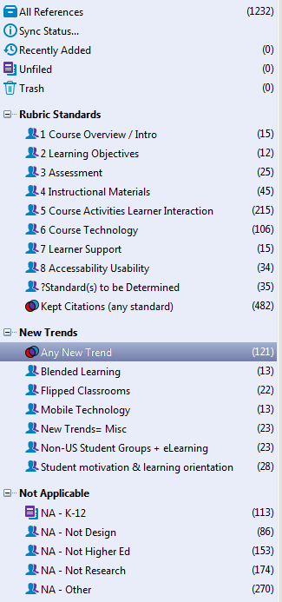

EndNote Sifting
Shared Library used by Team
Content Experts Sort by Standards
  based on Title/Abstract
  can apply to multiple
Identify New Trends
Exclusions (Not Applicable)
New Trends
The 3R’s of QM: Reading, Research & Rubrics

Slide 15
Full Text Assessment
Full text of articles obtained
  By Librarian using subscriptions & interlibrary loan
  For all articles sorted to Rubric Standard or Trends
  Attached to EndNote record
Second round of assessment by content experts
  Read full text or 24-page previews (for theses)
  Rate 1-5 stars for importance/strength
  Write annotations or research notes
The 3R’s of QM: Reading, Research & Rubrics

Slide 16
Final Clean Up
Transferred to Google Sheets
  Matched template from QM Research Library
  Accessible to QM staff for preliminary review
  Author abstracts or reviewers’ annotations used as description
  3, 4, 5 star rated items included in final report
The 3R’s of QM: Reading, Research & Rubrics

Slide 17
Bibliometrics
All Citations Identified (n=752 articles) | After Final Screening (n=98 articles)
International Review of Research in Open & Distance Learning (23) Computers & Education (22) Journal of Online Learning & Teaching (18) International Journal on E-Learning (17) British Journal of Educational Technology (15) American Journal of Distance Education (13) Quarterly Review of Distance Education (13) Journal of Applied Learning Technology (12) Interactive Learning Environments (11) TechTrends: Linking Research & Practice to Improve Learning (11) | Computers & Education (4) American Journal of Distance Education (4) British Journal of Educational Technology (3) International Review of Research in Open & Distance Learning (3) Quarterly Review of Distance Education (3) Turkish Online Journal of Distance Education (TOJDE) (3)
The 3R’s of QM: Reading, Research & Rubrics
Notes:
For Dissertations, top universities are:
Capella 13
Mississippi State, U Kentucky, Northcentral, Walden, Wayne State 3 each
Mich State, U North TX, U Southern Mississippi, Nova Southeastern, U South Florida, Kent State, 2 each

Slide 18
Of Interest
Greer, K., Hess, A., & Kraemer. (2016).The librarian leading the machine: Reassessment of library instruction methods. College & Research Libraries,. 77(3), 286-301. [Student outcomes, faculty outcomes, online instruction, empirical study, implications for practice]
Is the Computer Mightier than the Librarian?
Leahy, S. (2015). Faculty and perceptions of video in higher education online courses. Unpublished doctoral dissertation. Michigan State University, East Lasing , MI. [100 faculty – online classes, our types of video: instructor-created, third party, student-created, and synchronous video.]
The 3R’s of QM: Reading, Research & Rubrics

Slide 19
Flipped Classroom
Social Media as
Learning Tool
Mobile Technology
Accessibility
Single Institution
Few Multi-institutional
Outcomes Based
International
Language of the
Online Research
Observations
“The Times
They Are
A-Changin”’
Health Science &Medical Research
Qualitative Studies
Fewer Quantitative Studies
The 3R’s of QM: Reading, Research & Rubrics

Slide 20
SI = Situational Interest
PU = Perceived Utility
TAM=Technology Acceptance Model
Odel=Open-Ended Distance e-Learning
MOO=SOC/Ps Scalable online Courses or Programs
OTT = Online Task Thinking
DEET=Distance Education Elaboration Theory
CFHT= Cognitive Flexibility Hypertext Theory
VWE-SE = Virtual World Environment Self Efficacy
GCD = Guided collaborative discussion
DC = Dynamic Cueing
MSLQ =Motivated Strategies for Learning Questionnaire
The 3R’s of QM: Reading, Research & Rubrics

Slide 21
THANKS
The 3R’s of QM: Reading, Research & Rubrics

Slide 22
The 3R’s of QM: Reading, Research & Rubrics

