Slide 1
The Division of Labor
Should Not Divide Us
QM Regional Conference
New York, April 2019
Dr. Daphne Snowden, Mr. Jeremy Harvey and Dr. Diana Zilberman
Baltimore City Community College

Slide 2
Session Objectives
Review the a teacher/faculty’s role through the ages.
Define the traditional faculty roles.
Define the new faculty roles in the era of course design.
Recognize the various jobs of instructional designers.
Contrast the factory and artisanal modality of course design.
Analyze the impact of the division of labor in education on faculty and staff.
Recognize the principles of academic freedom.
Draft a plan for your institution to advance the best student experience in (online) courses.

Slide 3
The Question
How to create the best learning experience for students as faculty, administrators, and designers collaborate to ensure a quality course both in its design and its delivery?

Slide 4

Teaching throughout the Centuries
From tutor, story-teller, master, sensei, wise man/woman, or monk, the content, delivery, and assessment of learning belonged to one individual alone.
La Scuola Romana; Imperium Romanum; retrieved from the Internet on 4/22/2019 at https://www.romanoimpero.com/2016/04/la-scuola-romana.html

Slide 5
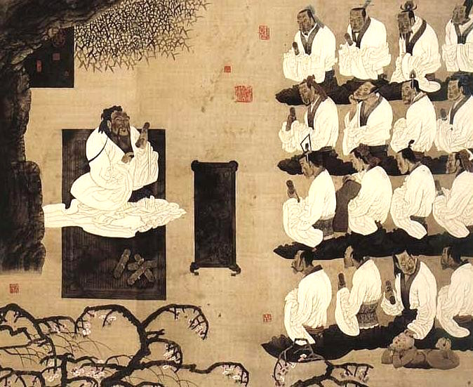

Teacher’s Role
Any recognized subject matter expert attracted disciples desiring to learn under his/her tutelage.
Picture retrieved from the Internet on 4/22/2019 at https://www.behance.net/gallery/8676529/Oral-Tradition
Picture retrieved from the Internet on 4/22/2019 at http://budothought.blogspot.com/2015/06/dont-say-my-deshi.html

Slide 6
Teacher’s Role
As colleges and schools appeared, the role of the teacher encompassed all aspects of teaching and learning.
  Selecting and communicating the content
  Selecting the teaching methods
  Guiding learning
  Assessing the learner

Slide 7
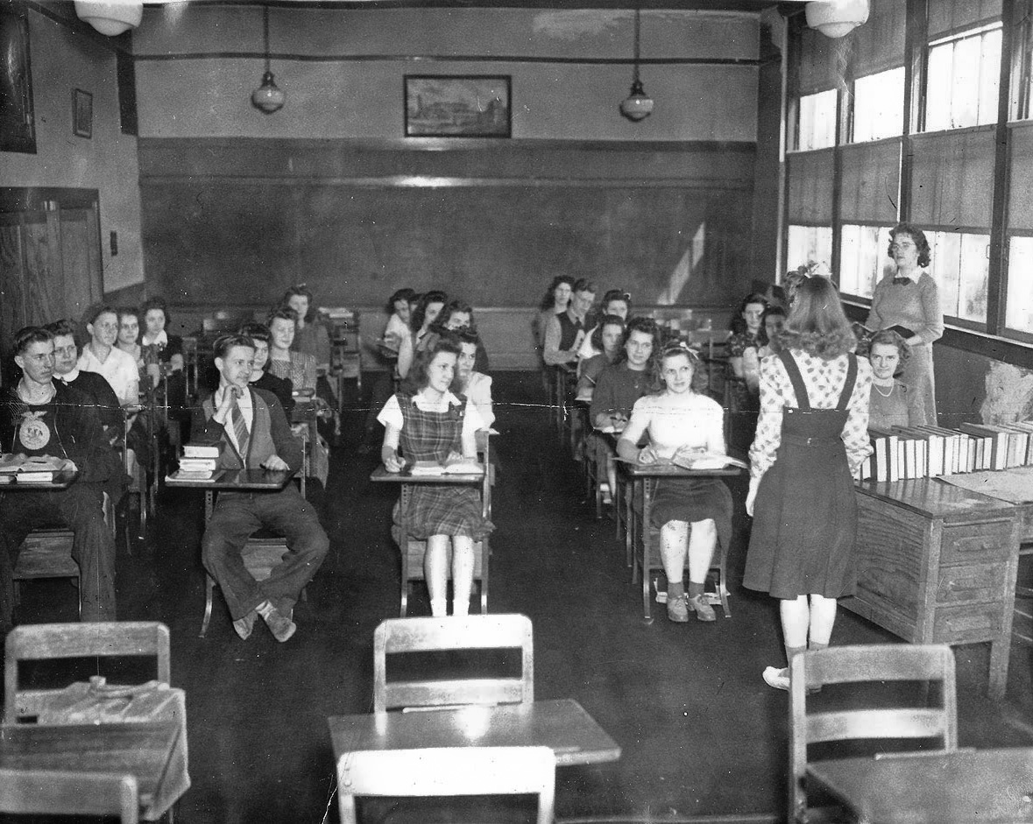
The Teacher Also Provided the
Learning Content
Few or non-existing learning resources required a great deal of memorization on the part of the learner.
High school classroom, 1940; retrieved from the Internet on 4/22/2019 at https://www.shorpy.com/node/9526?size=_original

Slide 8
Learning Resources (QM St. 4) and Publishers
In the 70s, 80s, and 90s, for many faculty, the adoption of a textbook was followed by adjusting (creating) the learning topics (even objectives), readings and assessments according to the text.
In time, publishers created educational software accompanying hardcopy textbooks.

Slide 9

The Mid 90th and the Internet
With the appearance of the Internet, educational technology programs made their way into schools and colleges.
The Learning Management System created the stage for a three-dimensional structure of a course: the course design.

Slide 10

Course Design and Delivery
Delivery and design opened a schism, separating, for the first time in history, one job (teacher) into two.

Slide 11
About Instructional Designers…

Slide 12
Who Are the Instructional Designers?
67% are female.
Average age is 45 years old.
87% have a master’s degree and 32% a PhD.
Past experience varies, but is largely in instructional design, teaching in higher ed, and technology development.
(2016, April 1). Instructional Design in Higher Education - Instructional-Design-in-Higher-Education-Report.pdf.
Retrieved from https://intentionalfutures.com/wp-content/uploads/2017/08/Instructional-Design-in-Higher-Education-Report.pdf
Notes:
According to a 2016 study by Intentional Futures, largely based on survey participation:
67% of IDs are female.
About 60% of IDs are between 30-50 years old. Average age is 45.
IDs are rather educated, with 87% having a Master’s degree (though not always in a directly related field) and 32% with PhDs.
In the study, IDs reported varied experience, though mostly in Instructional Design, teaching in Higher ed and technology development. They also reported experience in academic research, administration, graphic and web design, teaching k-12, and unrelated areas such as computer programming, journalism, and architecture.
https://intentionalfutures.com/insights/portfolio/instructional-design/

Slide 13
What Do They Do?
Design
  Planning and creation of courses and materials
Train
  Teach faculty, students, and sometimes staff how to apply instructions theories and use related technologies
Support
  Investigate and troubleshoot issues for instructional technologies, often including the learning management system
Manage
  Oversee projects and coordinate others such as IT, other IDs, faculty, and administrators
Notes:
IDs tend to wear many hats. It’s common for duties of IDs to have a wide variety, but most of them can be organized into four categories.
Course design is one large area. IDs are trained in course design and learning theories and are commonly involved in the planning and creation of courses and/or course materials. Sometimes this is done as assistance to faculty, sometimes IDs are tasked with creating courses themselves.
Train faculty and others on relevant topics. IDs are often in charge of or at least involved in faculty development. At our institution the E-Learning Department is responsible for most faculty training regarding learning theories and educational technology. We hold numerous sessions and events throughout the year (sometimes quick, hour long sessions, and sometimes multi-day training camps). We are also in charge of teaching students how to use the LMS and adjacent software and technologies.
IDs often also support faculty in troubleshooting issues and supporting their use of the technology. A large part of my job at BCCC is LMS administration. That can range from creating and maintaining accounts, troubleshooting issues (both major and minor), assisting with integrating new softwares, and resetting passwords.
And finally, manage projects. This will vary between institutions. Teams of IDs will need to coordinator with one another, faculty, and others to design courses and materials. For our college, I am frequently the liason between the faculty and 3rd party vendors for educational software. I also interface between those vendors and our IT department when adopting new technology or applying any maintenance.

Slide 14
The Many Titles of IDs
Instructional Designer
Instructional/Educational Technologist
Instructional Developer
Learning Experience Designer
Learning Architect/Strategist
Course Designer/Architect
Others?
Notes:
Often times, there is a effort to specialize. There are many similar, but not-quite-the-same titles floating around that all fall under the “Instructional Designer” umbrella.
These titles suggest different areas of specialization. Instructional Technologists implies more focus on the LMS and other educational technologies. An “Instructional Developer” would probably be more focused on building the course material, rather than planning it out. Some say that a “Learning Experience Designer” would put more focus on the learning, starting from their perspective, rather than focusing on the “instructional materials”.
However, in practice, especially for small teams or solo acts, these duties often overlap. IDs frequently end up doing all of the above, regardless of their title. I was hired as an Instructional Technologist, and while my focus probably is in the technology, I am often called on to help faculty with their course design and applying best practices and theories. I’m really the only ID at my school, so I have to be the whole package as best that I can.

Slide 15


IDs Can Help
Instructions Designers “design” the content.
Faculty “deliver” the content.
Notes:
In the most simple terms, IDs “design” the content and faculty “deliver” the content.
Faculty serve as the subject matter expert, content deliverer, and face of the institution. They know the content, and what information the student needs to be taught to meet the objectives. They deliver that content, whether it be in the classroom or through messages and videos in an online course. And they are, in many ways, the face of the institution to students. They build relationships with the students over the course of one or many courses, encourage students, and are the primary contacts that students have with the institution.
IDs serve as the instructional planner, learning technology expert, and a second set of eyes and ears. They take the faculty's content and organize it, structure it in a way to make sure it aligns with the objectives. If the faculty’s knowledge is the building materials, the ID is the architect. They identify the best tools to use to deliver that content, and ensure the faculty are in the best position to use those tools, with proper training and support. And, if they aren’t also subject matter experts for that course, they act as a second set or eyes who can identify where things could be explained better to the layperson.

Slide 16
Different Setups
In reality, there are different divisions of labor:
Some schools have solo IDs who do a combination of everything
Small teams can start to specialize and shift focus for more involved course design and support
Large teams allows for specialized, consistent help, assigning IDs and/or teams to specific courses with assistance lasting from the beginning to end of course design and delivery
Notes:
Typically small institutions, including BCCC, will have one or a few instructional designers who do everything.
They’ll help faculty with designing and building their courses, train the faculty on how to use relevant technologies, act as point of contact between faculty, IT, and vendors, provide ongoing support (including technical support).
When an institution has one or several small teams of IDs, they can start to specialize. This is where some of those various titles may start to have some differentiation. Faculty can get more consistent one-on-one support, or the help of a small team to help with finer details with their course design.
Large teams of IDs can further branch out and allow for extra specialization and consistent attention during course design and delivery. This can help greatly when employing a “Factory Line” model of course design, where a team of IDs and one or two knowledgeable faculty can build a course from the ground up for the rest of the department and adjunct to teach, helping to ensure quality and consistency.

Slide 17
Barriers Working With Faculty
Confusion over the role of the ID
  Faculty are unclear as to how and ID can help them
  IDs are commonly thought of as the LMS, or technical support
Faculty resistance is greater when institutional policies give course design oversight to ID.
Notes:
As the introduction of IDs to the academic process is still fairly new, there are hurdles that are still posing a problem when it comes to faculty and IDs working together.
One of the problems that IDs most commonly cite is that faculty just don’t know what they do or what help they can provide. This is a bit understandable. The role of ID is fairly new, and can vary from institution to institution. How are they suppose to know what to expect from the ID team at their institution. Especially adjunct, who likely teach at more than one school.
And while this seems to be shrinking, thankfully, there is a notion that IDs are primarily there to be support for the LMS, and not much else. It’s still a rather prevalent misconception.
IDs have also reported pushback from faculty who simply feel like they don’t need the help, or don’t understand where the divide between course design and delivery is supposed to be.

Slide 18
Two models of course design evolved.

Slide 19

The Artisanal Model of Course Design
The Artisanal Model = The faculty is the designer and the deliverer of the course.

Slide 20

The Factory Model of Course Design
The Factory Model:
The faculty delivers the course designed by a group made of:
  Instructional Designers
  Instructional Technologists
  Course Architects
  Content Specialists
  Subject Matter Experts (faculty members)

Slide 21
In the Factory Model
The created course design is copied to all sections of the same course.
Faculty members facilitate the course based on the same course design.
Faculty teaching the course may, or may not have participated in the creation of the design.

Slide 22
The New Teacher/Faculty’s Role
Subject Matter Expert in the design process
Facilitator in the delivery process
Content (QM St. 4) was delivered by the publishers of textbooks.
Learning Objectives (QM St. 1) and Assessment (QM St. 3) became mandated by accrediting bodies and increasing focus on outcomes and analytics.

Slide 23
A Paradigm Shift: Faculty’s New Role
Although many faculty members embrace their new role in the teaching and learning arena, some faculty resent their “diminished role” in view of what traditionally they used to control.
Often, faculty claim academic freedom when under institutional pressure when faced with their new roles.

Slide 24
Academic Freedom

Slide 25
What is academic freedom?
A scholar's freedom to express ideas without risk of official interference or professional disadvantage.
Faculty have the freedom to teach or communicate ideas or facts (including the topics about politics, religion and other controversial subject matter).
“We cannot protect academic freedom by denying others the right to an opposing view."

Slide 26
Supreme Court
The Supreme Court of the United States said that academic freedom means a university can "determine for itself on academic grounds:”
  Who may teach.
  What may be taught.
  How it should be taught.
  Who may be admitted to study.

Slide 27
Court Cases
The U.S. Supreme Court case of Sweezy v. New Hampshire the court ruled that if a university attempts to force a professor to change a grade, that is violation of the First Amendment (1957).
In Stronach v. Virginia State University, a district court judge held "that no constitutional right to academic freedom exists that would prohibit senior (university) officials from changing a grade given by (a professor) to one of his students.“
In 2008 the federal court ruled that professors have no academic freedom; all academic freedom resides with the university or college.
But university officials may exercise their discretionary authority and change the grade upon appeal by a student. The Stronach case has gotten significant attention in the academic community as an important precedent.

Slide 28
The 1940 Statement of Principles on Academic Freedom and Tenure Indicates
Academic freedom is essential and applies to both teaching and research.
  (1) Freedom in research is fundamental to the advancement of truth.
  (2) Academic freedom in its teaching aspect is fundamental for the protection of the rights of the teacher in teaching and of the student to freedom in learning.
Tenure:
  (1) freedom of teaching, research, and extracurricular activities, and
  2) a sufficient degree of economic security. Freedom and economic security, hence, tenure, are indispensable to the success of an institution in fulfilling its obligations to its students and to society.

Slide 29
Academic Freedom Principles
Teachers are entitled to full freedom in research and in the publication of the results.
Teachers are entitled to freedom in the classroom in discussing their subject, but they should be careful not to introduce into their teaching controversial matter which has no relation to their subject.

Slide 30
Academic Freedom Principles
College and university teachers are citizens, members of a learned profession, and officers of an educational institution.
The limitations of academic freedom because of religious or other aims of the institution should be clearly stated in writing at the time of the appointment.
When teachers speak or write as citizens, they should be free from institutional censorship or discipline, but their special position in the community imposes special obligations.

Slide 31
Academic Freedom Principles
As teachers are scholars and educational officers, they should remember that the public may judge their profession and their institution by their utterances.
Teachers at all times must be accurate and should exercise appropriate restraint, respect for the opinions of others, and make every effort to indicate that they are not speaking on behalf of the institution.
The institution has the freedom to appoint faculty, set standards and admit students.

Slide 32
Quality Matters, Models of Course Design & Academic Freedom
Quality Matters is a course review process.
Quality Matters is focused on the design of an online course.
Quality Matters DOES NOT look at the delivery or the teaching of the course.
It is a tool to evaluate course design and components, NOT the individual instructor.
A major tenet for Quality Matters is alignment of critical course components: learning objectives, assessments, and materials.
The QM Rubric DOES NOT prescribe any particular content that must be in a course, thereby ALLOWING FACULTY FULL ACADEMIC FREEDOM.

Slide 33
Any Tensions?

Slide 34
Where Do Tensions Exist in View of the New Faculty Roles?
Lack of understanding of instructional designers’ role.
Insufficient communication and collaboration among faculty and designers.
Faculty feeling resentful in view of perceived or real internal and external pressures to conform, including learning outcomes assessment, OERs, pre-packaged course design, QM, etc.

Slide 35
Your Input
Please go on your smart phone’s browser and access:
www.menti.com

Slide 36
Continuous Improvement
Next Steps
Strengthen faculty’s embracing the facilitator role by emphasizing its importance in
  Creating a positive social presence
  Providing timely and detailed feedback
  Cheering students through their progress
  Using technology to promote students’ engagement and active learning
Clarify instructional designers’ role at the institution.
Create an environment of trust for collaboration.
Other?

Slide 37
Thank you!
Dr. Daphne Snowden dsnowden@bccc.edu
Mr. Jeremy Harvey jharvey@bccc.edu
Dr. Diana Zilberman dzilberman@bccc.edu

