Slide 1
The Fresh Start Course: Quality Matters from the Start
Dr. Morris Thomas
Director, The Center for Excellence in Teaching, Learning and Assessment (CETLA)
Sebastien Auguste, MPA
Assistant Director for Digital Learning and Special Initiatives (CETLA)
Cindy Philpot, M.Ed
Assistant Director for Programming and Assessment (CETLA)

Slide 2

Objectives
Identify QM standards to address initial online course design components.
Apply the Quality Matters standards to initial online course delivery.
Explain how the Fresh Start course impacted online learning at scale.

Slide 3
The Fresh Start Course: Quality Matters From the Start
The Fresh Start Course was designed as a response to both faculty and learners adjusting to Emergency Remote Instruction.
Many faculty had not developed and or taught courses virtually, thus leading to limitations in the design for virtual instruction.
A reoccurring theme emerged involving issues with the initial impression for courses, i.e. where to start, what was expected, course navigation, etc.
To move from Emergency Remote Instruction to an enhanced quality virtual learning experience, a new professional development opportunity called The Fresh Start Course was developed.

Slide 4

Fresh Start Course Overview

Slide 5
Fresh Start Course and Quality Matters
Fresh Start Course Objectives
Quality Matter Standards
Enable course availability for registered learners
Create initial interactions within courses
Upload essential course documents
Arrange course content and activities in an organized manner
Navigate learners to initial activities/assignments
Support usability, accessibility, and readability for registered learners
Develop a sense of community
General Standard 1
  SRS 1.1, 1.2, 1.3, 1.4, 1.5, 1.6, 1.7, 1.8, 1.9
General Standard 5
  SRS 5.2, 5.3, 5.4
General Standard 7
  SRS 7.1, 7.2, 7.3, 7.4,
General Standard 8
  SRS 8.1, 8.2, 8.3, 8.4, 8.5
  (21) SRS informed the Fresh Start Course design

Slide 6


Slide 7

Poll Everywhere Activity

Slide 8
Fresh Start Impact
Approximately 150 faculty registered for the course during its initial semester.
Data from approximately 50 of the courses where the Fresh Start Course content was implemented found that approximately 30,000 learners will engage in an increased quality online learning experience as a result.
Faculty reported highly favorable feedback of their experience in taking the Fresh Start course.
Student evaluations of faculty who implemented the design elements from the Fresh Start Course commented on noticeable improvements in their learning experiences in these courses.

Slide 9
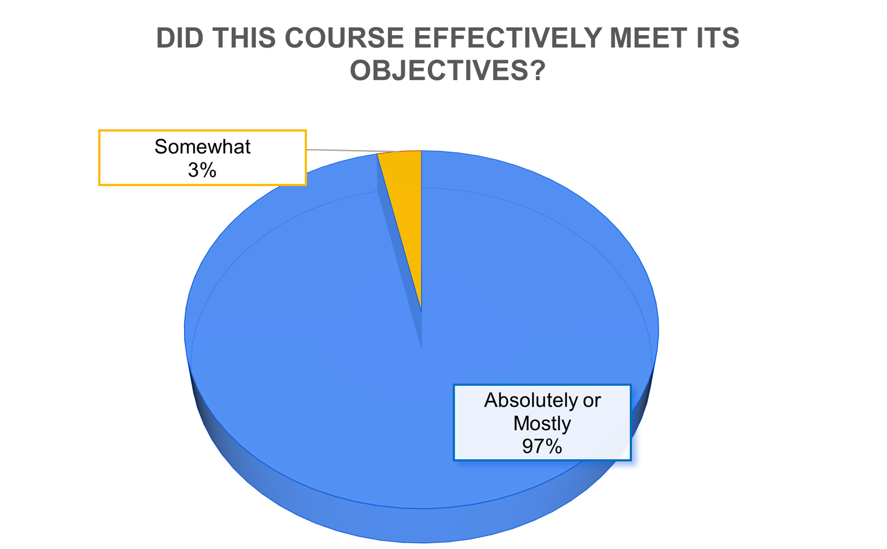
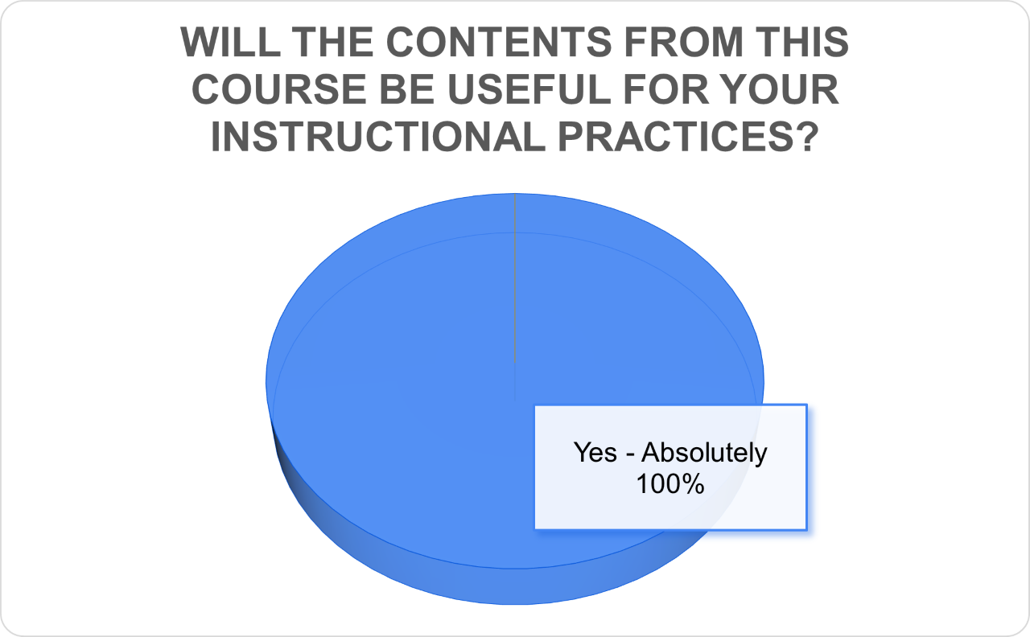
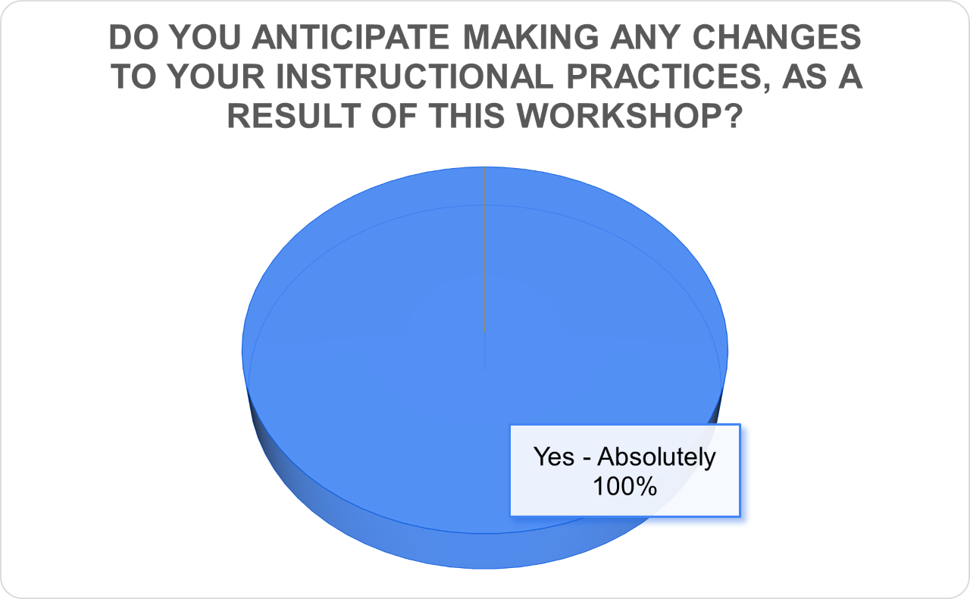
Fresh Start Impact Continued

Slide 10
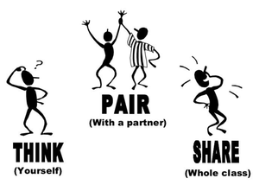
Think, Pair, Share Activity

Slide 11
Thank You!
“By providing every student with a quality education, and the material they need for class… we can help students from all backgrounds learn and thrive”
- London Wood

