Slide 1
The ID as Project Manager
Managing a Project When You’re NOT the Boss

Slide 2

Clay Alan Ham, PhD, PMP
HE & HE Administration
HE Accreditation
SC K-12 Online Program
QM K-12/CPE Master Reviewer
Certified PMP
cham@ed.sc.gov

Slide 3
How do you like “group work”?
- In less than 60 seconds … Yes? No? Maybe? -

Slide 4
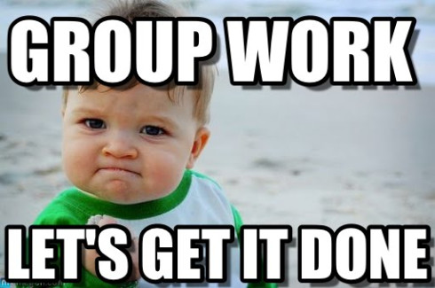
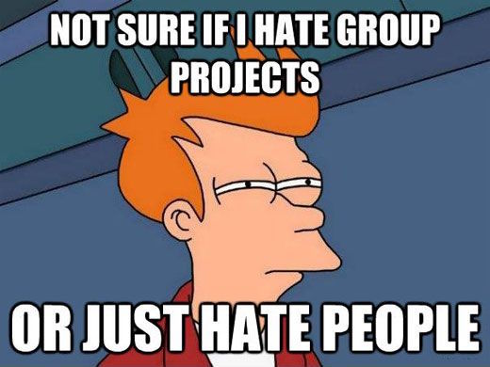
To group or not group?
To group or not to group?

Slide 5
Your best team experience?
- In less than 60 seconds … Who? What? Outcome? -

Slide 6
Session Description
Instructional Designer …
… completing the course
... managing a cross-functional team.

Slide 7

ID as Project Manager
Project management:
“The application of knowledge, skills, tools, and techniques to project activities to meet the project requirements.”
pmi.org

Slide 8

You should be able to:
Explain PM lingo …
Employ PM resources …
Evaluate project deliverables …

Slide 9
Talking like a Project Manager

Slide 10
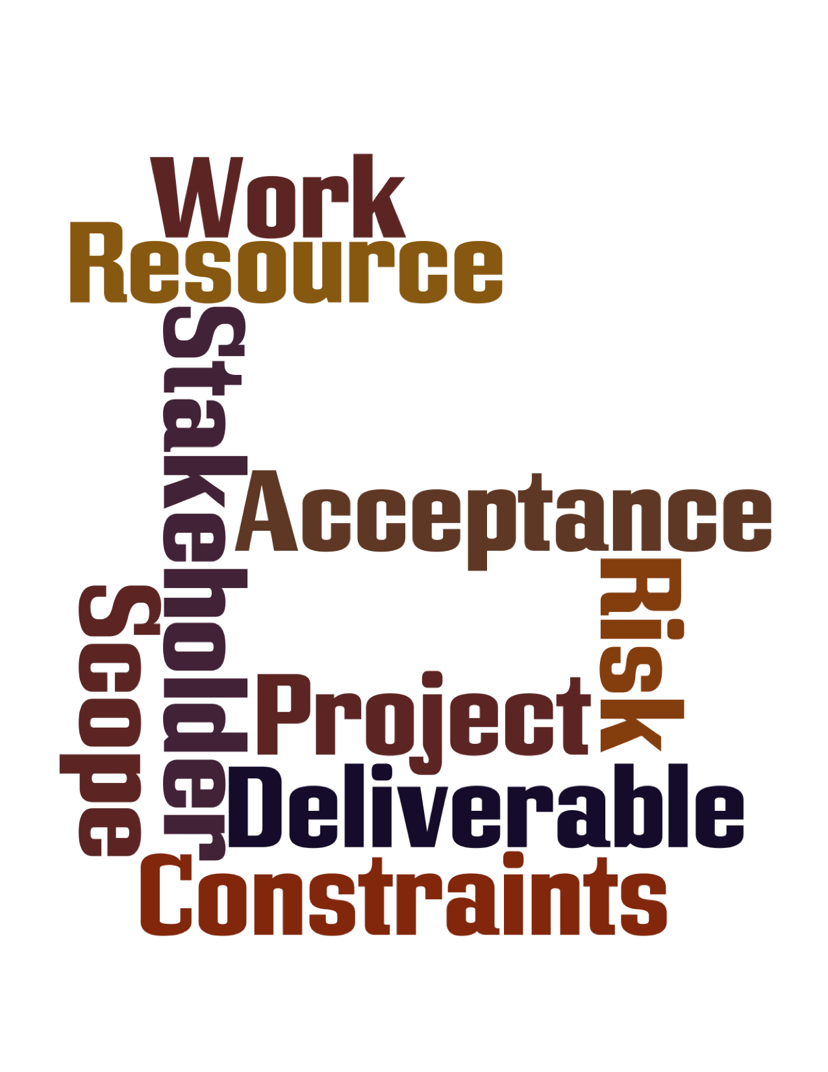

Slide 11
PM Lingo Matching (1)
Project
Deliverable
Scope
Resource
All the work and only the work to be done
Temporary group of tasks to create a new product
Product(s) produced as a result of the project
Anything necessary for completing the project

Slide 12
PM Lingo Matching (2)
Constraint
Risk
Acceptance
Stakeholder
Person/Group whose interest is affected by the project
Approval when project meets quality requirements
Factor which limits the ability to plan
Unknown event/condition which may affect the project

Slide 13
Which word?
Completed master course ready to copy for instructor facilitation
Completed by the master copy deadline prior to the beginning of the semester
Office closure for hazardous weather
Student, parent, and teacher
Meets quality standards (e.g., QM Rubric)
ID and Subject Matter Expert
Acceptance
Constraint
Deliverable
Resource
Risk
Stakeholder

Slide 14
Who are your stakeholders?
- In less than 60 seconds … Whose interest is affected? -

Slide 15
50%
Percentage of conflict that arises because of schedules, resources, and priorities.
Andy Crowe, The PMP Exam (5th ed.)

Slide 16
Managing the Project Team

Slide 17
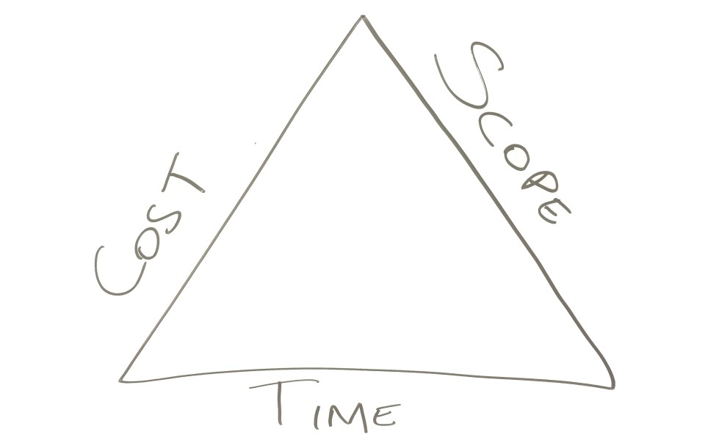
Triple Constraint
Work/Quality
Schedule
Resources

Slide 18
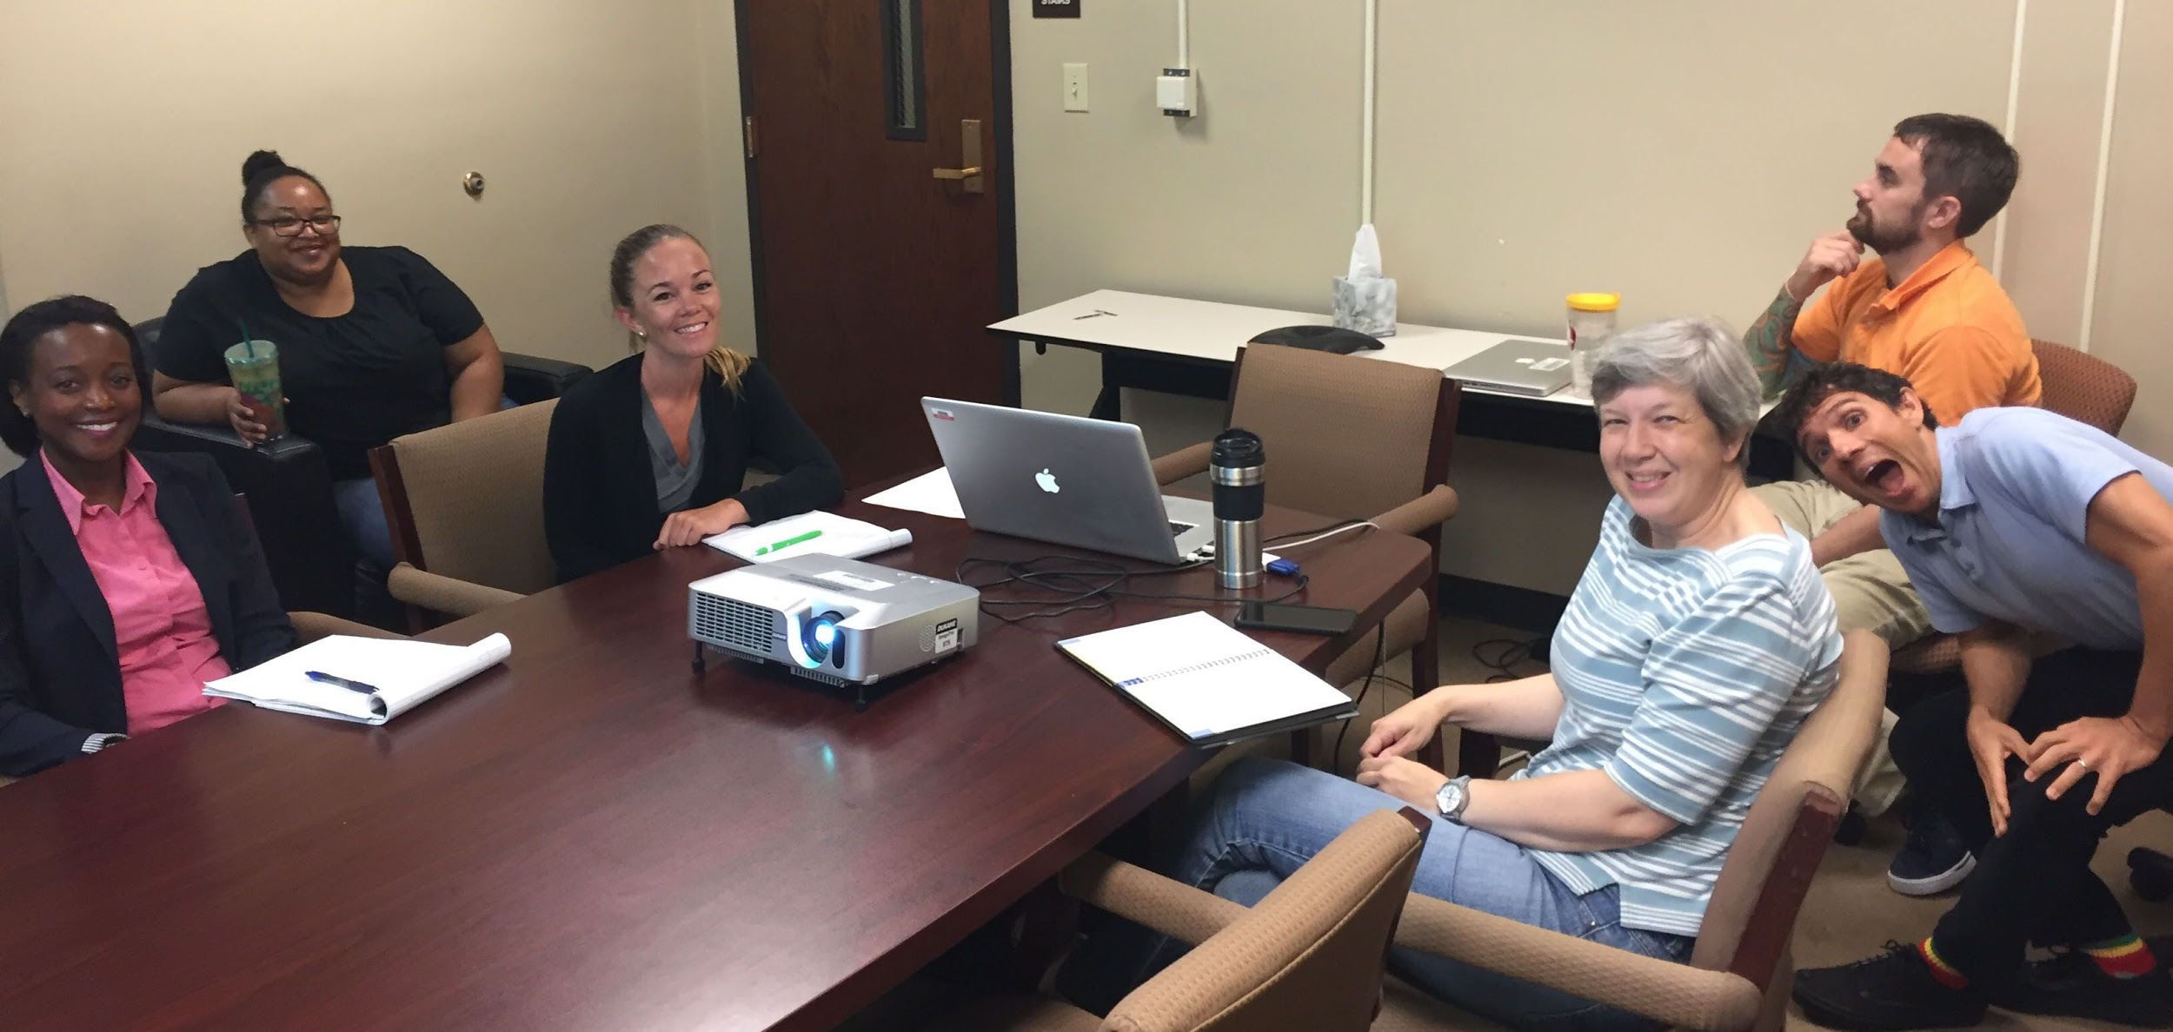
95 Deliverables
3 Phases
Design
Develop
Document

Slide 19
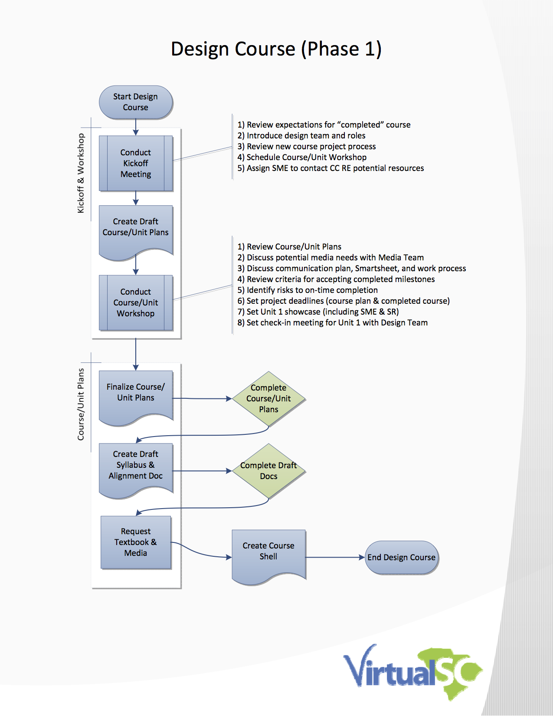
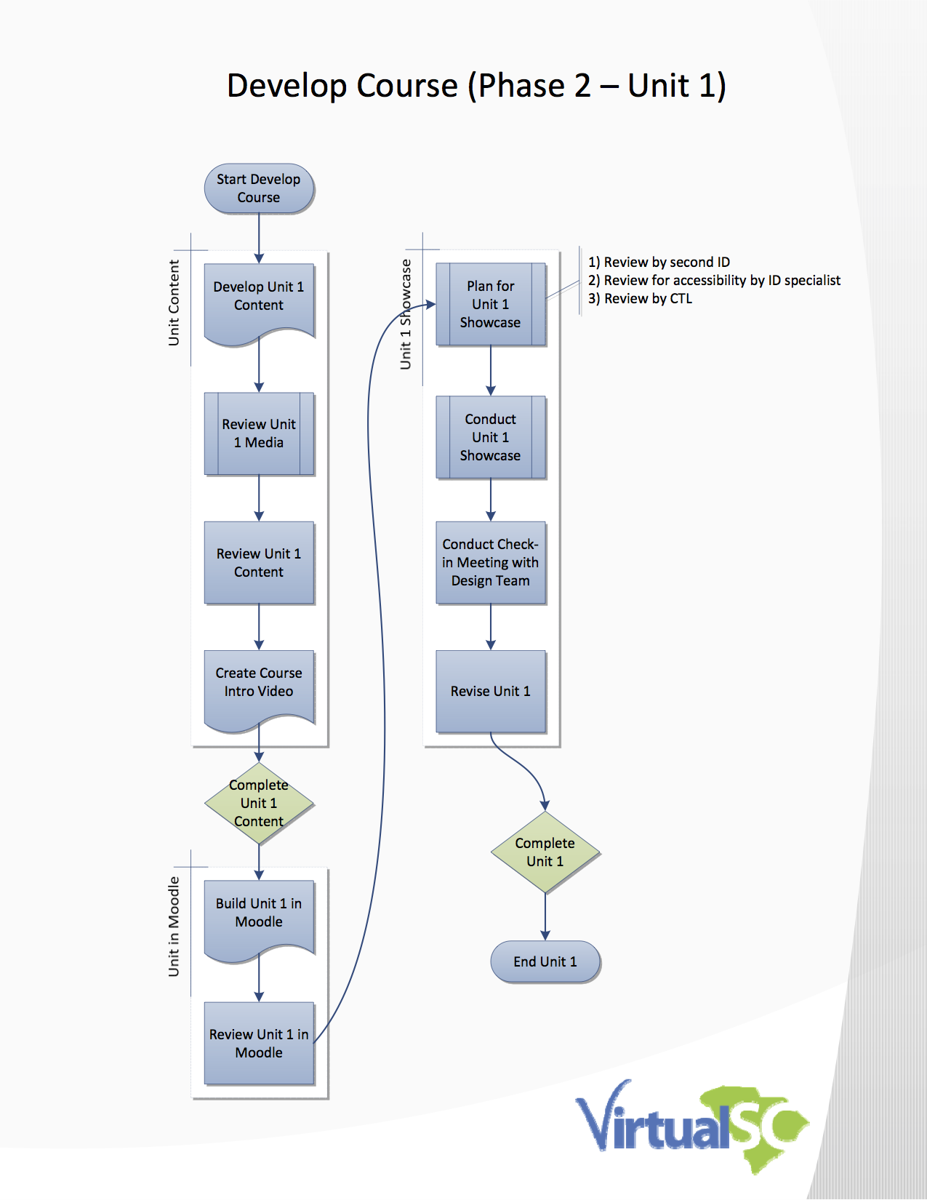

Slide 20
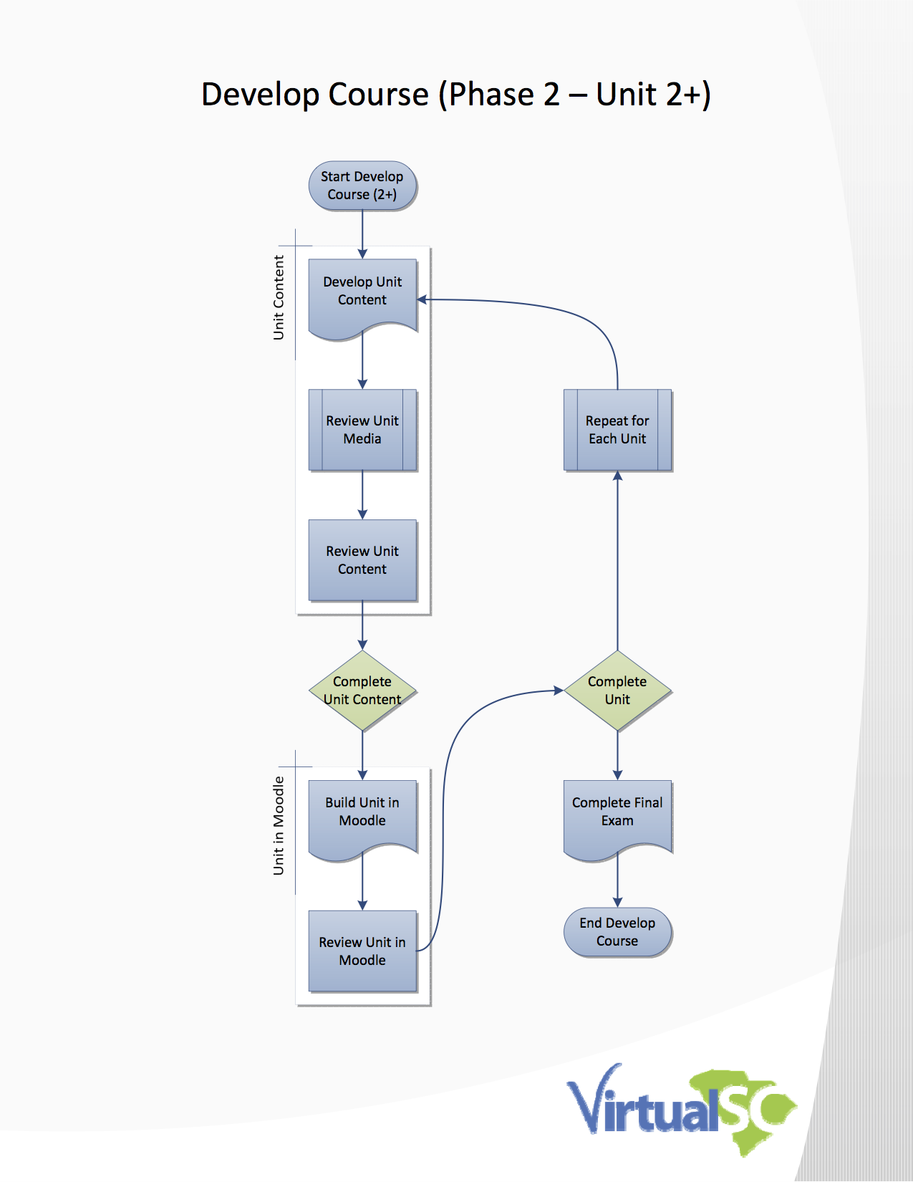
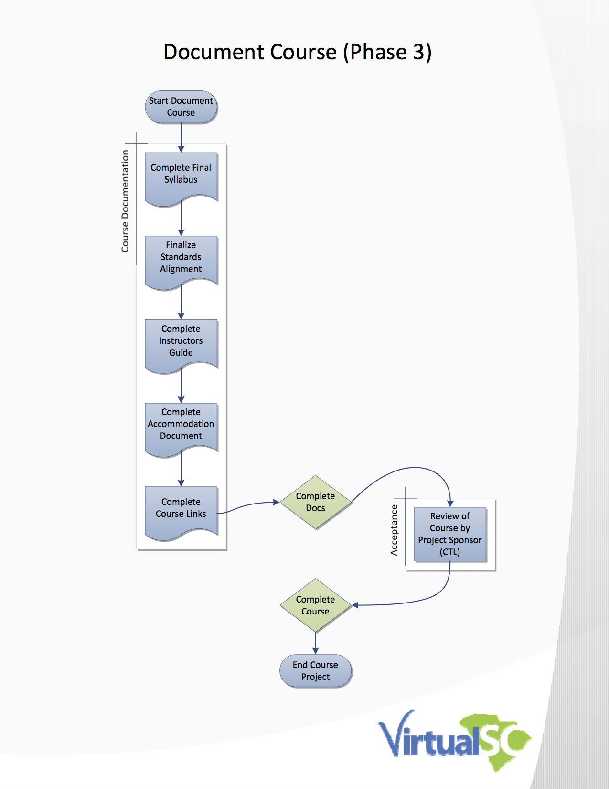

Slide 21
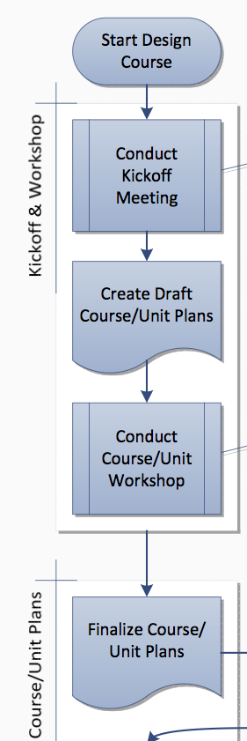
Design Course
Course/Unit Plans
Course Objectives
Final Assessments
Scope/Sequence of Units
Unit Objectives
Unit Assessments
Scope/Sequence within Units
Alignment to Standards

Slide 22
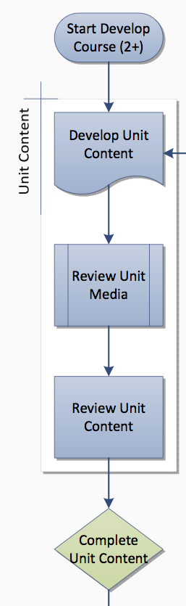
Develop Course
Unit Content
Assessments
Resources
Media
Activities
Tools
Framing for students
Grading Criteria
Instructions for LMS

Slide 23
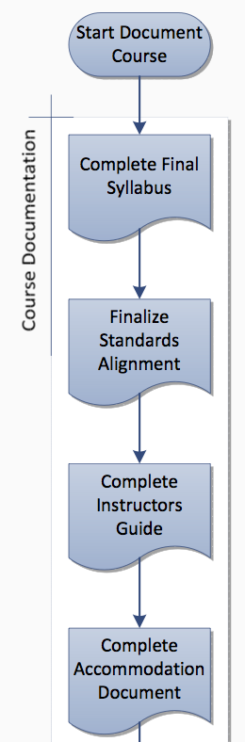
Document Course
Course Documentation
Syllabus
Standards Alignment
Instructor Guide
Accommodations
Course Links

Slide 24

Schedule
Dealing with time

Slide 25
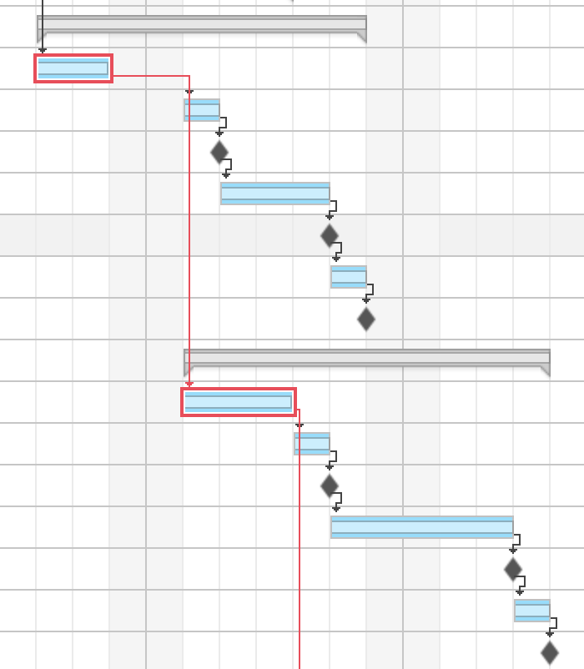

Gantt Chart
Shows project schedule
Marks the Critical Path
… to keep SME working!

Slide 26
Improve course projects?
- In less than 60 seconds … Scope? Schedule? -

Slide 27
IDs as PMs help the team create realistic deadlines and ensure the course project stays on schedule.

Slide 28
50%
Percentage of conflict that arises because of schedules, resources, and priorities.

Slide 29
Managing the Project Team

Slide 30

Who’s on team?
- Subject Matter Expert -

Slide 31
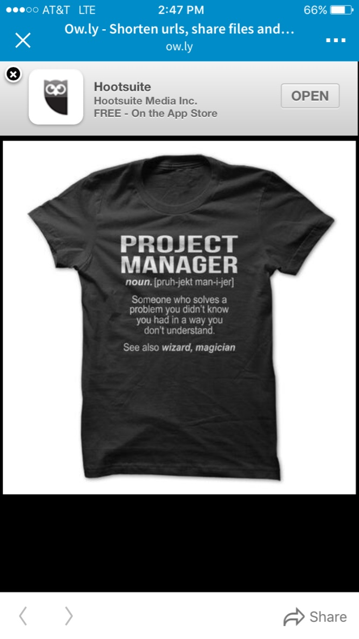
Project Manager
Noun. [pruh-jekt man-ijer]
Someone who solves a problem you didn’t know you had in a way you don’t understand.
See also wizard, magician

Slide 32

Leading a team when you’re not the boss

Slide 33


Slide 34

Project Team
Managing
motivation, power, conflict,
and communication

Slide 35
Develop the Project Team

Slide 36
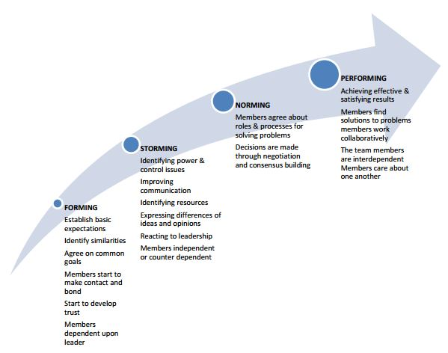
“Ladder of Team Development”
Bruce Tuckman, Developmental Sequence in Small Groups, Psychological Bulletin 63(6), (1965), 384-399.
Judith Stein, Using the Stages of Team Development, Learning & Development, HR at MIT

Slide 37
Tools for Develop Project Team
Five tools:
Interpersonal skills (aka “soft skills”)
Training
Team-building activities
Ground rules
Theories of motivation

Slide 38
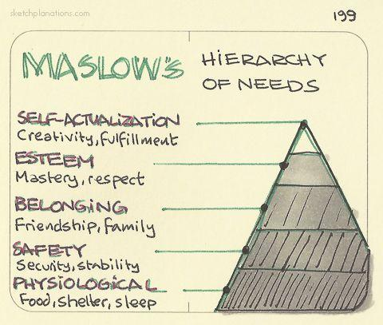
What do SMEs Need?
What do these needs suggest about …
- how we relate to SMEs?
- how we motivate SMEs?

Slide 39
Herzberg’s Motivation-Hygiene Theory
What factors influence satisfaction at work?
Hygiene factors OR Motivation Factors

Slide 40
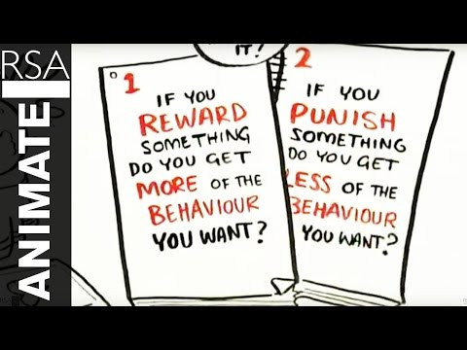
Drive:
the surprising truth
about
what motivates us
by
Daniel
Pink

Slide 41
Manage the Project Team

Slide 42

Forms of Power
Expert
Legitimate
Punishment
Referent
Reward

Slide 43
Tools for Manage Project Team
Five tools:
Interpersonal skills
Communication
Schedule
Constructive and destructive team roles
Conflict management

Slide 44
Constructive and Destructive Team Roles
Initiators
Information Seekers
Blockers
Recognition Seekers
Clarifiers
Withdrawers
Gate Keepers
Dominators
Encouragers
Information Givers
Topic Jumpers
Aggressors
Summarizers
Harmonizers
Devil’s Advocates

Slide 45

Conflict?
Collaboration
Compromise
Forcing
Problem-solving
Smoothing
Withdrawal

Slide 46
Challenging team experience?
- In less than 60 seconds … What takeaway will you try? -

Slide 47
IDs as PMs have limited authority and must influence through listening, persuading, and building trusting relationships.

Slide 48
50%
Percentage of conflict that arises because of priorities, schedules, and resources.

Slide 49
Evaluating Project Deliverables

Slide 50

Quality Assurance
Scope Definition
Acceptance Criteria
Review Procedures
Course Acceptance

Slide 51
Scope
Definition -- What IS a completed course?
Acceptance Criteria -- Does the course meet QUALITY standards?
Backwards-Design
Aligned with standards
VSC Course Template
QM standards
Legal regulations (e.g., copyright)
Accessible and readable
Documentation

Slide 52

Quality Control
Clear design
Well written
Alignment
Assessments
Instructional material
Activities
Tools
Accessibility

Slide 53
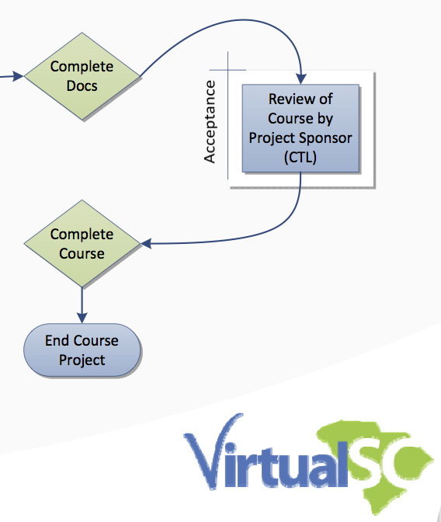
Acceptance
Review by Project Sponsor
___
Completed Master Course
Backwards-Design
Aligned with standards
VSC Course Template
QM standards
Legal regulations
Accessible and readable
Documentation

Slide 54
Quality assurance?
- In less than 60 seconds … How can your process improve quality?

Slide 55
IDs as PMs guide the design team through a review process to ensure the project produces a quality course.

Slide 56

Continuous Improvement
“Continuous improvement is better than delayed perfection” -- Mark Twain
"Quality is not an act, it is a habit.” -- Aristotle
"If you can't describe what you are doing as a process, you don't know what you're doing” -- W. Edwards Deming

Slide 57
Clay Alan Ham
cham@ed.sc.gov

