Slide 1
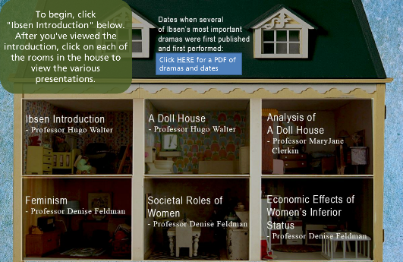


The Importance of Collaborative Multimedia Learning Objects for Learner Interaction and Success in Online Courses
Hugo Walter, PhD
Jarrod Cecere, MS

Slide 2
How Do We Make Lectures More Interesting and Engaging?
“A learning object can be any animation, simulation, homework assignment, video, etc., that enhances the learning process.”
  MERLOT “Multimedia Education Resource for Learning and Online Teaching (MERLOT), http://merlot.org

Slide 3
English Department Learning Objects
The Berkeley College English Department has produced a series of learning objects on important authors.
  Series of coordinated lectures using video, audio, and text.
  Focuses on an author and on one or more literary works.
  Offers a variety of perspectives on the work(s) of an author.

Slide 4
Learning Objects
Encourages the learner to develop critical thinking, reading, and interpretive skills and actively engages the learner in course content.
May be used in multiple English and Humanities courses.
Focuses on the work(s) of an author or on an image, issue, or theme.

Slide 5
Format of the Presentation
Dr. Hugo Walter, Professor of English and Humanities:
  Provide an overview of the development of learning objects at Berkeley College, and will show selections.
  Discuss how learning objects impact learner achievement of the course and module objectives, and actively engage the learner.
Jarrod Cecere, Senior Instructional Designer with the Berkeley College Online Faculty Support Team:
  Discuss the production process and the importance of learning objects in promoting learner interaction and success.

Slide 6
History of the English Department Learning Objects
Series of learning objects on famous authors in British, American, and European Literature:
  1. William Wordsworth (Dr. Hugo Walter)
  2. Edgar Allan Poe (Dr. Rich Schultz, Dr. Mike Jacobs, Dr. Hugo Walter)
  3. Henrik Ibsen (Dr. Mary Jane Clerkin, Dr. Denise Feldman, Dr. Hugo Walter)
  4. Thomas Hardy (Dr. Mary Jane Clerkin, Dr. Hugo Walter)

Slide 7
The Life and Work of Edgar Allan Poe

Slide 8

Henrik Ibsen Learning Object

Slide 9
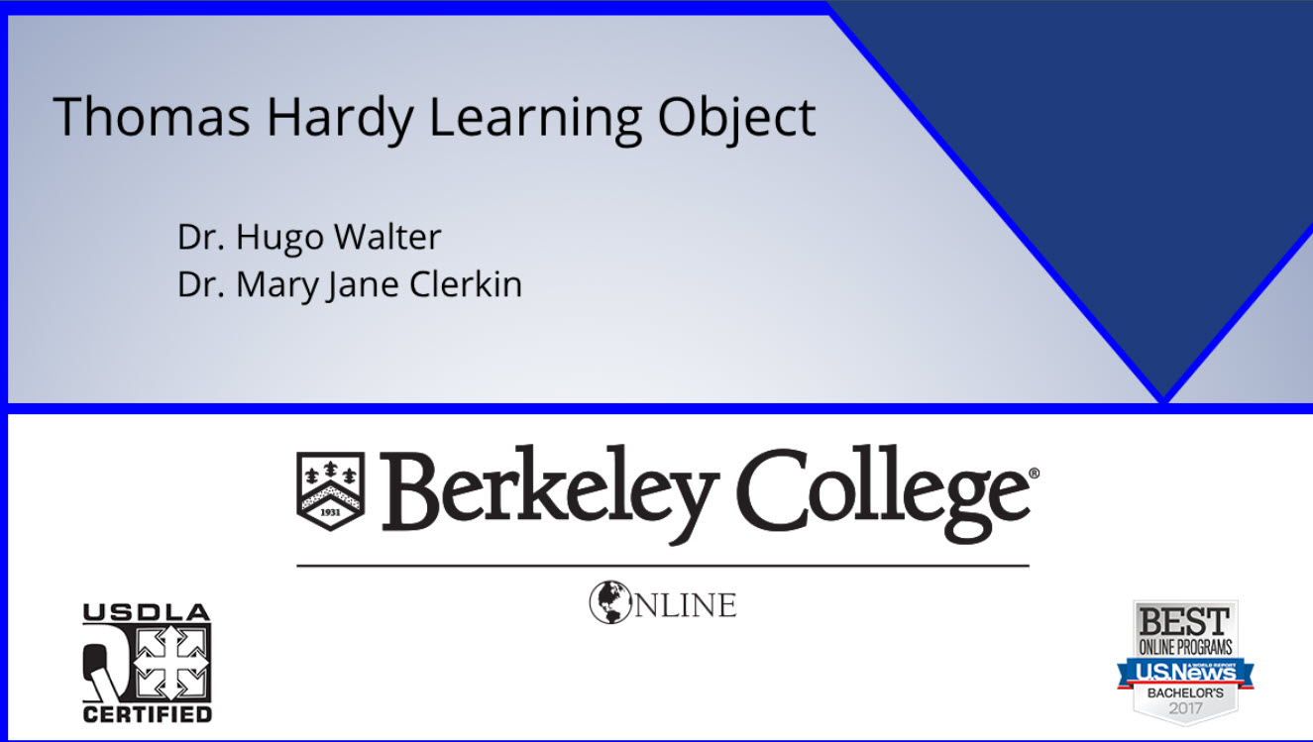
The Life and Works of Thomas Hardy

Slide 10
QM Specific Review Standard 5.1
“The learning activities promote the achievement of the stated learning objectives or competencies.”

Slide 11
Specific Review Standard 5.1 of the QM Rubric and my Art of Poetry Accelerated Online Course
Learning activities align with course and module objectives and actively engage the learner with the course content.
  Weekly class discussions
  Short essay
  Reflective journal
  Research paper

Slide 12
QM Specific Review Standard 5.2
“Learning activities provide opportunities for interaction that support active learning.”

Slide 13
Specific Review Standard 5.2 of the QM Rubric and My Art of Poetry Accelerated Online Course
Learner-content interaction
  Review the E.A. Poe Learning Object
Learner-instructor interaction
  Journal assignment on a major theme in Poe’s poem
  Discussion board assignments
Learner-learner interaction
  Discussion board assignments
  Group Projects

Slide 14
Future Learning Objects
A Learning Object on Great American Women Authors is planned for completion later in 2019.
We are also planning Learning Objects on Great British Women Authors and on Great Canadian Women Authors in the near future.

Slide 15
Production of Learning Objects at Berkeley College
Overview of the production process
How Learning Objects are incorporated into Berkeley College Online Courses

Slide 16
6 Steps to Developing and Implementing a Learning Object
1. Need
2. Brainstorming/Planning
3. Scripting
4. Production (Recording)
5. Post Production
6. Implementation

Slide 17
1. Need
Content you’d like to translate from onsite to online
A concept that reaches across courses and/or disciplines

Slide 18
2. Brainstorming/Planning
Meeting with the Instructional Designer and Instructional Technologist about the material faculty member would like to convey.
Storyboarding
Develop ideas for chunking the material.
Instructional Technologist brainstorms assets.

Slide 19
3. Scripting
Faculty member develops script based on discussion with Instructional Designer/Technologist.
Brevity
ADA Compliance
Used with teleprompter during recording.

Slide 20
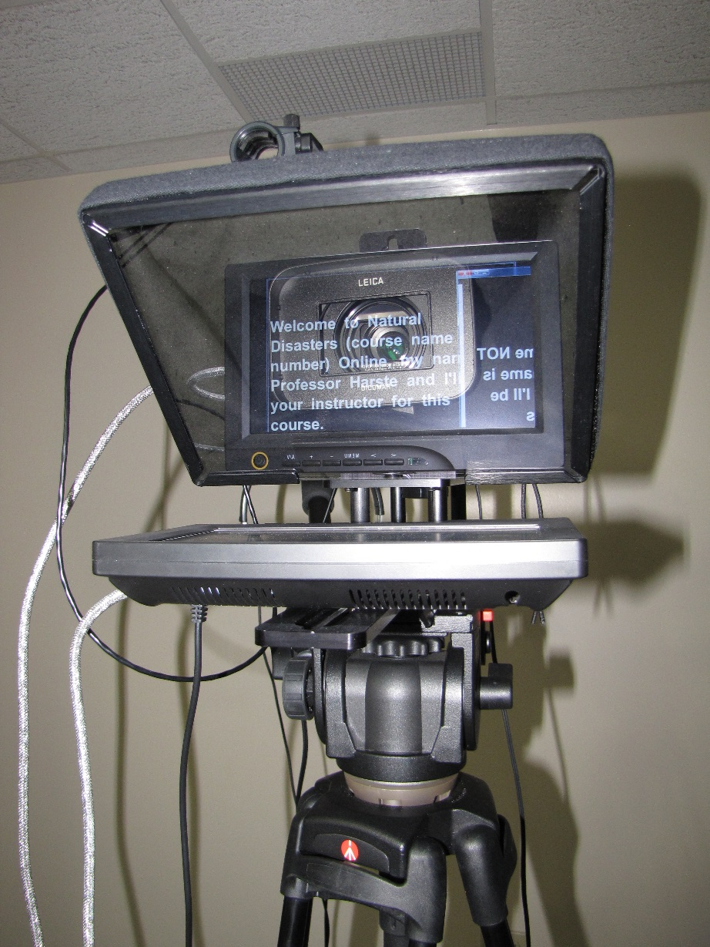
Teleprompter

Slide 21
4. Production
Instructional Technologist records faculty member in studio.

Slide 22
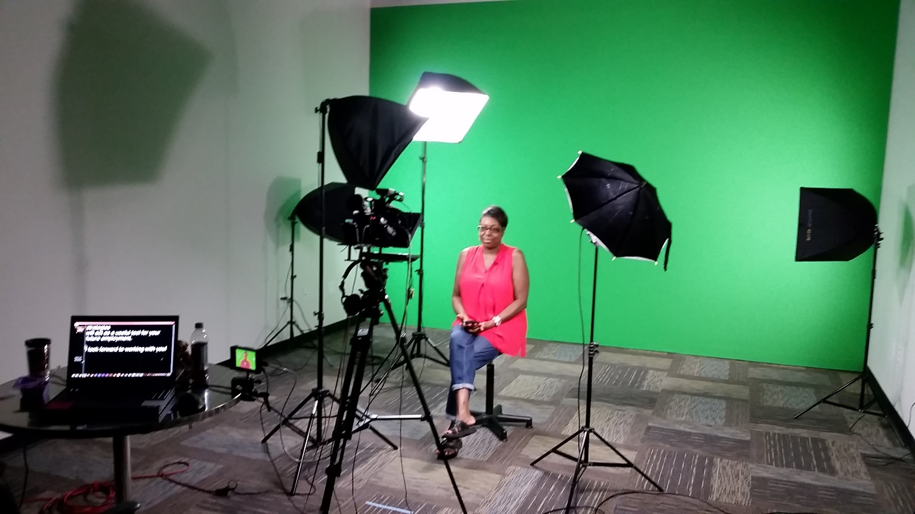
Studio

Slide 23
5. Post Production
Instructional Technologist creates finished video.
Instructional Designer creates Articulate Storyline with Interactive features.

Slide 24
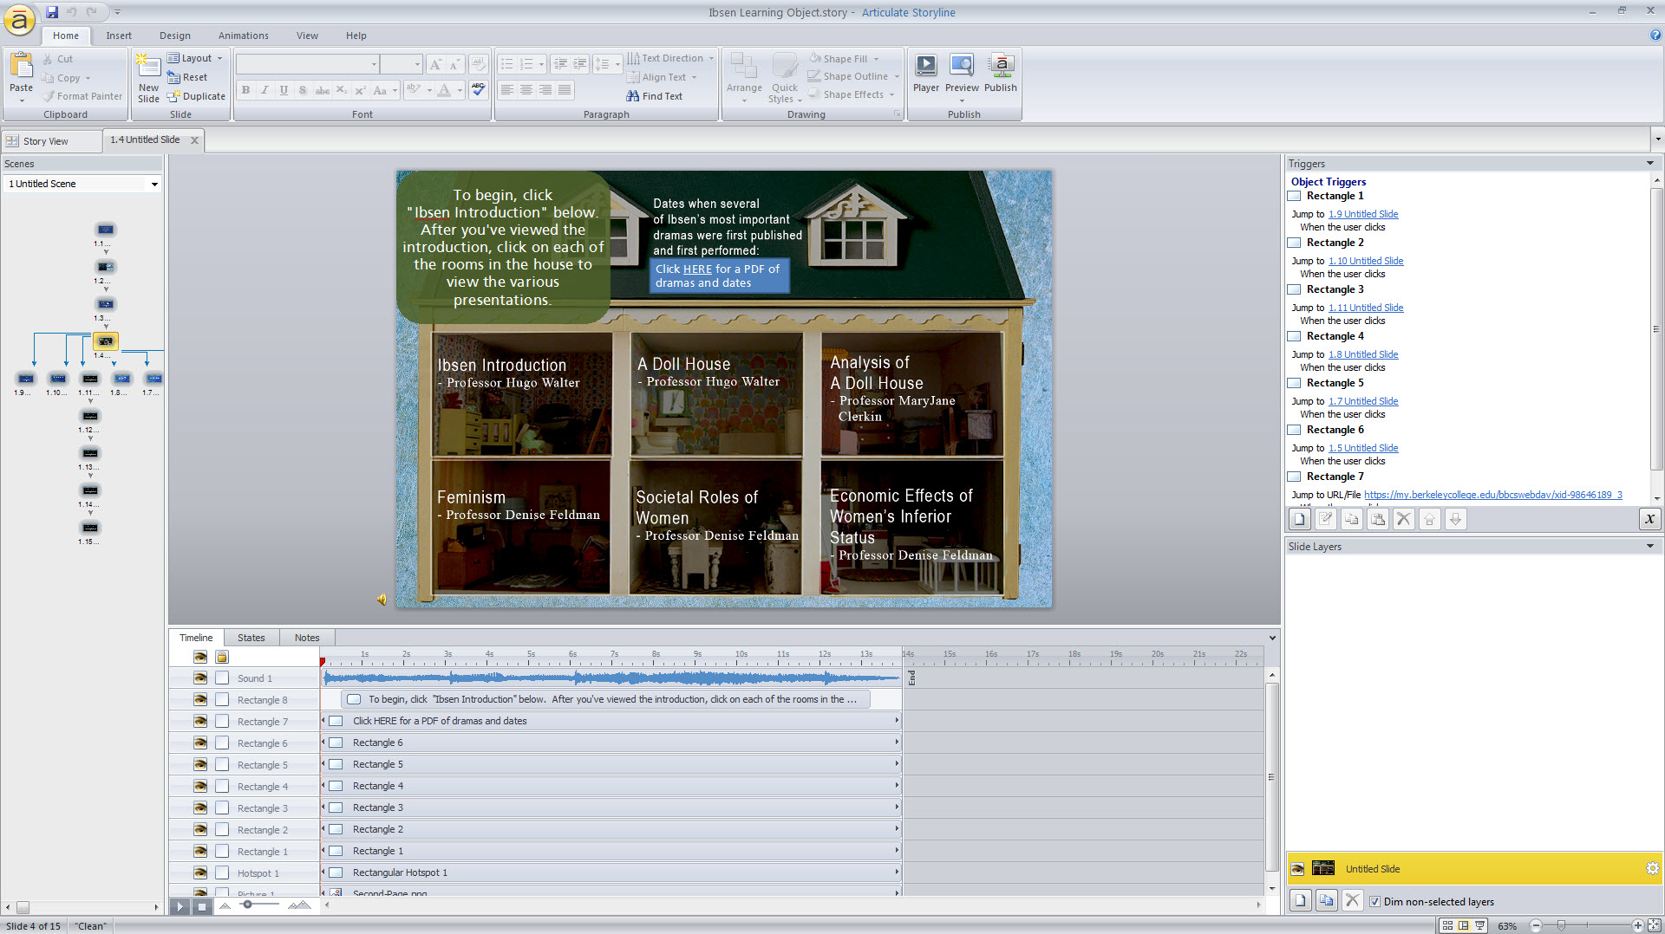
Articulate Storyline

Slide 25
6. Implementation
Link to finished product provided to faculty members who developed Learning Object.
Learning Object placed in courses as requested.
Learning Object Repository?

Slide 26

Questions?

Slide 27
Contact Information
Hugo Walter, PhD
  hgw@berkeleycollege.edu
Jarrod Cecere, MS
  jce@berkeleycollege.edu

