Slide 1


Theory + Practice = Culture of Quality
Flo Wolfe Sharp, EdD
Assistant Dean of Curriculum, Information Technology
Jahna Kahrhoff, PhD
Assistant Dean of Curriculum, Concord Law School & Education and Communication
October 2020
Notes:
Hello, I’m Jahna Kahrhoff and with me today is my colleague Flo Wolfe Sharp. We are both assistant deans of curriculum at Purdue university global, working with different schools. The assistant dean of curriculum oversees curriculum development and maintenance for a specific school or group of programs. Each assistant dean of curriculum works closely with their academic leadership team to plan, schedule, and complete curriculum initiatives to meet the priorities of each school and program. At the same time, we also ensure that our curriculum and innovation policies and procedures are followed.

Slide 2
Agenda
About Purdue University Global
Culture of Quality
Instructional Design Model
Audits
Course Metrics
Developing quality operating procedures
Notes:
Today, Flo and I would like to tell you about our Purdue University Global and what drives our culture of quality, as it relates to curriculum development and maintenance. Flo will talk about our instructional design model and how we use audits and checklists to track quality measures. After that, I will share how we use course metrics to further support our approach to quality. As we share, I invite you to think about the key drivers at your institution and how you can use them to monitor quality.

Slide 3
Outcomes
Describe the importance of integrating quality into design and development processes.
Identify factors that drive the creation of a culture of quality.
Evaluate practical ideas for developing and implementing quality operating procedures and checklists.
Notes:
By the end of our presentation, we hope that you will be able to describe the importance of integrating quality into design and development processes. Identify factors that drive the creation of a culture of quality. And evaluate practical ideas for developing and implementing quality operating procedures and checklists at your institution.

Slide 4
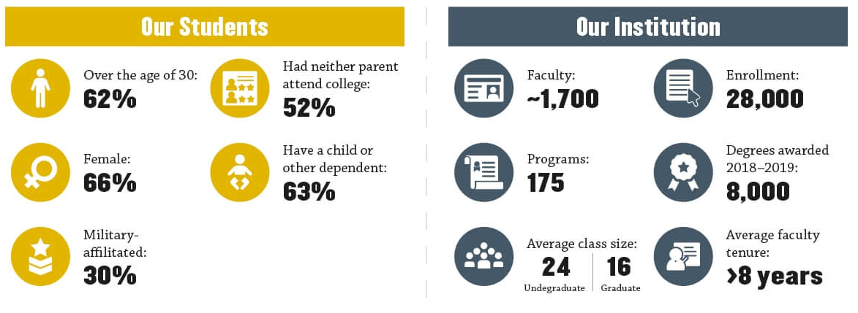
About Purdue University Global
Notes:
Purdue Global is a public, nonprofit university focused on providing a personalized online learning experience. We trace our roots to 1937 when we started out as postsecondary school providing training to underserved job seekers after the Great Depression. Over the years since then we evolved into Kaplan University, a name that is probably familiar to many of you, and we transitioned into a fully online institution. In early 2018 Kaplan University was acquired by Purdue University, forming a new institution called Purdue University Global.

Slide 5
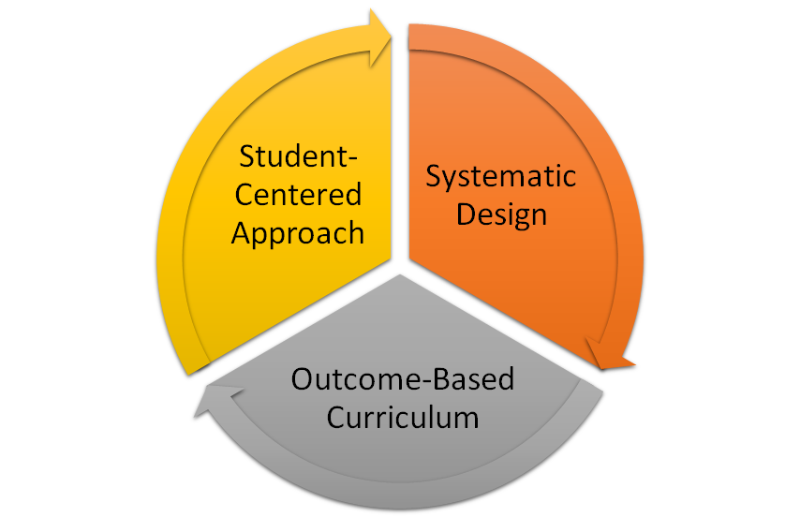
Culture of Quality at Purdue Global
Key Drivers
Notes:
Purdue Global is committed to a quality learning experience that is rigorous, engaging, and adapted to the needs of adult students. For us, having a culture of quality, means that everything we do in curriculum is designed to support that commitment.
There are three key drivers that inform how we design and manage our curriculum, how we integrated quality into our processes, and how we monitor quality on an ongoing basis. These are systematic design, outcome-based curriculum, and a student centered approach.
What are the key drivers at your organization? Go ahead and type them in the chat and write them down on a sheet of paper, we’ll come back to them later.

Slide 6
Research-Based Instructional Design Process
Motivation
Contextualization
Prepare
Practice
Perform
Notes:
Our instructional design process is grounded in learning science: We link theories of learning to the practice of designing and implementing learning solutions. The foundations for our instructional design process rely on three key elements: cognitive science (receiving information from the environment and creating meaning through processing, structure, and storage); adult learning theory (adult learners are self-directed, seek control over the learning experience, build off accumulated knowledge and experiences, are intrinsically motivated, and prefer problem-based or experiential learning they can apply immediately); and online learning theories that draw from behaviorism, constructivism, and transformative learning (chunking of information, relationship building, active participation, problem solving, student engagement and metacognition, student-student/student-content/student-instructor interaction).
The process also Incorporates motivation and contextualization:
Motivation: Building on that intrinsic motivation that is a characteristic of adult learners, we employ strategies that help provide Relevance, promote Confidence, and promote Satisfaction in learning.
Contextualization: The aspect of contextualization is closely linked to motivation, and focuses on authenticity of real-world contexts for adult learners. In our assignment descriptions and other learning materials, we refer to the reasons for the content; the tone is positive, encouraging, and conversational, and we encourage students to draw on prior experiences in their participation in the course. In addition, we leverage contextualization in three specific ways:
Prepare: This consists of content students need to learn to meet the learning objectives. “Nice to know” information is minimized; learner’s attention is drawn to critical elements; we may employe multimedia elements or interactive materials to present information. This includes readings, videos, worked examples, and other materials that scaffold student learning.
Practice: These are opportunities to practice new knowledge and reflect on it; practice activities are aligned to the outcomes and match the assessment activities. Students receive feedback on practice to help them develop the proficiency they need to successfully complete the assessment.
Perform: This is the summative assessment for the learning outcome. The format may vary (papers, journals, tests, labs, etc.), and aligns with objectives; detailed scoring rubrics are provided for all assessments and align with objectives; feedback is aligned with criteria in objectives and in rubric

Slide 7
ADDIE: Systematic & Collaborative Course Design
Analysis
Design
Development
Implementation
Evaluation
Course metrics
EOT Surveys
CL Meeting
Currency
Known Issues
Outcome mapping
Course design plan:
Content
Media
Assignments
Rubrics
Development guide
Content
Media
Assignments
Rubrics
Editorial
Hand-off to production
Audit
Migration
Three term report
CL Meeting
Chair, CL, Faculty, ADoC, CS
SME, CL, CS
SME, CL, CS
C&I Team
SME, CL
Chair, CL, Faculty, ADoC, CS
Notes:
Our process follows a traditional ADDIE approach. As you can see, we have multiple levels of collaboration throughout the process. This graphic shows how the ADDIE approach works in our environment. It’s this systematic process that allows us to emphasize course quality throughout the lifecycle.
We conduct an a ongoing analysis of student learning and course performance, which helps inform scheduling and overall project
goals. A range of course metrics - both quantitative, such as failure rates and GPA, and qualitative, such
as student end of term comments - are collected, reviewed, and analyzed for trends and outliers.
As we move through the development process, all course content undergoes several phases of review to ensure accuracy
and alignment with the university’s style requirements. This includes review before and after the course build by multiple parties.
We’ll look at those reviews, or audits, in just a moment.
First, let me introduce you to our team structure, so you can understand the levels of involvement in our course development process:
Our teams consist of the Curriculum Specialist, who lead the project; shares course data and statistics with the team; and provides instructional design expertise.
Course Leads or Subject Matter Experts are typically faculty qualified to teach the subject, and preferably with industry experience, who create the course content (assignments, readings, learning activities, discussions, etc.).
The Department Chair who is responsible for the content area.
The Assistant Dean of Curriculum, who manages the curriculum team for the school; and the Associate Dean, who manages the academic team for the school.
Media Developers, LMS Developers, and Editors who all contribute to producing the fina course.

Slide 8
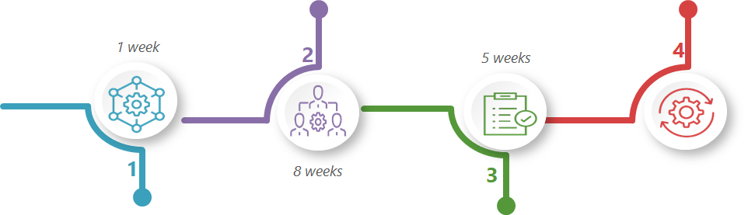
FULL REVISION: 14 Weeks
Ongoing Maintenance
Metrics Review
Three-Term Report
CL Annual MCO Checklist
Course Issues
Design and Development
Kickoff Meeting
Design/Develop/Review/Revise
Final Review
Analysis: Preparation and Planning
Prepare and review course data (starts 3 weeks prior to kick-off)
Planning Meeting
Implementation
Editorial
Production
Audit
Migration
Notes:
We have multiple timelines for revisions, based on how extensive the work is. A Full revision, which equates to either a new course or a course with more than 40% of the content changing, takes about 14 weeks. This image shows how the instructional design process aligns to the revision cycle.
We also have shorter timelines for minor changes, such as replacing a textbook or updating 3rd party tool links, that have further affect on course content.
Regardless of the length of the timeline, we still follow the same design approach. Because of the systematic nature of that process, analysis and design phases overlap as the outcomes of the analysis phase are used to make decisions in the design phase. In turn, the design phase consists of several decision points: confirming the instructional objectives for each course-level outcome, designing assessments that measure the outcome, sequencing the course content to align with the assessments and the learning objectives, designing appropriate content to scaffold learning, and choosing media that support all instructional decisions.
So let’s break down some of those processes, especially in the Implementation and Evaluation stages, that help us focus on the quality of our courses.

Slide 9
Audits
Pre- and post-production audits
  Team final review
  Curriculum specialist final review
  Editorial review
  Production audit
  School Audit
Notes:
We use multiple audits both pre and post production that help us look at a broad spectrum of quality indicators in our courses. These audits ensure we have multiple sets of eyes on every course, each looking at the course from different perspectives, but with the same benchmarks in mind.
Team Final Review: All members of the development team (CS, CL, chair, ADoC, etc.) are invited to review the completed dev guide and materials.
CS Final Review: CS finalizes any changes from the team review and prepares the final draft of the dev guide.
Editorial Review: The editorial team reviews the dev guide and any ancillary materials for grammar, spelling, mechanics, and compliance with SOPs and APA guidelines.
Production Audit: The production team conducts a peer audit of the completed course in the LMS.
School Audit: The course in the LMS is turned over to the school for review. The CS and CL are required to complete this review; school leadership may also participate. Comments are tracked in an audit sheet (EX: https://docs.google.com/document/d/1Do1PusoayNMupervM98AUHdOfS7CbgY5W_dEOGH8d14/edit?usp=sharing)

Slide 10
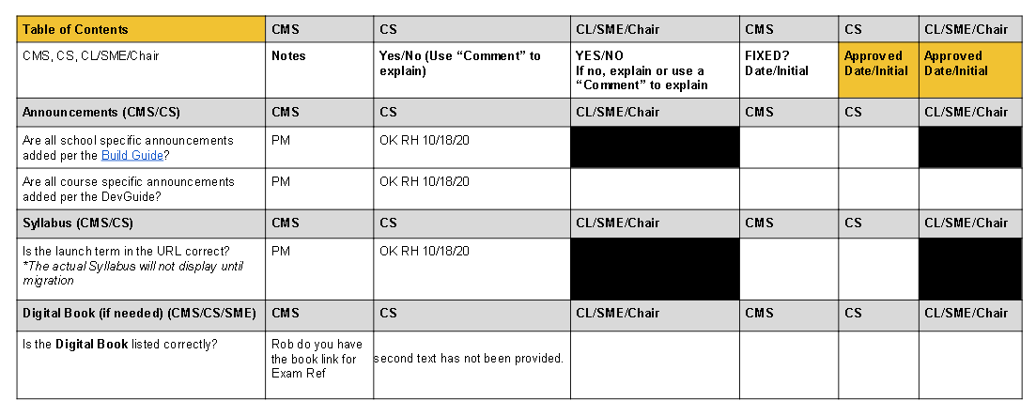
Notes:
This is a snippet of our post-production checklist.
The project team, comprising the CMS Developer, CS, SME or CL, and school leadership, use a standard and consistent
audit checklist during all revision work. The audit checklist ensures all team members conduct a comprehensive
review of all content, technology, and learning management system functionality within a course. Curriculum,
production, and the SME/CL must complete the audit checklist before Purdue Global releases a revision or new
course for student use.
The form used aligns to the build guide and development guide. The reviewers simply follow the checklist to make sure the Master Course Offering aligns with the documents the CS submitted. Each reviewer initials and dates the form to indicate the review was done.

Slide 11
Audits
Course Lead audits
  Entire Master Course Offering
  Resources only
Notes:
Course leads are responsible for another level of audit that takes place after the course is in use. Course Leads are faculty who are experts on a given course, and take responsibility for its ongoing review and maintenance.
To ensure that the content is current and accurate, CLs complete two audits per year. Curriculum provides checklists and guidelines for these audits to help faculty identify issues.
Entire MCO: The MCO is our master course in the Learning Management System. CLs check all course content including labs, links, and materials. They ensure everything is correct, current, and functioning.
Resources only: Using the MCO, CLs check resources only: readings, library materials, third-party resources. In addition to using the checklist, they contact publishers to learn of any pending updates. (EX: https://docs.google.com/forms/d/e/1FAIpQLScdLkjvkJwLuzdkqrXVTSqWvRUzKge7Km5nzGOqMUhsuWh9ig/viewform)
Course Leads also communicate back to Curriculum any course issues that arise. In addition, they hold quarterly meetings with faculty teaching their assigned courses to assess the course from teaching and student perspectives, share data metrics and survey results, and discuss recent updates.

Slide 12
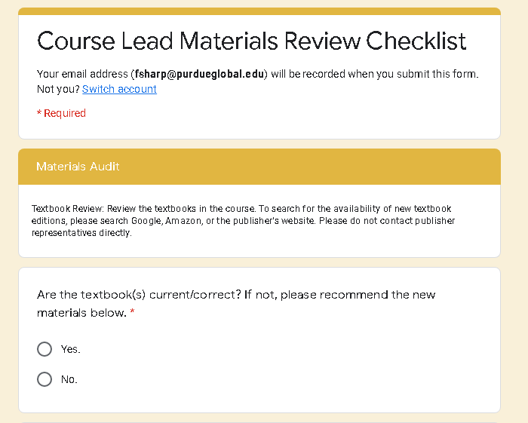
Notes:
This is an example of the materials audit checklist. We use a Google form, and the course lead simply follows the prompts to review the course materials and ensure they are current. The Course Lead is also asked to contact textbook and lab publishers to see if a revision or new edition is expected. This information helps us plan ahead for revisions to ensure students are receiving the latest material possible.
Any questions about either the instructional design or audit processes?

Slide 13


Course Metrics
Master Report
  Course-level metrics by term
Gradebook Report
  Course-level metrics by course unit
3-Term Report
  Data before and after each revision
Qualitative Data
  EOT Surveys
  Course Lead Notes
Continuous Improvement through Evaluation
Notes:
Like our various audits, we have multiple tools for gathering evidence about student success.
To understand how students are performing in the course, and especially how well they are achieving the stated learning outcomes, we look at a variety of metrics that are collected about each course. These metrics include quantitative metrics such as average course level assessment scores and average grades per unit; as well as qualitative metrics, such as feedback from our Course Lead and faculty, and student feedback on the end-of-term surveys.
The reports have been developed by the University’s assessment and research teams, in collaboration with curriculum to make sure we are collecting the right information and presenting it in a way that is useful for monitoring quality.

Slide 14
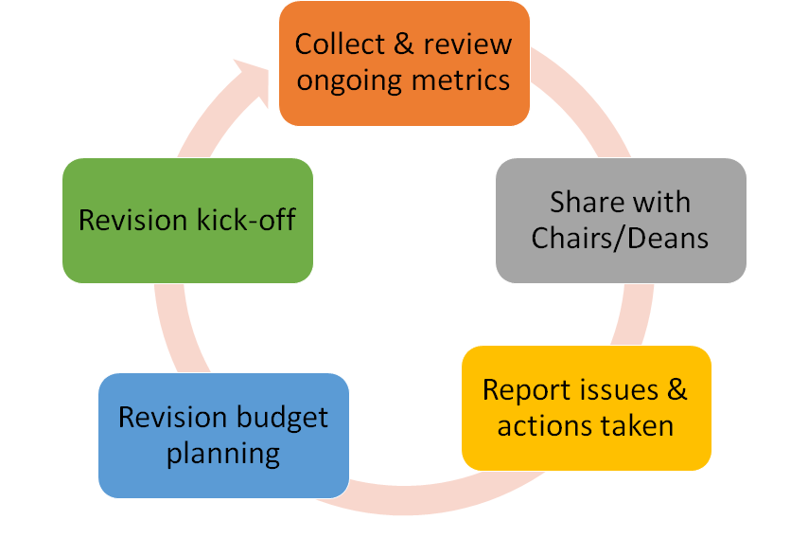
Course Metrics Review Cycle
Notes:
The metrics are reviewed by the assistant deans of curriculum, course leads, department chairs, and others an on-going basis and use the results to help make decisions about programs and courses.
Data serves as a catalyst for analysis and discussion about the quality of course, but we recognize that there are many other factors that impact student success. Data is analyzed by multiple stakeholders to identify areas of strength and opportunity in student performance and course quality. However, we never make curriculum decision based on data alone.
Metrics are collected and reviewed at the end of each term, which allows us to identify trend and low performing courses.
Courses that have been revised are reviewed three terms after the revision and compared with metrics from before the revision.
Metrics are also reviewed as part of the annual budget process, when we are deciding which courses to revise, how critical a revision might be.
Finally, course metrics are discussed with the Course Lead at the start of a full course revision to give insight about changes that need to be considered for specific units or assignments.

Slide 15
How Will You Implement Quality?
Think about your key quality drivers
How will you use those drivers to implement quality operating procedures and checklists?
Notes:
We started this presentation talking about our key drivers and we have shared with you how we build quality into the systematic design, our template, and development process to make sure the same level of quality is inherent in each master course, that our curriculum model focused on measurable learning outcomes and best practices for student learning.
I would like to open the chat for your ideas on how you will use your key drivers to drive and monitor quality.

