Slide 1
This One is Going to Need Some Work:
Building Relationships Through Difficult Conversations

Slide 2
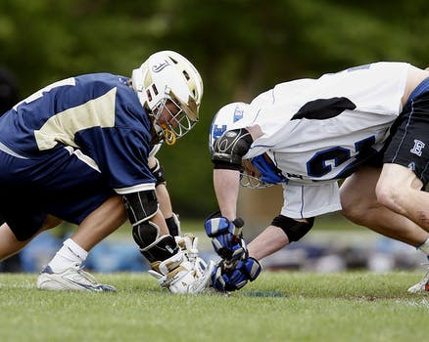
Confrontation

Slide 3

Build a Bridge

Slide 4

Let Them Drive

Slide 5

Start With The Good

Slide 6

Point Out Opportunities

Slide 7

Use Teaching Moments

Slide 8

Leave the Interaction Open

Slide 9

Build Your Path

Slide 10

How’d It Go?

Slide 11
This One is Going to Need Some Work:
Building Relationships Through Difficult Conversations
Lucy Gray Kefauver
lucy.kefauver@westliberty.edu
All images used have a Creative Commons license and are free for personal and commercial use without attribution.

