Slide 1

Tools for Infusing QM Standards into the Course Development Process
freepik.com

Slide 2
UMB Graduate School Snapshot
100% online courses (~70)
QM quality standards
Blackboard – Storyline, video, hyperlinked resources
IDs support course design
IDs develop “live” courses
Notes:
In an effort to assure quality across a newly established online initiative, the Graduate School’s instructional design staff have developed and are implementing a set of Quality Matters compliant course design tools. The Graduate School online program began in 2014 and currently comprises about 50 active graduate-level courses. All courses are delivered via Blackboard and include a mix of text, interactive Storyline modules, video, and various hyperlinked resources. The instructional design team routinely assists individual faculty members with designing their courses and also with developing the finalized “live” courses in Blackboard.

Slide 3

Quality Goals
>85% QM compliant
Notes:
Quality Matters was adopted at the outset for the development of the Graduate School’s online offerings. The goal was, and remains, an 85% or better initial compliance with the QM essential standards and, by the third offering, the same level of compliance with all QM review standards. Throughout the course design process, IDs and faculty strive to design courses with specific quality characteristics, including objective-assessment alignment, course outcome-module objective alignment, and learner-focused course activities that enable constructivist learning. Faculty are also encouraged to be responsive to students when giving assignment feedback and to actively engage in discussion forums.

Slide 4
Quality Goals
  Ensure alignment:
  Objectives Assessments Resources
Notes:
Quality Matters was adopted at the outset for the development of the Graduate School’s online offerings. The goal was, and remains, an 85% or better initial compliance with the QM essential standards and, by the third offering, the same level of compliance with all QM review standards. Throughout the course design process, IDs and faculty strive to design courses with specific quality characteristics, including objective-assessment alignment, course outcome-module objective alignment, and learner-focused course activities that enable constructivist learning. Faculty are also encouraged to be responsive to students when giving assignment feedback and to actively engage in discussion forums.

Slide 5
Quality Goals
  Ensure alignment:
  Objectives Assessments Resources
  Promote learner-centric lesson development
Notes:
Quality Matters was adopted at the outset for the development of the Graduate School’s online offerings. The goal was, and remains, an 85% or better initial compliance with the QM essential standards and, by the third offering, the same level of compliance with all QM review standards. Throughout the course design process, IDs and faculty strive to design courses with specific quality characteristics, including objective-assessment alignment, course outcome-module objective alignment, and learner-focused course activities that enable constructivist learning. Faculty are also encouraged to be responsive to students when giving assignment feedback and to actively engage in discussion forums.

Slide 6
Quality Goals
  Ensure alignment:
  Objectives Assessments Resources
  Promote learner-centric lesson development
  Encourage active learning
Notes:
Quality Matters was adopted at the outset for the development of the Graduate School’s online offerings. The goal was, and remains, an 85% or better initial compliance with the QM essential standards and, by the third offering, the same level of compliance with all QM review standards. Throughout the course design process, IDs and faculty strive to design courses with specific quality characteristics, including objective-assessment alignment, course outcome-module objective alignment, and learner-focused course activities that enable constructivist learning. Faculty are also encouraged to be responsive to students when giving assignment feedback and to actively engage in discussion forums.

Slide 7

Challenge
Professional development
  Applying QM Rubric
  Pedagogy
  Best practices for teaching online
Notes:
The challenges to ensuring quality course development are multi-faceted. While some faculty are experienced classroom teachers and others are novices at both face-to-face instruction and online learning, few if any had formal training in current pedagogic practices that would help to approximate QM implementation in their courses. In addition, few faculty had experience using Blackboard (or other LMSs) or were familiar with Blackboard’s features and how they might be utilized to deliver active learning. Compounding this situation was the fact that many faculty felt they were already over-scheduled with existing duties, and so adding formal training in current instructional design and pedagogic practices is viewed by many as unreasonable. Also, there are few institutional incentives for faculty that serve to prioritize quality course design or instructional practices.

Slide 8
Solution
Encourage faculty to use course design tools
Blackboard Course Template
Syllabus Template
Course Planning Storyboards
90 min. self-paced course on pedagogy, online T&L
1:1 Faculty and ID consults as needed
Notes:
Given the established goals and the associated challenges in developing the Graduate School’s online stable of courses, the IDs set about developing a set of tools to assist faculty in planning high quality, QM compliant courses. The tools include a Blackboard course template, a syllabus template, and an evolving series of course design worksheets that guide faculty during the course design process. The course design worksheets began as simple checklists of required course elements and then evolved through several iterations of single and multi-stage storyboards. These existing tools have been tried and successfully tested as a means of infusing QM standards into courses designed and delivered by faculty who have minimal formal pedagogic training or online course design experience.

Slide 9
Blackboard Course Template

Slide 10
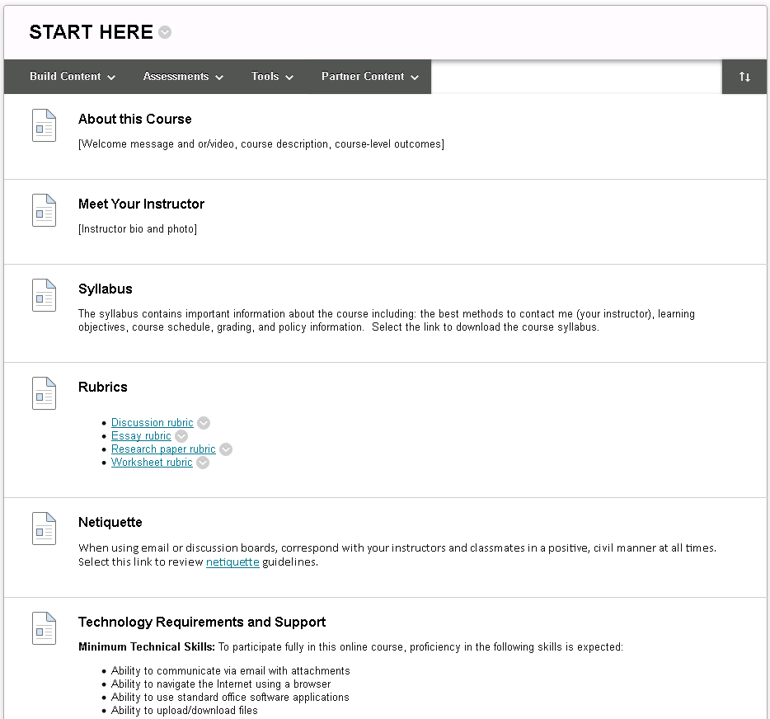
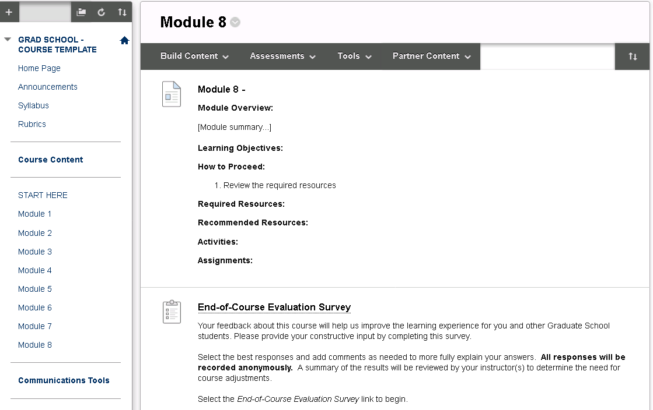
Blackboard Course Template

Slide 11
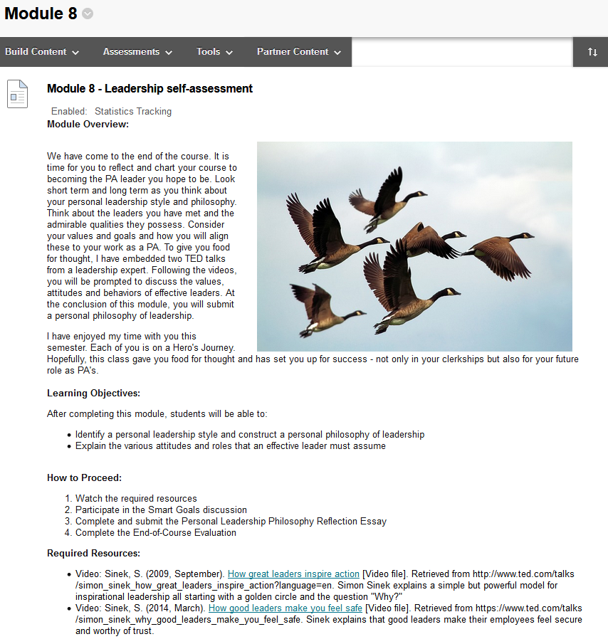
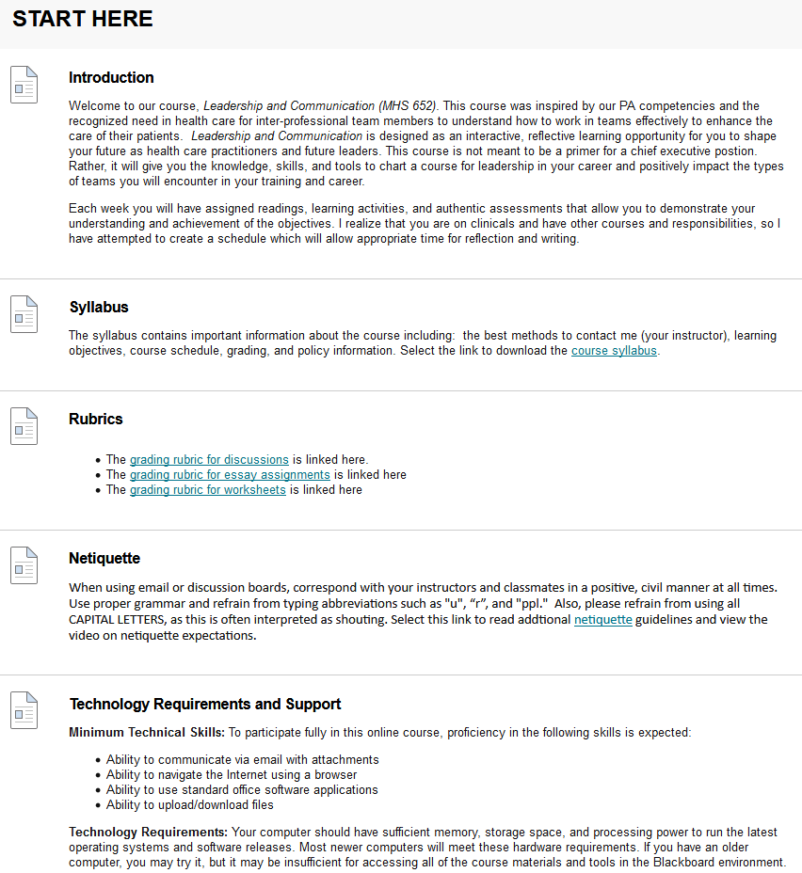

Slide 12
Blackboard Course Template
Blackboard Course Template
Provides…
  Purpose and structure of course (1.2)
  Online etiquette (1.3)
  Evaluation criteria (rubrics) (3.3)
  Citations of instructional materials (4.3)
  Course tools for learner engagement (6.1)
  Accessibility features (7.2)
  Tech support (7.1)
  Logical course navigation (8.1)

Slide 13
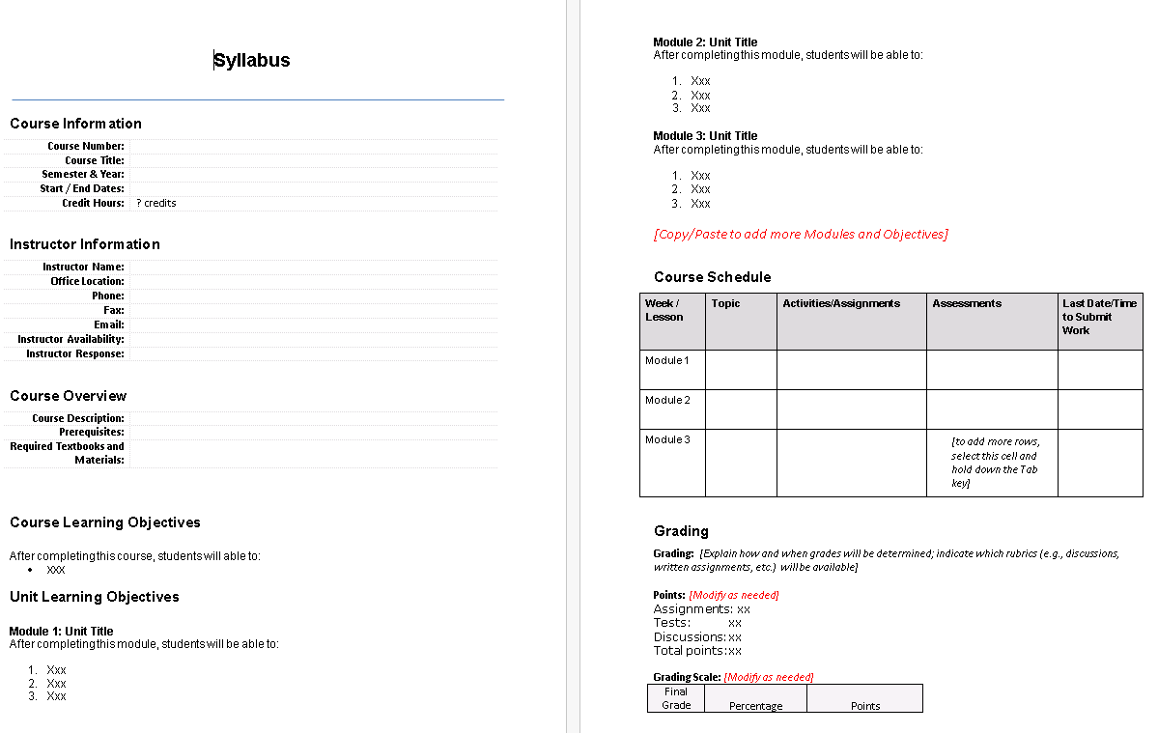
Syllabus Template

Slide 14
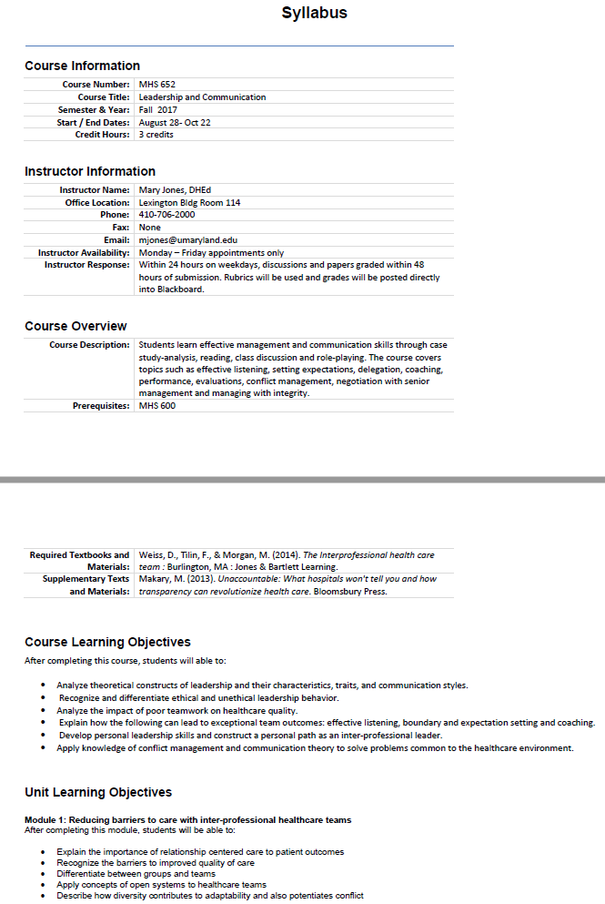
Syllabus Template

Slide 15
Syllabus Template
Provides…
  Course purpose & overview (1.2)
  Summary of course schedule, activities, & assessments (1.2)
  Course outcomes and module objectives (2.3)
  Grading policy (3.2)
  Learner feedback response time (5.3)
  ADA Accessibility (8.2)

Slide 16
Course Planning Storyboard

Slide 17
Course Planning Storyboard: An Evolution
List of course requirements
Storyboard Table
3-Phase Storyboard
Cloud-based Database

Slide 18

List of Requirements
To Do:
Kickoff Meeting
Prepare course introduction
Prepare course outcomes
Prepare module objectives
Prepare assessments
Identify course reading materials
Complete syllabus

Slide 19
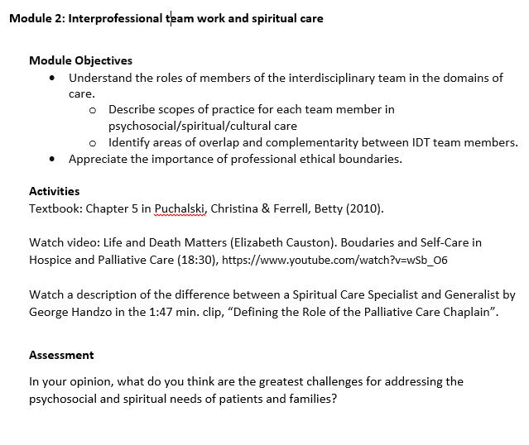
List of Requirements

Slide 20

List of Requirements
Easy to create
Poor alignment
Numerous missing elements
Difficult to assess plan’s quality
Need in-depth understanding of QM for good design
Notes:
The list of requirements is easy to create and to share. Without extensive faculty training prior to completing the list, poor overall QM compatibility of a course planned with this method is likely. Often, this method results in poor alignment and numerous missing elements such as course outcomes, module objectives, assessments, activities, and/or resources.

Slide 21
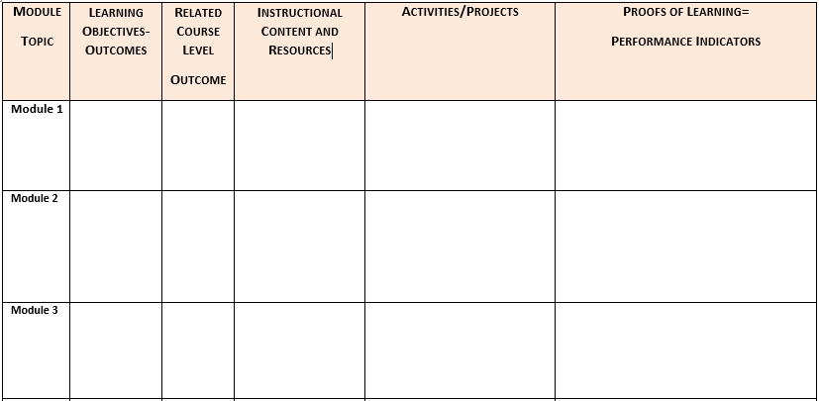
Storyboard Table
*Developed by Anne Arundel Community College

Slide 22
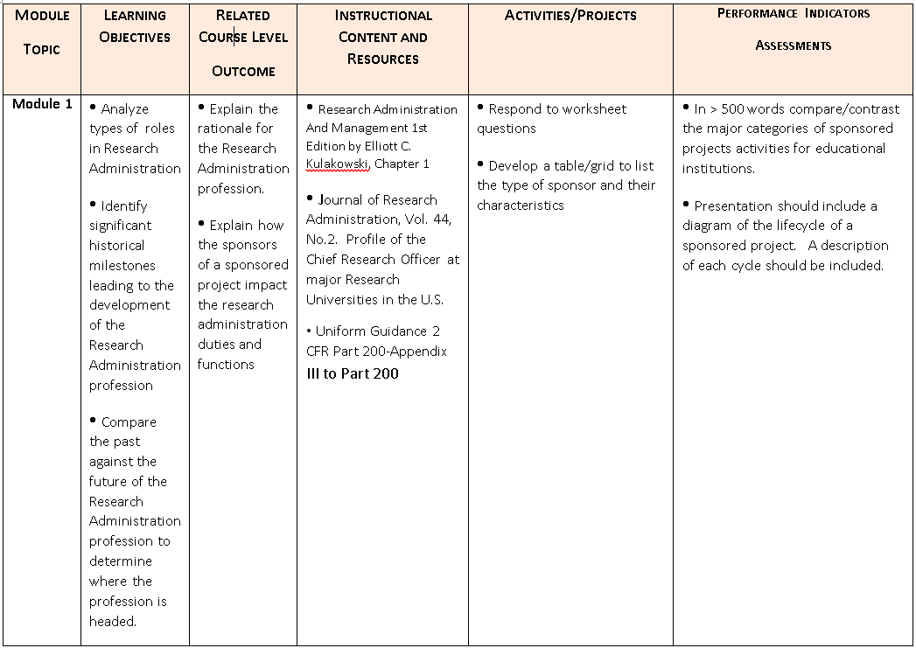
Storyboard Table

Slide 23
Storyboard Table
Easy to create
More structured
So-so alignment
Some missing elements
Less difficulty to assess plan’s quality
Need good understanding of QM for good design
Notes:
The list of requirements is easy to create and to share. Without some faculty training prior to completing the list, satisfactory overall QM compatibility of a course planned with this method is likely. Often, this method results in somewhat improved alignment and some missing elements such as assessments and/or resources.

Slide 24
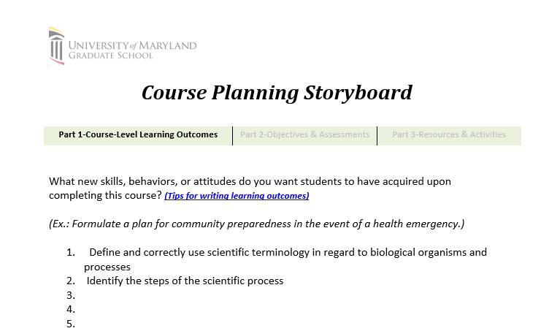
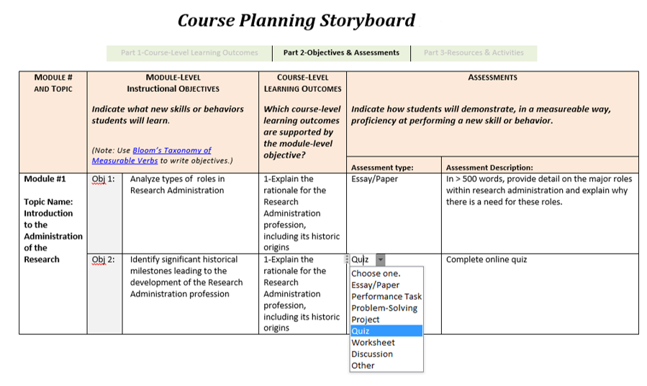
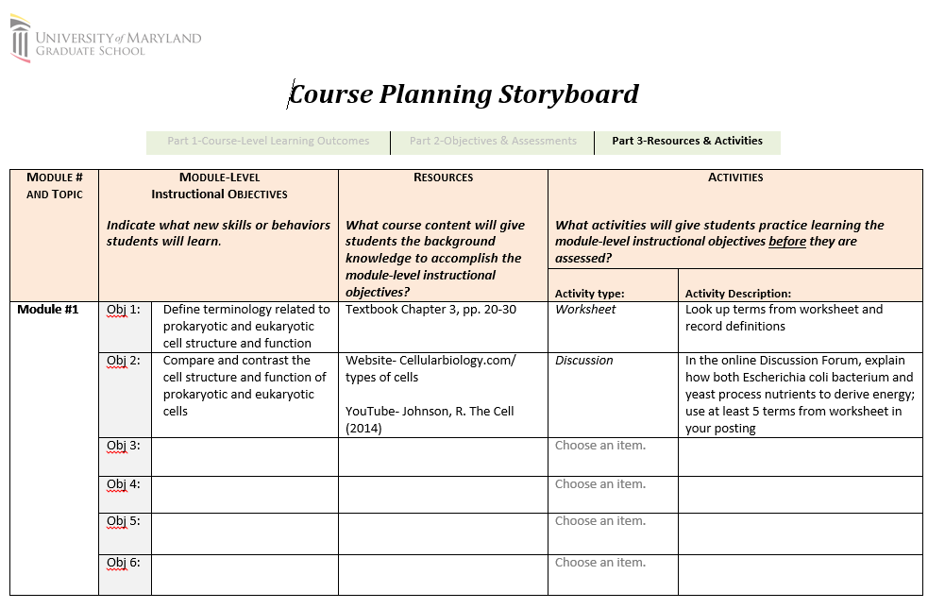
3-Phase Storyboard
Part 1: Course-Level Learning Outcomes
Part 2: Objectives & Assessments
Part 3: Resources & Activities
Iterative Process

Slide 25
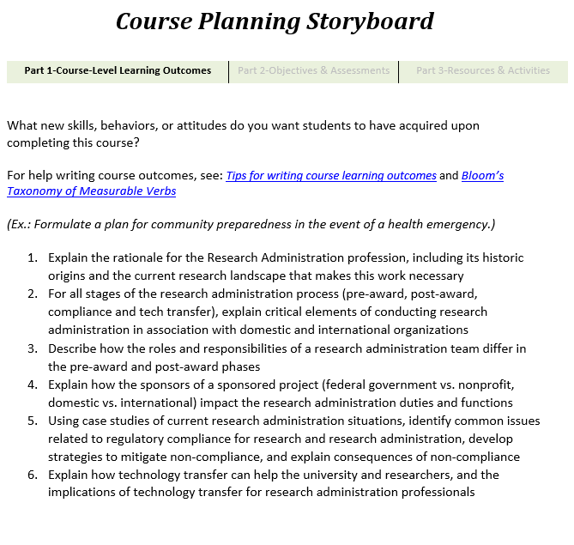
3-Phase Storyboard

Slide 26
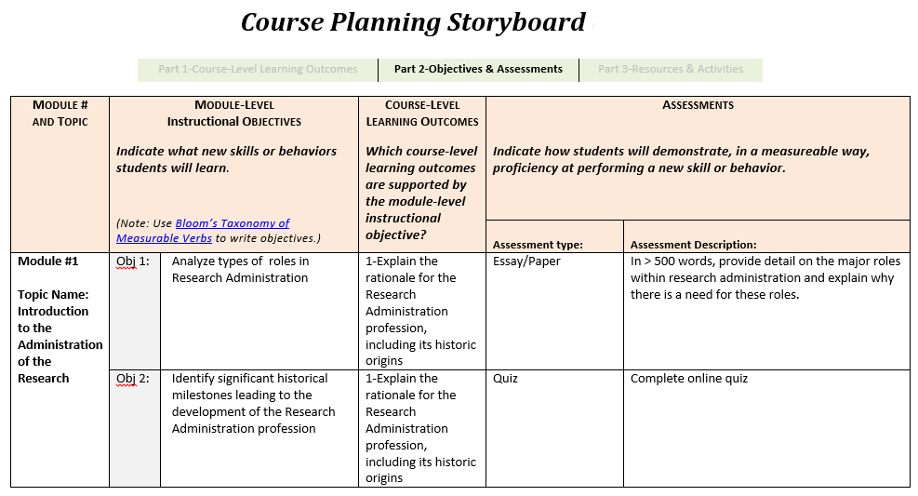
3-Phase Storyboard

Slide 27
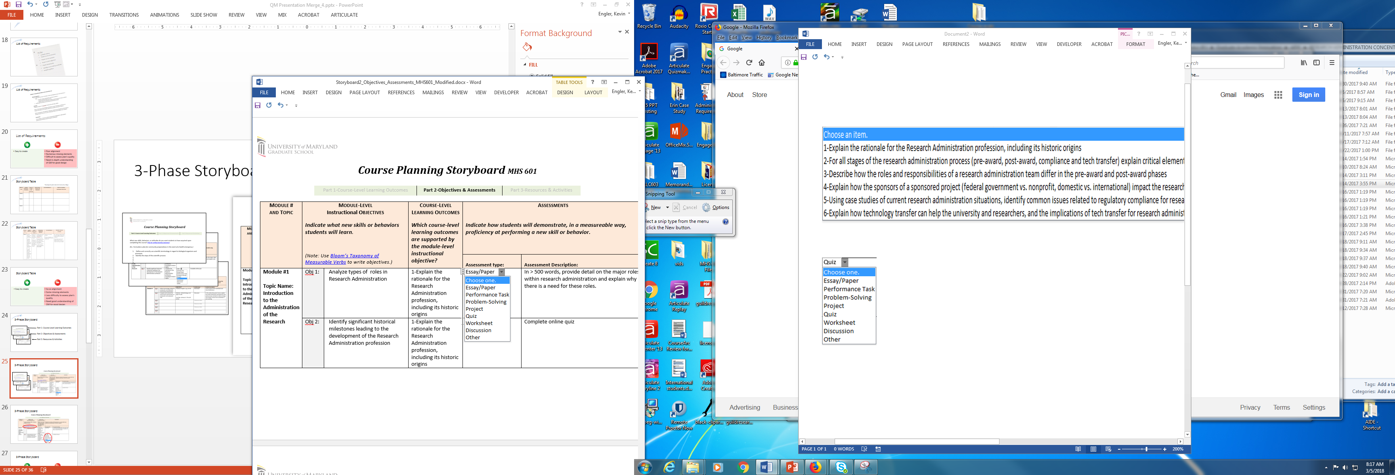
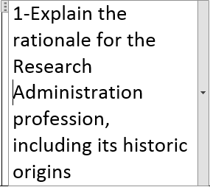
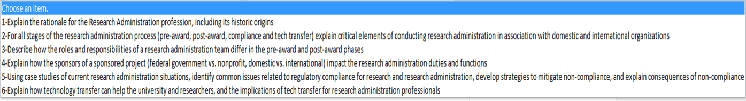
3-Phase Storyboard

Slide 28
3-Phase Storyboard
Easy to create
Good alignment
Few missing elements
Easier evaluation of course plan
Only basic understanding of QM for good design
Instructor may resist forms
Outcomes, objectives must be manually copied to Parts 2 & 3
Notes:
The list of requirements is easy to create and to share. If an instructor completes the storyboard, good alignment and few missing course elements will result in much improved QM compatibility. Evaluation of the course plan by IDs is also much easier.

Slide 29
Essential Standards of QM Rubric
Course Overview Introduction
1.1
1.2
Learning Objectives (Competencies)
2.1
2.2
2.3
2.4
2.5
Assessment and Measurement
3.1
3.2
3.3
Instructional Materials
4.1
4.2
Course Activities and Learner Interaction
5.1
5.2
5.3
Course Technology
6.1
6.2
Learner Support
7.1
7.2
Accessibility and Usability*
8.1
8.2

Slide 30
Essential Standards of QM Rubric
Course Overview Introduction
1.1
1.2
Learning Objectives (Competencies)
2.1
2.2
2.3
2.4
2.5
Assessment and Measurement
3.1
3.2
3.3
Instructional Materials
4.1
4.2
Course Activities and Learner Interaction
5.1
5.2
5.3
Course Technology
6.1
6.2
Learner Support
7.1
7.2
Accessibility and Usability*
8.1
8.2
Storyboard
Bb Course Template
Syllabus Template

Slide 31
Essential Standards of QM Rubric
Course Overview Introduction
1.1
1.2
Learning Objectives (Competencies)
2.1
2.2
2.3
2.4
2.5
Assessment and Measurement
3.1
3.2
3.3
Instructional Materials
4.1
4.2
Course Activities and Learner Interaction
5.1
5.2
5.3
Course Technology
6.1
6.2
Learner Support
7.1
7.2
Accessibility and Usability*
8.1
8.2
Storyboard
Bb Course Template
Syllabus Template

Slide 32


Cloud-Based Database
Biostats 101
Course Plan
Instructor
ID
Notes:
The ID staff have also developed a working prototype of a cloud-based QM-compatible planning tool that may serve as a springboard to a future collaborative and sharable course planning platform. While the prototype has not be deployed as yet, the ID staff hopes to use it as an idea generator for the next generation of course planning tools.

Slide 33
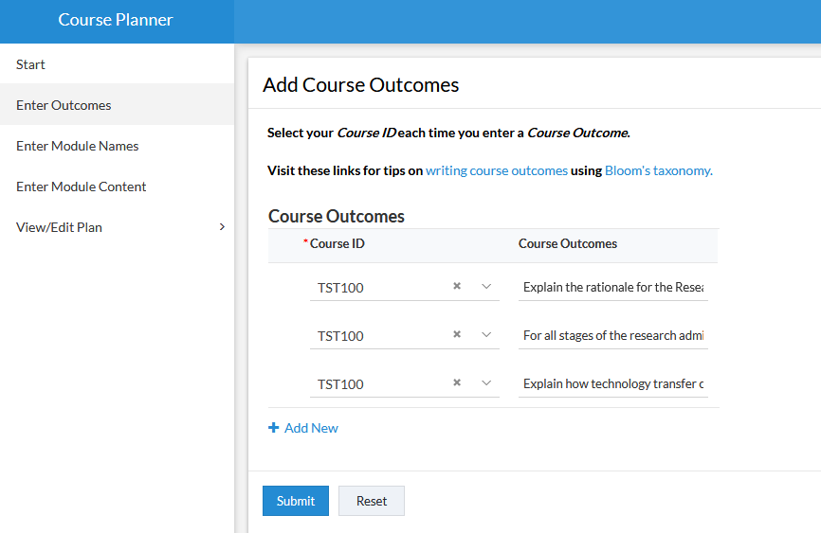
Collect Course Outcomes
*Developed with Zoho.com
Notes:
Zoho Creator engine

Slide 34
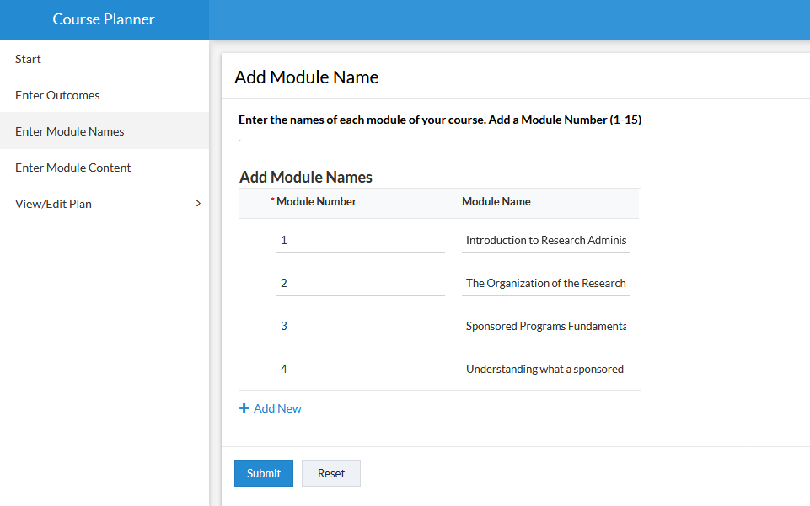
Collect Module Names

Slide 35
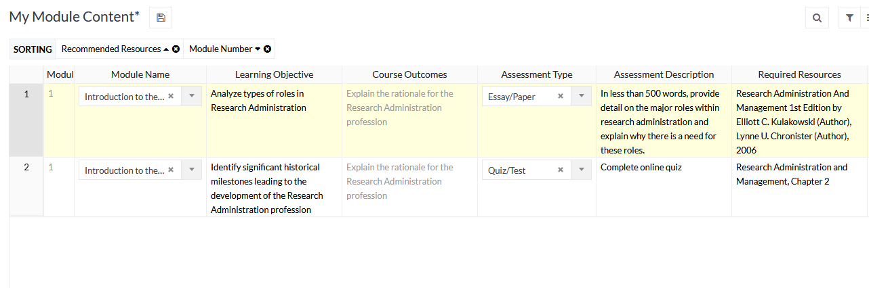
Report of Course Design
Also displays as Excel spreadsheet, PDF, or HTML

Slide 36

Review
Tools that encourage QM compatibility at UMB:
  Blackboard Course Template
  Syllabus Template
  Course Planning Storyboard
Download 3-Phase Storyboard files, syllabus template:
http://www.umaryland.edu/aide/documents/

Slide 37
Review
Benefits:
Improves quality compared to unstructured process
Increases course consistency school-wide
Reduces faculty training requirements
Download 3-Phase Storyboard files, syllabus template:
http://www.umaryland.edu/aide/documents/

