Slide 1


Toss those Cookie Cutters!
Grappling with Quality, Consistency, Scalability, and Academic Freedom
Pexels.com Free Image
QM CONNECT: 9th Annual Conference on Quality Assurance in Online Learning

Slide 2
Debra Canavan & Heather Nash
QM Alaska-System Leads / UAA
September 25, 2017
TRACK : The Power of QA

Slide 3
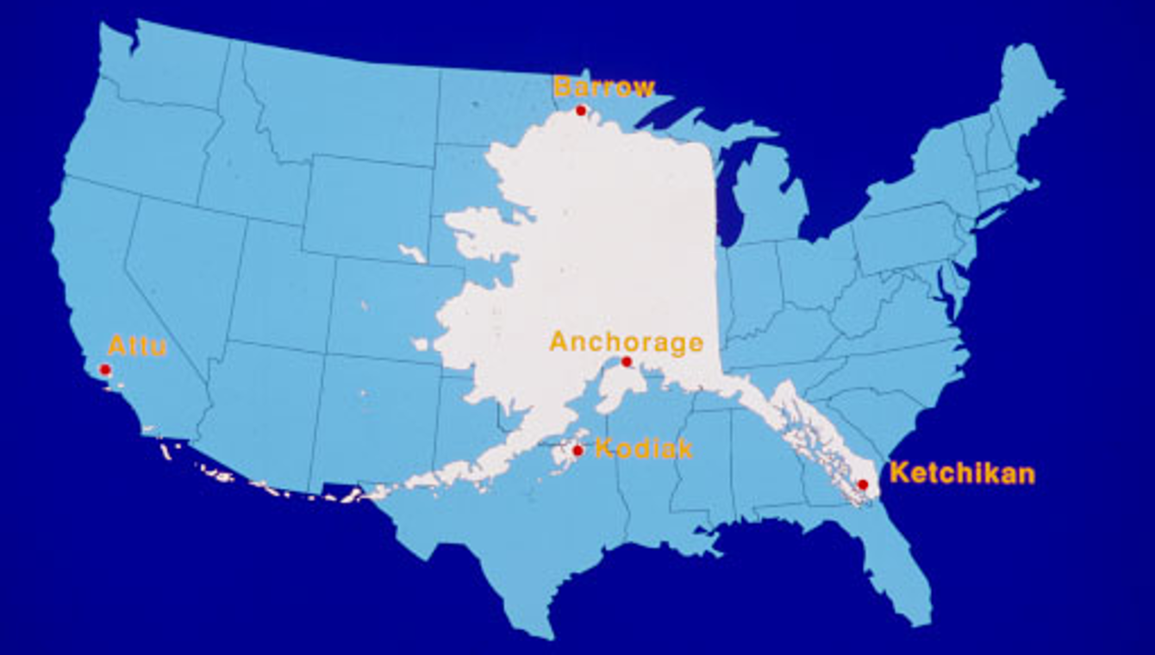
Alaska:
1/5th of entire contiguous states; < 1,000,000 people

Slide 4
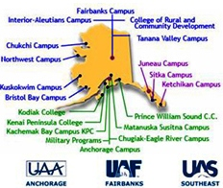
University
Dynamics
3 Major Academic Units (MAUs)
UAA: 5 community campuses
3+ extension sites
Students take courses from all over the system!

Slide 5
Learning Objectives:
Identify key structures, QA principles, and ideas underpinning the Online Master Course (OMC) framework.
Anticipate roadblocks and possible solutions for similar course design initiatives.
Examine similar initiatives at attendees' institutions for strategies & lessons learned.
Notes:
Frequently in Alaska Title III grants are Alaska Native Serving grants. UAA is too large and too diverse to qualify for that funding.

Slide 6

Title III Grant = ROLL
Online Master Course (OMC) Overview
UAA Robust Online Learning Grant

Slide 7
Academic Problem 1:
Low Retention Rates for Minority Students
 | Retention at UAA | Minority Students | Alaska Native Students
Overall | 67% | 53% | 50%
Incorporated some online learning | 71% | 66% | 65%
Enrolled in Baccalaureate programs | 77% |  | 71%
2015 UAA retention data - students with no online courses = 58% retention
Positive retention effect for students taking 1-24% of course load as online learning.

Slide 8
Institutional Management Problem 2: Inadequate Infrastructure and Course Development Model
Online Learning: From Individual to Collective Development and Delivery
Problem: Current Model (Individual Development) | Proposed Solution: Master Courses (Collective Development)
Each faculty member develops own version; no support from the institution. | Course developed by a team: subject matter, expert stakeholders, instructional designers, media and technology specialists
The average national cost for development of a basic online 3-hour credit courses is approximately $5,500; UAA incurs this cost each time an individual faculty member develops a course (i.e. 5 English courses = $27,500) | The one-time cost to the institution for each course would be $5,500.
No review for quality; no guarantee of quality | The stakeholder group decides what can be altered by individual instructors (i.e. change an activity but not the objectives or final assessments); the course is reviewed for quality design standards.
Notes:
Current: Individual Development without defined standards or processes
Proposed: Collective Development with defined standards and processes

Slide 9
OMC QM Connect Jeopardy!

Slide 10
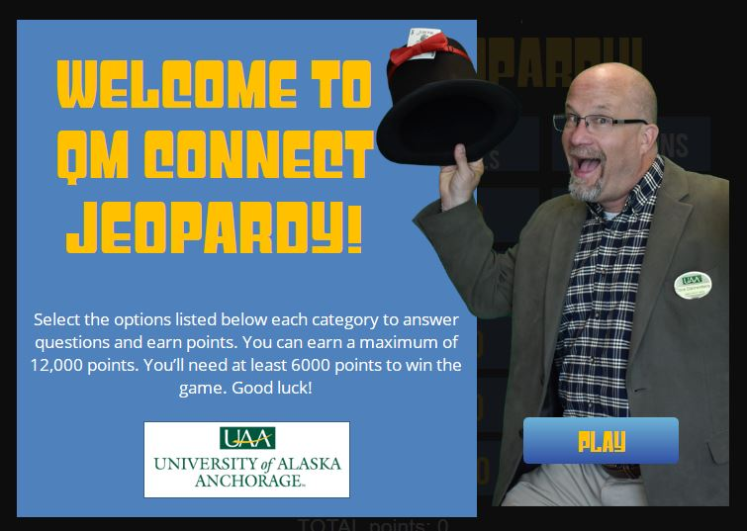
How to Play Along
No texts
Use a browser (any device)
https://goo.gl/3tovb7
3tovb7

Slide 11
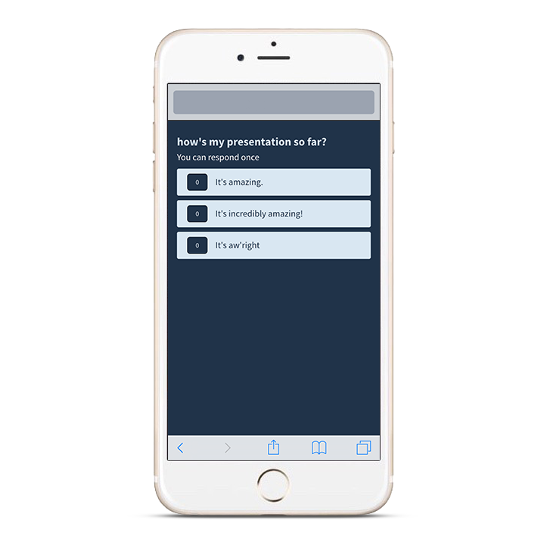
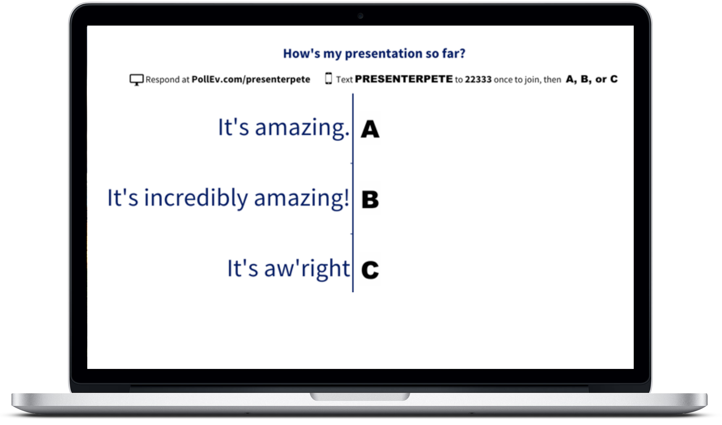
Jeopardy Polling (Poll Everywhere)
Notes:
Select the option of your choice by clicking on it.

Slide 12
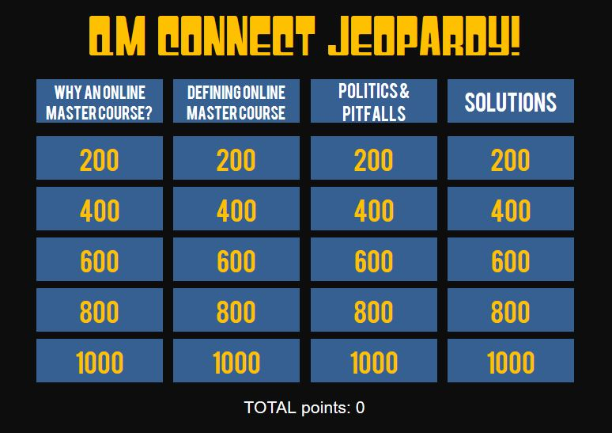
Jeopardy Game Screen
https://goo.gl/3tovb7
Notes:
Okay! Let’s Play!

Slide 13
Current Progress STATS
OMC Results So Far
UAA Robust Online Learning Grant: What is a Master Course?

Slide 14
Grant Years 1 & 2 (Oct. 2015 – Sept. 2017)
Fall 2016
  2 courses (3 sections by 2 faculty); 155 students
Spring 2017
  2 new courses & 2 repeated courses (5 sections by 3 faculty); 237 students
Summer 2017
  1 course (1 section by 1 faculty); 28 students
Fall 2017
  4 new courses & 3 repeated courses (16 sections by 13 faculty); 456 students

Slide 15
Current Impact
9 master course templates developed
@ 1,200 students served in the first two years of the grant
9 courses currently in recruitment or development
Minimum of 26 new master courses during the grant 2015-2020, encompassing the highest-enrolling general education requirements.

Slide 16
Closing Thoughts…

Slide 17
Something to Think About
What is your institution’s definition of a Master Course and how do you use master courses?
What challenges has your institution faced with online master course templates?
Do you have any recommendations for building and implementing online master courses?

Slide 18
Help us improve!
Please take a few minutes to complete the session evaluation in the conference app today!
We’d love to hear your thoughts, questions,
and suggestions. Contact us!

Slide 19
Thank You!
Debbi Canavan, MS CTE
dacanavan@alaska.edu
907-483-1202
Kodiak, Alaska
Heather Nash, PhD
hmnash@alaska.edu
907-786-6520
Anchorage, Alaska
University of Alaska Anchorage, Academic Innovations & eLearning

