Slide 1
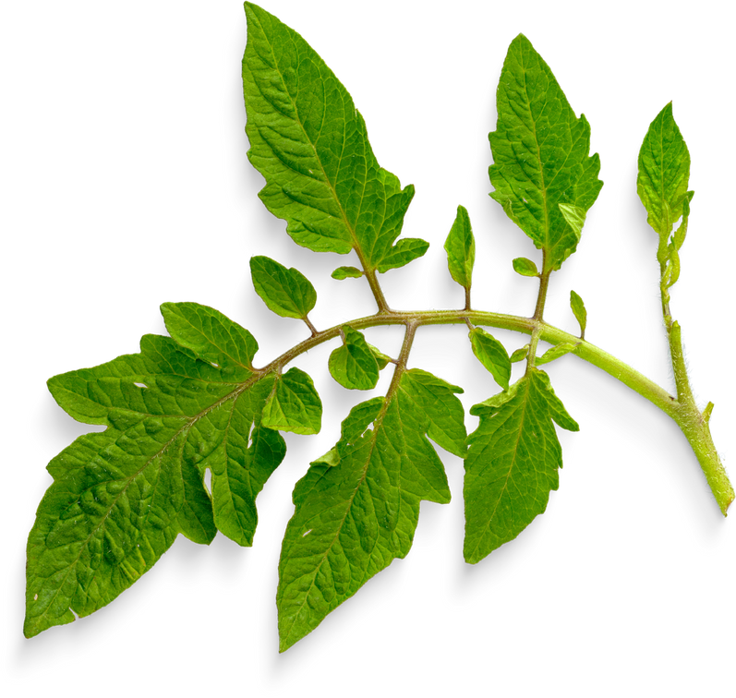


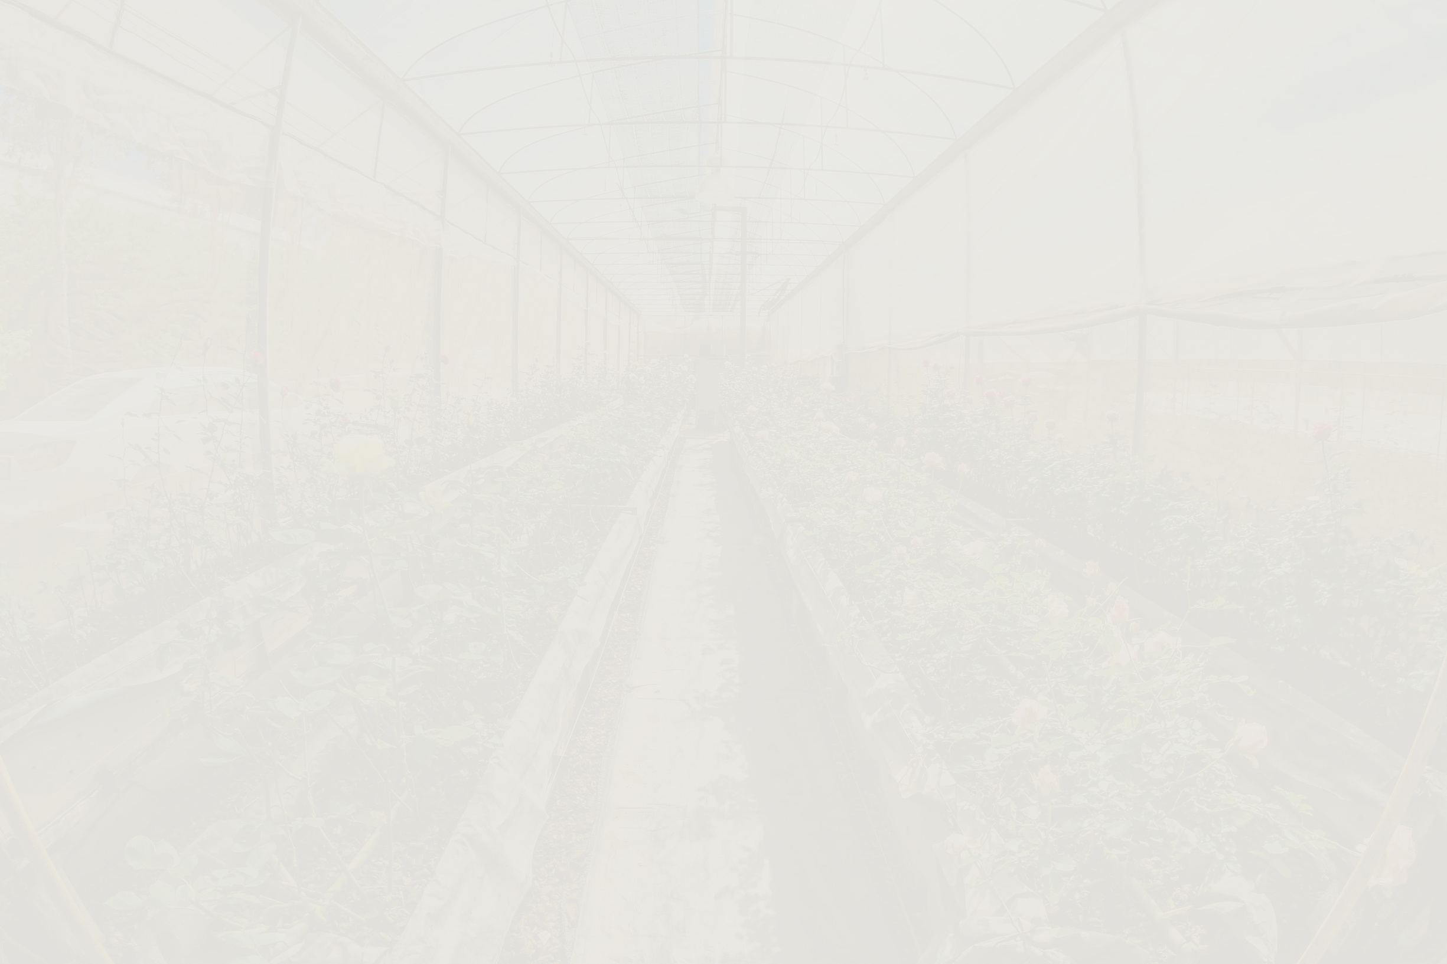

Transforming Online Learning Through Self-Determination Theory
Choice, Growth, and Connection
Notes:
Introduction
Education
Current Role
Spring break garden install
Plant/flower rename

Slide 2



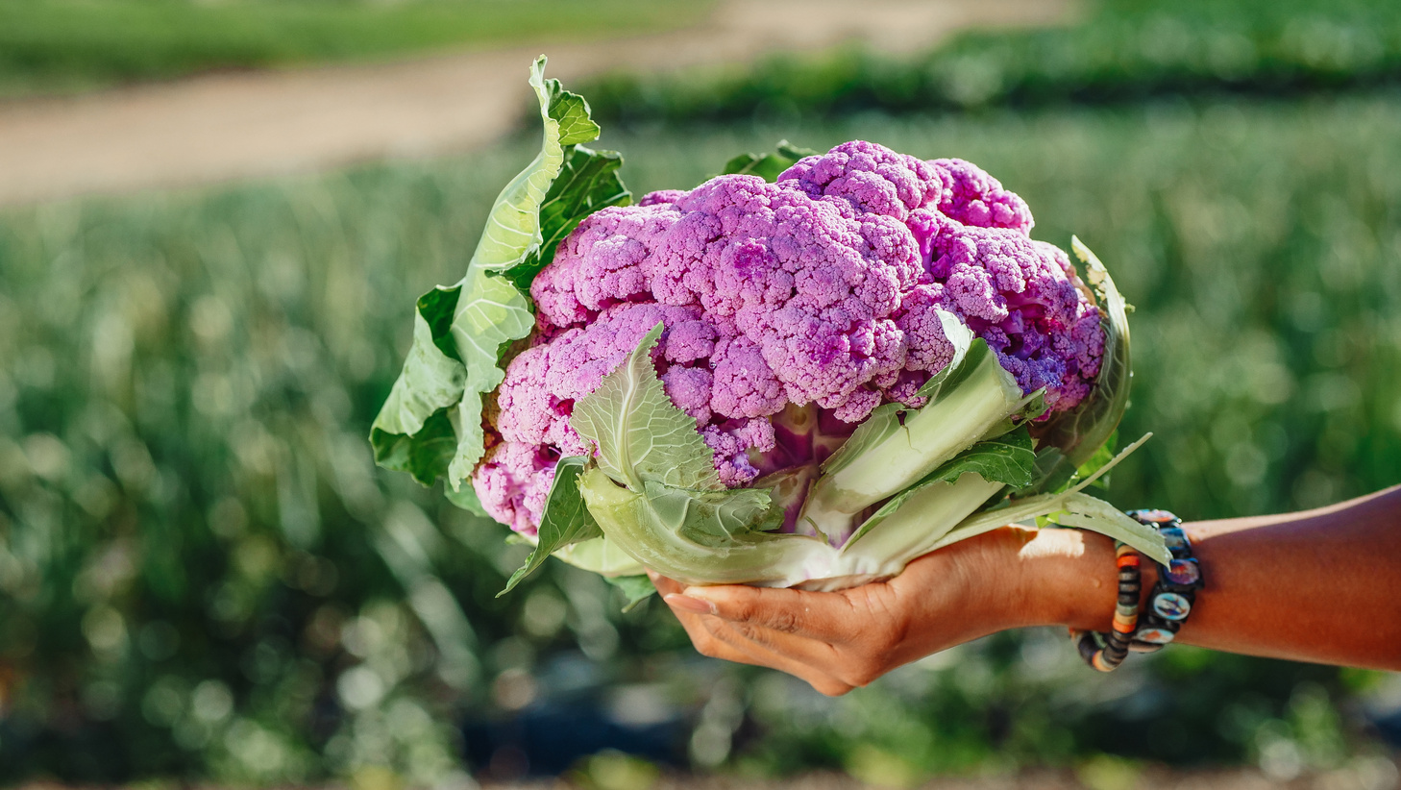
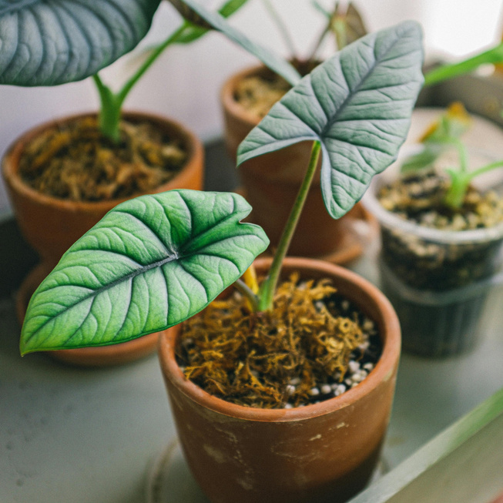


When Did Learning Feel Alive for You?
Think about a time when you felt deeply motivated to learn.
What did it look like?
What did it feel like?
What did it sound like?"
Let’s talk about it!
Notes:
Introduce breakout rooms -
You’ll be in breakout rooms for 5–6 minutes to share a moment of motivated learning.
Start alphabetically by the first letter of your plant/flower name
Chat waterfall -
These experiences often have three things in common: autonomy, competence, and relatedness — the core of Self-Determination Theory.
Which was dominant in your learning experience?

Slide 3


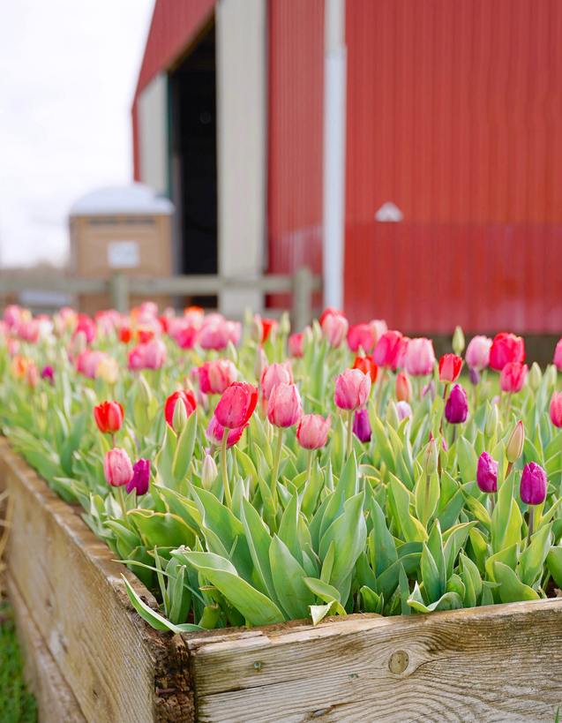
What Is Self-Determination Theory (and Why Does It Matter)?
01
Autonomy
Ownership
Choice
MOTIVATION
02
Competence
Growth
Feedback
03
Relatedness
Connection
Collaboration
Notes:
Self-Determination Theory (Ryan & Deci) helps us understand how to support authentic motivation. Basil & Reyes (2009) applied this to student success in social work education — and their findings apply beautifully to online learning.
Motivation increases when students feel ownership (autonomy), growth (competence), and connection (relatedness).

Slide 4








How Can We Empower Student Autonomy?
Topic
Format
What they’re passionate or curious about
The tech or medium they prefer using
Tools
Audience
How they show what they’ve learned
Who they’re creating the work for
Notes:
In my garden, I don’t control every move a plant makes.
I create options: native species, microclimates, companion planting.
Then nature takes it from there — bees choose which blossoms to visit, seeds find where they grow best, and volunteers sprout up all over!
In learning, autonomy is the same. When students can choose how they demonstrate learning — whether through a video, a paper, or a digital story — they grow with confidence and curiosity. Autonomy isn’t chaos; it’s intelligent design that honors self-direction.

Slide 5

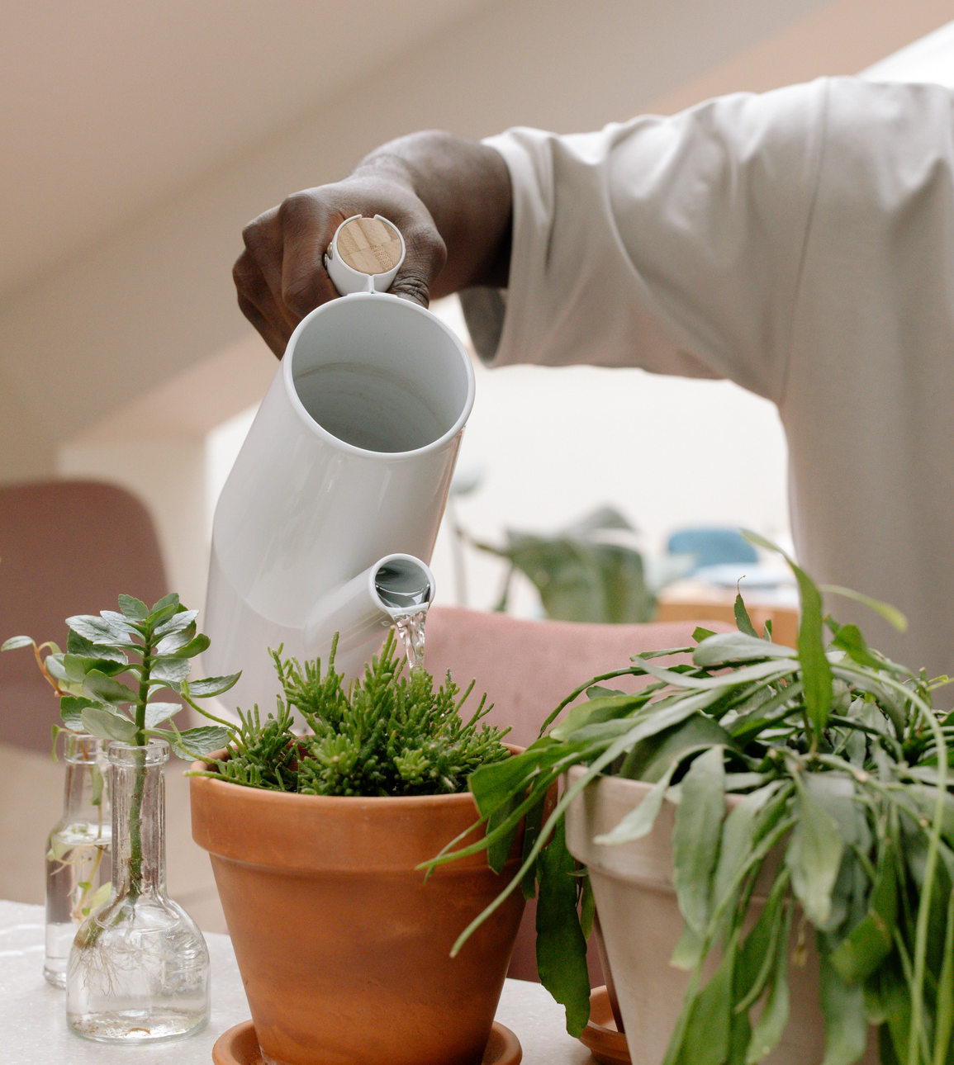
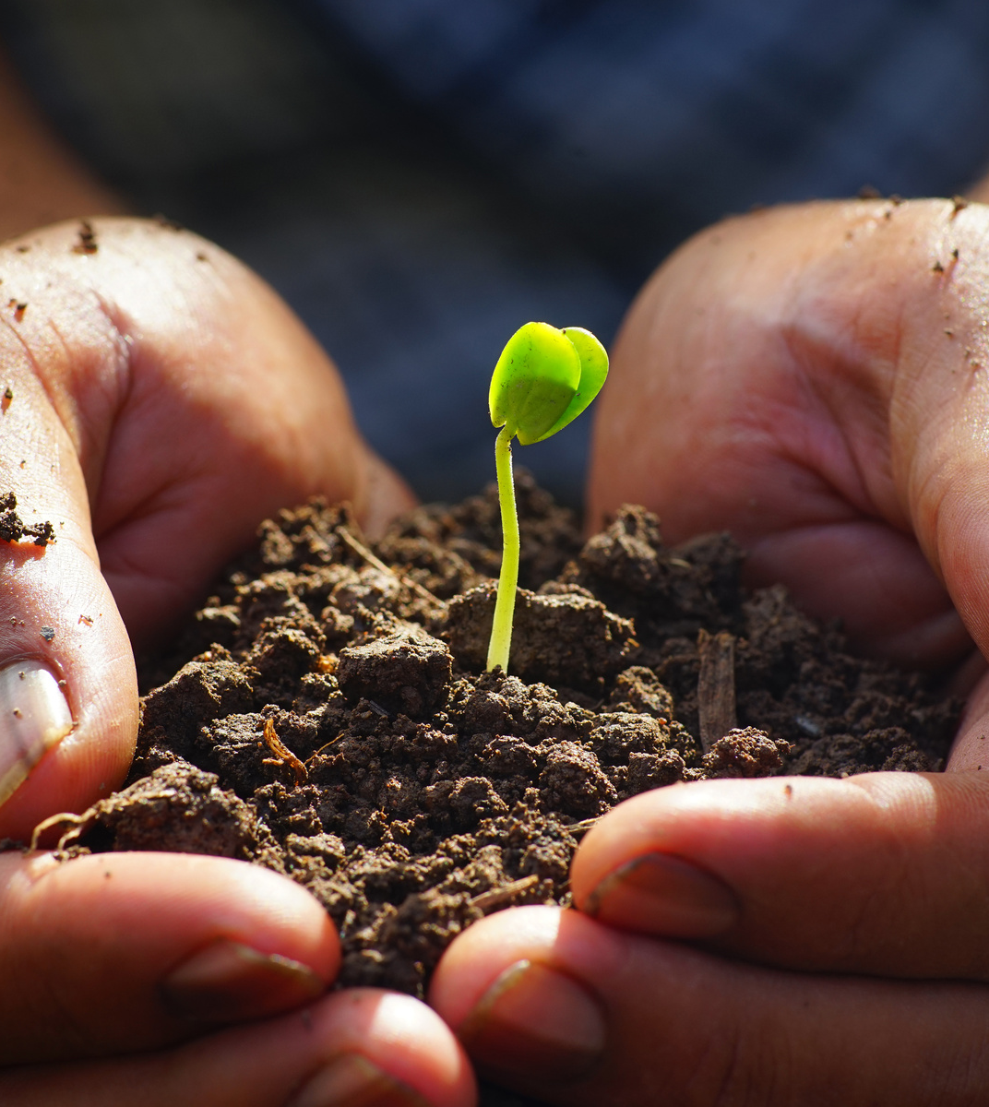

How Can We Promote Student Growth Through Feedback?
💬 Reflect > Grade
📈 Progress > Perfection
Ungrading
Focus on feedback and learning, not points
Self-assessment
Students reflect on progress and set goals
Revision cycles
Improve work through feedback and re-submission opportunities
Notes:
You wouldn’t expect a seedling to fruit without good soil and support.
You build healthy soil, prune when needed, and let roots take hold.
Over time, the garden self-regulates, producing with less intervention — because it’s ready.
Students need this too: feedback, ungraded practice, reflection. When we create learning conditions where students see their own growth — through revision, challenge, and support — we nurture competence.

Slide 6
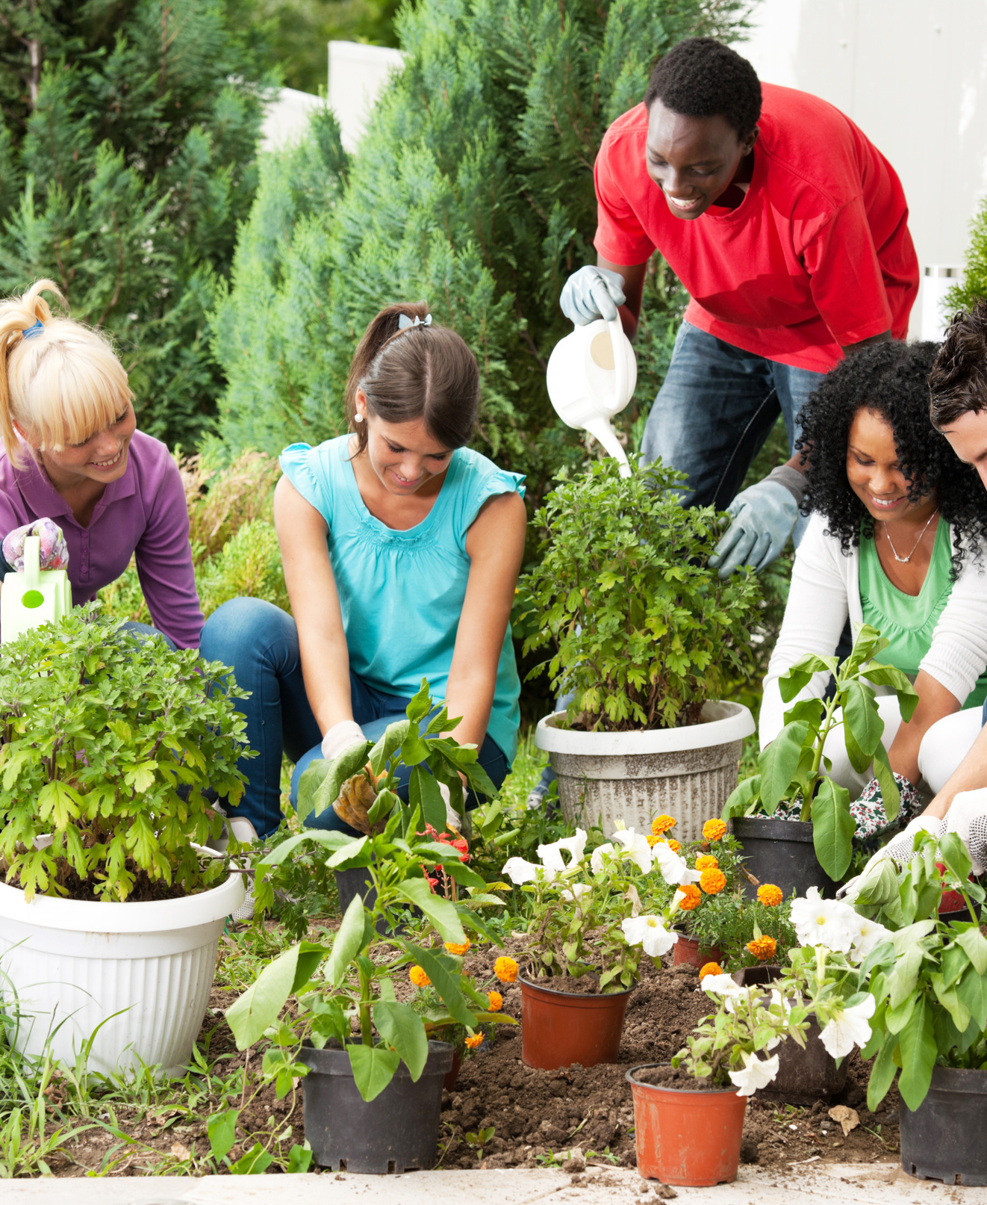

How Can We Foster Meaningful Peer Connection?
Collaborative tools
Social presence
Choose tools that support purposeful peer interaction
Start with low-stakes introductions and check-ins
Perspective-sharing
Shared goals
Encourage diverse ideas and personal connection to content
Foster teamwork through collective tasks or missions
Notes:
My food forest doesn’t thrive alone.
It’s a buzzing network — bees, butterflies, birds, soil microbes — all working in relationship.
One flower’s bloom supports another’s fruit. It’s not just pretty — it’s essential.
In learning, relatedness means belonging, connection, shared purpose.
Discussion, group reflection, and shared goals create a sense of I matter here.
Like pollinators, students need community to flourish — especially online.

Slide 7
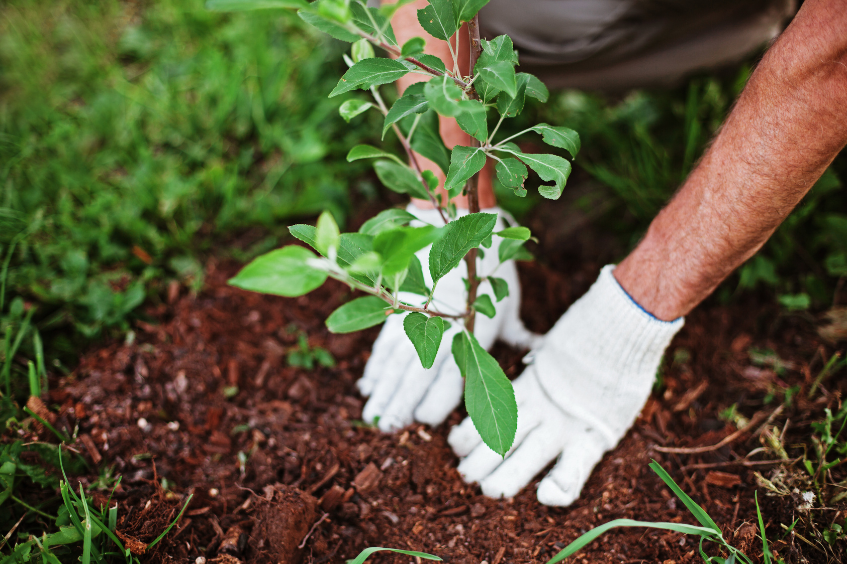
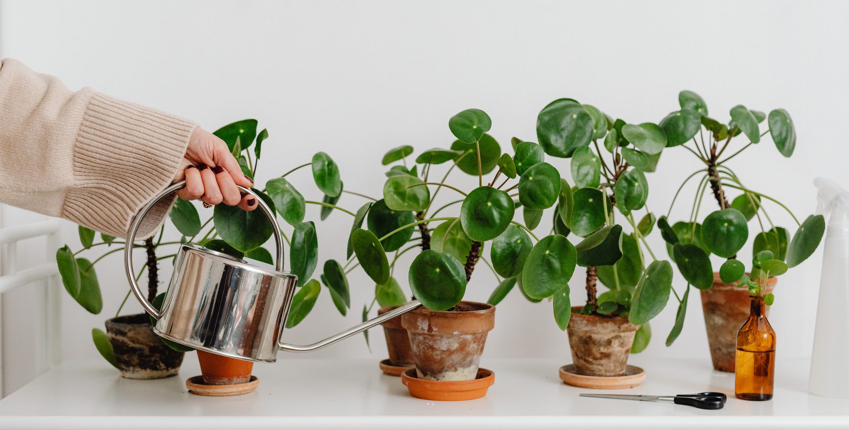
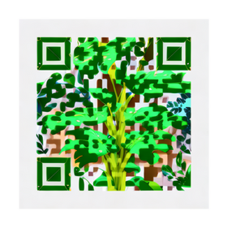
Post to the Padlet: What’s one SDT-aligned strategy you’ll try in your course?
Autonomy – Competence – Relatedness
How Will You Apply What You’ve Learned?
Notes:
https://padlet.com/fswbucs1/transforming-online-learning-through-self-determination-theo-n0vzshjbw7b5qbc8
Your garden is not forced to grow — it’s invited to.
Just like students.
When we nurture autonomy, competence, and relatedness, we don’t just grow learners — we cultivate ecosystems of thriving.
Take a moment to post one takeaway or strategy you’ll bring back to your online course.
You’ll also get access to everyone’s ideas — a shared strategy bank!”

Slide 8
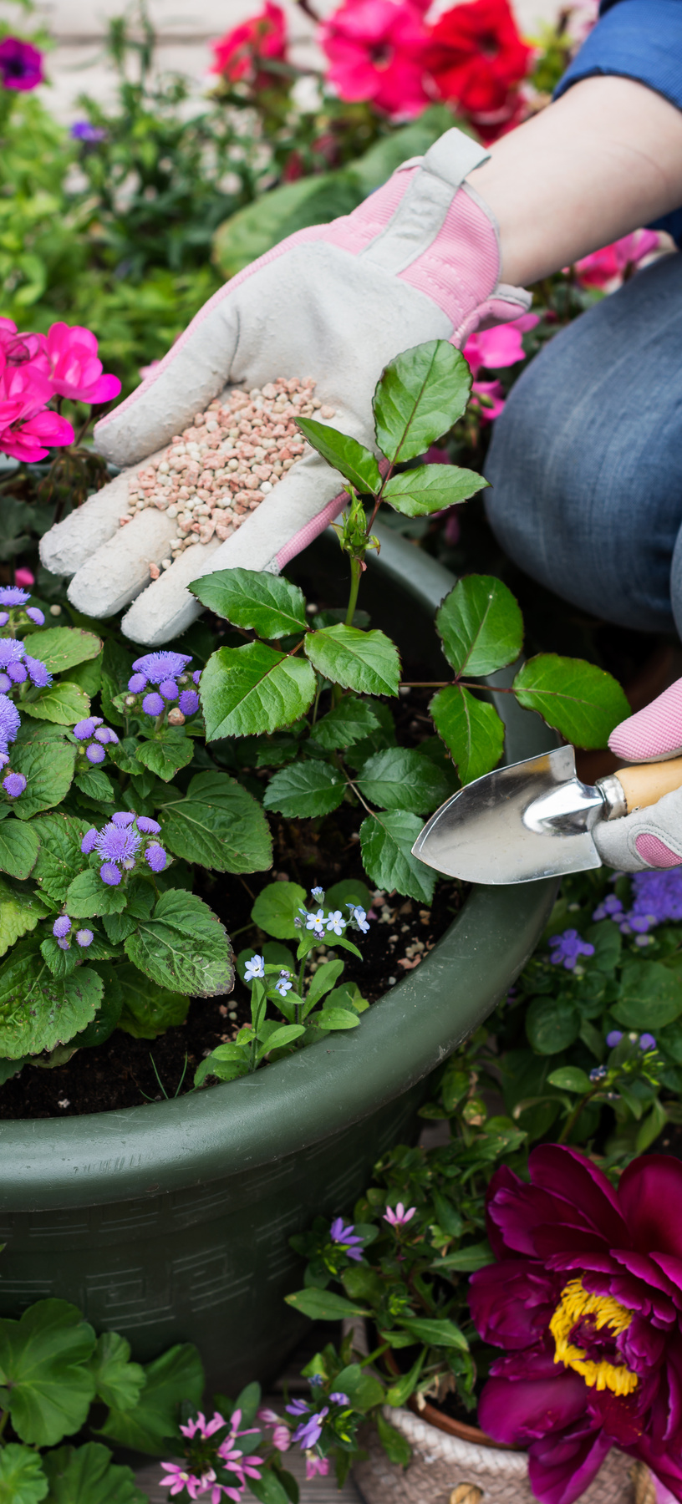


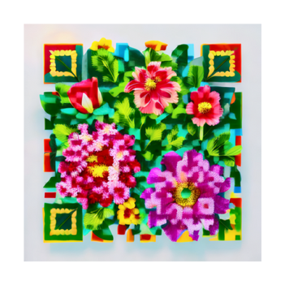
Keep in Touch!
E-mail
hrolson@fsw.edu
LinkedIn
Notes:
https://www.linkedin.com/in/drheather-olson/

