Slide 1
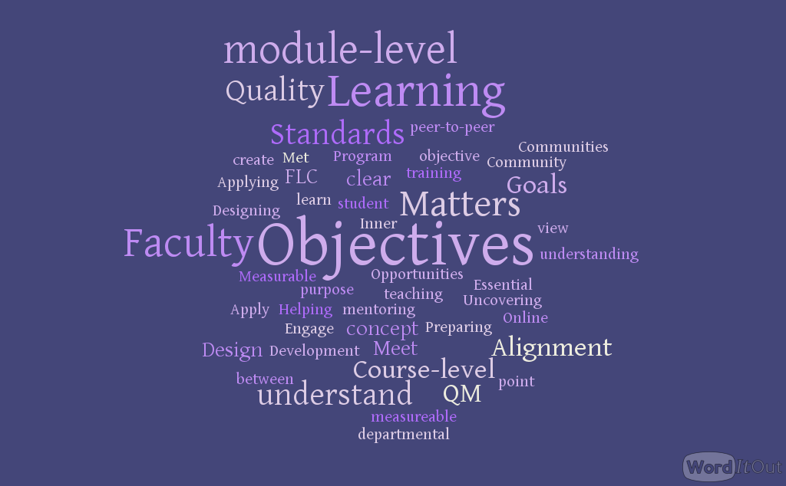

Writing Course and Module-Level Objectives
Workshop: QM Standards 2.1 & 2.2

Slide 2

Workshop Agenda
What Are Learning Objectives and Outcomes?
Review QM Standards 2.1 and 2.2
Purpose of Learning Objectives: For Instructors and for Learners
Measurable Objectives
Alignment, 2.1 and 2.2
Small Group Writing Workshop
Whole Group Share
Workshop Feedback

Slide 3

What are learning objectives?
A statement of the specific and measurable knowledge, skills, attributes, and habits learners are expected to achieve and demonstrate as a result of their educational experiences in a program, course, or module.
Example: “Upon completion of this workshop, learners will be able to summarize QM Standards 2.1 and 2.2.”

Slide 4
Workshop Objectives
By the end of this workshop, participants will be able to:
Identify the purpose of learning objectives for instructors and learners
Summarize QM Standards 2.1 and 2.2
Explain the concept of alignment
Distinguish between measurable and unmeasurable learning objectives
Analyze peer objectives according to QM Standards 2.1 and 2.2
Design one or more measurable objectives for their own course

Slide 5
QM Standard 2.1
The course learning objectives describe outcomes that are measurable.

Slide 6
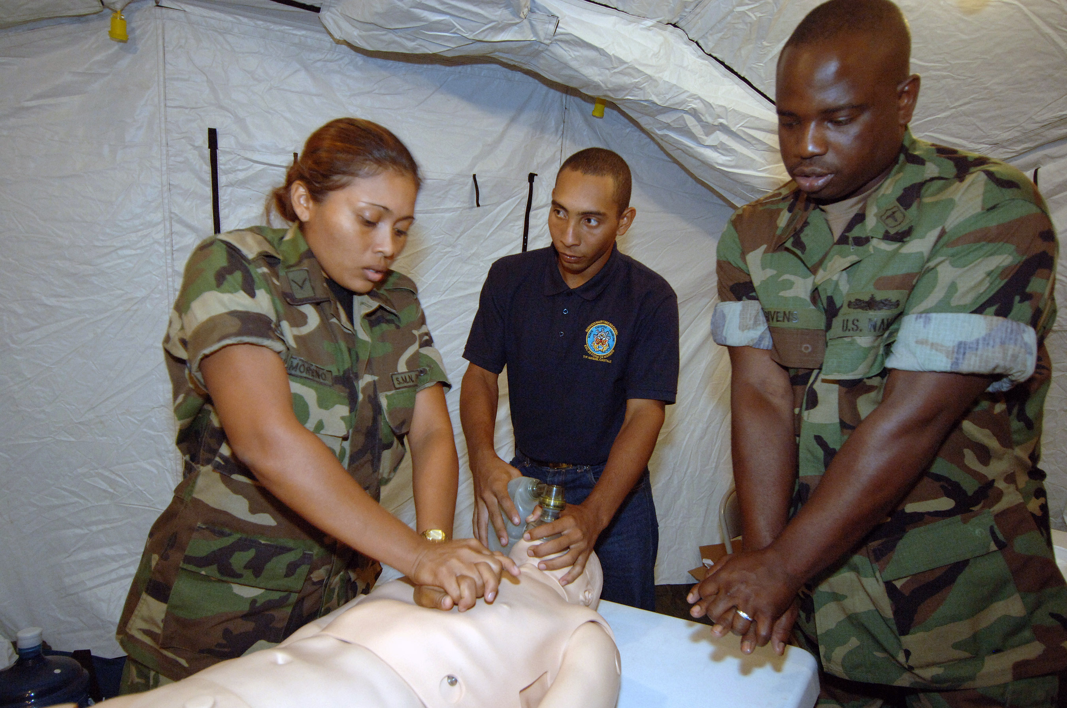
What are learning outcomes?
A learning outcome is a demonstration of the actual level of attainment of knowledge, skills, attributes, and habits expected as a result of the educational experiences in a program, course, or module
Example: Your (the learner’s) presentation of an accurate summary of QM Standards 2.1 and 2.2
Example: A medic’s demonstration of the proper procedure for administering CPR

Slide 7
Purpose of Course-Level Learning Objectives
Remember our definition of a Learning Objective: “A statement of the specific and measurable knowledge, skills, attributes, and habits learners are expected to achieve and demonstrate as a result of their educational experiences in a course.”

Slide 8
Course-Level Objectives
Instructors write course-level objectives to:
goals
focus
expectations
accountability
standards
Illustrate course goals and focus
Relate explicit expectations for learners
Practice accountability for instructor and learners
Demonstrate accreditation standards and program-level objectives are met

Slide 9

Course-Level Objectives
Learners use course-level objectives to:
Identify the major topics and areas of focus for the course
Clarify the expectations for their coursework
Predict how much time and effort are required to be successful in the course
Identify the relevance of the course for their academic major and college experience

Slide 10
QM Standard 2.2
The module/unit learning objectives describe outcomes that are measurable and consistent with the course-level objectives.

Slide 11

Why Does Standard 2.2 Matter?
Clarity for students
Confirmation that module and course objectives align
Consistency in course design
Clarity for university accreditation review (HLC for UNI) and applicable disciplinary program review

Slide 12
Purpose of Module/Unit-Level Learning Objectives

Slide 13

Module/Unit-Level Objectives
Instructors write module-level objectives to:
Describe skills, content, and mastery students need to acquire in each unit
Construct scaffolding for students to reach course-level objectives
Practice alignment for content, activities, assignments, assessments, and technology

Slide 14

Module/Unit-Level Objectives
Learners use module-level objectives to:
Develop relevant skills
Focus their time and effort and to plan ahead
Gauge their mastery of content and skills
Identify the purpose and relevancy of content, activities, assignments, assessments, and technology

Slide 15
What are measurable objectives?
Contain one verb per objective – short and sweet!
Use measurable verbs (Bloom’s revised are best)
2 Minute Workshop Activity: Test with your peers whether you can you assess if an objective is measurable (use examples on provided worksheet)
Not Measurable | Measurable
Understand plagiarism | Summarize what it means to plagiarize
Recognize plagiarism | Identify Plagiarism
Avoid plagiarism | Use (or Practice, Apply) APA documentation
Appreciate APA documentation | Use (or Practice, Apply) APA documentation

Slide 16
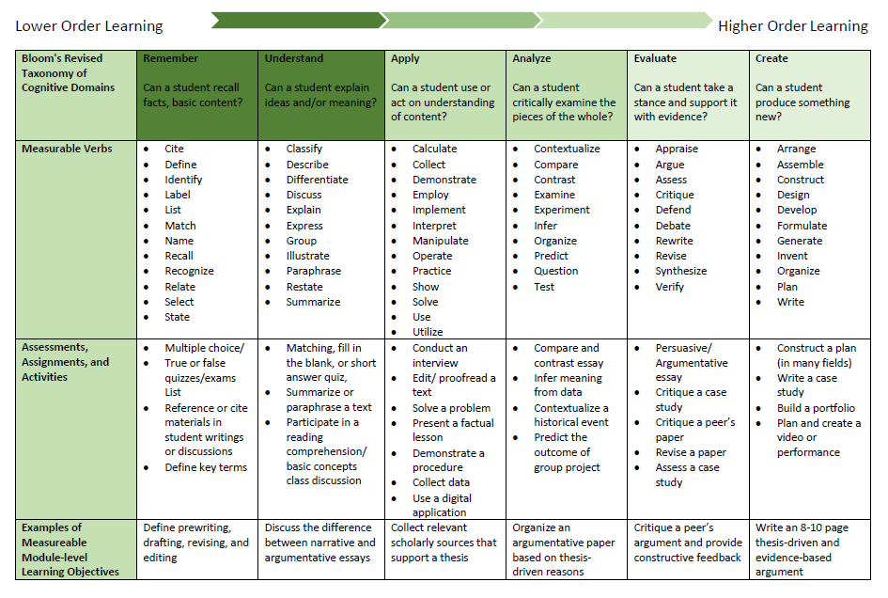
Bloom’s Taxonomy (Revised)

Slide 17
Alignment
In their 2014, Fifth Edition Rubric, QM defines alignment as “critical course elements working together to ensure that students achieve the desired learning outcomes.”
a.k.a. Scaffolding; it all adds up; one thing leads to another

Slide 18

Standards 2.1 and 2.2 Met?
Course-Level Learning Objectives (2.1) and Module-Level Learning Objectives (2.2) must be present
Both course and module-level objectives must be measurable
Module-level objectives must align with course-level objectives
Once you have met these standards, a QM review can progress
**Without these, the review stops, so it is critical not to put off developing the objectives!

Slide 19
QM Standards that Must Align
Learning Objectives
Instructional Materials
Learner Interaction and Engagement
Course Technology
Assessment and Measurement

Slide 20
Goal: Know how to properly research and write an argumentative essay
Course-level Objectives | Module-level objectives
Create a college-level, thesis-driven research paper | Choose a relevant topic Practice prewriting strategies Write a thesis statement Draft a research paper Draft a bibliography Edit and proofread a research paper and bibliography
Develop and fine-tune critical research skills | Identify scholarly resources for use in a research paper Analyze scholarly resources Revise thesis and essay based on research findings
Demonstrate correct use of relevant documentation style (APA, MLA) | Use APA in-text citations Summarize plagiarism Create a bibliography in APA style
Provide critical feedback for peers in writing and research workshops | Critique peers’ arguments, support, and use of sources in a constructive manner

Slide 21

Final Step: Alignment with Course Content
What do you want to include to assess student learning?
Design all course activities and assessments to measure course and unit level objectives
Ensure that you measure only the objectives you have listed
  Omit anything that does not relate to a listed objective -OR- create an objective for that content if it is related to a necessary skill

Slide 22
Goal: Know how to properly research and write an argumentative essay
Course-level Objectives | Module-level objectives | Course Assignments and Assessments to measure objectives
Create a college-level, thesis-driven research paper | Choose a relevant topic Practice prewriting strategies Write a thesis statement Draft a research paper Draft a bibliography Edit and proofread a research paper and bibliography | Pre-writing assignment Thesis drafting workshop in discussion board Research paper and bibliography draft assignment Editing and Proofreading workshop Final Research Essay assignment
Develop and fine-tune critical research skills | Identify scholarly resources for use in a research paper Analyze scholarly resources Revise thesis and essay based on research findings | Library resources assignment to find 5 relevant scholarly journal articles related to research essay topic Annotated bibliography assignment Research findings revision discussion board
Demonstrate correct use of relevant documentation style (APA, MLA) | Use APA in-text citations Summarize plagiarism Create a bibliography in APA style | Editing and Proofreading workshop Short answer quiz Research paper and bibliography draft assignment Final Research Essay assignment
Provide critical feedback for peers in writing and research workshops | Critique peers’ arguments, support, and use of sources in a constructive manner | Thesis drafting workshop in discussion board Editing and Proofreading workshop Research findings revision discussion board

Slide 23
Small Group Objective Writing Workshop
Crafting or Revising Course-Level Objectives: 10 minutes
Crafting Module-Level Objectives: 10 minutes
Group Member Feedback on Peer Goals: 10 minutes

Slide 24
Option 1: Crafting Course-Level Objectives
10 Minute Workshop Part 1: Use Handouts Provided to Craft or Revise Course-Level Objectives
If you develop your own course-level objectives (they are not institutionally mandated) and have not yet developed those, begin with this worksheet.
Jot down course goals
Craft them into measurable objectives using Bloom’s taxonomy verbs
Questions? Look at the sample alignment chart handout
Course Goals | Course Objectives
1. 2. | 1. 2.

Slide 25
Option 2: Revising Course-Level Objectives
10 Minute Workshop Part 1: Use Handouts Provided to Craft or Revise Course-Level Objectives
If you have already developed your own course-level objectives and they are not institutionally mandated:
Determine if they are measurable and, if not,
Revise them to be measurable
Questions? Look at the sample alignment chart handout
Current Course-level Objectives | Measurable? | Revised Course-level Objectives
1. 2. | 1. 2. | 1. 2.

Slide 26
Crafting Module/Unit-Level Objectives
10-Minute Workshop Part 2: Use Handouts Provided to Craft or Revise Module-Level Objectives
For each module (unit) of your course:
1.) Map the module objective to the course level objective to which it aligns
Questions? Look at the sample alignment chart handout
Module Objective | Course-level outcome to which it aligns
1. 2. | 1. 2.

Slide 27

10 Minute Workshop Part 3: Giving Peer Feedback
Are your partners’ course level goals specific and measurable?
  If not, provide a helpful recommendation for revision
Are your partners’ module level goals specific and measurable?
  If not, provide a helpful recommendation for revision
Share any other insight or helpful recommendations you may have with your peer

Slide 28
Group Share and Wrap-up
How did the workshop help you to think differently about objectives and alignment?
What was challenging for you as you crafted your objectives?

Slide 29
Workshop Survey
Please take a moment to fill out our workshop survey before leaving the presentation room. We appreciate your feedback!

